Slide 1
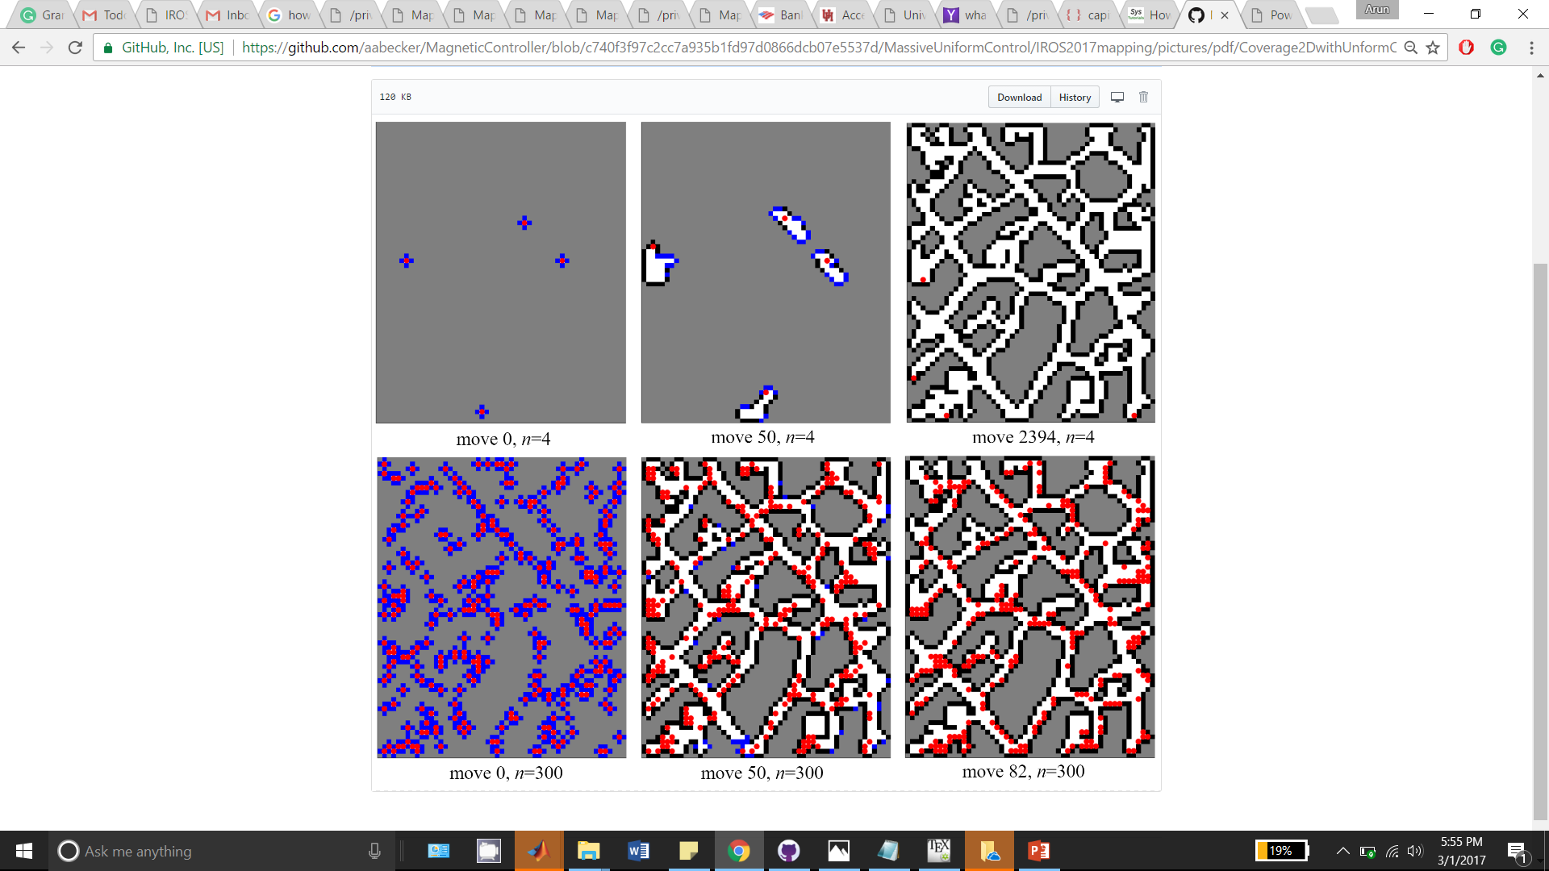
Frontier (blue)
Particle (red)
Free space (white)
Unknown (grey)
Obstacle (black)
move 0, n = 4
move 50, n = 4
move 2394, n = 4
move 0, n = 300
move 50, n = 300
move 82, n = 300

