Slide 1
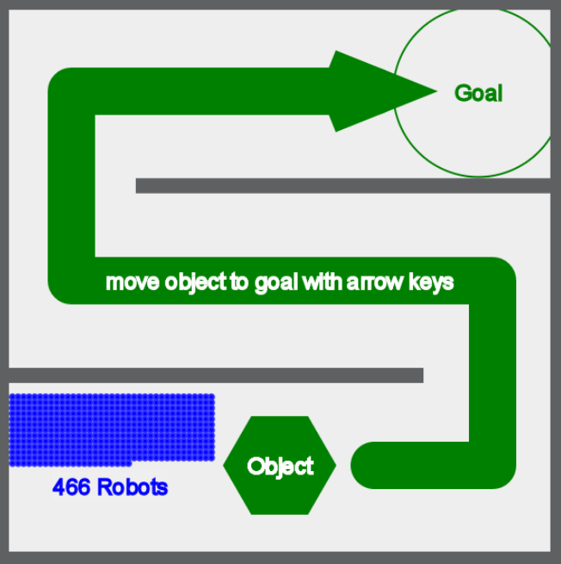
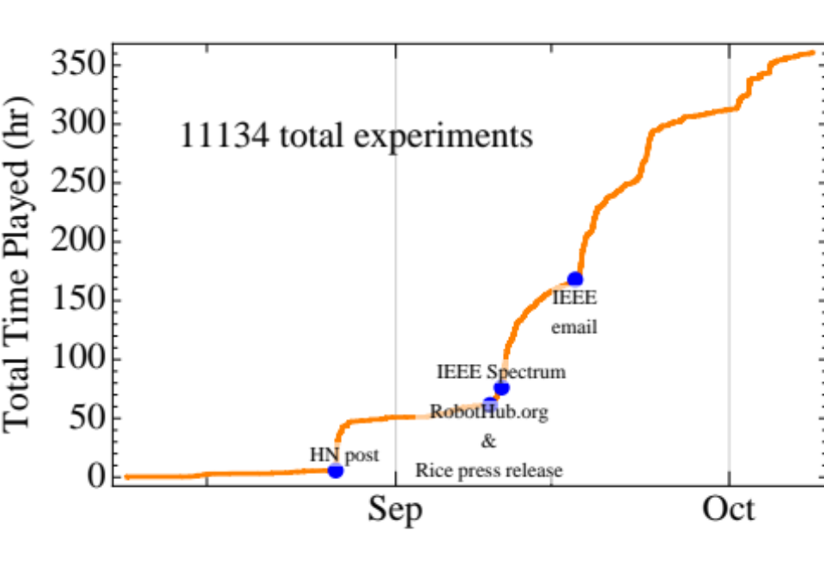
Crowdsourcing Swarm Manipulation Experiments:
A Massive Online User Study with
Large Swarms of Simple Robots
Aaron Becker¹, Chris Ertel², and James McLurkin²
¹Cardiovascular Surgery, Boston Children’s Hospital and
Harvard Medical School, Boston, MA, USA
²Computer Science, Rice University, Houston, TX, USA
What is the best way to control large robotic swarms for manipulation tasks?
To find out, we launched www.SwarmControl.net
Volunteers completed over 11,000 experiments on 5 manipulation tasks
Experiments varied levels of feedback, # of robots, control architecture, and disturbance strength
FREE: All code available online!
Screenshot from one experiment

