Slide 1

Eje 1
o
n
X3
Eje 3
Z3
Norm2
Z1
X2
Z2
Eje 2
X1
Z0
X0

Slide 2
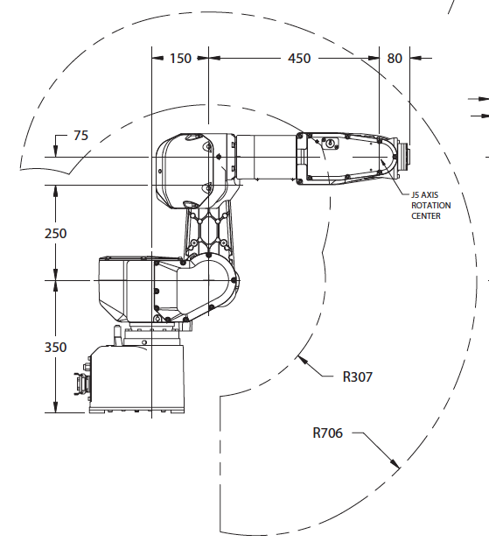
n
X3
X4,5,6
Eje 3
Eje 5
Eje 4
a
Eje 6
Z3
Z5
Z 4,6
Z 1
X2
Z2
X 1
Eje 2
Z 0
X 0
Eje 1

Slide 3














$$P_{e}$$
$$P_{w}$$
(x, y, z)
$$l_{3}⋅Cθ_{1}$$
$$q_{3}$$
$$r$$
$$P_{e}$$
$$α$$
$$l_{2}⋅Cθ_{1}$$
$$q_{2}$$
$$P_{w}$$
$$β$$
(x, y, z)
$$l_{1}⋅Cθ_{1}$$
$$l_{0}$$
Y
Z
$$q_{1}$$
X
X

Slide 4





Z
e
$$l_{4}$$
w
$$l_{3}$$
$$z_{e}$$
θ₃₋₂
$$P_{e}$$
θ₃₋₁
Y
γ
θ₂₋₁
$$l_{2}$$
α
β
θ₁₋₁
X
θ₁₋₂

Slide 5
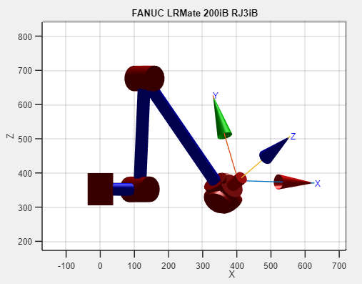
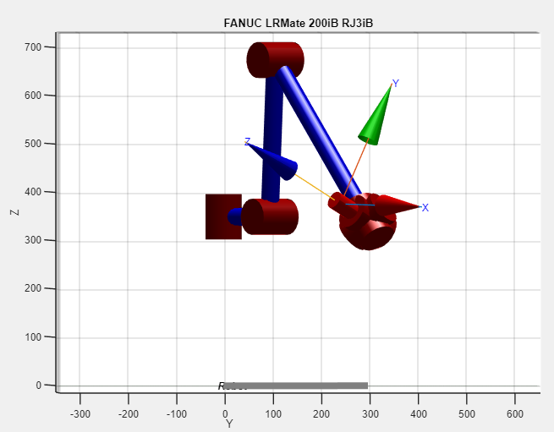



$244,$747
$$376,467$$
$$403,533$$

