Slide 1
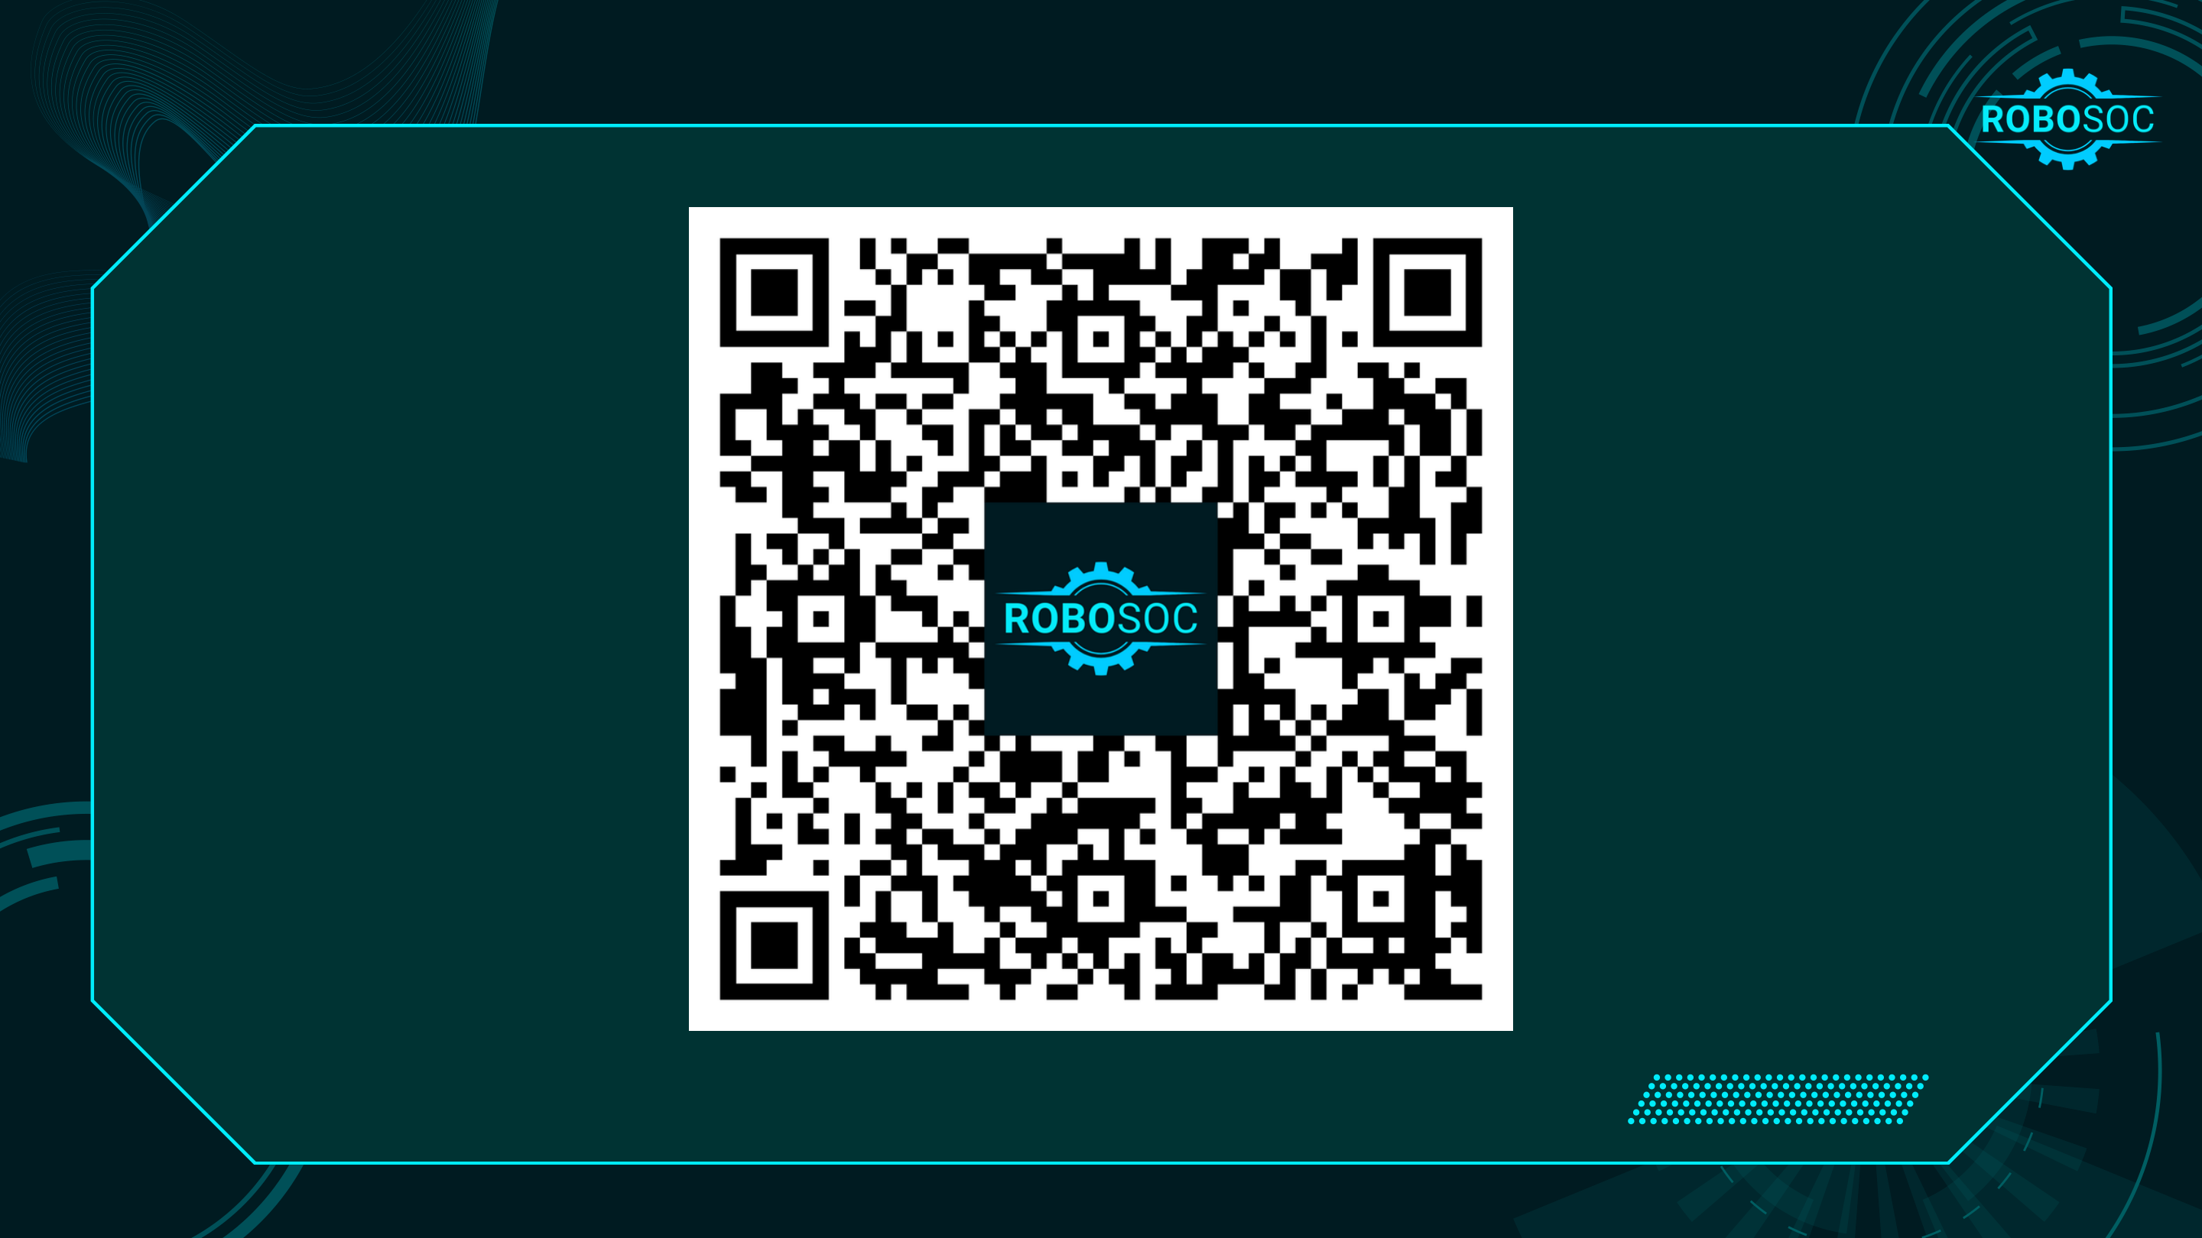
Notes:
Attendance / sign-in QR code (carried over from the existing deck).

Slide 2

Notes:
Workshop 2: Sensors. Last time: circuits, LEDs, buttons. This time the circuit senses the world.

Slide 3



What are Sensors?
Sensors are electronic components that detect something in the physical world — light, nearby objects, a finger — and turn it into an electrical signal a circuit (or a robot) can act on.
Light
Objects
Touch
Light sensor (LDR)
Infrared obstacle sensor
Capacitive touch sensor
Street lights that come on at dusk. Phone screens that dim in the dark.
Parking sensors. Robot bumpers. Automatic taps that see your hands.
Lift buttons. Touch lamps. Hidden controls behind a panel.
Build 1 today
Build 2 today
Build 3 today
Notes:
Ask the room for examples before revealing the cards. Every sensor today outputs a simple ON/OFF signal — no coding needed.

Slide 4
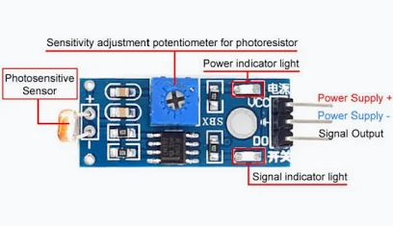
Light Sensor Module
The beige disc is an LDR: its resistance drops when light hits it.
The chip on the board turns that into ON / OFF on the DO pin.
Blue screw = how dark counts as “dark”.
Two LEDs: power (always on) and detection (switches).
VCC
→ red (+) rail
GND
→ blue (−) rail
DO
leave free
Notes:
LDR = light dependent resistor. The LM393 comparator compares the LDR voltage with the screw setting and snaps DO high or low. Room lights count too: if someone opens the blinds, the threshold effectively moves.

Slide 5
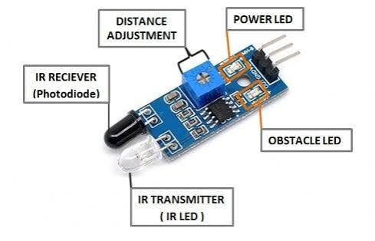
Infrared Obstacle Sensor Module
The clear LED sends out infrared light; the black LED catches the bounce.
Bounce comes back = object detected. OUT goes LOW and the obstacle LED lights.
Blue screw = detection distance, about 2–30 cm.
White reflects well. Matte black barely reflects at all.
VCC
→ red (+) rail
GND
→ blue (−) rail
OUT
leave free
Notes:
Active IR: it transmits and receives. Sunlight and some room lights contain IR, so near a window it can trigger on its own. Black tape and black paper on the challenge table absorb IR.

Slide 6
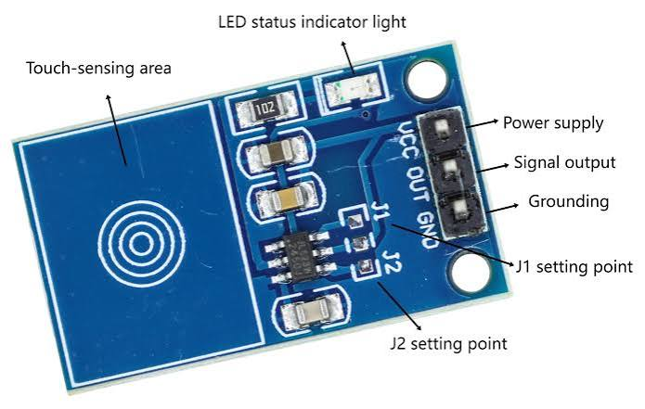
Capacitive Touch Sensor Module
Senses the charge of your finger, like a phone screen.
Works through paper, card and thin plastic.
SIG goes HIGH while you touch the spiral, LOW when you let go.
Runs on 2–5.5 V and reacts in about 60 ms.
VCC
→ red (+) rail
GND
→ blue (−) rail
SIG
→ LED via 330 Ω
Notes:
TTP223B. SIG can only supply a few milliamps: one or two LEDs through resistors is fine, nothing bigger. Metal covers shield the pad and stop it working. The two solder jumpers on the back change behaviour — leave them alone today.

Slide 7
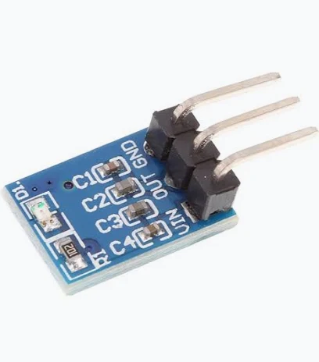
3.3 V Voltage Regulator
Four AA cells give about 4.8–6 V. The sensors want 3.3 V.
The regulator turns whatever the batteries give into a steady 3.3 V.
Pins: VIN (battery +) · GND · OUT (3.3 V)
It senses nothing. It just keeps the power safe.
4 × AA
≈ 4.8–6 V
Regulator
VIN → OUT
3.3 V
to the sensors
Notes:
The packs in the photos are NiMH (1.2 V each = 4.8 V). Alkaline AAs are 1.5 V each = 6 V. Never connect the battery pack straight to a sensor — always through the regulator.

Slide 8
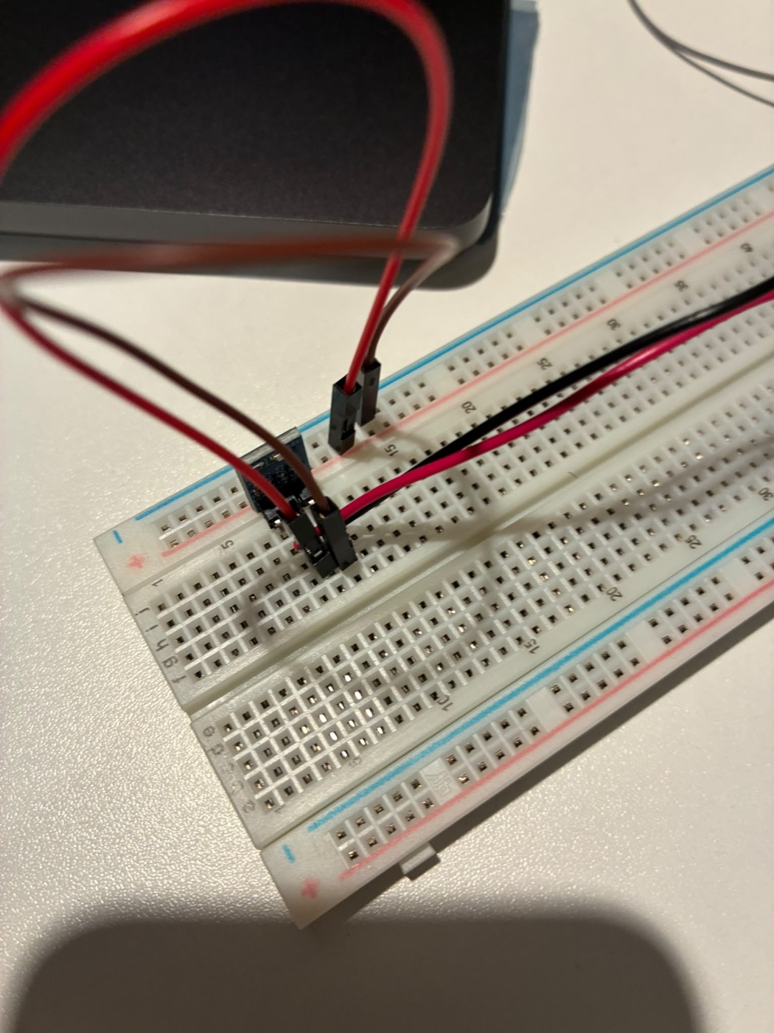
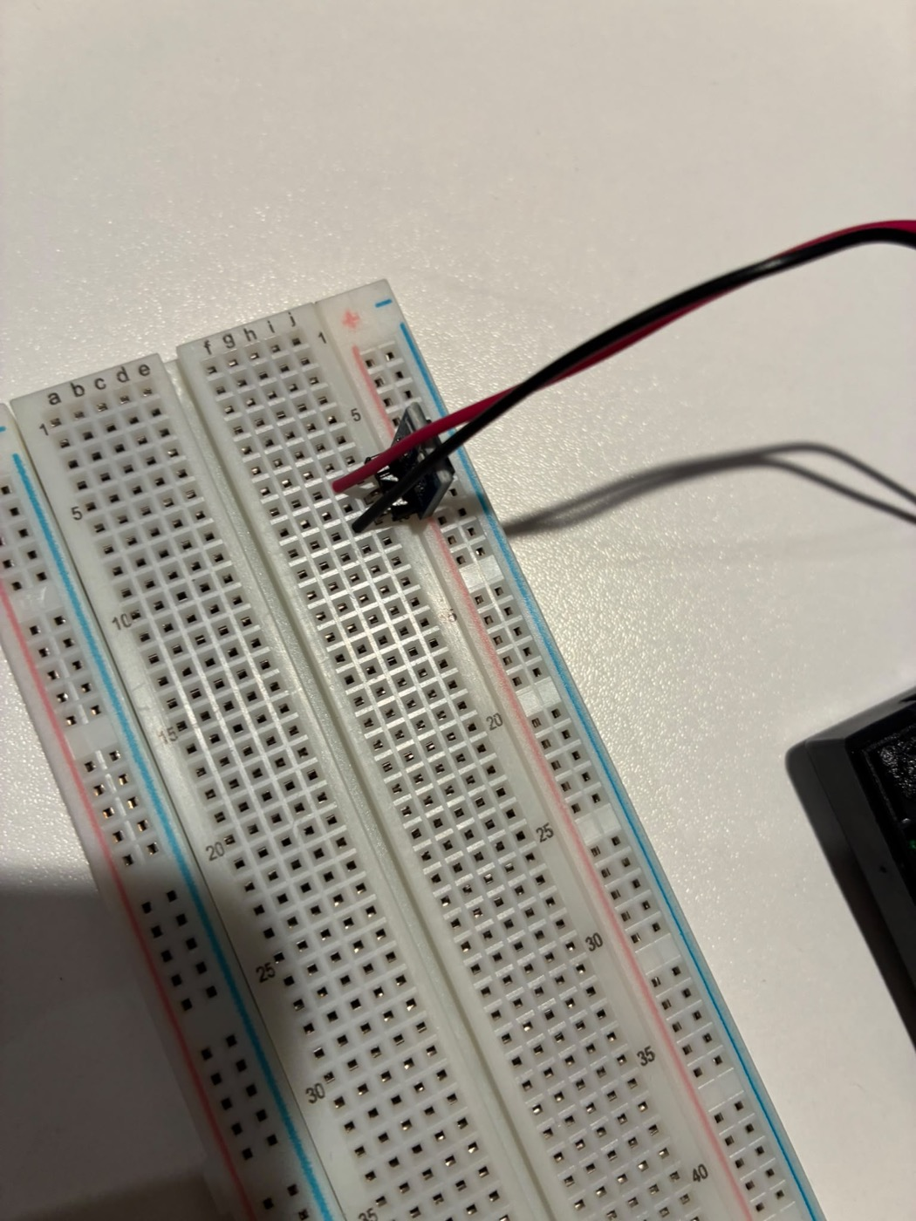
Step 0: Power the breadboard
Push the regulator's three pins into three separate numbered rows of the breadboard.
Battery red (+) → the regulator's VIN row. Battery black (−) → the regulator's GND row.
Regulator OUT row → red (+) rail. Regulator GND row → blue (−) rail.
When you on the batteries the voltage regulator should light up to indicate its receiving current
Regulator in its own rows, OUT and GND jumpered to the rails
Battery red to VIN, black to GND
Notes:
From the guide — prepare the power supply: (1) batteries removed, regulator's three pins into three separate numbered rows; (2) battery red → VIN row, battery black → GND row; (3) OUT row → red (+) rail, GND row → blue (−) rail. If you have a multimeter handy, OUT to GND should read about 3.3 V.

Slide 9
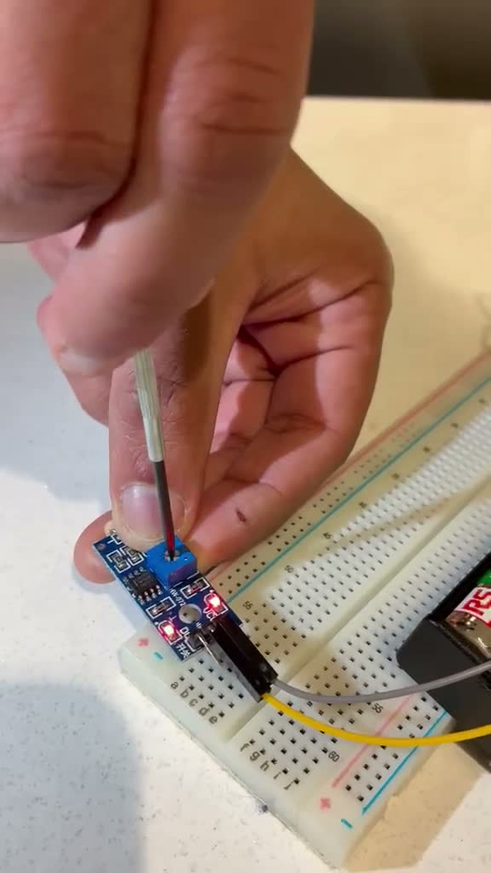
Build 1 in action
Notes:
Plays automatically and loops. What to point out: the power LED is on; the detection LED flips when a hand covers the LDR; the screwdriver on the blue screw moves the switching point. Common issue: the screw is a multi-turn pot, so keep turning, slowly.

Slide 10
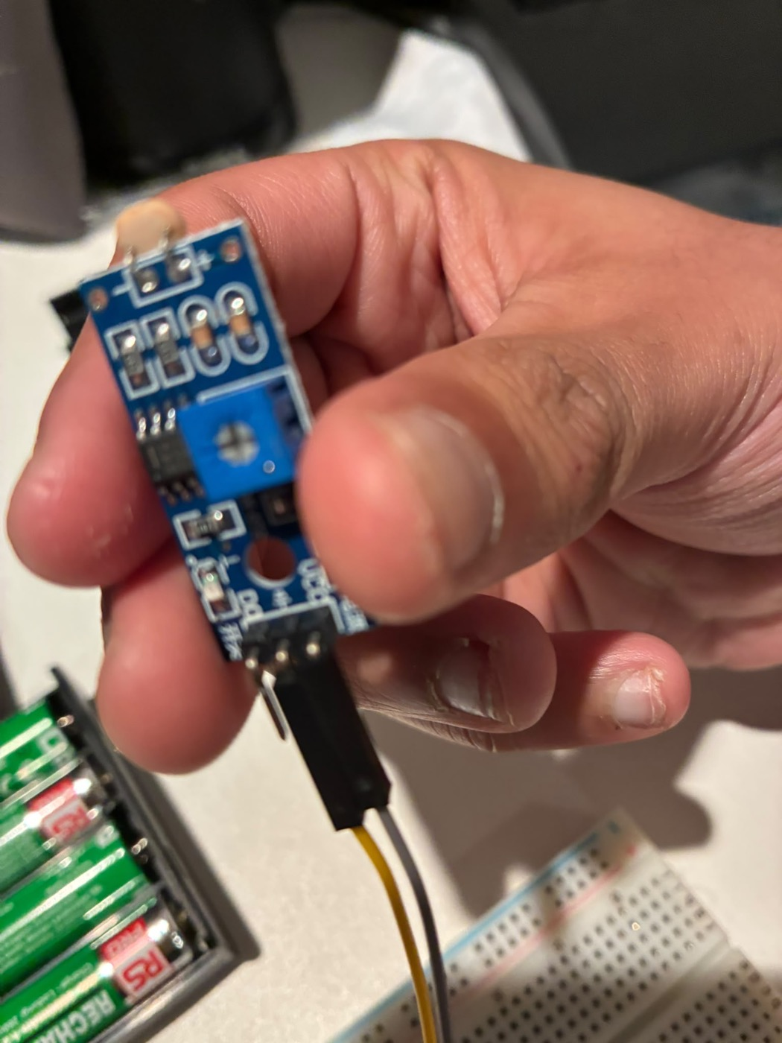
Build 1: Light detector
Wire it
Test it
Sensor VCC → red (+) rail with a female-to-male jumper
Sensor GND → blue (−) rail with another female-to-male jumper
DO stays disconnected
Cover and uncover the beige LDR disc with your hand — watch the detection LED switch
Shine your phone torch at the LDR
Gently turn the blue screw to move the threshold
Find the setting where your shadow trips it but normal room light doesn't
LDR disc at the bottom, blue threshold screw in the middle, pins VCC · GND · DO at the top
Notes:
Guide Step 2 — connect the light sensor: VCC → red (+3.3 V) rail (F–M jumper); GND → blue (−) rail (F–M jumper); leave DO disconnected; check printed pin labels. Step 3 — test: cover/uncover the LDR and watch the detection LED; shine a torch and turn the blue screw to change the threshold.

Slide 11
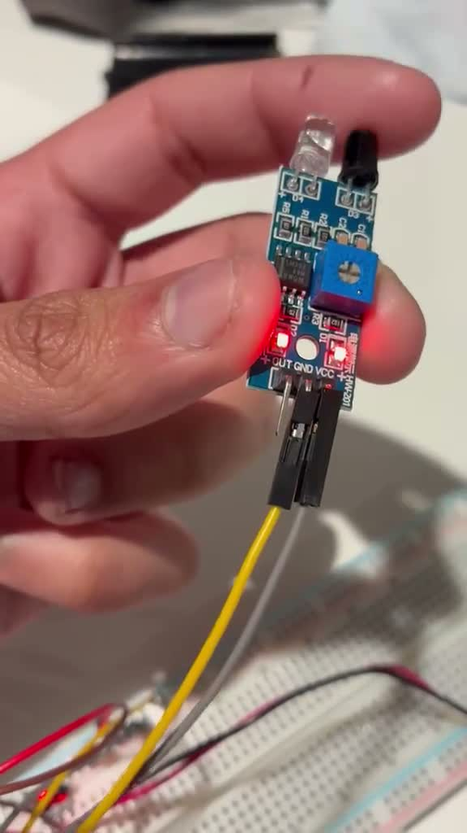
Build 2 in action
Notes:
Click to play. What to point out: power LED on with batteries in, obstacle LED off with nothing in front; a hand in front lights the obstacle LED, moving away switches it off; the screw sets how far away counts as in front. Worth trying live: white paper vs black paper at the same distance (matte black absorbs IR), tilting the object, and a shiny surface at an angle. These set up the challenge materials.

Slide 12
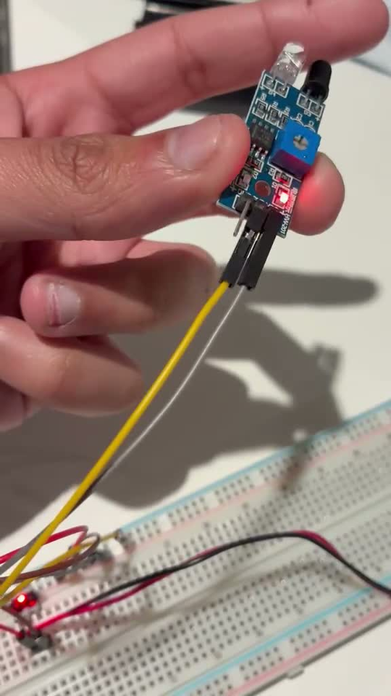
Build 2: Infrared obstacle sensor
▶ Finger in front: both LEDs on
Wire it
Test it
Sensor VCC → red (+) rail with a female-to-male jumper
Sensor GND → blue (−) rail with another female-to-male jumper
OUT stays disconnected — the pin order is different from the light sensor
Batteries in
Point the two “eyes” (clear + black LEDs) at a small box
Move the box slowly closer — the obstacle LED should light
Turn the blue screw and try again: the trip distance moves
Swap the box for black paper, then white paper. Same distance, different answer?
Notes:
Guide Step 2 — connect the IR sensor: VCC → red (+3.3 V) rail; GND → blue (−) rail; leave OUT/DO disconnected; check printed pin labels. Step 3 — test: point the two IR components at a small box and move it slowly closer; watch the detection LED; adjust the blue screw and try again.

Slide 13
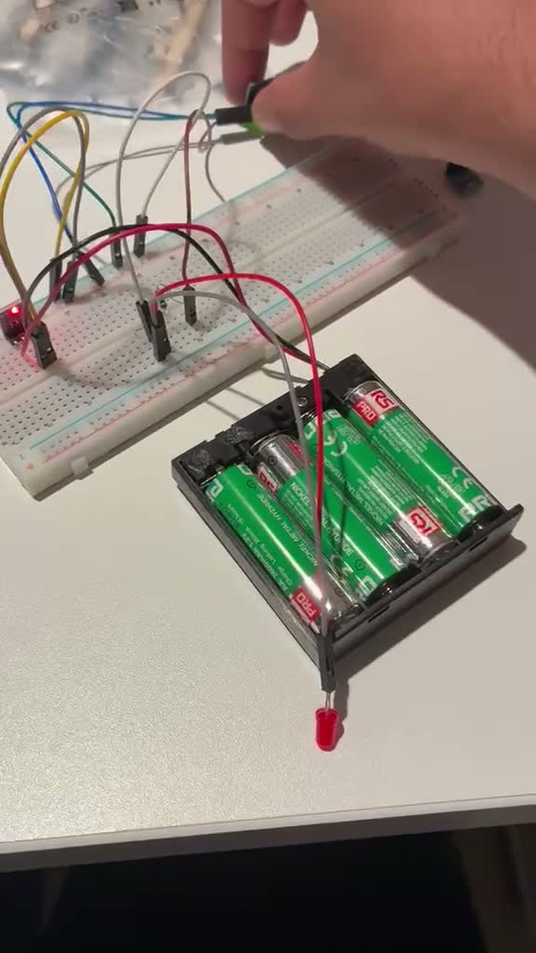
Build 3 in action
Notes:
Plays automatically and loops. The sensor's own LED and the red LED on the breadboard light together while the finger is on the spiral, and both go off on release. LED not lighting? Long leg must be in row 20, short leg in row 22; resistor B20–B25; SIG in C25; B22 to the − rail.

Slide 14
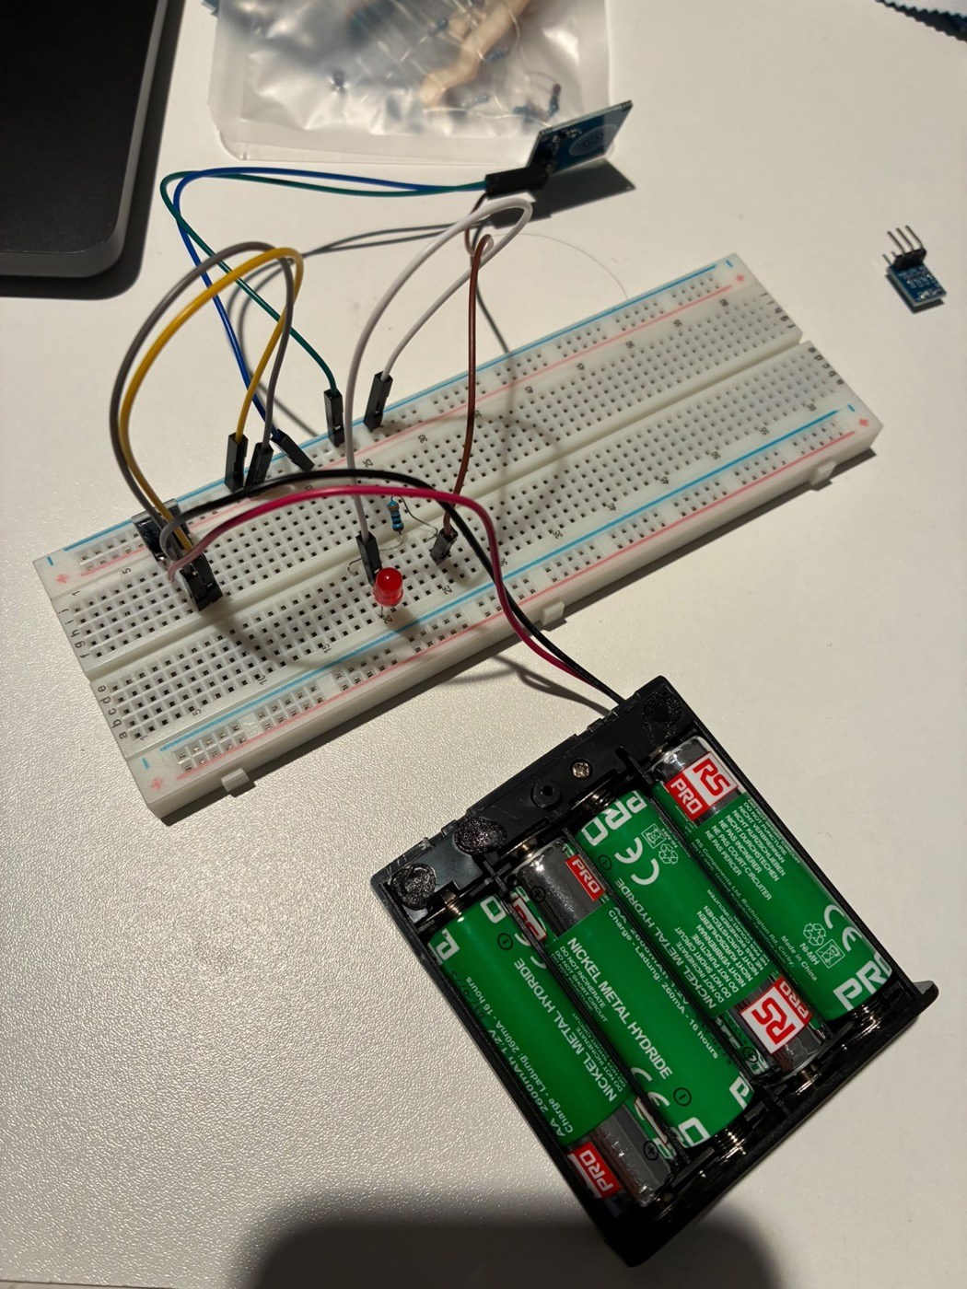
Build 3: Touch sensor + LED
Wire it — batteries out, row numbers matter
Sensor VCC → red (+) rail, GND → blue (−) rail (female-to-male jumpers). Leave SIG free for now
LED: long leg (+) → A20, short leg (−) → A22
330 Ω resistor: one leg → B20, other leg → B25
Sensor SIG → C25 (female-to-male). Then B22 → blue (−) rail (male-to-male)
Batteries in. Touch the white spiral — the red LED should light while you hold it
Signal path
SIG
sensor output
330 Ω
B25 → B20
LED +
long leg, A20
LED −
short leg, A22
GND
B22 → − rail
Notes:
Guide Steps 2–5. Step 2: VCC → red (+3.3 V) rail, GND → blue (−) rail (F–M jumpers); leave SIG free. Step 3: LED long leg (+) → A20, short leg (−) → A22; 330 Ω resistor B20 → B25. Step 4: sensor SIG → C25 (F–M); B22 → blue (−) rail (M–M). Signal path: SIG → 330 Ω → LED long leg → LED short leg → GND. Step 5: batteries in, touch the white spiral. If the sensor LED lights but the red LED doesn't: flip the LED (long leg in row 20), re-check rows, or the output may need an LED driver.

Slide 15

Can sensors be fooled?
Notes:
Pause here. Ask the room: has anyone's sensor done something odd already? Take two or three answers before the next slide.

Slide 16


yes
Physical wear
Environment
Design limits
Loose jumpers, bent header pins, flat batteries
Most “broken” sensors are a wire that moved
Fix: batteries out, push every pin home
Room lights and sunlight shift the light sensor's threshold
Sunlight carries IR and can false-trigger the IR sensor
Black absorbs IR, white reflects it
One threshold, one range, one surface type
Touch needs a finger-sized conductor — a pen does nothing
Tune the screw, shield the sensor with a cardboard hood
Notes:
Connect each cause to the materials on the challenge table: black tape and black paper hide from IR, white paper shows up, card hides a touch pad, a cardboard hood blocks room light from the LDR.

Slide 17

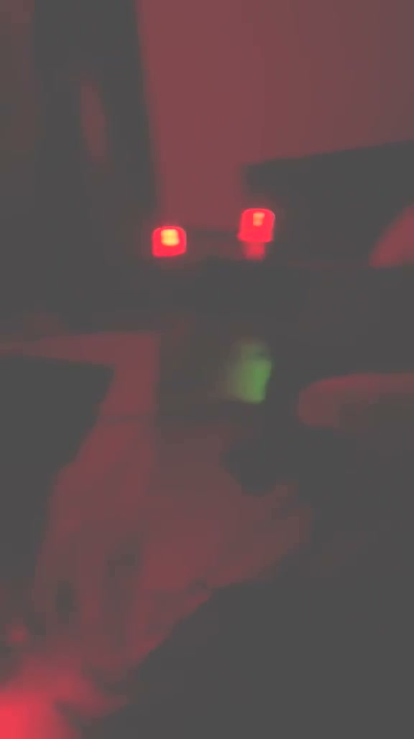
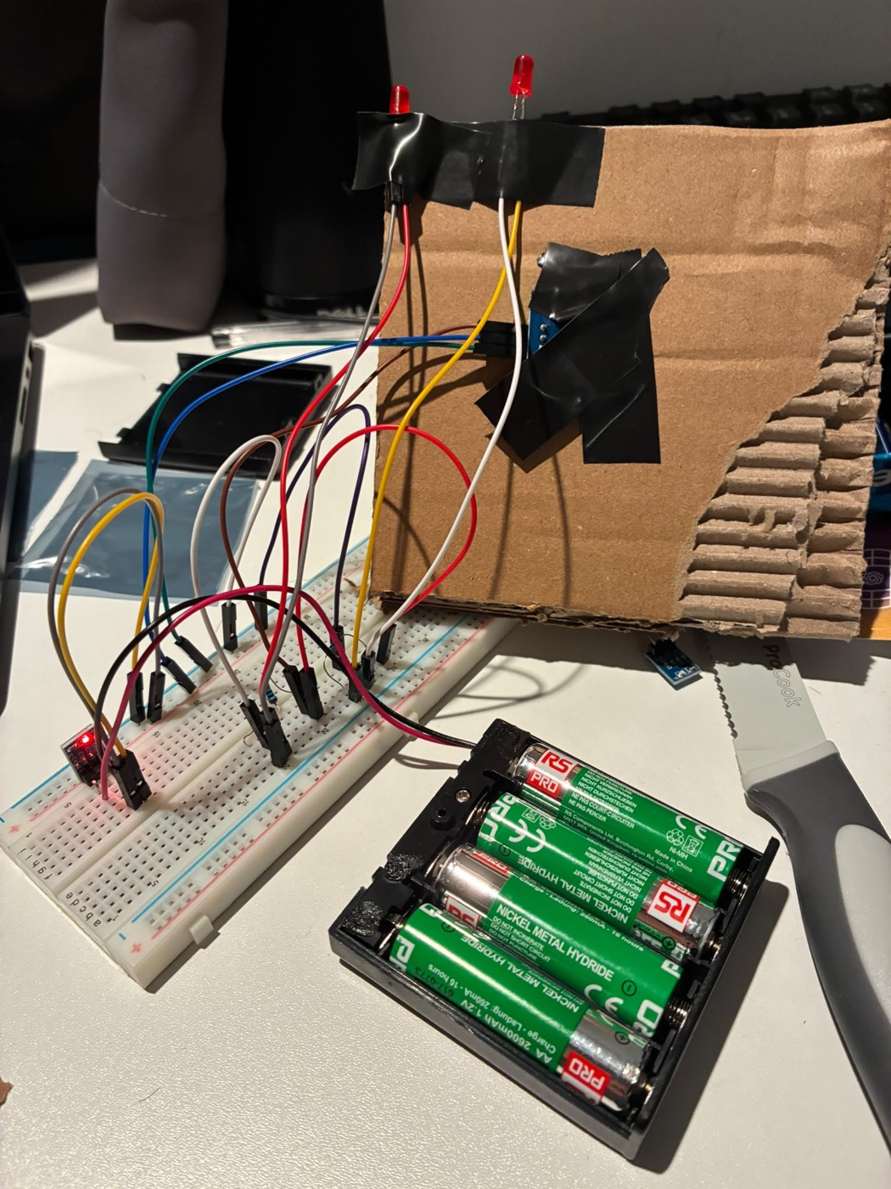
Build Challenge
The brief
In your team, build something that uses a sensor.
You can use multiple sensors
Best build wins chocolates!!
you can connect led’s/push buttons with multiple female to male jumper wires
Notes:
Edit the build time to suit the session. Right-hand side is Ayush's own build: a TTP223 touch pad taped behind a piece of cardboard with two red LEDs taped on top (second LED + 330 Ω resistor wired to the same SIG row). The clip is filmed with the lights off so the LEDs stand out — click to play. Judge on: works reliably, creative idea, clever use of materials, clear 30-second pitch.

Slide 18
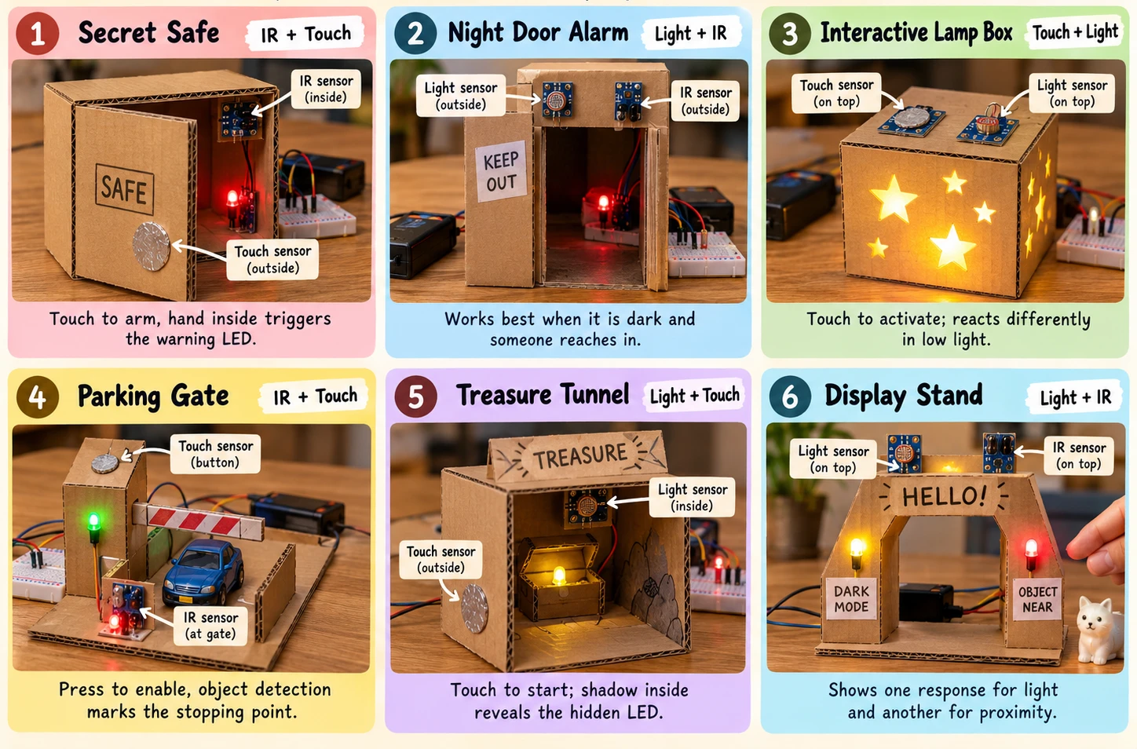
Notes:
Six starting points, each using two of today's sensors: 1 Secret safe (IR + touch): touch to arm, a hand inside trips the warning LED. 2 Night door alarm (light + IR): works when it is dark and someone reaches in. 3 Interactive lamp box (touch + light): touch to activate, reacts differently in low light. 4 Parking gate (IR + touch): press to enable, the IR sensor marks the stopping point. 5 Treasure tunnel (light + touch): touch to start, a shadow inside reveals the hidden LED. 6 Display stand (light + IR): one response for light, another for proximity. Teams can also do a single-sensor build — a hidden touch doorbell, an IR parking sensor, a shadow alarm.

Slide 19








come up the front and take
Cardboard
LEDs
Resistors
Push buttons
Black paper
Tape
White paper
Scissors
And jumper wires, screwdriver
Notes:
Plus everything in the kit: breadboard, battery pack, 3.3 V regulator, jumper wires and the three sensors. Ask before cutting; batteries out while taping things down.

Slide 20
REMINDER!
YOU MUST PURCHASE A MEMBERSHIP IN ORDER TO ATTEND WORKSHOPS AND TAKE PART IN COMPETITIONS!!!
YOU WILL ALSO GET PRIORITY FOR SOCIAL EVENTS AND BADMINTON / VOLLEYBALL TEAM
ONLY £5 ON OUR SU PAGE
Notes:
Membership reminder (carried over).

Slide 22
🏐 Volleyball IMS
🏐 Represent Robotics Society in University IMS volleyball
🤝 Play with other society members
🎉 No experience needed - just come along and have fun!
🏆 Compete against other university teams
📅 Next match this Sunday!
Notes:
IMS volleyball plug (carried over). Update the match date.

Slide 23


Slide 24


