Slide 1
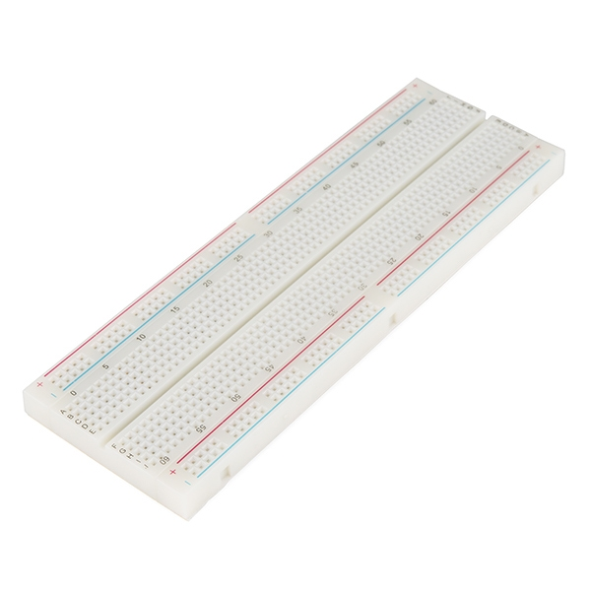
Breadboard
Build circuits without soldering
Each row of 5 holes is connected
The centre gap separates the sides
01
Notes:
Power rails run along the edges. Stock photograph: SparkFun Breadboard Full-Size (Bare), https://www.sparkfun.com/breadboard-full-size-bare.html. Image: https://www.sparkfun.com/media/catalog/product/1/2/12615-01.jpg. Power rails on this stock board are split halfway along each edge. Background facts: https://learn.sparkfun.com/tutorials/how-to-use-a-breadboard/all

Slide 2
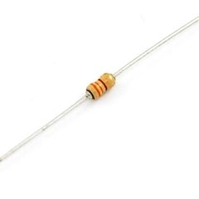
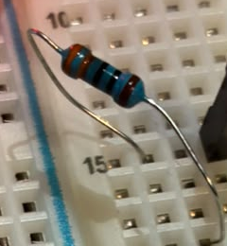
Resistor
Limits current
Protects the LED
Works either way round
330 Ω
02
Notes:
Stock photograph of a 330 ohm resistor: https://www.sparkfun.com/resistor-330-ohm-1-6th-watt-pth.html. Image: https://www.sparkfun.com/media/catalog/product/0/8/08377-02-L.jpg. The 330 Ω label refers to the stock image. The original physical resistor photo is retained below. Photo crop from user-provided 6511da4d-988a-425b-80e9-baec1281ec09.jpeg. Facts: https://learn.sparkfun.com/tutorials/activity-guide-for-sparkfun-tinker-kit/all

Slide 3
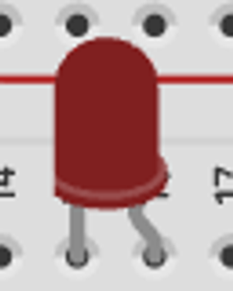

LED & push button
LED
Current flows one way
Anode (+): long leg
Cathode (−): short leg / flat side
Push button
Press to complete the circuit
Release to break the circuit
03
Notes:
LED polarity applies to the LED, not the push button. For a four-leg tactile button, two pairs of pins are already connected internally. Pressing joins the pairs. Component crops: user-provided pushbutton1.png. Facts: https://learn.sparkfun.com/tutorials/how-to-use-a-breadboard/all and https://learn.sparkfun.com/tutorials/experiment-guide-for-the-sparkfun-tinker-kit/all

Slide 4
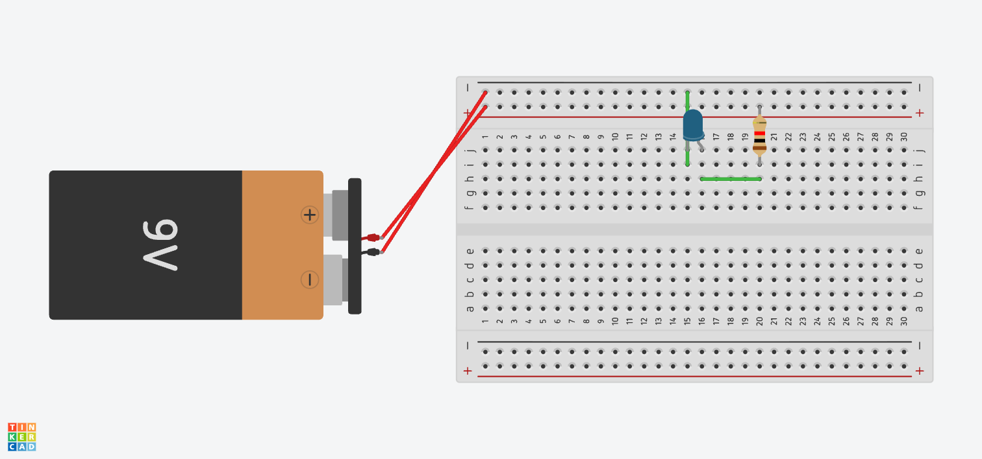
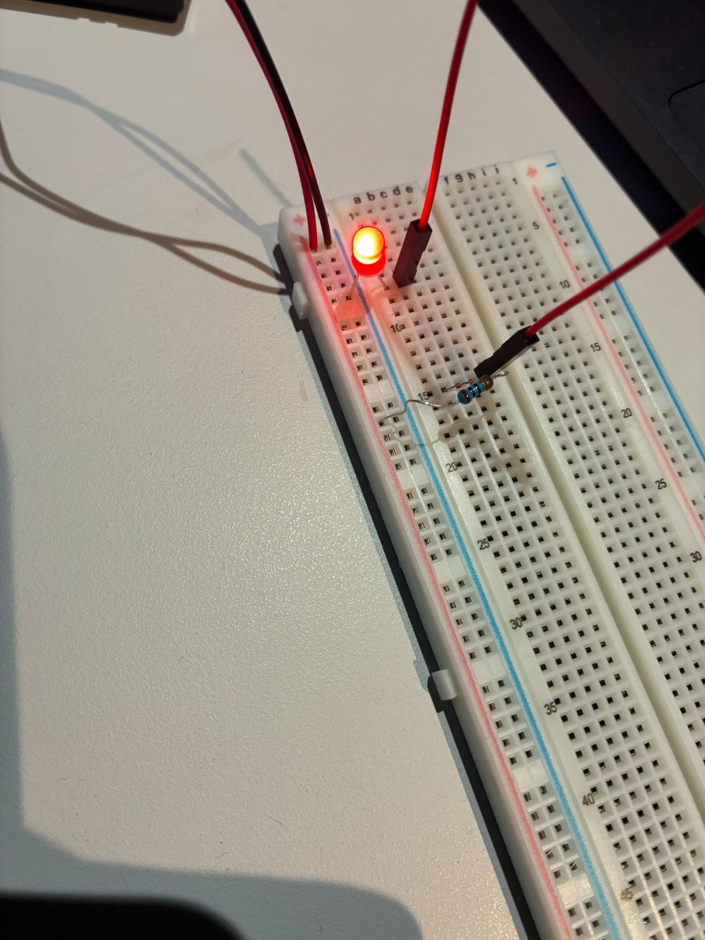
Circuit 1: Basic LED
Tinkercad
Physical build
04
Notes:
Images: user-provided basicled.png and 1e0b2a93-538f-49cb-8971-525cd170d08f.jpeg. The examples use different board layouts and LED colours. Follow the electrical connections, rather than matching row numbers.

Slide 5
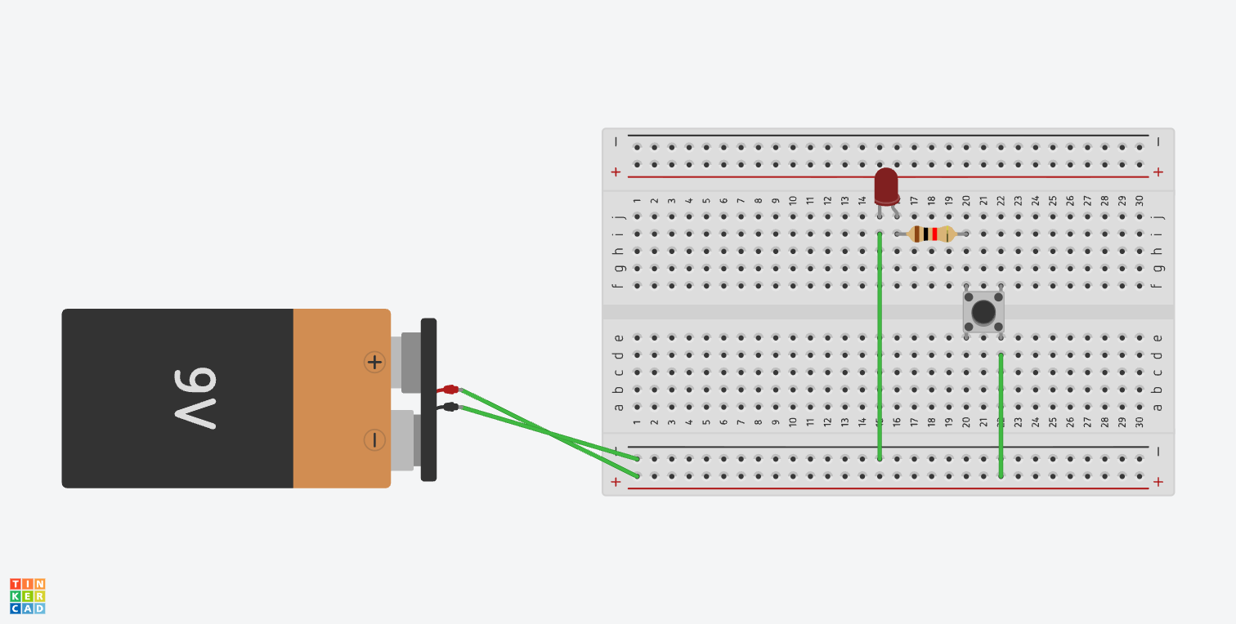
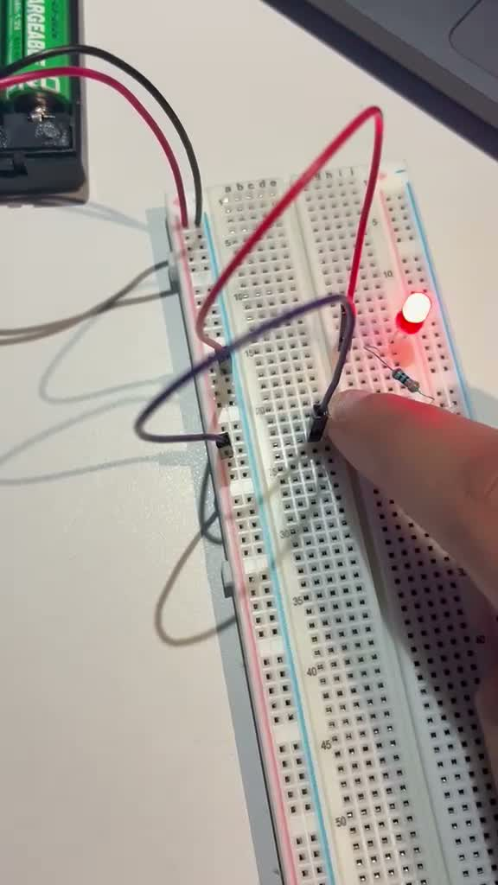
Circuit 2: Push-button LED
Tinkercad
Physical build
05
Notes:
Images: user-provided pushbutton1.png and still at 4.5 seconds from WhatsApp Video 2026-10-14 at 10.47.02 AM.mp4. The photo demonstrates the button pressed and LED on. Physical wiring layout differs from Tinkercad.

