Slide 1

ROBOTICS CLUB IIT KANPUR Science And Technology Council
Summer Project 2016

Slide 2
GAMING CONSOLE
TEAM MEMBERS:
Madhukar Bharti
Uday Kiran Damodara
Niskarsh Kumar
Shubhanshu Malpani

Slide 3
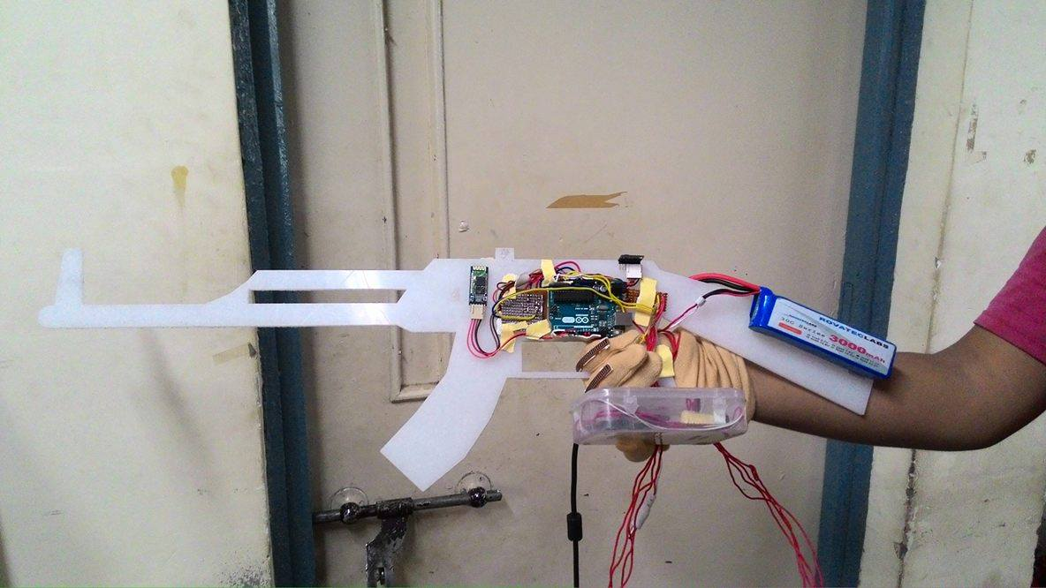
AIM
To make a console to control movements in common games.

Slide 4
Components Used
Arduino Uno
Inertial Measurement Units
MPU6050
GY85
Flex Sensors(*2)
Bluetooth Module
LiPo Battery

Slide 5
How the task was achieved
IMU MPU6050 to control the movement keys (W A S D)
Use the IMU GY85 to control the mouse
Use LI-PO Battery to power Arduino for using Bluetooth Communication
Flex sensors to control left and right click of the mouse
Bluetooth module HC-05 to wirelessly transmit the IMU data to processing

Slide 6
Problems Encountered
Obtaining yaw from the IMU data
Adjusting the mouse sensitivity
Merging the data of both IMUs
Integarting with the game
Most of the games have the mouse pointing the center of the screen

Slide 7
How the problems were solved
Using Direction Cosine Matrix instead of complementary filter to obtain yaw.
By using complementary filter the yaw
changes along with change in pitch also.
This was solved by carefully calibrating the mouse and keeping several thresholds for to control movement speed

Slide 8
References
https://www.cdiweb.com/datasheets/invensense/MPU-6050_DataSheet_V3%204.pdf
https://docs.oracle.com/javase/7/docs/api/java/awt/Robot.html
http://www.java-tips.org/java-se-tips-100019/21-java-awt/1758-how-to-use-robot-class-in-java.html
http://wiki.iteadstudio.com/Serial_Port_Bluetooth_Module_(Master/Slave)_:_HC-05
http://engineering.stackexchange.com/questions/3348/calculating-pitch-yaw-and-roll-from-mag-acc-and-gyro-data

Slide 9
Future Plans
Integrate the mouse control completely for the games
Control of the game
Make the console more user friendly and customizable

Slide 10
THANK YOU

