Slide 1

Introduccion a Kurento
One to many video call
Alberto Pavo Blas

Slide 2
What is kurento?
Kurento is a WebRTC media server and a set of client APIs making simple the development of advanced video applications for WWW and smartphone platforms. Kurento features include group communications, transcoding, recording, mixing, broadcasting and routing of audiovisual flows.
Kurento provides a Kurento Client’s API based on “Media Elements”, WebRtcEndpoint, RecorderEndpoint, FaceOverlayFilter ... Each Media element has a capability. Connecting these elements applications are constructed.
Kurento offer two clients Java and Javascript. Javascript Client can use Node.Js

Slide 3
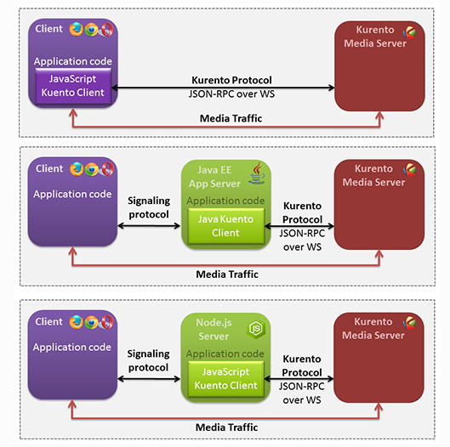

Slide 4
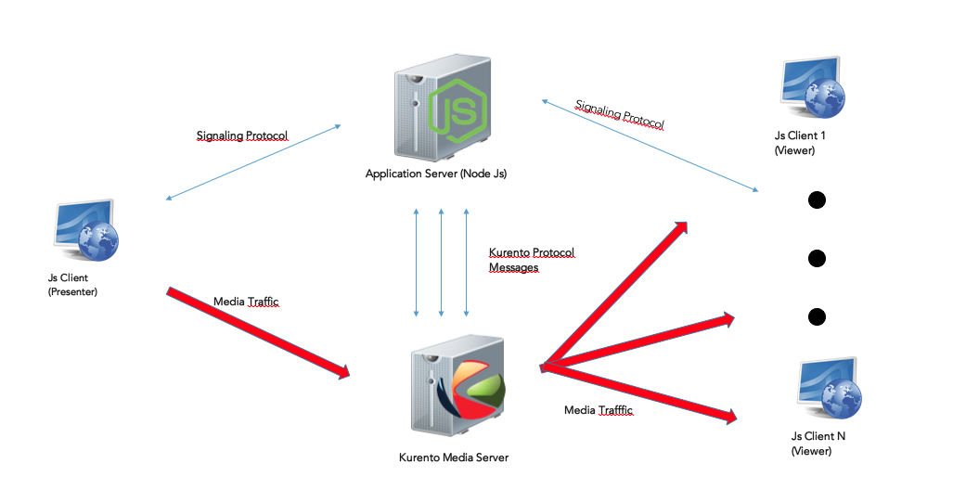
One to many Call
Kurento have many apllications but one was explained in concretly “One to many call”, consists of diffusion of video.

Slide 5
One to many Call
This application is based on connect different “WebRtcEndPoints”. A WebRtcEndPoints is a media element holds the capability of sending and receiving WebRTC media streams. In Kurento jargon, a graph of connected media elements is called a Media Pipeline.
There are two types of user:
Presenter, one peer sending media, only a one presenter in application.
Viewer, N peers receiving the media from the Presenter

Slide 6
One to many call
At the client-side, the logic is implemented in JavaScript. At the server-side we use a Node.js application server consuming the Kurento JavaScript Client API to control Kurento Media Server capabilities.To communicate this entities, two Websockets are used:
First implement a signalling protocol between NodeJs server and client.
The second is used to communicate the Kurento JavaScript Client executing at Node.js and the Kurento Media Server.
ICE is used for to establish the WebRTCconnection between the Kurento client and server and SDP is used for connect WebRtcPeer in the browser with the WebRtcEndpoint in the server.
Finally the media traffic is exchange between Client and KMS.

