Slide 1
New instance
Near a previously tracked one?
Update the tracked instance
position = new_position
counter = counter + 1
Near a previously candidate one?
Update the candidate instance
position = new_position
counter = counter + 1
New candidate instance
position = new_position
counter = 1

Slide 2
Candidate instance
counter >= 0 ?
counter == thresh ?
New tracked instance
position = candidate_pos
counter = thresh
Delete this candidate instance
Penalize candidate
counter =- 1
Tracked instance
counter >= 0 ?
Penalize tracked
counter =- 1
Delete this
tracked instance

Slide 3
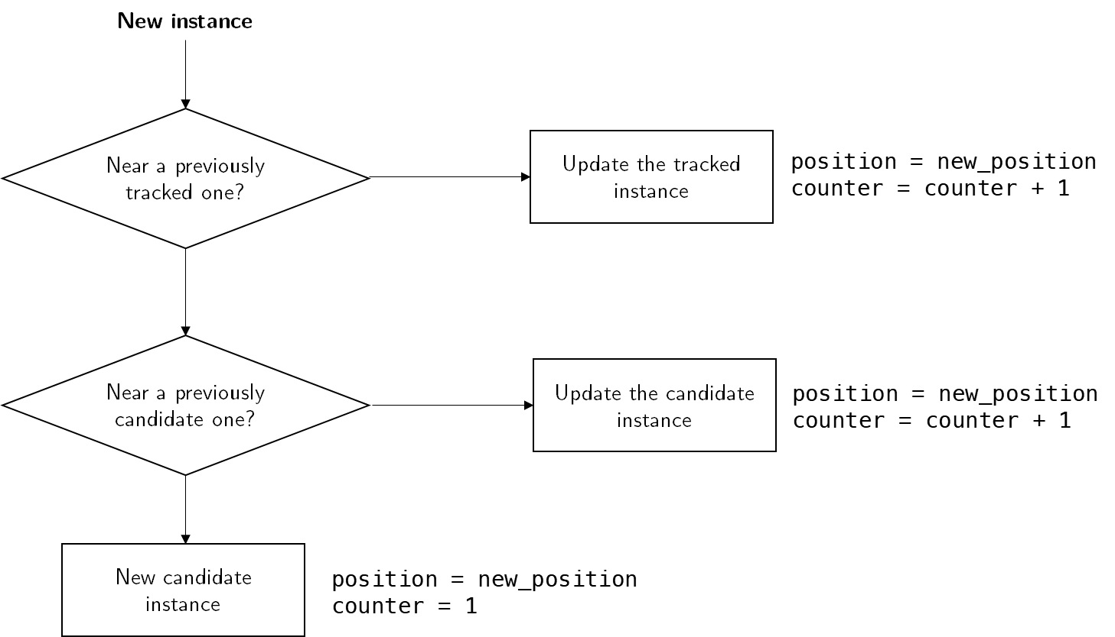
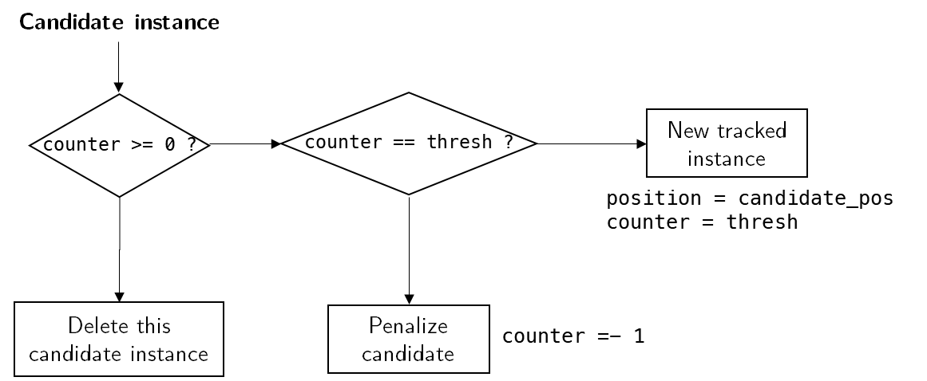
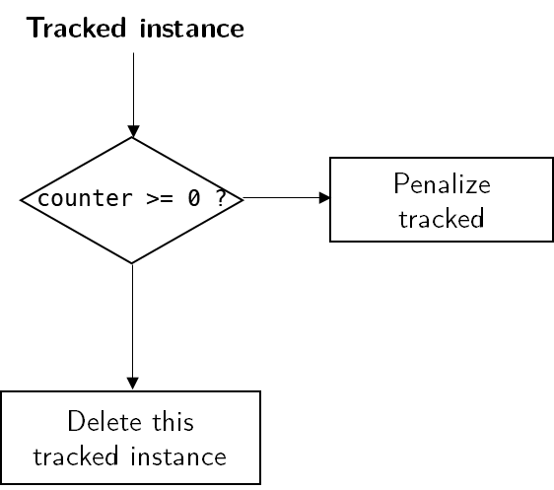
1) For a new instance in the current frame
2) Iteration over all candidate instances
3) Iteration over all tracked instances

