Slide 1
Perception block
Image acquisition
(RGBD sensor)
Actuation block
Following behavioral
(case-based schema)
Person detection
(SSD CNN)
Tracked
persons
Angular
error
Linear
error
Face detection
(Haar-liked cascade
classifier)
Trackers
Movement response
(PID Controller)
Face reidentification
(MobileNet CNN)

Slide 2
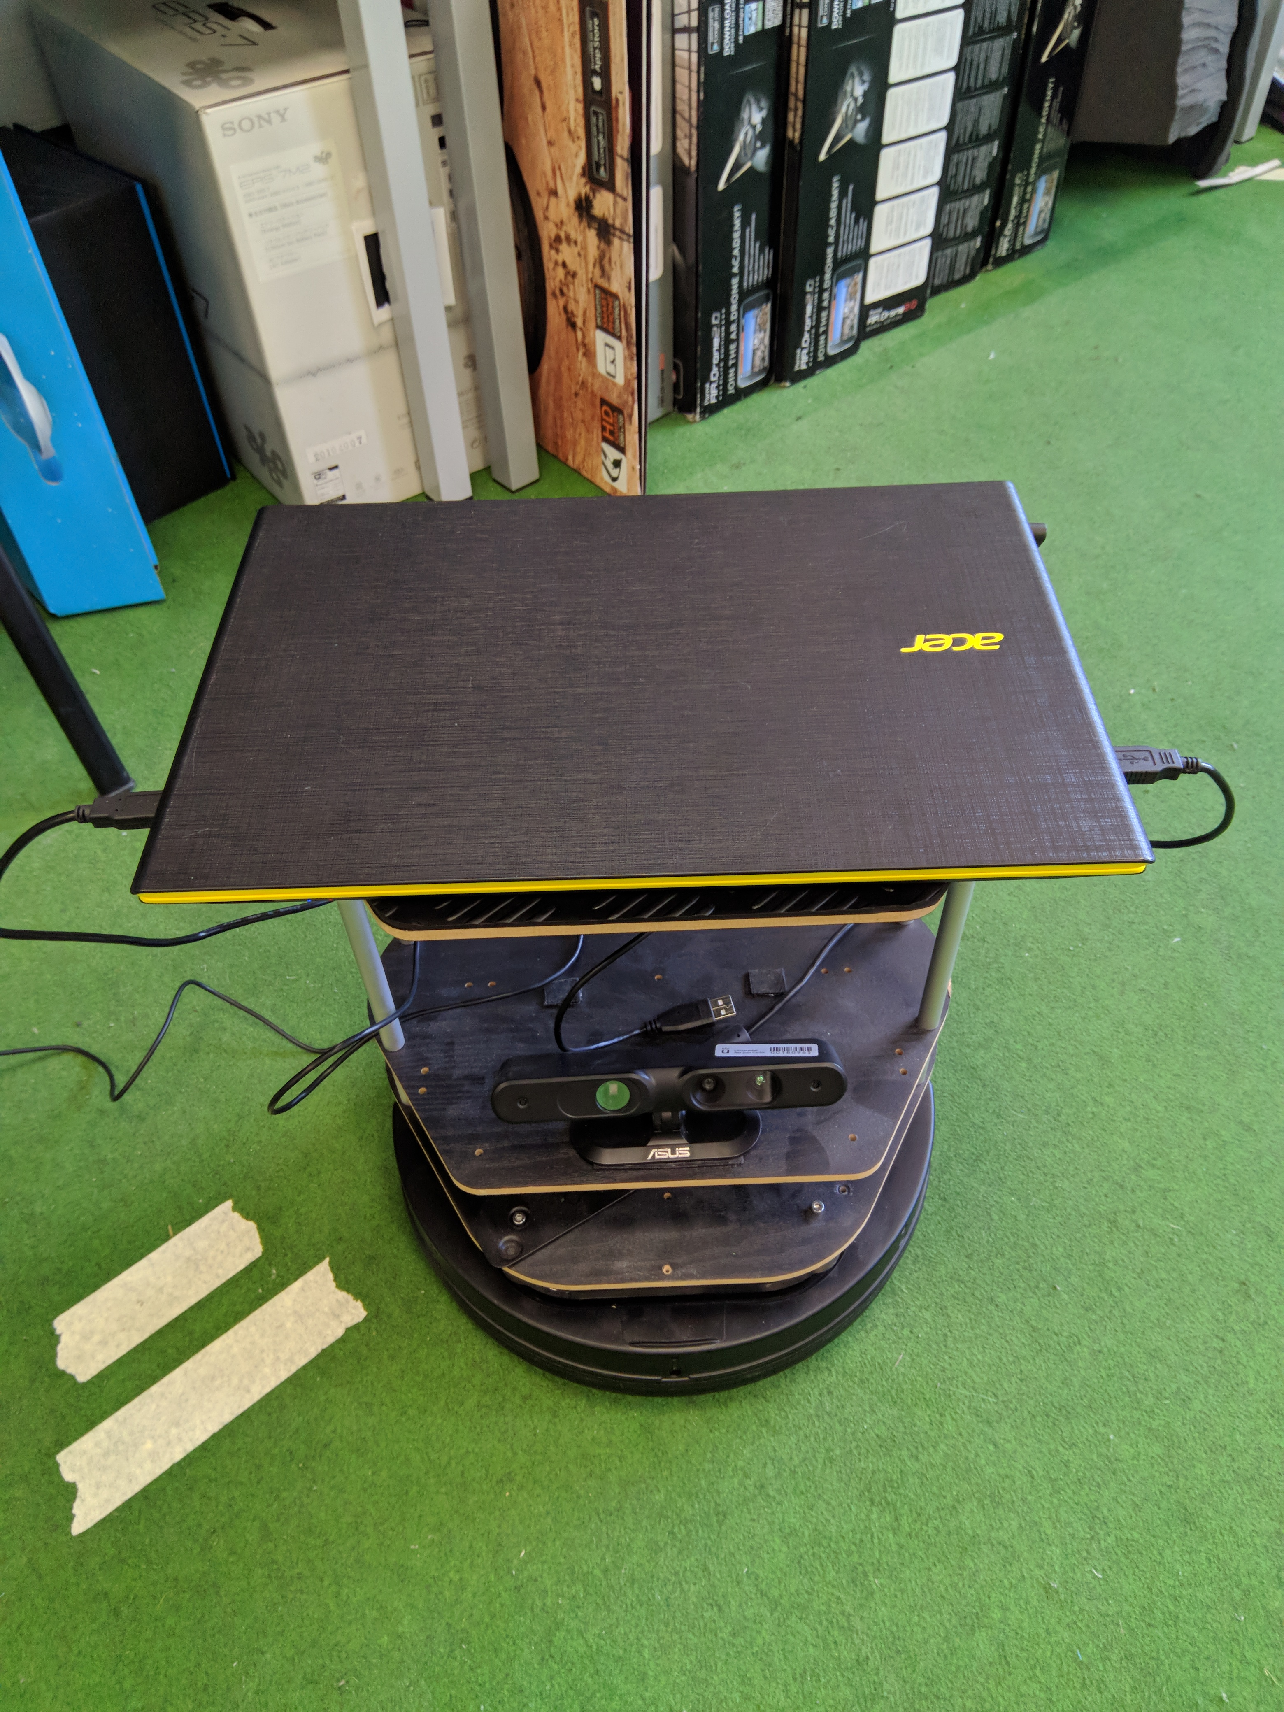
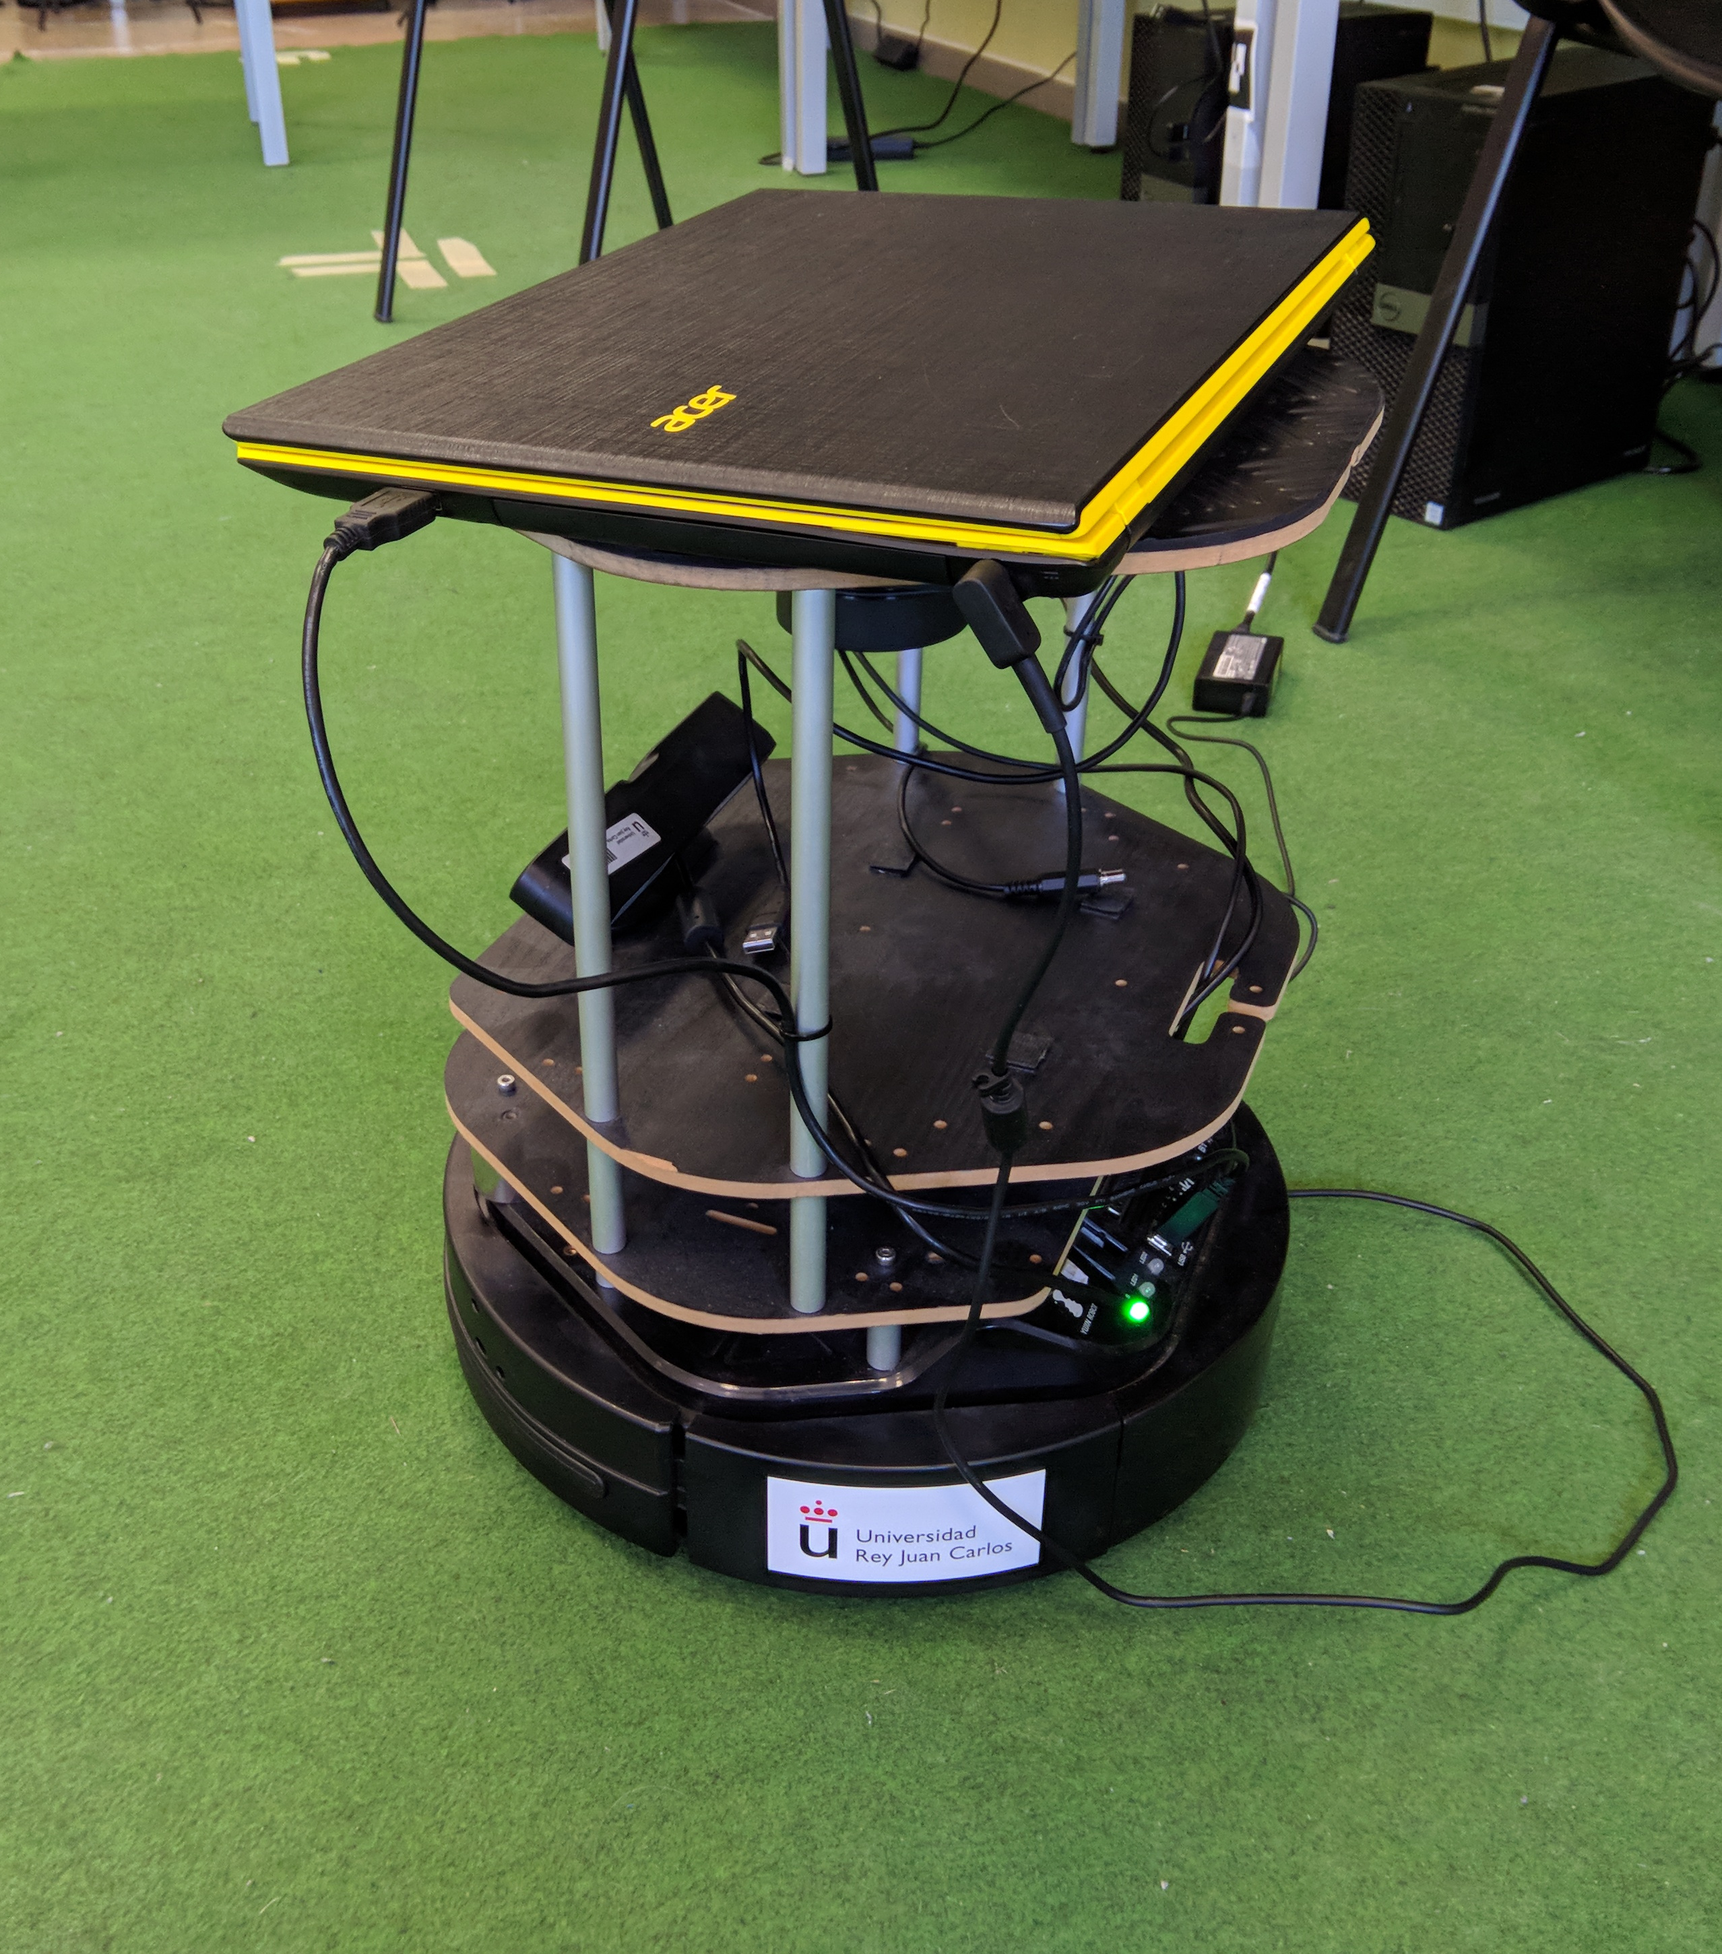
a) Frontal view
b) Side view

Slide 3
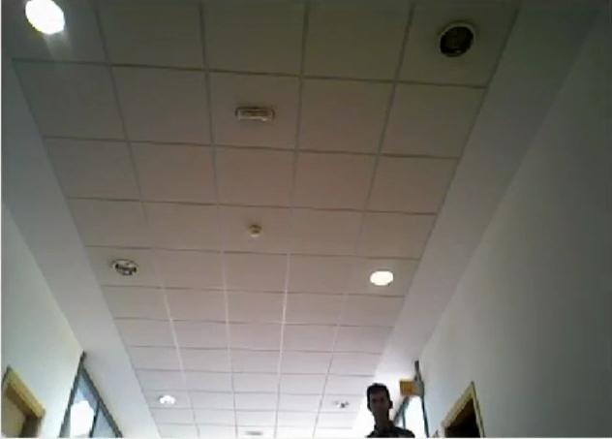
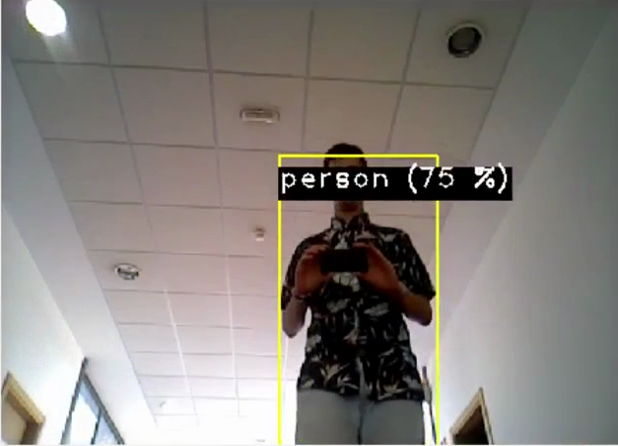
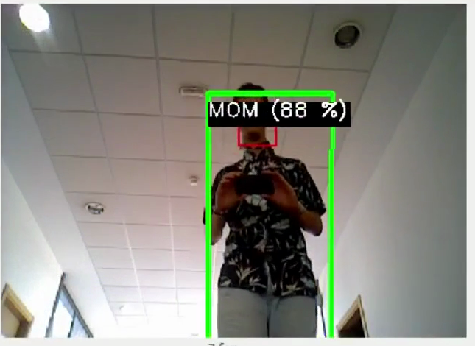

Slide 4


