Slide 1
functional_architecture
Full system
Perception
Module
Actuation
Module
Target
Image
source
Camera
Benchmark
RGB-D camera
Neural
pipeline
PID
controller
Motors
ROSBag
Optical tracker

Slide 2
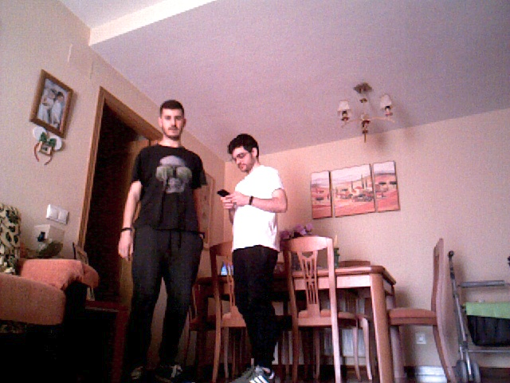
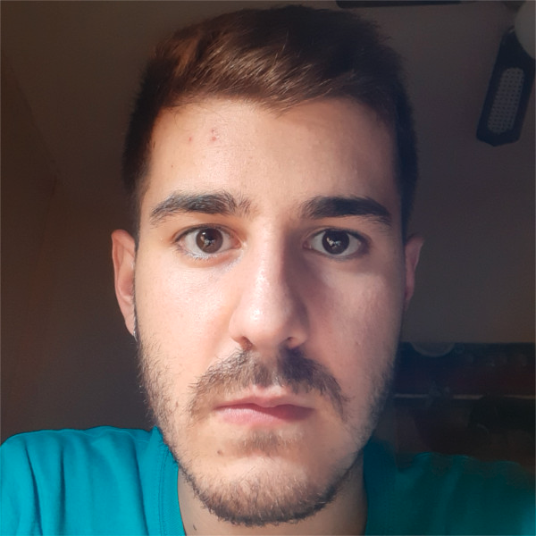
neural_pipeline
persons
Neural pipeline
Person detection
Network
Input
image
faces
Face detection
Network
Face encoding
Network
similarities
1.07
1.42
Reference face

Slide 3
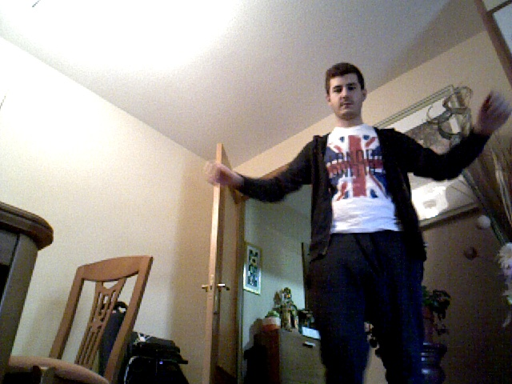
person_detection

Slide 4
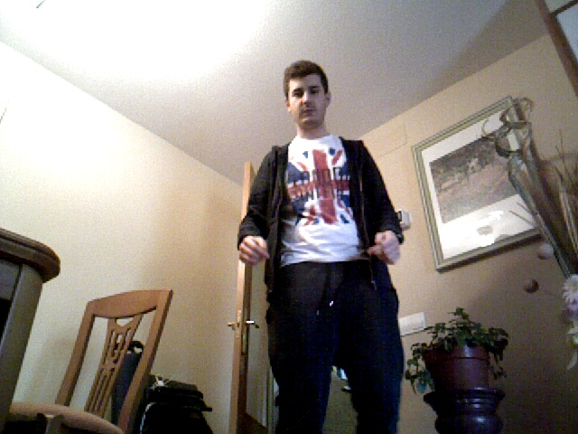
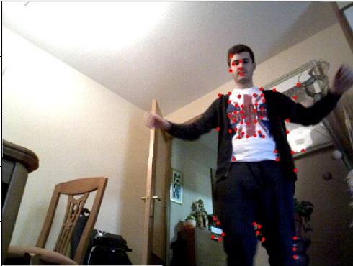
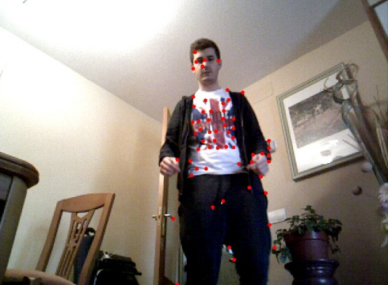
tracker_demo

Slide 5
tracker_update
t
t+1
x
σ_{y}
t
x
σ_{y}
t+1
σ_{x}
σ_{x}
t
t+1

Slide 6
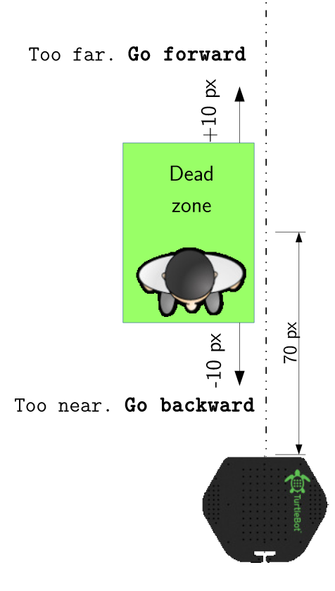
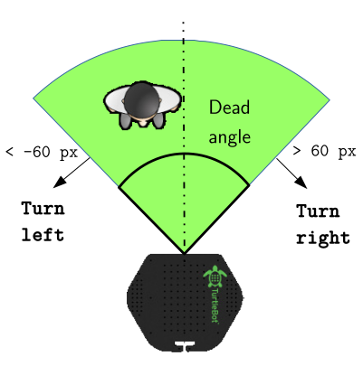
velocity_controllers
a
Go forward
130 cm
Safe zone
Safe zone
jaja
100 cm
< -50 px
> 50 px
Go backward
40 cm
aa
Turn left
Turn right
a
Turn right
Angular controller
Linear controller

Slide 7
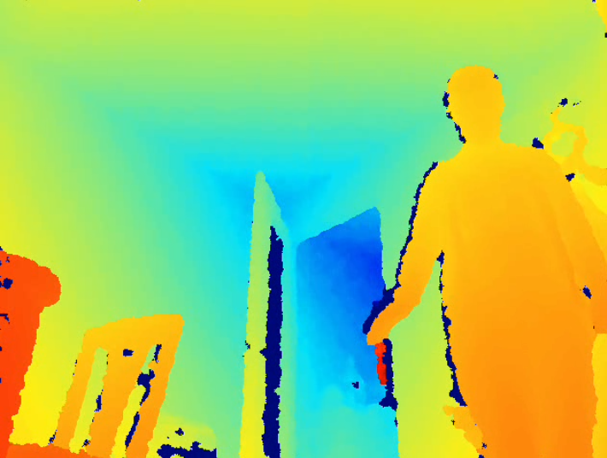
controller_error_computation
Angular error computation
Linear error computation
Trimming
+
grid sampling
+
median
x
x
(depth image)
94 px
127 cm

Slide 8
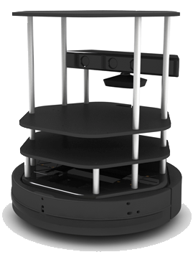
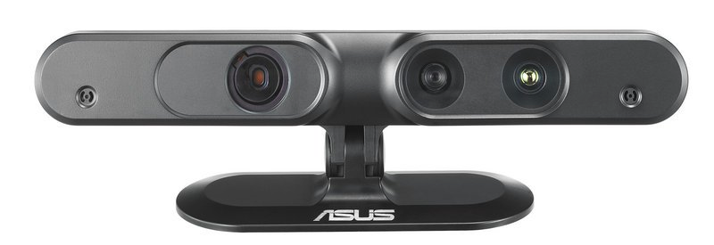
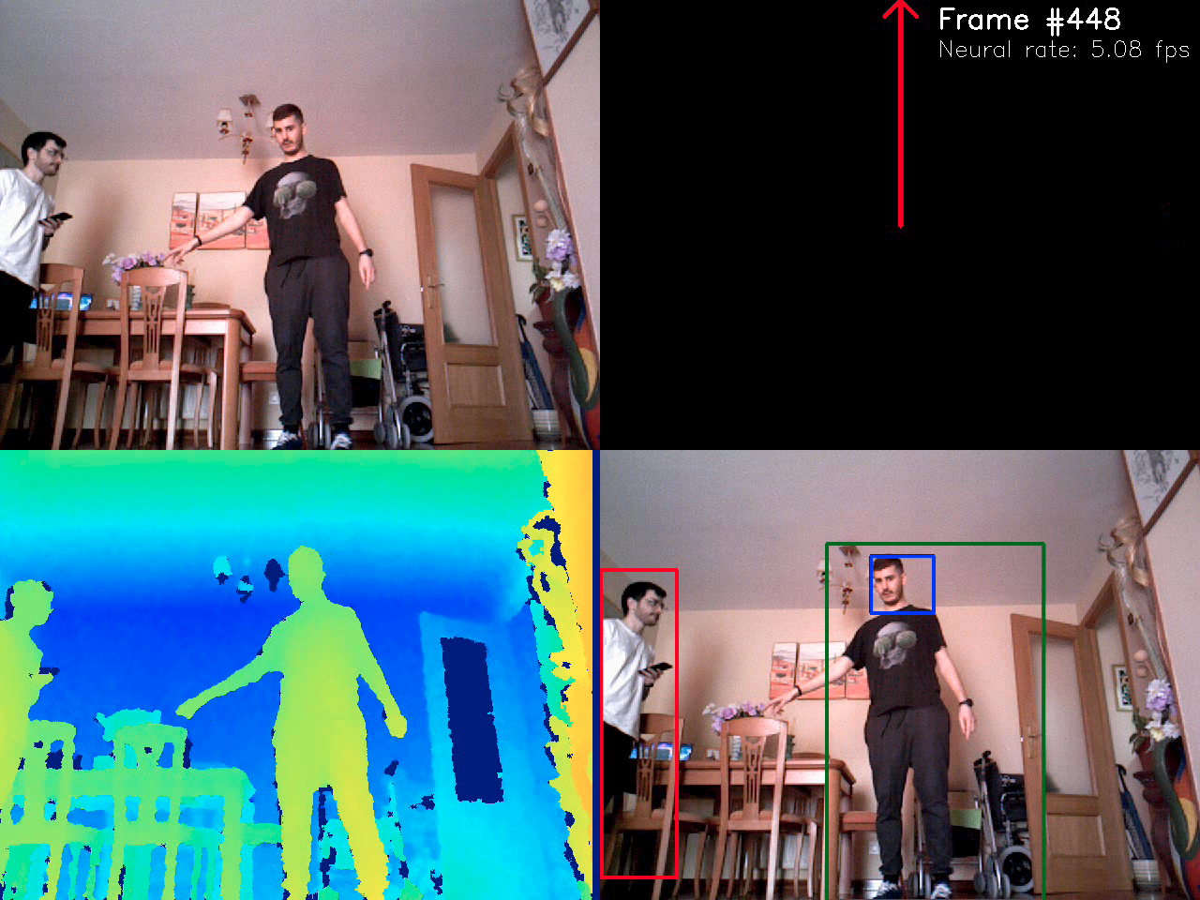
software_architecture
Threads
Tracker
NetworksController
Main
Turtlebot 2
ROSCam
ASUS Xtion
ASUS Xtion
(synchronous source)
ROSBag
(asynchronous source)
Output image

Slide 9
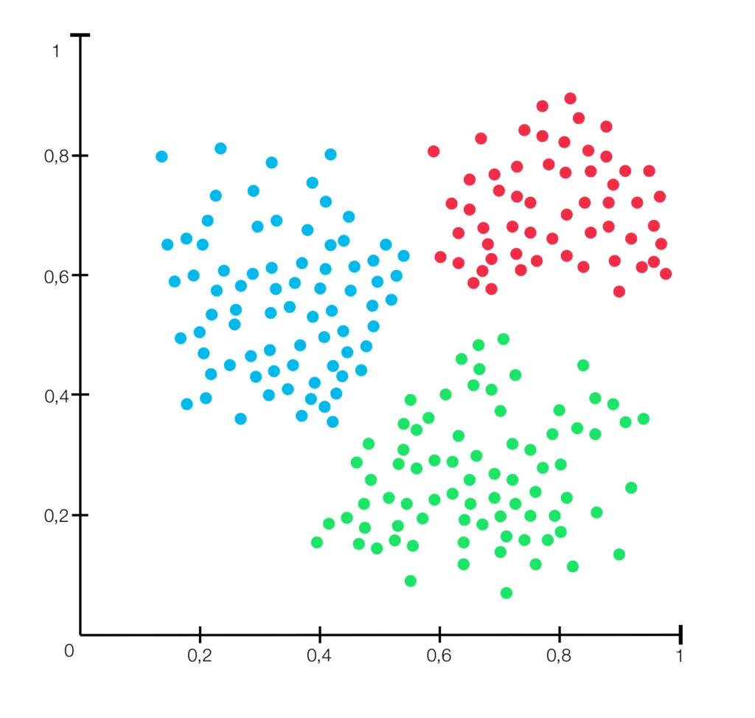
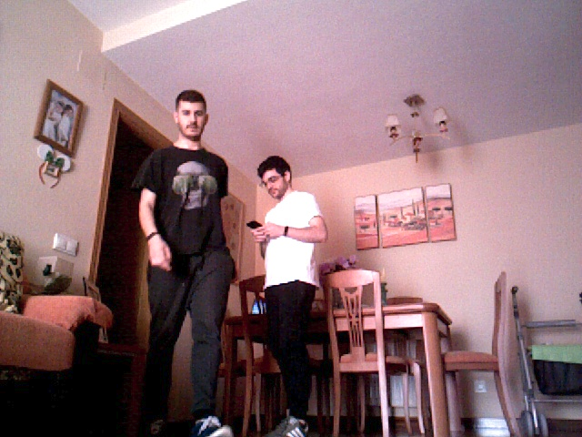
face_encoder
Latent space

