Slide 1
functional_architecture
Full system
Perception
Module
Actuation
Module
Image
source
Target
Camera
Tracker
RGB-D camera
Benchmark
Neural
pipeline
PID
controller
ROSBag
Motors

Slide 2
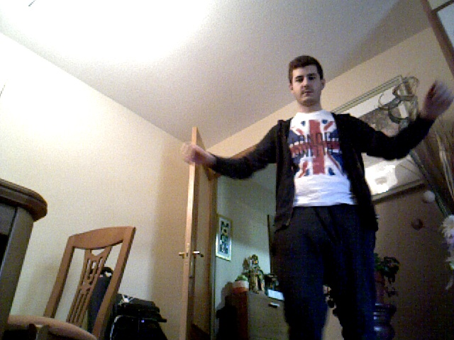
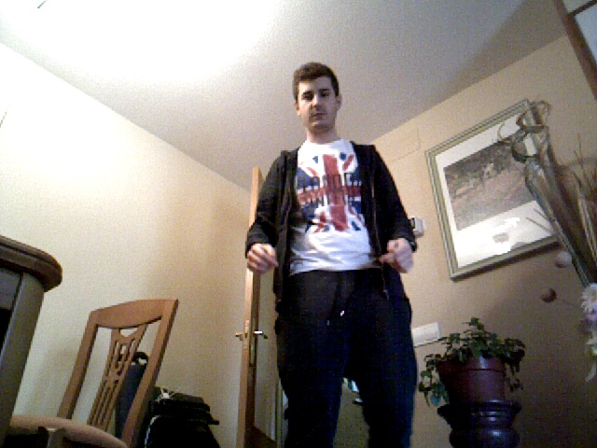
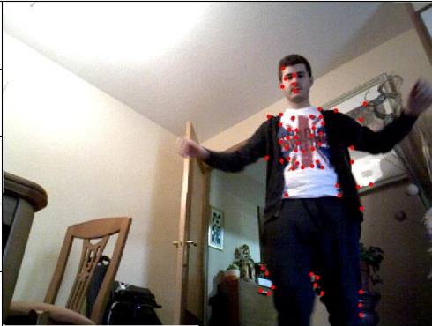
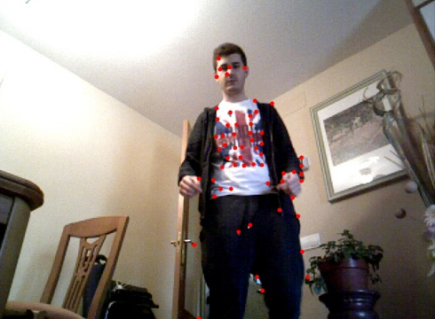
tracker_demo

Slide 3
tracker_update
t
t+1
x
σ_{y}
t
x
σ_{y}
t+1
σ_{x}
σ_{x}
t
t+1

Slide 4
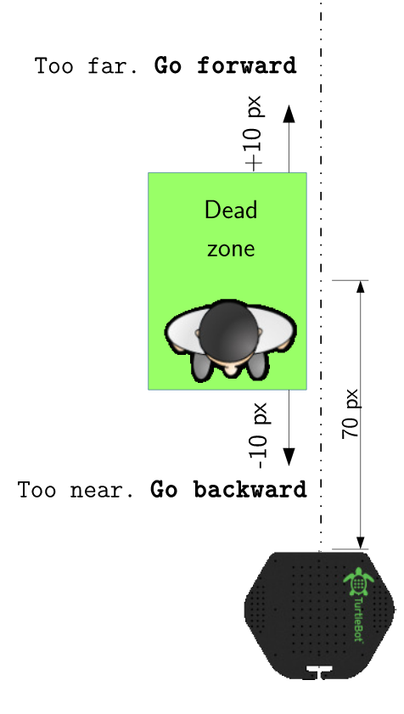
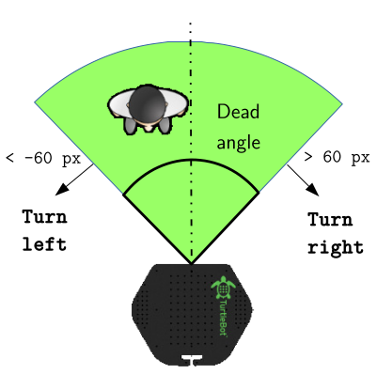
velocity_controllers
Linear controller
Angular controller
130 cm
Safe zone
Safe zone
jaja
100 cm
< -50 px
> 50 px
40 cm
aa
Turn left
Turn right
Turn right

Slide 5
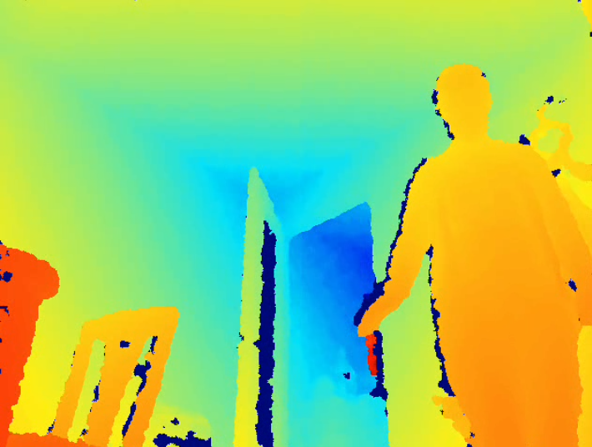
controller_error_computation
Angular error computation
Linear error computation
x
Grid sampling +
median
x
94 px
(depth image)

