Slide 1
End-to-End Model-Free Reinforcement Learning
for Urban Driving using Implicit Affordances
Marin Toromanoff, Emilie Wirbel, Fabien Moutarde
Center for Robotics, MINES ParisTech, PSL
16 marzo 2020

Slide 2
Summary
Winner of camera Only track of the CARLA challenge
implicit affordances
Allowing training of replay memory based RL with much larger network and input size than most of network used in previous RL works.
much more challenging than the original CARLA benchmark
The first RL agent successfully driving from vision
Increased complexity
in urban environment including intersection management and traffic lights detection besides lane keeping, pedestrians and vehicles avoidance
Extensive parameters and ablation studies of implicit affordances and reward shaping

Slide 3
Challenges in AD
Highly variable situations
Imitation learning leads to distribution mismatch
Data augmentation
End-to-end system needed
human driver is always in an almost perfect situation
currently mostly limited to lane keeping and lateral control

Slide 4
DRL TO THE RESCUE
Does not suffer from distribution mismatch
RL algorithms rely on a replay buffers allowing to learn from past experiments
Notes:
on the other side lets the algorithm learn by itself by providing a reward signal at each action taken by the agent and thus does not suffer from distribution mismatch. This reward can be sparse and not describing exactly what the agent should have done but just how good the action taken is locally. The final goal of the agent is to maximize the sum of accumulated rewards and thus the agent needs to think about sequence of actions rather than instantaneous ones. One of the major drawbacks of DRL is that it can need a magnitude larger amount of data than supervised learning to converge, which can lead to dificulties when training large networks with many parameters. Moreover many RL algorithms rely on a replay buffer [21, 25, 12] allowing to learn from past experiments but such buffers can limit the size of the input used (e.g. the size of the image). That is why neural networks and image size in DRL are usually tiny compared to the ones used in supervised learning. Thus they may not be expressive enough to solve such complicated tasks as urban driving. Therefore current DRL approaches to autonomous driving are applied to simpler cases, e.g. only steering control for lane keeping [18] or going as fast as possible in racing games [24, 16]. Another drawback of DRL, shared with IL, is that the algorithm appears as a black box from which it is difficult to understand how the decision was taken

Slide 5
DRL DRAWBACKS
It can need a magnitude larger amount of data than supervised learning to converge
difficulties when training large networks with many parameters
buffers can limit the size of the input used (e.g. the sizeof the image)
algorithm appears as a black box from which it is difficult to understand how the decision was taken
Notes:
That is why neural networks and image size
in DRL are usually tiny compared to the ones used in su-
pervised learning. Thus they may not be expressive enough
to solve such complicated tasks as urban driving

Slide 6
DRL DRAWBACKS
It can need a magnitude larger amount of data than supervised learning to converge
difficulties when training large networks with many parameters
buffers can limit the size of the input used (e.g. the sizeof the image)
algorithm appears as a black box from which it is difficult to understand how the decision was taken
Use coined affordances = privileged information as auxiliary losses
Notes:
The idea is to train a network to predict high level information such as semantic segmentation maps, distance to center of the lane, traffic light state etc... This prediction can then be used in several ways
by a classic controller as in Sauer et al.
as auxiliary loss helping to find better features
to the main imitative task loss as in Mehta et al. [23]
in a model-based RL approach as in the really recent work of Pan et al. [26]
while also providing some interpretable feedback on how the decision was taken.

Slide 7
End-to-End Autonomous Driving with RL:
Related work
Imitation learning better results than an RL baseline using the A3C algorithm with discrete actions.
RL with DDPG and continuous actions to fine-tune an imitation agent
“Learning to Drive in a Day” in which an agent is trained directly on the real car for steering.
A really recent work also integrates RL on a real car and compares different ways of transferring knowledge learned in CARLA in the real world.
Notes:
TORCS is a racing game, the goal of those
works is to reach the end of the track as fast as possible and
thus does not handle intersections nor traffic lights. So all research relevant is performed in CARLA
DDPG one → mostly imitation learning and no considering traffic lights
RL in real cars → Even if their studies are really interesting, their results are preliminary and applied only on few specific real-world scenarios. Both of these works only handle steering angle for lane keeping and a large gap has to be crossed before reaching throttle and steering control simultaneously in urban environment on a real car with RL

Slide 8
End-to-End Autonomous Driving with RL:
Related work
SplitNet finding features from perception task >> model-free RL agent
network to predict high-level information such as probability of collision or being off-road in the near futures >> model-based RL scheme
Notes:
The first one by Gordon introduced SplitNet on which they explicitly decompose the learning scheme in finding features from perception task and use these features as input to their model-free RL agent. But their scheme is applied to a completely different task, robot navigation and scene exploration
train a network to predict high-level information such as probability of collision or being off-road in the near futures from a sequence of observations and actions. They use this network in a model-based RL scheme by evaluating different trajectories to finally apply the generated trajectory giving the lowest cost. However, they use a model-based approach and do not handle traffic light signal.

Slide 9
CARLA CHALLENGE
the goal is to drive in unseen maps from sensors to control, ensuring lane keeping, handling intersections with high level navigation orders (Right, Left, Straight), handling lane changes, pedestrians and other vehicles avoidance and finally handling traffic lights US and EU at the same time
Notes:
The CARLA Challenge is an open competition for
autonomous driving relying on the CARLA simulator. This competition addresses specifically the problem of urban driving. This is much more challenging than the original CARLA benchmark [7]. The CARLA Challenge consists in 4 different tracks with the only difference being the sensors available, from cameras only to a full stack perception. We will only handle the “Camera Only” track there, in fact we even used only a single frontal camera for all this work

Slide 10
RL Setup: Rainbow-IQN Ape-X
Value-based RL as it is the current state-of-the-art on Atari
Notes:
value-based RL as it is the current state-of-the-art on Atari and is known to be more data efficient than policy-based method However, it has the drawback of handling only discrete actions
CARLA is too slow for RL and cannot generate enough data if only one instance is used => train on multiple maps of CARLA at the same time
The reward used for the training relies mostly on the waypoint API present in the latest version of CARLA (CARLA 0.9.X). waypoints position and orientation of all lanes in the current town. This is fundamental to decide what path the agent has
to follow. And the different possibilities at each intersection
When arriving at an intersection, we choose randomly a possible maneuvre (Left,Straight or Right) and the corresponding order is given to the agent. The reward relies on three main components: desired speed, desired position and desired rotation.

Slide 11
RL Setup
Value-based RL as it is the current state-of-the-art on Atari
Implementation of Rainbow-IQN Ape-X without the dueling network https://arxiv.org/pdf/1803.00933v1.pdf
Notes:
value-based RL as it is the current state-of-the-art on Atari and is known to be more data efficient than policy-based method However, it has the drawback of handling only discrete actions
CARLA is too slow for RL and cannot generate enough data if only one instance is used => train on multiple maps of CARLA at the same time
The reward used for the training relies mostly on the waypoint API present in the latest version of CARLA (CARLA 0.9.X). waypoints position and orientation of all lanes in the current town. This is fundamental to decide what path the agent has
to follow. And the different possibilities at each intersection
When arriving at an intersection, we choose randomly a possible maneuvre (Left,Straight or Right) and the corresponding order is given to the agent. The reward relies on three main components: desired speed, desired position and desired rotation.

Slide 12
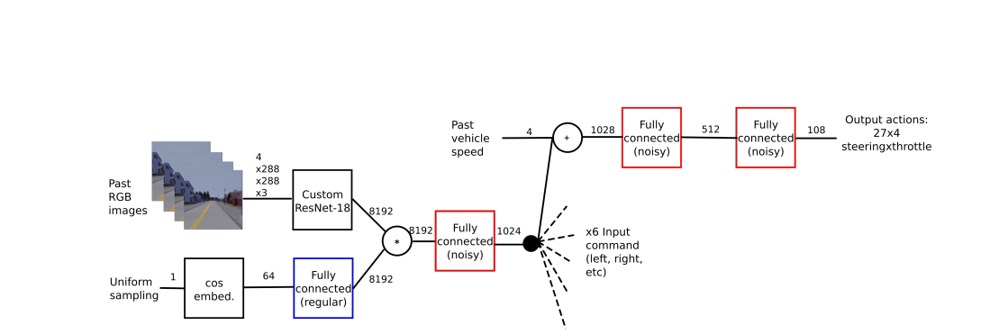
Notes:
The idea is to split the training in two phases: first an encoder backbone (Resnet-18 [11]) is trained to predict affordances such as traffic light state
or distance to center of the lane. Then the output features of this encoder is used as the RL state instead of the raw images. Therefore the RL signal is only used to train the last part of the network. Moreover the features are used directly in the replay memory rather than the raw images,
which corresponds to approximately 20 times less memory needed.

Slide 13

RL Setup: Rainbow-IQN Ape-X
Unlike Most of networks in model-free RL & images = small network
18 convolutional layers and 30M parameters
4×288×288×3 gray scale image by concatenating 4 consecutive frames
temporality & traffic lights detection
Resnet-18 and a conditional network
to handle 6 different maneuvers
most of state-of-the art advances in supervised learning such as residual connections and batchnorm
Notes:
One of the larger networks used for model-free RL for Atari is the large architecture from IMPALA [8] which consists of 15 convolutional layers and 1.6 million parameter: as comparison our architecture has 18 convolutional layers and 30M parameters
Moreover IMPALA used more than 1B frames when we used only 20M
Typically taking a 84 × 84 grayscale image as input. Our first observation is that traffic light state (particularly for US traffic lights which are farther) can not be seen on so small images. Therefore a larger input size has been chosen (around 40 times larger): 4×288×288×3 by concatenating 4 consecutive frames as a simple and standard [25, 7] way to add some temporality in the input. We choose this size as it was the smallest one we tested on which we still had a good accuracy on traffic light detection (using a conventional supervised training).

Slide 14
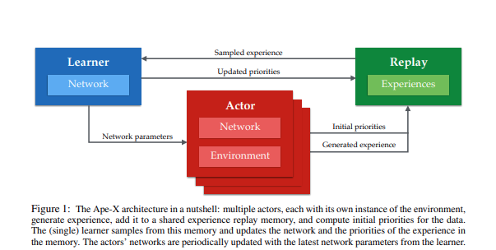
RL Setup: Rainbow-IQN Ape-X
Notes:
value-based RL as it is the current state-of-the-art on Atari and is known to be more data efficient than policy-based method However, it has the drawback of handling only discrete actions.

Slide 15
RL Setup
Value-based RL as it is the current state-of-the-art on Atari
Implementation of Rainbow-IQN Ape-X without the dueling network https://arxiv.org/pdf/1803.00933v1.pdf
Train on multiple maps of CARLA at the same time
Notes:
value-based RL as it is the current state-of-the-art on Atari and is known to be more data efficient than policy-based method However, it has the drawback of handling only discrete actions
CARLA is too slow for RL and cannot generate enough data if only one instance is used => train on multiple maps of CARLA at the same time
The reward used for the training relies mostly on the waypoint API present in the latest version of CARLA (CARLA 0.9.X). waypoints position and orientation of all lanes in the current town. This is fundamental to decide what path the agent has
to follow. And the different possibilities at each intersection
When arriving at an intersection, we choose randomly a possible maneuvre (Left,Straight or Right) and the corresponding order is given to the agent. The reward relies on three main components: desired speed, desired position and desired rotation.

Slide 16
RL Setup
Value-based RL as it is the current state-of-the-art on Atari
Implementation of Rainbow-IQN Ape-X without the dueling network https://arxiv.org/pdf/1803.00933v1.pdf
Train on multiple maps of CARLA at the same time
The reward used relies mostly on the waypoint API
Notes:
value-based RL as it is the current state-of-the-art on Atari and is known to be more data efficient than policy-based method However, it has the drawback of handling only discrete actions
CARLA is too slow for RL and cannot generate enough data if only one instance is used => train on multiple maps of CARLA at the same time
The reward used for the training relies mostly on the waypoint API present in the latest version of CARLA (CARLA 0.9.X). waypoints position and orientation of all lanes in the current town. This is fundamental to decide what path the agent has
to follow. And the different possibilities at each intersection
When arriving at an intersection, we choose randomly a possible maneuvre (Left,Straight or Right) and the corresponding order is given to the agent. The reward relies on three main components: desired speed, desired position and desired rotation.

Slide 17
RL Setup
Value-based RL as it is the current state-of-the-art on Atari
Implementation of Rainbow-IQN Ape-X without the dueling network https://arxiv.org/pdf/1803.00933v1.pdf
Train on multiple maps of CARLA at the same time
The reward used relies mostly on the waypoint API
At the beginning of an episode, the agent is initialized on a random waypoint on the city
Notes:
value-based RL as it is the current state-of-the-art on Atari and is known to be more data efficient than policy-based method However, it has the drawback of handling only discrete actions
CARLA is too slow for RL and cannot generate enough data if only one instance is used => train on multiple maps of CARLA at the same time
The reward used for the training relies mostly on the waypoint API present in the latest version of CARLA (CARLA 0.9.X). waypoints position and orientation of all lanes in the current town. This is fundamental to decide what path the agent has
to follow. And the different possibilities at each intersection
When arriving at an intersection, we choose randomly a possible maneuvre (Left,Straight or Right) and the corresponding order is given to the agent. The reward relies on three main components: desired speed, desired position and desired rotation.

Slide 18
RL Setup
Value-based RL as it is the current state-of-the-art on Atari
Implementation of Rainbow-IQN Ape-X without the dueling network https://arxiv.org/pdf/1803.00933v1.pdf
Train on multiple maps of CARLA at the same time
The reward used relies mostly on the waypoint API
At the beginning of an episode, the agent is initialized on a random waypoint on the city
At an intersection, give a random possible maneuver (Left,Straight or Right) to the agent. The reward relies on three main components: desired speed, desired position and desired rotation.
Notes:
value-based RL as it is the current state-of-the-art on Atari and is known to be more data efficient than policy-based method However, it has the drawback of handling only discrete actions
CARLA is too slow for RL and cannot generate enough data if only one instance is used => train on multiple maps of CARLA at the same time
The reward used for the training relies mostly on the waypoint API present in the latest version of CARLA (CARLA 0.9.X). waypoints position and orientation of all lanes in the current town. This is fundamental to decide what path the agent has
to follow. And the different possibilities at each intersection
When arriving at an intersection, we choose randomly a possible maneuvre (Left,Straight or Right) and the corresponding order is given to the agent. The reward relies on three main components: desired speed, desired position and desired rotation.

Slide 19
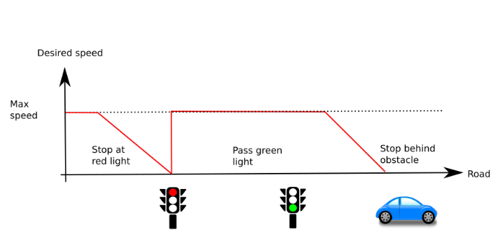
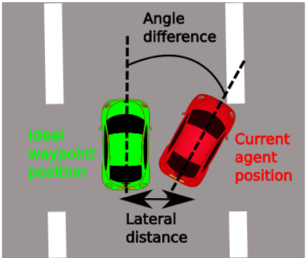
RL Setup: Reward function
Notes:
The desired speed reward is maximum (and equal to 1) when the agent is at the desired speed, and linearly goes down to 0 if the agent speed is lower or higher. The desired speed, illustrated on Figure 2, is adapting to the situation: when the agent arrives near a red traffic light, the desired speed goes linearly to 0 (the closest the agent is from the traffic light), and goes back to maximum allowed speed when it turns green. The same principle is used when arriving behind an obstacle, pedestrian, bicycle or vehicle. The desired speed is set to a constant maximum speed (here 40km/h) on all other situations.
The second part of the reward, the desired position, is inversely proportional to the distance from the middle of the lane (we compute this distance using the waypoints mentioned above). This reward is maximum equal to 0 when agent is exactly in the middle of the lane and goes to -1
when reaching a maximum distance from lane Dmax . When the agent is further than Dmax , the episode terminates. For all our experiments, Dmax was set to 2 meters: this is the distance from the middle of the lane to the border. Other termination conditions are colliding with anything, running
a red light and being stuck for no reason (i.e. not behind an obstacle nor stopped at a red traffic light). For all those termination conditions, the agent receives a reward of -1.
With only the two previous reward components, we observed the trained agents were not going straight as oscillations near the center of lane were giving almost the same amount of reward as going straight. That is why we added our third reward component, desired rotation. This reward
is inversely proportional to the difference in angle between the agent and the orientation of the nearest waypoint from the optimal trajectory

Slide 20
DRL with large networks challenges
Much longer and harder to train
replay memory = memory usage constraints
pre-train the convolutional encoder part of the network to predict some high-level information and then freeze it while training the RL
Notes:
The intuition is that the RL signal is too weak to train the whole network but can be used to train only the fully connected part. Moreover this solves the replay memory issue as we can now store features directly in the replay memory and not the raw images

Slide 21
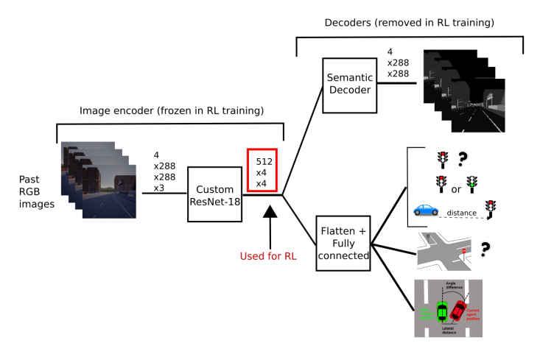
Notes:
We use 2 main losses for our
supervised phase: traffic light state (binary classification) and semantic segmentation.
Indeed all relevant information but traffic light state is contained in our semantic segmentation. We use 6 classes for the semantic mask: moving obstacles, traffic lights, road markers, road, sidewalk and background. We also predict some other affordances to help the supervised training such as the distance to the incoming traffic light, if we are in an intersection or not, the distance from the middle of the lane and the relative rotation to the road. The two last estimations are coming from our viewpoint augmentation (without it the autopilot is always perfectly in the middle of the lane with no rotation)

Slide 22
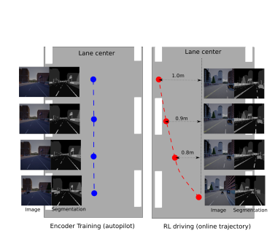
Data augmentation
Notes:
To solve this, we suggest to add viewpoints aug-
mentation by moving the camera around the autopilot. With his augmentation the encoder performance is much better while the RL agent drives and explores and we found this was mandatory to obtain good performance during the RL training phase.

Slide 23
Actions
9 < steering values < 27
Throttle = 3
Braking = 1
36 (9 × 4) or 108 (27 × 4) actions for our experiments
Notes:
few discrete actions (only 5 for steering) resulted in agents oscillating and failing to stay in lane. Better results can be obtained by using more steering actions such as 9 or 27 different steering values. Throttle is less of an issue: 3 different values for throttle are used, plus one for brake. This
leads to a total of 36 (9 × 4) or 108 (27 × 4) actions for our experiments. We also try to predict the derivative of steering angle: the prediction of network is used to update the previous steering (which is given as input) instead of using directly the prediction as current steering

Slide 24

Actions
To reach more fine-grained discrete actions
simultaneously use multiple predictions of different trained agents and average them
Notes:
as the encoder is frozen, it
can be shared, so the computational overhead of averaging
multiple snapshots of the same training is almost negligible
(less than 10% of the total forward time for averaging 3
predictions). Therefore, all our reported results are obtained
by averaging 3 consecutive snapshots of the same training
together (for example, results at 10M steps is the bagging
of snapshots at 8M, 9M and 10M)

Slide 25
Experiments and Ablation Studies: Scenario
Hardest environment in the available maps of CARLA
Randomly spawn pedestrians crossing the road ahead of our agent
Changing weather
20M iterations on CARLA, with 3 actors (6.6M steps for each actor)
with framerate of 10 FPS. Equivalent to 20 days of simulated driving
10 scenarios of urban situations each one consisting in 10
consecutive intersections
Notes:
Town05 includesthe biggest urban district, is mainly multi-lane and US style:
the traffic lights are on the opposite side of the road and much harder to detect.
Training in one scenario to make training time feasible
20M iterations on CARLA, with 3 actors (so 6.6M steps for each actor) and with a framerate of 10 FPS. Thus 20M steps is equivalent to around 20 days of simulated driving (as a comparison the
most standard time [25, 6] used to train RL for Atari games is 200M frames corresponding to around 40 days and can go to more than 5 years of gametime
We also define some scenarios on highway but those
cases are much easier and thus less discriminative: for ex-
ample our best model goes off-road less than one time every
100km on highway situation. Highway scenarios are mostly
used for evaluating the oscillations of our different agents

Slide 26
Experiments and Ablation Studies: metrics
Average percentage of intersections successfully crossed
Percentage of traffic lights passed without infraction
Percentage of pedestrians passed without collision
the mean absolute rotation between the agent and the road along
the episode
Notes:
test models 10 times on each scenario varying the weather condition and resetting the position of all other agents
Note that the last two are slightly less relevant, as a non-moving car will never run a red traffic light nor crash a pedestrian

Slide 27
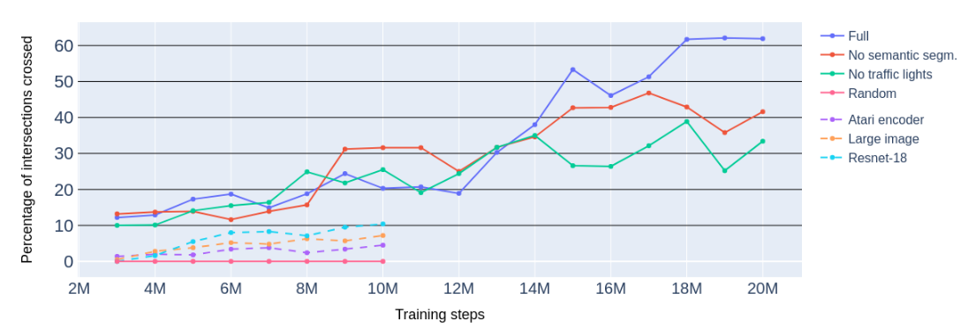
Experiments and Ablation Studies: Results
Notes:
without affordances learning, agents fail to learn and do not even succeed to pass one intersection in average (less than 10% intersections crossed).
it is important to note that training the bigger image
encoder (respectively the full resnet-18) took 50% more time than training with our implicit affor-
dances scheme even considering the time used for the supervised phase. Consequently these experiments are stopped after 10M steps. These networks also require much more memory, because full images are stored in the replay mem-
ory. As expected, these experiments prove that training a large network using only RL signal is hard.

Slide 28
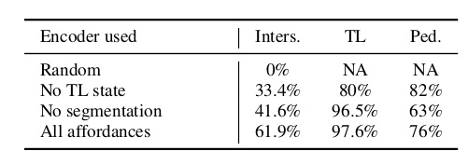
Experiments and Ablation Studies: Results
Notes:
removing the traffic light state has a huge impact on the final performance. As expected the RL agent using an encoder trained without the traffic light loss is running more red traffic lights. It is interesting to note that this ratio is much better than a random choice (which would be 25% of success for traffic light because traffic lights are green only 25% of the time). This means that the agent still discretization used and reward shaping succeeds to detect some traffic light state signal in the fea
tures. We guess that as the semantic segmentation includes a traffic light class (but not the actual state of it) the features contain some information about traffic light state. Removing the semantic segmentation loss from the encoder training also has an impact on final performance. As expected,
performance on pedestrian collision is worse than any other training meaning the network has trouble to detect pedestrians and vehicles (this information is only contained in the semantic map).

Slide 29
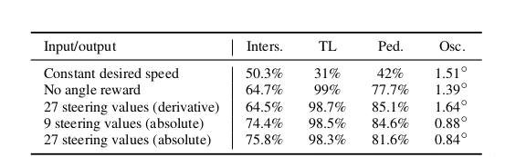
Experiments and Ablation Studies: Results
Notes:
The most interesting result of these experiments is the one from Constant desired speed. Indeed, the agent fails totally at braking for both cases of red traffic light or pedestrian crossing: its performance is much worse than any other agent. The agent trained with desired speed set to constant runs 70% of traffic lights which is very close to a random choice. It also collides with 60% of pedestrians. This experiment shows how important the speed reward component is to learn a braking behaviour.
Surprisingly, we find that predicting derivative of steering results in more oscillations, even more than when removing the desired rotation reward component. Finally, taking 9 or 27 different steering values does not have any significant impact and both of these agents reach the best performance with low oscillation.

Slide 30
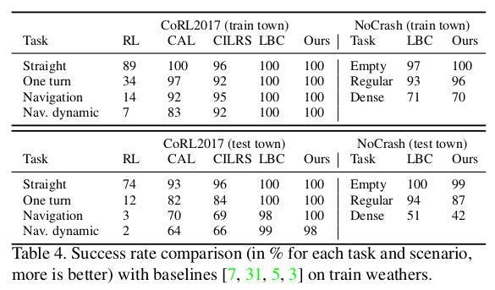
Experiments and Ablation Studies: Results
Notes:
LBC reimplemented on open-source the CARLA benchmark on the newest version of CARLA (0.9.6). LBC is the only one outperforming us in the hardest task of CoRL2017 benchmark
(Conference on robot learning?)
LBC [3] which uses IL, is the only one outperforming
our RL agent on the hardest task of CoRL2017 benchmark (ie. Nav. dynamic). We also have similar results to the LBC baseline on the much harder NoCrash benchmark. Note that we can only compare to LBC because other works have not
been tested yet on the NoCrash benchmark with pedestrians.
Finally, our work is outperforming the only other RL
baseline [7] by a huge margin. This is also the first time a RL approach matches and even outperforms IL approaches on the CARLA benchmark
Pregunta a sergio aquí por qué en la página de leaderboard LBC tiene tan peores resultados

Slide 31
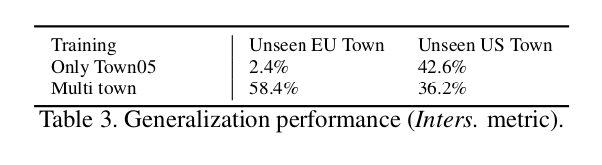
Experiments and Ablation Studies:
Generalization
Notes:
confirming the interest
of training 3 different towns (1 EU and 2 US) at the same time

Slide 32
Future work
apply our implicit affordances scheme for policy-based or actor-critic
to train our affordance encoder on real images in order to apply this method on a real car.

