Slide 1
Reinforcement Learning-Based Autonomous Driving at
Intersections in CARLA Simulator
Rodrigo Gutiérrez-Moreno, Rafael Barea, Elena López-Guillén
, Javier Araluce and Luis M. Bergasa
University of Alcalá

Slide 2
Intersections problem
60% of severe traffic injuries in Europe
29% of all car crashes and 18% of pedestrian fatalities
large amount of information
existing solutions
prediction and collaborations (V2V, V2I)
TTC (tuning parameters have to be adjusted, and this task can be laborious)
Reinforcement learning
Imitation learning
Developing an agent that allows
safe and reliable decisions is a hard task to implement manually

Slide 3
Approach
Curriculum learning
DRL
Diferent intersections
An execution layer is in charge of the
motion, while a decision-making layer executes the high-level actions
No rules
Traffic lights
Stop signal
First stage → SUMO
Second stage → Carla
No rules
Traffic lights
Stop signal

Slide 4
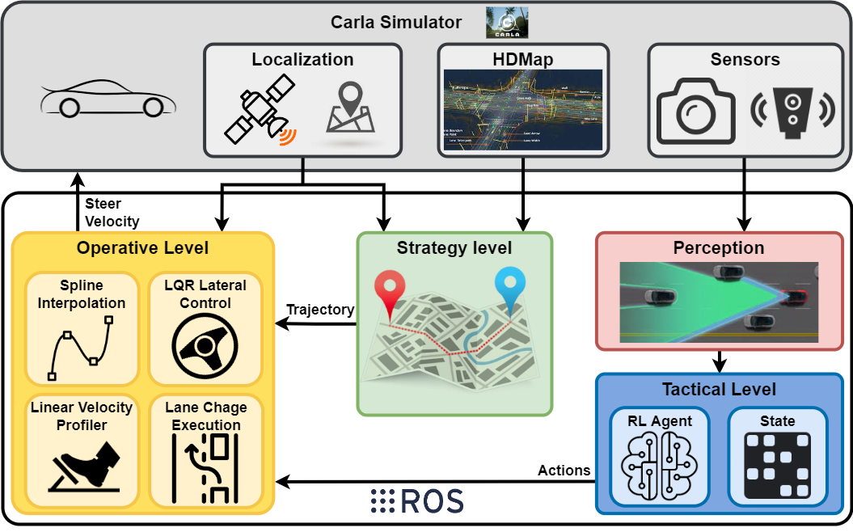
Notes:
The strategy level defines the trajectory; the tactical
level is in charge of the high-level decisions, and the operative level executes the control
maneuvers. This paper is focused on the tactical level

Slide 5
Approach
Strategy Level
Tactical Level
Operative Level
HD map input → road and lanes graph → Dijkstra algorithm → route as waypoints → ROS
state vector to execute a high level action each time step
classic controller performs
a smooth interpolation of the way-points using Linear
Quadratic Regulator (LQR) techniques && velocity profile is generated
Notes:
The path-planning module is described in our previous paper [33]. This module first
generates a directed graph of roads and lanes using the HD map input. Then, it calculates
a topological (road-lane) route between the ego vehicle location, which is provided by the
simulator, and the goal location, applying the Dijkstra algorithm to the previously generated
graph. Finally, the route is calculated as a list of way-points centered in the lanes and
separated by a given distance. The route is calculated and published in a Robot Operating
System (ROS) [34] topic every time a new goal location is set. The road information, such
as velocity limit, road lanes, or road type, is also defined in this ROS message

Slide 6

Policy-based method
where Et is the expectation, πθ is the policy and Ât is an estimator of the advantage function
at a time step t

Slide 7

PPO
where c1 , c2 are coefficients, S denotes an entropy bonus, and LVF
t ( θ ) is a squared-error loss
where epsilon is a hyperparameter and rt (θ ) is the probability ratio:

Slide 8
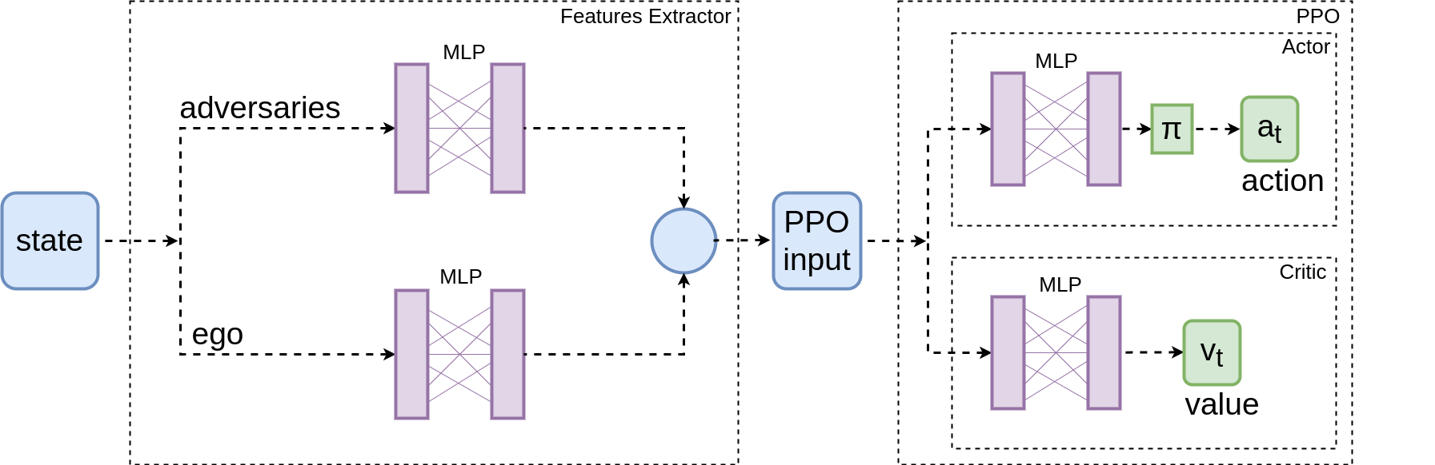
Notes:
Neural network: After two fully connected layers, both adversaries and ego vehicle features
are concatenated and fed the actor–critic structure with two layers of 128 neurons each

Slide 9
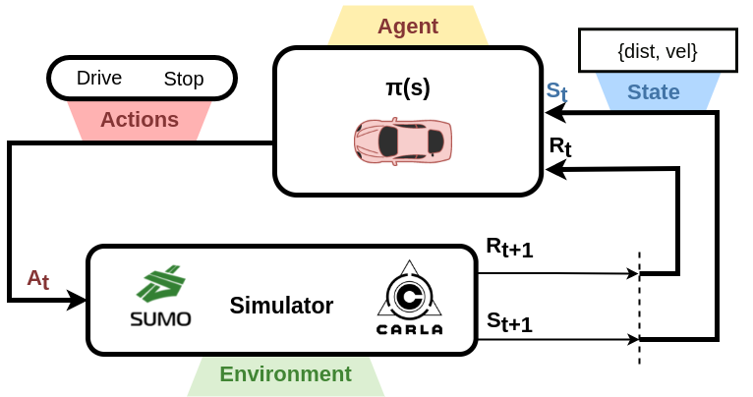
The perception data are directly obtained from the simulator’s ground truth.
In real applications, these data could be obtained using the fusion of cameras and lidars
continuous state vector and a set of discrete action
define the intersection scenarios as an MDP

Slide 10
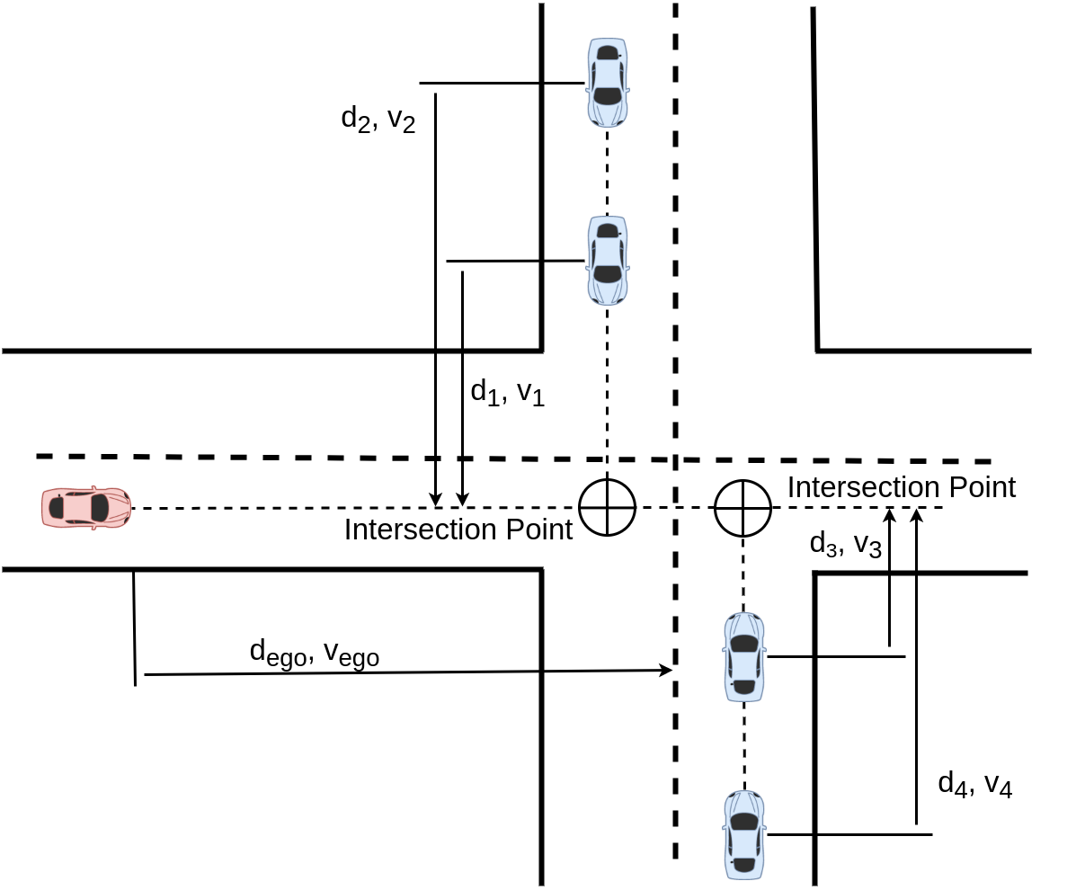
inputs
distance to the intersection point and its longitudinal velocity: si = {di , vi } normalized between 0 and 1
state vector as the collection of the individual states of the two closest vehicles for each lane and the ego vehicle

Slide 11
outputs
a = {stop, drive}.
Both actions set a desired velocity, stop sets 0 m/s and drive sets the nominal velocity of 5 m/s.

Slide 12
Rewards
Goal is to drive through the intersection as fast as possible avoiding adversarial vehicles
Negative reward when collision. -2
Positive reward when reaches the goal. 1
Cumulative reward based on velocity. K * v
Negative reward proportional to the duration. 0.2 / t
Notes:
Large reward values can lead to large gradients according to [37]. Therefore, all the rewards are scaled to keep the total reward rt ∈ [−1, 1.2].

Slide 13
Intersection scenarios
We present the hypothesis that the RL agent (ego vehicle) is capable of driving only
based on the position and speed of the adversarial vehicles
We need to define the scenarios in the two simulators slightly different to obtain similar
intersection scenarios. In CARLA, the simulation is slower than in SUMO, so we use a
shorter road and generate fewer adversaries, but the ego vehicle faces a similar situation
when it approaches the intersection
Notes:
The CARLA Challenge is an open competition for
autonomous driving relying on the CARLA simulator. This competition addresses specifically the problem of urban driving. This is much more challenging than the original CARLA benchmark [7]. The CARLA Challenge consists in 4 different tracks with the only difference being the sensors available, from cameras only to a full stack perception. We will only handle the “Camera Only” track there, in fact we even used only a single frontal camera for all this work

Slide 14
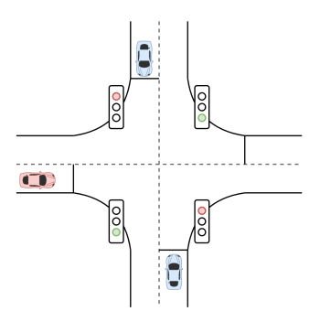
Intersection scenarios
collisions can be avoided even though the ego vehicle
misses the traffic light
Notes:
The CARLA Challenge is an open competition for
autonomous driving relying on the CARLA simulator. This competition addresses specifically the problem of urban driving. This is much more challenging than the original CARLA benchmark [7]. The CARLA Challenge consists in 4 different tracks with the only difference being the sensors available, from cameras only to a full stack perception. We will only handle the “Camera Only” track there, in fact we even used only a single frontal camera for all this work

Slide 15
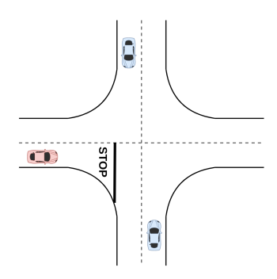
Intersection scenarios
These adversaries never stop, forcing the ego vehicle to stop and cross when there is a big enough gap
Notes:
The CARLA Challenge is an open competition for
autonomous driving relying on the CARLA simulator. This competition addresses specifically the problem of urban driving. This is much more challenging than the original CARLA benchmark [7]. The CARLA Challenge consists in 4 different tracks with the only difference being the sensors available, from cameras only to a full stack perception. We will only handle the “Camera Only” track there, in fact we even used only a single frontal camera for all this work

Slide 16
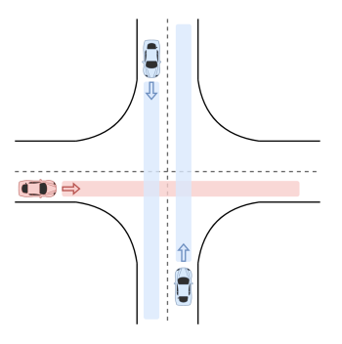
Intersection scenarios
most difficult scenario (adversaries vary more in behavior)
driver is obliged to yield to vehicles approaching from his right
Notes:
The CARLA Challenge is an open competition for
autonomous driving relying on the CARLA simulator. This competition addresses specifically the problem of urban driving. This is much more challenging than the original CARLA benchmark [7]. The CARLA Challenge consists in 4 different tracks with the only difference being the sensors available, from cameras only to a full stack perception. We will only handle the “Camera Only” track there, in fact we even used only a single frontal camera for all this work

Slide 17
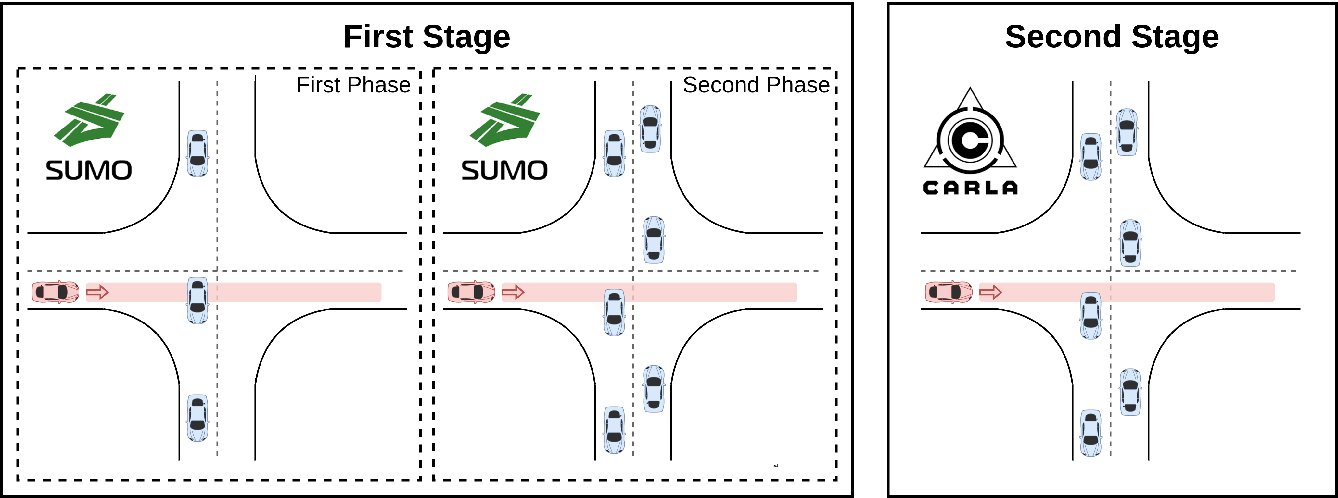
Experiments
5M
5M
SUMO does not have sensors neither vehicle dynamics
SUMO is much faster than CARLA
SUMO is developed using openAIGym
Notes:
The CARLA Challenge is an open competition for
autonomous driving relying on the CARLA simulator. This competition addresses specifically the problem of urban driving. This is much more challenging than the original CARLA benchmark [7]. The CARLA Challenge consists in 4 different tracks with the only difference being the sensors available, from cameras only to a full stack perception. We will only handle the “Camera Only” track there, in fact we even used only a single frontal camera for all this work

Slide 18
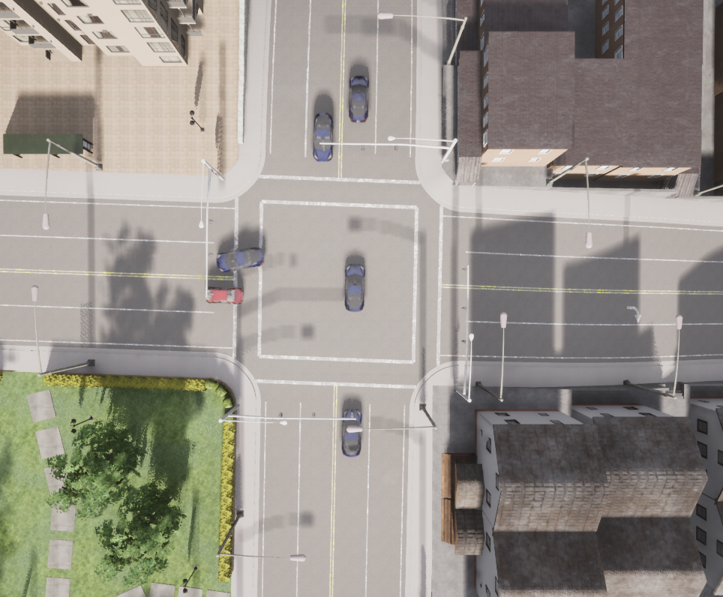
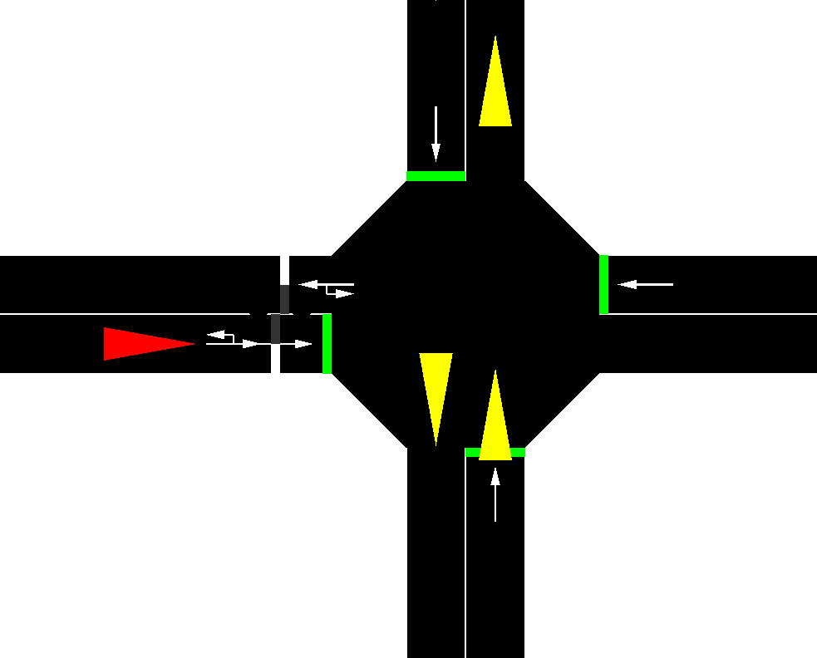
Experiments
In CARLA, three vehicles are spawned in each lane. These have different behaviors:
they can yield, cross or stop randomly.

Slide 19

Evaluation metrics

Slide 20
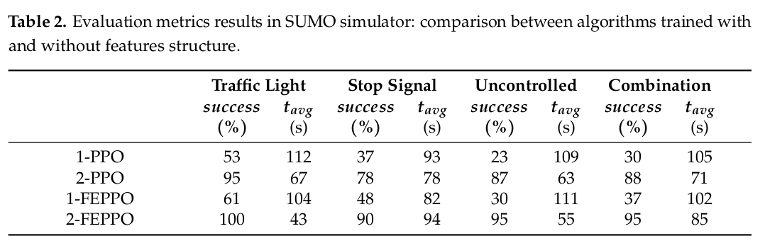
Results

Slide 21
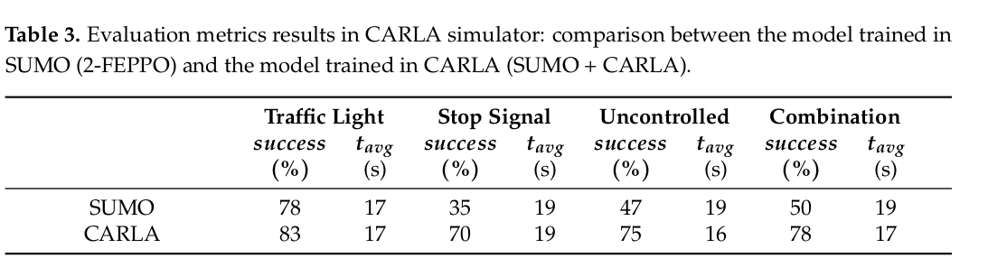
Results

Slide 22
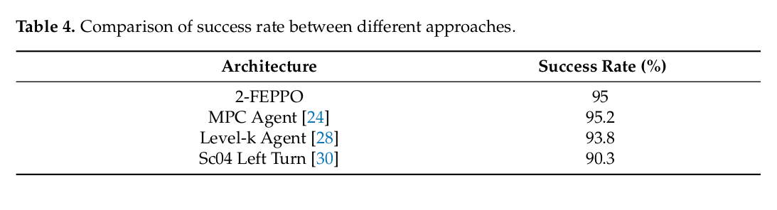
Results
Notes:
It is a difficult task to present a comparison with the state of the art, since different
scenarios and problems are defined in different works. However, in Table 4, we present
a comparison in terms of success rate at an uncontrolled intersection. This table shows
the results of our approach and some other similar approaches that can be found in the
literature. The obtained success rates indicate that our results are on par or even better than
other competitive approaches

Slide 23
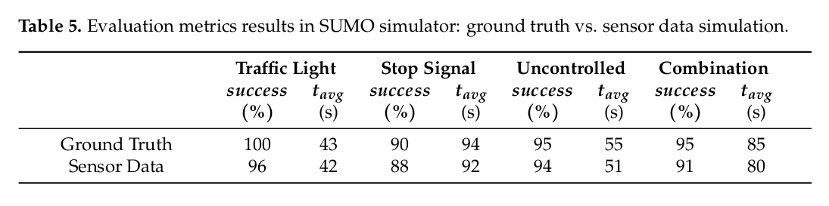
Results
Notes:
We present a first approach where the state vector is directly obtained from
the SUMO simulator and a second more realistic approach, where this vector is defined
using an estimation of the parameters. We have studied this estimation in a 3D object
detection benchmark (KITTI dataset [41]) where ground truth is provided by a Velodyne
laser scanner and GPS localization system. We have processed these sensor data using
the PointPillar algorithm [42], and we have obtained a maximum distance error of ±5 m
(for distances between 0 and 100 m). Finally, we have modified our state vector by adding
this error

Slide 24
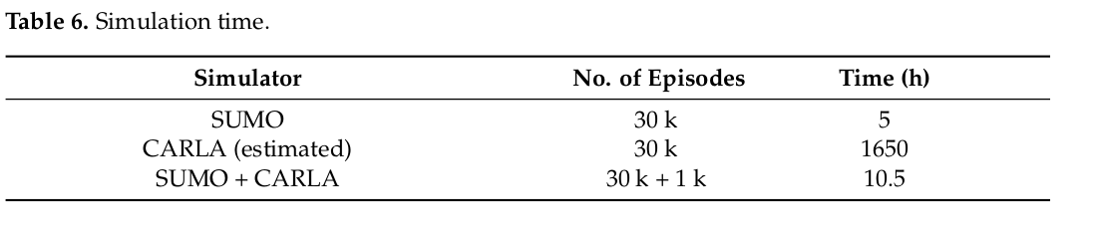
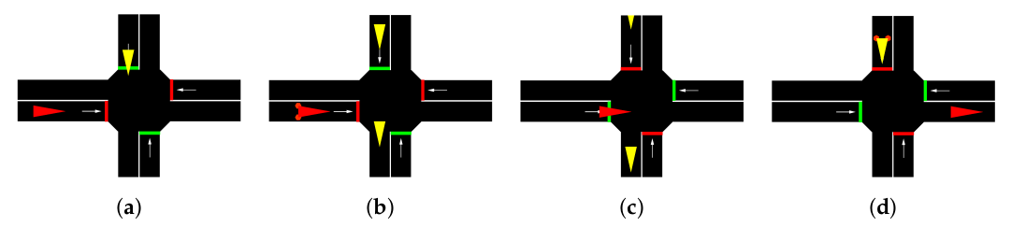
Discussion
SUMO is faster
Curriculum learning enabled PPO to converge
The agent sometimes does not follow the rules (cross a red traffic light)

Slide 25
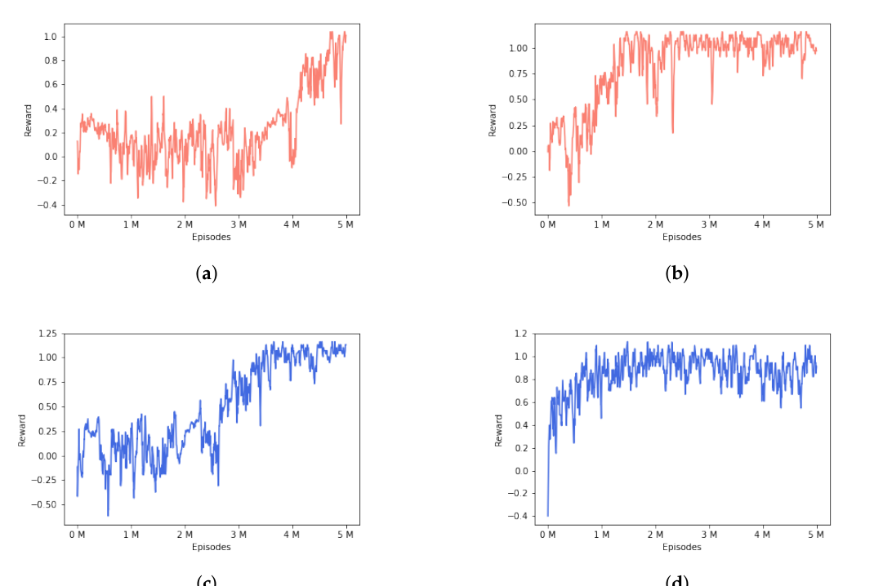
Discussion
Features extractor improved the 2 stage training performance
Notes:
Episodes mean rewards. Comparison between the two approaches described in the paper:
with (right) and without (left) features extractor module. The red charts correspond to the first
training phase and the blue charts corresponds to the second training phase. (a) One-phase PPO
episodes mean reward with adversaries in one lane. No features extractor layer. (b) One-phase
FEPPO episodes mean reward with adversaries in one lane. Features extractor layer. (c) Two-phase
PPO episodes mean reward with adversaries in two lanes. No features extractor layer. (d) Two-phase
FEPPO episodes mean reward with adversaries in two lanes. Features extractor layer

Slide 26
Future work
Use sensor data instead of ground truth
Use this system in a real environment
Notes:
The CARLA Challenge is an open competition for
autonomous driving relying on the CARLA simulator. This competition addresses specifically the problem of urban driving. This is much more challenging than the original CARLA benchmark [7]. The CARLA Challenge consists in 4 different tracks with the only difference being the sensors available, from cameras only to a full stack perception. We will only handle the “Camera Only” track there, in fact we even used only a single frontal camera for all this work

