Slide 1
Project 1 – Mo Money$ Movie$
How to Make the Most Money$ with one Movie
We are representatives for a small indie film company. Today we will share with you the insights that we have gained in our search for determining the greatest return for your investment.
Chuck Bui
Christopher Turner
Jack Jeffries
Sarah Brittle

Slide 2
Project 1 – Mo Money$ Movie$
Scope and Criteria
Our assumption was to find a genre with the highest return on investment, the optimal budget range with the best rate of return and determine how of a high rating to aim for to entice movie goers.
Answer the questions:
Does budget affect overall profit?
Do ratings need to be high to be profitable?
Which genres stand out as big money makers?
We looked at only theater released movies within the year range of 2005-2015 with a ‘measurable’ budget and revenue: minimum $5000 for each
Key Metrics: Movie budgets, profits, ratings and genre
Resources: Kaggle data set with 45,000 movies, OMDB API
Notes:
QuickStarter has created an outline to help you get started on your presentation. Some slides include information here in the notes to provide additional topics for you to research.
More key facts:
Academic conference: CHI 2016, SIGGRAPH 2015, EuroVis 2015, VAST 2014, AVI 2016, KDD 2016, UIST 2015, INTERACT 2015, MICCAI 2015, PacificVis 2015, ICDM 2015, WSCG 2016, NIPS 2015, CVPR 2016, WWW 2016, CIKM 2015, AAAI 2016, VMV 2014, CGI 2015, CSCW 2016, ICPR 2016, HICSS 2016, IEEE VR 2015, FG 2015, ICCS 2014, TAP 2015, IJCNN 2015, ICASSP 2016, ICML 2016, IJCAI 2016, VRST 2015, ECCV 2016, ICIP 2015, SCCG 2014, FM 2015, PADL 2016, SBMF 2015, PEPM 2016, SIGMOD 2016, ICFEM 2015, SEFM 2015, LOPSTR 2015, iFM 2016, FMICS 2015, TASE 2015, PPDP 2015, WFLP 2014, UbiComp 2014, ICANN 2014

Slide 3
Quick take of the data acquisition
Data set, “movies_metadata.csv” from Kaggle with over 3500 upvotes which has a Usability rating of 8.24 and 45,000 movies. This was needed for its budget and revenue data.
Based on our criteria, we filtered that down to 2,316 movies for our dataset.
Created an API call for OMDB to cross reference with the cleaned data set by utilizing IMDB ID’s, which is a universal standard for movie data. This was needed for ratings and number of votes data.

Slide 4
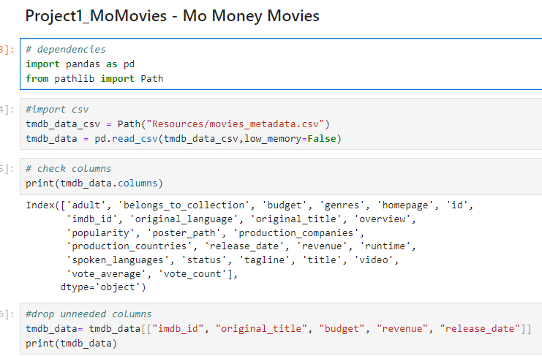
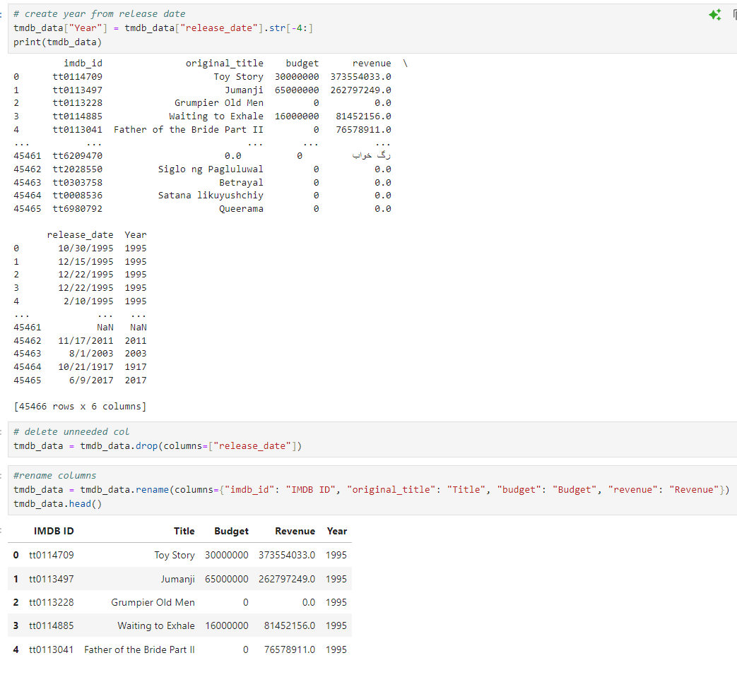
Importing the data and begin cleaning
Notes:
QuickStarter has created an outline to help you get started on your presentation. Some slides include information here in the notes to provide additional topics for you to research.
More key facts:
Academic conference: CHI 2016, SIGGRAPH 2015, EuroVis 2015, VAST 2014, AVI 2016, KDD 2016, UIST 2015, INTERACT 2015, MICCAI 2015, PacificVis 2015, ICDM 2015, WSCG 2016, NIPS 2015, CVPR 2016, WWW 2016, CIKM 2015, AAAI 2016, VMV 2014, CGI 2015, CSCW 2016, ICPR 2016, HICSS 2016, IEEE VR 2015, FG 2015, ICCS 2014, TAP 2015, IJCNN 2015, ICASSP 2016, ICML 2016, IJCAI 2016, VRST 2015, ECCV 2016, ICIP 2015, SCCG 2014, FM 2015, PADL 2016, SBMF 2015, PEPM 2016, SIGMOD 2016, ICFEM 2015, SEFM 2015, LOPSTR 2015, iFM 2016, FMICS 2015, TASE 2015, PPDP 2015, WFLP 2014, UbiComp 2014, ICANN 2014

Slide 5
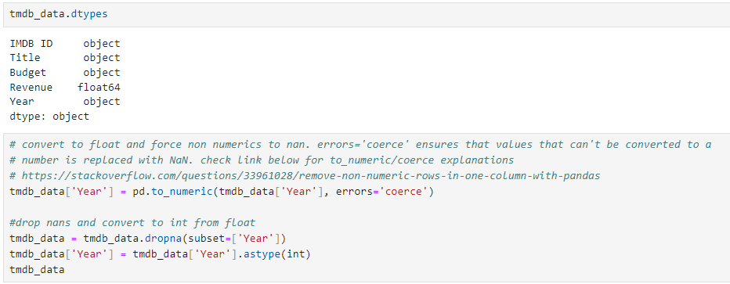
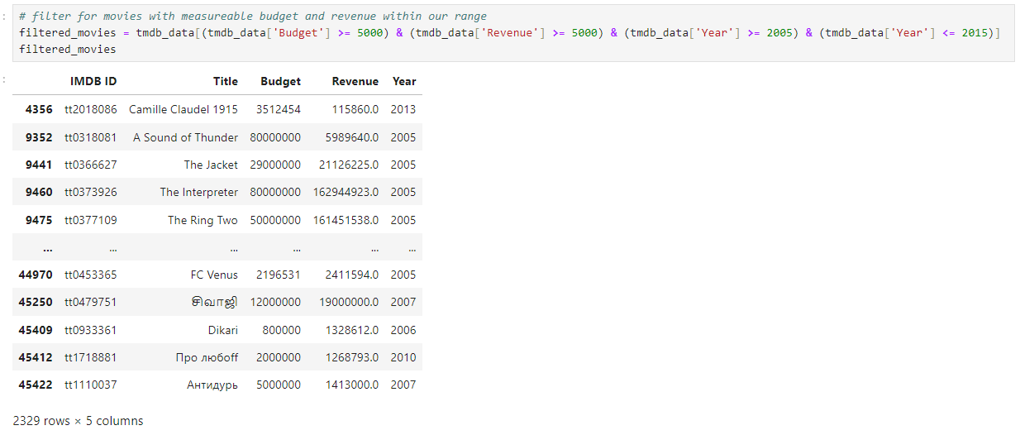
Cleaning budget and year | Creating the filter for criteria
Notes:
QuickStarter has created an outline to help you get started on your presentation. Some slides include information here in the notes to provide additional topics for you to research.
More key facts:
Academic conference: CHI 2016, SIGGRAPH 2015, EuroVis 2015, VAST 2014, AVI 2016, KDD 2016, UIST 2015, INTERACT 2015, MICCAI 2015, PacificVis 2015, ICDM 2015, WSCG 2016, NIPS 2015, CVPR 2016, WWW 2016, CIKM 2015, AAAI 2016, VMV 2014, CGI 2015, CSCW 2016, ICPR 2016, HICSS 2016, IEEE VR 2015, FG 2015, ICCS 2014, TAP 2015, IJCNN 2015, ICASSP 2016, ICML 2016, IJCAI 2016, VRST 2015, ECCV 2016, ICIP 2015, SCCG 2014, FM 2015, PADL 2016, SBMF 2015, PEPM 2016, SIGMOD 2016, ICFEM 2015, SEFM 2015, LOPSTR 2015, iFM 2016, FMICS 2015, TASE 2015, PPDP 2015, WFLP 2014, UbiComp 2014, ICANN 2014

Slide 6
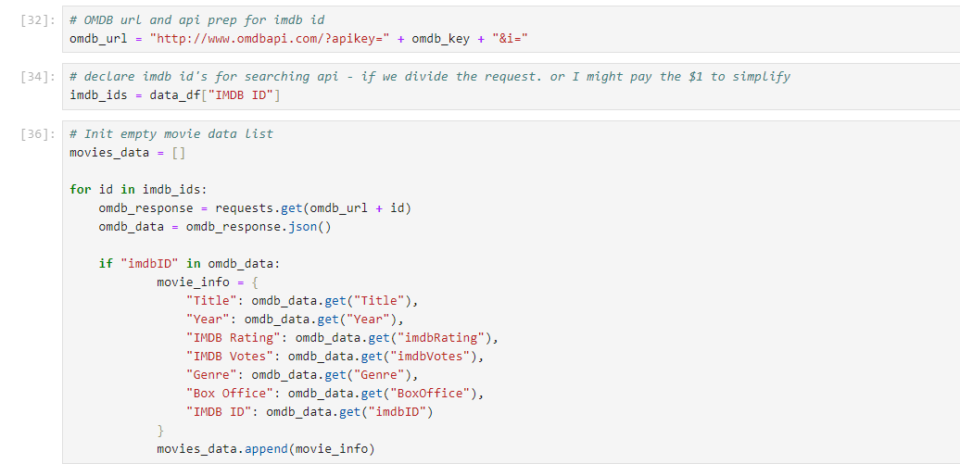
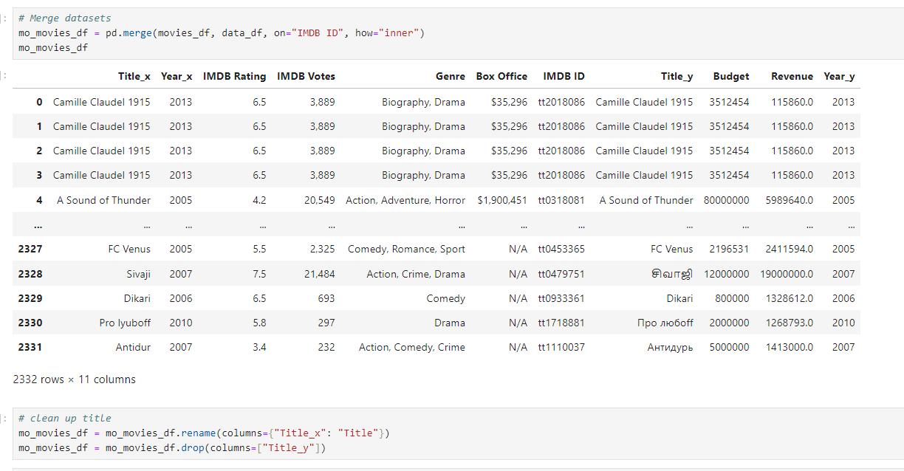
API by imdb id from filtered data set | merging and renaming

Slide 7
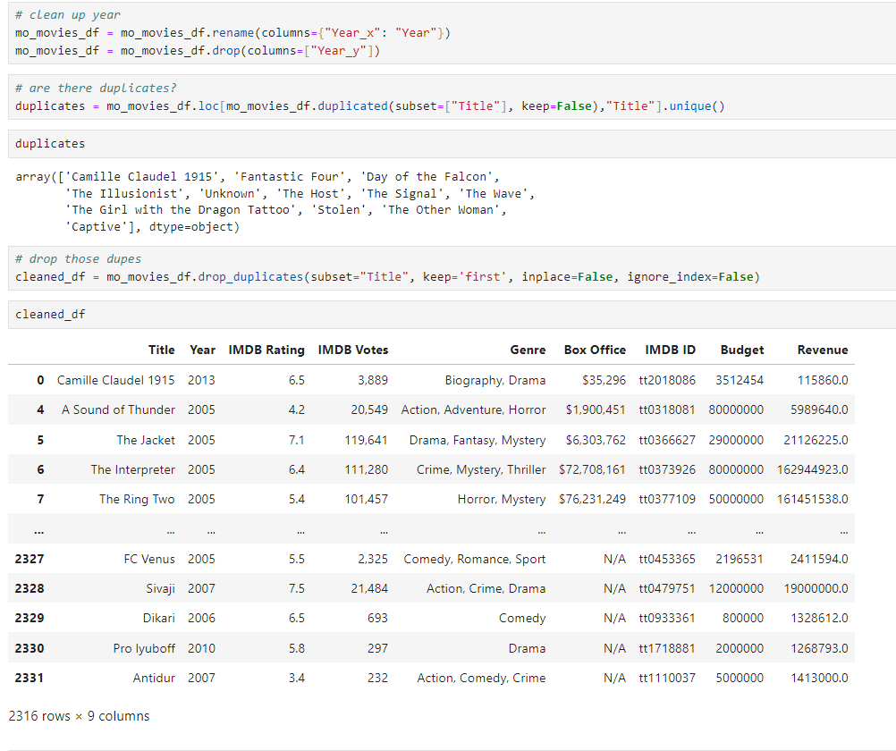
Dropping a few duped movies and creating our dataset

Slide 8
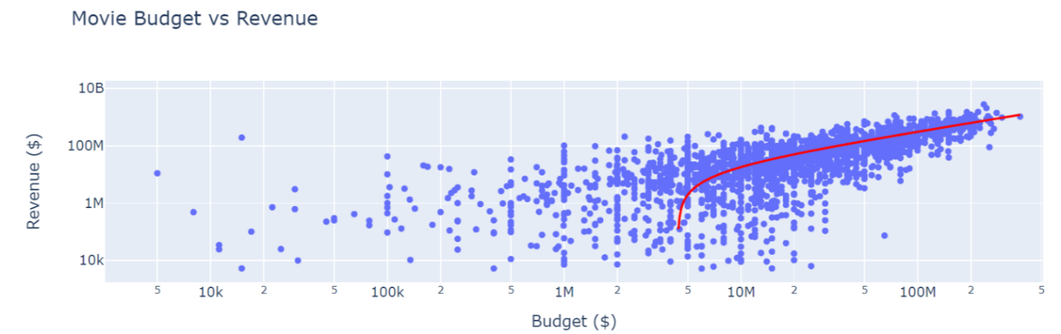
Budget vs revenue
Figure 1 Scatter plot showing the relationship between money spent and money earned
The graph shows a relative correspondence between amount spent and amount earned
There is a moderate r value of .6 between these two

Slide 9
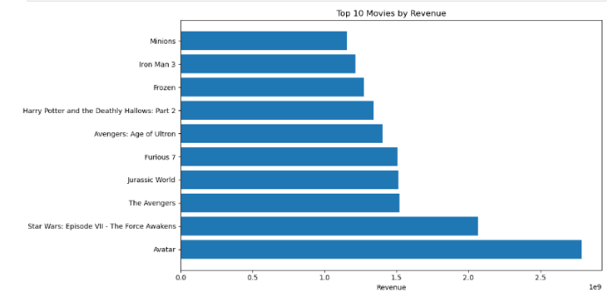
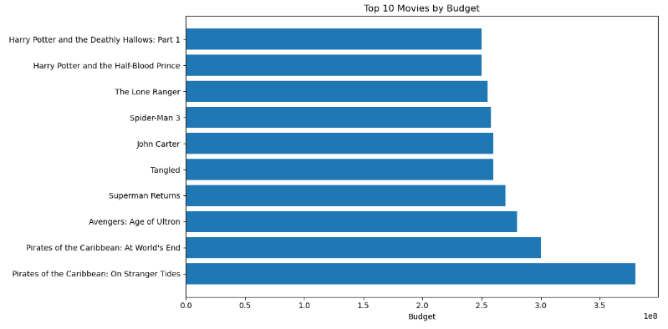
Budget vs revenue cont’d
Figure 2 Top ten movies by budget and by revenue. Only one movie exists in both of these graphs.
While there is a moderate correlation, there are some outliers. For example, Avengers: Age of Ultron is the only movie from top 10 by budget that is also in top 10 by revenue.
A high budget does not always equate to ROI, as movies that make more are also the movies that spend more.

Slide 10
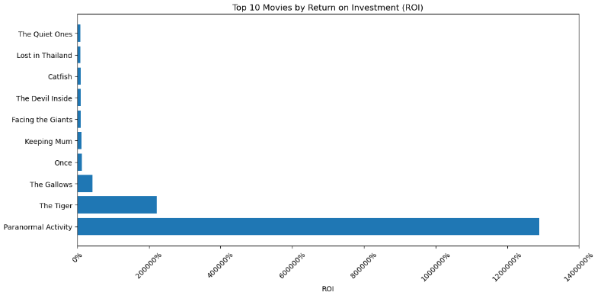
Return on investment
While there is a moderate correlation, there are some outliers. For example, Avengers: Age of Ultron is the only movie from top 10 by budget that is also in top 10 by revenue.
Figure 3 The highest return on investment. "Paranormal Activity" stands out as a clear outlier.

Slide 11
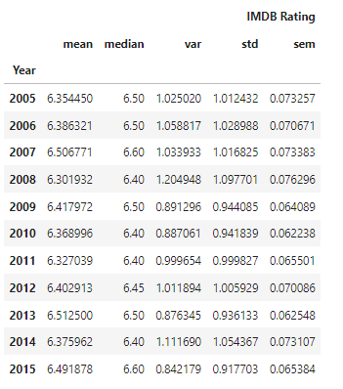
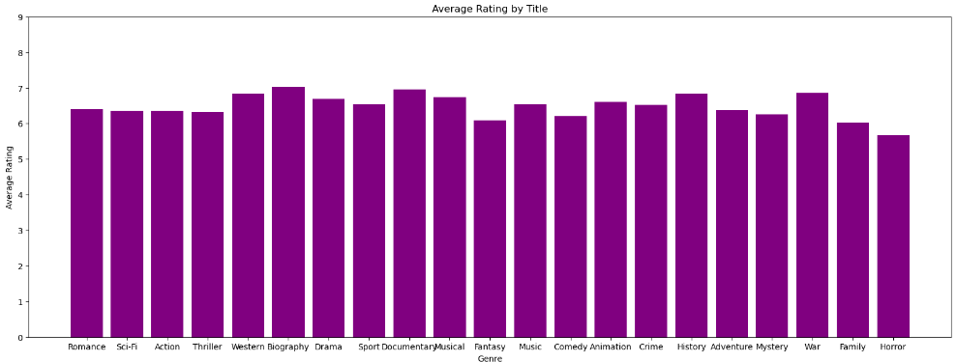
Do ratings matter for profit?
Overall, ratings remain the same across all years and genre.
The decade average variable is just .2

Slide 12
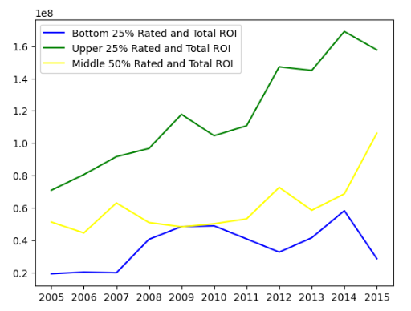
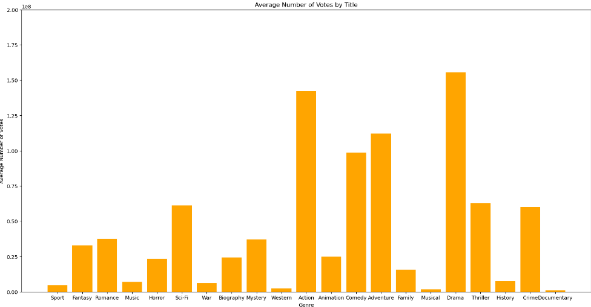
Do ratings matter for profit? cont’d
Average number of votes show that engagement may be higher for certain genres, but the average ratings for these genres still remain comfortably within the range of all genres.

Slide 13
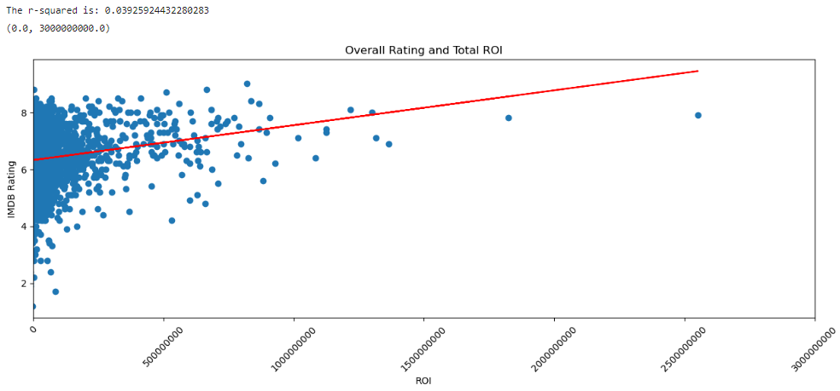
Do ratings matter for profit? cont’d
NO

Slide 14
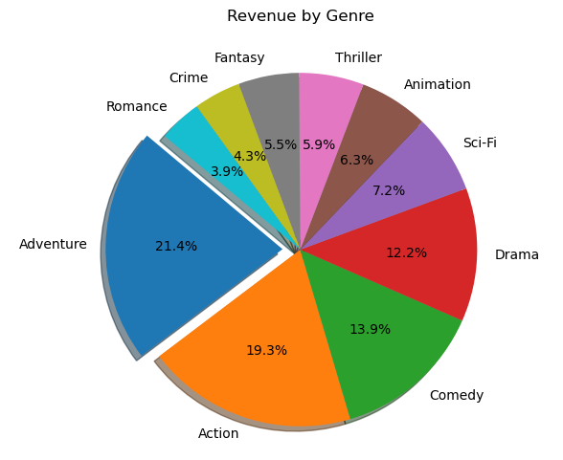
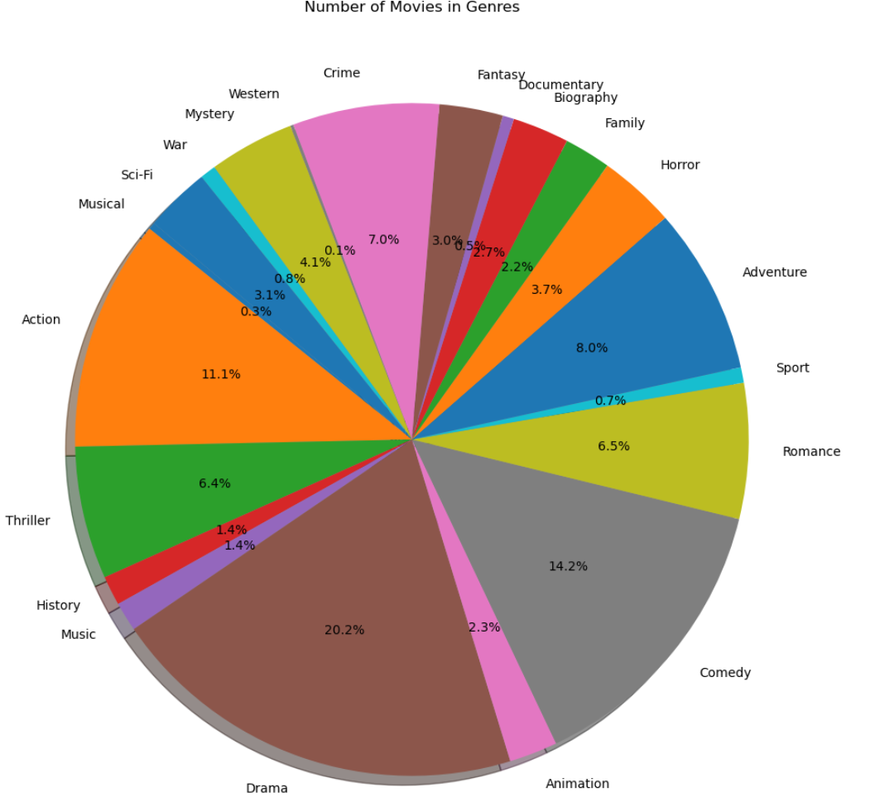
Genre vs rating and revenue
Of the 2,316 movies, Drama is the highest reported
Adventure only takes up 8% of the movies by volume.
Adventure has the highest revenue, followed closely by Action

Slide 15
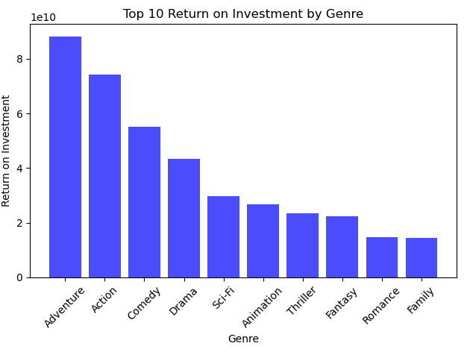
Genre vs Return on investment
Shown previously, Adventure has a low saturation.
But you can clearly see that it’s ROI is well above most other genres.
This make genre a great choice for a new movie.
Figure 7 Adventure and action movies deliver the highest return on investment.

Slide 16
conclusion
Being highly rated is not an important factor in making profit. An average rating of 6-7 out of 10 is sufficient.
Our genre should be an action-adventure movie to utilize our top two highest earning genres.
The top ten of genres suggests that a higher budget does not guarantee a higher ROI. We suggest a medium budget of $37,441,333 to maximize profits.
We believe our data justifies our conclusion to aim for creating an average rated action-adventure movie, with a medium budget to maximize our total profit.

