Slide 1
Movies data exploration and Visualization

Slide 2
Project 1 – Mo Money$ Movie$
How to Make the Most Money$ with one Movie
We are representatives for a small indie film company. Today we will share with you the insights that we have gained in our search for determining the greatest return for your investment.
Scope: Theater released movies within the range of 2005-2015 with a measurable budget and revenue: minimum $5000 for each
Key Metrics: Movie budgets, profit, ratings and genre
Resources: Kaggle movies data set, OMDB API
Notes:
QuickStarter has created an outline to help you get started on your presentation. Some slides include information here in the notes to provide additional topics for you to research.
More key facts:
Academic conference: CHI 2016, SIGGRAPH 2015, EuroVis 2015, VAST 2014, AVI 2016, KDD 2016, UIST 2015, INTERACT 2015, MICCAI 2015, PacificVis 2015, ICDM 2015, WSCG 2016, NIPS 2015, CVPR 2016, WWW 2016, CIKM 2015, AAAI 2016, VMV 2014, CGI 2015, CSCW 2016, ICPR 2016, HICSS 2016, IEEE VR 2015, FG 2015, ICCS 2014, TAP 2015, IJCNN 2015, ICASSP 2016, ICML 2016, IJCAI 2016, VRST 2015, ECCV 2016, ICIP 2015, SCCG 2014, FM 2015, PADL 2016, SBMF 2015, PEPM 2016, SIGMOD 2016, ICFEM 2015, SEFM 2015, LOPSTR 2015, iFM 2016, FMICS 2015, TASE 2015, PPDP 2015, WFLP 2014, UbiComp 2014, ICANN 2014

Slide 3
Acquiring the data
Importing and cleaning the data set, “movies_metadata.csv” from Kaggle with over 3500 upvotes which has a Usability rating of 8.24.
Based on our criteria, we filtered that down to 2,316 movies for our data.
Create API call for OMDB to cross reference with the cleaned data set by utilizing the IMDB ID.
Merging and parsing that data and prepping for further exploration
-Chris

Slide 4
Present the basic data?
We could have each person jump in one at a time to explain the basic plots/graphs about their data.
Explain the roles of each person for the data exploration?
Then delve deeper with 2 minutes per person?
-Chris

Slide 5
Exploring financial data
3 quick overview points about direction and questions
2
3
-Jack

Slide 6
Budget vs revenue or whatever slide 1
Screengrabs from labeled plots
2 short summary points – quick and easy to read with explanation

Slide 7
Budget vs revenue or whatever slide 2
Screengrabs from labeled plots
2 short summary points – quick and easy to read with explanation

Slide 8
Exploring ratings data
3 quick overview points about direction and questions
2
3
-Sarah

Slide 9
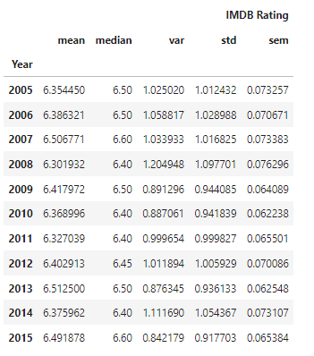
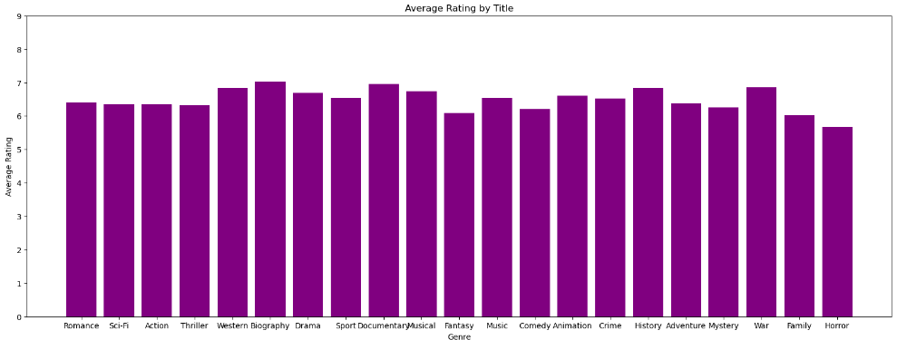
Does ratings matter for profit?
Overall, ratings remain the same across all years and genre.

Slide 10
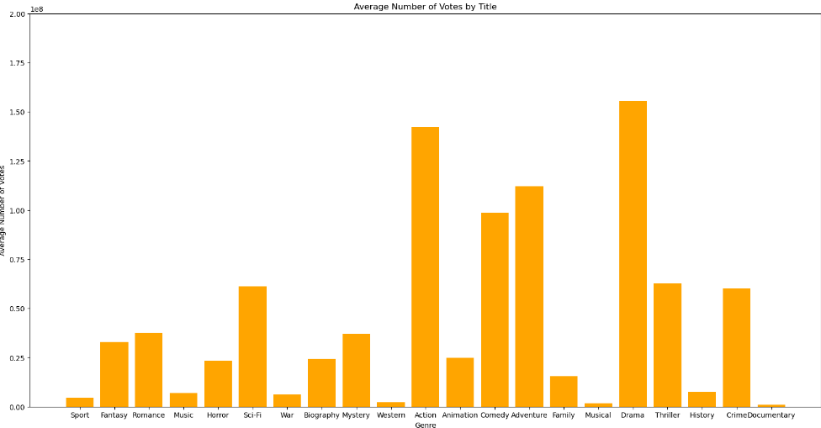
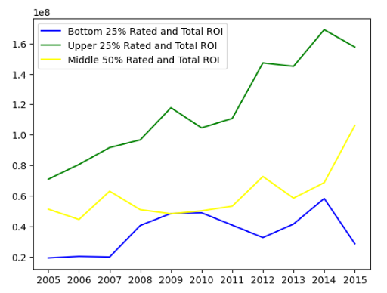
Does ratings matter for profit?

Slide 11
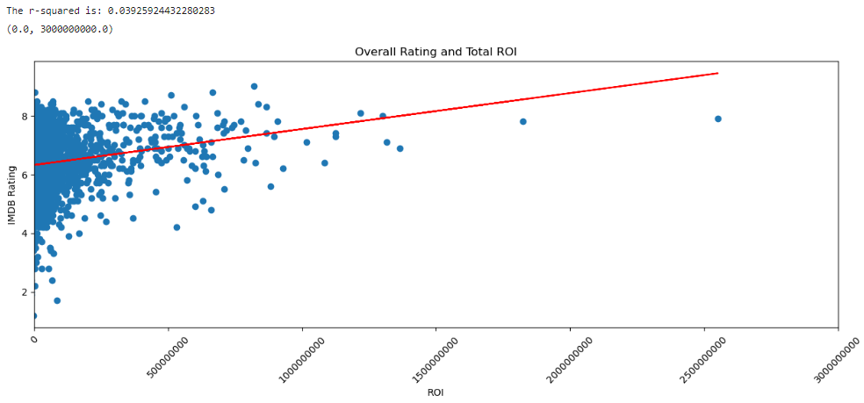
Does ratings matter for profit?
NO

Slide 12
Exploring genre data
3 quick overview points about direction and questions
2
3
-Chuck

Slide 13
genre vs ratings or whatever slide 1
Screengrabs from labeled plots
2 short summary points – quick and easy to read with explanation

Slide 14
genre vs revenue or whatever slide 2
Screengrabs from labeled plots
2 short summary points – quick and easy to read with explanation

Slide 15
conclusion
Conclusion points
1
2
3
4
-Chris?
-Sarah?

Slide 16
Works cited
Movies metadata data set - movies_data_clean (kaggle.com)
OMDB API - The Open Movie Database
str.contains code - python - pandas dataframe str.contains() AND operation - Stack Overflow

