Slide 1
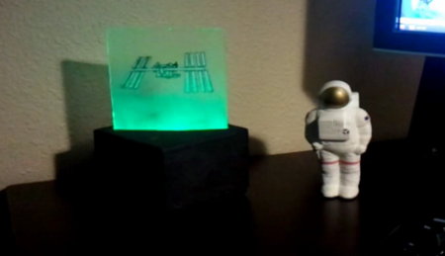
ISS Lamp
Aka. Oooh.. I want one of those!

Slide 2
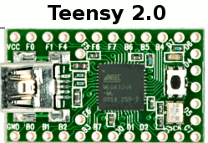
Overview (original)
PC
-linux
-python
Heavens-above.com
USB
-RGB LED’s (PWM)

Slide 3

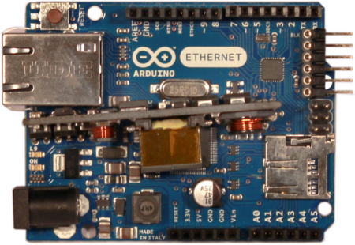
Initial idea
-Maybe use the nabduino? (MPLABX)
uhaapi.com -> json
dk.pool.ntp.org –> time
Arduino +ethernet shield with POE
-fully embedded solution
-one connection (CAT5e w/POE)
-Display for info
-LED’s
NO-GO:
Only visible passes from uhaapi ☹
Not enough memory to parse HTML tables from heavens-above.com

Slide 4
Revised idea
dk.pool.ntp.org
Robottobox
-Python
Arduino +ethernet shield with POE
Heavens-above.com
-ALL PASSES

Slide 5
The arduino side of things aka. C++ and shitty sandboxes
Arduino abstraction layer pros/cons:
No interrupts
No direct timer access
PWM = analogWrite() … urgh.
Realtime, not so much.
HUGE userbase with good advice
Tons of ”ready to use” libraries

Slide 6
Wat do?
Get NTP time
Get data about next pass
Calculate time to next pass
Display pass info on VFD
Pretend to be a clock (with 30 second NTP refresh)
At 5 minutes before pass, start countdown, flash lights
At pass start, light up. If pass is visible: Tell user where to look
At pass end, turn lights down.
Rinse, Repeat.

Slide 7
ARDUINO CODE

Slide 8
The robottobox side of things aka. Learning python
Open port 1337 (UDP)
listen for incoming message
Get heavens-above passes pages, both visible and non visible.
Visible passes ∊ All passes – so check for match, visible have priority
Remove passes that are in the past
Respond to sender with next pass data

Slide 9
Parsed ISS data anatomy
Regular pass example:
“R 1354485026 S-10 1354485108 SE-12 1354485190 ESE-10”
Visible pass example:
“V -2.0 1354481759 SE-10 1354481769 S-22 1354481779 SW-10”
Regular
Start
Max
End
Visible
Magnitude

Slide 10
PYTHON CODE

Slide 11
DEMO

Slide 12

Future ideas:
pool.ntp.org
Heavens-above.com
-ALL PASSES
Arduino +ethernet shield with POE
Geolocation based on IP?
http://www.hostip.info/
-Parse pass data in memory friendly nibbles

