Slide 1
Self Organising Map
Parallelisation
A story of bottlenecks

Slide 2


Slide 3
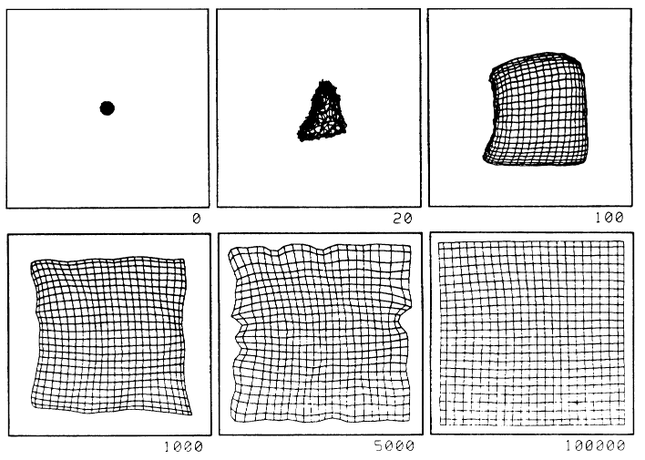
SOM

Slide 4
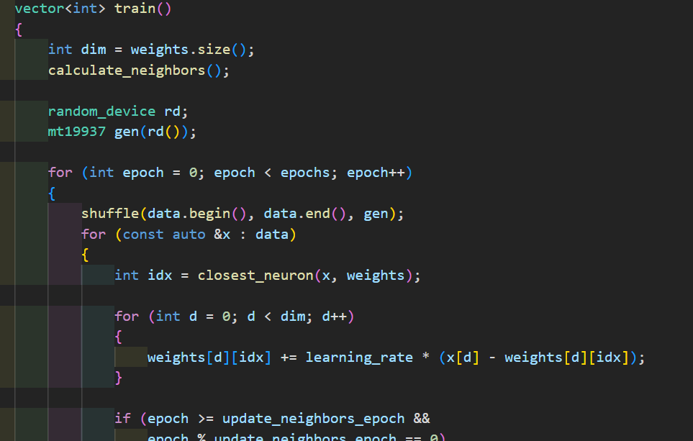

Slide 5
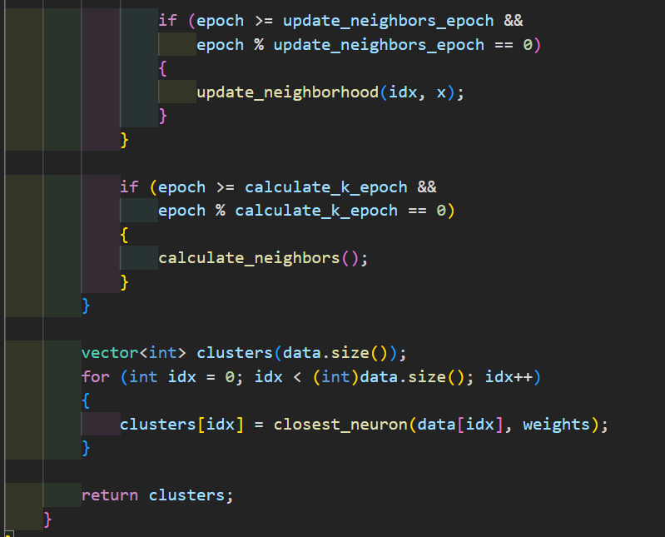

Slide 6
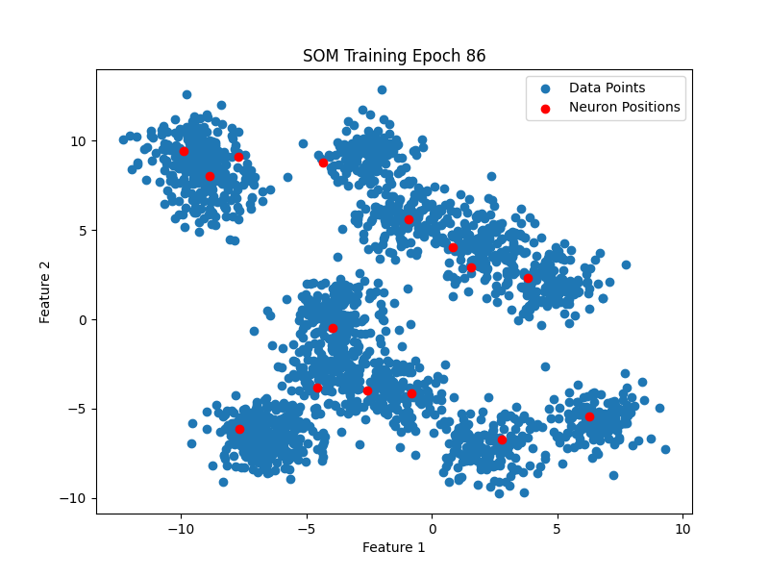

Slide 7
Speedups vs Slowdowns

Slide 8

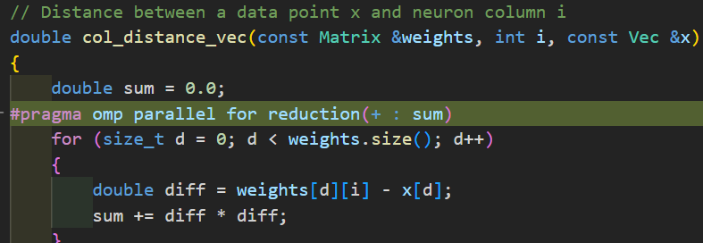
Slowdowns

Slide 9
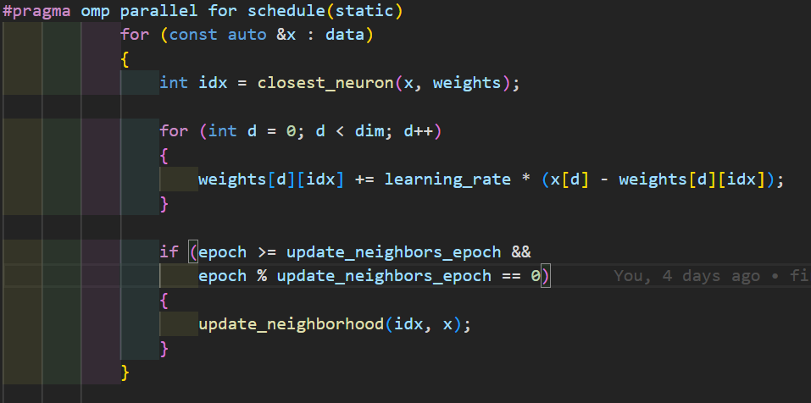
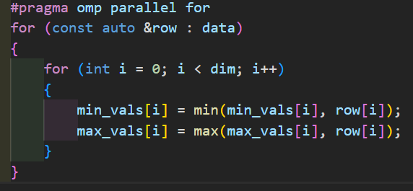
Slowdowns

Slide 10
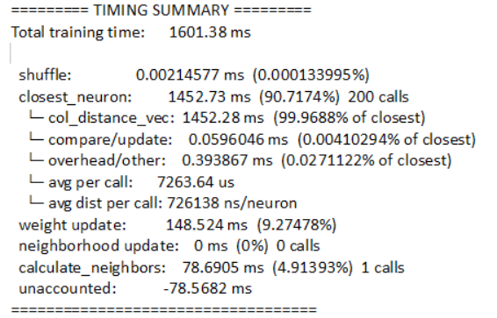

Slide 11
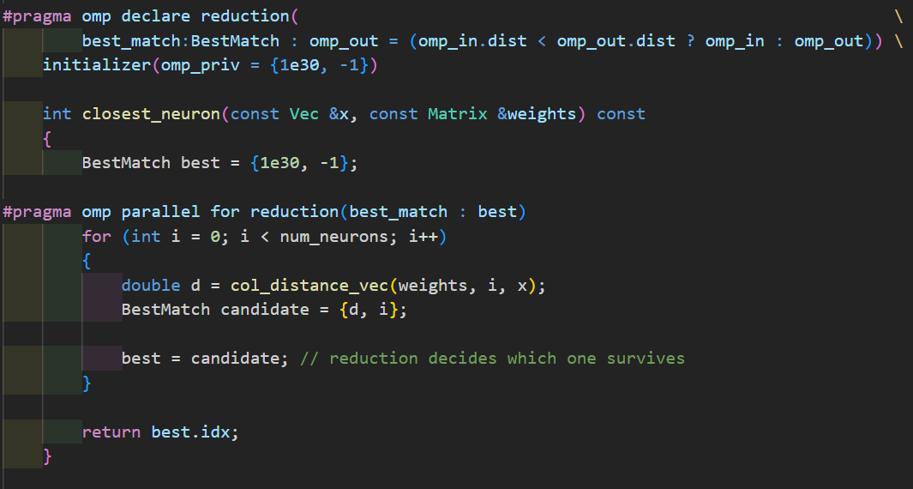
Slowdowns

Slide 12
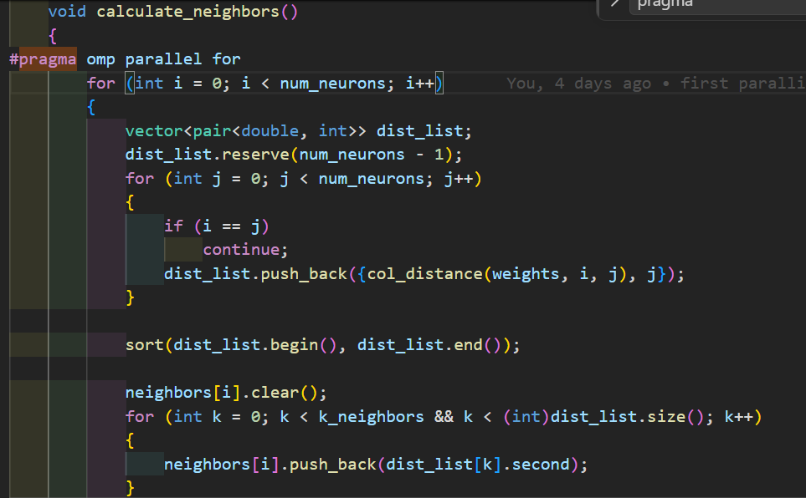
Slowdown

Slide 13
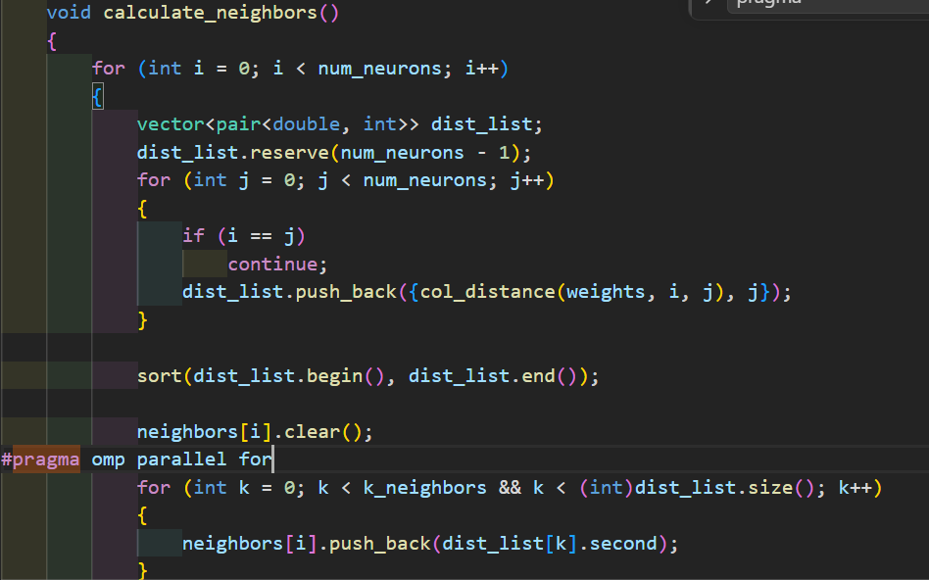
Slowdown

Slide 14
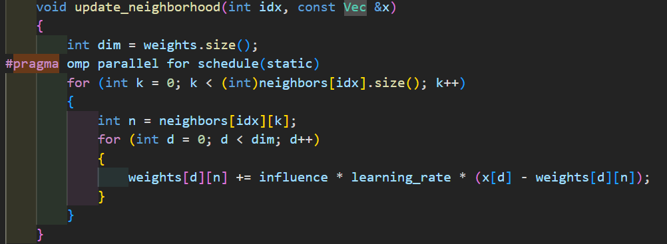

Slowdown

Slide 15
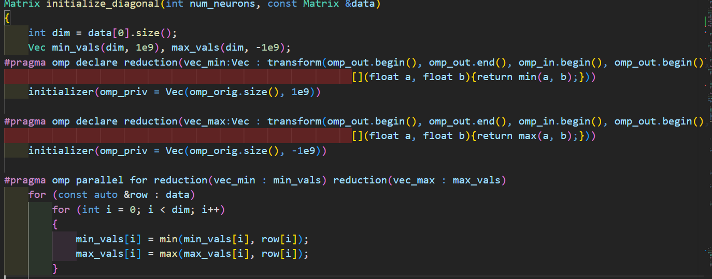
Speedup
2s -> 0.12s
16.6

Slide 16




Slide 17

Amazing Speedup

