Slide 1
CRYPTO TRADING BOT
Roberto García, Gonzalo Etse, Habib Aminu

Slide 2
Mission
Crypto is for enthusiastics, for people who follow their passions and do not let this world setbacks overcome them.
For this reason, it should be really taken into account this niche-sector opinions by mass-extracting and analyzing them, correlating them with crypto prices.
By doing this, new project trends, visions and focus-changes can be anticipated, and investments can be fostered where they can be made the most out of.
https://github.com/Robson-55/Crypto_Trading_Bot

Slide 3
Project Definition
→ Establishing an Automated Investment Fund in Enzyme platform.
→ Performing sentiment analysis and prediction of future prices. Hypothesis: Price and Sentiment analysis correlated.

Slide 4
Data Extraction
→ Scrapping market data from certain cryptocurrencies
-Coingecko presents easily accessible data, but with limited resources.
-Gemini allows for highly detailed data, but accessibility is complicated due to the amount of call.
→ Scrapping past Reddit messages related to those cryptocurrencies:
Use PRAW & Pushshift for searching public reddit comments/submissions via the pushshift.io API.
→ Scrapping recent news from Cryptopanic:
Cryptopanic is a news aggregator with a user base that will value the news based on how positive, negative or relevant it is.

Slide 5
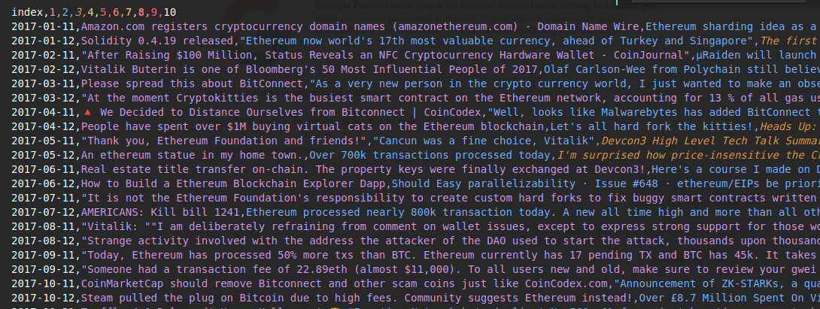
Development - Phase 1 (sentiments)
→ Scrapping from relevant subreddits using PRAW based on date and score.
→ Reformat to get top10 threads per day
→ Pass the dataframe of subreddits through an already pre-trained transformer (DISTILBERT) in order to perform sentiment analysis and transform them into scores (0-negative, 1-positive).
→ Taking 10 scores per day is an enough low number to assure every day will have at least 10 Reddit posts. In case there would not be enough, an averagin method of that day score would be applied to the leftovers.
→ The obtained dataframe will be called “X”

Slide 6
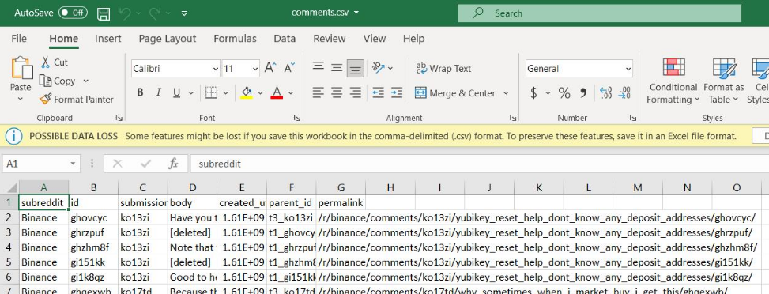
Reddit Scrapping

Slide 7
How to obtain scores from text? -> DISTILBERT
DISTILBERT - WHAT IS IT?
→ DISTILBERT is a small, fast, cheap and light Transformer model trained by distilling BERT base. It has 40% less parameters, runs 60% faster while preserving 95% of its performance.
→ BERT (Bidirectional Encoder Representations from Transformers) is a transformer based machine learning for natural language processing developed by Google.

Slide 8
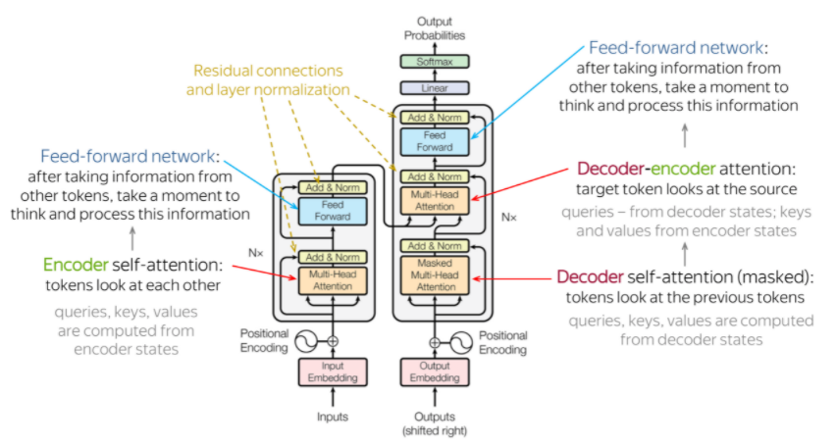
Transformer - What is it?
→ A transformer is a deep learning model that adopts the mechanism of attention, differentialy weighing the significance of each part of the input data. It is normally used in Natural Language processing and Computer Vision.

Slide 9
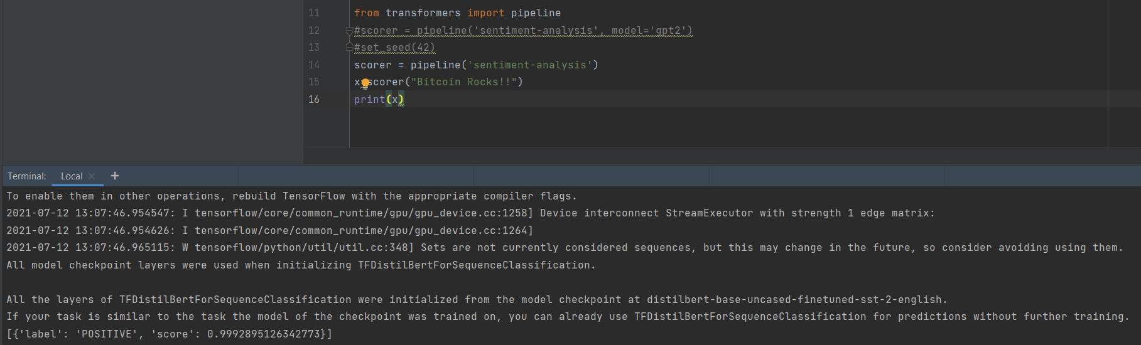
DISTILBERT: Sentiment Analysis

Slide 10
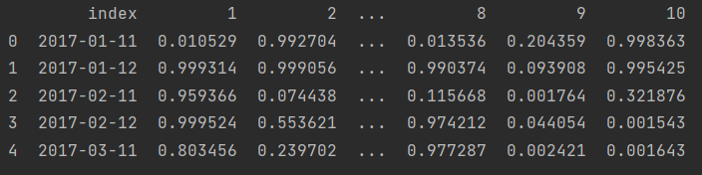
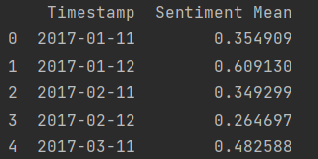
DISTILBERT: Sentiment Analysis

Slide 11
Development - Phase 2 (market data)
→ Scrapping from Coingecko the cryptocurrencies historic of some market data (prices, volume…)
→ Storing it into a dataframe called “Y”
→ Merging daily market data with sentiment scores (Merging “X” and “Y”), resulting in dataframe “Z”

Slide 12
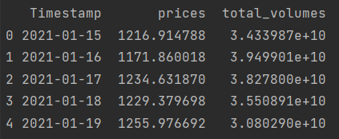
Coingecko Scrapping
After some transformations in Python, this is the result for Ethereum for a given time range:

Slide 13
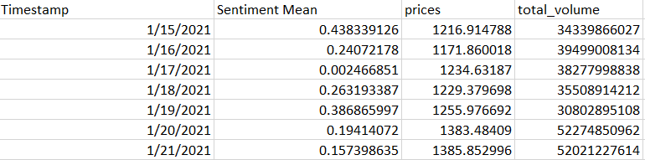
Merging Prices and Sentiment Scores – table “Z”

Slide 14
Development - Phase 3 (training model)
→ Splitting of the dataset “Z” into training and test sets (we save the test prices (20%) and empty them to optimize the training)
→ Training of the neural network (LSTM)for price prediction with “Z_train” and “Z_test”

Slide 15
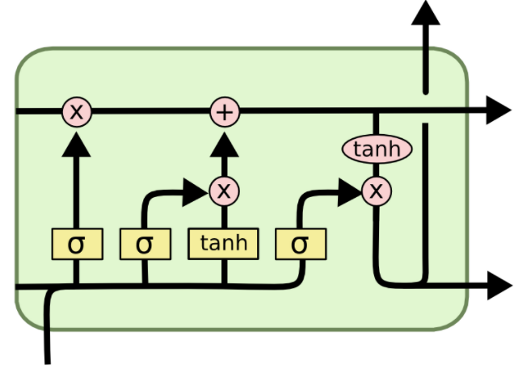
LSTM - What is it?
→ LSTM (Long Short Term Memory) is an artificial Recurrent Neural Network (RNN) architecture used in the field of deep learning. Unlike standard feedforward neural networks, LSTM has feedback connections. It can not only process single data points, but sequences of data (in this case it will use “windows” of 30 days of prices and volumes).

Slide 16
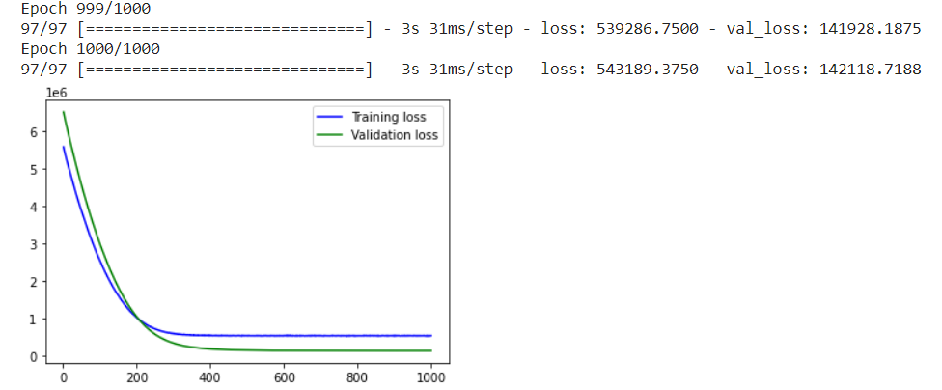
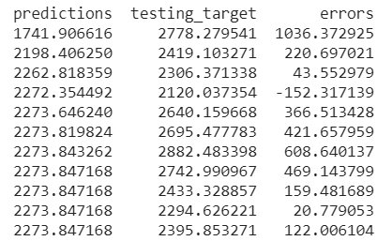
Training of the lstm

Slide 17
Development - Phase 4 (new sentiments)
→ Scrapping news from multiple sources through Cryptopanic
→ Pass these news on a daily basis through the DISTILBERT sentiment analyzer and obtain their scores
→ Merge these scores with its corresponding new market data on a daily basis, obtaining new dataframes called “A+”

Slide 18
Development - Phase 5 (Model Predictions)
→ Feed the already trained LSTM neural net with “A+” dataframe in order for it to make the prices predictions
→ Predictions will be for the following weeks and months prices.
🡪 Establishing the cryptocurrencies asset allocation on Enzyme based on these predictions

Slide 19
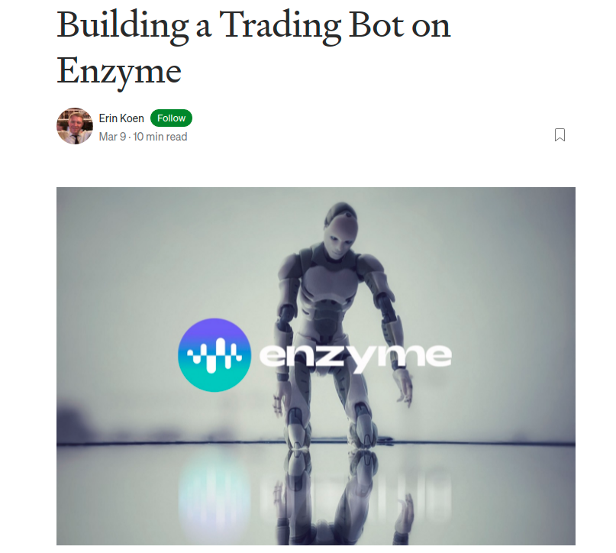
Development - Phase 6 (ENZYME BOT)
→ Enzyme is a decentralized fund manager that allows for humans (or bots) to run a fund in which third parties can invest with a limited cost compared to traditional funds.
→ Enzyme provides full transparency about how strategies are performing, together with information about how they’re set up, operated and composed.
→ A fund can be carried on by a code that performs based on other process. To complete the decentralized model we would have to have the complete code running in Lambda with storage in AWS or Ocean Protocol (decentralized data access).
→ We use a community made Trading Bot, and adapt the decision making to our own DL results. The bot will be running on the Ethereum testnet Covan.
→ Connect Algo Trading decisions to the Trading Bot actions.
Source: https://medium.com/enzymefinance/building-a-trading-bot-on-enzyme-e002b6419b23

Slide 20
Tools
→ Python 3.8
🡪 Libraries: requirements.txt
→ Github
🡪 Enzyme

Slide 21
Final Thoughts
-Scrap & clean Hour Price data through coingecko or gemini APIs
-Scrap & clean, using PRAW, subreddits related to the selected crypto assets
-Apply Text-Sentiment analysis over the subreddit posts and merge with Price data
-Apply LSTM over the multivariate dataset
-Set an enzyme-fund over a COVAN testnet and fetch transaction costs
-Calculate ROI & Risks of changes of strategy based on the algorithms decisions - (Todo in the future)
-Set Bot transactions - (Todo in the future)
-Set code on Amazon Lambda - (Todo in the future)

