Slide 1





Short Vowels
ă
ĕ
ĭ
ŏ
ŭ
apple
egg
pig
frog
sun
Short vowels are found in closed syllables — the vowel is closed in by a consonant and says its short sound.

Slide 2






Long Vowels
ā
ē
ī
ō
ū
ū
acorn
fever
tiger
ocean
unicorn
tulip
Long vowels say their own name. Found in open syllables where the vowel is not closed in by a consonant.

Slide 3





Lazy Vowels
a
e
i
o
u
ə
ə
ə
ə
ə
sofa
garden
pencil
lemon
circus
The schwa (ə) is the most common English vowel sound — a weak "uh" that any vowel can make in an unstressed syllable.

Slide 4

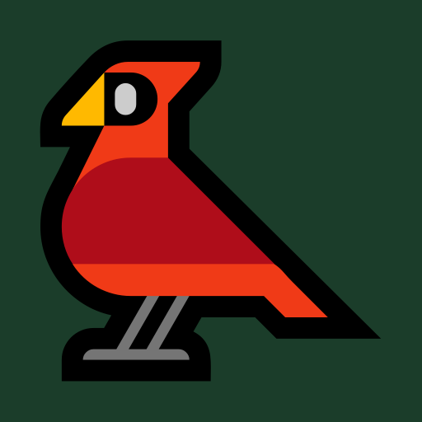



R-Controlled Vowels
ar
ir
er
or
ur
star
bird
fern
corn
fur
When a vowel is followed by r, the r changes the vowel sound. Sometimes called "bossy r" vowels.

Slide 5




The Letter Y can also make vowel sounds.
y
y
y
y
consonant sound
long i
long e
short i
yarn
fly
happy
gym
Y is the only letter that acts as both a consonant and a vowel.

Slide 6
Short Vowels
ă
ĕ
ĭ
ŏ
ŭ
apple
egg
pig
frog
sun
Short vowels are found in closed syllables — the vowel is closed in by a consonant and says its short sound.

Slide 7
Short Vowels
ă
ĕ
ĭ
ŏ
ŭ
apple
egg
pig
frog
sun
Short vowels are found in closed syllables — the vowel is closed in by a consonant and says its short sound.

Slide 8
Short Vowels
ă
ĕ
ĭ
ŏ
ŭ
apple
egg
pig
frog
sun
Short vowels are found in closed syllables — the vowel is closed in by a consonant and says its short sound.

Slide 9
Short Vowels
ă
ĕ
ĭ
ŏ
ŭ
apple
egg
pig
frog
sun
Short vowels are found in closed syllables — the vowel is closed in by a consonant and says its short sound.

Slide 10
Short Vowels
ă
ĕ
ĭ
ŏ
ŭ
apple
egg
pig
frog
sun
Short vowels are found in closed syllables — the vowel is closed in by a consonant and says its short sound.

Slide 11
Long Vowels
ā
ē
ī
ō
ū
ū
acorn
fever
tiger
ocean
unicorn
tulip
Long vowels say their own name. Found in open syllables where the vowel is not closed in by a consonant.

Slide 12
Long Vowels
ā
ē
ī
ō
ū
ū
acorn
fever
tiger
ocean
unicorn
tulip
Long vowels say their own name. Found in open syllables where the vowel is not closed in by a consonant.

Slide 13
Long Vowels
ā
ē
ī
ō
ū
ū
acorn
fever
tiger
ocean
unicorn
tulip
Long vowels say their own name. Found in open syllables where the vowel is not closed in by a consonant.

Slide 14
Long Vowels
ā
ē
ī
ō
ū
ū
acorn
fever
tiger
ocean
unicorn
tulip
Long vowels say their own name. Found in open syllables where the vowel is not closed in by a consonant.

Slide 15
Long Vowels
ā
ē
ī
ō
ū
ū
acorn
fever
tiger
ocean
unicorn
tulip
Long vowels say their own name. Found in open syllables where the vowel is not closed in by a consonant.

Slide 16
Long Vowels
ā
ē
ī
ō
ū
ū
acorn
fever
tiger
ocean
unicorn
tulip
Long vowels say their own name. Found in open syllables where the vowel is not closed in by a consonant.

Slide 17
Lazy Vowels
a
e
i
o
u
ə
ə
ə
ə
ə
sofa
garden
pencil
lemon
circus
The schwa (ə) is the most common English vowel sound — a weak "uh" that any vowel can make in an unstressed syllable.

Slide 18
Lazy Vowels
a
e
i
o
u
ə
ə
ə
ə
ə
sofa
garden
pencil
lemon
circus
The schwa (ə) is the most common English vowel sound — a weak "uh" that any vowel can make in an unstressed syllable.

Slide 19
Lazy Vowels
a
e
i
o
u
ə
ə
ə
ə
ə
sofa
garden
pencil
lemon
circus
The schwa (ə) is the most common English vowel sound — a weak "uh" that any vowel can make in an unstressed syllable.

Slide 20
Lazy Vowels
a
e
i
o
u
ə
ə
ə
ə
ə
sofa
garden
pencil
lemon
circus
The schwa (ə) is the most common English vowel sound — a weak "uh" that any vowel can make in an unstressed syllable.

Slide 21
Lazy Vowels
a
e
i
o
u
ə
ə
ə
ə
ə
sofa
garden
pencil
lemon
circus
The schwa (ə) is the most common English vowel sound — a weak "uh" that any vowel can make in an unstressed syllable.

Slide 22
R-Controlled Vowels
ar
ir
er
or
ur
star
bird
fern
corn
fur
When a vowel is followed by r, the r changes the vowel sound. Sometimes called "bossy r" vowels.

Slide 23
R-Controlled Vowels
ar
ir
er
or
ur
star
bird
fern
corn
fur
When a vowel is followed by r, the r changes the vowel sound. Sometimes called "bossy r" vowels.

Slide 24
R-Controlled Vowels
ar
ir
er
or
ur
star
bird
fern
corn
fur
When a vowel is followed by r, the r changes the vowel sound. Sometimes called "bossy r" vowels.

Slide 25
R-Controlled Vowels
ar
ir
er
or
ur
star
bird
fern
corn
fur
When a vowel is followed by r, the r changes the vowel sound. Sometimes called "bossy r" vowels.

Slide 26
R-Controlled Vowels
ar
ir
er
or
ur
star
bird
fern
corn
fur
When a vowel is followed by r, the r changes the vowel sound. Sometimes called "bossy r" vowels.

Slide 27




The Letter Y
y
y
y
y
y
consonant
long i
long e
short i
long e
yarn
fly
happy
gym
monkey
Y is the only letter that acts as both a consonant and a vowel. As a consonant it begins a syllable; as a vowel it ends one.

Slide 28
The Letter Y
y
y
y
y
y
consonant
long i
long e
short i
long e
yarn
fly
happy
gym
monkey
Y is the only letter that acts as both a consonant and a vowel. As a consonant it begins a syllable; as a vowel it ends one.

Slide 29
The Letter Y
y
y
y
y
y
consonant
long i
long e
short i
long e
yarn
fly
happy
gym
monkey
Y is the only letter that acts as both a consonant and a vowel. As a consonant it begins a syllable; as a vowel it ends one.

Slide 30
The Letter Y
y
y
y
y
y
consonant
long i
long e
short i
long e
yarn
fly
happy
gym
monkey
Y is the only letter that acts as both a consonant and a vowel. As a consonant it begins a syllable; as a vowel it ends one.

Slide 31
The Letter Y
y
y
y
y
y
consonant
long i
long e
short i
long e
yarn
fly
happy
gym
monkey
Y is the only letter that acts as both a consonant and a vowel. As a consonant it begins a syllable; as a vowel it ends one.

Slide 32
Today we are learning to...
Vowels can make many sounds.
Vowels can make short, long, lazy and R controlled sounds.
There are other vowel sounds not listed in this video.
www.mrspelling.com

Slide 33
What is a Vowel?
A vowel is a speech sound made with your mouth open and your breath flowing freely — your tongue and lips do not block the air.
The five vowel letters are:
a
e
i
o
u
Y can also act as a vowel most of the time.
Vowels are the "open" sounds in words. Every syllable has at least one vowel sound.

Slide 34
Please Note
Vowels can make many different sounds. This video shows some of the most common vowel sounds, but there are more sounds not listed here.
www.mrspelling.com

