Slide 1
Stop Making Pie Charts!
An opinionated guide to the
craft of data visualisation
Robin Gower
Open Data Manchester
30.06.15
infonomics.ltd.uk
@robsteranium

Slide 2
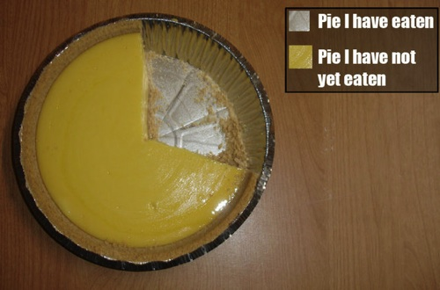

Slide 3
Motivation
Components
Perception
Guidance

Slide 4
Motivation
Notes:
Why do we visualise data?

Slide 5
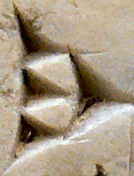
Data – raw symbols
CC BY 2.0 Flickr Procilas Moscas
Notes:
Data are the raw symbols that allow us to store, transmit, and process outside of our brains.

Slide 6
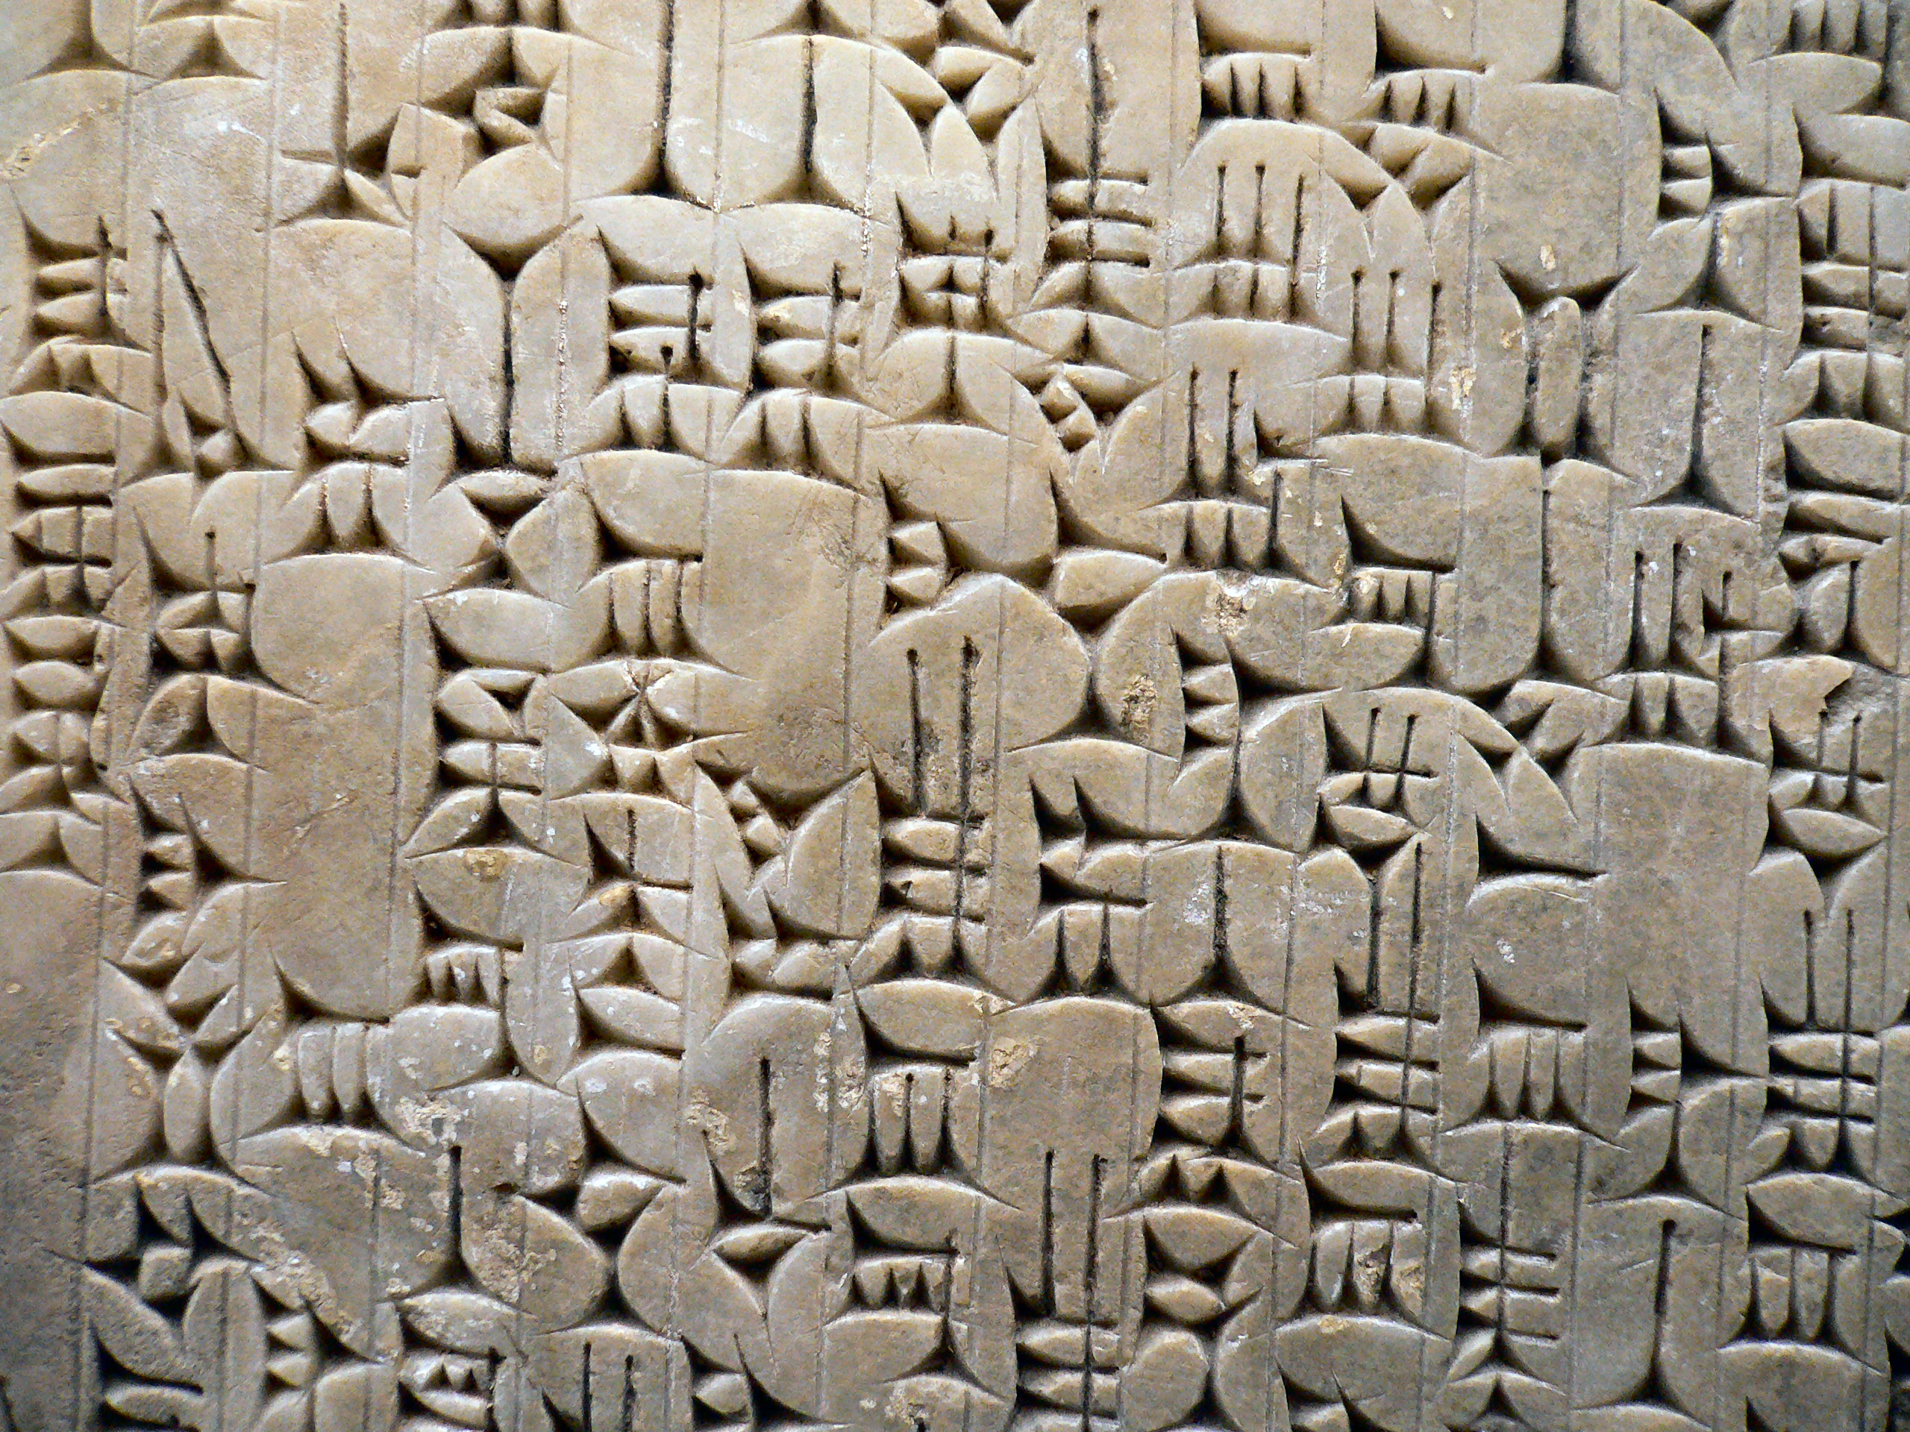
Information – meaning from context
CC BY 2.0 Flickr Procilas Moscas
Notes:
Information is data that is given meaning through contextual relationships.
Here the term from above is given meaning in the context of the other terms organised on this tablet.

Slide 7
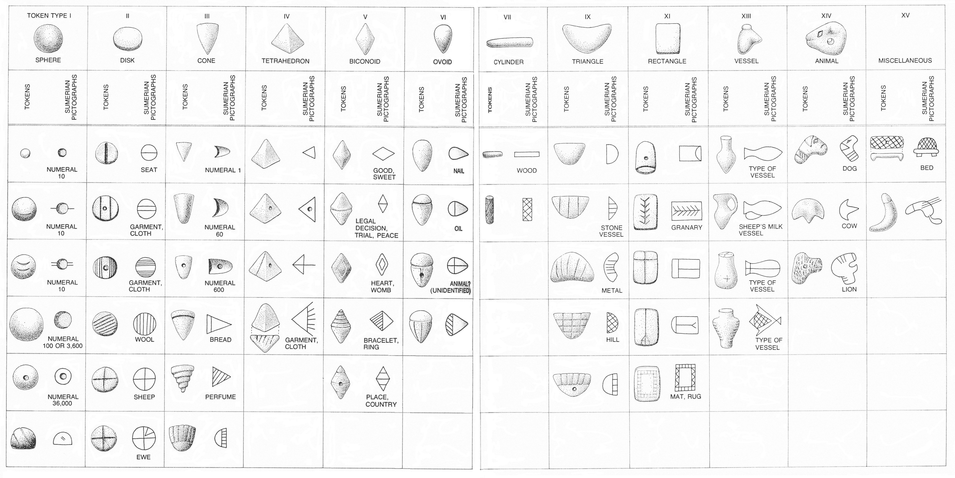
Visualisation – representation of the abstract
Copyright | Denise Schmandt-Besserat (1977) The Earliest Precursor of Writing, Scientific American
Notes:
Visualisation is the representation of abstract data encoded in visual (and interactive) form.

Slide 8
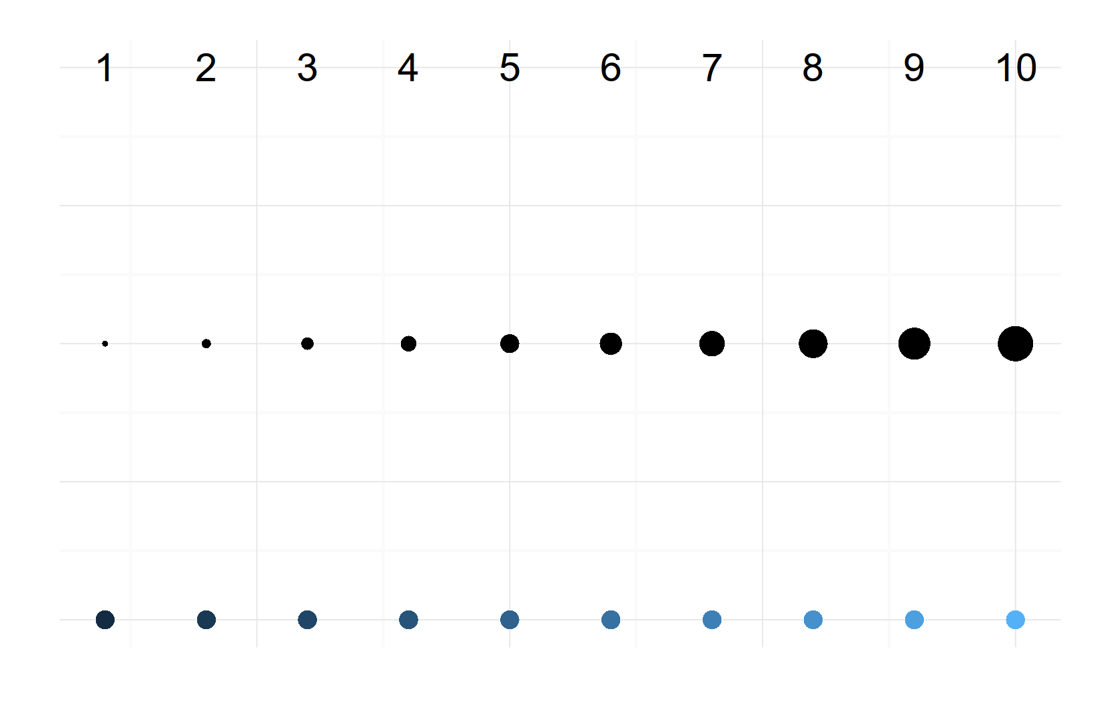
Encoding – data → aesthetics
CC BY SA 4.0 Robin Gower 2015
Notes:
We encode information into a visualisation by setting aesthetic attributes according to the data.
The viewer must study the visualisation to decode the information.
We leverage the power of visual perception to assist us to interpret information.

Slide 9
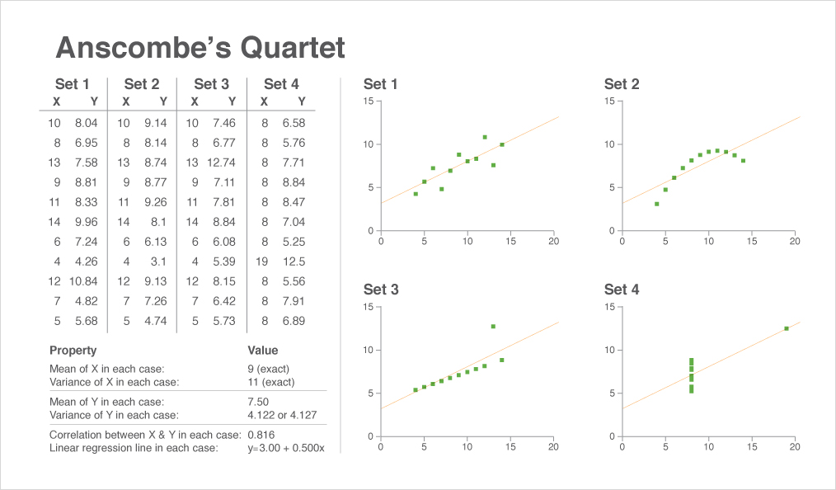
How similar are these sets?
Anscombe (1973) Graphs in Statistical Analysis reproduced in Anthony (2012) Qlik Design Blog
Notes:
Anscombes Quarter provides an excellent demonstration of the power of visualisation to aid interpretation.
How similar are these 4 sets?

Slide 10
How similar are these sets?
Anscombe (1973) Graphs in Statistical Analysis reproduced in Anthony (2012) Qlik Design Blog
Notes:
Statistical analysis finds them to be similar.

Slide 11
How similar are these sets?
Anscombe (1973) Graphs in Statistical Analysis reproduced in Anthony (2012) Qlik Design Blog
Notes:
Visualisation shows the differences very clearly.
Anscombe's quartet demonstrates both the effect of outliers on statistics and the importance of inspecting your data graphically as part of the analytical process.

Slide 12
Components

Slide 13
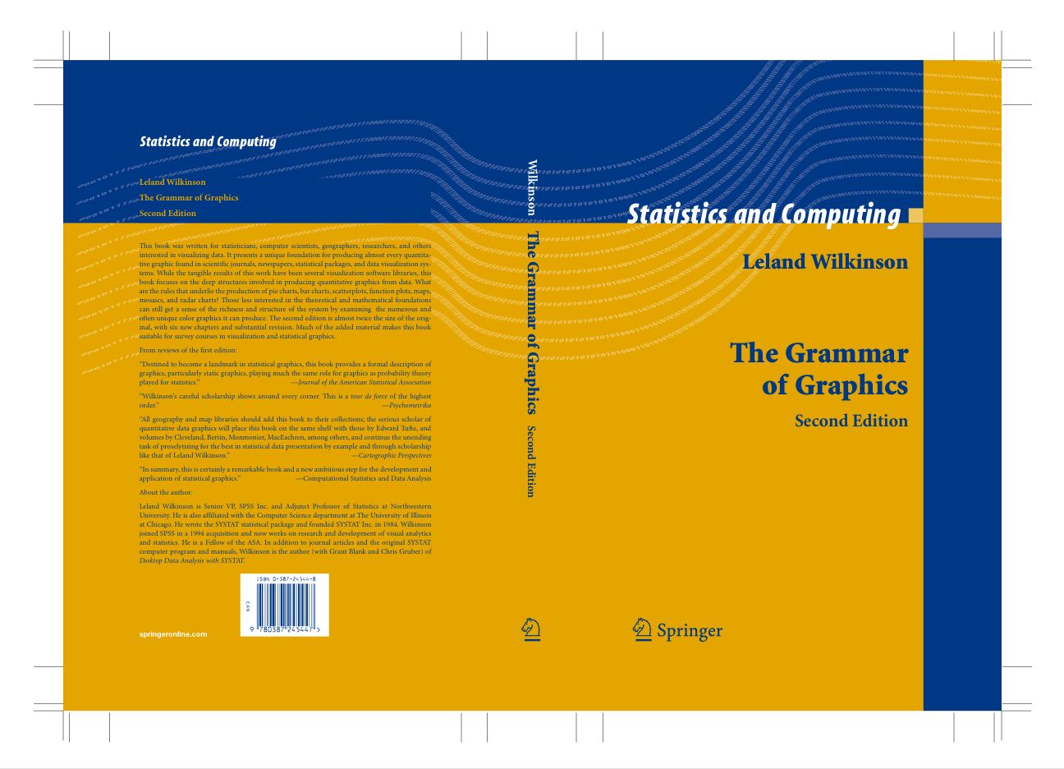
Notes:
“charts are usually instances of much more general objects… a pie is a divided bar with polar coordinates”

Slide 14
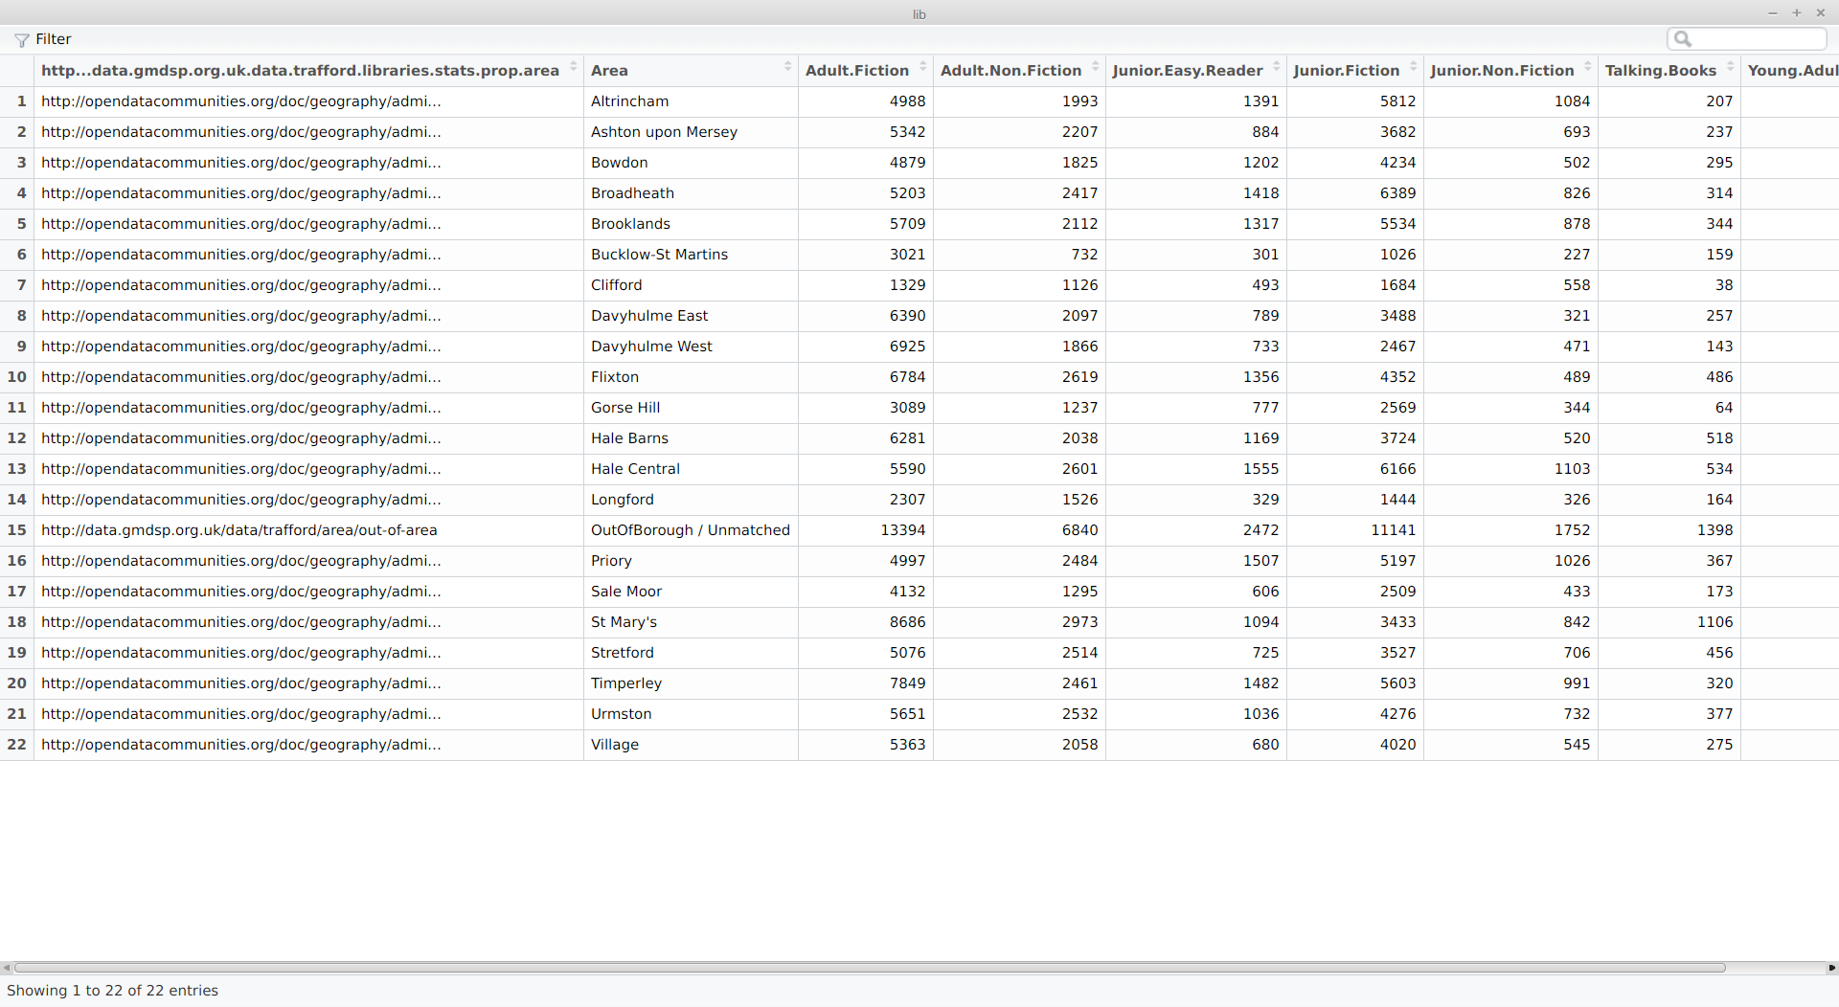
Variables
Trafford MBC 2015 http://data.gmdsp.org.uk/data/trafford/libraries/stats/loans
Notes:
Variables are created from source datasets.
Here we have library loans data opened as part of the Greater Manchester Data Synchronisation Project.
Each column provides a variable. Here each row is a different area of Trafford.

Slide 15
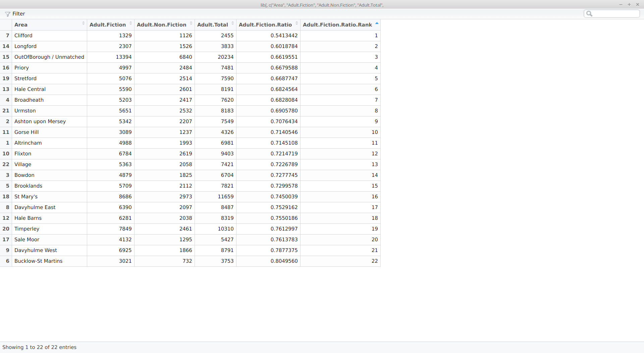
Transformations
Trafford MBC 2015 with Infonomics calculations
Notes:
The variables are manipulated in transformations.
Here we add a total for all adult book loans, a ratio of fiction-to-non-fiction and a rank ordering.
These are a critical part of the visualisation. A lot of design decisions depend upon the interaction of statistcal research as well as graphical analysis. For example, we could present a bivariate plot of fiction vs non-fiction or a uni-variate plot of the ratio.

Slide 16

Scales – mapping to a common unit
CC BY-SA 2.0 Flickr Guian Bolisay
Notes:
Scales are used to map variables into a common measurement.

Slide 17
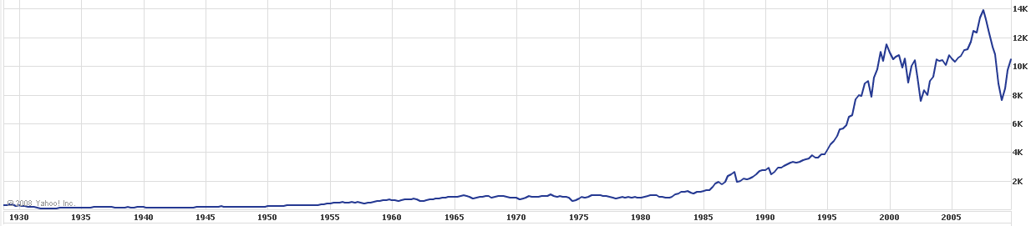
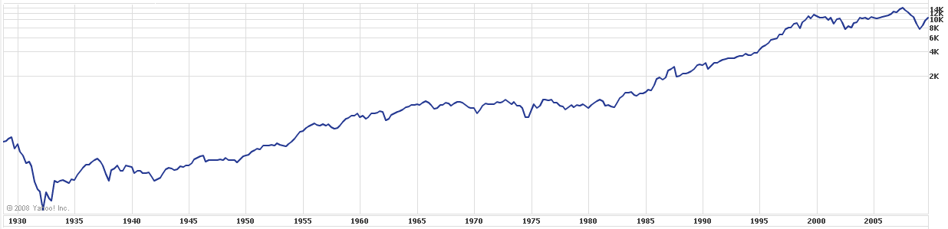
Scales – mapping to a common unit
Yahoo Finance via the Generalist ( http://legeneraliste.perso.sfr.fr/?p=echelle_log_eng)
Notes:
Logarithmic scales make it easier to compare values which either cover a large range, or cluster towards one end of the range.
Under the linear scale, the larger absolute movements in the past 20 years dwarf previous changes.
What's more important in stocks is percentage change. With a logarithmic scale, the same vertical change is equivalent to the same percentage change whatever the absolute level of the index.
Now we can see the Great Depression and the Post-war Boom.

Slide 18

Coordinates – mapping to the display
CC BY 2.0 Flickr Carsten Frenzl 2013
Notes:
The coordinate system maps from the scale to the display.

Slide 19
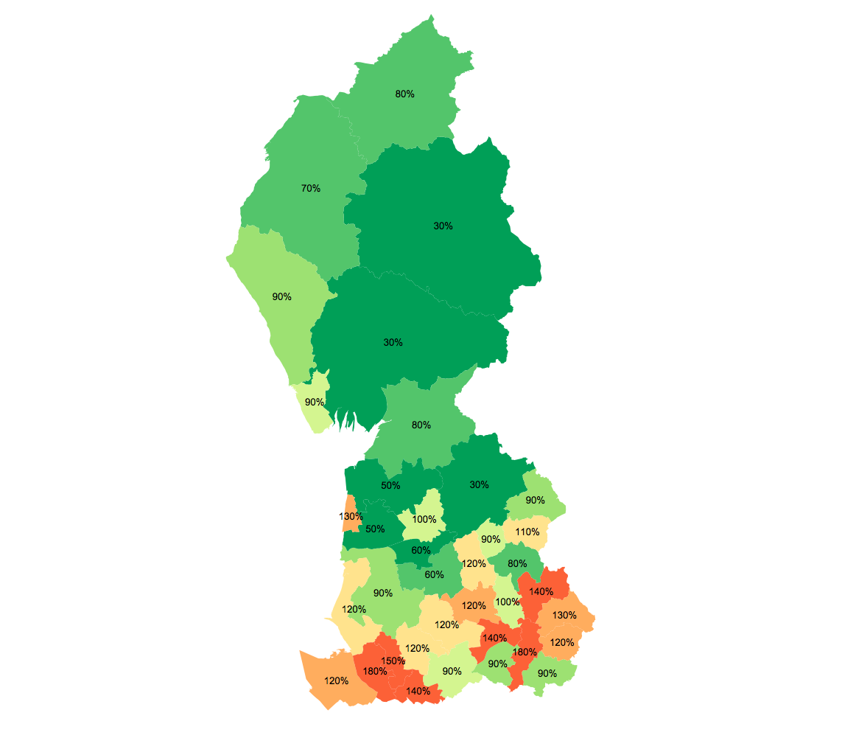
Coordinates – mapping to the display
DWP 2012 JSA Claimants in the North West, Location Quotients analysis by Infonomics
Notes:
The coordinate system maps from the scale to the display.
This chart shows location quotients, the share relative to the average where >100% is “more than their fair share”.
One confounding problem with charting like this is that it encodes area (Cumbria is big)

Slide 20
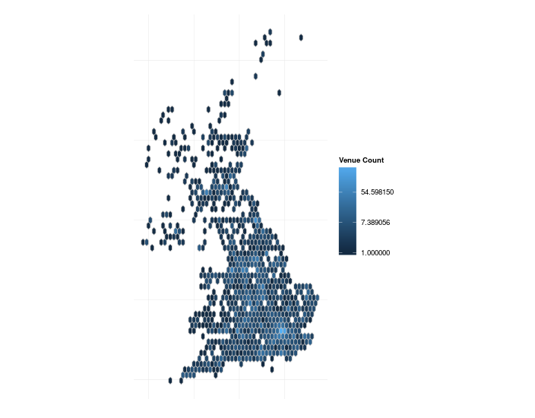
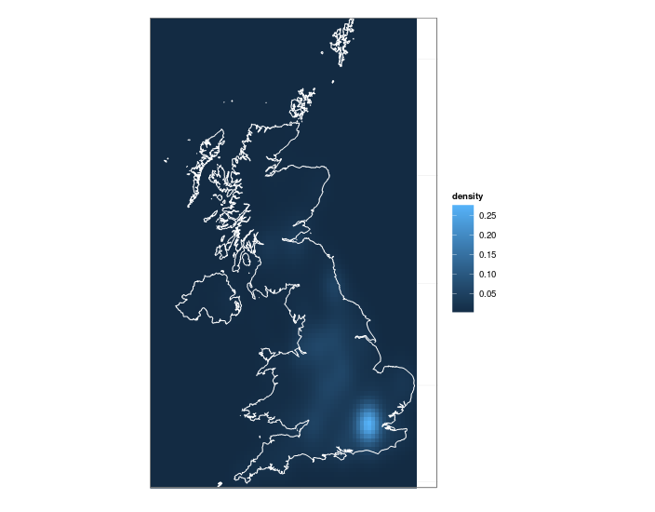
Coordinates – mapping to the display
Distribution of Cultural Venues – Infonomics analysis of Culture24 data
Notes:
Hexagonal binning is a great choice for map data as each bin has roughly similar radius and it tessellates.
Density estimation takes this to the extreme building many overlapping bins and plotting the average.

Slide 21
Elements – aesthetic attributes
this page is intentionally left blank
Notes:
Elements describe the marks and their aesthetic attributes.
Points, lines, areas, angles, textures, shapes.
There are lots of examples throughout this presentation so I've not sought to display any particular ones here.

Slide 22
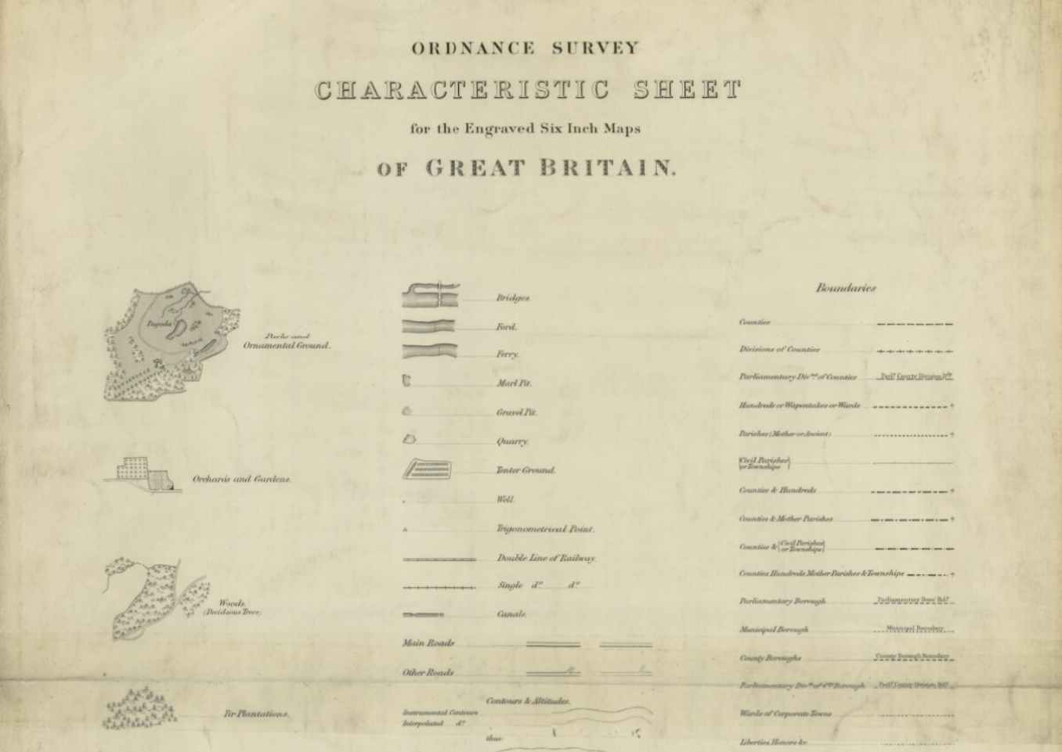
Guides – to provide context
Out-of-Copyright Ordnance Survey 1887
Notes:
Guides provide context – e.g. legends/ axes.
http://maps.nls.uk/os/6inch-england-and-wales/index.html

Slide 23
Perception
Notes:
As we noted above, visualisations require that the viewer is able to decode the representation.
It is important that we choose a representation that is easy to decode accurately, making best use of the brains abilities and avoiding optical illusions etc.

Slide 24
Pre-attentive Processing
3.1415926535897932384626433832795028841971693993751058209749445923078164062862089986280348253421170679821480865132823066
Notes:
Pre-attentive processing allows us to recognise attributes without consciously focussed thought
How many zeros are there?

Slide 25
Pre-attentive Processing
3.1415926535897932384626433832795028841971693993751058209749445923078164062862089986280348253421170679821480865132823066
Notes:
Here the task is much easier because we've used a colour-coding that may be processes pre-attentively.
It is rapid, parallel and automatic but approximate.
Attentive processing requires us to identify objects sequentially and hold them in memory. It is slower but more precise.

Slide 26
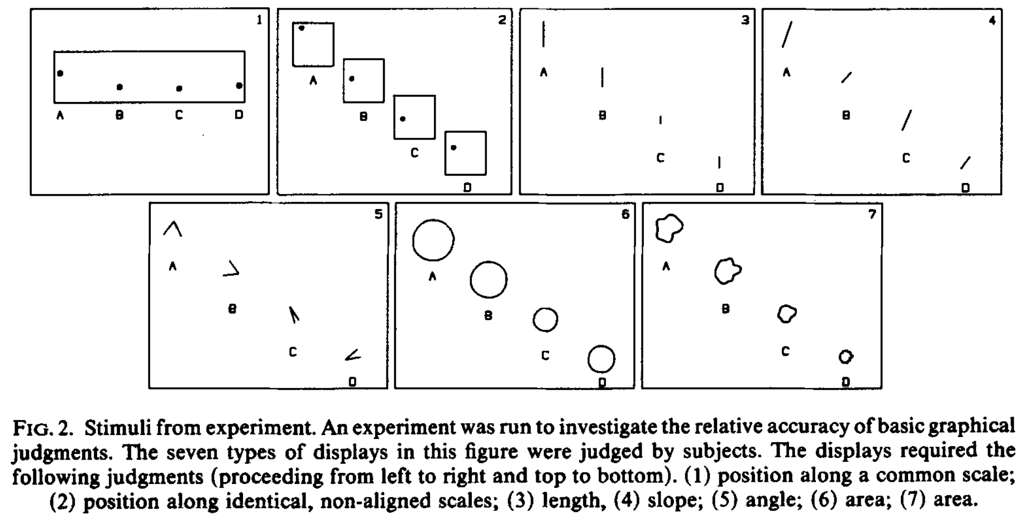
Decoding accuracy
Cleveland, McGill (1986) An experiment in graphical perception, Int J Man-Machine Studies

Slide 27
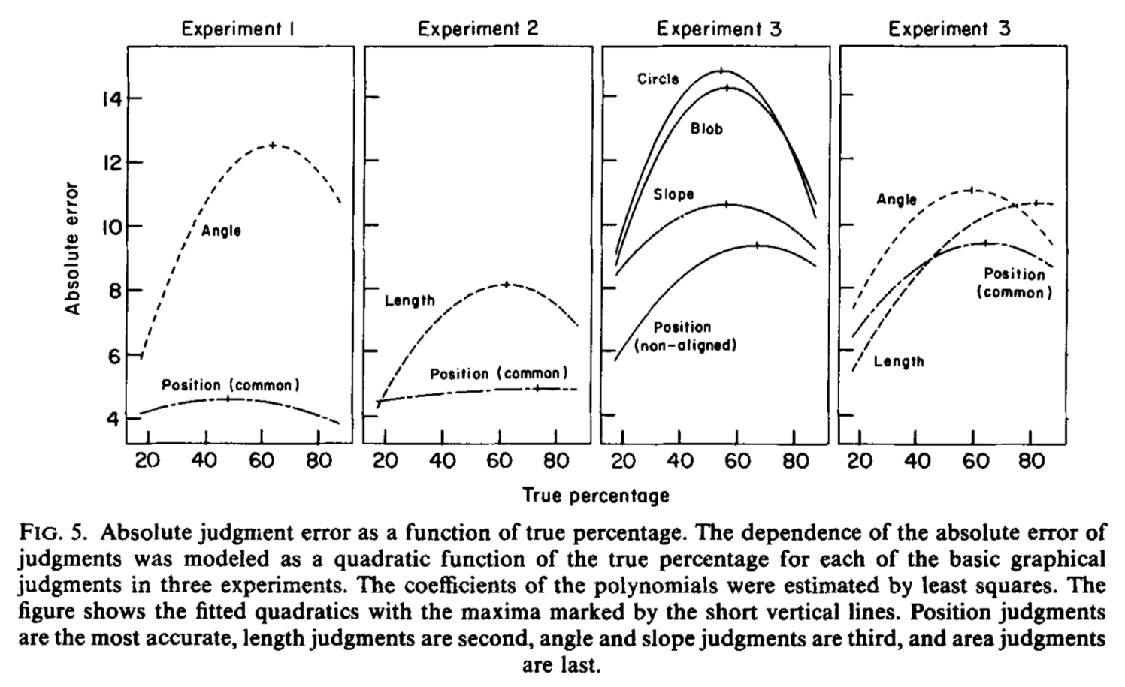
Decoding accuracy
Cleveland, McGill (1986) An experiment in graphical perception, Int J Man-Machine Studies
Notes:
Position is the most accurate, length judgements are second, angle and slope judgements are third, and area judgements are last.
Errors are smaller at the extremes.
Error curve maxima are not clustered at 50%, rather higher and vary by type of judgement.
No distinction between viewers according to training (professional vs college vs high-school).

Slide 28
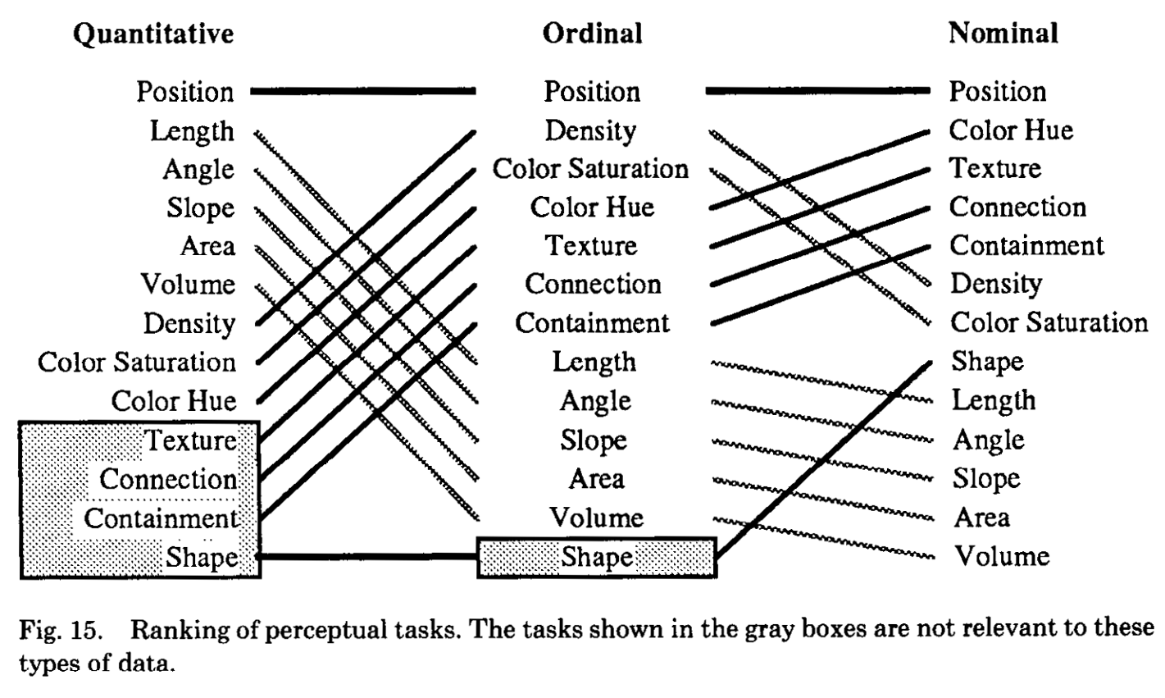
Ranking of Perceptual Tasks
Mackinley 1986 Automating the Design of Graphical Presentations of Relational Information
Notes:
Jock Mackinley has sought to extend this analysis to include non-quantitative perceptual tasks – ordinal ranking and nominal (categorical) comparisons.
Based upon analyses of perceptual tasks but has not been validated empirically.
Position is still the best performing encoding.
Area is worse at ordinal coding as it's easy to confuse adjacent levels (critical to ordinal comparison but less important in quantitative comparison). It's ranked lower for nominal comparison as the view may perceive an ordinal ranking by size.

Slide 29
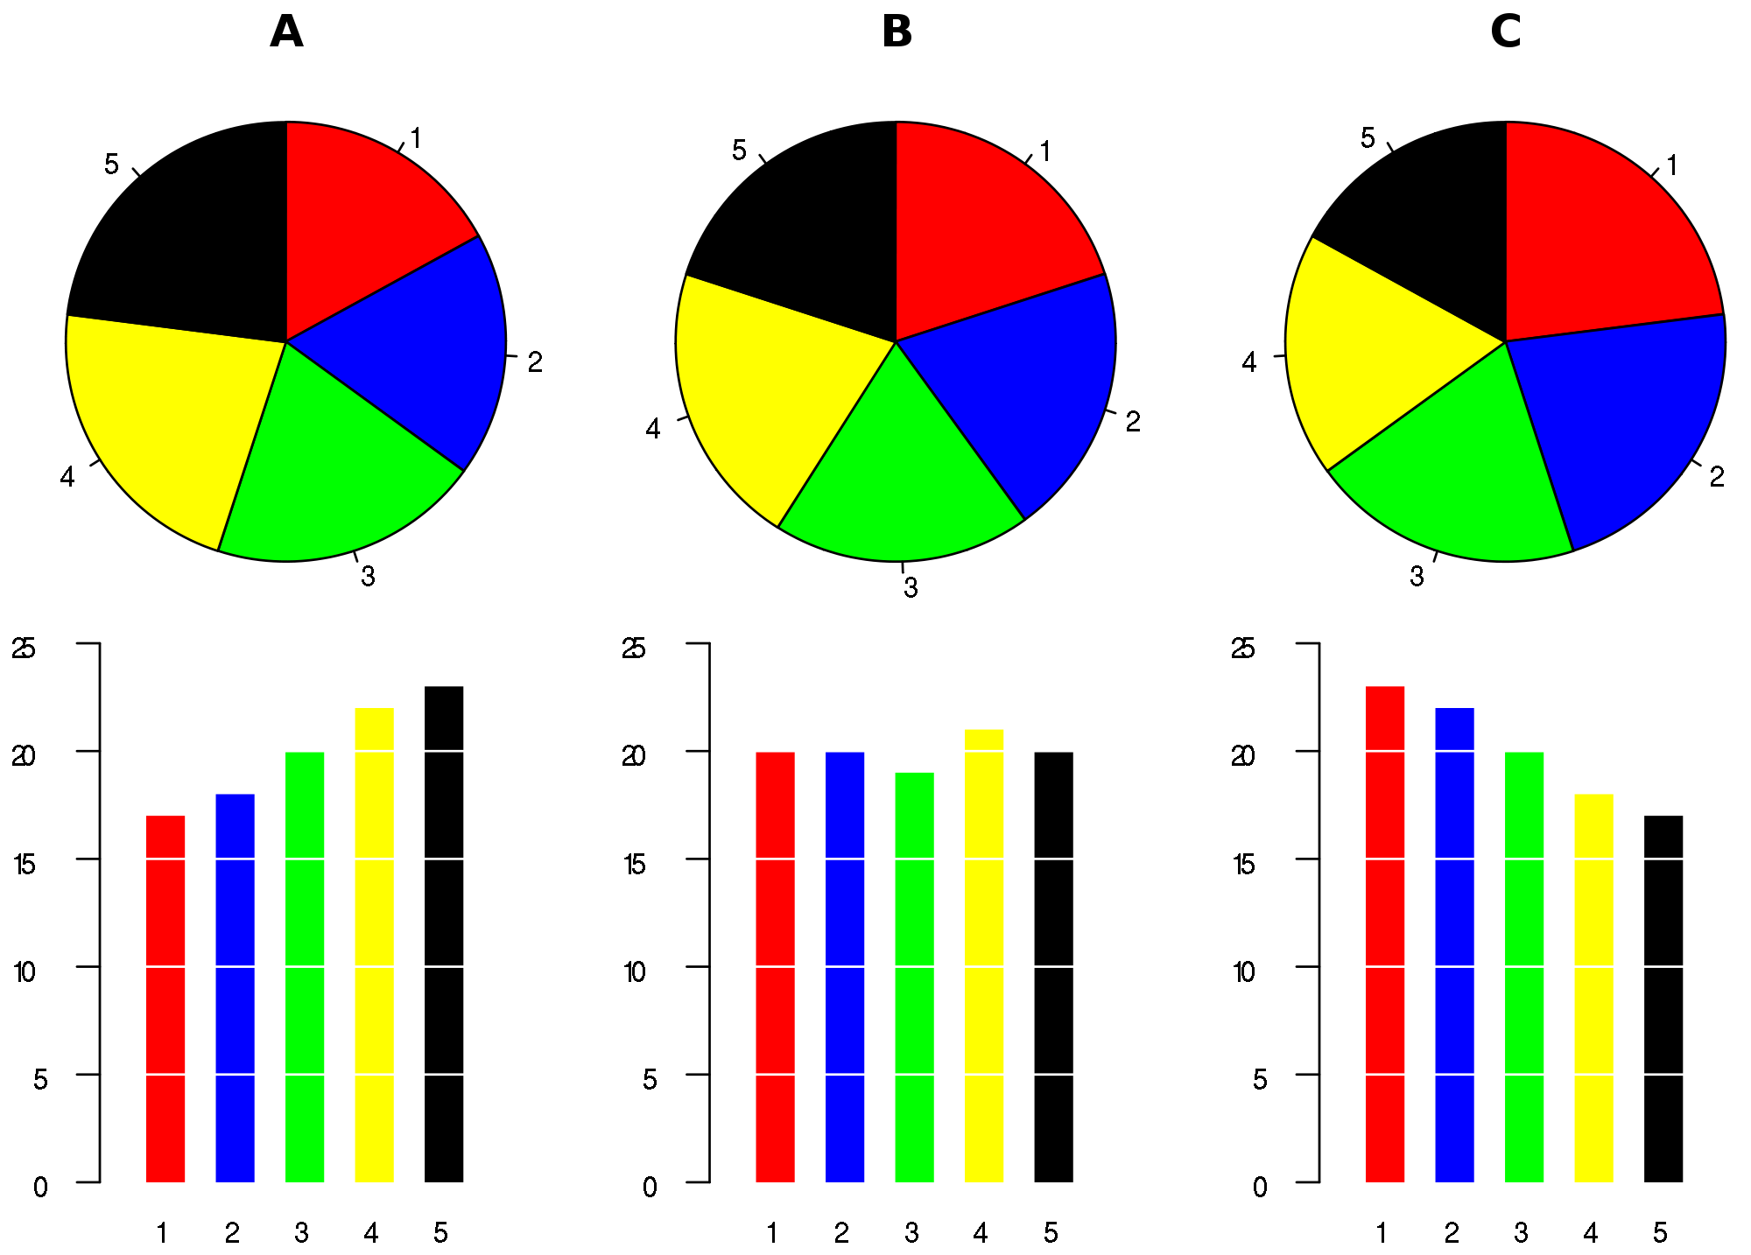
CC BY 1.0 WikiMedia Commons Shutz 2007
Notes:
Can you spot the difference between these pies?
Area is a poor choice for encoding quantitative data.
Although pies can also be interpreted by the angles – they are not-aligned which makes it harder.

Slide 30
CC BY 1.0 WikiMedia Commons Shutz 2007
Notes:
The corresponding bar charts show the differences immediately.

Slide 31
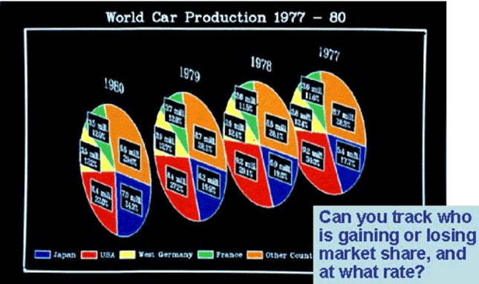
Visualization: Using Computer Graphics to Explore Data and Present Information
Judith R. Brown, et. al., John Wiley & Sons, 1995
Notes:
Just because you can do something, doesn't mean you should.
If we're seeking to show trends over time, why not use a line chart?

Slide 32
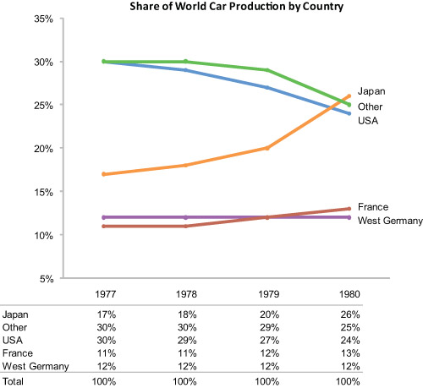
Stephen Few http://www.perceptualedge.com
Notes:
The equivalent line chart is much easier to interpret.
Note tables of data (beneath) makes use of position to distinguish variable levels nominally or ordinally

Slide 33
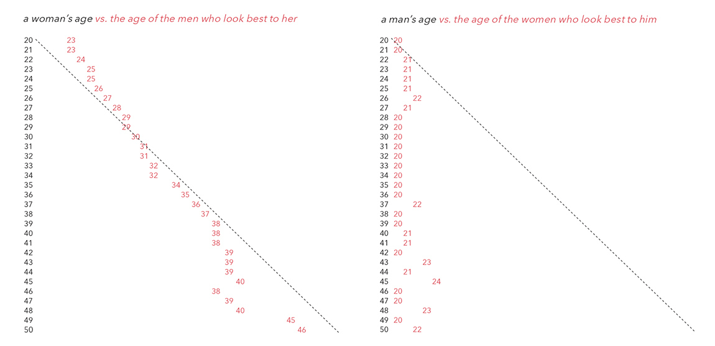
Aesthetics – Position
Copyright Christian Rudder, Dataclysm

Slide 34
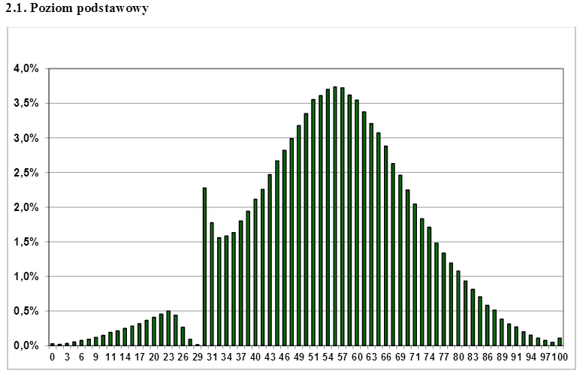
Aesthetics – Position
Polish Central Examination Board Matura Test Scores 2013 cke.edu.pl

Slide 35
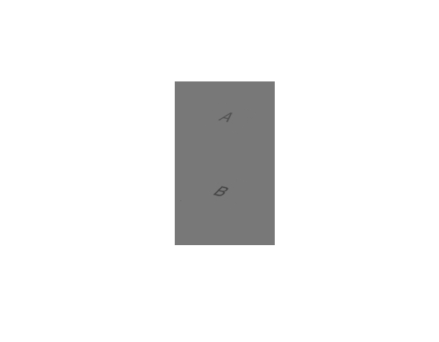
Aesthetics – Colour – depends on context
Notes:
Grayscale is particularly difficult.
A and B are the same colour although the checkerboard context tricks the eye into seeing them differently

Slide 36
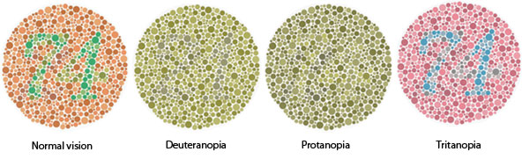
Aesthetics – Colour – not the same to everyone
Notes:
5% of your audience will not be able to distinguish red and green

Slide 37
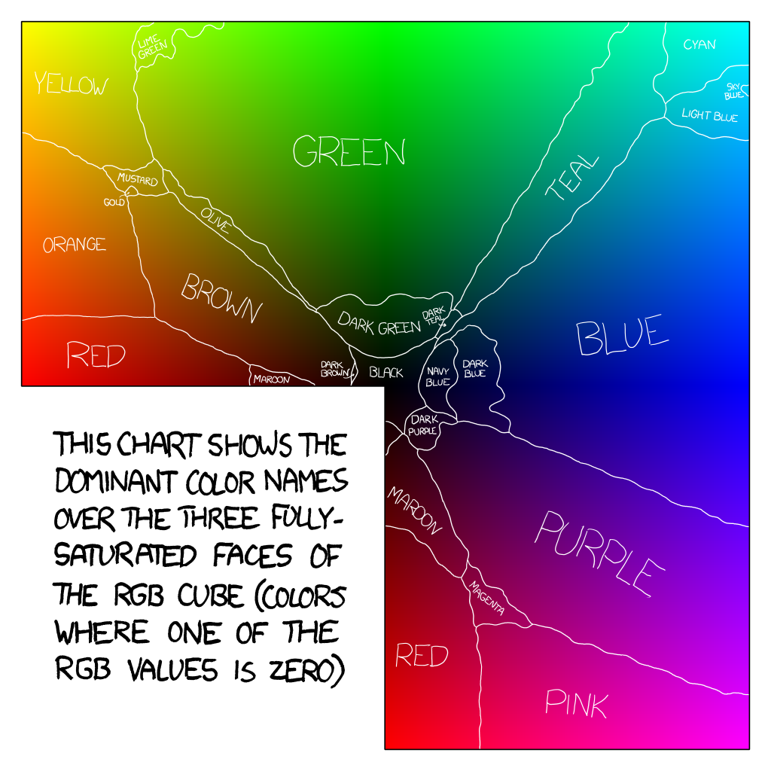
Aesthetics – Colour – limits to perception
XKCD Colour Survey 2010 http://blog.xkcd.com/2010/05/03/color-survey-results/
Notes:
It's difficult to retain the meaning of more than 9 colours simultaneously (in short term memory)
XKCD colour survey – 223k user sessions
It's hard enough to perceive more than 5 levels
Colours, therefore, aren't great for quantitative scales
Muted colours are easier on the eye

Slide 38
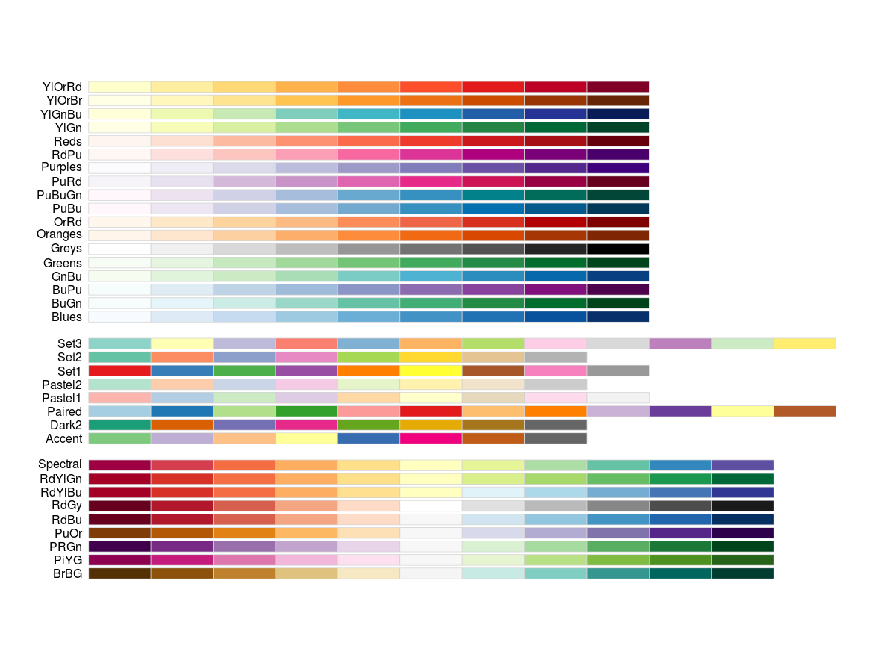
Aesthetics – Colour – reach for a palette
Brewer Colour Palette
Notes:
Brewer colour palette
Different colour schemes for different purposes – spectra, qualitative, diverging.
Muted pastel tones avoid after-images caused by highly saturated colours.
Useful for grouping and search.

Slide 39
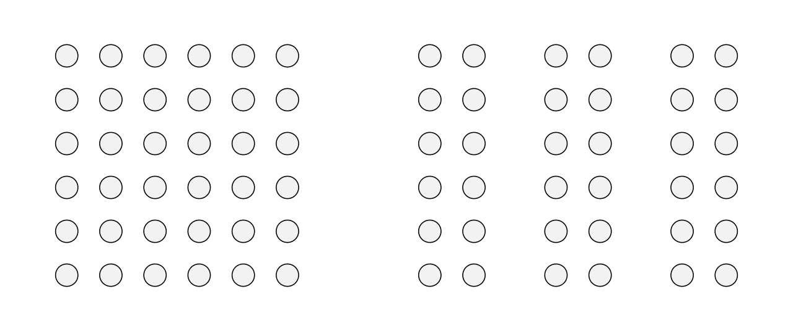
Gestalt laws of grouping – proximity

Slide 40
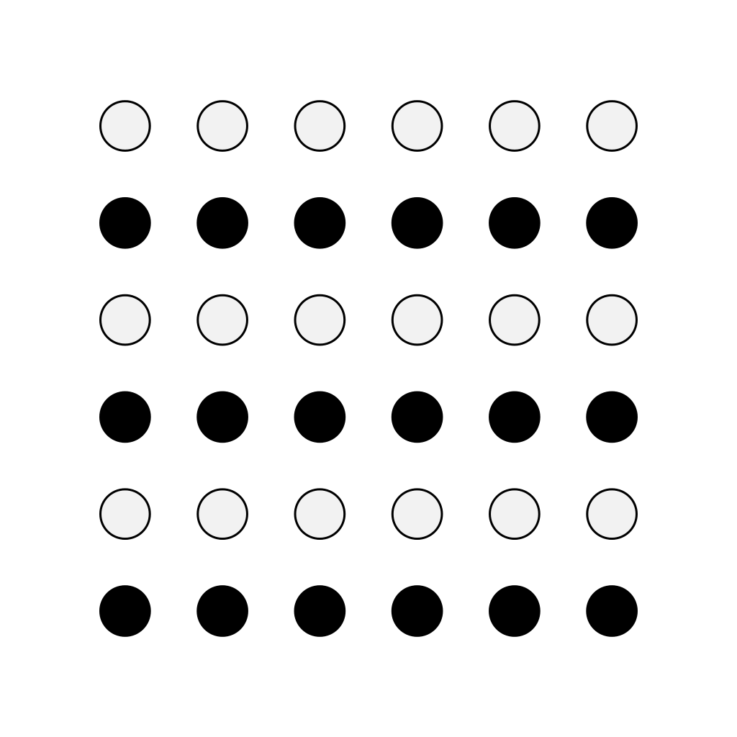
Gestalt laws of grouping – similarity

Slide 41

Gestalt laws of grouping – closure

Slide 42

Gestalt laws of grouping – continuation

Slide 43
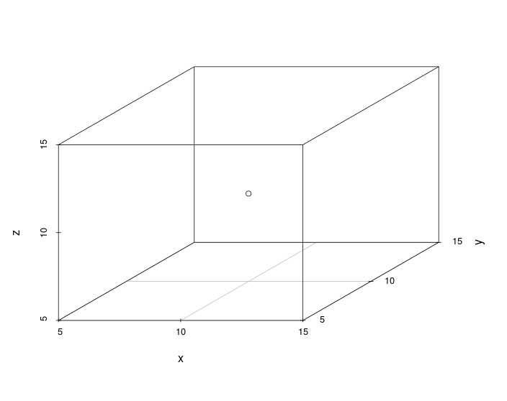
3D is bad (on 2D displays)
CC BY SA 4.0 Robin Gower 2014

Slide 44
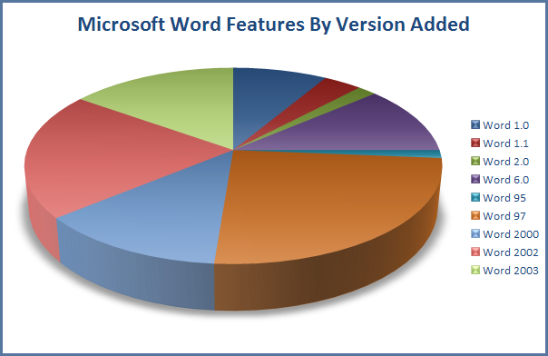
http://blog.jgc.org/2009/08/please-dont-use-pie-charts.html

Slide 45
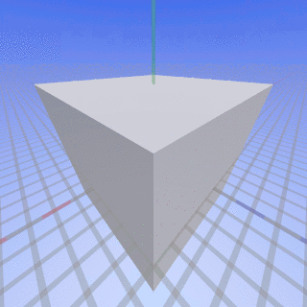
Perspective Distortion
CC BY SA 4.0 WikiMedia Commons SharkD 2007

Slide 46
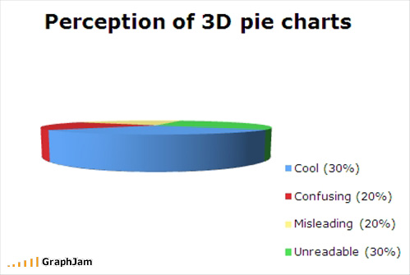
Perception vs Perspective

Slide 47
Guidance
Guidance

Slide 48
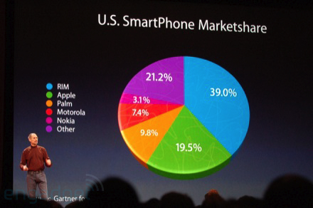
Chart Junk – 3d pies are a great way to deceive
2008 Macworld Expo via Engadget
Notes:
Chart-junk are the extraneous elements that don't represent the numbers and are detrimental to our understanding of the data.
The 3D distortion here is not only unnecessary, it actually makes it look like the iPhone has more market share than the “other” category.

Slide 49
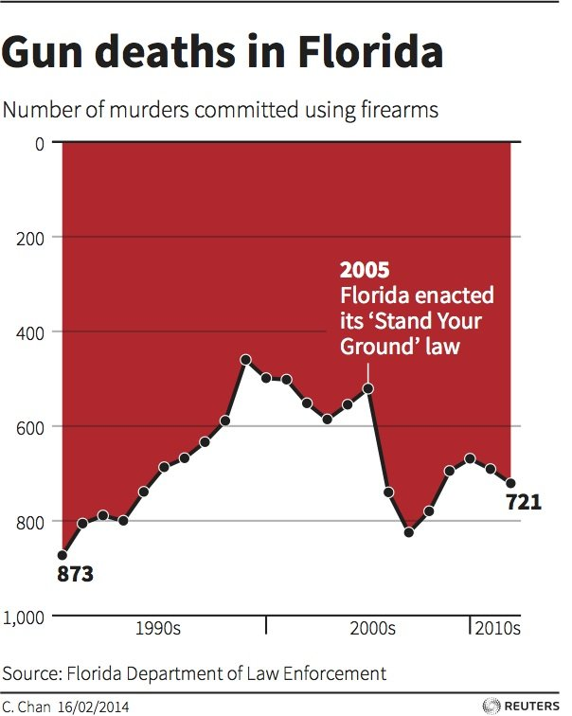
Chart Junk – you can lie with line charts too
Florida Dept of Law Enforcement via Reuters
Notes:
The “Stand Your Ground Law” authorises people to defend themselves with lethal force.
This chart switches the y-axis giving the impression that murders fell after the introduction of the law.
The author claimed it was a personal preference meant to evoke images of dripping blood.

Slide 50
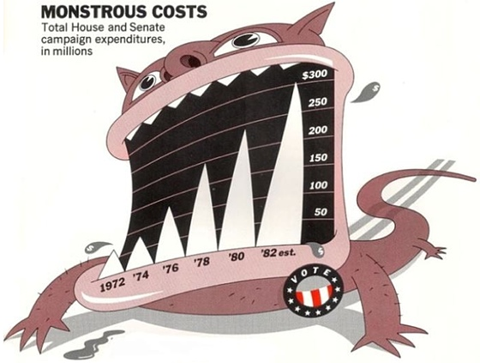
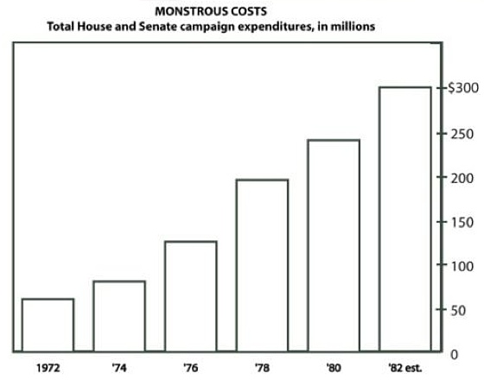
Chart Junk – improves memorability
Bateman et al (2010) Useful Junk? via eagereyes.org
Notes:
Nigel Holmes argues that data graphics must engage the readers interest.
Bateman et al published a study which concludes that participants were better able to recall Holmes-style charts 1-3 weeks later
Robert Kosara on eagereyes distinguishes 3 types of chart-junk: useful (infographics, annotations, explanatory text), harmless, and harmful

Slide 51
Data-Ink Ratio
Data-ink
Data-ink Ratio
=
Total ink used to print the graphic
proportion of a graphic’s ink devoted to the
non-redundant display of data-information
=
=
1 – proportion of graphic that can be erased
Tufte (1983) The Visual Display of Quantitative Information
Notes:
“A large share of ink on a graphic should present data-information, the ink changing as the data change.
Data-ink is the non-erasable core of a graphic, the non-redundant ink arranged in response to variation in the numbers represented”

Slide 52
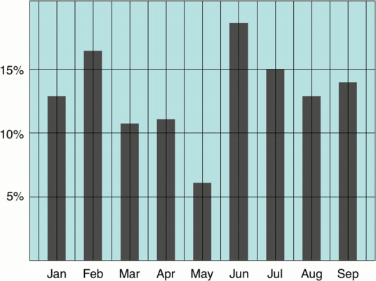
Data-Ink Ratio - Example
CC BY NC 2.0 Tim Bray
Notes:
“Erase non-data ink, within reason”
“Erase redundant data-ink, within reason”

Slide 53
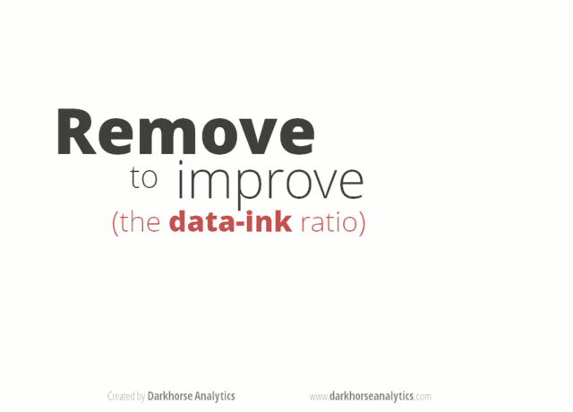
Data-Ink Ratio
http://darkhorseanalytics.com/blog/data-looks-better-naked/
Notes:
The problem is that some non-data ink can help by providing context – e.g. graphs axis lines.
Shouldn't forget the “within reason” part of Tufte's suggestions – even if he does.

Slide 54
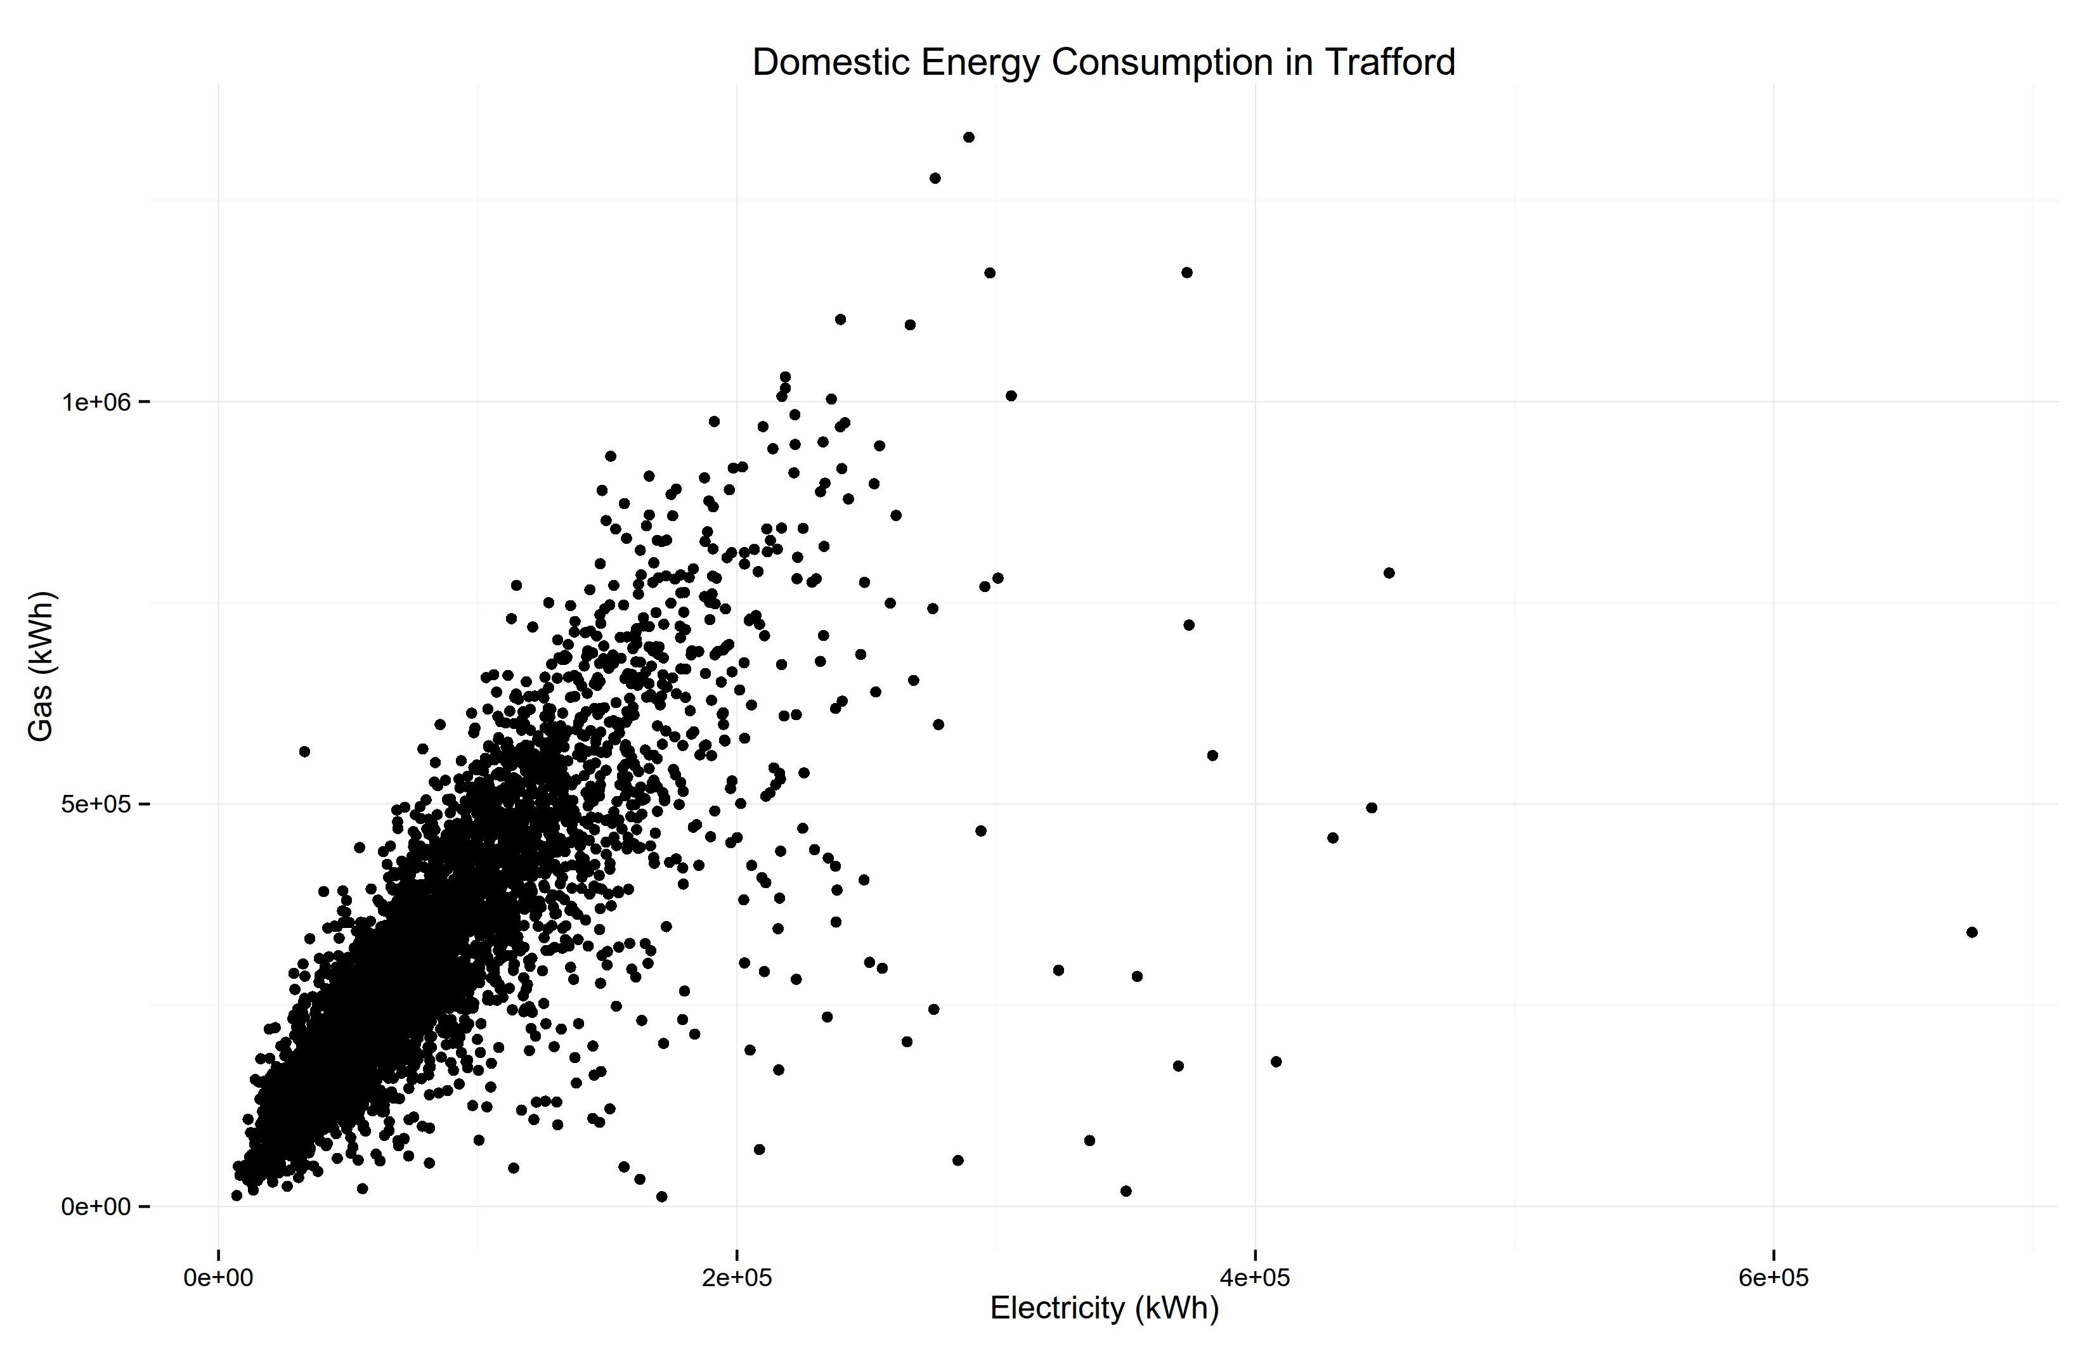
Over-plotting
Open Government License DataGM 2013

Slide 55
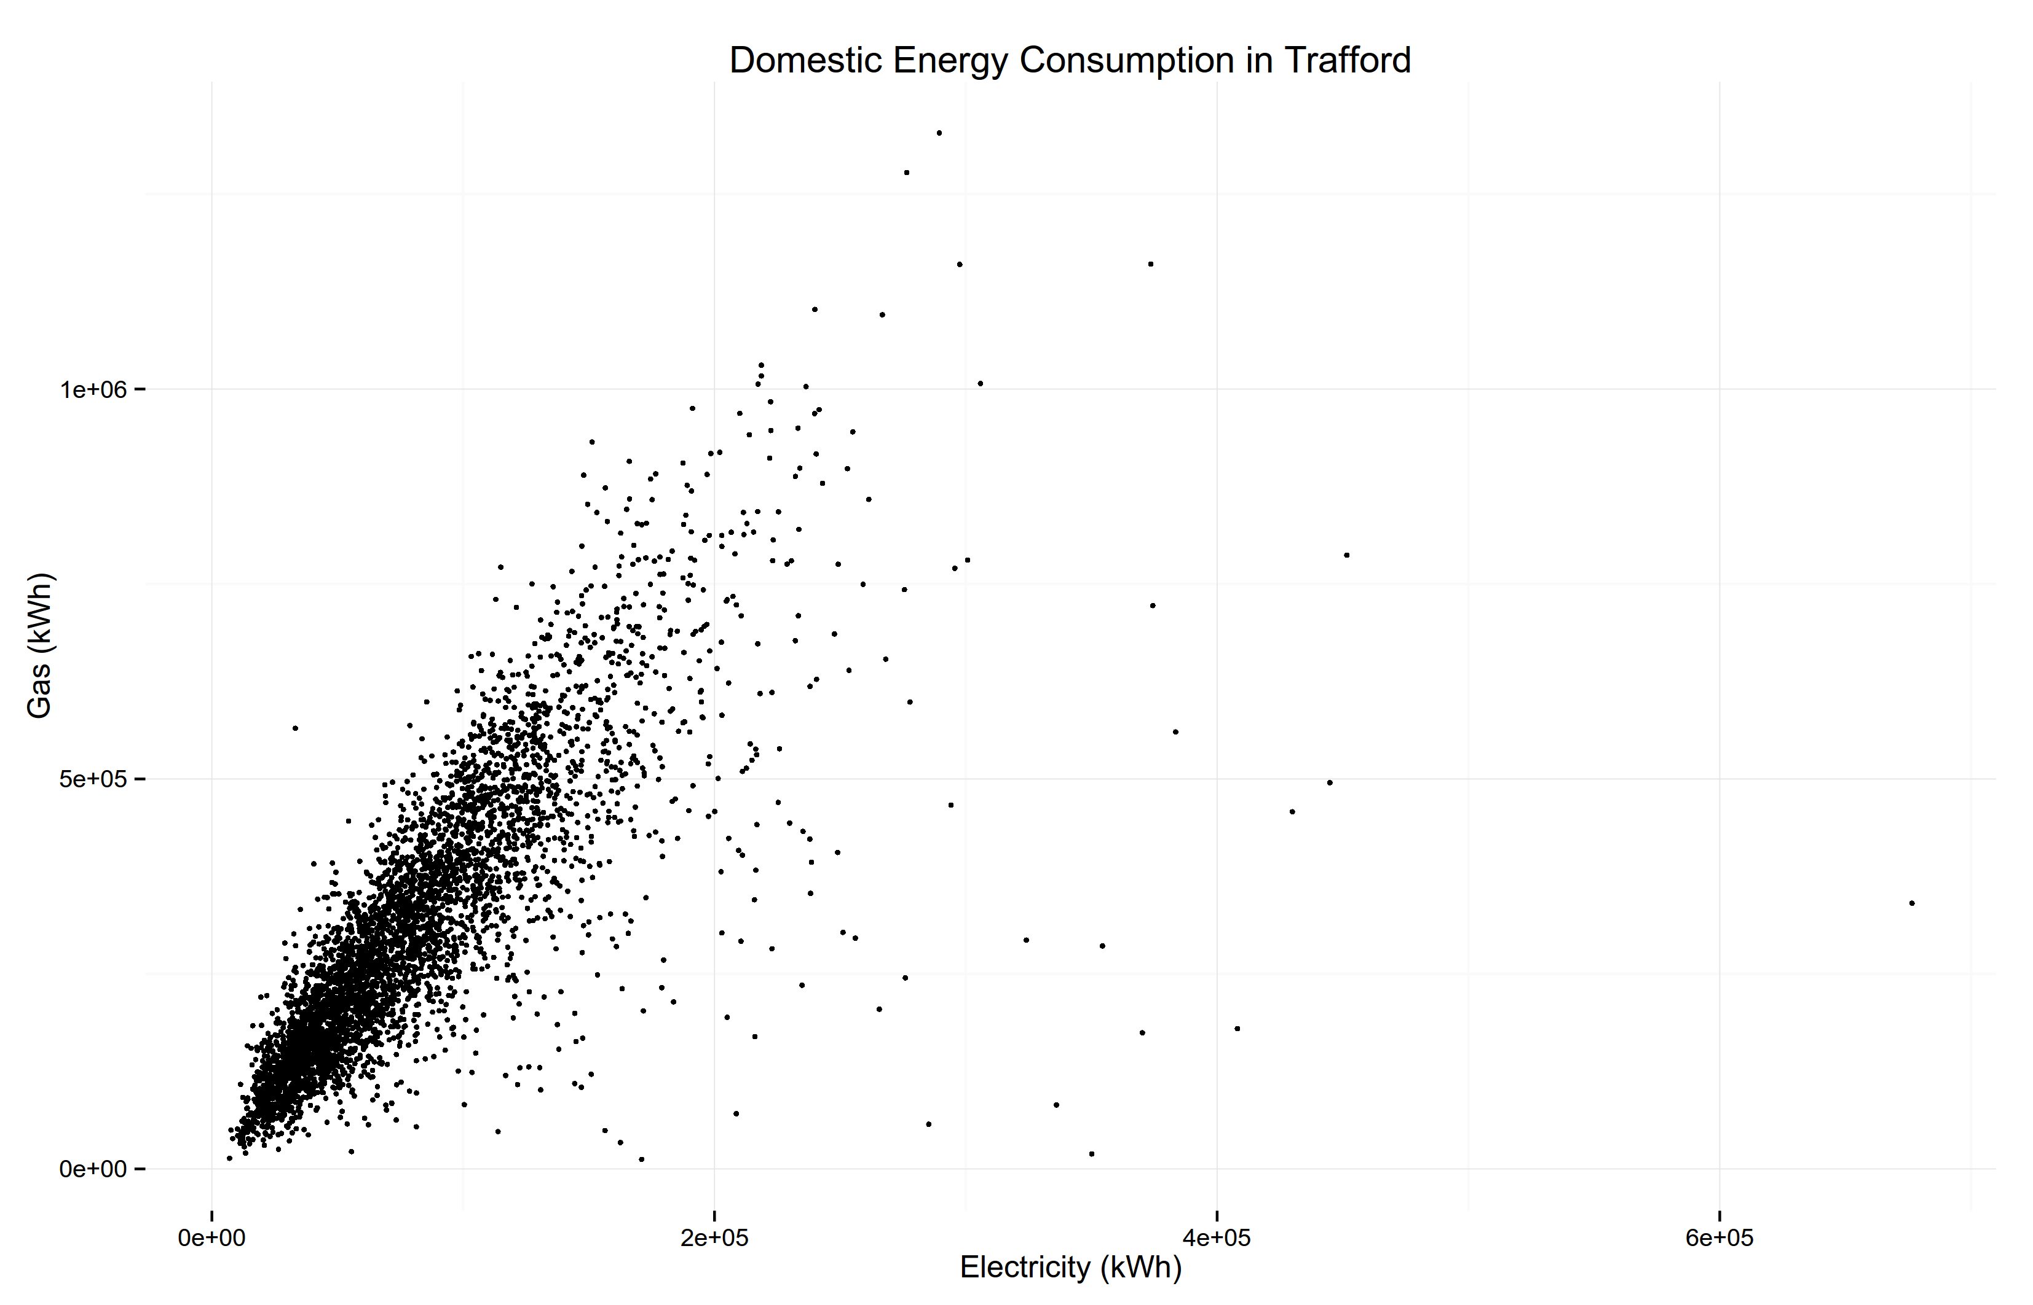
Over-plotting - smaller
Open Government License DataGM 2013
Notes:
Shrink the dots (but can't go far enough)

Slide 56
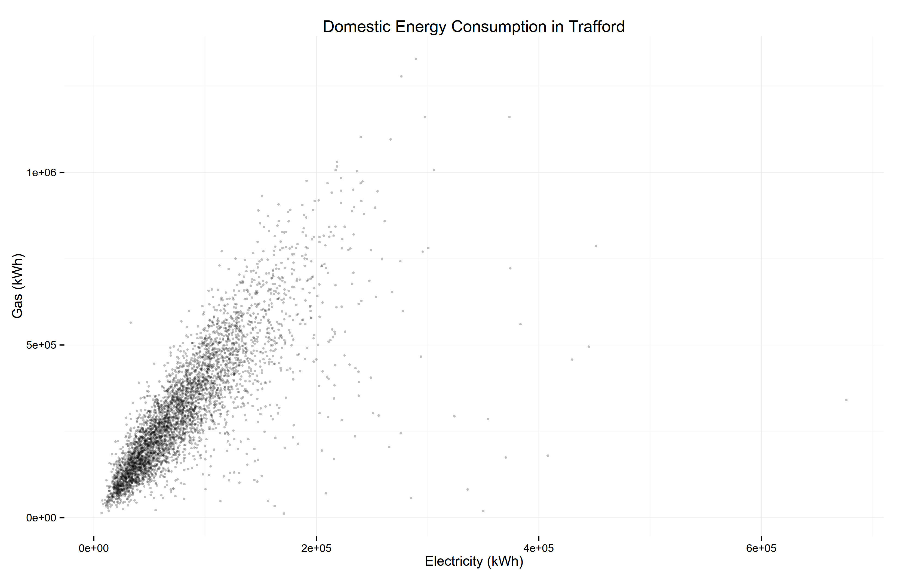
Over-plotting - transparency
Open Government License DataGM 2013
Notes:
Transparency leverages overplotting – higher contrast means more points
Still lose individual points and main bulk is concentrated in the corner

Slide 57
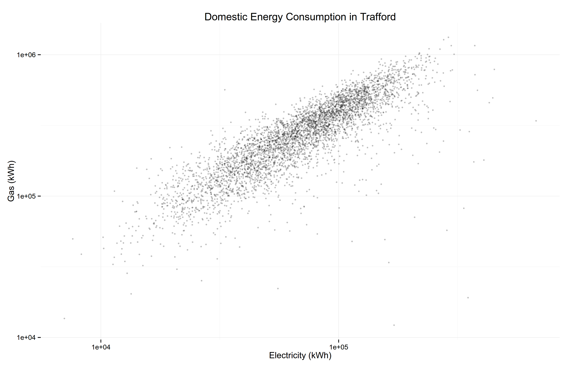
Over-plotting – logarithmic scale
Open Government License DataGM 2013
Notes:
Logarithmic scales stretch the point cloud out but are harder to interpret.
Note that the scales now start in different places.

Slide 58
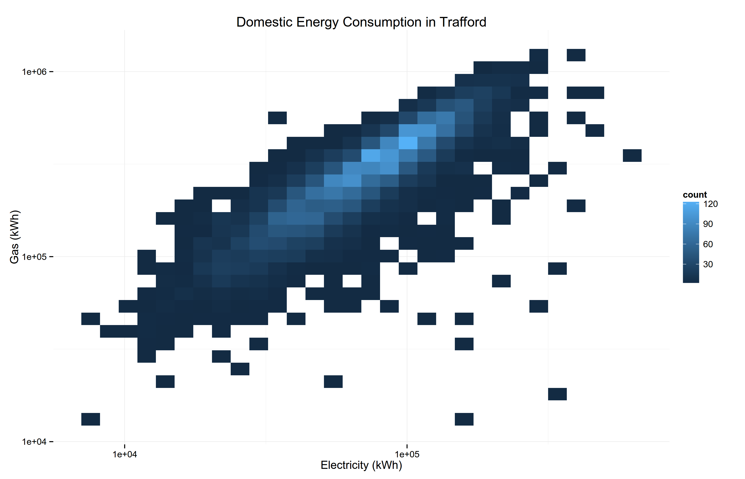
Over-plotting – binning
Open Government License DataGM 2013
Notes:
Binning allows us to fully represent overplotted points and outliers.

Slide 59
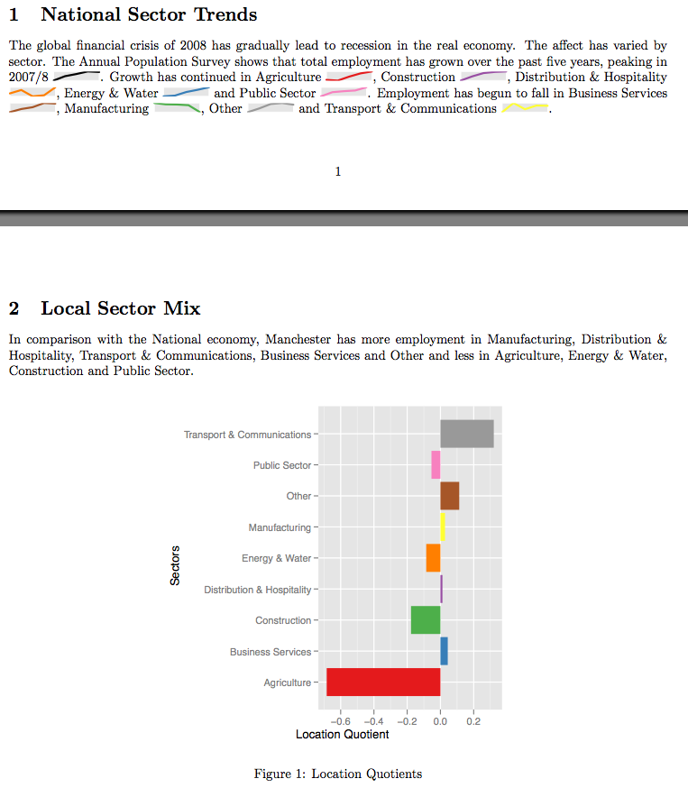
Sparklines
Robin Gower (2009) Infonomics AutoReporter
Notes:
Sparklines are small word-like charts
Sacrifice context by dropping scales and axes but are thus small enough to fit into paragraphs of text.
Useful for describing the shape of trends.

Slide 60
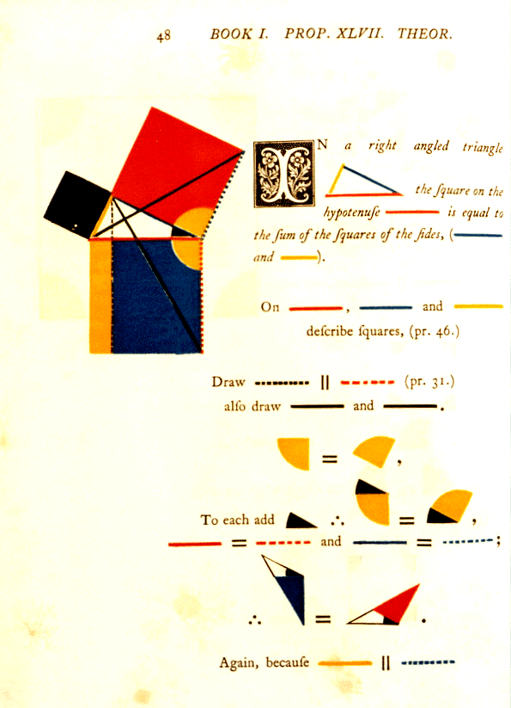
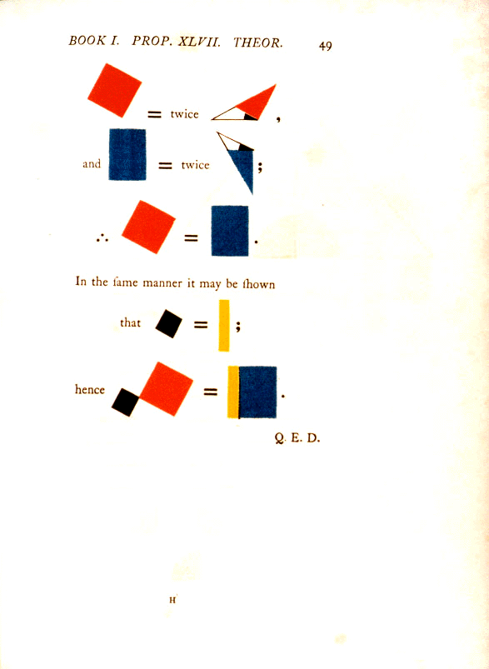
Oliver Byrne's Euclid 1847 (https://www.math.ubc.ca/~cass/Euclid/byrne.html)
Notes:
Delightful mix of images and text to visualise Euclids propositions of geometry

Slide 61
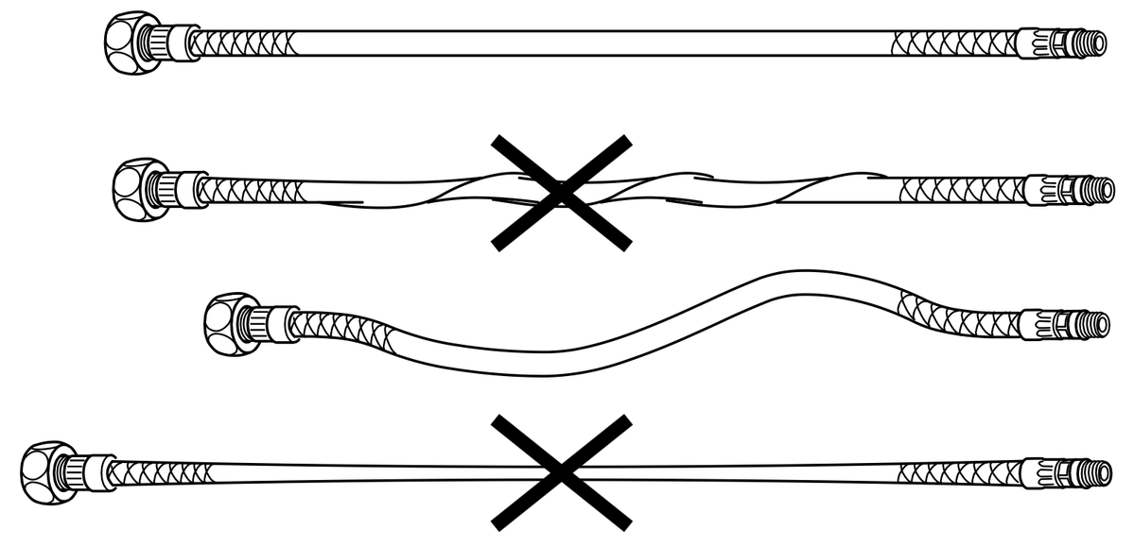
Small Multiples
IKEA discovered via Tufte twitter
Notes:
A group of similar charts using similar scales and axes to allow them to be compared.

Slide 62
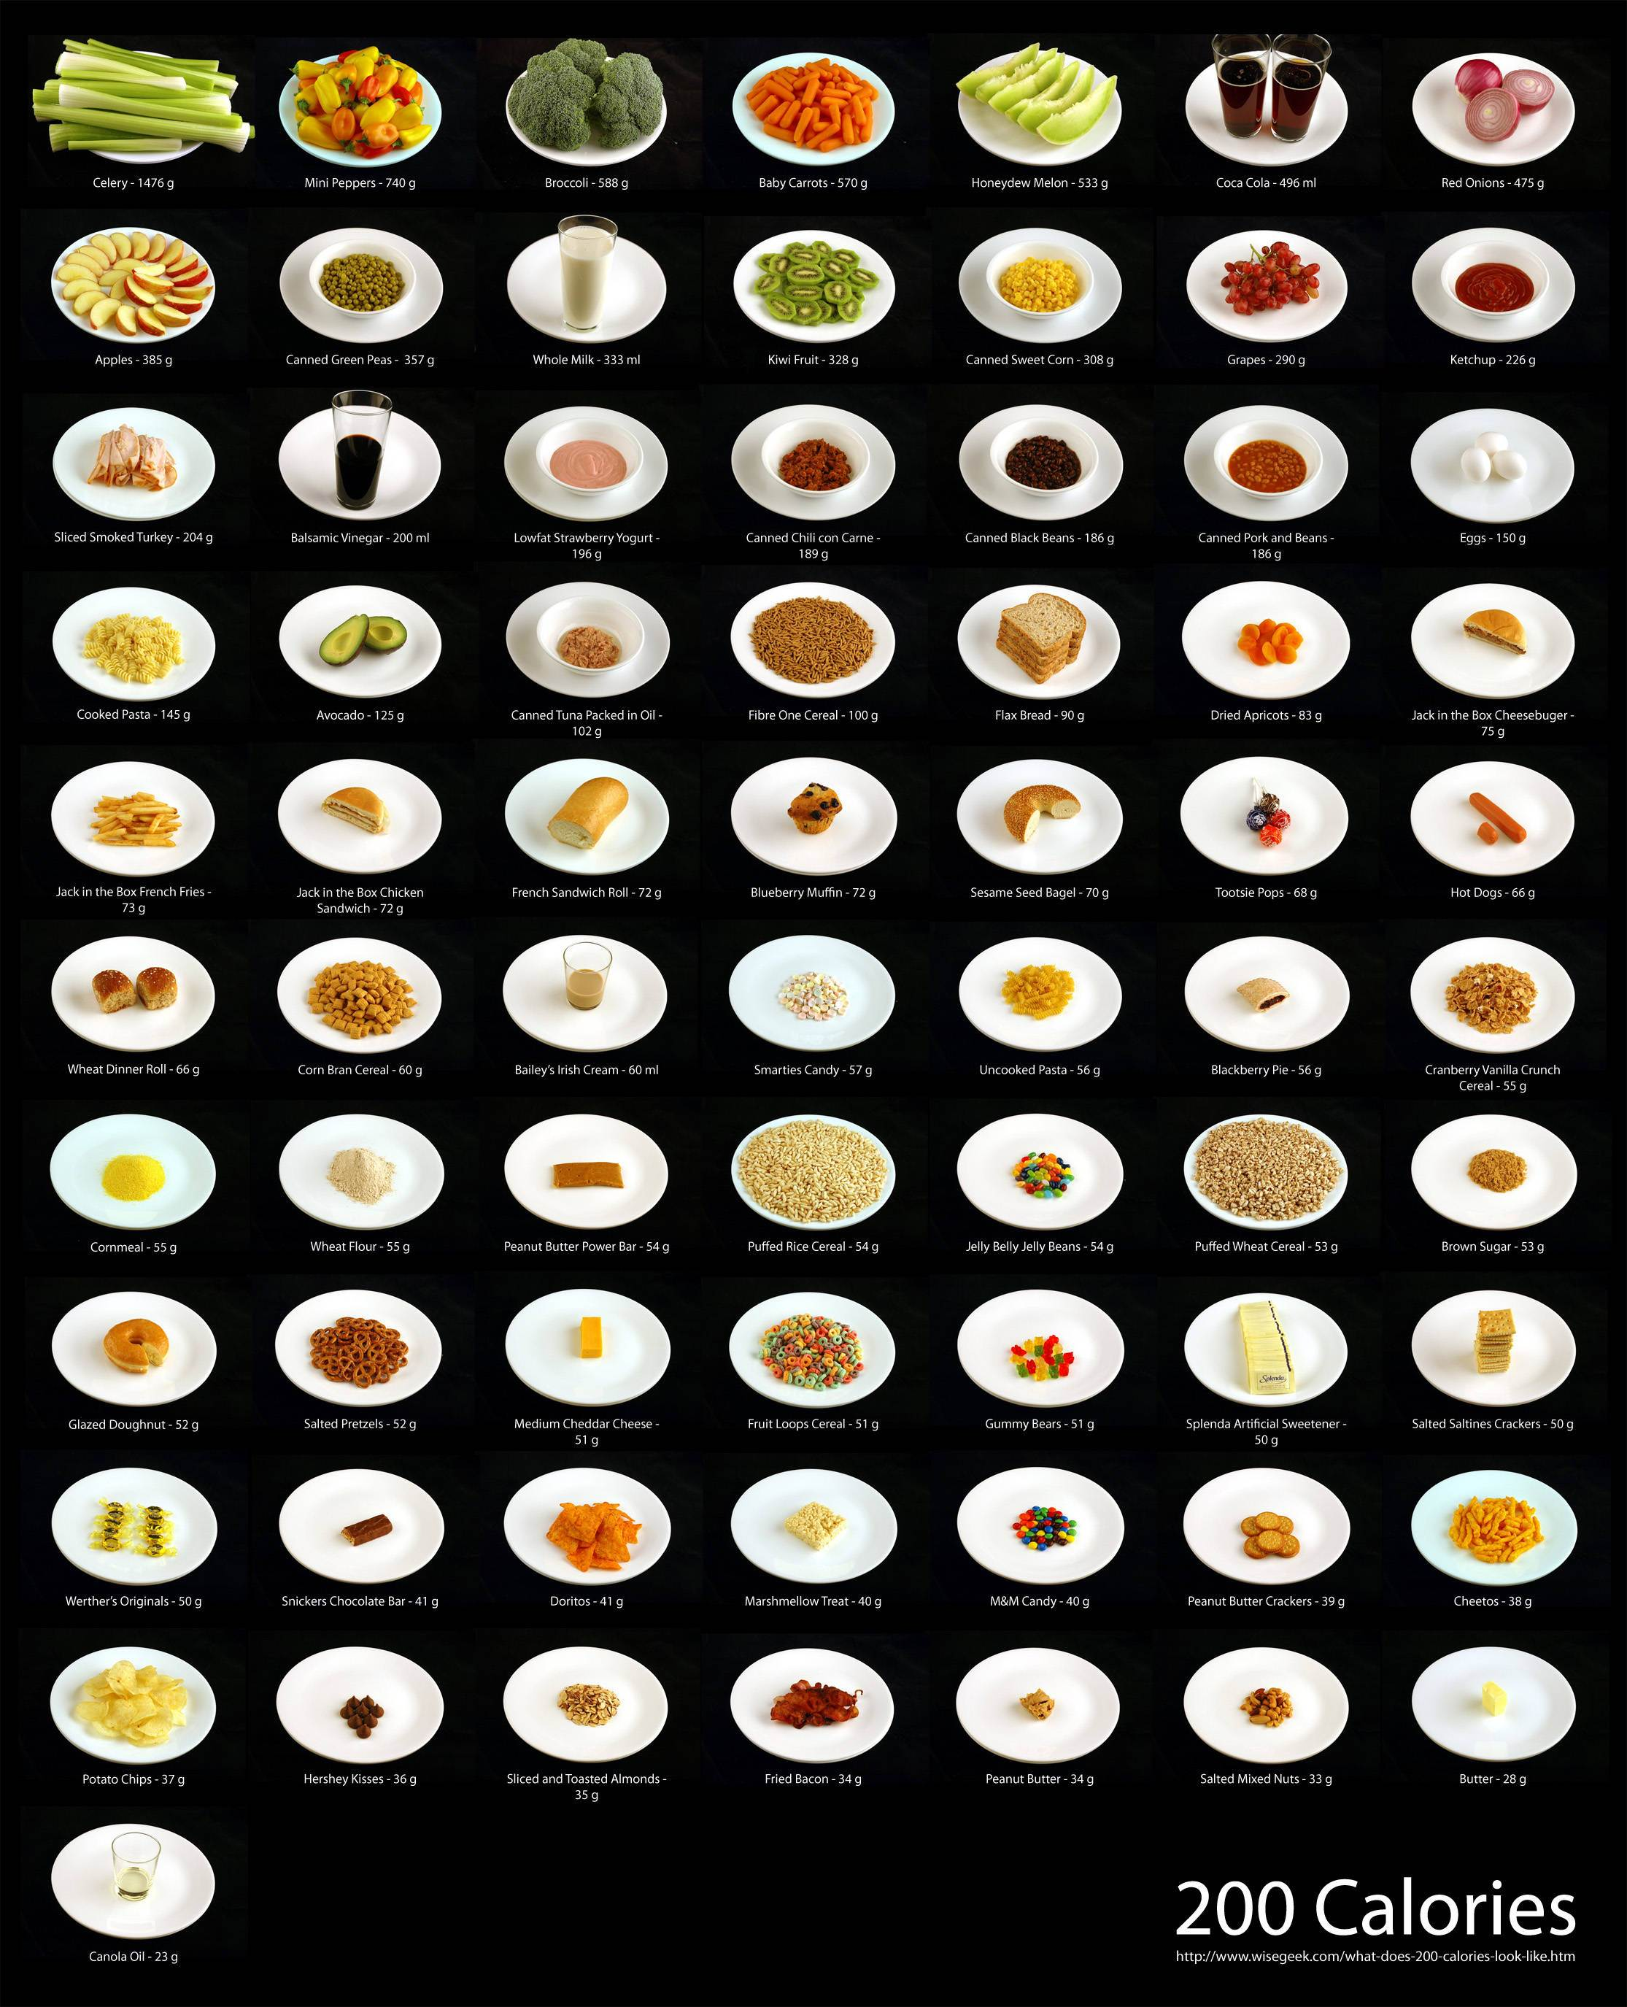
Small Multiples
200 Calories – wisegeek.com
Notes:
Comparable – each is 200kcal.
200kcal doesn't need to mean anything – each dish give context to all of the others.
Consistent plate size provides a scale with figure-ground effect: the more plate you can see, the higher the energy-per-volume.

Slide 63
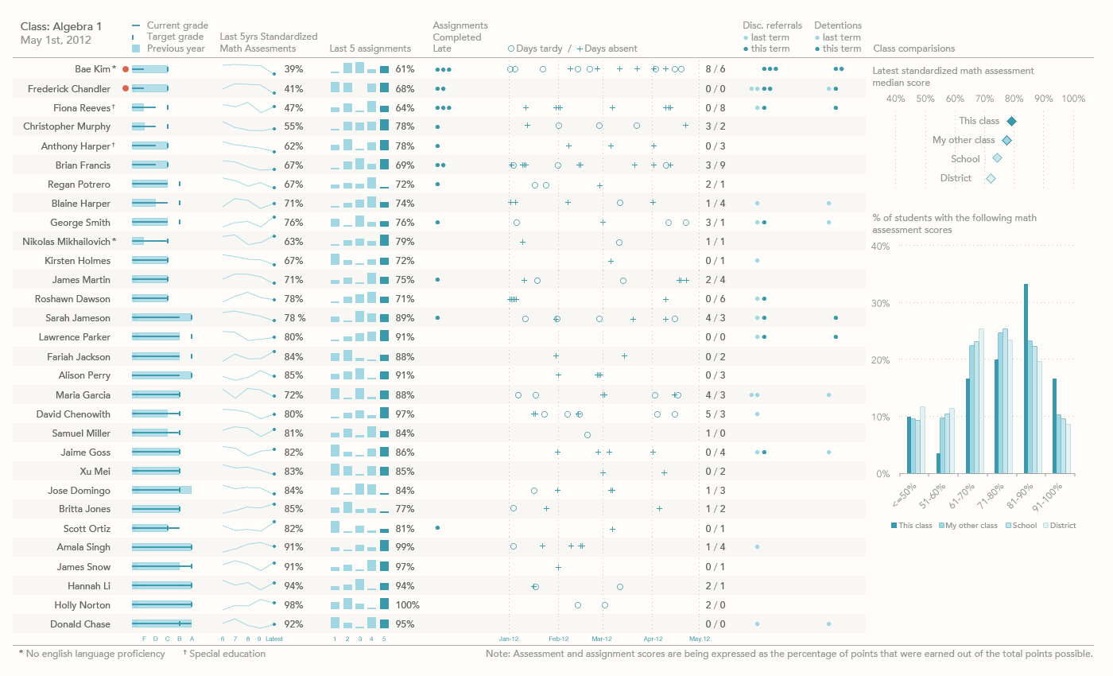
Jason Lockwood 2012 Perceptual Edge Competition Winner

Slide 64
Stop Making Pie Charts!
An opinionated guide to the
craft of data visualisation
Robin Gower
Open Data Manchester
30.06.15
infonomics.ltd.uk
@robsteranium

