Slide 1


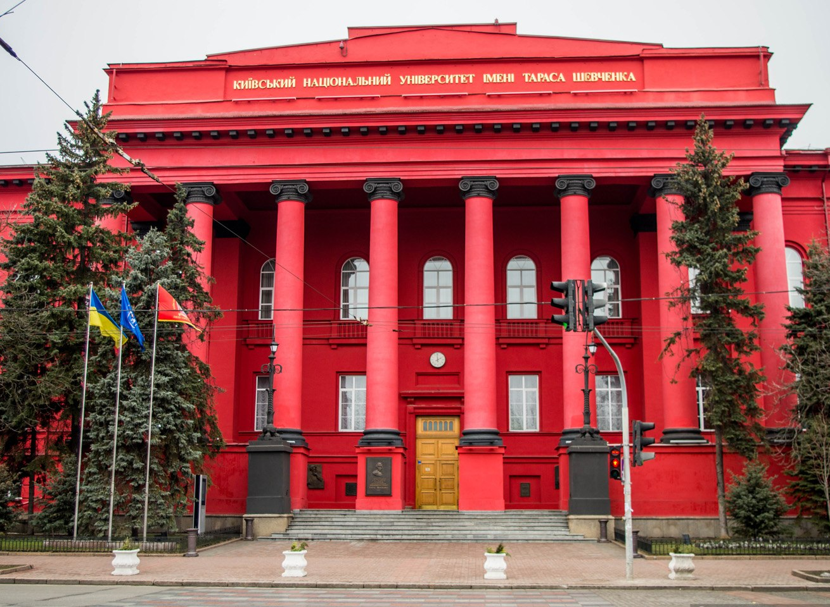


Dynamical System Modeling and Stability Investigation DSMSI-2025
AUTOMATIC IDENTIFICATION OF MUSICAL INSTRUMENTS
Student: Volodymyr Kuz
Scientific Supervisor: Dr. Andrii Shatyrko, Associate Professor, DSc in Physics and Mathematics
Taras Shevchenko National University of Kyiv
May 08-10, 2025, Kyiv, Ukraine

Slide 2
Introduction
The goal of this study was to investigate whether traditional spectral analysis methods combined with machine learning can achieve reliable classification of musical instruments. We expected that even with simple models, careful feature extraction would lead to high accuracy in recognizing solo instruments — which is important for music classification, retrieval, and automatic annotation.
Problem Statement: Given a musical piece, it is required to develop a program that can classify the musical instruments present in it.
Dynamical System Modeling and Stability Investigation, DSMSI-2025

Slide 3
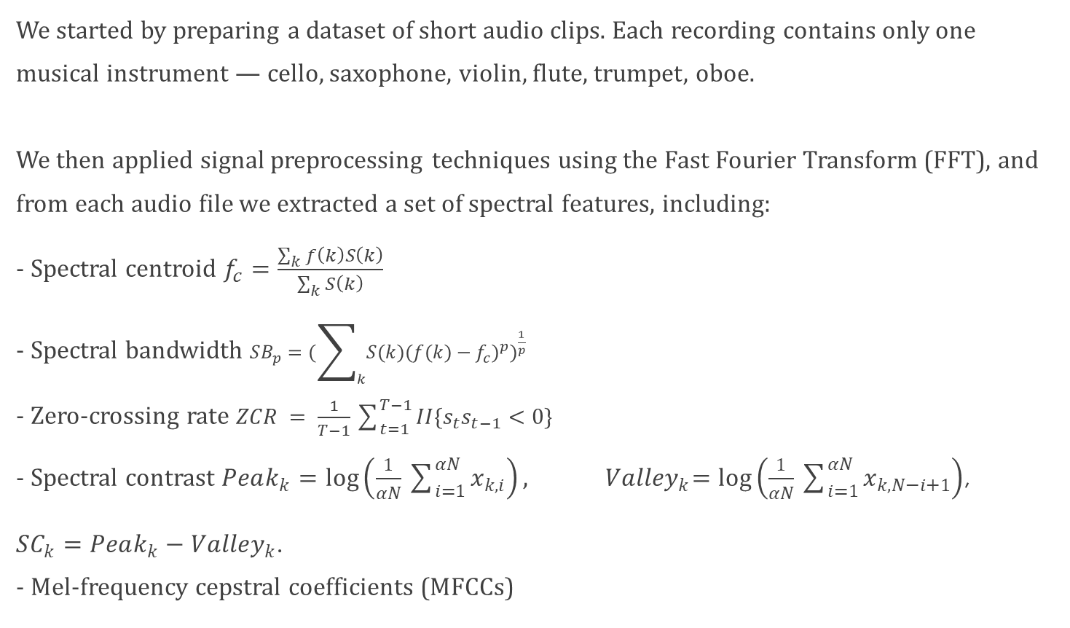
Dataset and Preprocessing
We started by preparing a dataset of short audio clips. Each recording contains only one musical instrument — cello, saxophone, violin, flute, trumpet, oboe. We then applied signal preprocessing techniques using the Fast Fourier Transform (FFT), and from each audio file we extracted a set of spectral features, including: - Spectral centroid $f_{c}=\frac{\sum_{k}{f\left(k\right)S\left(k\right)}}{\sum_{k}{S\left(k\right)}}$ - Spectral bandwidth $SB_{p}=(\sum_{k}{S(k){{(f(k)−f_{c})}^{p})}^{\frac{1}{p}}}$ - Zero-crossing rate $ZCR = \frac{1}{T−1}\sum_{t=1}^{T−1}{II\{s_{t}s_{t−1}<0\}}$ - Spectral contrast $Peak_{k}=log\left(\frac{1}{αN}\sum_{i=1}^{αN}{x_{k,i}}\right), { Valley}_{k}=\log\left(\frac{1}{αN}\sum_{i=1}^{αN}{x_{k,N−i+1}}\right)$,
$SC_{k}=Peak_{k}−Valley_{k}$. - Mel-frequency cepstral coefficients (MFCCs)

Slide 4
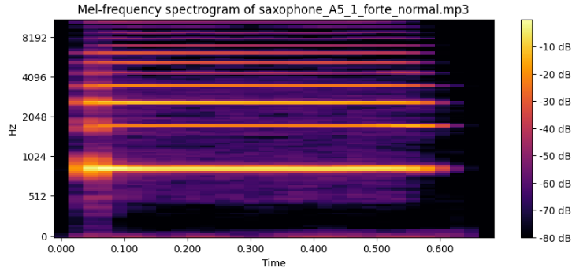
Figure: 1 Spectrogram

Slide 5
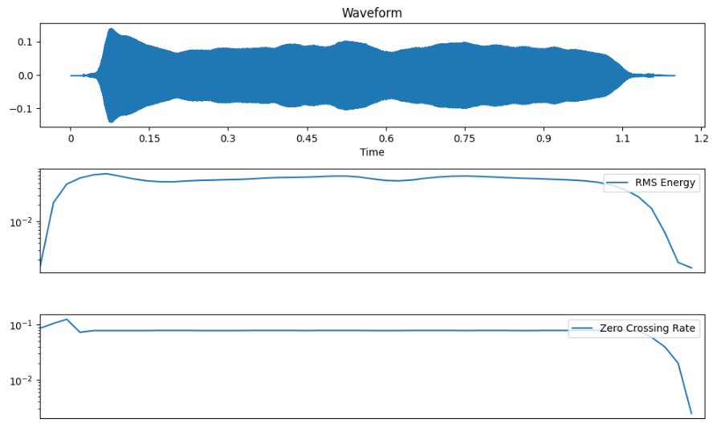
Figure: 2 Spectral characteristics

Slide 6
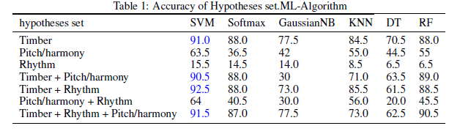
Models and Training
After extracting all the spectral features necessary for training the model, we face the final—and perhaps the most interesting and challenging—task: applying a machine learning algorithm to train the model using a dataset of musical pieces.
Figure: 3 Algorithms comparison

Slide 7
Approximate Nearest Neighbor (ANN)
The approximate nearest neighbor algorithm returns data points whose distance from the query point does not exceed more than a factor of C compared to the distance to the exact nearest neighbors. The strength of this approach lies in the fact that, in many practical cases, an approximate nearest neighbor is almost as effective as an exact one. In particular, when the distance metric accurately reflects the user's notion of similarity or quality, small differences in distance become negligible.

Slide 8
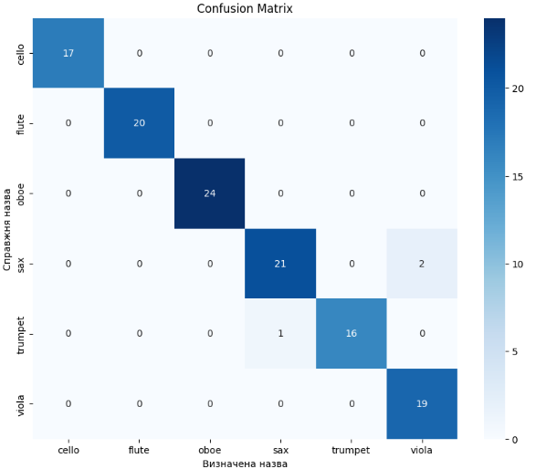
Figure: 4 ANN result

Slide 9
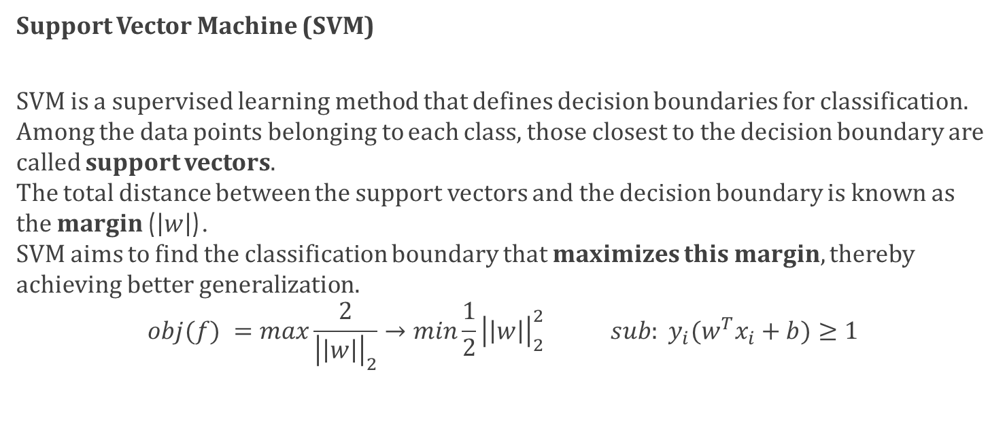
Support Vector Machine (SVM)
SVM is a supervised learning method that defines decision boundaries for classification. Among the data points belonging to each class, those closest to the decision boundary are called support vectors. The total distance between the support vectors and the decision boundary is known as the margin ($\left|w\right|$). SVM aims to find the classification boundary that maximizes this margin, thereby achieving better generalization.
$$obj(f) =max\frac{2}{{\left|\left|w\right|\right|}_{2}}→min\frac{1}{2}{\left|\left|w\right|\right|}_{2}^{2 } sub: y_{i}(w^{T}x_{i}+b)≥1$$

Slide 10
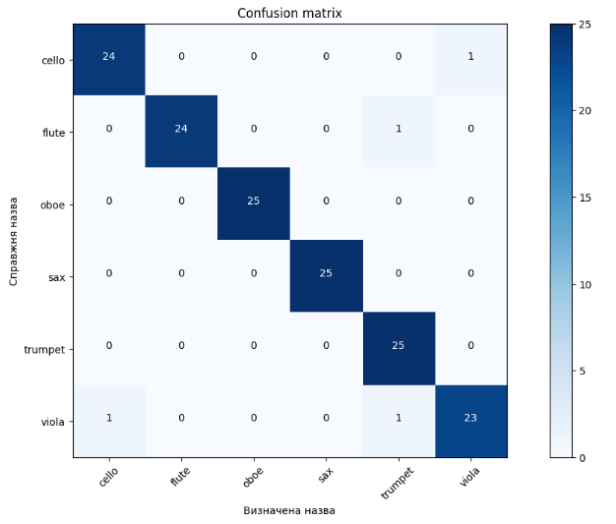
Figure: 5 SVM result

Slide 11
Results and Comparison
ANN accuracy: 97.5%
SVM accuracy: 97%
Model choice not critical – both performed well
Feature quality was key to high accuracy

Slide 12
Discussion and Future Extension
Based on this foundation, we can now move toward more complex applications.
Apply pipeline to the recognition of military vehicles and equipment from battlefield audio.
Of course, this introduces many new challenges: - High levels of noise - Low-quality or corrupted recordings - Very limited training datasets
Needs: source separation, noise filtering, data augmentation.
Potential for defense and military applications.

Slide 13
Thank you for your attention

