Slide 1


Project Discussion: Adult census income
Samuele Ramassone
Katiuscia Pellone
Roberto Di Stefano

Slide 2
Outline
Dataset description
Data cleaning and preprocessing
Descriptive analysis
Unsupervised learning
Supervised learning
Conclusions

Slide 3
Dataset
Dataset was initially splitted in training and testing set, respectively:
Training set: 32560 rows x 15 features
Test set: 16281 rows x 15 features
The Adult dataset is from the Census Bureau and the task is to predict whether a given adult makes more than $50,000 a year based attributes such as education, race, age, ecc...

Slide 4
Dataset
Dataset on US population in 1994
Features are both continuous and categorical, e.g. :
Age, hours-per-week are continuous;
Race, sex, workclass are categorical.
This implies the need to encode the data to bring it all into the same domain
The dataset is unbalanced, in fact the 75% of the income observations is equal to "<=50K".

Slide 5
Data cleaning
We delete the rows which contains duplicates or insignificant values, in our case, the ones with the '?' ;
We drop also useless features:
Fnlwgt ( final weight );
Education;
Capital-gain;
Capital-loss

Slide 6
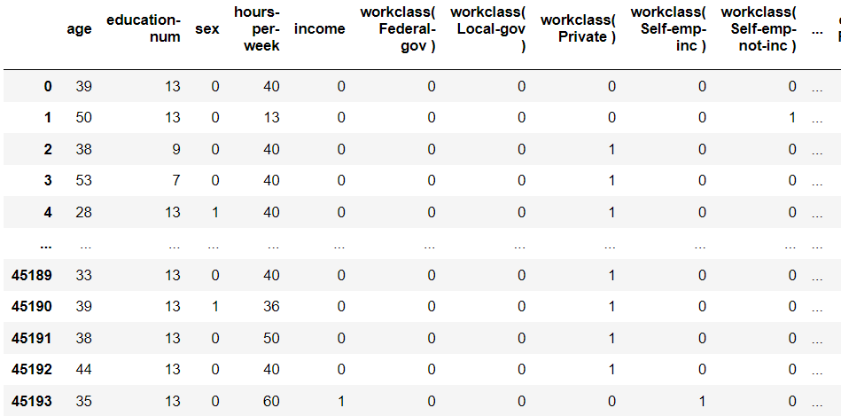
Preprocessing
We converted categorical binary features (sex and income) into binary values
The categorical values are converted into binary vectors using the OneHotEncoding

Slide 7
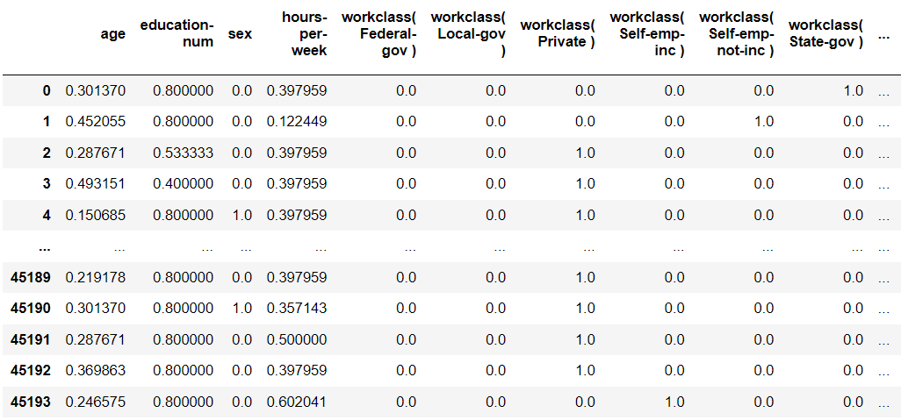
Preprocessing
Before the analysis we normalize the data, for reducing the dependence of the unit of measure, we have done this with the MinMaxScaler

Slide 8
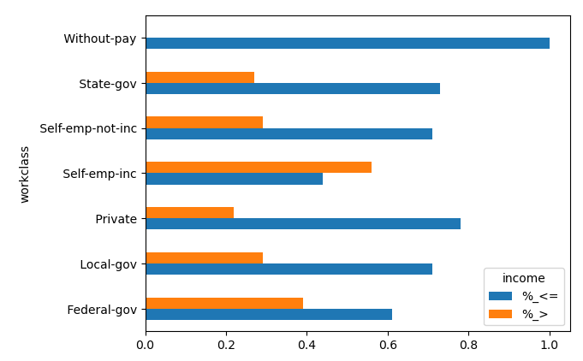
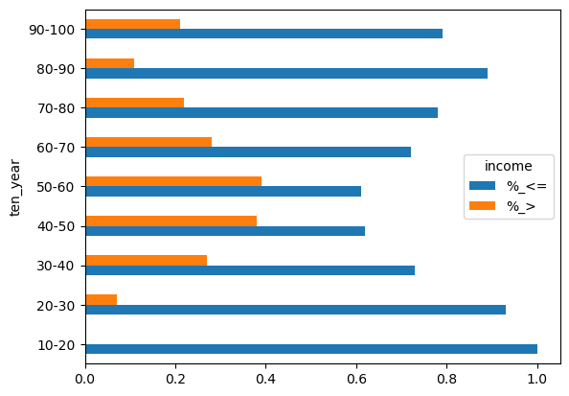
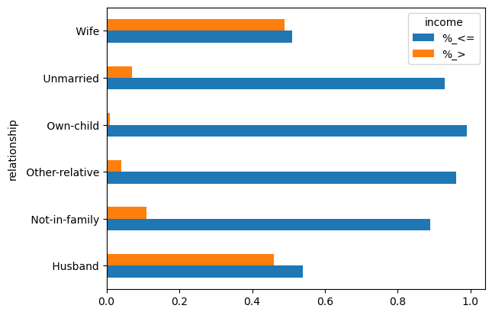
Descriptive Analysis
Thanks to the left histogram we detected that the feature "relationship" gave us redundant informations, that are yet detected by sex and marital-status

Slide 9
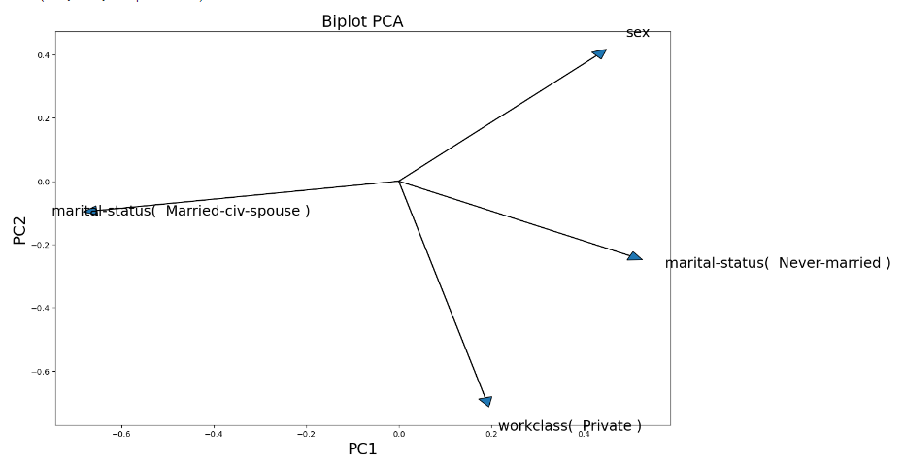
Unsupervised learning
Principal Component Analysis (PCA)

Slide 10
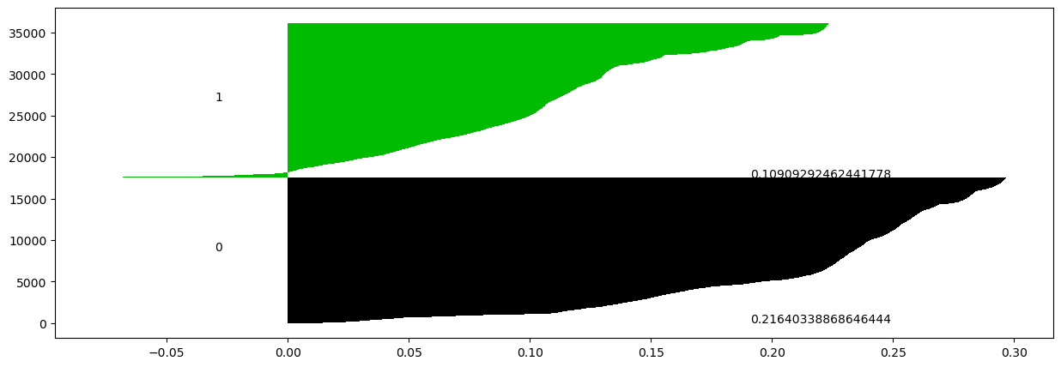
Unsupervised learning
Silhoulette plot of the Clusters

Slide 11
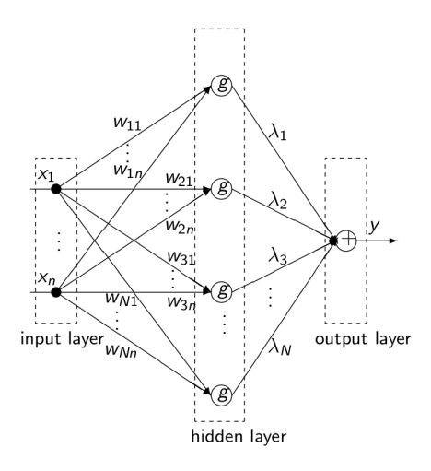
Supervised learning
We used several models:
MLPClassifier
Decision Tree
Random Forest
Logistic Regression

Slide 12
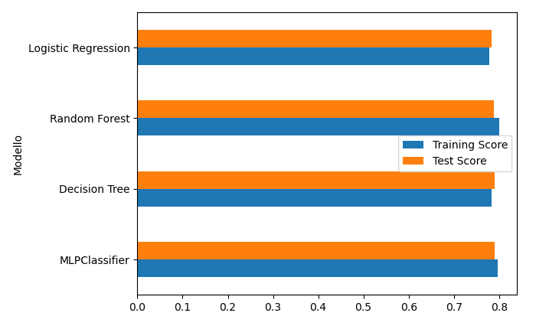
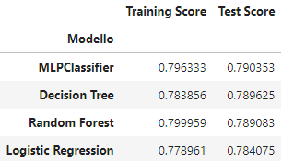
Supervised learning
The performances are all very similar :
Being the dataset unbalanced, the accuracy is evaluated through Balanced Accuracy

Slide 13
Conclusions
In unsupervised learning, measuring the low silhouette value we can see that the data is not very clusterizable
In supervised learning we can see that there is no overfitting and the result obtained with the different models are similar around 80% of accuracy

Slide 14
Grazie per l’attenzione

