Slide 1
ETL of Youtube Videos
Group Members:
Ludan Zhang
Yuan Zhong
John Stauffer
Bryan Carro

Slide 2
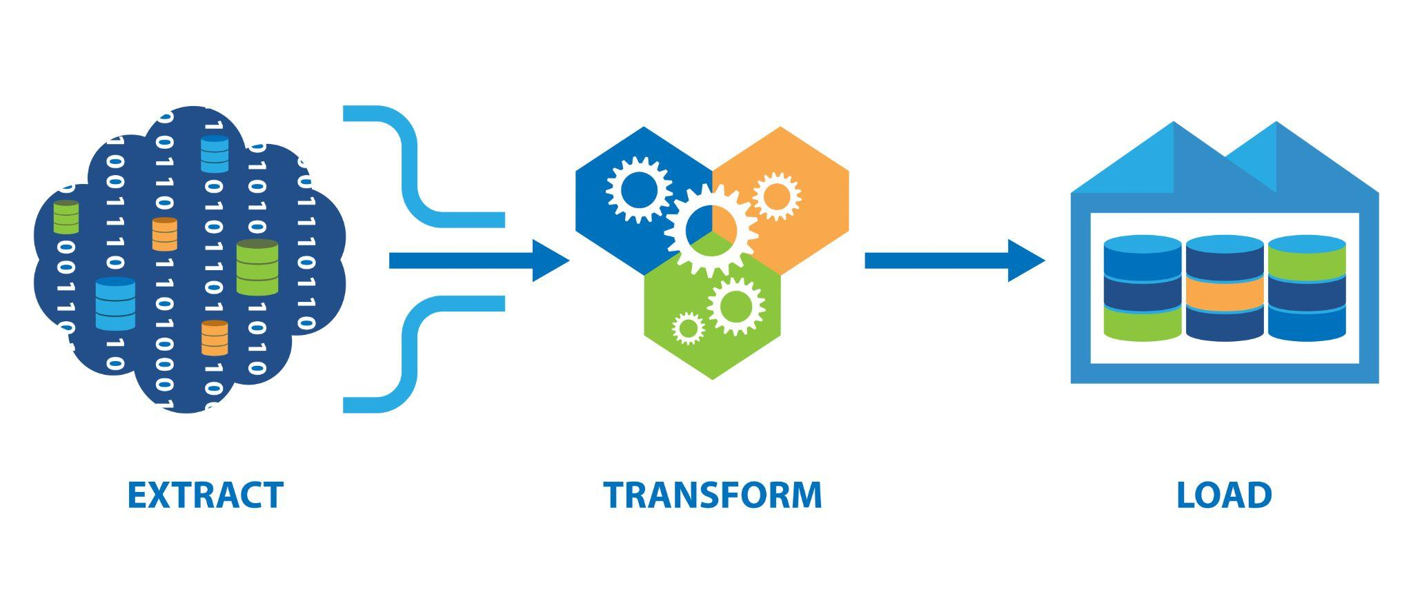

Dataset
Perform Extract → Transform → Load
Two datasets obtained in Kaggle
Top Trending Youtube Videos in the US
One CSV
One JSON
Notes:
- Select a data sets with sufficient data to perform Extract → Transform → Load
-Youtube is a popular website with a lot of data available to perform analysis
- We found two datasets on Trending Youtube Videos of 2017 (we found the datasets in Kaggle)

Slide 3
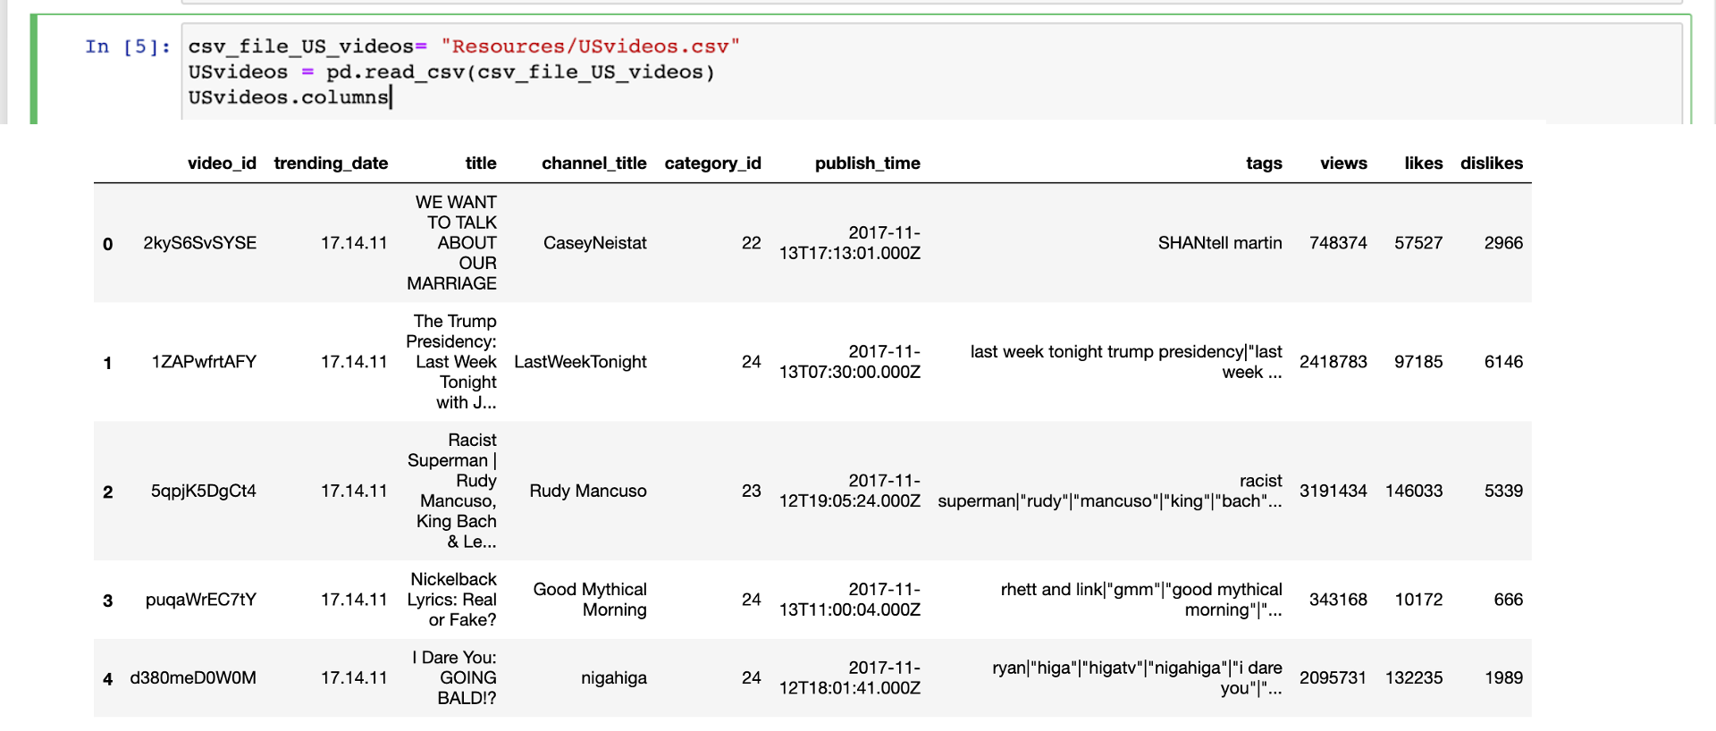
Read in the USvideos.csv file into DataFrame
Index(['video_id', 'trending_date', 'title', 'channel_title', 'category_id', 'publish_time', 'tags', 'views', 'likes', 'dislikes', 'comment_count', 'thumbnail_link', 'comments_disabled', 'ratings_disabled','video_error_or_removed', 'description'], dtype='object')
Notes:
The first dataset we are working with is a csv file that contains top trending youtube videos in the United States.

Slide 4
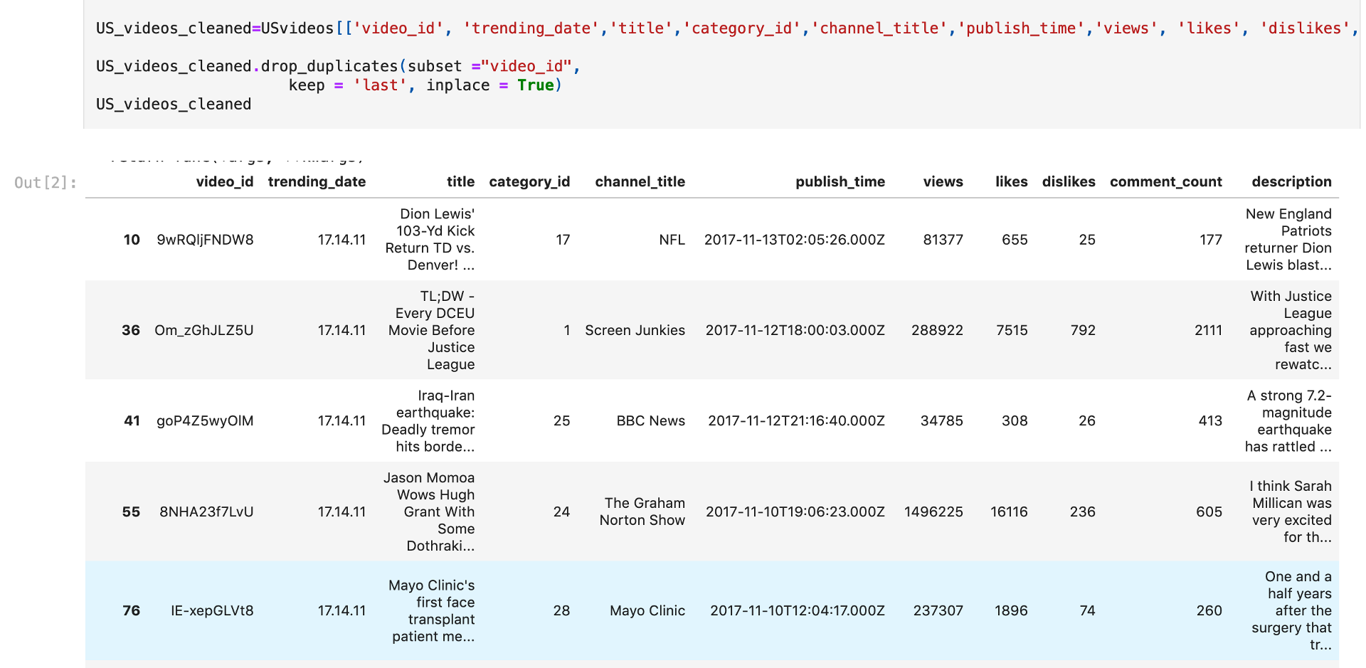

Slide 5
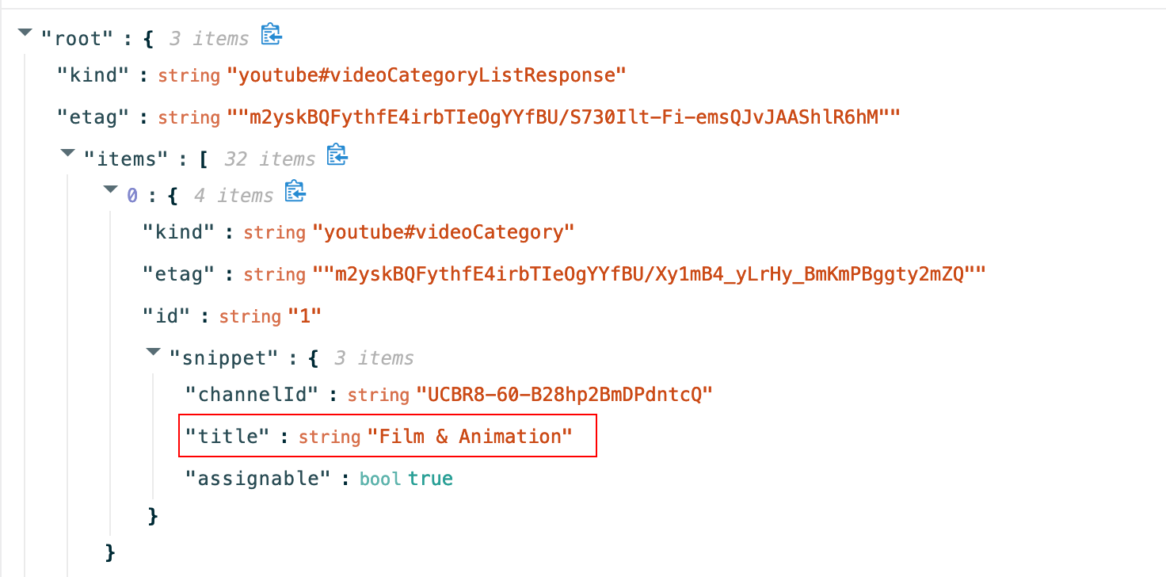
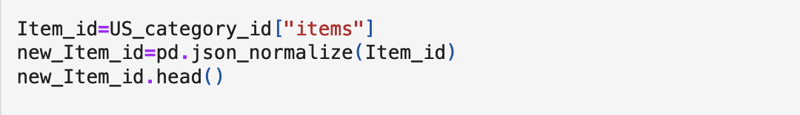

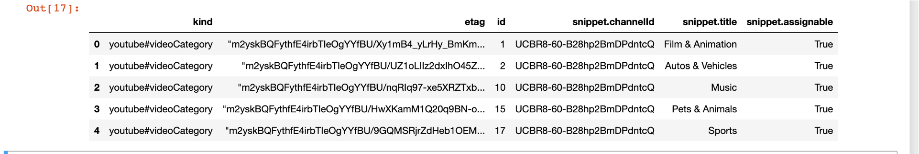
Flatten the json file
Pandas.json_normalize()

Slide 6
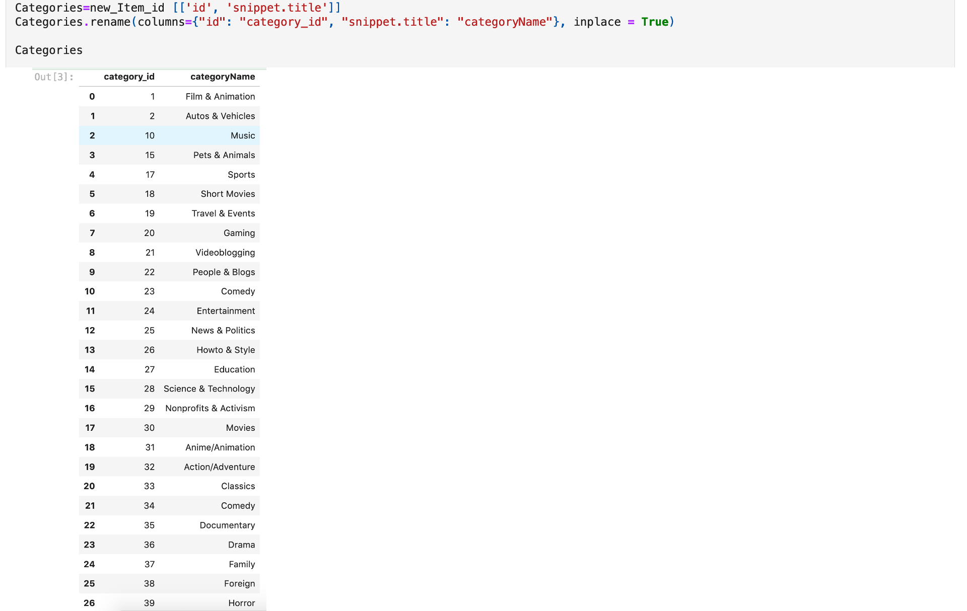

Slide 7
Data Cleaning
Normalize nested Json file to get the desired data
Convert data type
Join two tables together
Get rid of the undesired columns

Slide 8



Data Loading
Import “create_engine”
Create table in PostgreSQL using the same column name
Connect to PostgreSQL from Jupyter notebook
Push dataset to the PostgreSQL table

Slide 9
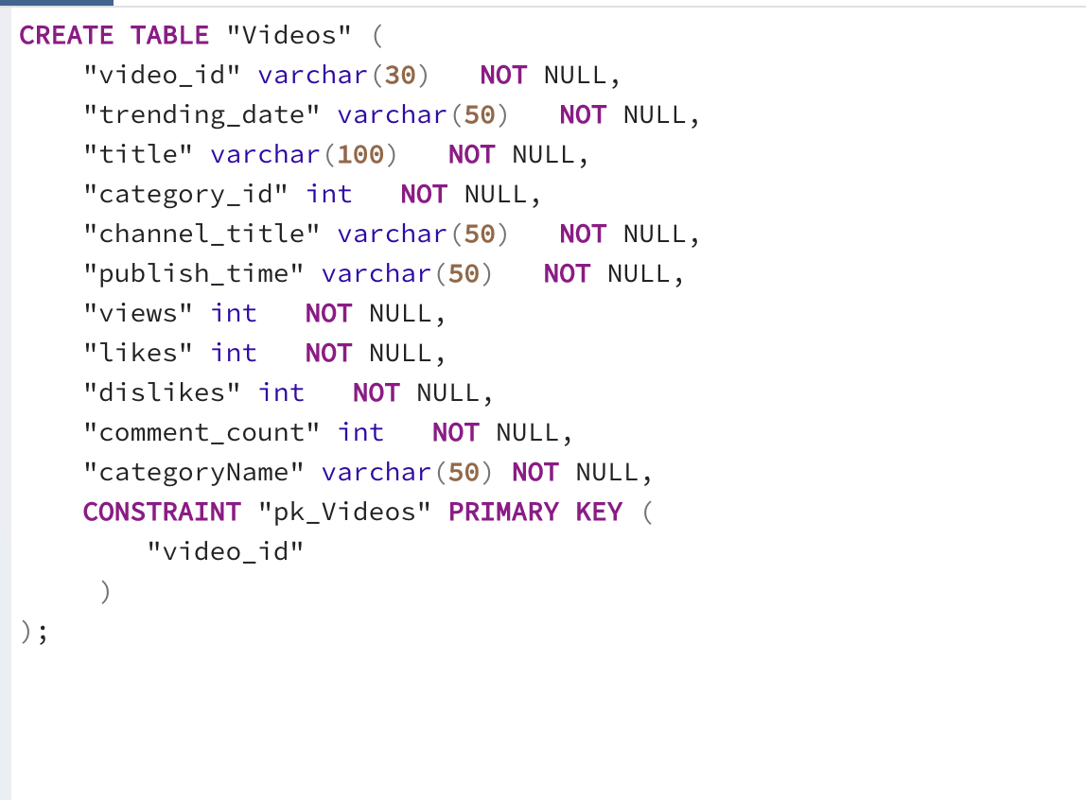
Table Creation
Created two tables
Used text data type for the description so there was no limit on long descriptions

Slide 10
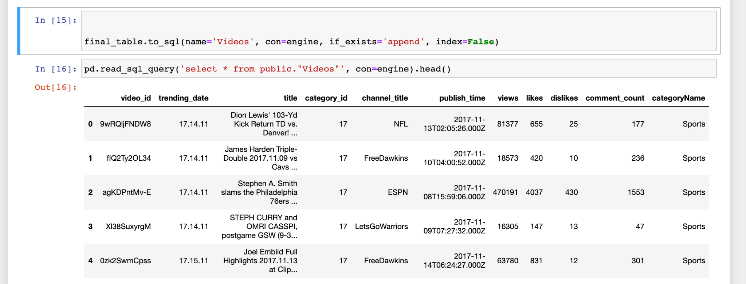
Loading to SQL
Notes:
We loaded the pandas file to postgres

Slide 11

Analysis
Data Analyst will be able to perform various analysis such as
Differences between video categories
Correlation between likes and views
Average views of trending videos
Relationship between Published Month and Average View
Notes:
Music Category is the most popular

Slide 12
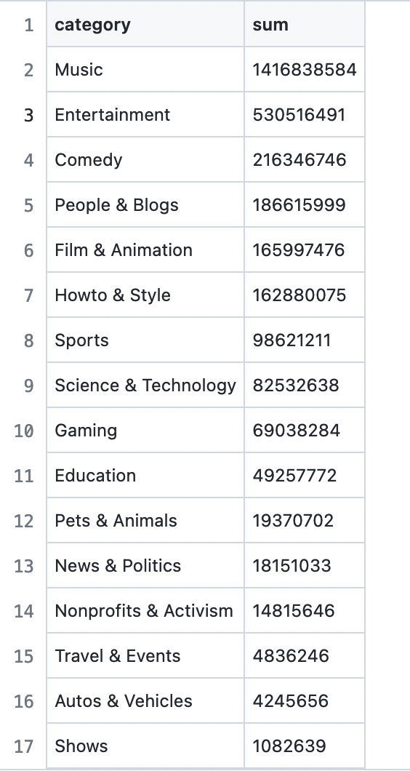
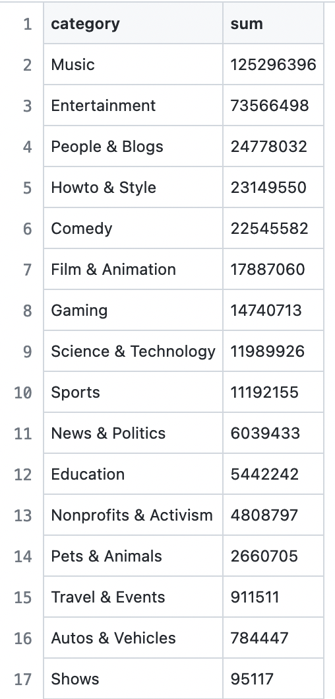
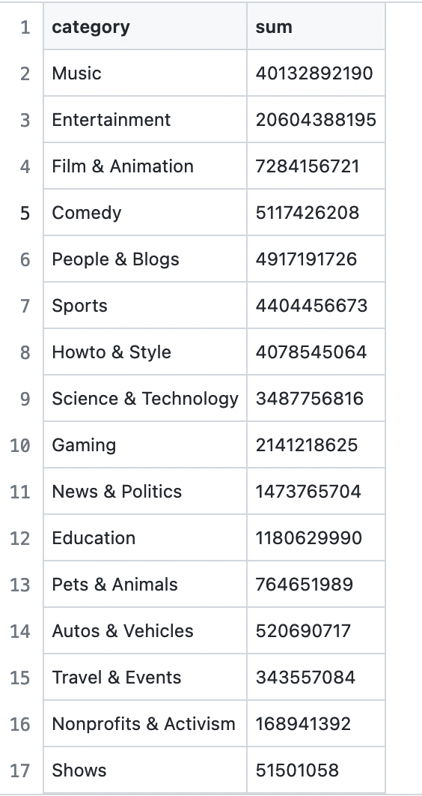

Slide 13
Questions?

