Slide 1

CLASSIFYING BUSINESS VS PERSONAL TWEET
By TEAM
HACKTION

Slide 2

PROBLEM DESCRIPTION
To classify the tweet as either business or personal tweet.
A person may tweet both about business and personal.
Twitter has a lot of audience around 317 million users.
Also the tweets are in multiple languages.

Slide 3


Tools used
Python Packages
Naïve Bayes Classifier
Django
Tweepy
Bootstrap – open source library for UI

Slide 4

gist
Collecting tweets for processing
Pre-processing the tweets
Passing the pre-processed tweets to train the classifier
Collecting test data – tweets to test if it is personal or business
Passing the test data into trained classifier for processing
Classifying the tweets and calculating accuracy.

Slide 5

More on classifier …
Naïve Bayes Classifier is used to classify the tweets as personal or business
Naïve Bayes Classifier relies on the classic NLP concept called Bag of words.
The list of words that occur in the training set are collected.
The list is associated with number of times it occurs.
The classifier predicts the test data based on this list.

Slide 6

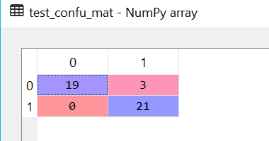
Accuracy and confusion matrix

Slide 7

Future work
Training data collection can be done in a precise way based on the business rules.
Feature selection algorithms can be used to get more accurate results with Naïve Bayes Classifier.

Slide 8


