Slide 1
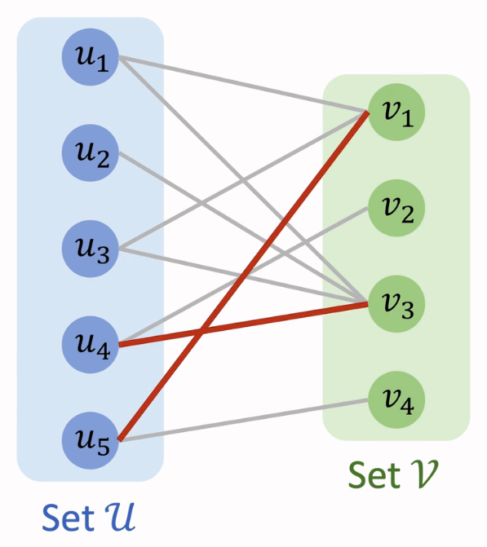
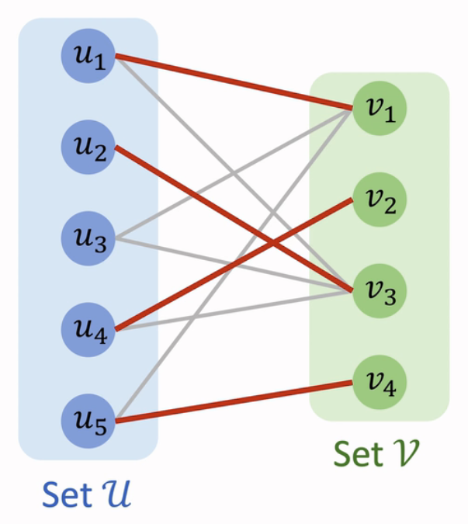


$$u_{1}→v_{1}→u_{5}→v_{4}$$
$$u_{3}→v_{1}→u_{1}→v_{3}→u_{2}$$

Slide 2
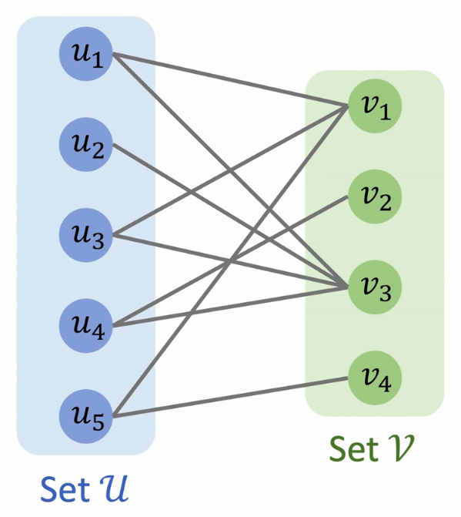









$$M=∅$$
$$u_{1}→v_{1}$$
$$M=\left\{e_{1,1}\right\}$$
$$u_{4}→v_{2}$$
$$M=\left\{e_{1,3},e_{3,1}\right\}$$
$$u_{3}→v_{1}→u_{1}→v_{3}$$
$$M=\left\{e_{1,3},e_{3,1},e_{4,2}\right\}$$
$$u_{5}→v_{4}$$
$$M=\left\{e_{1,3},e_{3,1},e_{4,2},e_{5,4}\right\}$$

Slide 3
 | object1 | object2 | object3 | object4
track1 | 82 | 83 | 69 | 92
track2 | 77 | 37 | 49 | 92
track3 | 11 | 69 | 5 | 86
track4 | 8 | 9 | 98 | 23
 | object1 | object2 | object3 | object4
track1 | 13 | 14 | 0 | 23
track2 | 40 | 0 | 12 | 55
track3 | 6 | 64 | 0 | 81
track4 | 0 | 1 | 90 | 15
step 1
-69
-37
-5
-8
step 2
 | object1 | object2 | object3 | object4
track1 | 13 | 14 | 0 | 8
track2 | 40 | 0 | 12 | 40
track3 | 6 | 64 | 0 | 66
track4 | 0 | 1 | 90 | 0
 | object1 | object2 | object3 | object4
track1 | 13 | 14 | 0 | 8
track2 | 40 | 0 | 12 | 40
track3 | 6 | 64 | 0 | 66
track4 | 0 | 1 | 90 | 0
step 3
step 4
-0
-0
-0
-15
 | object1 | object2 | object3 | object4
track1 | 7 | 14 | 0 | 2
track2 | 34 | 0 | 12 | 34
track3 | 0 | 64 | 0 | 60
track4 | 0 | 7 | 96 | 0
 | object1 | object2 | object3 | object4
track1 | 7 | 14 | 0 | 2
track2 | 34 | 0 | 12 | 34
track3 | 0 | 64 | 0 | 60
track4 | 0 | 7 | 96 | 0
-6
-6
-6
-6
step 3
-6
-6
+6
+6

Slide 4
 | object1 | object2 | object3 | object4
track1 | 82 | 83 | 69 | 92
track2 | 77 | 37 | 49 | 92
track3 | 11 | 69 | 5 | 86
track4 | 8 | 9 | 98 | 23
 | object1 | object2 | object3 | object4
track1 | 16 | 15 | 29 | 6
track2 | 21 | 61 | 49 | 6
track3 | 87 | 29 | 93 | 12
track4 | 90 | 89 | 0 | 75
98-
原代价矩阵
转化后的代价矩阵

Slide 5
 | object1 | object2 | object3
track1 | 82 | 83 | 69
track2 | 77 | 37 | 49
track3 | 11 | 69 | 5
track4 | 8 | 9 | 98
 | object1 | object2 | object3 | object0
track1 | 82 | 83 | 69 | 0
track2 | 77 | 37 | 49 | 0
track3 | 11 | 69 | 5 | 0
track4 | 8 | 9 | 98 | 0
 | object1 | object2 | object3 | object0
track1 | 82 | 83 | 69 | 0
track2 | 77 | 37 | 49 | 0
track3 | 11 | 69 | 5 | 0
track4 | 8 | 9 | 98 | 0
-0
-0
-0
raw cost matrix
1. init
2. step 1
-0
 | object1 | object2 | object3 | object0
track1 | 82 | 83 | 69 | 0*
track2 | 77 | 37 | 49 | 0
track3 | 11 | 69 | 5 | 0
track4 | 8 | 9 | 98 | 0
 | object1 | object2 | object3 | object0
track1 | 82 | 83 | 69 | 0*
track2 | 77 | 37 | 49 | 0
track3 | 11 | 69 | 5 | 0
track4 | 8 | 9 | 98 | 0
 | object1 | object2 | object3 | object0
track1 | 82 | 83 | 69 | 0*
track2 | 77 | 37 | 49 | 0
track3 | 11 | 69 | 5 | 0
track4 | 8 | 9 | 98 | 0
3. step 2
4. step 3
5. step 6-1
 | object1 | object2 | object3 | object0
track1 | 77 | 78 | 64 | 0*
track2 | 72 | 32 | 44 | 0
track3 | 6 | 64 | 0 | 0
track4 | 3 | 4 | 93 | 0
 | object1 | object2 | object3 | object0
track1 | 77 | 78 | 64 | 0*
track2 | 72 | 32 | 44 | 0
track3 | 6 | 64 | 0’ | 0
track4 | 3 | 4 | 93 | 0
 | object1 | object2 | object3 | object0
track1 | 77 | 78 | 64 | 0*
track2 | 72 | 32 | 44 | 0
track3 | 6 | 64 | 0* | 0
track4 | 3 | 4 | 93 | 0
-5
-5
-5
-5
-5
-5
-5
-5
-5
-5
-5
-5
6. step 6-2
7. step 4
8. step 5
 | object1 | object2 | object3 | object0
track1 | 77 | 78 | 64 | 0*
track2 | 72 | 32 | 44 | 0
track3 | 6 | 64 | 0* | 0
track4 | 3 | 4 | 93 | 0
 | object1 | object2 | object3 | object0
track1 | 77 | 78 | 64 | 0*
track2 | 72 | 32 | 44 | 0
track3 | 6 | 64 | 0* | 0
track4 | 3 | 4 | 93 | 0
 | object1 | object2 | object3 | object0
track1 | 74 | 75 | 64 | 0*
track2 | 69 | 29 | 44 | 0
track3 | 3 | 61 | 0* | 0
track4 | 0 | 1 | 93 | 0
-3
-3
-3
-3
-3
-3
-3
-3
9. step 3
10. step 6-1
11. step 6-2
 | object1 | object2 | object3 | object0
track1 | 74 | 75 | 64 | 0*
track2 | 69 | 29 | 44 | 0
track3 | 3 | 61 | 0* | 0
track4 | 0’ | 1 | 93 | 0
 | object1 | object2 | object3 | object0
track1 | 74 | 75 | 64 | 0*
track2 | 69 | 29 | 44 | 0
track3 | 3 | 61 | 0* | 0
track4 | 0* | 1 | 93 | 0
 | object1 | object2 | object3 | object0
track1 | 74 | 75 | 64 | 0*
track2 | 69 | 29 | 44 | 0
track3 | 3 | 61 | 0* | 0
track4 | 0* | 1 | 93 | 0
12. step 4
13. step 5
14. step 3
 | object1 | object2 | object3 | object0
track1 | 74 | 75 | 64 | 0*
track2 | 69 | 29 | 44 | 0
track3 | 3 | 61 | 0* | 0
track4 | 0* | 1 | 93 | 0
 | object1 | object2 | object3 | object0
track1 | 74 | 74 | 64 | 0*
track2 | 69 | 28 | 44 | 0
track3 | 3 | 60 | 0* | 0
track4 | 0* | 0 | 93 | 0
 | object1 | object2 | object3 | object0
track1 | 74 | 74 | 64 | 0*
track2 | 69 | 28 | 44 | 0
track3 | 3 | 60 | 0* | 0
track4 | 0* | 0’ | 93 | 0
-1
-1
-1
-1
15. step 6-1
16. step 6-2
17. step 4-1
 | object1 | object2 | object3 | object0
track1 | 74 | 74 | 64 | 0*
track2 | 69 | 28 | 44 | 0
track3 | 3 | 60 | 0* | 0
track4 | 0* | 0’ | 93 | 0
 | object1 | object2 | object3 | object0
track1 | 74 | 74 | 64 | 0*
track2 | 69 | 28 | 44 | 0
track3 | 3 | 60 | 0* | 0
track4 | 0* | 0’ | 93 | 0
 | object1 | object2 | object3 | object0
track1 | 71 | 71 | 64 | 0*
track2 | 66 | 25 | 44 | 0
track3 | 0 | 57 | 0* | 0
track4 | 0* | 0’ | 96 | 3
-3
-3
-3
-3
-3
-3
+3
+3
18. step 4-2
19. step 6-1
20. step 6-2

Slide 6
 | object1 | object2 | object3 | object0
track1 | 71 | 71 | 64 | 0*
track2 | 66 | 25 | 44 | 0
track3 | 0’ | 57 | 0* | 0
track4 | 0* | 0’ | 96 | 3
 | object1 | object2 | object3 | object0
track1 | 71 | 71 | 64 | 0*
track2 | 66 | 25 | 44 | 0
track3 | 0’ | 57 | 0* | 0
track4 | 0* | 0’ | 96 | 3
 | object1 | object2 | object3 | object0
track1 | 71 | 71 | 64 | 0*
track2 | 66 | 25 | 44 | 0
track3 | 0’ | 57 | 0* | 0
track4 | 0* | 0’ | 96 | 3
21. step 4-1
22. step 4-2
23. step 6-1
 | object1 | object2 | object3 | object0
track1 | 46 | 46 | 39 | 0*
track2 | 41 | 0 | 19 | 0
track3 | 0’ | 57 | 0* | 25
track4 | 0* | 0’ | 96 | 28
 | object1 | object2 | object3 | object0
track1 | 46 | 46 | 39 | 0*
track2 | 41 | 0’ | 19 | 0
track3 | 0’ | 57 | 0* | 25
track4 | 0* | 0’ | 96 | 28
 | object1 | object2 | object3 | object0
track1 | 46 | 46 | 39 | 0*
track2 | 41 | 0* | 19 | 0
track3 | 0 | 57 | 0* | 25
track4 | 0* | 0 | 96 | 28
-25
-25
-25
-25
-25
-25
+25
24. step 6-2
+25
25. step 4
26. step 5
 | object1 | object2 | object3 | object0
track1 | 46 | 46 | 39 | 0*
track2 | 41 | 0* | 19 | 0
track3 | 0 | 57 | 0* | 25
track4 | 0* | 0 | 96 | 28
 | object1 | object2 | object3 | object0
track1 | 46 | 46 | 39 | 0*
track2 | 41 | 0* | 19 | 0
track3 | 0 | 57 | 0* | 25
track4 | 0* | 0 | 96 | 28
track2 → object2
track3 → object3
track4 → object1
27. step 3
28. done
29. final valid assignments

