Slide 1

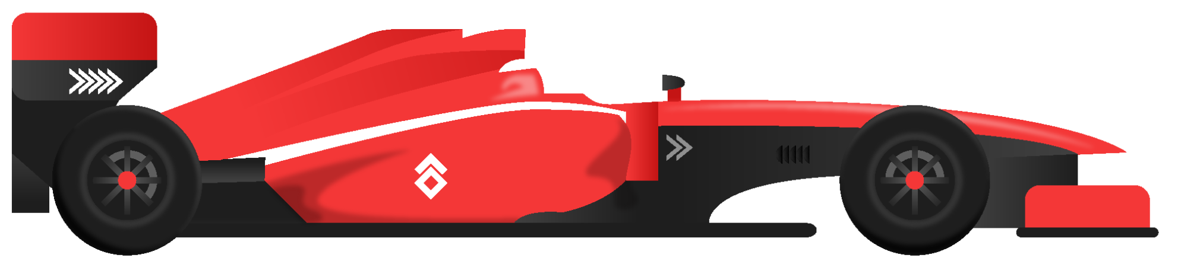
F1TRACK
Simone Della Porta & Rocco Iuliano

Slide 2
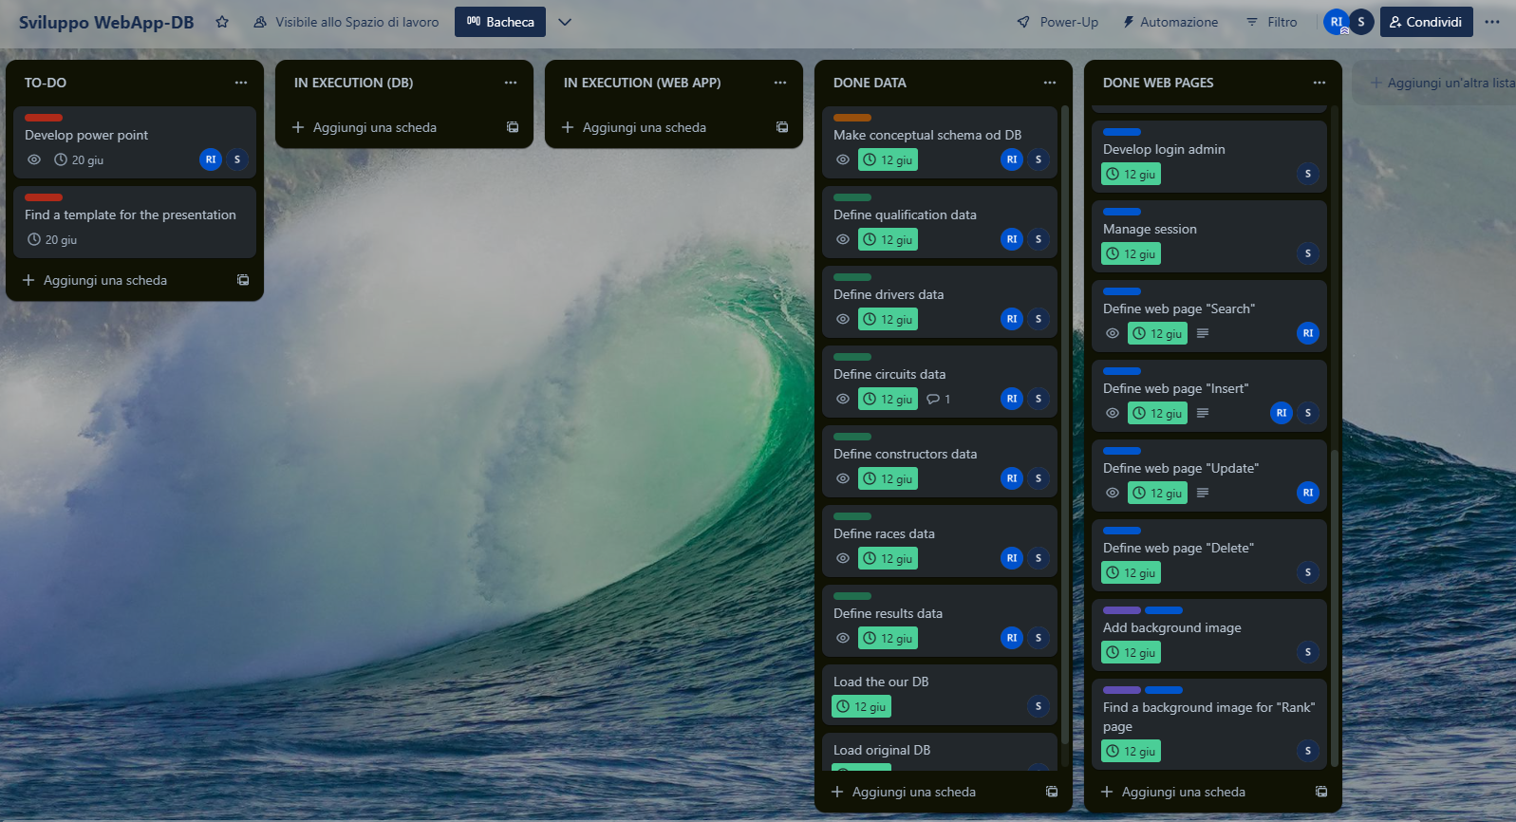

Project management

Slide 3



CONDUCTED STEPS
02
Preprocessing
01
Find data
We used Kaggle
We developed a python script for data cleaning
04
03
Develop WebApp
Develop DB
We used MongoDB
We used Python and Flask

Slide 4
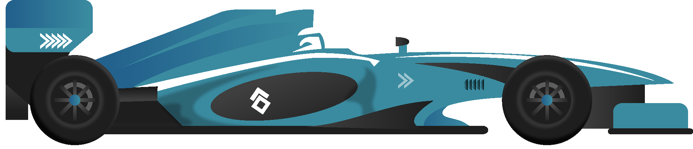
01
Find data

Slide 5
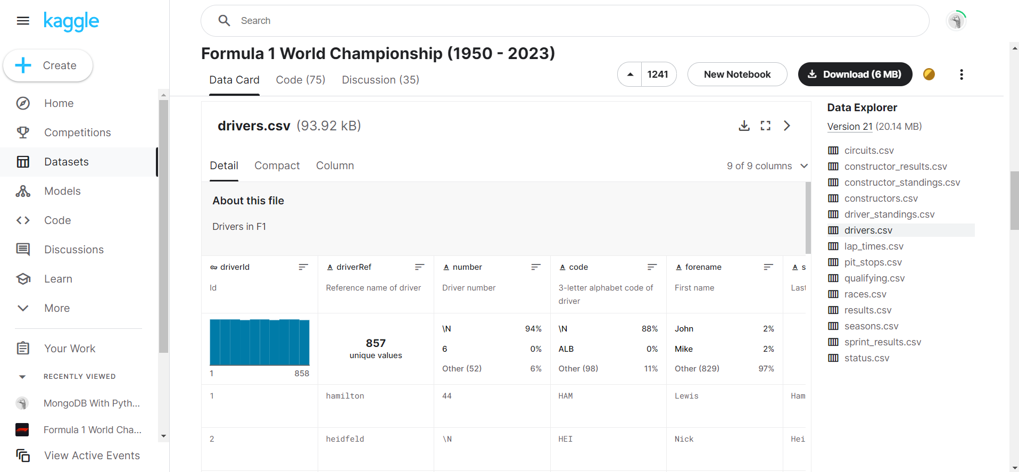

Slide 6
02
Preprocessing

Slide 7
OUR MINIWORLD
Drivers
Constructors
Circuits
Races
Qualifying
Results
01
02
03
04
05
06
07
08
09
Season
Status
Users

Slide 8
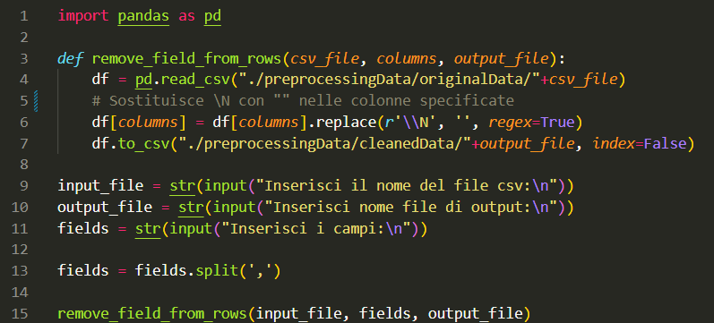
We replaced the ‘\N’ characters with an empty value to apply the mongoDB schemaless property.

Slide 9
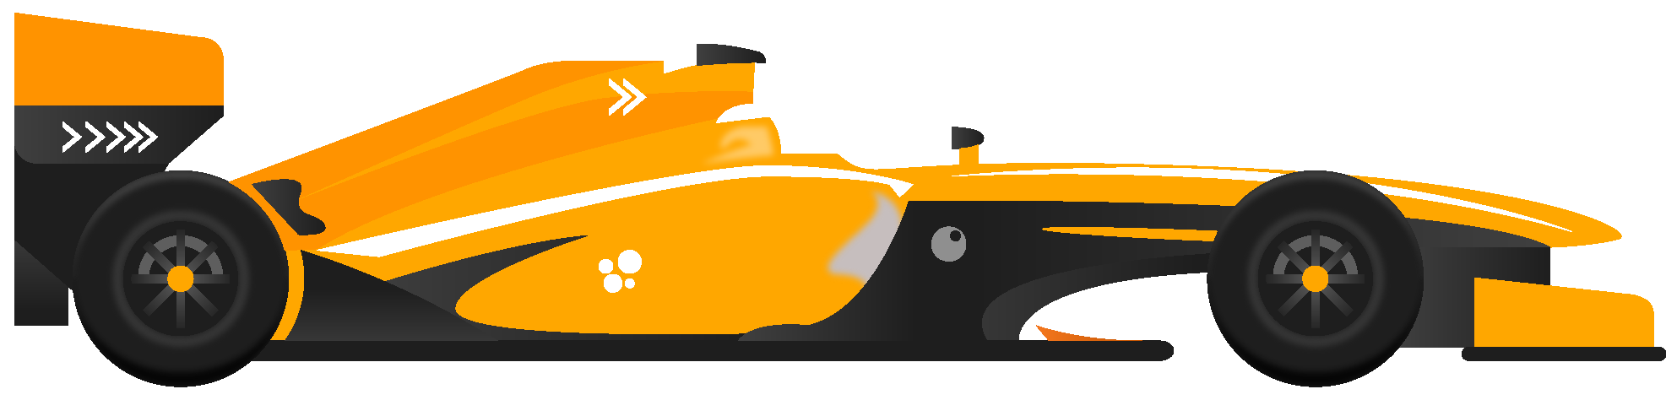
03
MongoDB

Slide 10
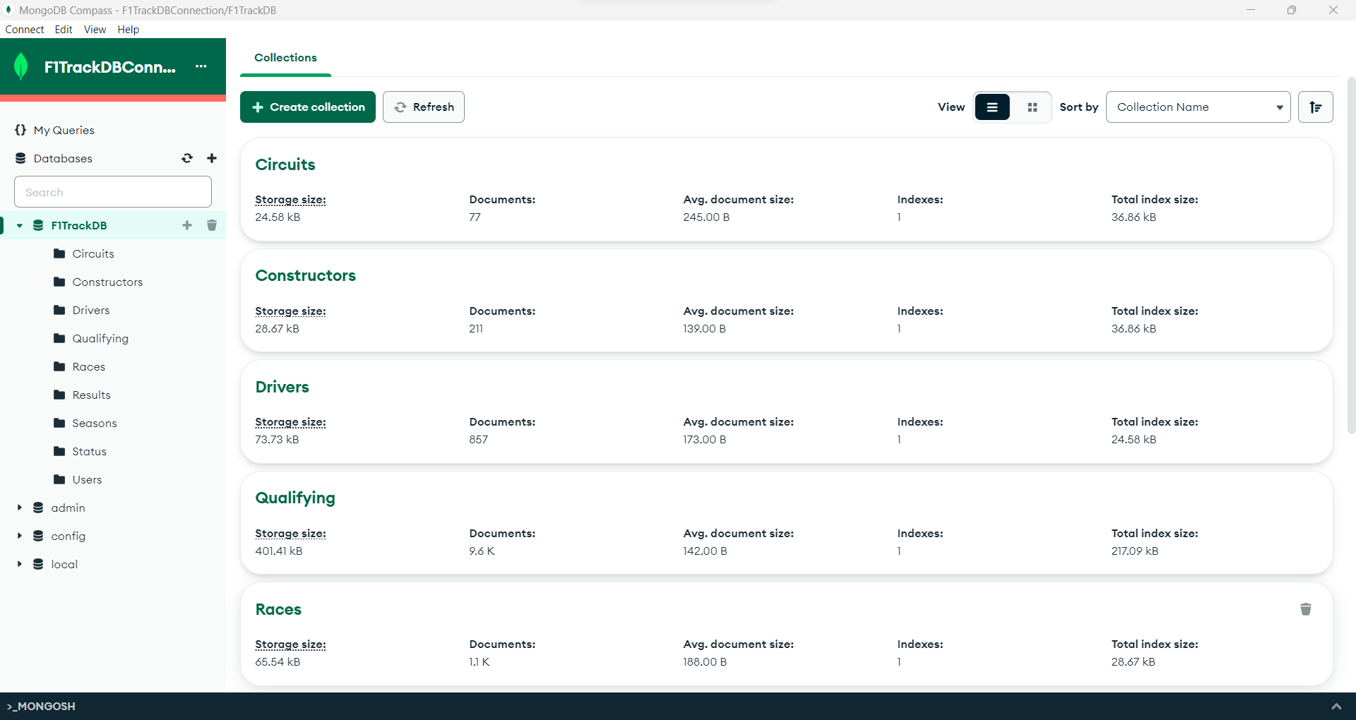

Slide 11

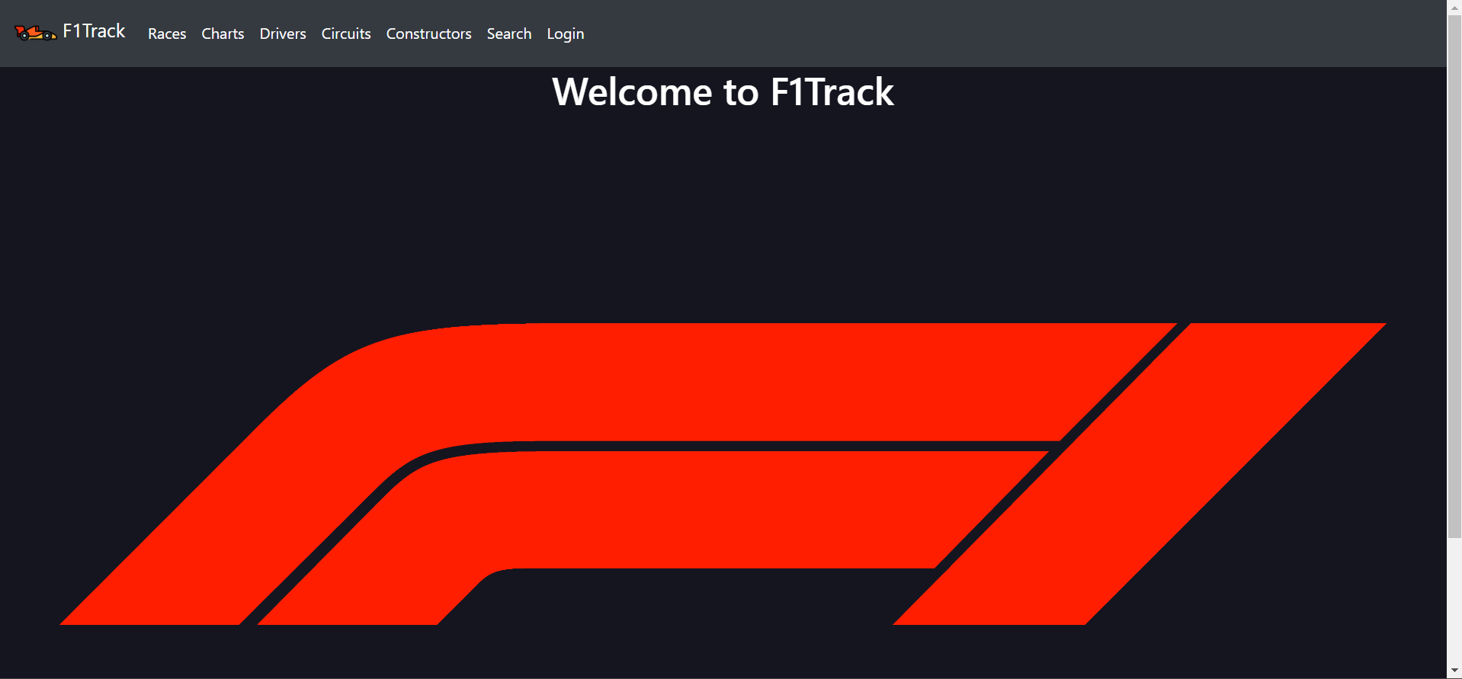
04
WebApp

Slide 12

THANKS
DO YOU HAVE
ANY QUESTIONS?
r.iuliano13@ studenti.unisa.it s.dellaporta6@studenti.unisa.it
Scan me to the GitHub repo

Slide 13


