Slide 1
Ordinal Logit & ABM?

Slide 2

Ethnic (or else) concentration can be considered as an ordinal variable which order is meaningful, with upper categories including the lower ones (e.g. 60% homogeneity includes all levels below 60)and fits the condition for ordered logit
The discrete choice becomes between neighborhoods that fall into different degrees of ethnic (or ses) concentration
Preferences can be predicted, but not on a continuous variable. Nevertheless, it came as easier to compute and manage large dataset (different census tract can be assigned to different categories)

Slide 3



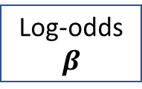



Regression model(s), conditional/ordered logit, compute the likelihood that people select one option according to change in degree of option’s characteristics taken as predictor
Coefficients of regression is the log-odds (β in the ABM)
Computed in ABM upon theory:
Utility function
𝛽
(interest in macro phenomena)
Utility is not a “random variable”
compared to odds ratio of other options
$$\frac{exp⁡(βxU)}{(1+ \exp\left(βxU\right))}$$
exponentiation
$$exp⁡(βxU)$$
Probability
Log-odds
$$β$$
Odds ratio
ln$(odds)$
$$\frac{P}{(1−P)}$$
$$P_{x}=\frac{exp⁡(βxU)}{\sum{exp⁡(βkU)}}$$
log($\frac{P}{(1−P)})$
To initialize the ABM informing about preferences from a population -> estimate β
Conditional logit: would refer to a continous independent variable (utility)
Ordered logit to an ordinal (meaningful categories) indipendent variable (utility)
A conditional logit would be better, but to the aim to inform on preferences of people not much different
Discrete choice and regression models:
estimated as probability from observation
not possible to compute β*Utility, since Utility remains a random variable
log-odds β is considered the utility derived from observation and used to predict probability

Slide 4
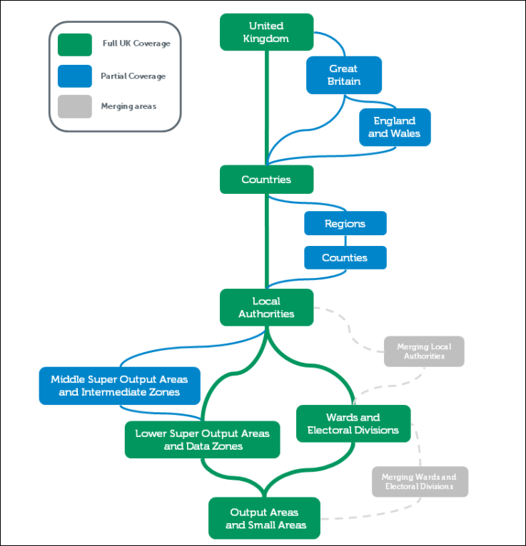
I gave a try:
Census track UK 2011, data from Bent (multicultural Borough of London): 34 neighborhoods (Ward)
Age participants: > 16 years old
Ethnic (white, asian, black) and SES concentration (high, medium, low)
Ordinal logit (polr() in MASS package)
Data from: http://infuse.ukdataservice.ac.uk/
https://stats.idre.ucla.edu/r/dae/ordinal-logistic-regression/
http://infuse.ukdataservice.ac.uk/help/definitions/2011geographies/index.html

Slide 5
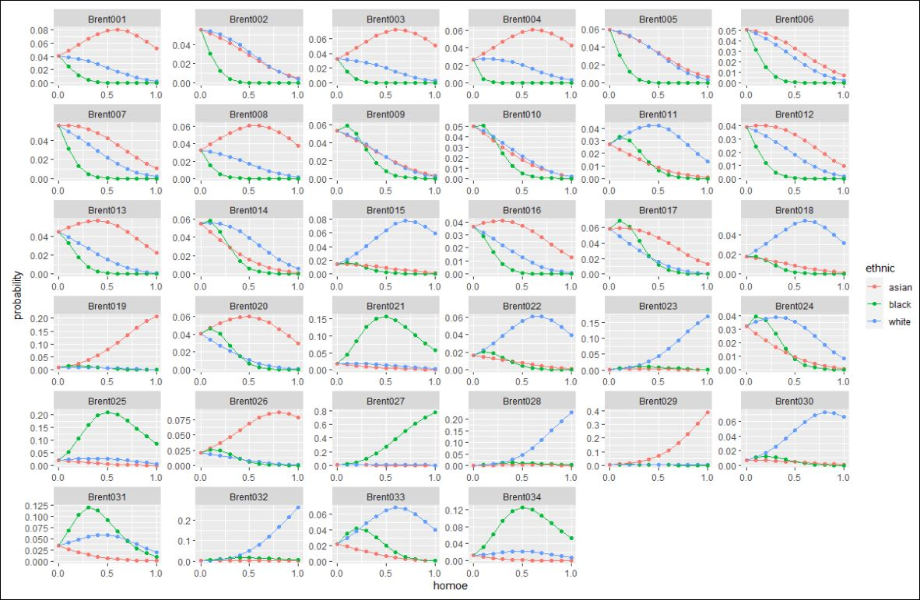
To compare with the ABM, need of:
Options characteristic: ethnic concentration + proxy value concentration
Discern between characteristics of individuals (joint distribution): ethnicity + proxy value orientation (e.g. education, ses) at the individual level
Conditional logit: necessary to compute comparison for each option (34 neighborhoods), not feasible
Multinomial Regression: nonsense to compute the probability of LSOA1 vs others, rather the categories the neighborhoods fall into (e.g. on homogeneity scale), which do have a meaning -> ordinal logit
x-axis: ethnic homogeneity (continuous)
y-axis: prob. to reside in that neighborhood for a member of each ethnic group (color)
computed for each of 34 neighborhoods
Multinomial regression. Anyway, we don’t need this for the ABM: we are not interested in the specific neighborhood A vs B, but on the effect of their composition on the choice of residents

Slide 6
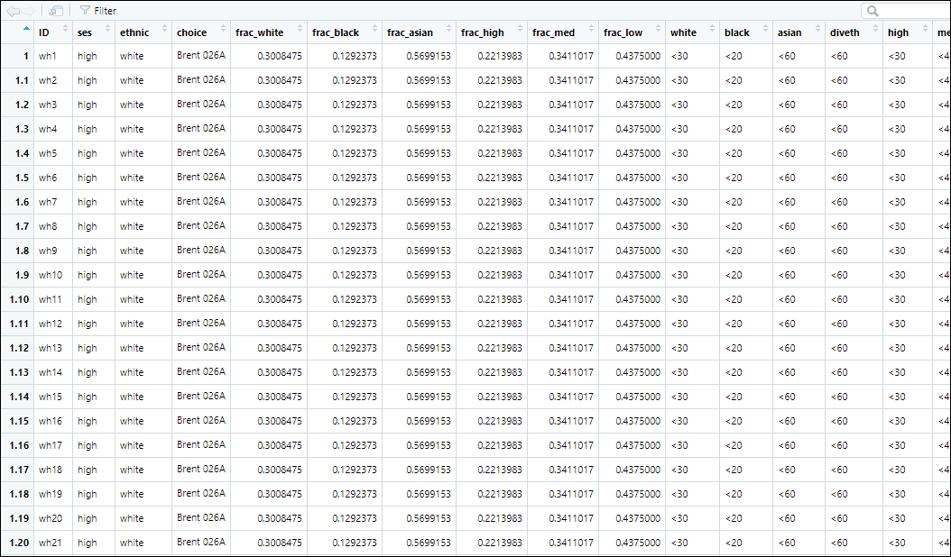
Dataset:
I repeat observation in each row from aggregated data, reporting the ethnicity & ses of individual and characteristics of their neighborhood (option they chose)
Based on their ses and ethnic membership, neighborhood are sorted into ordinal category for ethnic and ses concentration
file: Brent_RP.csv

Slide 7

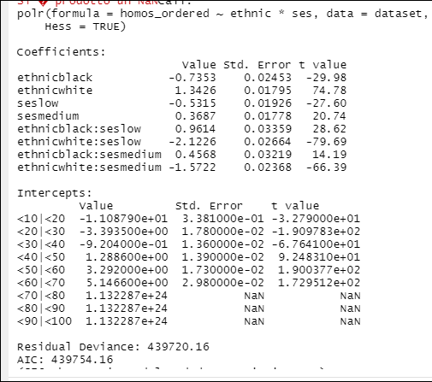
The model
Specified it is an ordinal variable and categories meaningful
Hessian matrix, R needs to keep the information for summary of the model
Model: predict the category of ethnic concentration people live in based on main effect of ses and ethnicity of people and their interaction:
Compared to ABM:
Identify the between ethnic groups / proxy value orientation
Cross-category ethnicity & value orientation
MW: these are relative utilities, that compare the likelihood of one group vs the reference level (Asian high status). Use the log-odds computed from each probability estimated. RP: Done, see slide 11 and file prob_logodds.csv
How to read:
For each increase to a higher category of ethnic concentration, a black person is expected to reside less in such neighborhood compared to an Asian (reference level) with a likelihood at log odds scale equal to -0.7353. For a White the likelihood increases of 1.3426 points at log-odds scale.
Same done for ses concentration
These are the β, from which probability will be estimated
Assumptions to check, more serious decisions (some not relevant to ABM, e.g. reference level), and exploration

Slide 8
I then compute the probability of an individual of each ses*ethnicity category to reside in one neighborhood based on its range of ethnic and ses concentration
Conditions to compute probability to
Compute probability based on the ordinal logit model

Slide 9
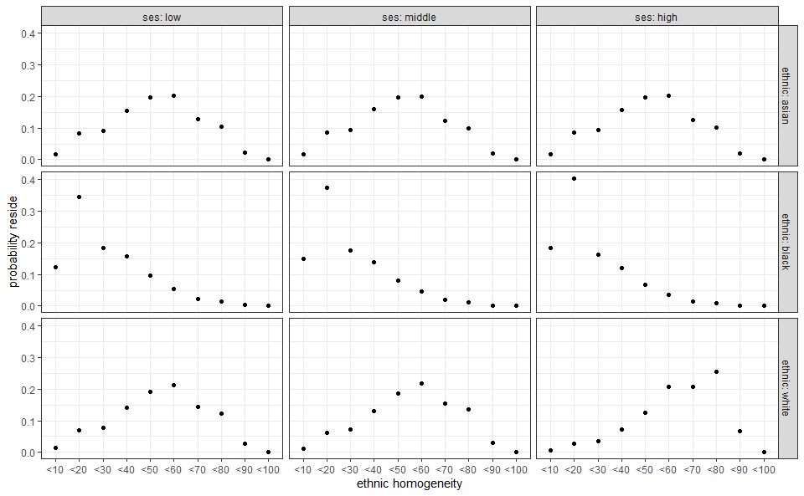
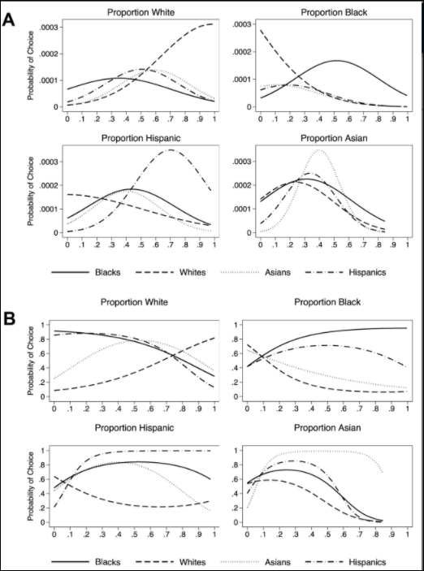
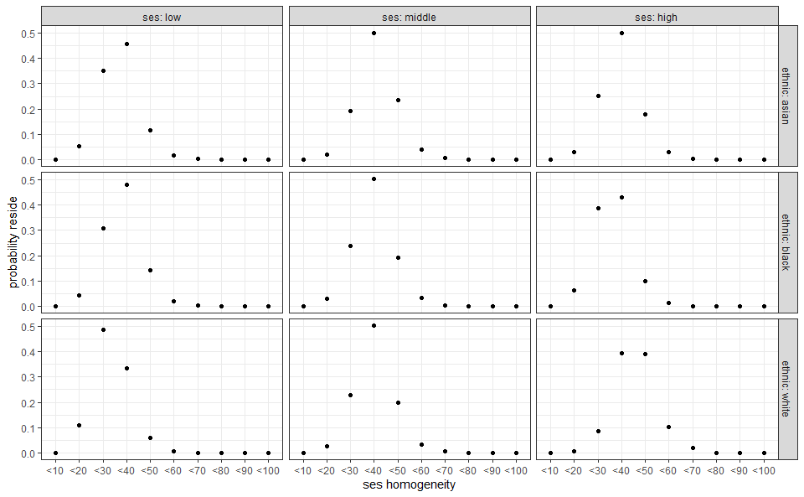
Output
Example Bruch 2014 with conditional logit which I would like to replicate
Anyway, the trends are visible
I merged in the next slide

Slide 10
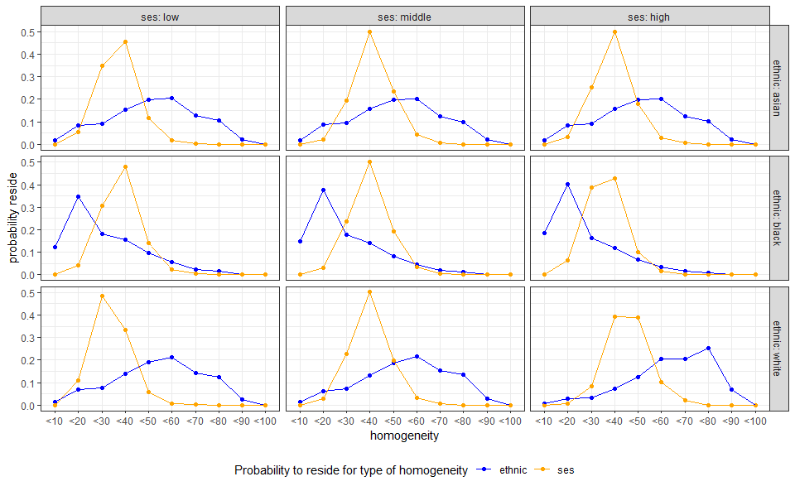
Here I just merged the two plots in the previous slides, I thought easier to compare. Blue color is the “ethnic homogeneity” graph, yellow color the “ses homogeneity” in the previous slides.
x-axis: the concentration categories from 0 to 100% in steps of 10%, equal for the ethnic and ses concentration
y-axis: the probability to reside in that type of neighborhood; color differentiates between probability depending on ethnic concentration (blue) or ses concentration (yellow)

Slide 11
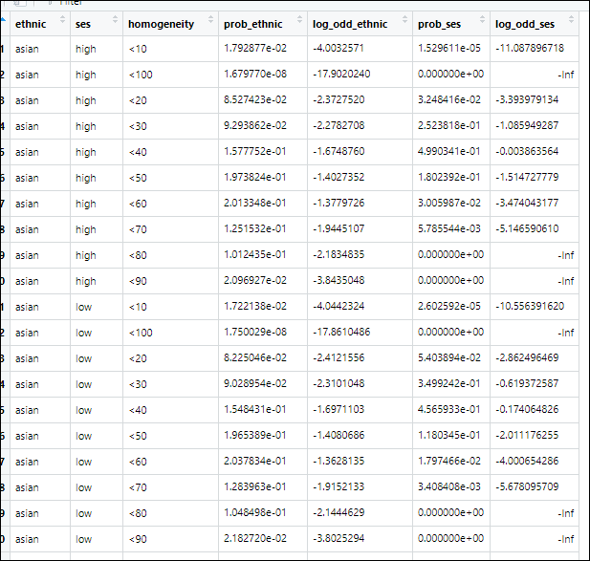
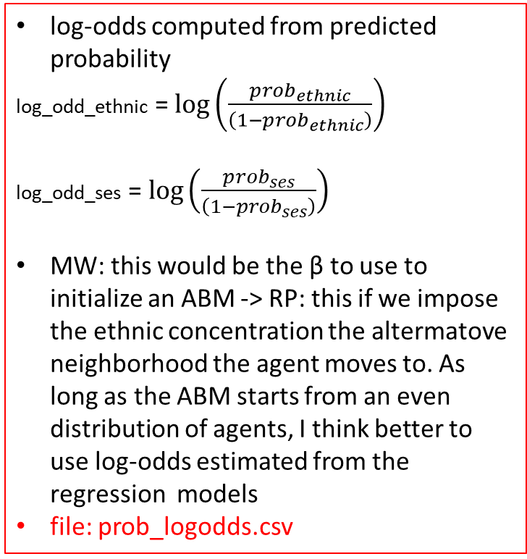
log-odds computed from predicted probability
log_odd_ethnic = $\log\left(\frac{prob_{ethnic}}{\left(1−prob_{ethnic}\right)}\right)$
log_odd_ses = $\log\left(\frac{prob_{ses}}{\left(1−prob_{ses}\right)}\right)$
MW: this would be the β to use to initialize an ABM -> RP: this if we impose the ethnic concentration the altermatove neighborhood the agent moves to. As long as the ABM starts from an even distribution of agents, I think better to use log-odds estimated from the regression models
file: prob_logodds.csv

Slide 12
Other notes MW:
Conditional logit: does not allow for individual characteristics in the model, only characteristics of the option; Mixed logit allows for both characteristics of option and characteristics of individuals. Following this definition (among others), we aim at mixed logit
Try using the ethnic concentration of neighborhood people live in on a continuous scale as dependent variable (y). Would not be a discrete choice but continuous preference. The paradigm of choice modeling remains. RP This would suffice for abm need. Papers on the topic (to check):
Quillian, L. (2015). A comparison of traditional and discrete-choice approaches to the analysis of residential mobility and locational attainment. The ANNALS of the American Academy of Political and Social Science, 660(1), 240-260.
Alba, R. D., & Logan, J. R. (1993). Minority proximity to whites in suburbs: An individual-level analysis of segregation. American journal of sociology, 98(6), 1388-1427.
RP: other cross-categories available in UK Census:
Ethnicity X SES (used in these slides), available also 2001
Ethnicity X Education (qualification), available also 2001
Ethnicity X Occupation
Availability for each geography and time to check, depending on final decision

Slide 13
Possible next step (Paper with MW, AF)
Investigate the theoretical assumptions of ABM from data: how people of different categories differ
We could initialize an agent-based model with more preferences and more ethnic groups, upon the insights from Paolillo & Flace, Paolillo & Loren
Methodological choice to make:
Comparison of different cities, e.g. based on relative group size, proxy of value distribution (Leicester)
Output Area would be even closer to Schelling, I think ordinal logit will support better on this, classifying different options in fewer categories, or with continuous variable

