Slide 1
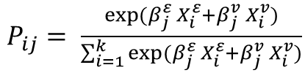

Theoretical model and types of agents
ETHNICITY
*
*
Value
Segregation
How scenarios of hybrid segregation in modern societies, i.e. people of the same group are integrated, others are not, can be explained?
Mechanism: spatial sorting with discrete choice
Focus of the model on:
  Different preferences: values and ethnicity
  Heterogeneity in ethnic and value preferences within group and between groups
  Relative group sizes
  Observed phenomena:
    Global ethnic and value segregation
    Ethnic and value segregation for 4 types of agents
VALUE
~
~
*
*
~
~
Ethnic
Segregation
*
β_ethnic
~
β_value
$$U= X_{e }+ X_{v}+ ε$$
Neighborhood utility computation for all agents
$P_{ij}= \frac{\exp{({β_{j}^{ε}}_{ }X_{i}^{ε}+{β_{j}^{v}}_{ }X_{i}^{v})}}{\sum_{i=1}^{k}{\exp{({β_{j}^{ε}}_{ }X_{i}^{ε}+{β_{j}^{v}}_{ }X_{i}^{v})}}}$
Probability of agent j to move to neighborhood i

Slide 2
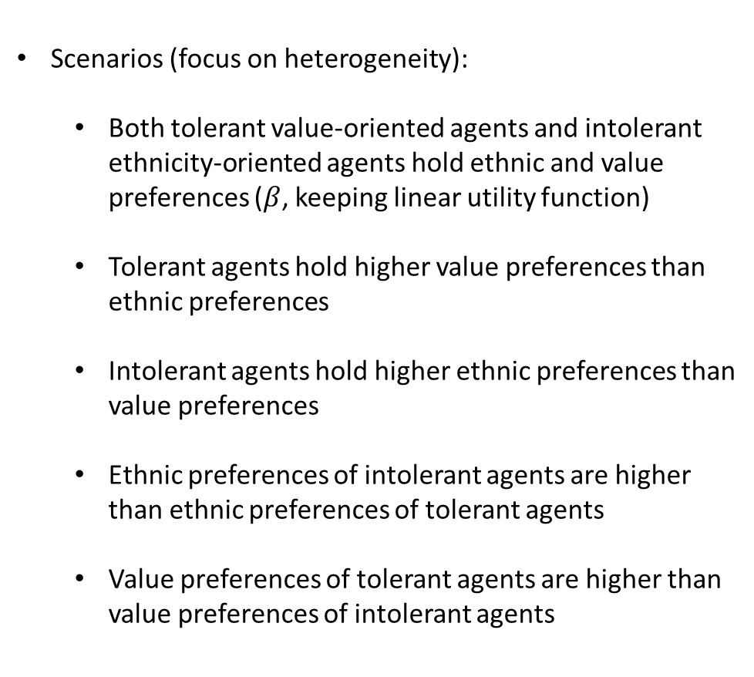
  Scenarios (focus on heterogeneity):
    Both tolerant value-oriented agents and intolerant ethnicity-oriented agents hold ethnic and value preferences ($β$, keeping linear utility function)
    Tolerant agents hold higher value preferences than ethnic preferences
    Intolerant agents hold higher ethnic preferences than value preferences
    Ethnic preferences of intolerant agents are higher than ethnic preferences of tolerant agents
    Value preferences of tolerant agents are higher than value preferences of intolerant agents
Heterogeneity
Individual
βe□ ≥ βv□
;
βv○ ≥ βe○
βeL□ ≥ βeL○
βeM□ ≥ βeM○
Within group
βvL○ ≥ βvL□
βvM○ ≥ βvM□
Between group?

Slide 3
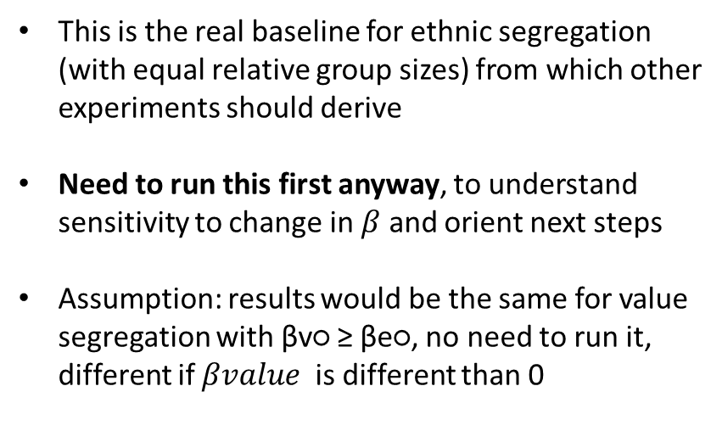
Experiments
βe□
10
9
8
7
6
5
4
3
2
1
0
X | X | X | X | X | X | X | X | X | X | X
X | X | X | X | X | X | X | X | X | X
X | X | X | X | X | X | X | X | X
X | X | X | X | X | X | X | X
X | X | X | X | X | X | X
X | X | X | X | X | X
X | X | X | X | X
X | X | X | X
X | X | X
X | X
X
This is the real baseline for ethnic segregation (with equal relative group sizes) from which other experiments should derive
Need to run this first anyway, to understand sensitivity to change in $β$ and orient next steps
Assumption: results would be the same for value segregation with βv○ ≥ βe○, no need to run it, different if $βvalue$ is different than 0
Ethnic segregation
Total random relocation due to group size Segregation = 0.50
0 | 1 | 2 | 3 | 4 | 5 | 6 | 7 | 8 | 9 | 10
βe○

Slide 4
Intolernat/tolerant
minority
Intolernat/tolerant
minority
0.8
0.8
0.5
0.5
0.2
0.2
0.2
0.5
0.8
0.2
0.5
0.8
Intolernat/tolerant
locals
Intolernat/tolerant
locals
Local/minority 0.5/0.5
Local/minority 0.8/0.2
Map of relative group sizes both for ethnic composition and value composition
In each intersection, the conditions of ethnic preferences and value preferences for all 4 types of agents should occur, it is not feasible

Slide 5
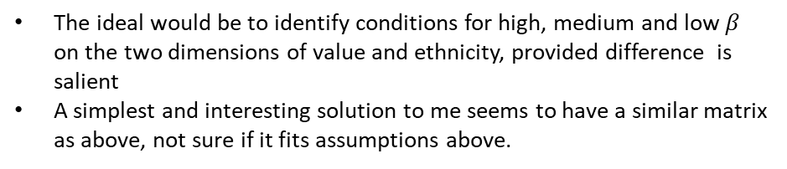
maxβe
% cons.
minority
medβe
0.8
minβe
0.5
high
mdm
low
βe>βv | βe>βv | βe=βv
βe>βv | βe=βv | βv>βe
βe=βv | βv>βe | βv>βe
0.2
0.2
0.5
0.8
low | mdm | high
% cons.
locals
Local/minority 0.5/0.5
Local/minority 0.8/0.2
The ideal would be to identify conditions for high, medium and low $β$ on the two dimensions of value and ethnicity, provided difference is salient
A simplest and interesting solution to me seems to have a similar matrix as above, not sure if it fits assumptions above.

