Slide 1
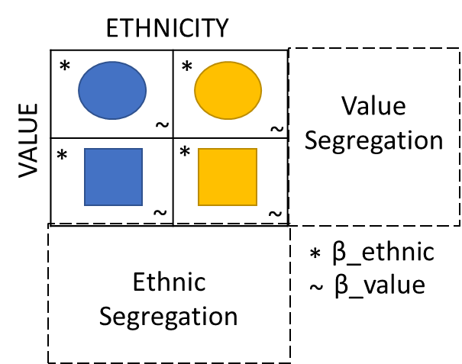
OFFICIAL

Slide 2
ETHNICITY
VALUE
ETHNICITY
*
*
Value
Segregation
VALUE
~
~
*
*
~
~
Ethnic
Segregation
*
β_ethnic
~
β_value

