Slide 1
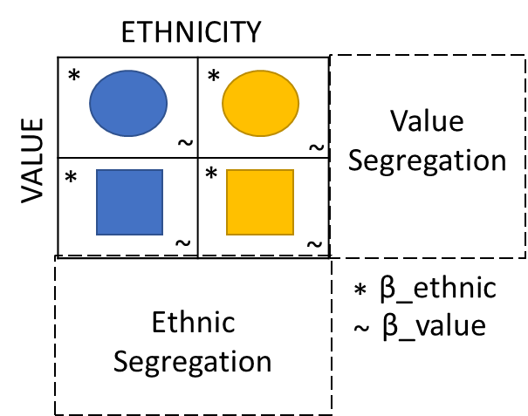
OFFICIAL

Slide 2
ETHNICITY
VALUE
ETHNICITY
*
*
Value
Segregation
VALUE
~
~
*
*
~
~
Ethnic
Segregation
*
β_ethnic
~
β_value

Slide 3
βe□
Heterogeneity
10
9
Individual
βe□ ≥ βv□
;
βv○ ≥ βe○
8
7
6
βeL□ ≥ βeL○
βeM□ ≥ βeM○
Within group
5
βvL○ ≥ βvL□
βvM○ ≥ βvM□
4
3
Between group?
2
1
0
1
2
3
4
5
6
7
8
9
10
βe○

Slide 4
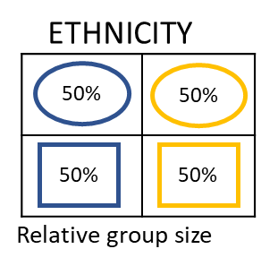
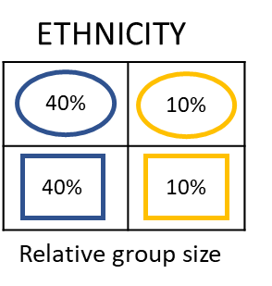
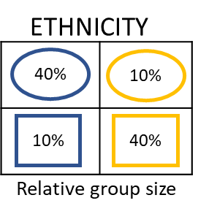
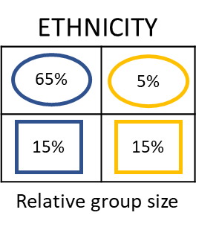
βe□
10
9
8
7
6
5
4
3
2
1
0
X | X | X | X | X | X | X | X | X | X | X
X | X | X | X | X | X | X | X | X | X
X | X | X | X | X | X | X | X | X
X | X | X | X | X | X | X | X
X | X | X | X | X | X | X
X | X | X | X | X | X
X | X | X | X | X
X | X | X | X
X | X | X
X | X
X
βv○
10
9
8
7
6
5
4
3
2
1
0
X | X | X | X | X | X | X | X | X | X | X
X | X | X | X | X | X | X | X | X | X
X | X | X | X | X | X | X | X | X
X | X | X | X | X | X | X | X
X | X | X | X | X | X | X
X | X | X | X | X | X
X | X | X | X | X
X | X | X | X
X | X | X
X | X
X
Ethnic segregation
Value segregation
Total random relocation due to group size Segregation = 0.50
0 | 1 | 2 | 3 | 4 | 5 | 6 | 7 | 8 | 9 | 10
Baseline:βv=0
0 | 1 | 2 | 3 | 4 | 5 | 6 | 7 | 8 | 9 | 10
βe○
βv□
bl:org=0.5
bl>crl:sqr=0.5
org>crl:sqr=0.5
bl:org=0.8
bl>crl:sqr=0.5
org>crl:sqr=0.5
bl:org=0.5
bl>crl:sqr=0.8
org>crl:sqr=0.2
bl:org=0.8
bl>crl:sqr=0.8
org>crl:sqr=0.2
Notes:
orange frame: baseline condition. Ethnic and value segregation, provided the first relative group size condition is taken, would not differ. In other conditions would differ because of probability to find similar ones

Slide 5
βe□
10
9
8
7
6
5
4
3
2
1
0
X | X | X | X | X | X | X | X | X | X | X
X | X | X | X | X | X | X | X | X | X
X | X | X | X | X | X | X | X | X
X | X | X | X | X | X | X | X
X | X | X | X | X | X | X
X | X | X | X | X | X
X | X | X | X | X
X | X | X | X
X | X | X
X | X
X
βv○
10
9
8
7
6
5
4
3
2
1
0
X | X | X | X | X | X | X | X | X | X | X
X | X | X | X | X | X | X | X | X | X
X | X | X | X | X | X | X | X | X
X | X | X | X | X | X | X | X
X | X | X | X | X | X | X
X | X | X | X | X | X
X | X | X | X | X
X | X | X | X
X | X | X
X | X
X
Ethnic segregation
Value segregation
Total random relocation due to group size Segregation = 0.50
0 | 1 | 2 | 3 | 4 | 5 | 6 | 7 | 8 | 9 | 10
0 | 1 | 2 | 3 | 4 | 5 | 6 | 7 | 8 | 9 | 10
βv□
βe○
bl:org=0.5
bl>crl:sqr=0.5
org>crl:sqr=0.5
bl:org=0.8
bl>crl:sqr=0.5
org>crl:sqr=0.5
bl:org=0.5
bl>crl:sqr=0.8
org>crl:sqr=0.2
bl:org=0.8
bl>crl:sqr=0.8
org>crl:sqr=0.2
Notes:
Provided that the increase of segregation is monotonic linear, when value segregation is included, the faceted condition for low, medium, high betas might be explored, and how they change as effect of relative group sizes

Slide 6

Heterogeneity
Individual
βe□ ≥ βv□
;
βv○ ≥ βe○
βeM□ ≥ βeM○
βeL□ ≥ βeL○
;
$$→$$
βeL□ ≥ βeM○
;
βeM□ ≥ βeL○
Within group
;
βvM○ ≥ βvM□
βvL○ ≥ βvL□
Between group

Slide 7
Income
Ethn 1
Ethn 2
*
*
Value 1
~
~
*
*
Value 2
~
~
Preferences
-
Costs
Notes:
This would assume that different value (i.e. tolerance) derives directly from income. You can imagine it comes both from income and ethnic group = $P_{v}=f(I,E)$

Slide 8




Income
Ethn 1
Ethn 2
*
*
Value 1
~
~
*
*
Value 2
~
~
$$β_{e}+ β_{v}$$
$$P=$$
$$U$$
$$− C$$

