Slide 1
Ethnic distribution (population level)
multidiversity / majority-minority
Native
Migrant
probability a native is liberal
40 | 10
10 | 40
Liberal
35 | 15
15 | 35
50
50 % liberal native
30 | 20
20 | 30
Value distribution (population level)
25 | 25
25 | 25
60 % liberal native
70 % liberal native
80 % liberal native
Conservative
50
50
50

Slide 2
Ethnic distribution (population level)
classical majority/minority
Native
Migrant
40 | 10
40 | 10
Liberal
35 | 15
35 | 15
30 | 20
30 | 20
50
Value distribution (population level)
25 | 25
25 | 25
Conservative
50
50 % ethnic native
60 % ethnic native
70 % ethnic native
80 % ethnic native

Slide 3
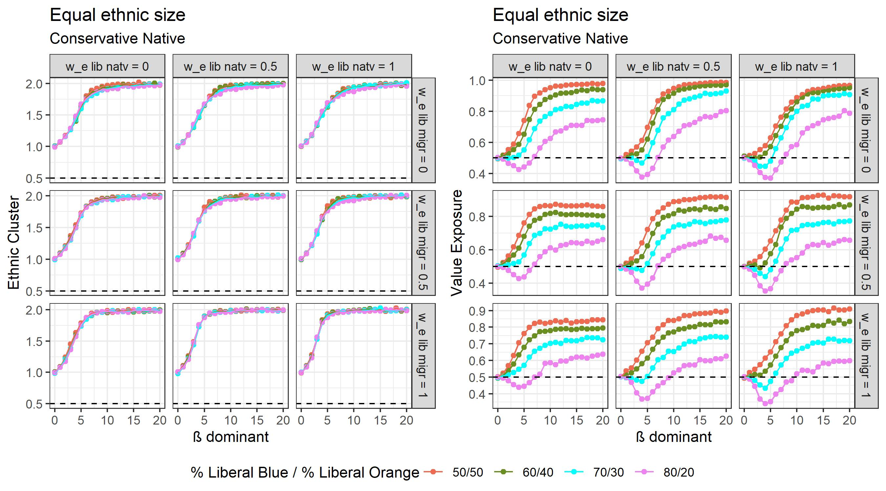
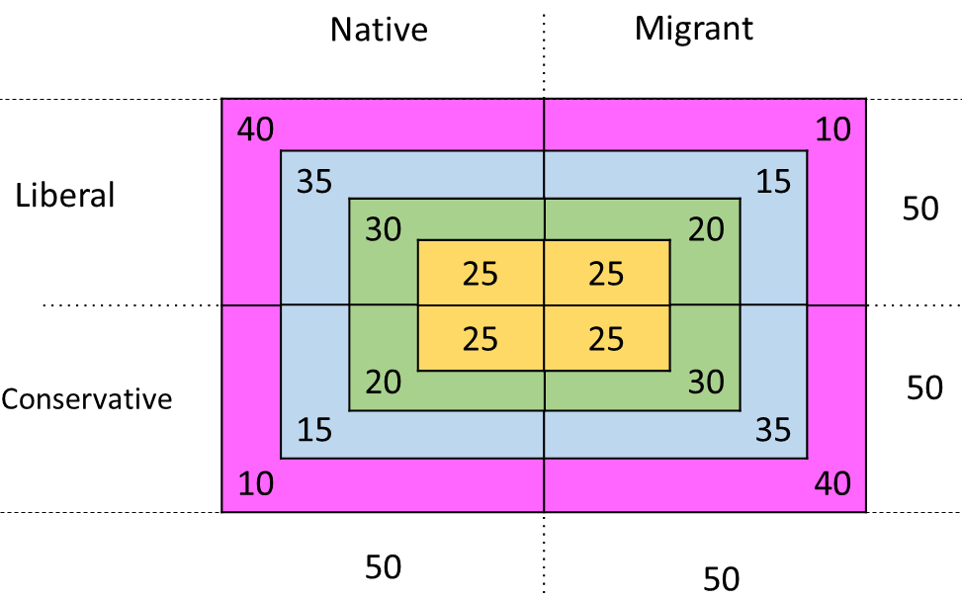
Conservative native are underrepresented, show same ethnic exposure as conservative migrant, who represent majority value in the migrant group and 40% of population
Main differences are in the value exposure
Value segregation as by-product decreases as the percentage of liberals increases in the own group, as there are more liberals and conservative need to assimilate to maximize ethnic preference
Conservative native show value assimilation for low level of determinism when they are under-represented (80% liberal native), to then increase and remain lower than other conditions. The assimilation occurs because due to lower determinism (5), because all agent maximize to a certain degree, but still relocate randomly, so they are tolerated by liberals
As conservative native become under-represented, the by-product value segregation decreases, as they need to relocate close to liberals co-ethnic, numerically higher, which still will tolerate them. The increase in ethnic preference of liberals native do not change much
Higher decrease in by-product value segregation occurs when liberal migrant become more ethnically conservative, more evidently when liberal migrant represent higher shares of population (making up to 50%)
The value assimilation is higher when liberal native increase their ethnic preference

Slide 4
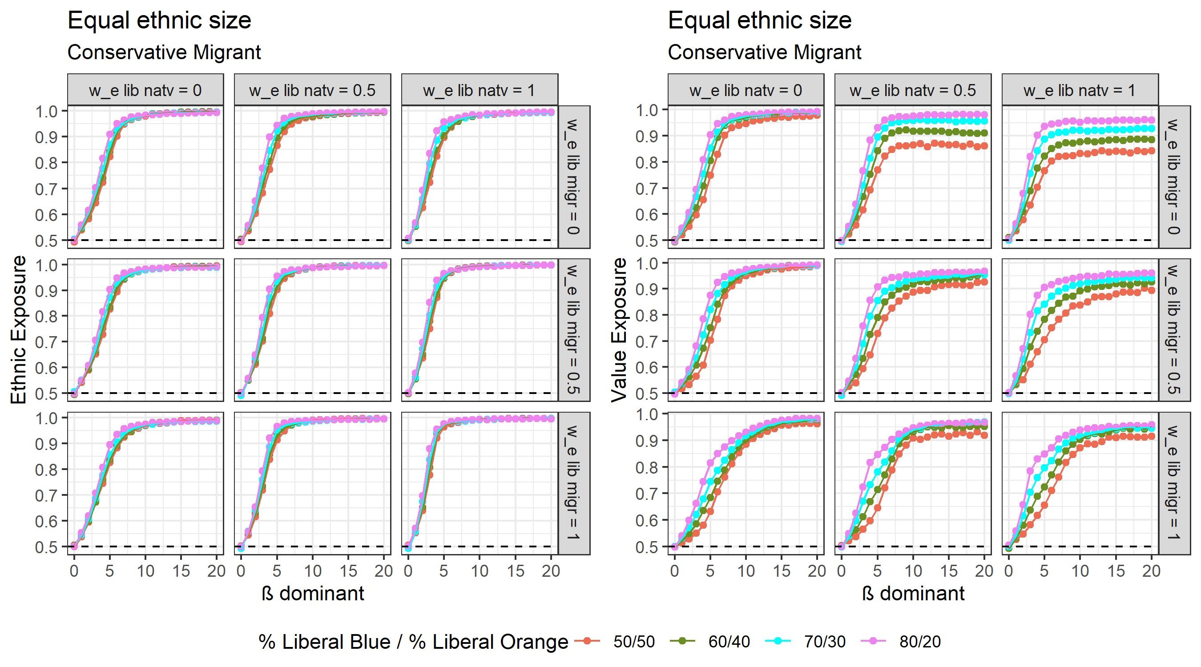
Conservative migrant show same ethnic patterns but different value segregation due both to value group size and increase in ethnic preference of liberals in both groups.
By-product value segregation slightly increases as liberals are more represented in society, as the equivalent number of agents in liberals counter-ethnic part
As liberal native increase their ethnic preference, by-product value segregation of conservative migrant decreases, more evidently as liberal are equally distributed between ethnic groups. As liberals only care about value, they form dense neighborhood, as they considrer also ethnic similarity, the neighborhood breaks into small neighborhood, on which limits liberal migrants relocate. Conservative migrant relocate on the boundaries of such neighborhoods, where they have more chance to find co-ethnics (-> better understand)
Effect of neighborhood density of liberals

Slide 5
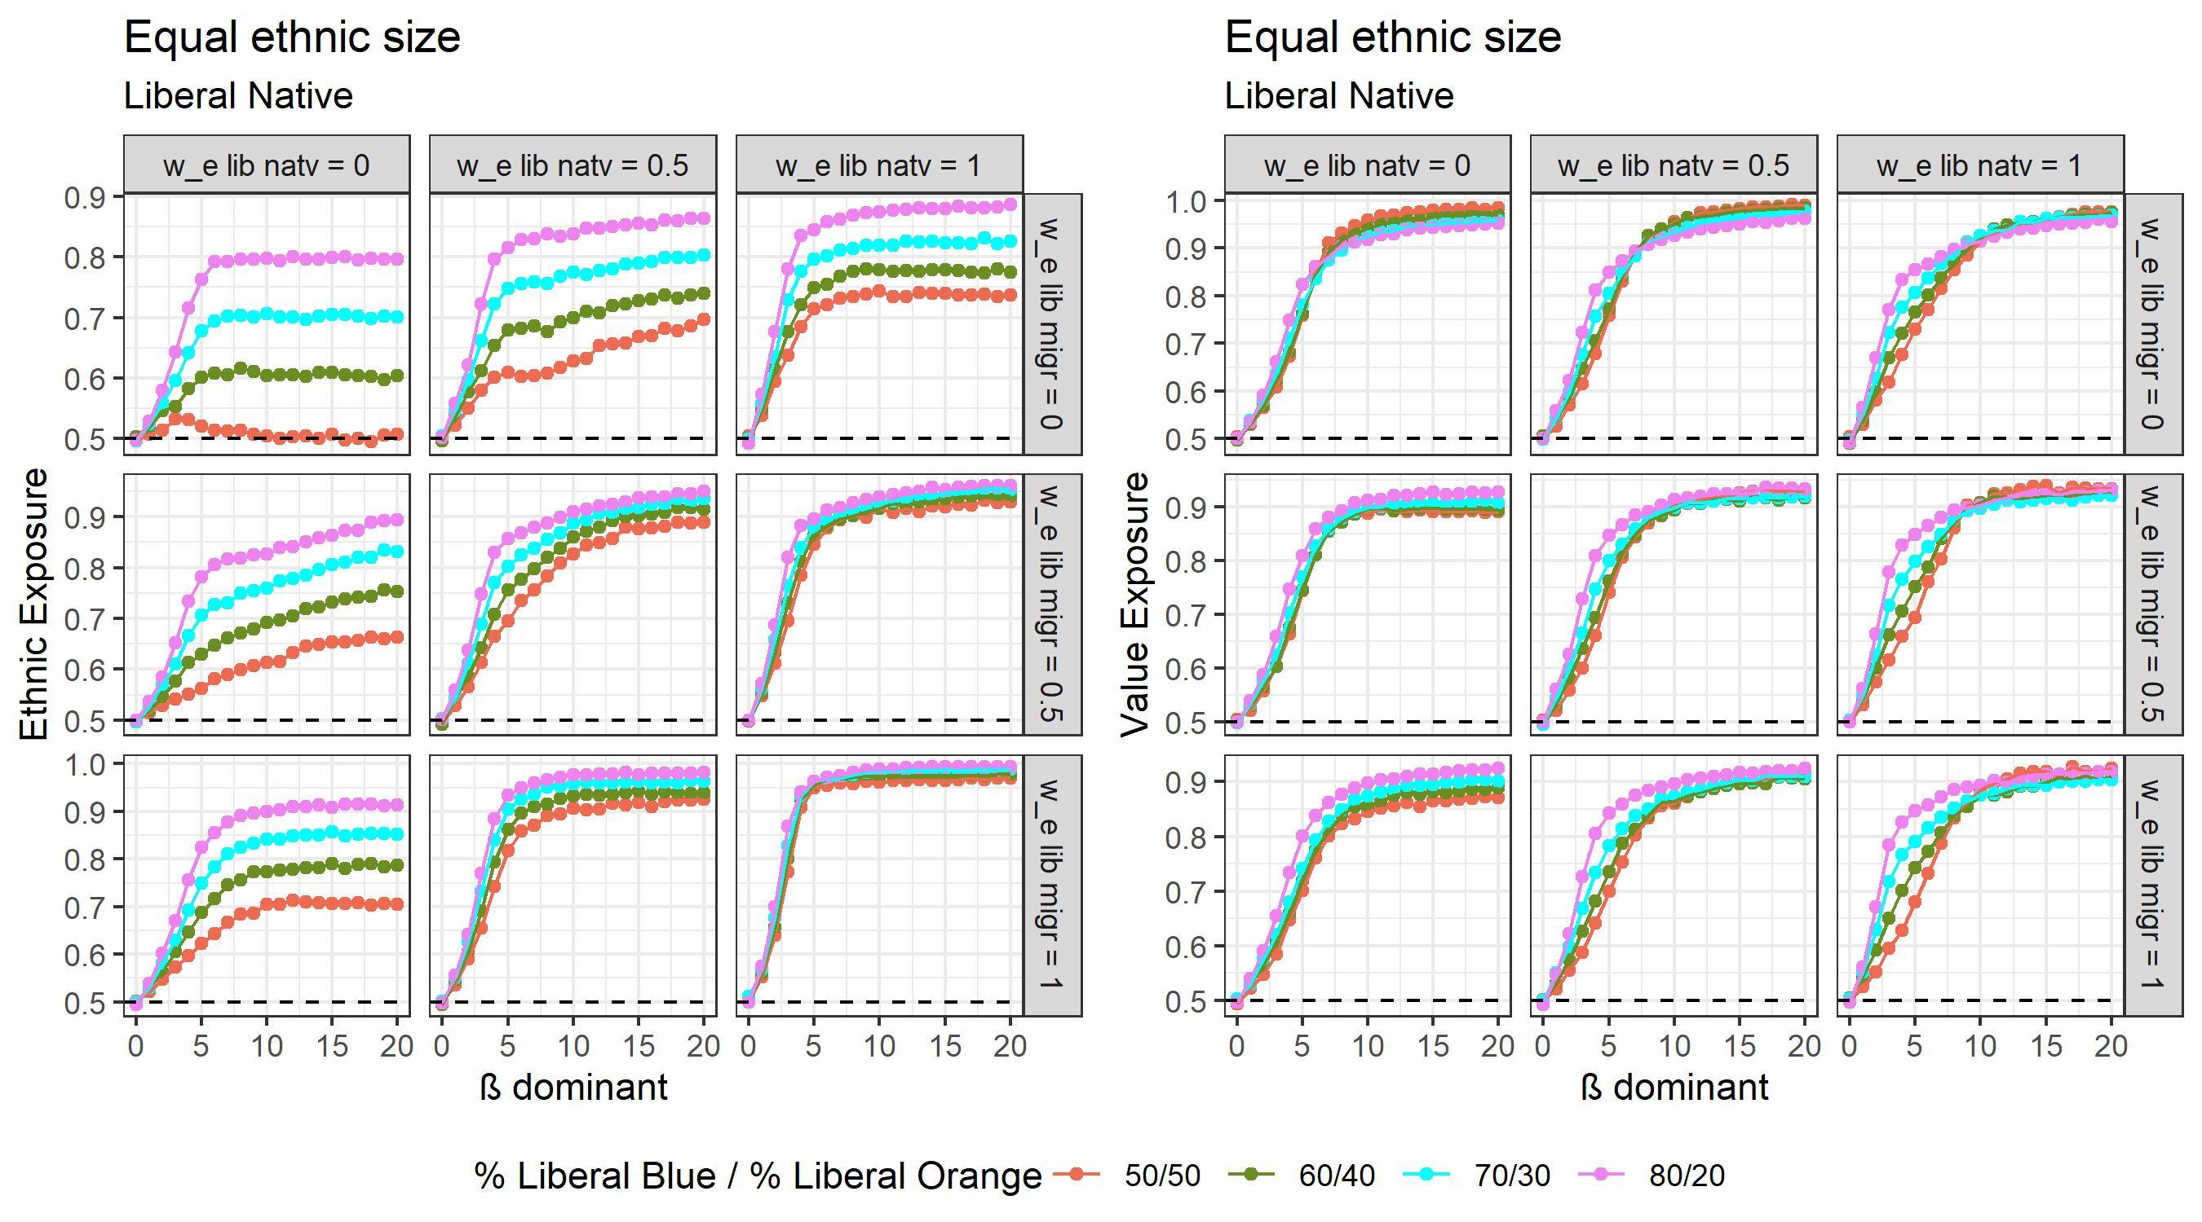

Slide 6
