Slide 1
Agent-Based Modeling Laboratory
Master Universitario di II livello
"Social Data Science" 23/25
Rocco Paolillo
CNR-IRPPS
NetLogo basics
17/04/2025
Reference file: netlogo_basics.nlogo in the repository

Slide 2
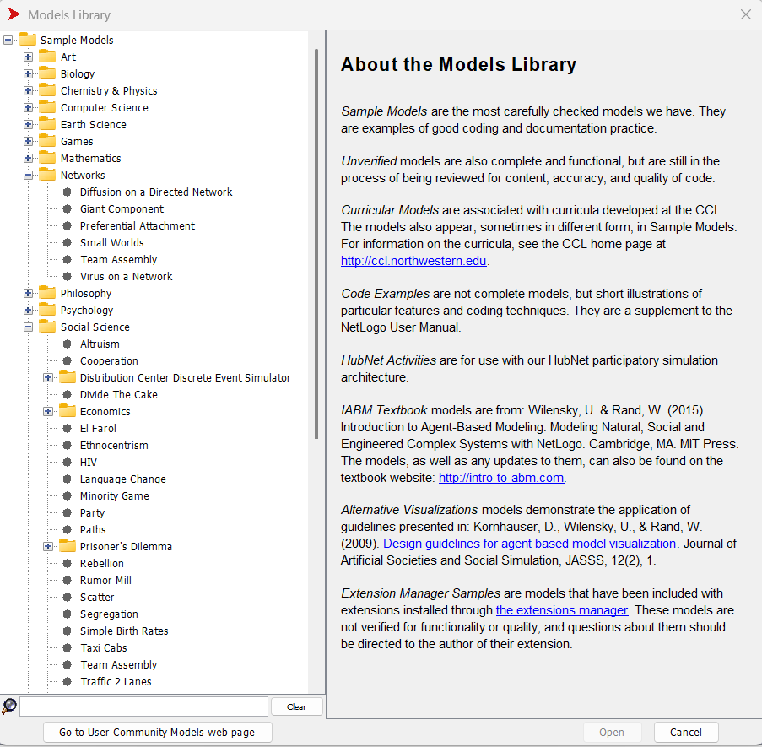

NetLogo
https://ccl.northwestern.edu/netlogo/index.shtml
Programming language (Scala, Java)
Integrated Development Environment
Open Source
Uri Wilensky at Northwestern University
Since 1999
Implement agent-based modeling
Basic programming commands
Parallel computing & experiments (BehaviorSpace)
Widely used in social simulation community
Many models in the library modifiable
Some extensions
Support dictionary: https://ccl.northwestern.edu/netlogo/docs/dictionary.html#lput
File > Models Library
Missione 4 • Istruzione e Ricerca

Slide 3
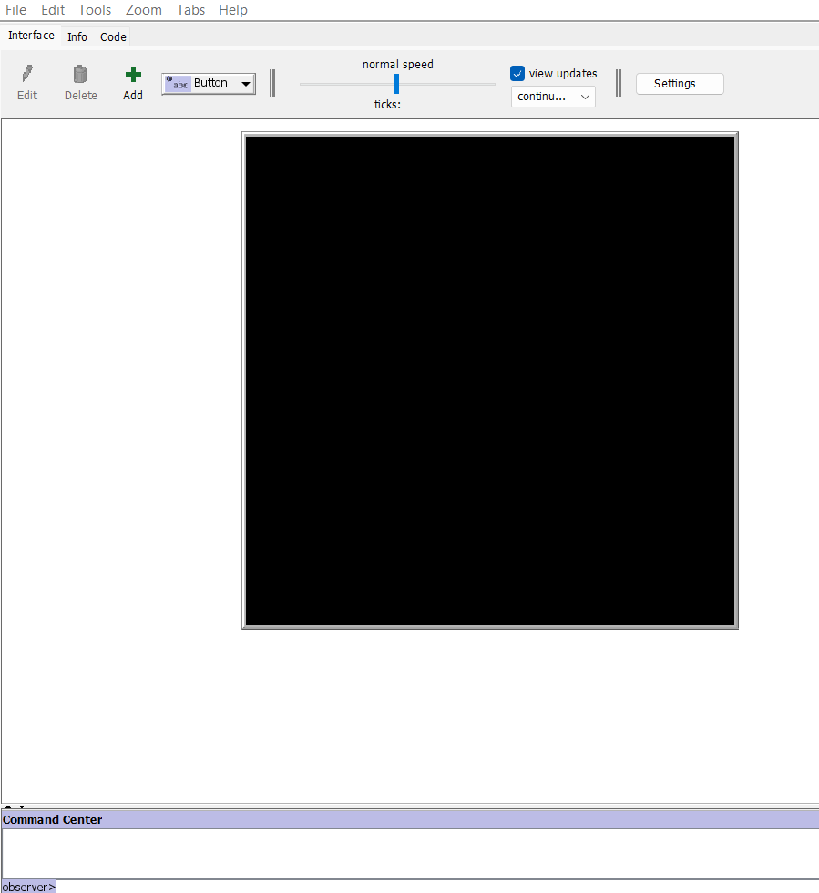
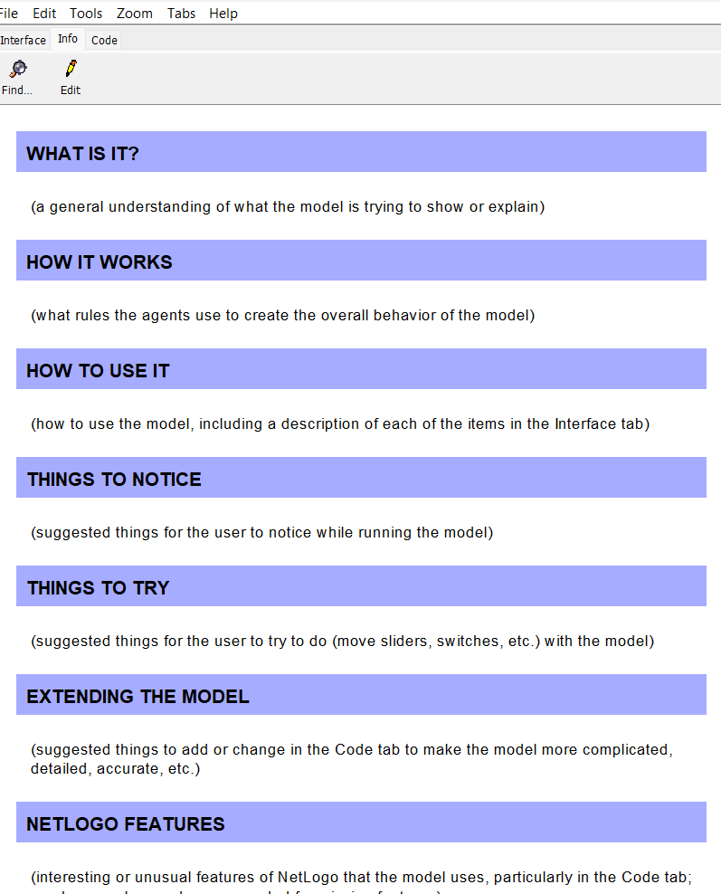
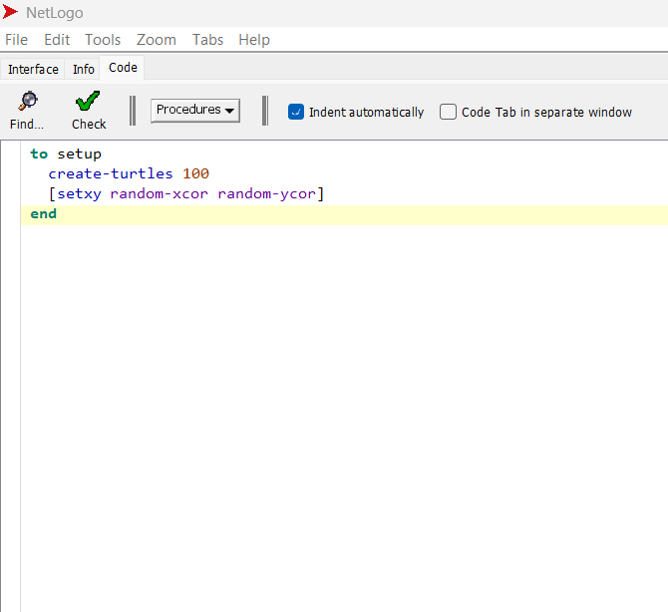
Interface tab
Info tab
Code tab

Slide 4
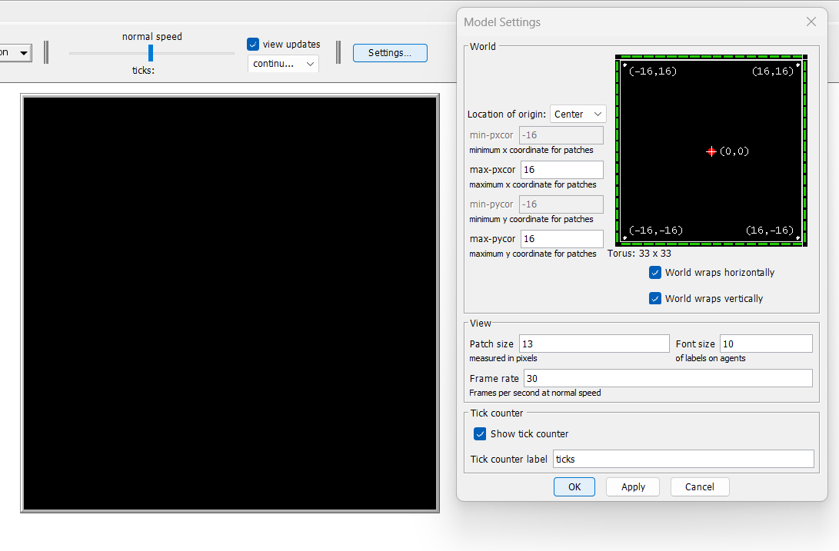

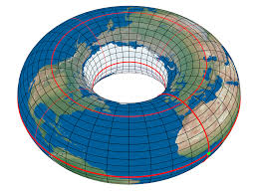
The world: where things happen
It is built on carthesian x-axis & y-axis
You can think of it as a grid, each cell called patch
Size customizable
By defaut, it wraps horizontally and vertically (periodic boundaries conditions: a torus world) – you can set this off

Slide 5
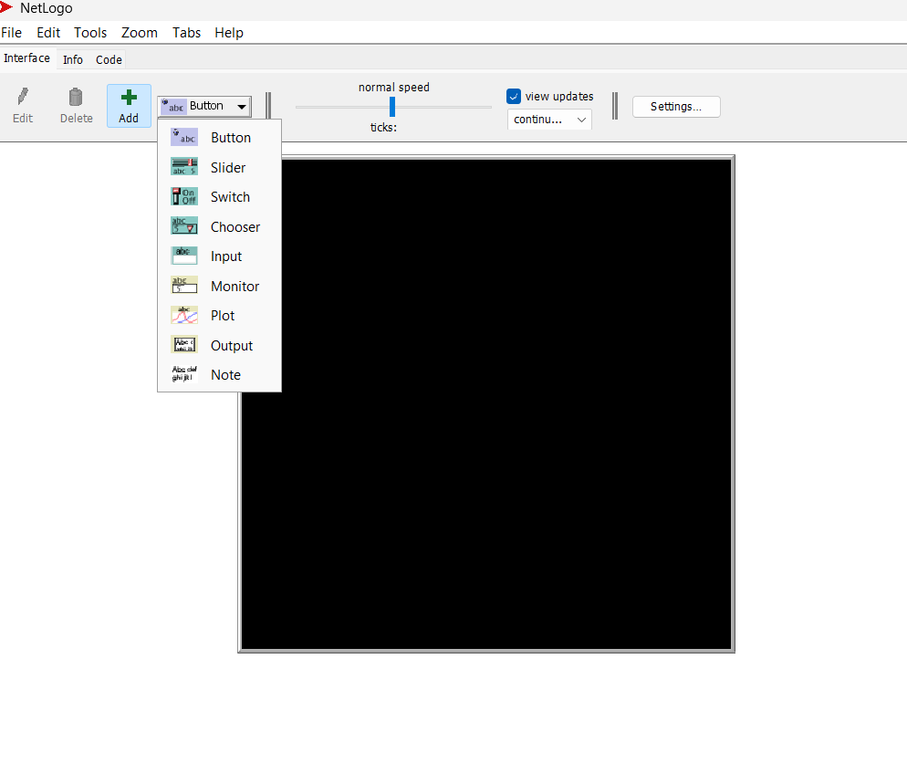
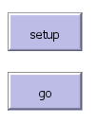


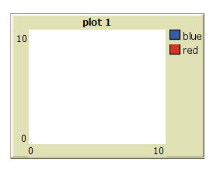

Interface tab
Buttons to call a command
Sliders: tunable parameters
Switch: on/off states
Monitor (number)
plots

Slide 6
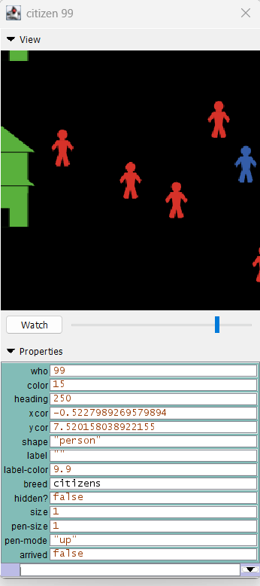
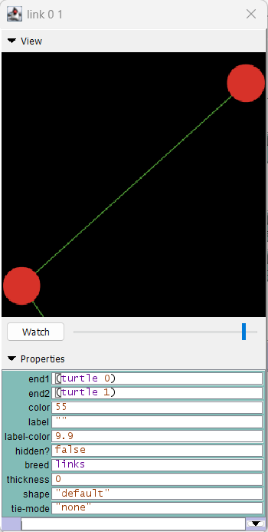
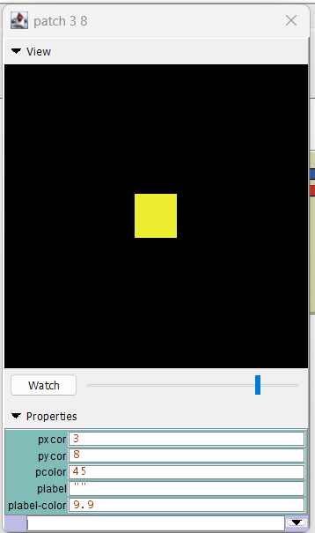
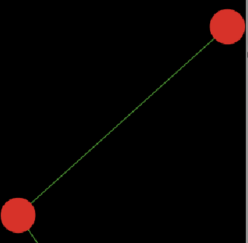



The «agents»
Turtles:
hold information
state & dynamic variable
can move
can be part of a specific breed with specific variables (the equivalent of a class o agent-type in other languages)

Slide 7

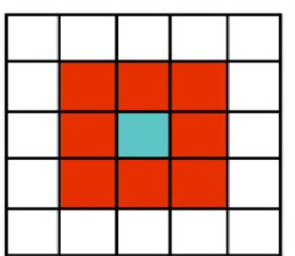
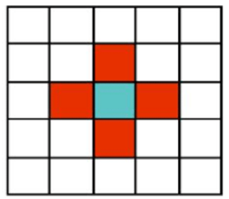
Cellular grid
Most common spatial dimensions already at-hand
We can still model new measures or relation with space between agents
This doesn’t mean we need to use a spatial scale for every model
Moore neighborhood
Von Neumann neighborhood
In python mesa:
neighbors = self.model.grid.get_neighbors(
pos=self.pos,
moore=True,
include_center=False)
neighbors
ask turtles-on neighbors
count turtles-on neighbors

Slide 8


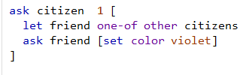
Basic concepts
Scope: a procedure, or a variable, can be:
global: accessible to every agent in the simulation and relative code
local: not accessible to all agents or all procedures with everyone
define a procedure we can ask one agent(s) to execute (and more)
Useful when we need to distinguish behaviors or procedures of only a specific group
ask
an action to execute
only members of the class citizen have an individual variable «arrived»
report
an information to extrapolate
only citizen 1 when running this command knows and can interact with his «friend», who does not exist to other citizens
In python:
def move(self):
# some code

Slide 9

Let me ask all of you, but ask you, but ask to ask to some of you...
the entire agentset of citizens is asked to [move]. The cycle ends when all citizens have completed the task.
(every citizen in random order starts the command [move]. They (kind of) start together, but each citizen can complete the command in different times, affecting the conditions of those starting later (asynchronous behavior).
a tick is a measure of time as model step, it defines the closing of a «cycle» after the previous procedures have been executeed. Usually it goes at the end of go that collects all macro procedures of the simulation. Not the equivalent of seconds in real time!
specifically citizen with who = 1 is asked to move.
a citizen asks another citizen to do something
a citizen asks an agent of another agentset (patch) to do something

Slide 10
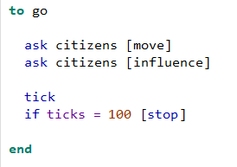
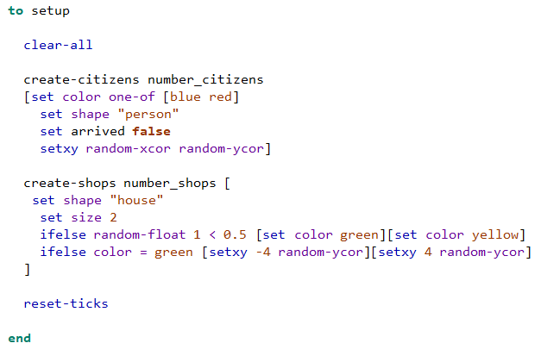
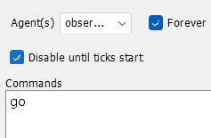
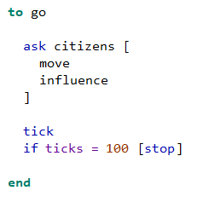
Two «core» procedures
all agents first «move» in random order, when all agents have «moved»,
then all agents «influence» in random order:
at that point a cycle is completed (tick advances of 1 unit)
we need to clean up everything before we start a new model run
if the number of ticks (completed cycles) is equal to 100, the simulation stops
initialize some «classes» of agents and their numeric instances
at each cycle, one random agent «first moves than «influences», then another random agent «first moves than influences» and so forth:
the cycle is done when all agents have run in this order (tick advances of 1 unit)
reset the updating of the world (set to cycle 0)
__init__ in other languages as python
A scheduler in other languages as python

Slide 11

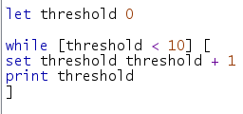
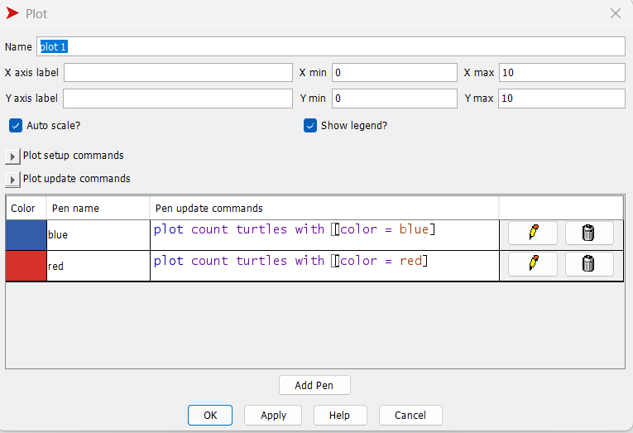



Some more
continuous loop
Numeration in NetLogo starts from 0!
Loop runs a procedure forever, or until a stop condition (quite cumbersome, more efficient with forever button)
Lists are useful for storing values to operate on
(see button lists)
[1 3 5]
[[1 2 4][2 5 6]]
Anonymous procedures are useful to run a procedure over elements of a list
While runs a procedure so far as the condition holds
foreach [1 3 4] [x -> show x + 1 ]
Plots
All turtles must fit the condition
It is enough one turtle fits the condition
Input, equivalent to arguments of a function
(see show report)
To include seeed number: avoid randomness initialization

Slide 12



Extra: other platforms and programming languages
MESA library
https://mesa.readthedocs.io/latest/
a tutorial from conversion NetLogo > Mesa
https://github.com/LABSS/NetLogo2Mesa.git
GAMA (spatially explicit models)
https://gama-platform.org/
check, to model networks
https://networkx.org/documentation/stable/index.html

Slide 13
THANK YOU!
rocco.paolillo@cnr.it

