Slide 1
Docker PostgreSQL HA
Warm Standby

Slide 2

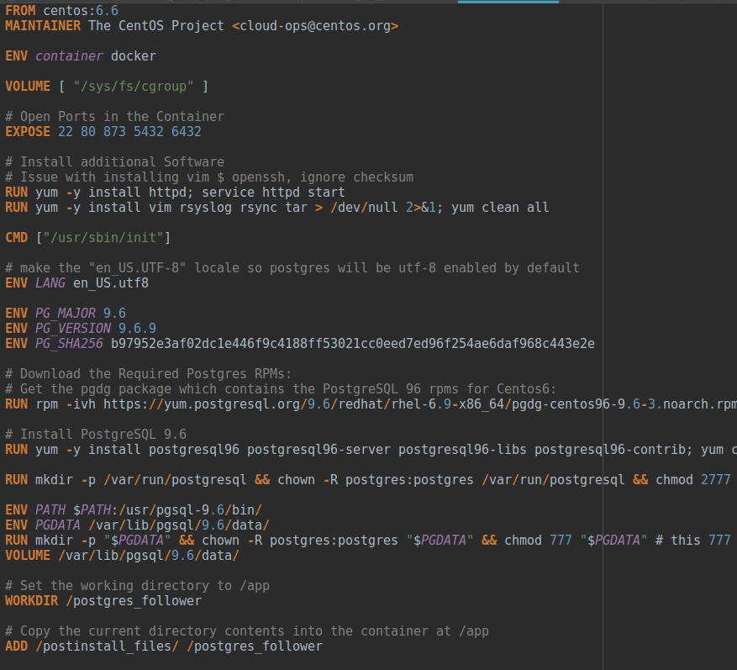

STEP 1 – Create Postgres Services
Dockerfile: Leader & Follower
Base image: Centos 6.6
Expose Ports
Install RPMs
Setup Directories
Add Postinstall files
Dummy Health_Check

Slide 3
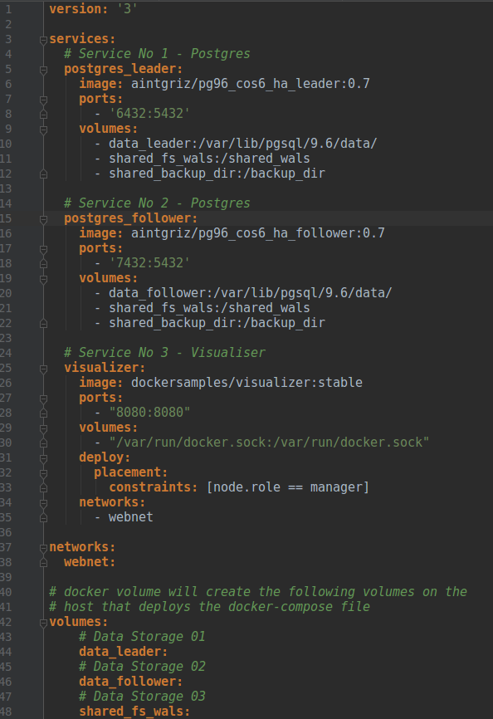
STEP 2 – Compose the Docker Stack
Docker-compose.yml
Create Postgres Leader Service
Create Postgres Follower Service
Map Ports from Container to local host
Create localhost volumes and map the containers
Data Directory
Shared File Systems for:
WAL files
Backup directory for base back up
Use default netowrking for containers

Slide 4
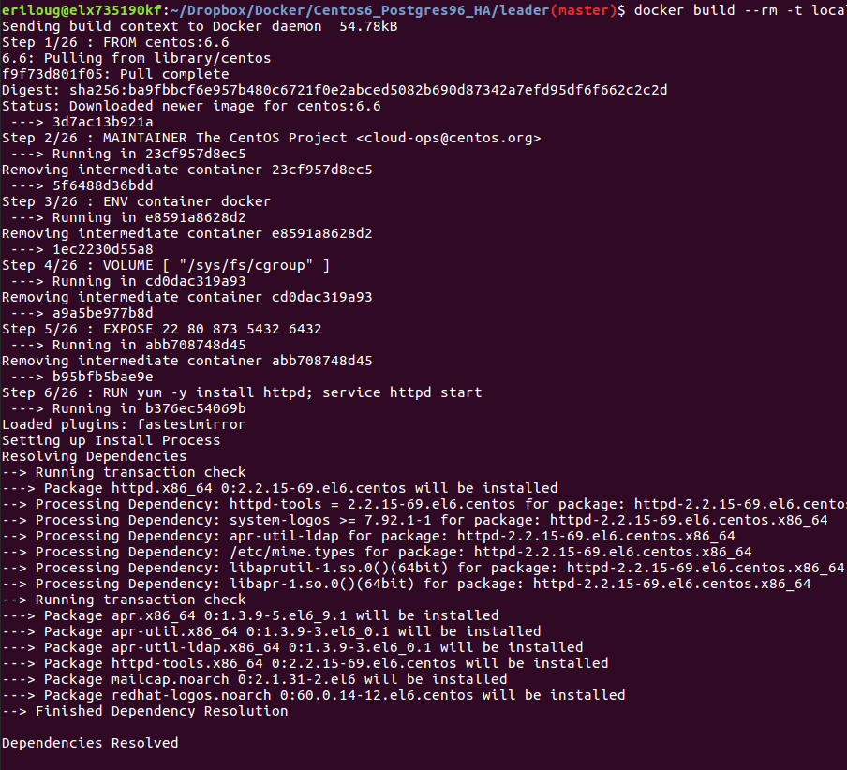
STEP 3 – Build the Docker Images
Docker- Images
Build a local image of Leader/Follower:
docker build --rm -t local/pg96_cos6_ha_leader .
Tag the image:
docker tag: local/pg96_cos6_ha_leader:latest aintgriz/pg96_cos6_ha_leader:0.7
Push the image to the repository:
docker push aintgriz/pg96_cos6_ha_leader:0.7

Slide 5
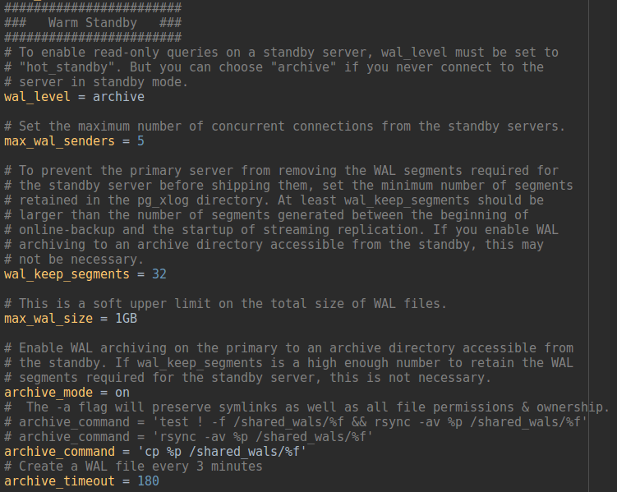

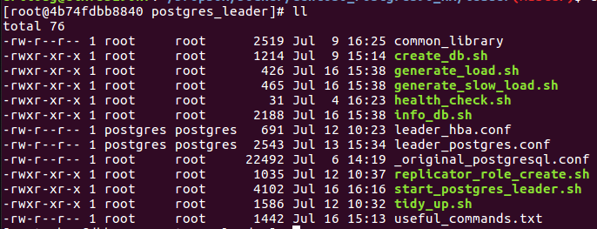

STEP 4 – Deploy the Stack
v
STEP 6 – Start/Initialiase Postgres
Docker- Stack
docker stack deploy -c docker-compose.yml HA
Take the Hostname for Leader and Follower
Hostname –I --> 10.0.0.4 & 10.0.0.6
These values will then be used to update the following files when prompted:
Pg_hba.conf
Recovery.conf
The start script on follower initializes the server
The start script on the leader does the following:
Enable rsyslog
Initialize the database
Copies Customized configurations
Sets the required host based authentication
Sets Archive mode = on
Copies the WALs to shared directory (rsync, cp, etc)
Creates a Replicator Role
Creates a dummy database
Generates 3000 rows into database
STEP 5 – Connect to the Docker Containers
docker exec -ti $(docker ps -qf name=HA_postgres_leader) bash
docker exec -ti $(docker ps -qf name=HA_postgres_follower) bash

Slide 6
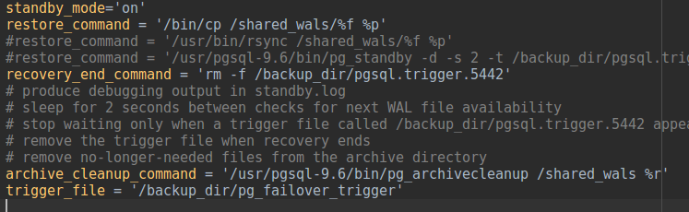
STEP 7 – Backup Leader
Stops postgres on the follower
Creates a recovery.conf and passes in the leaders hostname
Triggers a backup check point on the WALs
Takes a backup of leader and generates a tar file in the shared file system (pg_base_backup)
Untar the backup and replaces the follower data directory with the backup
Restarts postgres
Replays the WALs from the check pointed WAL
Sync all WALs from now on
If a trigger file is created, then the follower can be promoted to Leader

Slide 7
STEP 7 – Resources
Repo:
https://github.com/RoccoRichie/docker_centos6_pg96
Docker Hub:
Leader:
https://hub.docker.com/r/aintgriz/pg96_cos6_ha_leader/tags/
Follower:
https://hub.docker.com/r/aintgriz/pg96_cos6_ha_follower/tags/

