Slide 1

Dictionaries
CS-101
Mahindra Ecole Centrale

Slide 2
Dictionaries – where it stands in your reference frame
By this time you all would be quite familiar with the concept of Lists
Explicitly, a list is a series of elements in an unique sequence
Implicitly, the very fact that it is a sequence adduces a second identity to each element – its position in the sequence, or index number
The index number is an integer that starts with zero at the first element, increasing by one
Thus effectively, in a list, each element represents a pair – its index number, and its actual value
The index number is set by default and is silent, what we see explicitly is just the value.

Slide 3
Dictionaries – where it stands in your reference frame
In a Dictionary, the index number associated with each element is explicitly stated
What this implies is that unlike in a List, where the position of an element is sacrosanct because its unique index is by default associated with that position, in a Dictionary the user can place the index-value pair anywhere in the sequence
This is the first dimension of Generalization of the concept of a List to the concept of a Dictionary
Formally, a dictionary may be stated as:
my_dictionary = {0 : “apple”, 1 : “orange”, 2 : “guava”, 3 : “pear”}
which could equally well be written as:
my_dictionary = {2 : “guava”, 0 : “apple”, 3 : “pear”, 1 : “orange”}.

Slide 4
Dictionaries – where it stands in your reference frame
The second dimension of generalization of List into Dictionary relates to the nature of the Index itself
It can be anything – integer, float or string – as long as it is unique. Not an integer alone, and obviously not any sequence.
So we may write:
my_dictionary = {‘one’ : ‘apple’, ‘B’ : ‘orange’, ‘X’ : ‘guava’}
So as you see the word “index” now has no meaning
Instead we call it as a key
The original element we now call as value
And the key:value pair we call as an item.
And the general form is
dictionary_name = {key_1: value_1, key_2: value_2, key_3: value_3}.

Slide 5
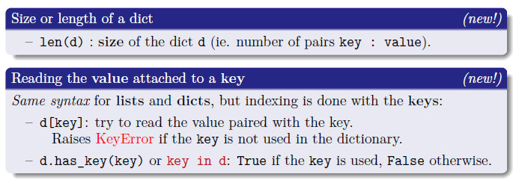
Dictionaries – elementary operations

Slide 6
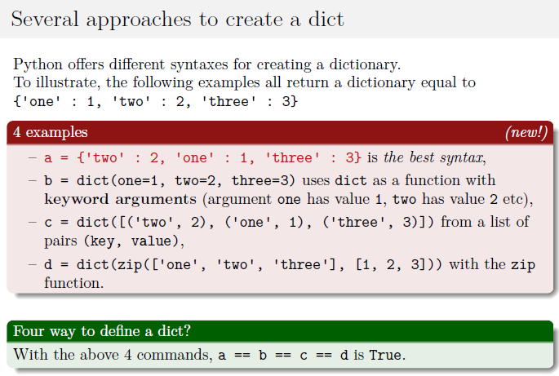
Dictionaries – elementary operations

Slide 7
Dictionaries – elementary operations
You may also start with an empty dictionary and then build up gradually, as in example below :
# Create an empty dictionary:
python_words = {}
# Fill the dictionary, pair by pair.
python_words['list'] ='A collection of unconnected values, with an order'
python_words['dictionary'] = 'A collection of key-value pairs'
python_words['function'] = 'A set of instructions defining a set of actions’
# Final Result
python_words = {'list' : 'A collection of unconnected values, with an order' ,
'dictionary' : 'A collection of key-value pairs’,
'function‘ : 'A set of instructions defining a set of actions’}

Slide 8
Dictionaries – elementary operations
You can access any value by its key, e.g.
print python_words['list']
- A collection of unconnected values, with an order
You can modify any value by redefining it using its key.
# Modify one of the keys:
python_words['function'] = 'A set of instructions defining a set of actions in a programming language’
# Final Result
python_words = {'list' : 'A collection of unconnected values, with an order' ,
'dictionary' : 'A collection of key-value pairs’,
'function‘ : 'A set of instructions defining a set of actions in a
programming language’}
And you can delete any item by deleting its key:
del python_words[‘list’]
How would you modify the key of an item keeping the value same?

Slide 9
Dictionaries – looping over dictionaries
# The basic dictionary
my_dict = {'key_1': 'value_1', 'key_2': 'value_2', 'key_3': 'value_3'}
# Looping over the keys
for k in my_dict.keys():
print "Key is ", k
# Looping over the keys, default mode where “keys()” is redundant
for k in my_dict:
print "Key is ", k
# Looping over the values
for v in my_dict.values():
print "Value is ", v
# Looping over both keys and values in a single loop
for k, v in my_dict.items():
print "Key is ", k
print "Corresponding value is ", v

Slide 10
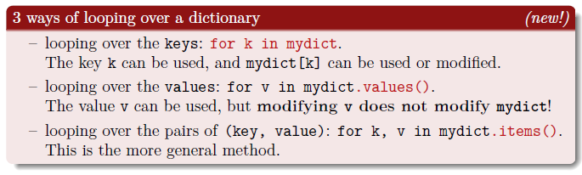
Dictionaries – looping over dictionaries
One can loop through a dictionary by going over its keys, going over its values, or going over its key-value pairs
Going over keys is the default mode
We have seen examples of each.

Slide 11
Nested Dictionaries – Values themselves can be Lists or Dictionaries
# This program stores people's favorite numbers, and displays them.
favorite_numbers = {'Ram': [3, 11, 19, 23, 42], 'Shyam': [2, 4, 5], 'Hari': [5, 35, 120]}
# Display each person's favorite numbers.
for name in favorite_numbers:
print name, "'s favourite numbers are:"
print favorite_numbers[name]
# Output
Ram 's favourite numbers are
[3, 11, 19, 23, 42]
Shyam 's favourite numbers are
[2, 4, 5]
Hari 's favourite numbers are
[5, 35, 120]

Slide 12
Nested Dictionaries – Values themselves can be Lists or Dictionaries
# Display each person's favorite numbers.
for name in favorite_numbers:
print name, "'s favourite numbers are:"
for number in favorite_numbers[name]:
print number
# Output
Ram 's favourite numbers are:
3
11
19
23
42
Shyam 's favourite numbers are:
2
4
5
Hari 's favourite numbers are:
5
35
120

Slide 13
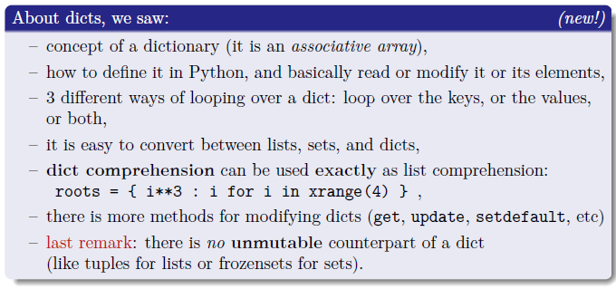
Summarizing Dictionaries
A good source of information on dictionaries is:
http://introtopython.org/dictionaries.html

