Slide 1
SHORTEST PATH PROBLEM

Slide 2
Shortest path problem
Let us consider number of cities connected with roads and a traveler wants to travel from his home city A to destination B with minimum cost. So, the traveler will be interested to know the following:
Is there a path from city A to city B?
If there are more than one path from city A to B, than whick is smallest or least cost path ?
The solution to this problem is suggested by E.W. Dijkstra and algorithm is popularly known as Dijkstra’s Algorihtm

Slide 3
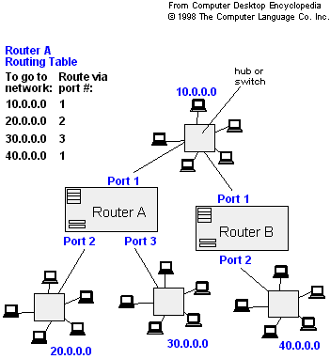
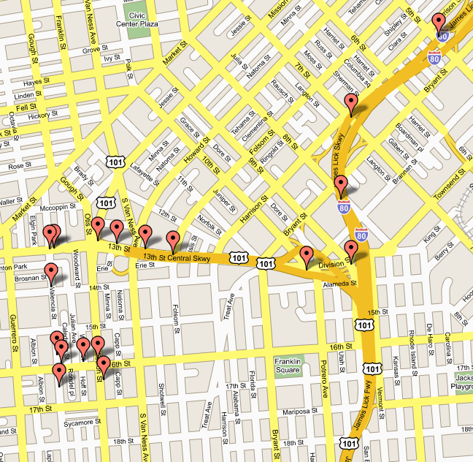
Applications
- Maps (Map Quest, Google Maps)
- Routing Systems

Slide 4
Dijkstra’s Algorithm
Slide Courtesy: Uwash, UT

Slide 5
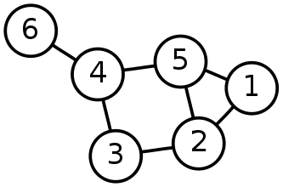
Single-Source Shortest Path Problem
Single-Source Shortest Path Problem - The problem of finding shortest paths from a source vertex v to all other vertices in the graph.

Slide 6
Applications
- Maps (Map Quest, Google Maps)
- Routing Systems

Slide 7
Dijkstra's algorithm
Dijkstra's algorithm - is a solution to the single-source shortest path problem in graph theory.
Works on both directed and undirected graphs. However, all edges must have nonnegative weights.
Input: Weighted graph G={E,V} and source vertex v∈V, such that all edge weights are nonnegative
Output: Lengths of shortest paths (or the shortest paths themselves) from a given source vertex v∈V to all other vertices

Slide 8
Approach
Given a graph and a source vertex in the graph, find shortest paths from source to all vertices in the given graph.
We maintain two sets, one set contains vertices included in shortest path tree , other set includes vertices not yet included in shortest path tree. At every step of the algorithm, we find a vertex which is in the other set (set of not yet included) and has a minimum distance from the source.
Below are the detailed steps used in Dijkstra’s algorithm.
1) Create a set sptSet (shortest path tree set) that keeps track of vertices included in shortest path tree, i.e., whose minimum distance from source is calculated and finalized. Initially, this set is empty. 2) Assign a distance value to all vertices in the input graph. Initialize all distance values as INFINITE. Assign distance value as 0 for the source vertex so that it is picked first. 3) While sptSet doesn’t include all vertices ….a) Pick a vertex u which is not there in sptSet and has minimum distance value. ….b) Include u to sptSet. ….c) Update distance value of all adjacent vertices of u. To update the distance values, iterate through all adjacent vertices. For every adjacent vertex v, if sum of distance value of u (from source) and weight of edge u-v, is less than the distance value of v, then update the distance value of v.

Slide 9
Dijkstra’s Animation
http://optlab-server.sce.carleton.ca/POAnimations2007/DijkstrasAlgo.html

Slide 10
Example: Initialization
Distance(source) = 0
0
∞
Distance (all vertices but source) = ∞
A
2
B
4
1
3
10
∞
C
2
D
2
E
∞
5
8
∞
4
6
F
1
G
∞
∞
Pick vertex in List with minimum distance.

Slide 11
Example: Update neighbors' distance
0
2
A
2
B
4
1
3
10
∞
C
2
D
2
E
∞
5
8
1
4
6
Distance(B) = 2
F
1
G
Distance(D) = 1
∞
∞

Slide 12
Example: Remove vertex with minimum distance
0
2
A
2
B
4
1
3
10
∞
C
2
D
2
E
∞
5
8
1
4
6
F
1
G
∞
∞
Pick vertex in List with minimum distance, i.e., D

Slide 13
Example: Update neighbors
0
2
A
2
B
4
1
3
10
3
C
2
D
2
E
3
5
8
1
4
6
Distance(C) = 1 + 2 = 3 Distance(E) = 1 + 2 = 3 Distance(F) = 1 + 8 = 9 Distance(G) = 1 + 4 = 5
F
1
G
9
5

Slide 14
Example: Continued...
Pick vertex in List with minimum distance (B) and update neighbors
0
2
A
2
B
4
1
3
10
3
C
2
D
2
E
3
5
8
1
4
6
Note : distance(D) not updated since D is already known and distance(E) not updated since it is larger than previously computed
F
1
G
9
5

Slide 15
Example: Continued...
Pick vertex List with minimum distance (E) and update neighbors
0
2
A
2
B
4
1
3
10
3
C
2
D
2
E
3
5
8
1
4
6
F
1
G
No updating
9
5

Slide 16
Example: Continued...
Pick vertex List with minimum distance (C) and update neighbors
0
2
A
2
B
4
1
3
10
3
C
2
D
2
E
3
5
8
1
4
6
Distance(F) = 3 + 5 = 8
F
1
G
8
5

Slide 17
Example: Continued...
Pick vertex List with minimum distance (G) and update neighbors
0
2
A
2
B
4
1
3
10
3
C
2
D
2
E
3
5
8
1
4
6
F
1
G
Previous distance
6
5
Distance(F) = min (8, 5+1) = 6

Slide 18
Example (end)
0
2
A
2
B
4
1
3
10
3
C
2
D
2
E
3
5
8
1
4
6
F
1
G
6
5
Pick vertex not in S with lowest cost (F) and update neighbors

Slide 19
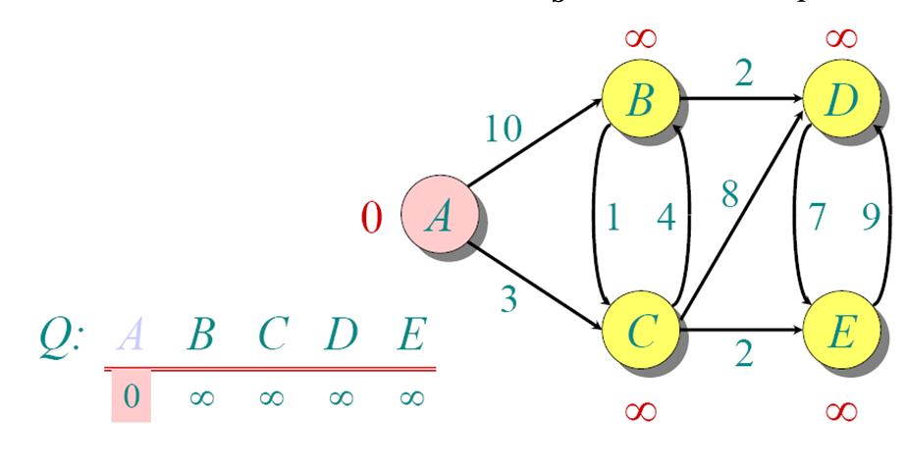
Another Example

Slide 20
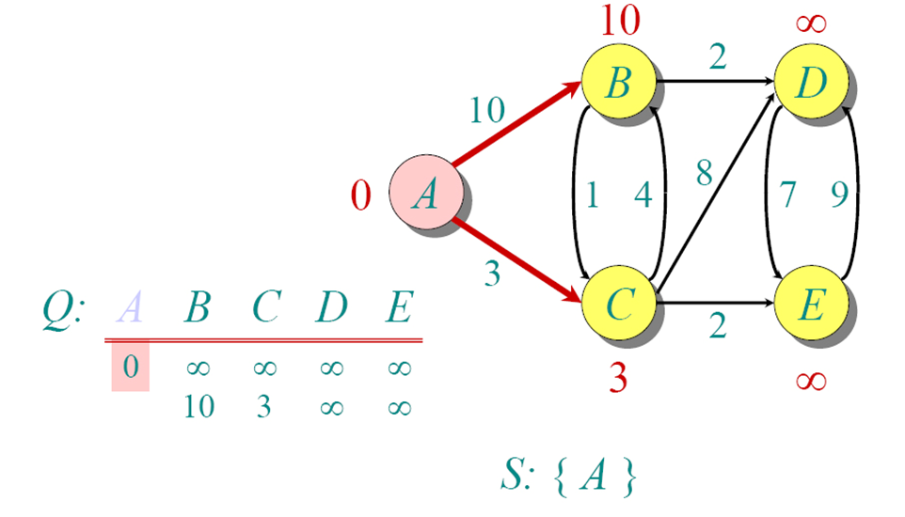
Another Example

Slide 21
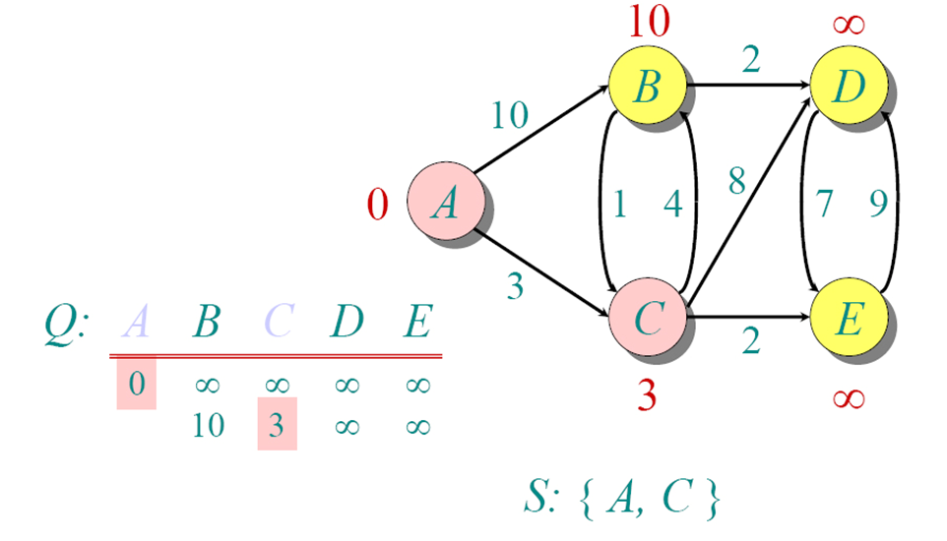
Another Example

Slide 22
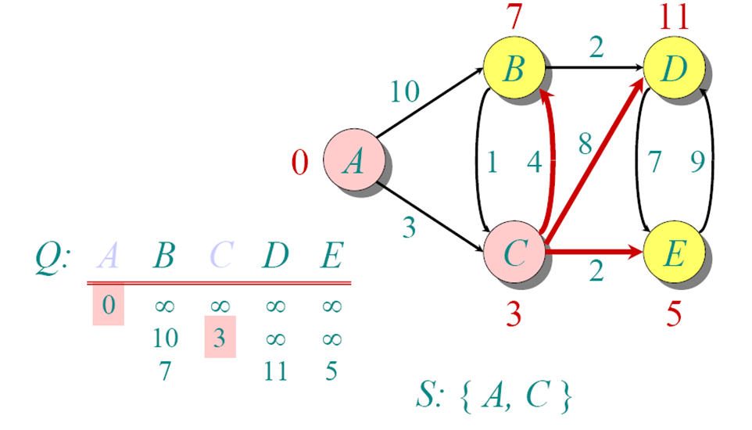
Another Example

Slide 23
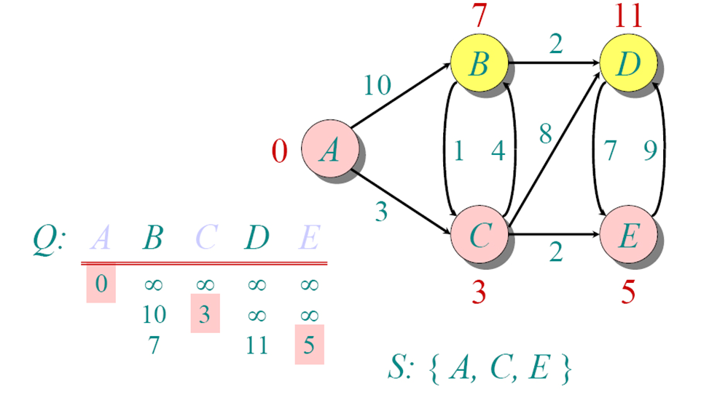
Another Example

Slide 24
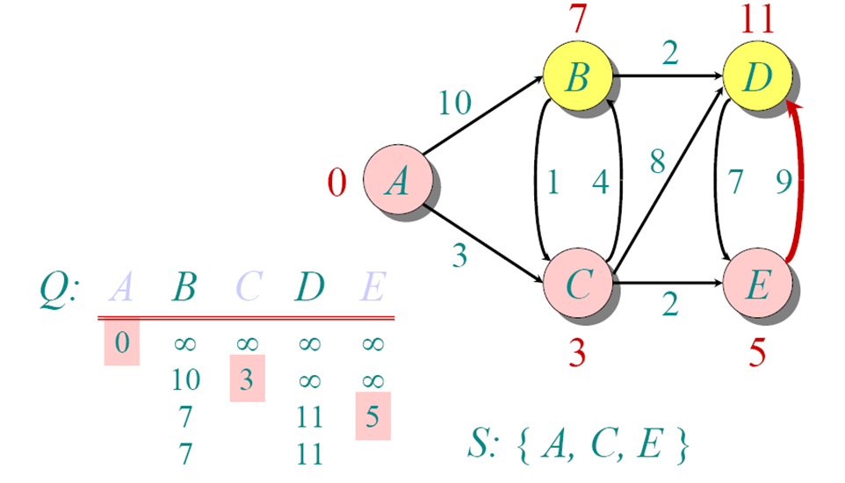
Another Example

Slide 25
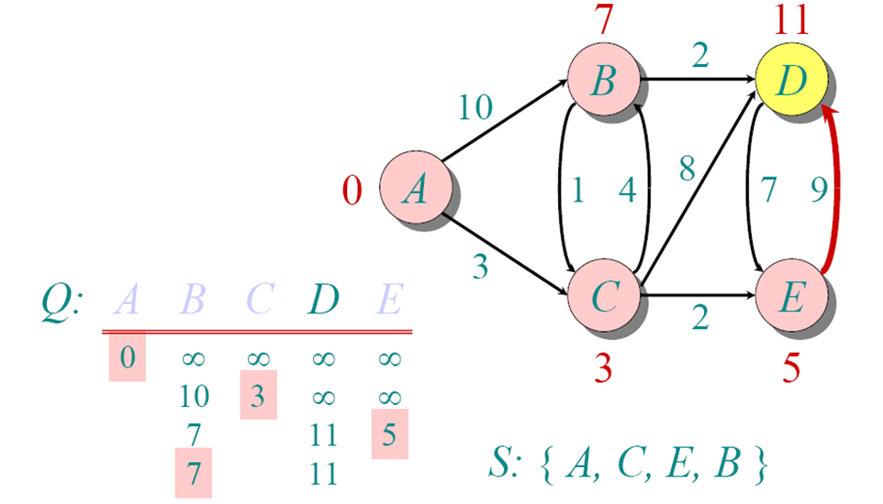
Another Example

Slide 26
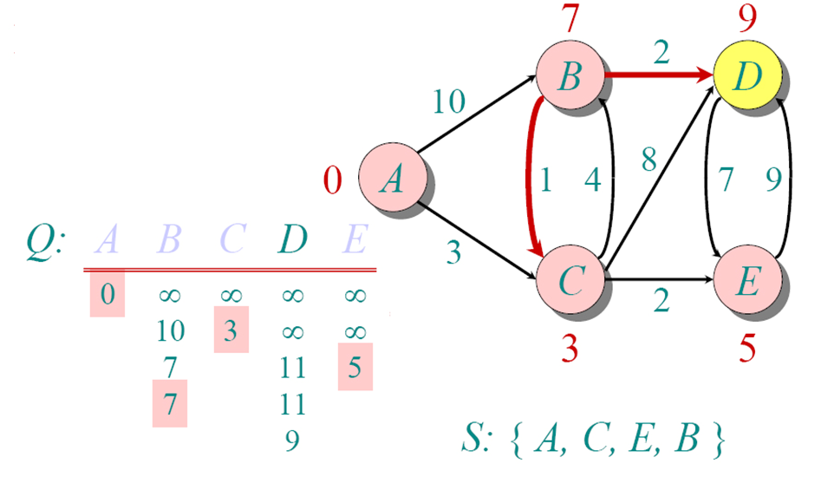
Another Example

Slide 27
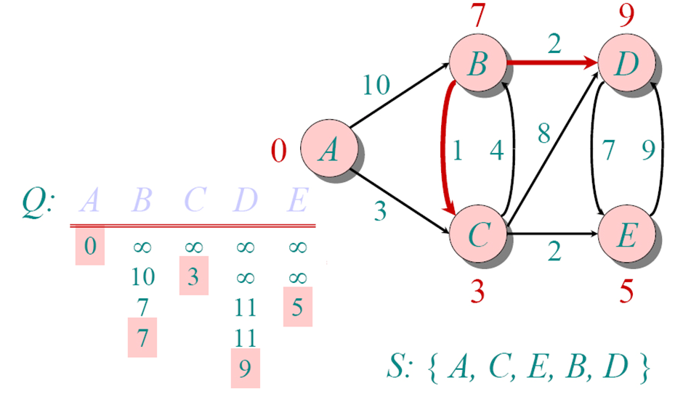
Another Example

Slide 28
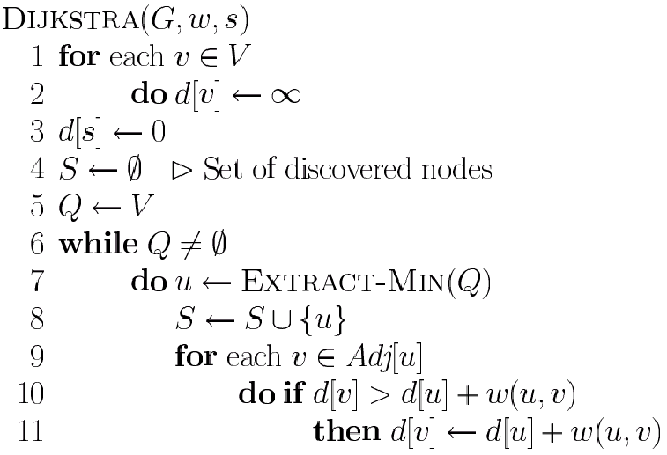
Dijkstra’s Pseudo Code
Graph G, weight function w, root s
Distance updation

Slide 29
Time Complexity: Using List
The simplest implementation of the Dijkstra's algorithm stores vertices in an ordinary linked list or array
Good for dense graphs (many edges)
|V| vertices and |E| edges
Initialization O(|V|)
While loop O(|V|)
Find and remove min distance vertices O(|V|)
Potentially |E| updates
Update costs O(1)
Total time O(|V²| + |E|) = O(|V²| )

Slide 30
Summary
Greedy method
Solved following problems using greedy method
Fractional and 0/1 knapsack problem
Prim’s and Krushkal’s for MST
Optimal merge pattern
Huffman coding
Shortest path problem (Dijkstras)

Slide 31
Time Complexity: Priority Queue
For sparse graphs, (i.e. graphs with much less than |V²| edges) Dijkstra's implemented more efficiently by priority queue
Initialization O(|V|) using O(|V|) buildHeap
While loop O(|V|)
Find and remove min distance vertices cost O(log |V|)
Potentially |E| updates
Update costs O(log |V|)
Total time O(|V|log|V| + |E|log|V|) = O(|E|log|V|)
|V| = O(|E|) assuming a connected graph

