Slide 1
BINARY SEARCH

Slide 2
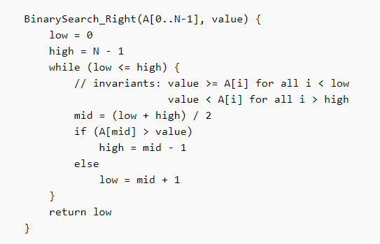
Iterative Pseudocode:

Slide 3
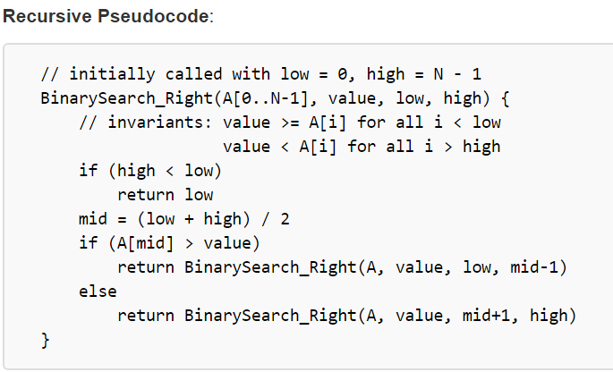

Slide 4
