Slide 1
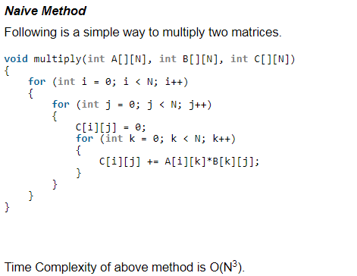
Strassen’s Matrix Multiplication

Slide 2
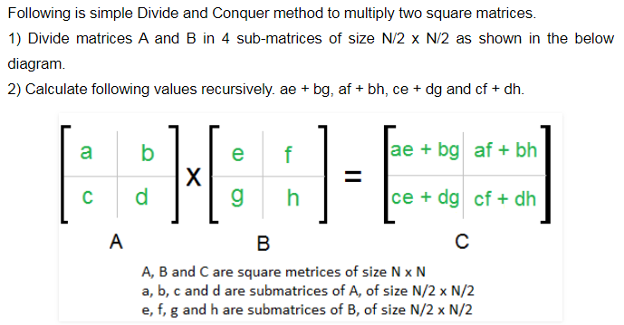
Divide and Conquer Approach

Slide 3
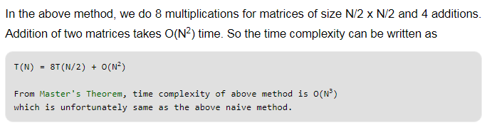
Divide and Conquer Approach

Slide 4
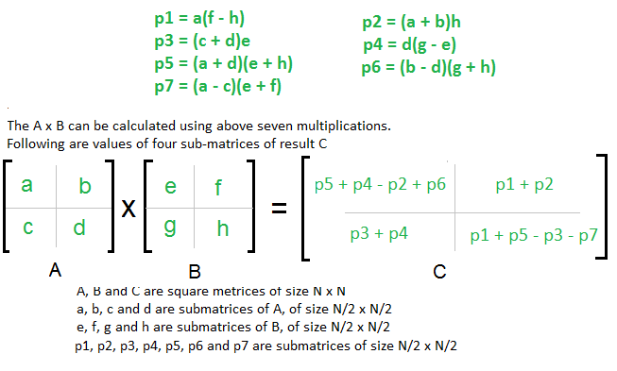
Simple Divide and Conquer also leads to O(N³), can there be a better way?
In the above divide and conquer method, the main component for high time complexity is 8 recursive calls. The idea of Strassen’s method is to reduce the number of recursive calls to 7.
Strassen’s method is similar to above simple divide and conquer method in the sense that this method also divide matrices to sub-matrices of size N/2 x N/2 as shown in the previous diagram, but in Strassen’s method, the four sub-matrices of result are calculated using following formulae.

Slide 5
Time Complexity of Strassen’s Method
Addition and Subtraction of two matrices takes O(N²) time. So time complexity can be written as
T(N) = 7T(N/2) + O(N²)
From Master's Theorem, time complexity of above method is O(N^{Log7}) which is approximately O(N^{2.8074})

Slide 6
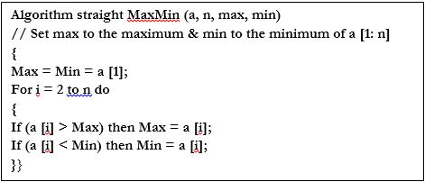
Max-Min Problem
Problem Statement
The Max-Min Problem is finding the maximum and minimum value in an array
Naïve Approach
In this method, the maximum and minimum number can be found separately.
Analysis
The number of comparison in Naive method is 2n - 2.
The number of comparisons can be reduced using the divide and conquer approach.

Slide 7
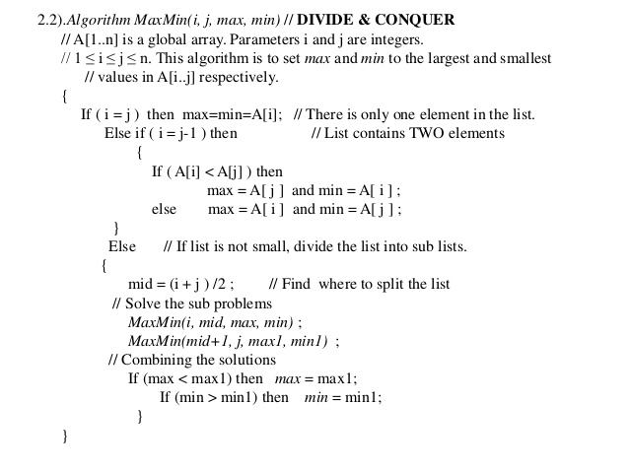
Divide and Conquer Approach.
In this approach, the array is divided into two halves. Then using recursive approach maximum and minimum numbers in each halves are found. Later, return the maximum of two maxima of each half and the minimum of two minima of each half.

Slide 8
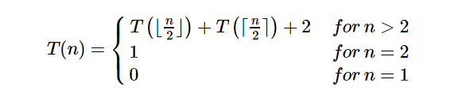
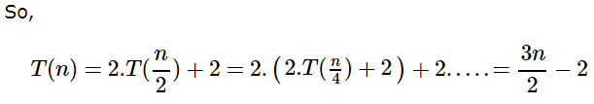
Analysis of Time Complexity
Let T(n) be the number of comparisons made by Max−Min Algorithm, then the recurrence relation can be represented as
Let us assume that n is in the form of power of 2. Hence, n = 2^{k} where k is height of the recursion tree.
Note: Compared to Naïve method, in divide and conquer approach, the number of comparisons is less. However, using the asymptotic notation both of the approaches are represented by O(n).

Slide 9
Max-Min Problem
The Max-Min Problem in algorithm analysis is finding the maximum and minimum value in an array.

Slide 10
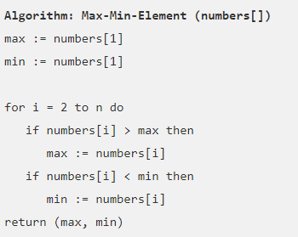
Naïve Method

Slide 11
Analysis
The number of comparison in Naive method is 2n - 2.
The number of comparisons can be reduced using the divide and conquer approach.

Slide 12
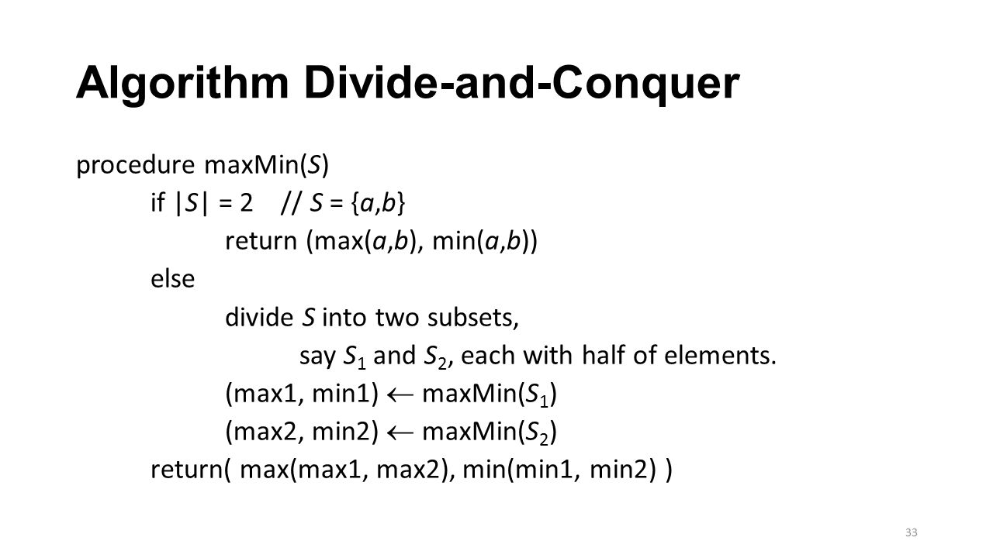

Slide 13
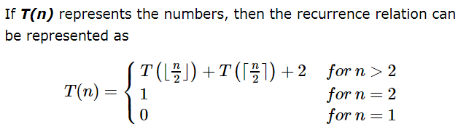
Analysis

Slide 14
Summary
General Divide and Conquer (DAC) method
Solved and analyzed following five problems using DAC
Binary Search
Merger Sort
Quick Sort
Strassen’s Matrix Multiplication.
Max-Min

