Slide 1

Ajeet K. Jain, M. Narsimlu
(ML TEAM)- SONET, KMIT, Hyderabad

Slide 2

This session deals with
Why Clustering
What is Clustering
Types of Clustering Algorithms
KMeans

Slide 3


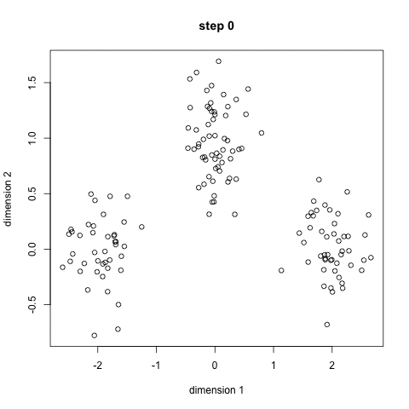
Clustering is a Machine Learning technique that involves the grouping of data points.
we can use a clustering algorithm to classify each data point into a specific group
data points that are in the same group should have similar properties and/or features, while data points in different groups should have highly dissimilar properties and/or features.

Slide 4

Clustering can be considered the most important unsupervised learning problem
it deals with finding a structure in a collection of unlabeled data.
clustering could be “the process of organizing objects into groups whose members are similar in some way”.
A cluster is a collection of objects which are “similar” between them and are “dissimilar” to the objects belonging to other clusters

Slide 5
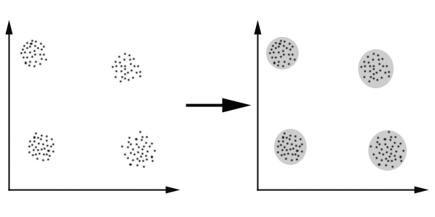

Slide 6

Marketing: finding groups of customers with similar behavior given a large database of customer data containing their properties and past buying records;
Biology: classification of plants and animals given their features;
Libraries: book ordering;
Insurance: identifying groups of motor insurance policy holders with a high average claim cost; identifying frauds;
City-planning: identifying groups of houses according to their house type, value and geographical location;
Earthquake studies: clustering observed earthquake epicenters to identify dangerous zones;
WWW: document classification; clustering weblog data to discover groups of similar access patterns.

Slide 7











Aprior Algorithms
KMeans
Mixture of Gaussians
Exclusive clustering algorithm
probabilistic clustering algorithm
Fuzzy C-means
Hierarchical clustering
overlapping clustering algorithm

Slide 8

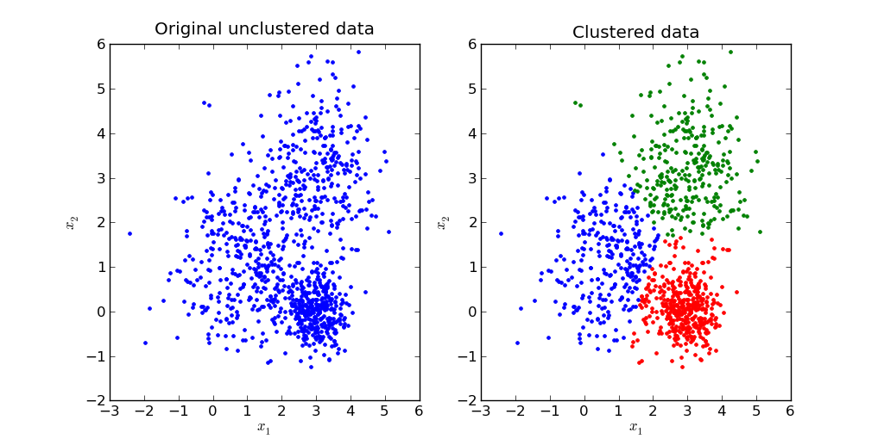
The goal of this algorithm is to find groups(clusters) in the given data.
Clustering is a type of Unsupervised learning

Slide 9

Image Segmentation
Clustering Gene Segementation Data
News Article Clustering
Clustering Languages
Species Clustering
Anomaly Detection

Slide 10

Assuming we have inputs x1, x2, x3, ..., xn and value of K
Step 1 - Pick K random points as cluster centers called centroids.
Step 2 - Assign each xi to nearest cluster by calculating its distance to each centroid.
Step 3 - Find new cluster center by taking the average of the assigned points.
Step 4 - Repeat Step 2 and 3 until none of the cluster assignments change.

Slide 11
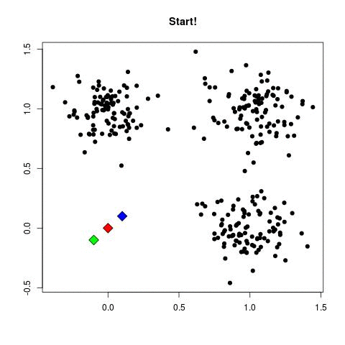
K-Means Clustering on a two dimensional data

Slide 12



Step 3
we find the new centroid by taking the average of all the points assigned to that cluster.

Slide 13
Step 4
we repeat step 2 and 3 until none of the cluster assignments change.
That means until our clusters remain stable

Slide 14

We often know the value of K. In that case we use the value of K.
Else we use the Elbow Method.

Slide 15
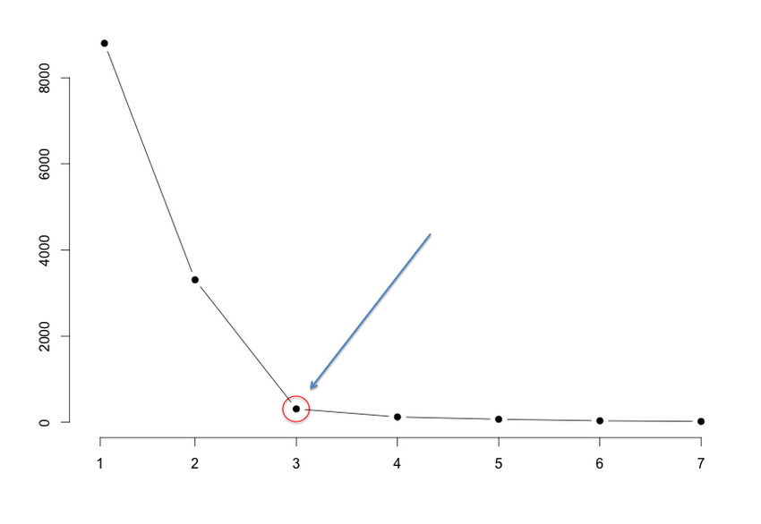

Slide 16
We run the algorithm for different values of K(say K = 10 to 1) and
plot the K values against SSE(Sum of Squared Errors).
Else we use the Elbow Method.
select the value of K for the elbow point

Slide 17

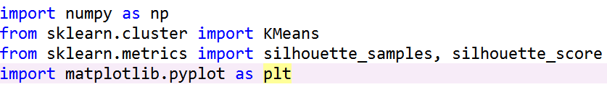

Slide 18

Silhouette analysis can be used to study the separation distance between the resulting clusters.
The silhouette plot displays a measure of how close each point in one cluster is to points in the neighboring clusters.
This measure has a range of [-1, 1].
+1 indicate that the sample is far away from the neighboring clusters.
0 indicates that the sample is on or very close to the decision boundary between two neighboring clusters
negative values indicate that those samples might have been assigned to the wrong cluster.

Slide 19

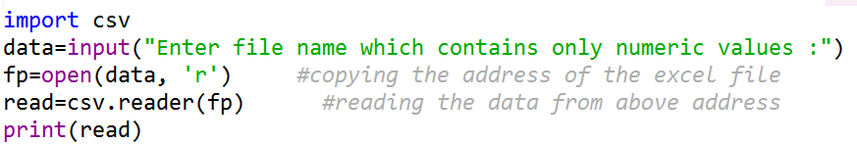

Slide 20

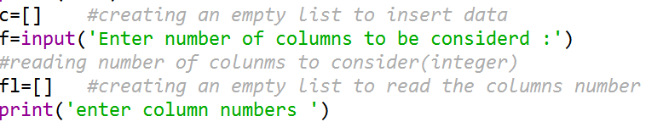

Slide 21

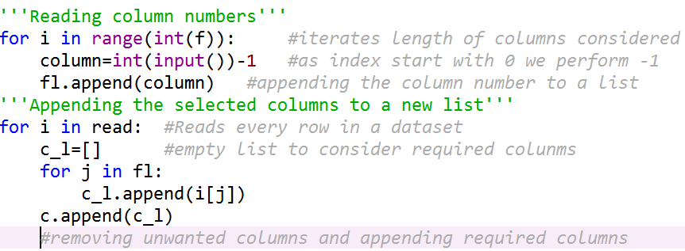

Slide 22

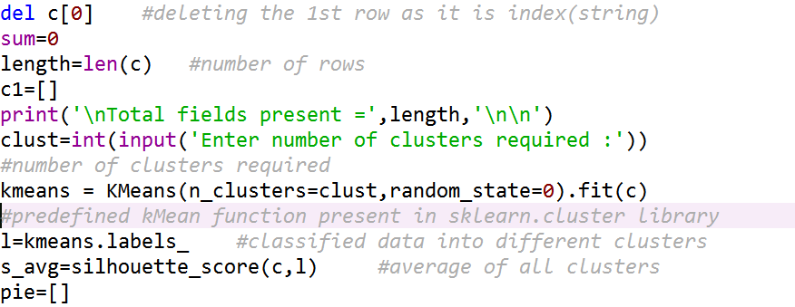

Slide 23

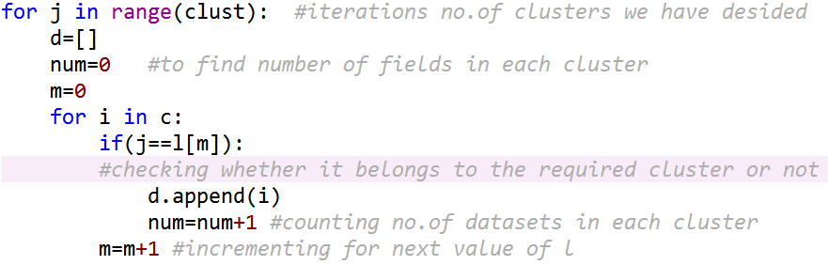

Slide 24
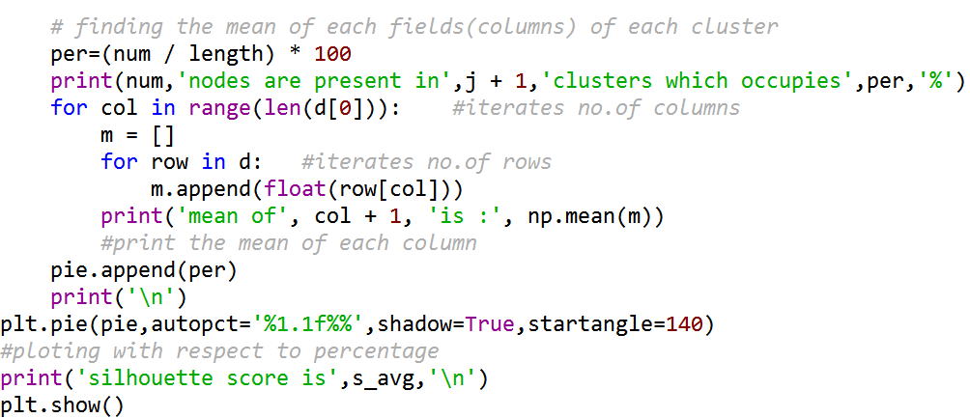

Slide 25

You are aware of
K-Means study
We will proceed with
Case Study

Slide 26


