Slide 1
Organizational Learning in Healthcare
Student’s Name
Date

Slide 2
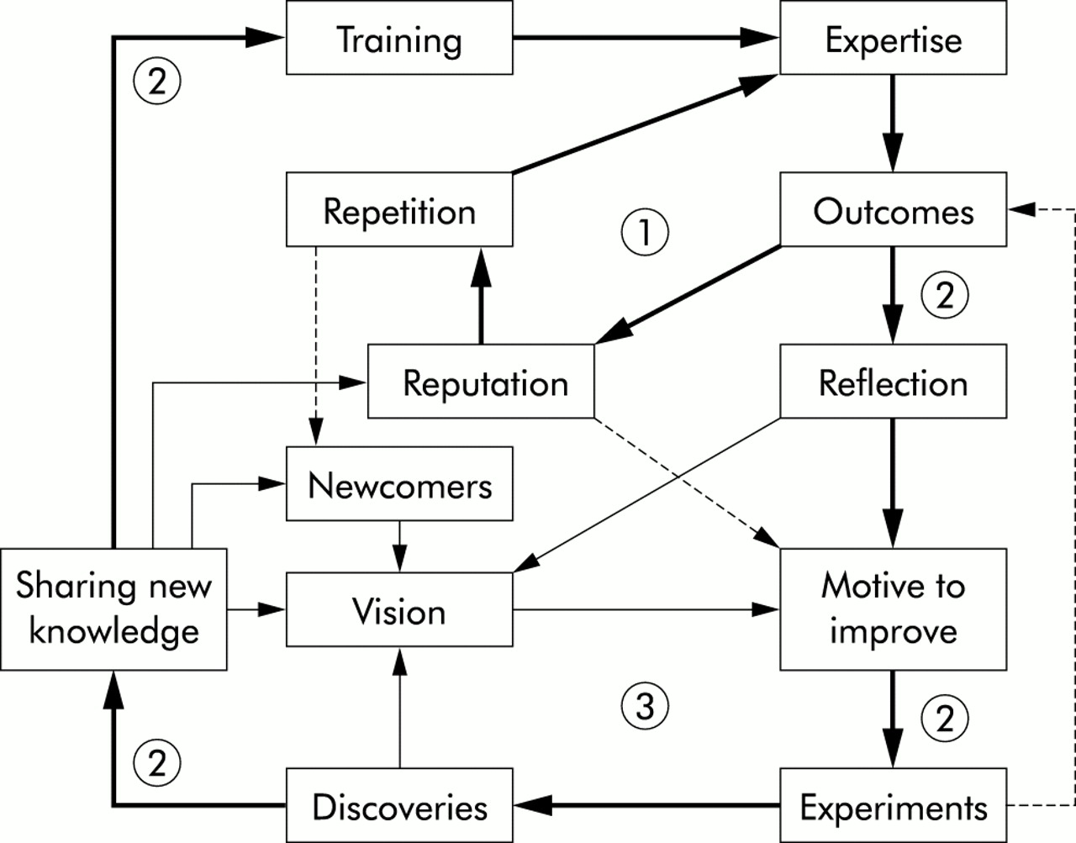
Introduction
Quality and safety can be improved in the healthcare industry through organizational learning.
Organizational learning refers to the process of enhancing knowledge and utilization of technological advances.
Effective organizational learning is supported by cultural values of openness and excellence.
Notes:
Healthcare organizations can enhance quality and safety by strengthening their organizational learning capabilities. Organizational learning is a more extensive process of increasing knowledge and innovating work routines through the interaction of action and reflection than individual focused training and repetition. Effective organizational learning is bolstered by openness and competence as cultural values; learning mechanisms that encourage information flow, challenge assumptions, and aid systems thinking; and resource commitment.

Slide 3
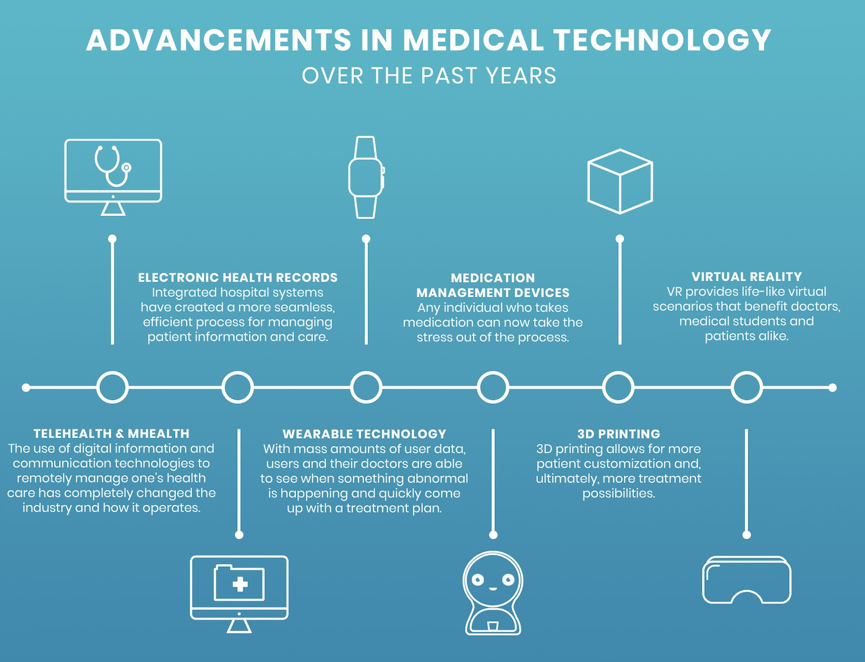
Concepts of Organizational Learning: Innovation and Creativity
It focuses on improving existing processes, procedures, systems and services offered by the organization.
Innovation and creativity also fo cuses on creating strategies for de livering improvements in quality and safety through the utilization of technology (Lyman et al., 2019).
Innovation and creativity can be represented through the implemen tation of technical advancements such as electronic health records and wearable technology in health care settings.
Notes:
Some of the major concepts of organizational learning include innovation and creativity. Innovation and creativity in healthcare setting focuses on improving quality of care and patient outcomes. Innovation and creativity also focuses on creating strategies for delivering improvements in quality and safety through the utilization of technology (Lyman et al., 2019). Implementation of technical advancements such as electronic health records, 3D printing, telehealth and wearable technology in healthcare settings.

Slide 4
Continuous Improvement
Continuous im provement is a structured, long-term approach to improving patient care and outcomes.
Continuous im provement aims for operational excel lence.
Continuous im provement can be achieved though ongoing training and financed by the management.
Continuous im provement is sup ported and owned by front line staff such as nurses and physicians.
Notes:
Continuous improvement is a structured, long-term approach to improving patient care and outcomes. Continuous improvement aims for operational excellence. Continuous improvement can be achieved though ongoing training and financed by the management. Continuous improvement is supported and owned by front line staff such as nurses and physicians.

Slide 5
Knowledge Management
Many healthcare or ganizations already use knowledge management to or ganize, store and share knowledge.
Medical malpractice is reduced when knowledge is appro priately docu mented and practi tioners are aware of standard procedures (Falkenström & Höglund, 2019).
Knowledge man agement helps in empowering em ployees by enabling them to learn from latest available in formation.
Notes:
Many healthcare organizations already use knowledge management to organize, store and share knowledge. Medical malpractice is reduced when knowledge is appropriately documented and practitioners are aware of standard procedures (Falkenström & Höglund, 2019). Knowledge management helps in empowering employees by enabling them to learn from latest available information.

Slide 6
Steps of Creating Innovation in Healthcare Step One: Creating Goals and Strategy for the Program
Innovation in healthcare re quires innovation strategies and goals that help in the ef fective implementation of in novation within an organiza tion.
Workers are drivers of innova tion and they need to be in volved in the process of creat ing strategies and goals for the innovation program.
Employees can help in the process of thinking about rele vant ideas that are specific to the goals of the organization’s innovation program (Babaeinesami & Ghasemi, 2021).
Notes:
Innovation in healthcare requires innovation strategies and goals that help in the effective implementation of innovation within an organization. Workers are drivers of innovation and they need to be involved in the process of creating strategies and goals for the innovation program (Babaeinesami & Ghasemi, 2021). Employees can help in the process of thinking about relevant ideas that are specific to the goals of the organization’s innovation program.

Slide 7
Step Two: Promote the program effectively
The management needs to focus on fre quently promoting the innovation program to employees and other appropriate stake holders.
A simple plan of alerts before and during the program will keep the program in the minds of participants when needed.
It is also essential to have digital communica tion for leaders and decision makers in the organization that will be evaluating the ideas and selecting the ones to act on.
Notes:
A simple plan of reminders before and during the program will keep the program in the minds of participants when needed. It is also critical to have digital communication for the organization's leaders and decision makers who will be reviewing ideas and deciding which ones to act on. While it may seem counter intuitive for a modern innovation program, offline promotion should also take place, whether it is through including the program in meetings or putting up physical promotional materials around the workspace.

Slide 8
Step Three: Completing the innovation pipeline
Leaders should also pay attention to decision makers to keep the innovation pipeline intact.
Feedback from workers also helps in improving the in novation process.
Giving feedback is the key goal of an effective innova tion program.
Feedback from employees and decision makers can be used in improving the organization’s innovation pro gram.
Notes:
Leaders should also pay attention to decision makers to keep the innovation pipeline intact. Feedback from workers also helps in improving the innovation process. Giving feedback is the key goal of an effective innovation program. Feedback from employees and decision makers can be used in improving the organization’s innovation program.

Slide 9
The need for continuous change in healthcare industry
Continuous improvement is designed to increase productivity and ef ficiency, reduce waste and enhance employee satisfaction.
Healthcare organizations use continuous improvement to achieve quality improvement.
Examples of continuous improvement activities within healthcare in dustry include; identifying changes needed by the organization, alignment of organizational goals and creating a clear vision and working towards achieving it.
Notes:
Continuous improvement is designed to increase productivity and efficiency, reduce waste and enhance employee satisfaction. Healthcare organizations use continuous improvement to achieve quality improvement. Examples of continuous improvement activities within healthcare industry include; identifying changes needed by the organization, alignment of organizational goals and creating a clear vision and working towards achieving it.

Slide 10
Conclusion
Organizational learning can help to improve quality and safety in the healthcare industry.
Innovation and creativity are also con cerned with developing strategies for delivering quality and safety im provements through the use of tech nology.
When knowledge is properly docu mented and practitioners are aware of standard procedures, medical mal practice is reduced.
Employees can assist in the process of brainstorming ideas that are relevant to the goals of the organization's inno vation program.
Notes:
Organizational learning can help to improve quality and safety in the healthcare industry. Innovation and creativity are also concerned with developing strategies for delivering quality and safety improvements through the use of technology. When knowledge is properly documented and practitioners are aware of standard procedures, medical malpractice is reduced. Employees can assist in the process of brainstorming ideas that are relevant to the goals of the organization's innovation program.

Slide 11
References
Babaeinesami, A., & Ghasemi, P. (2021). Ranking of hospi tals: A new approach comparing organizational learning criteria. International Journal of Healthcare Management, 14(4), 1031-1039.https://doi.org/10.1080/20479700.2020.1728923
Falkenström, E., & Höglund, A. T. (2019). “There is total si lence here” Ethical competence and inter-organizational learning in healthcare governance. Journal of Health Or ganization and Management. https://doi.org/10.1108/JHOM-05-2019-0130
Lyman, B., Jacobs, J. D., Hammond, E. L., & Gunn, M. M. (2019). Organizational learning in hospitals: A realist re view. Journal of Advanced Nursing, 75(11), 2352-2377. https://doi.org/10.1111/jan.14091

