Slide 2
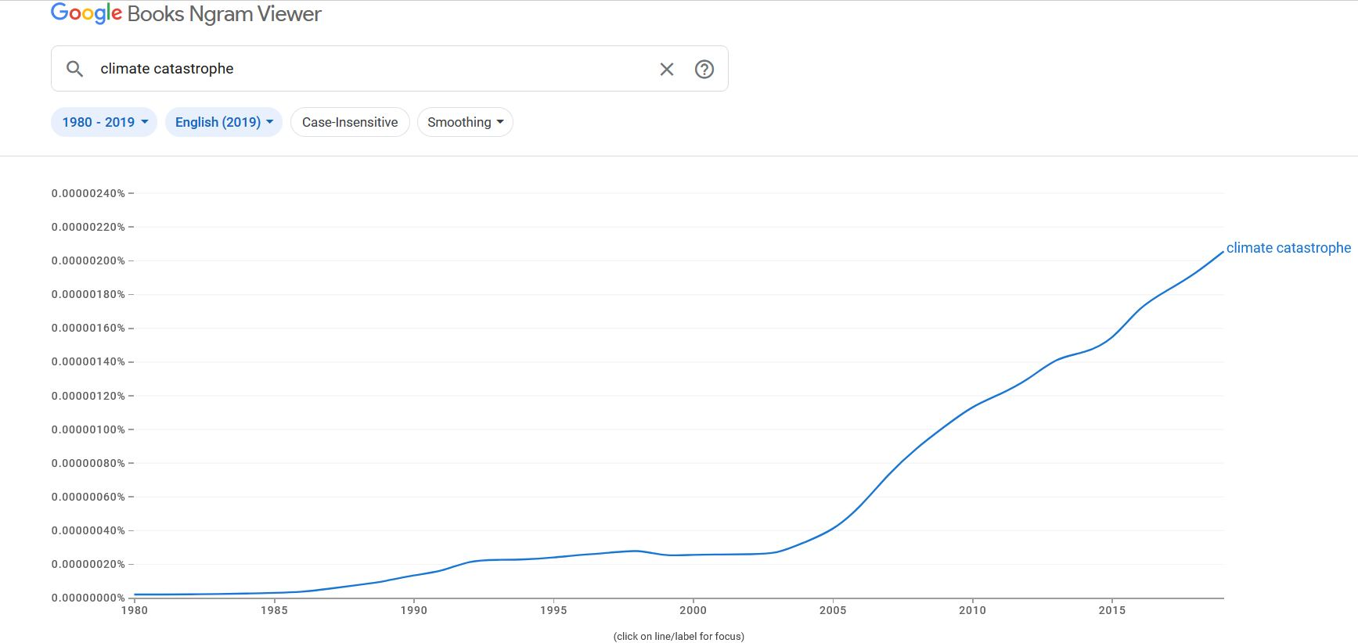

Slide 3
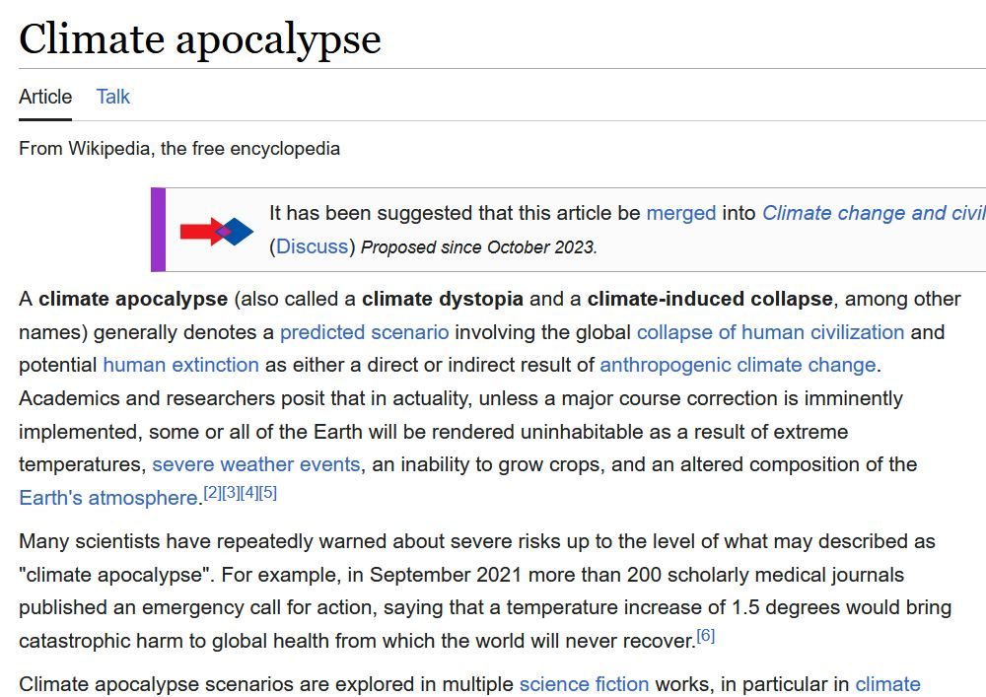
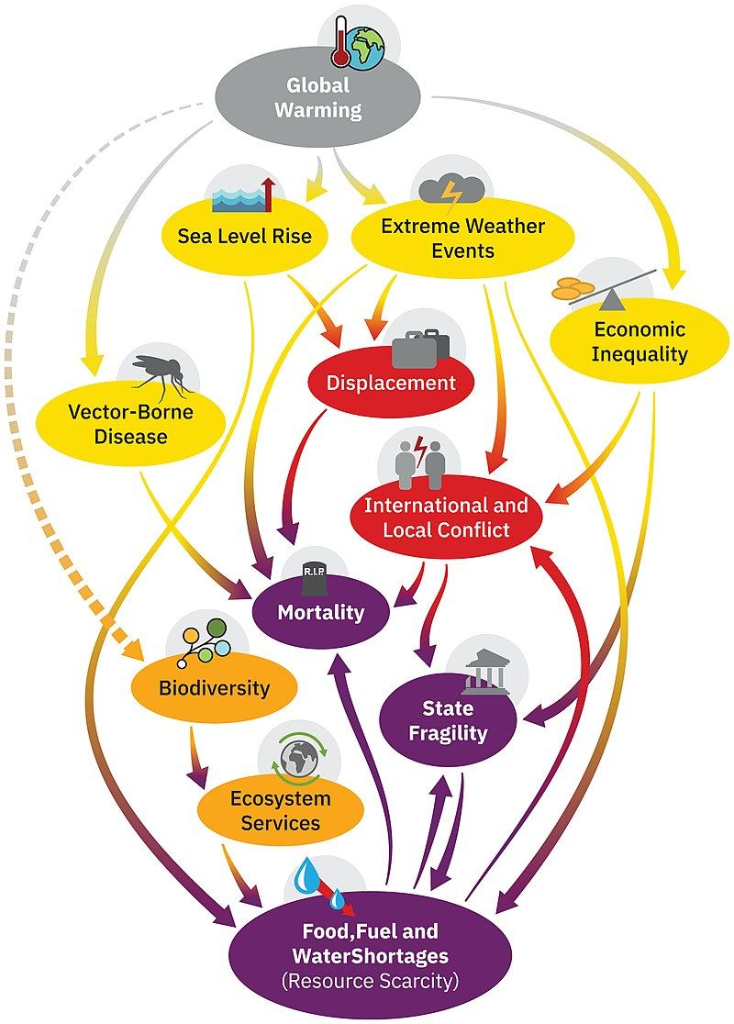

Slide 4
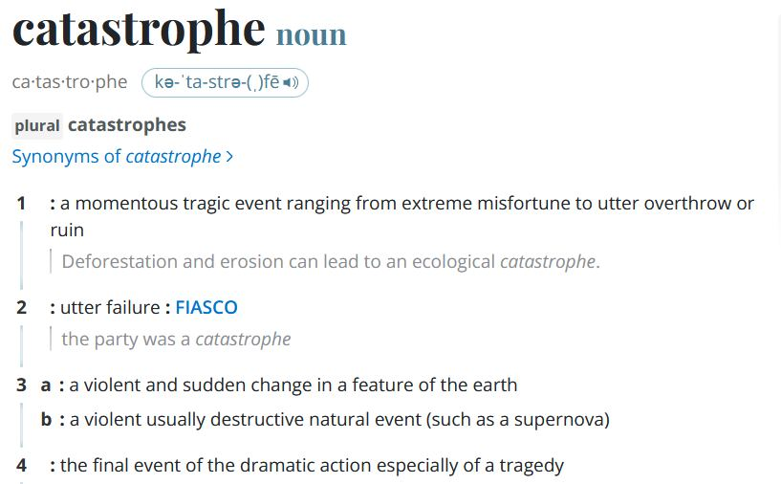

Slide 5
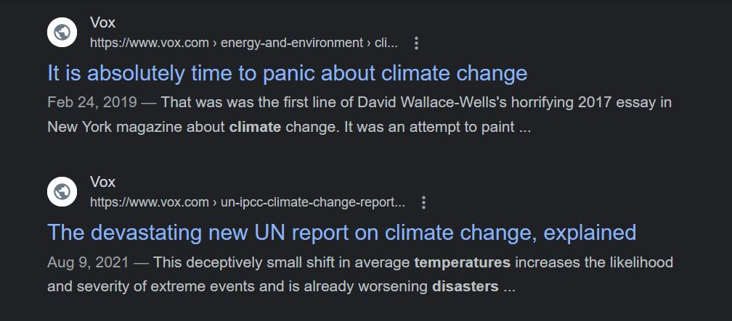

Slide 6
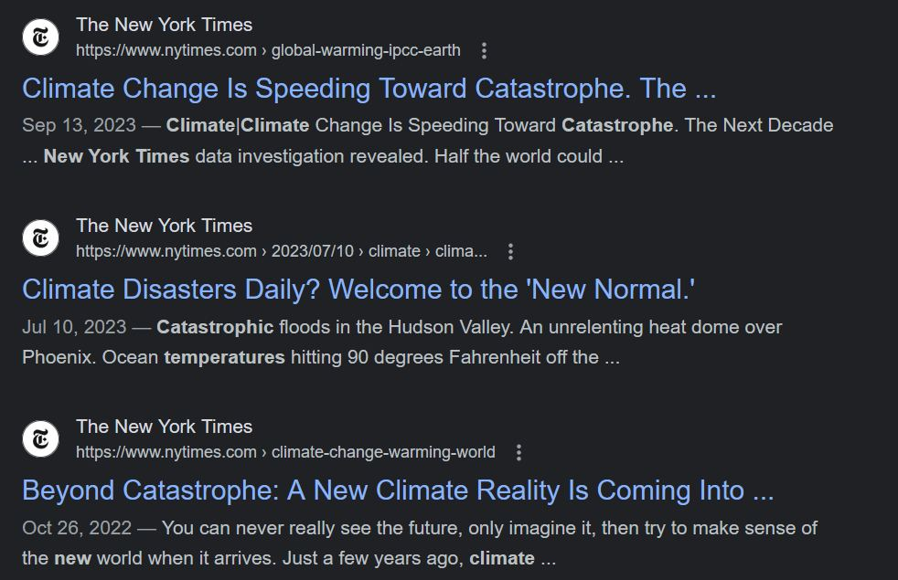

Slide 7
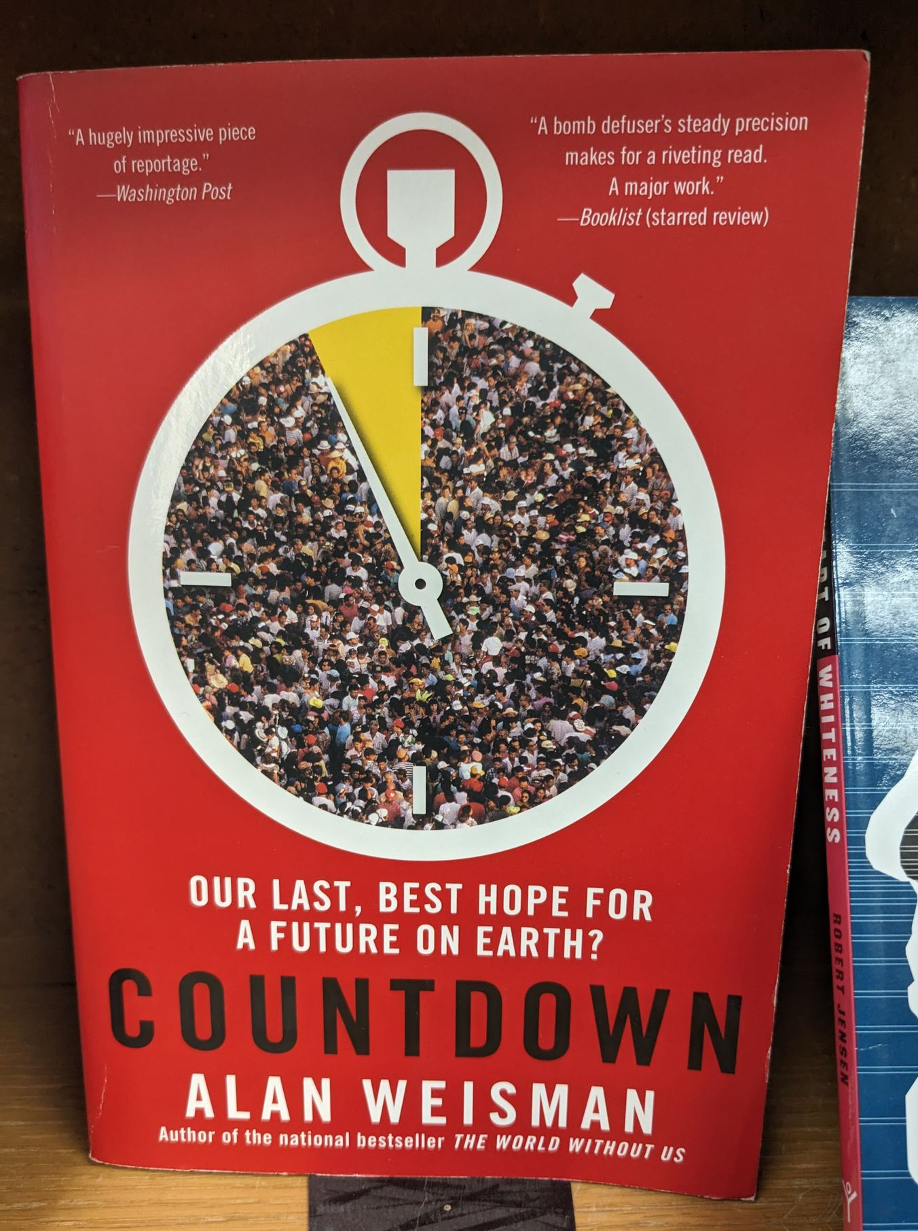
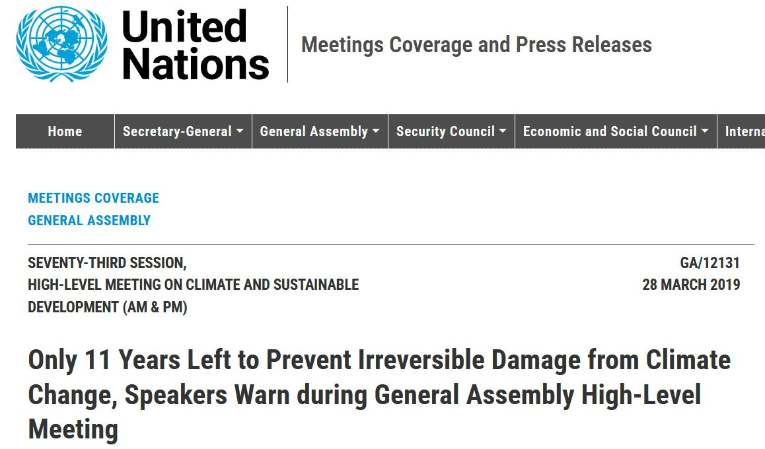
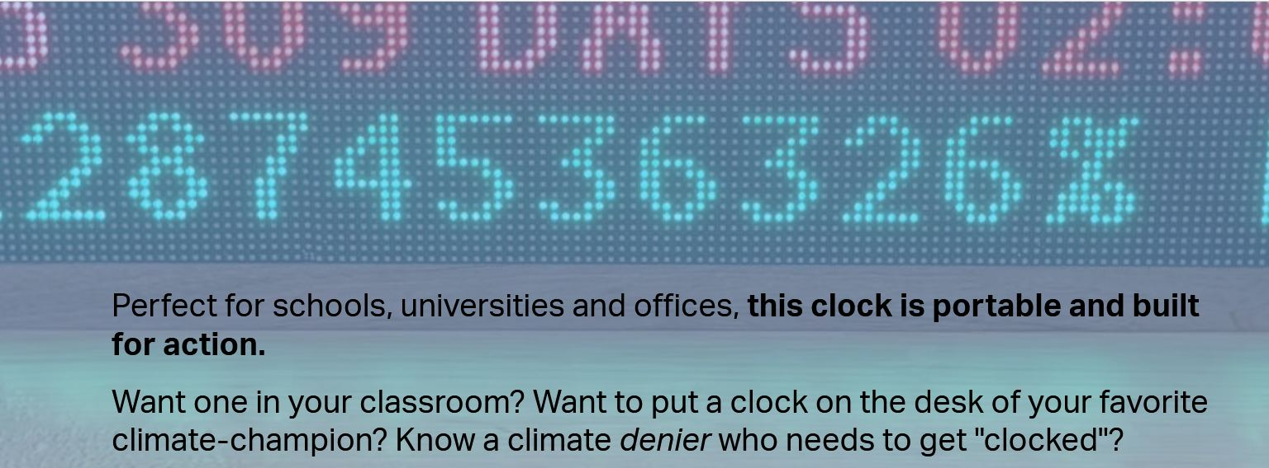
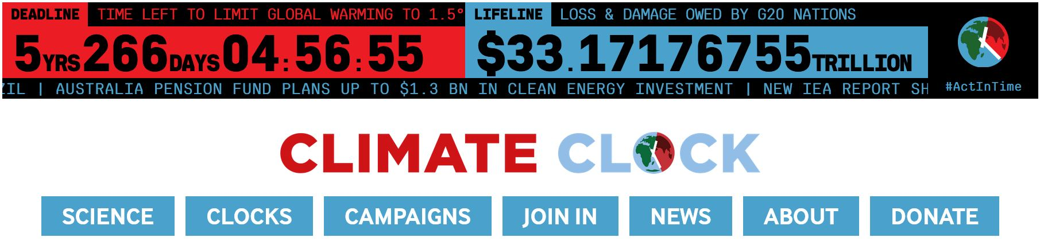
Only 7 now!

Slide 8
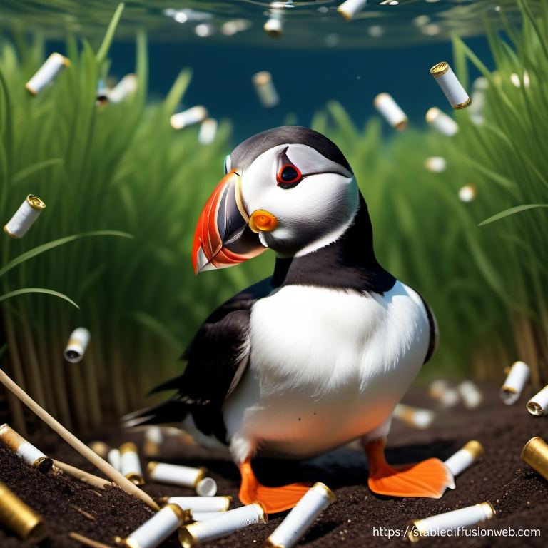
Swimming in a Sea of Buts and Cans

Slide 9
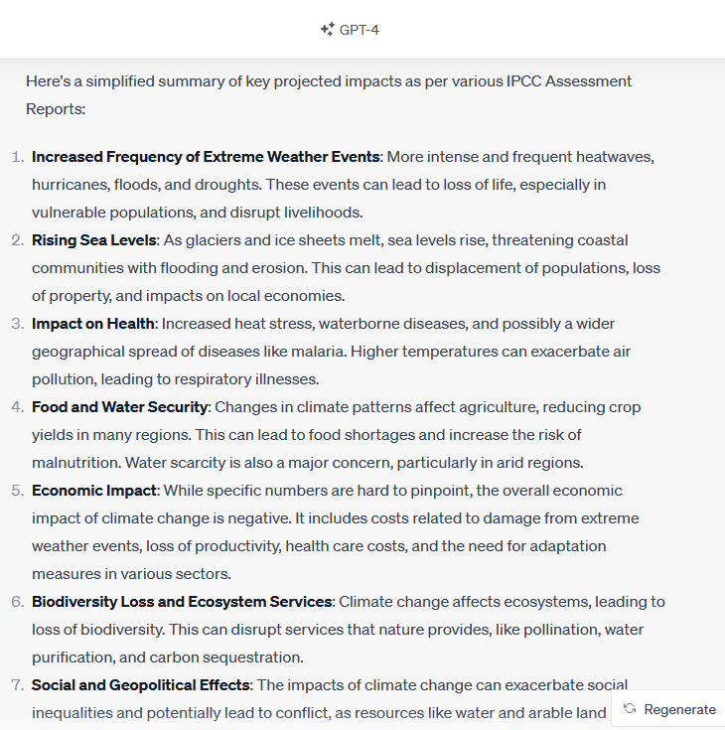
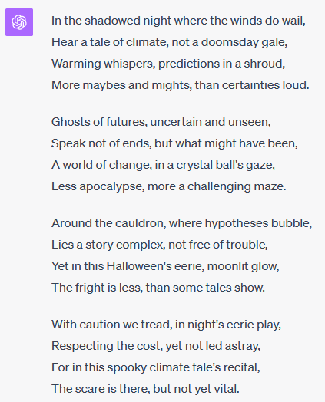

Slide 10
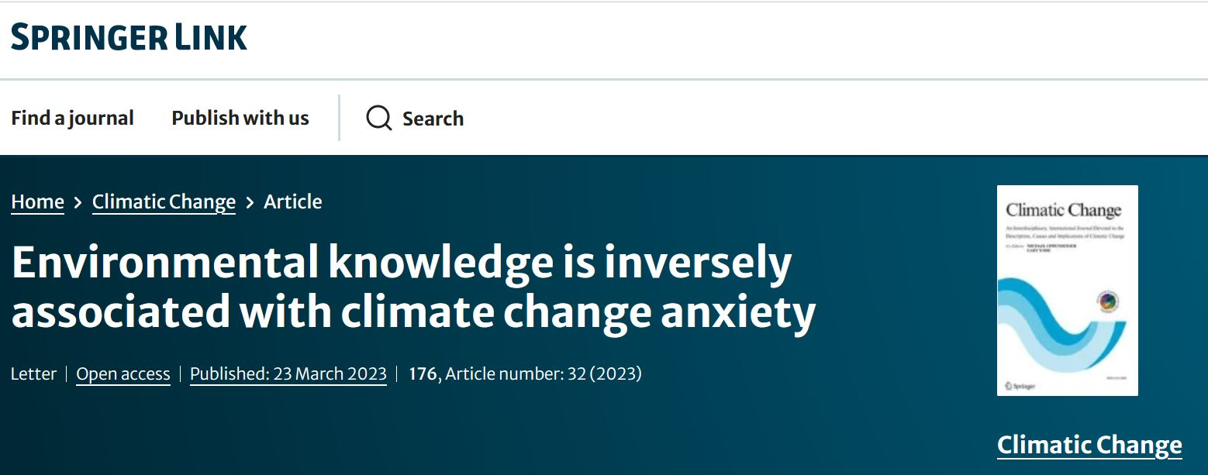
FINDING: people who possess 𝗺𝗼𝗿𝗲 overall environmental knowledge or climate-specific knowledge experience 𝗹𝗲𝘀𝘀 climate change anxiety
Therefore: less knowledge → more anxiety
Task: educating our kids instead of scaring them

Slide 11
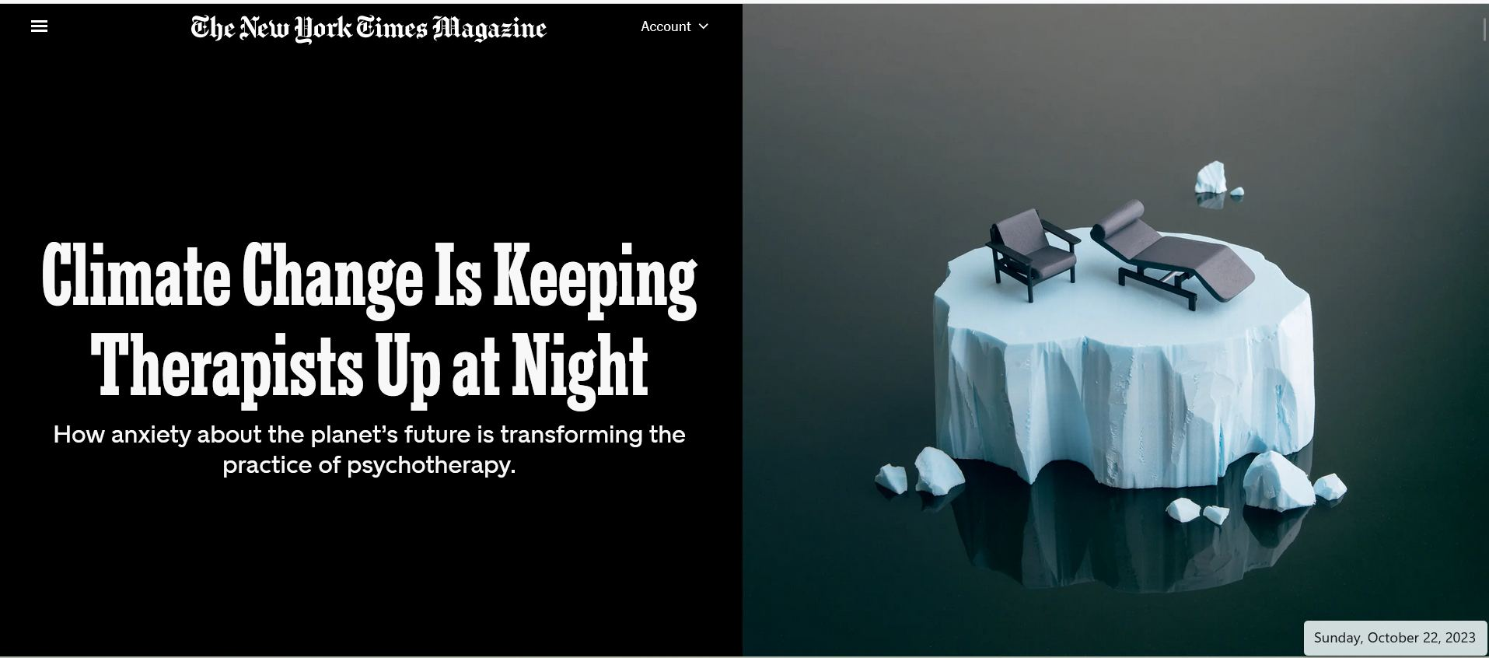

Slide 12


Slide 13


Ding Dong
… the Climate Witch is Dead

Slide 14
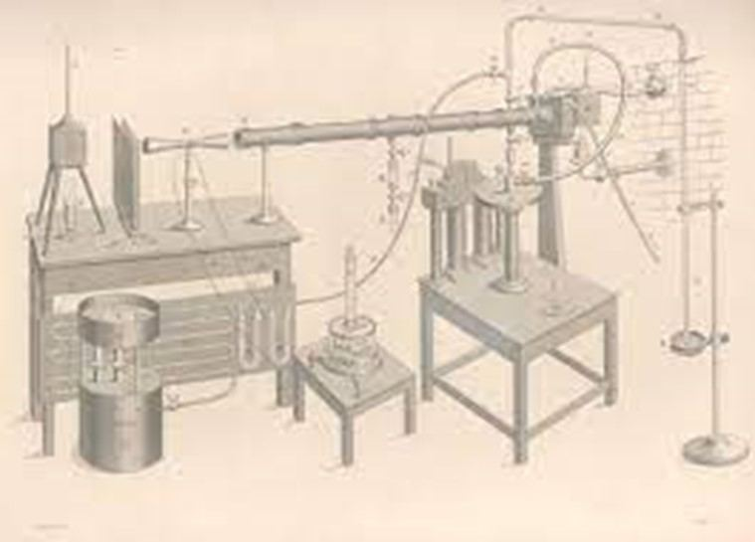
From Eunice Foote to John Tyndal to “Consensus”
Doubling CO₂ → 1°C temperature increase (logarithmically)
No One (Serious) is Doubting
CO₂ and other GHGs, land use changes, affect global climate, and this includes air, land, oceans
There’s been warming
Humans have caused (at least half) of it
There is going to be more warming
We are not adapted to any different climate, so change is costly
Where Does the “Catastrophe” Come From?
CO₂ hasn’t doubled (yet) and 1° is not going to harm anyone!
The “consensus” is on human caused warming, NOT on CRISIS

Slide 15

Taking the Edge Off
You’ve been bathed in doombubbles since you were born
Must you continue?
The Most Puzzling Reactions
To question catastrophe, is not even in the same sport as questioning “the science”
Tl;Dr → climate is a complex modeling exercise, let’s assume it’s all correct, the assumptions make sense, etc. and still see what those results imply.

Slide 16

As Compared To … ?
Does the doom and gloom make sense?
What are your instincts telling you?
What did COVID do?
Cost 2 years of global growth
Global excess mortality ~ 3 million per year
→ bad case of GW like COVID with 90% less death, no lockdowns
→ but we’d be 6x richer when it happens
Exactly HOW do you think climate change will doom us?

Slide 17

Taking the Edge Off
AR6, WG2 → 3068 pages (Impacts)
AR6, WG3 → 2042 pages (Mitigation)
These are over and above the WG1 science
Should you read into it, here is what you will see regarding disaster damages

Slide 18
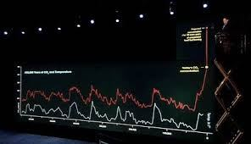
How Do You Think AGW Will Doom Us?
AR6 Scientific Findings
Sea level rise → 2 feet by 2100, 2 to 5 meters by 2300
Extreme heat events
Wildfires (The smoke from them)
THC slowing may cool northeast and north Europe
2.5 to 4.0 ECS
Global precipitation increase between 7.7 and 15.5%.
Worst case for Asia and Africa is 10% or so less precipitation
Does idea of accessing 10% more water over 100 years sound daunting?
Under SSP5-8.5 average global income per person rises to $140,000 by 2100 and also that we would burn large amounts of coal.

Slide 19
Modeled Damages Come From …
Temperature:
“has a hill-shaped relationship w/ag, forestry, water and energy.”
Precipitation:
“increased precipitation is generally beneficial … to agriculture, forestry, and water but no effect on energy”
Coastal Damages:
“coastal damages increase as sea level rises”
Carbon Dioxide:
“carbon dioxide, through fertilization, is strictly beneficial”

Slide 20
AR6, WG2, Ch11
Popular presentations do NOT match what the IPCC experts are saying. The most fair reading of the report Is that it is just not true that we are seeing increases in intensity and frequencies of most extreme events

Slide 21
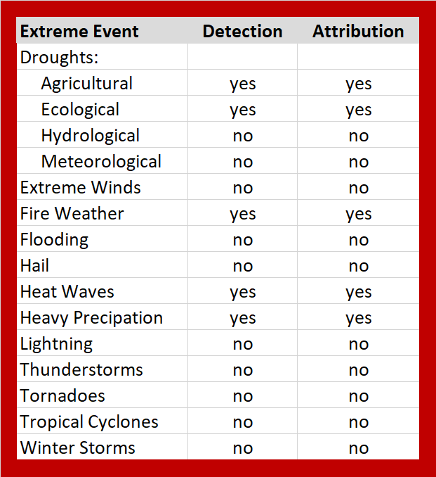
Detection?
Does the IPCC think that there is a statistical change in the indicated weather event/system over time?
“the process of demonstrating that climate or a system affected by climate has changed in some defined statistical sense, without providing a reason for that change” (90% p-value)
Attribution?
Does the IPCC believe that human induced climate change is leading to the detection of a change in a system’s properties?
“the process of evaluating the relative contributions of multiple causal factors to a change or event with an assessment of confidence.”

Slide 22

Serious? Yes. Catastrophe? Sus.
1 IPCC Says No 7 Global Agriculture
2 Mosquito Bites 8 Resilience
3 Heat v. Cold 9 Fuel for the Fire
4 Energy Futures 10 Good Ol' Days of 2023
5 Richer is Greener 11 Niagara Falls
6 Cheap Lifeboats 12 Buried Bodies

Slide 23
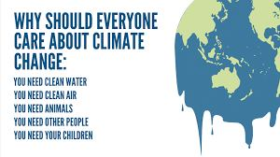

One The IPCC Experts Say NO to: 1. High Emissions Scenarios (RCP/SSP) 2. High Feedback (ECS)

Slide 24
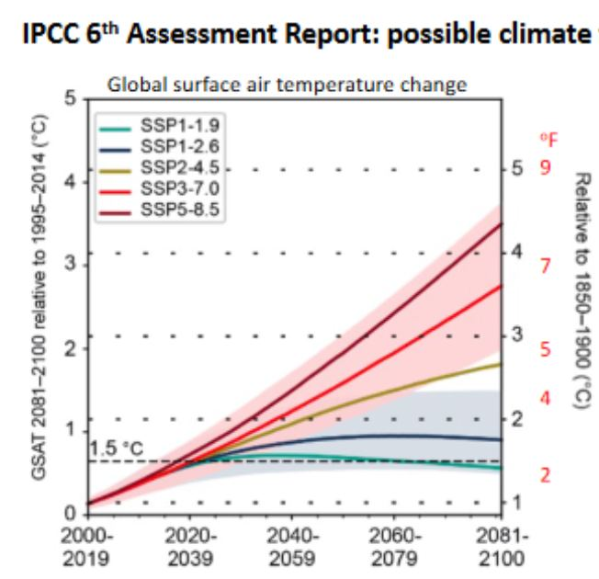
Expert Modeling Scenarios
Extreme Changes Not Possible Without:
Strong population growth
Strong economic growth
This is the path
we are on.

Slide 25
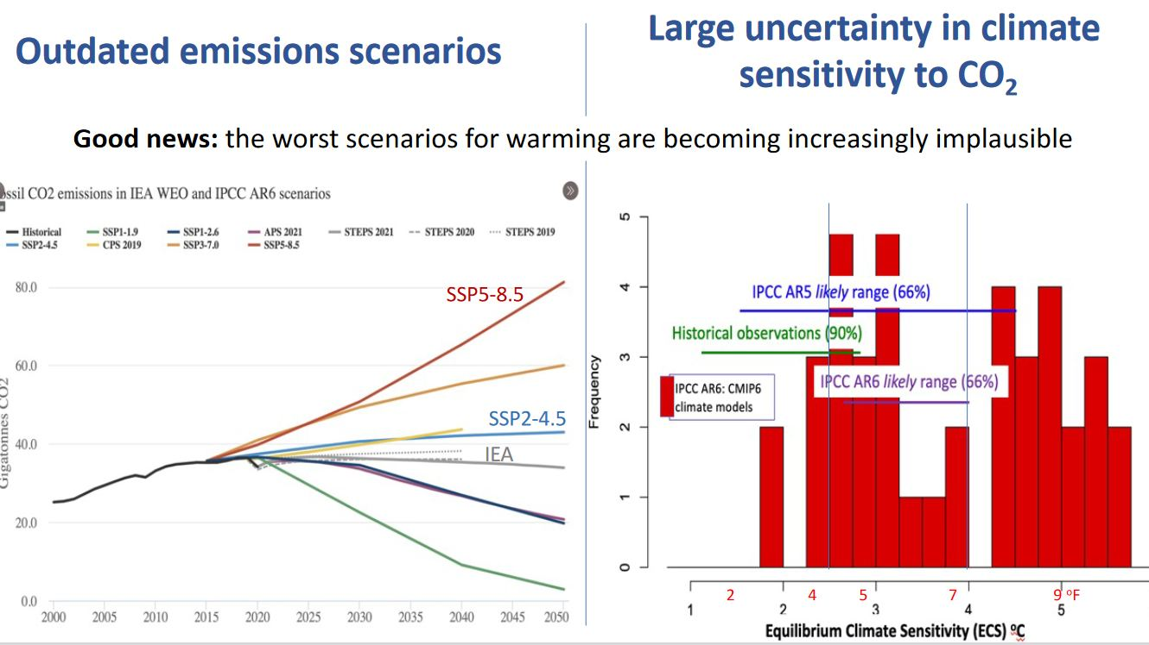
The Worst of the Worst … Unlikely

Slide 26
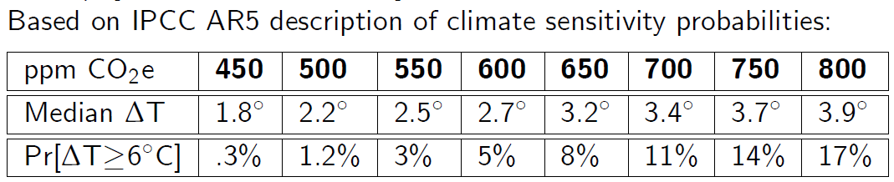

Slide 27

Feedback: TCS, ECS and Tipping Points
Does initial “forcing” / warming create more/less subsequent warming?
What We’ve Observed (Experimental)*
Atmospheric CO₂ concentrations in 1880: 280 ppm
Atmospheric CO₂ concentrations in 2023: 420 ppm
→ 50% increase
Global Average Temperatures have risen 1.1°C from 1880 baseline
→ ECS (Observed)* is “only” 2
Upshot: NO CATASTROPHE if the ECS is only 2
Note: Current pace adds 3ppm/yr to concentrations → 2070 doubling

Slide 28

ECS Uncertainty from AR1 to AR6
AR1 (1990)
1.5°C to 4.5°C
Median unspecified
AR2 (1995)
1.5°C to 4.5°C
Median unspecified
AR3 (2001)
1.5°C to 4.5°C
Median SRES A1B
AR4 (2007)
2.0°C to 4.5°C
Median SRES A1B
AR5 (2014)
1.5°C to 4.5°C
Median RCP4.5
AR6 (2023)
2.5°C to 4.0°C
Median SSP2-4.5
Expected range has narrowed. See Lewis (2016)
EXTREME values considered less likely (but not gone)

Slide 29
(Im)Plausible Pathways
ALL OF:
The U.N. Framework Convention on Climate Change
The Intergovernmental Panel on Climate Change
Peer-reviewed research and the global scenario community
Agree that on current policies, the world is tracking below a SSP2-4.5 scenario.

Slide 30
One: Extreme Pathways Now “TEWA”
“The Emission World Avoided”
Current (2023) modeling sees “approximately flat global GHG emissions from 2025 towards the end of century . . .” and is
“an approximate depiction of future emissions in the absence of further climate policy action and assuming continuation of “current trends” as of the early 2020s.” (like in RCP4.5 or SSP2-4.5).

Slide 31
US Special Presidential Envoy for Climate
At the New York Climate Summit
“We're currently heading towards something like 2.4 degrees, 2.5 degrees of warming on the planet”
But Just Two Years Ago:
“Currently, as we’re talking today, we are regrettably on course to hit somewhere between 3, 4 degrees at the current rate.”
IEA Net Zero Assessment (2023)
projects a median warming in 2100 under “stated policies” of ~2.4 degrees Celsius

Slide 32
IPCC AR6 (March 2023)
High-end scenarios (like RCP8.5) can be very useful to explore high-end risks of climate change but are not typical ‘business-as-usual’ projections and should therefore not be presented as such.

Slide 33
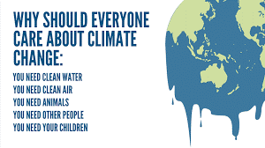

Two Mosquito Bites: Climate is NOT Well-Being’s Limiting Factor

Slide 34
Two: Economic Quinine
CLIMATE IS NOT THE MAIN DRIVER OF MOST OF OUR PROBLEMS
Climate “solutions” may not be best way to deal with problems.
Impacts of climate change will be small relative to the impact of changes in population, age, income, technology, relative prices, lifestyle, regulation, governance, public health, other development
IPCC AR3 (2001) → spread in insect vectors, most particularly of malaria, would impose the most serious cost from Climate Change
Atmospheric CO₂ concentration at that time? 370ppm
Atmospheric CO₂ concentration today? 420ppm
IPCC AR6 (2023) → virtually no mention of malarial progress or threat

Slide 35
Illustration: Public Health and Infectious Disease
1900-1936 (David Cutler and Geoffrey Miller):
Availability of clean water explains 50% of the decline in the overall US mortality rate
75% of the decline in INFANT mortality
Evil DDT?
WHO estimates that DDT saved between 50-100 million lives
1945 Venezuela had 8 million cases, in 1958 → 800
Italy 412,000 in 1945 to 37 cases in 1968
India reduced cases from 10 million in 1935 to 286,000 (1969)
Sri Lanka reduced from 3 million after WWII to 29 in 1964
1972: NAS President, Biologist Philip Handler, “DDT is the greatest chemical that has ever been discovered”

Slide 36
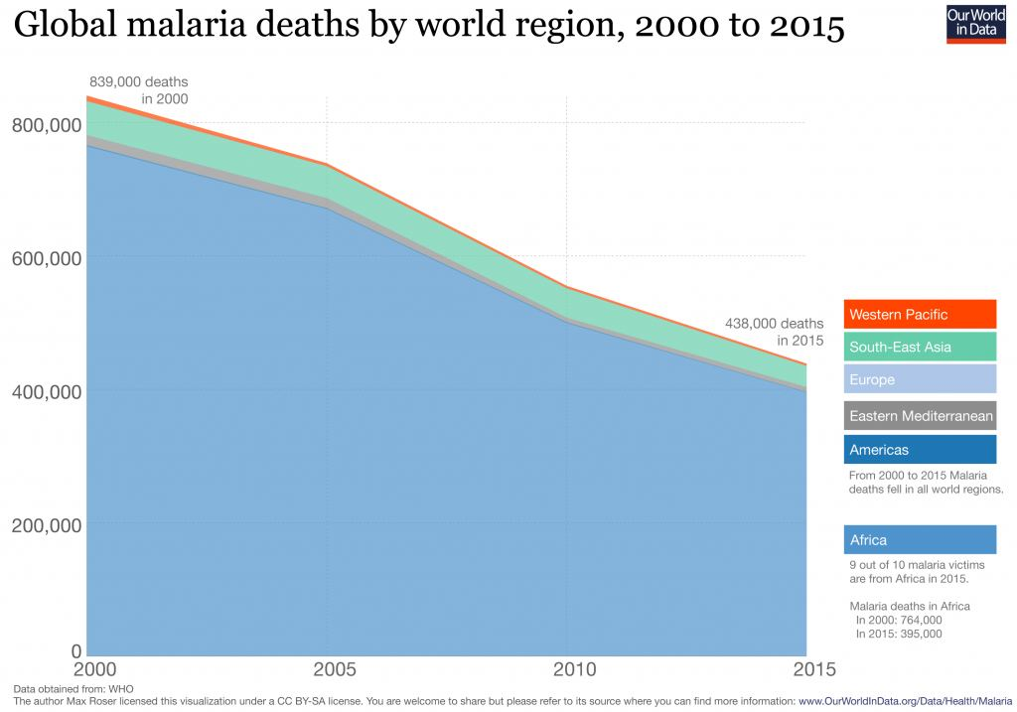
Two: A Malaria Case Study
Then, Climate Change in the Third IPCC Report was reported to be expected to cause a doubling of malaria risk – killing up to 2 million people per year by 2080.
Instead:
World Health Organization:
Malaria deaths fell to the lowest level ever recorded in 2019.
Mortality rate fell ~60% past 20 years
24.7 per 100,000 in 2000.
10.1 per 100,000 in 2019.

Slide 37
Two: A Malaria Case Study
Global warming is predicted to allow mosquitos to survive at higher altitudes, and thrive in regions of Colombia and Ethiopia where they are not usually found
Some reports suggest an additional 3 million infections per year
Context:
less than 2% of Africa is currently too high for malaria
Malaria’s distribution is not well correlated with temperatures
Many tropical countries have no malaria
Some cold ones, including Arctic Russia, have suffered in the past
As world warmed, malaria incidence has decreased at a rate of 5 million per year
627,000 people died from malaria in 2012, a total of 800 in all of the Americas, a place authors suggest increased malaria
New study finds that malaria eradication has little to do with temperature and a lot to do with … household size

Slide 38
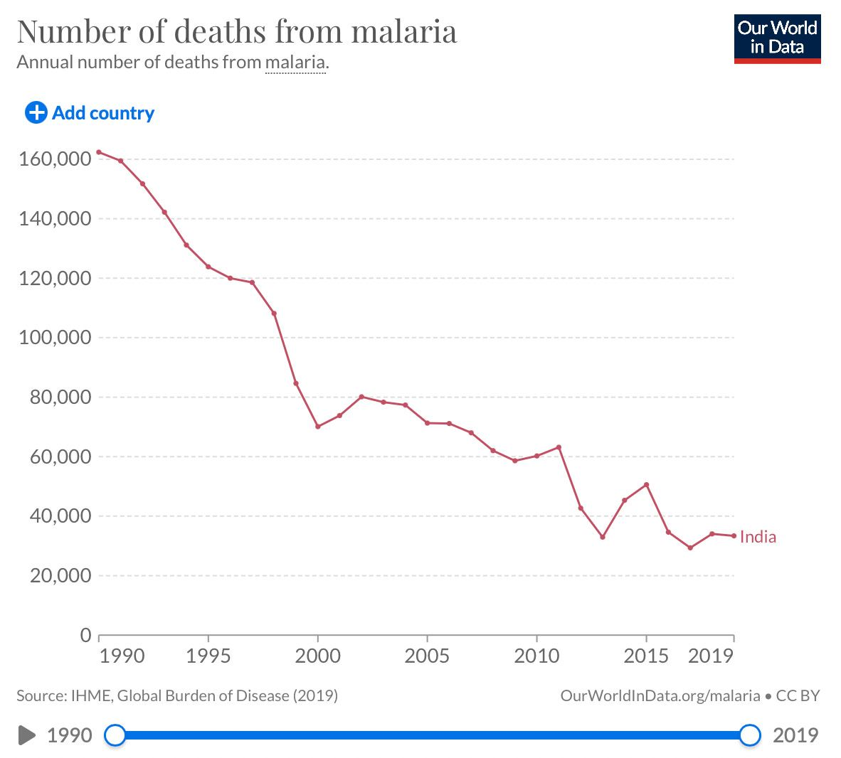
Why? Despite AGW …
Not bed nets
Not GMO Mosquitos
But … government prevention of water logging after storms and floods
But … massively improved sanitation systems
But … better hospital management

Slide 39

Two: Last Month’s News

Slide 40
Two: A Sea-Level Case Study
What makes sea-level rise “bad?”
Destroys coasts, properties, makes inland flooding more likely. OTOH, new coastline, deeper harbors, and a CENTURY to adapt.
What leads to sea-level rise?
Melting glaciers
Thermal expansion
Subsidence
Fresh water usage
Natural causes?

Slide 41
Two: Applying the EWOT
Water Problems? Oceans Rising?
Seas have risen by about 7 inches since 1880.
40% of this due to thermal expansion
Fresh water use and groundwater pumping 0.8mm per year
Predictions
3.6cm per decade continued rise (double historical rate)
Seas higher by 10 to 38 inches in next 100 years (with the higher end estimates becoming less likely according to IPCC)
Groundwater/freshwater extraction at 1.4cm per decade
Alternatives
Option A: Slow industrial civilization, cool the globe
Option B: Price groundwater, establish reservoirs, mine the glaciers

Slide 42
Two: Applying the EWOT
Water Problems? Oceans Rising?
CHALLENGE: reduce 3.6cm per decade of sea level rise
PART 1: Eliminate groundwater withdrawals
Easy if we use nuclear and renewables and geothermal for desalination, price access to aquifers) → -1.4cm
PART 2: Quadruple global reservoir capacity (which is not nearly as resource intensive or crazy as mining for batteries and wind and solar) → -2.4cm
COMBINED these efforts would FULLY OFFSET ANY CLIMATE IMPACTS WITHOUT ANY “STANDARD” GW MITIGATION efforts

Slide 43

Three Hot (Only) Under the Collar?

Slide 44
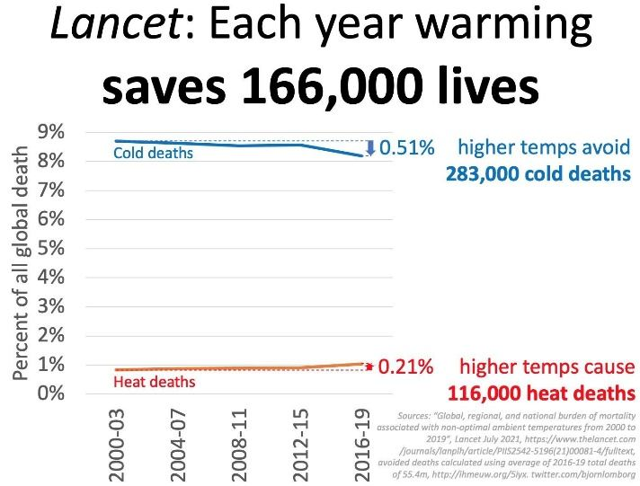
Three: Heat vs. Cold
Models Do Not Predict “We Will All Boil”
Warmer at night, and in colder regions toward the poles
Cold is More Dangerous to Humans (Lancet, 2015)
Cold deaths comprise over 90% of all temperature-related deaths
7.3% of all global deaths from “non-optimal” heat
7.2% of these are from cold
0.4% of these are from heat
US/rich countries, cold deaths 2x heat deaths
Regardless, the planet is NOT optimized for us

Slide 45

Four Energized

Slide 46
Four: Energy Opportunities
If renewables and nuke “bros” are right …
Abundant, cheap, clean energy:
CO₂ removal / scrubbing
Taking water from atmosphere and depositing it as ice on poles
Desalination
Irrigation
Creation of green, clean closed-loop synfuels
Terrascaping
Outdoor climate control
Geoengineering emergency solutions become viable

Slide 47

Five Humans are BRAINS not just BELLIES

Slide 48
Five: IPAT and the EKC
I = P A T has it precisely backward
Sustainability argument is that more people, more wealth and more technology are bad for the planet
EKC
The evidence says precisely the opposite. More people, more wealth and more technology → more prosperity AND more resources
People are BRAINS not “just” bellies
UPSHOT → we have a LOT of resource slack to address problems

Slide 49
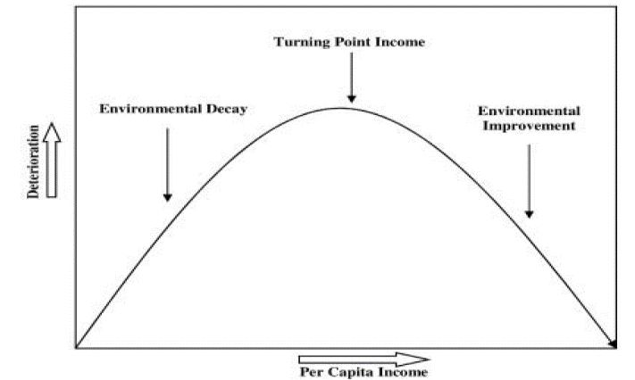
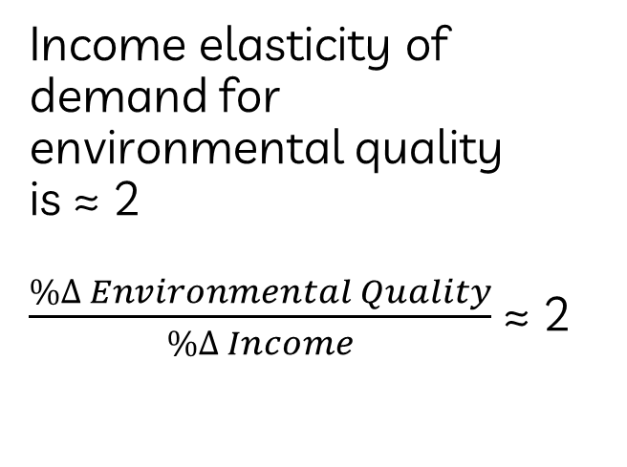
I = Population x Affluence x Technology
Income elasticity of demand for environmental quality is ≈ 2 $\frac{\%∆ Environmental Quality}{\%∆ Income}$ ≈ 2

Slide 50
I = Population x Affluence x Technology
Illustrations: There is No “Single” Kuznets Curve
“Peak”/”Trough” for:
Deforestation appears to be $8,200
SO2 and fecal coliform at apx $7,000 and $3,000
Carbon dioxide emissions appears to be $30,000
- Early papers show no turning point for particulate matter
Economists find systematic positive relationship between income changes and Environmental Quality (Grossman and Krueger, 1995, QJE) – avg of $13,000 today
Do all aspects of environmental quality deteriorate or improve systematically with economic development?
Degree of property rights / contract enforcement matters
Other institutions and their feedback on the economy matters

Slide 51
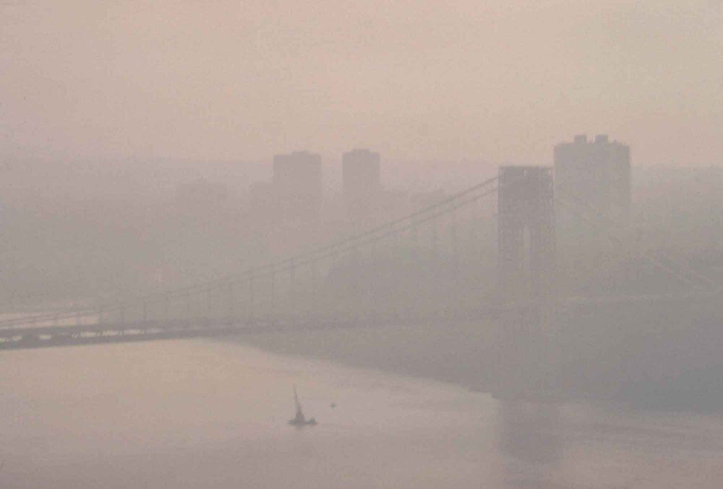
NYC Air Quality, May 1973 George Washington Bridge

Slide 52
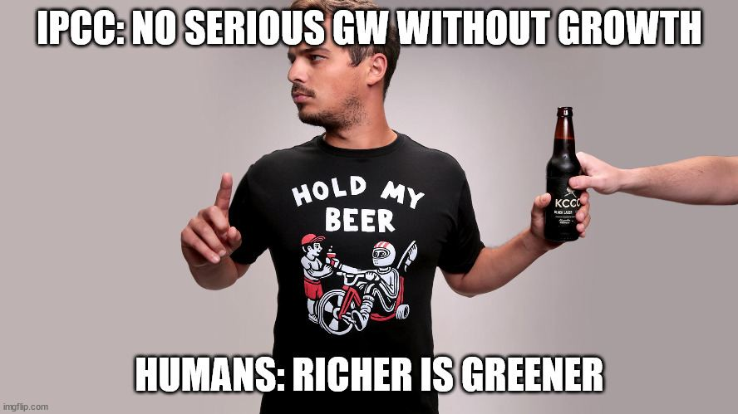

Slide 53
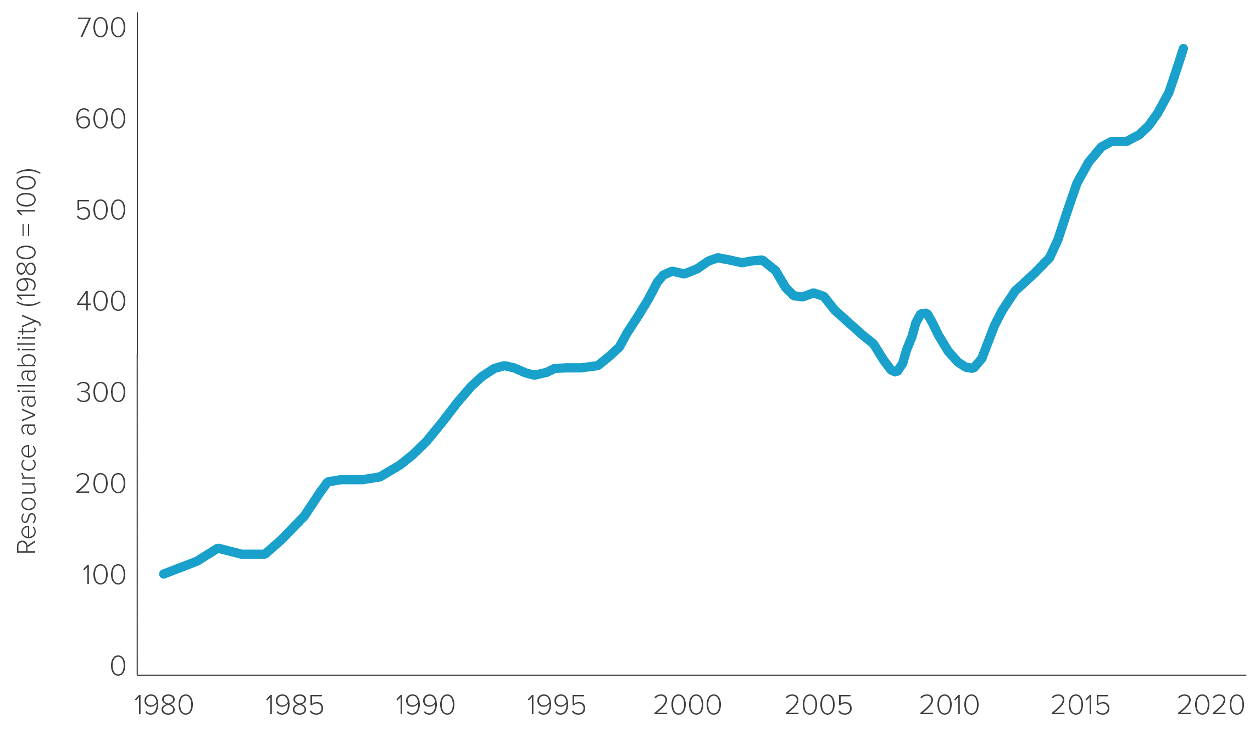
I = Population x Affluence x Technology

Slide 54
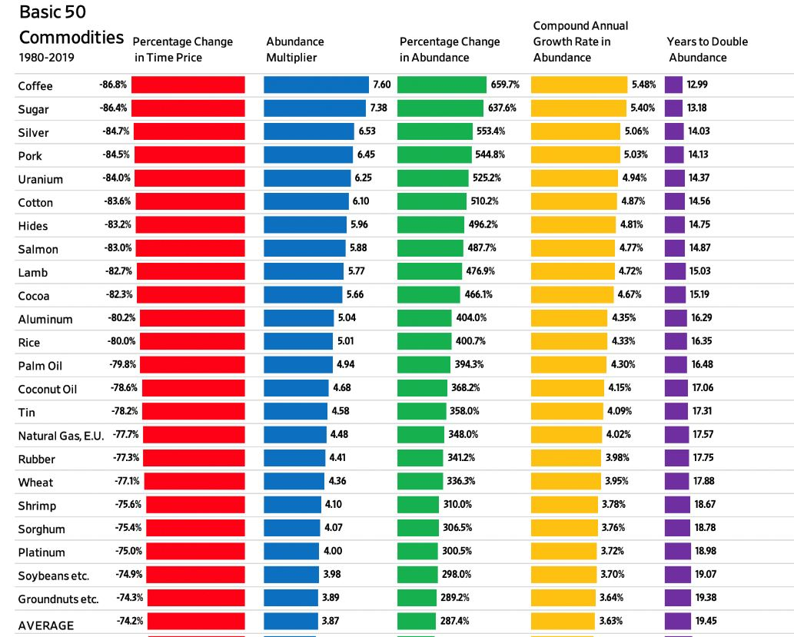
I = Population x Affluence x Technology

Slide 55
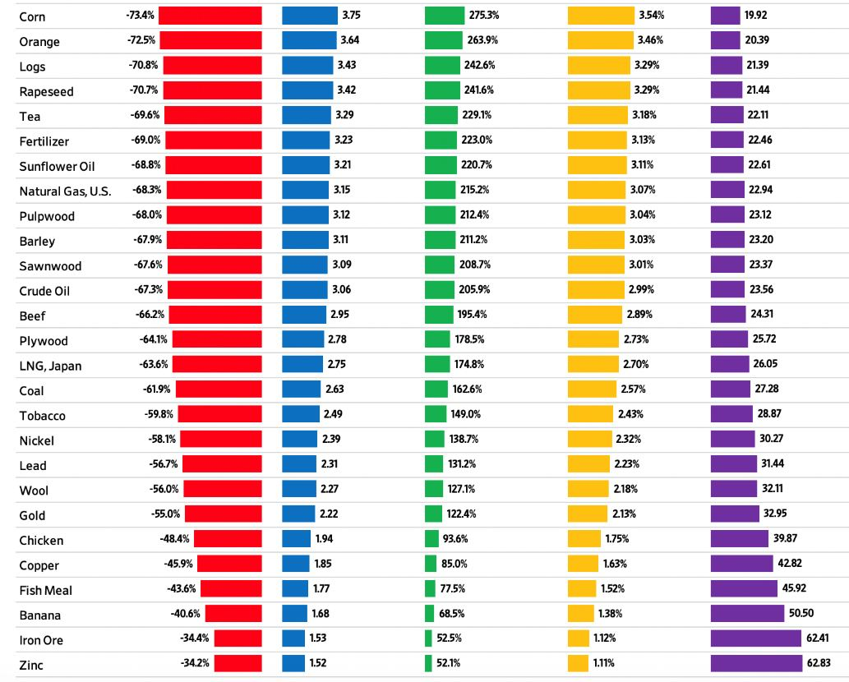
I = Population x Affluence x Technology

Slide 56
I = Population x Affluence x Technology
Almost every one of the most dangerous pollutants of all-time have been eradicated
Typhoid polluted most rivers, including the Hudson
Smallpox was devastating, but pursued to end of earth
Dysentery is unheard of in wealthy nations
Aside: is eliminating smallpox “sustainable?”

Slide 57
I = Population x Affluence x Technology
Illustration: When Did Korea Clean Up Its Air?
By 2002, SK’s economy had emerged as one of richest in the world (in 1960s it was poorer than modern day poorest countries)
In 2002, it ranked 120th out of 122 countries for air quality
Yet again it was a fully developed nation and a democracy
When will China clean up its air?
Once Korea started cleanup, however, improvements come fast. In 2022 index of environmental quality (Yale), they were 30th

Slide 58
I = Population x Affluence x Technology
Illustration: China
Famous Grossman and Krueger estimate was that around $13,000 per year, “overall” conditions improve
China’s current income per capita estimated in the $17,000 range
Air quality appears to be important political issue in China
US started to clean up in 1960s at $28,000
China is, “ahead of schedule”

Slide 59
I = Population x Affluence x Technology
Illustration: Wealth and Wildlife (WWF Living Planet Report)
A thought question: Which would be better for wildlife and wild-lands on our planet?
If the 1.2 billion people in Africa and 422 million people of South America had their high farm yields and living standards raised to that of Germany, Sweden and Korea?
If the 1.1 billion Americans, Canadians, and Europeans reduced their materialism, consumption and agricultural output down to current African or pre-IR levels?

Slide 60
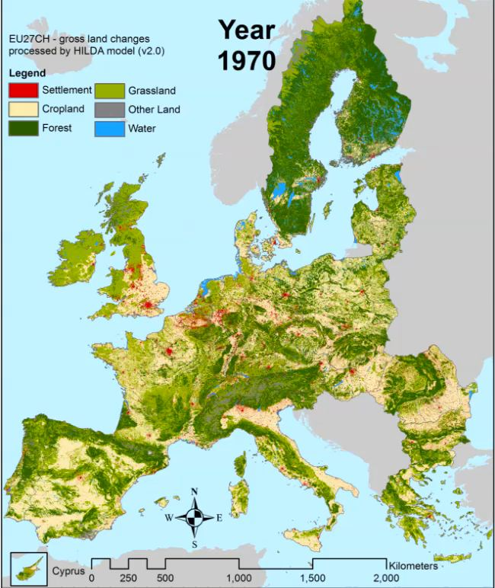
I = Population x Affluence x Technology
Illustration: The Greening of Europe (and the World)
Since 1900, in Europe:
Forests recovered by 1/3
Driven by France, Italy, Spain
Driven by end of Communism
Increased timber production in Scandinavia
Cropland has decreased
Overall is much greener
Urbanization

Slide 61
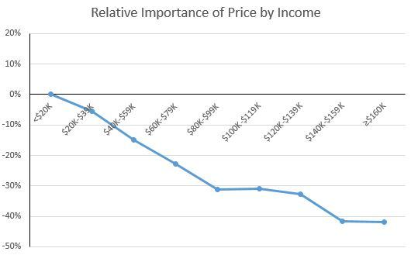
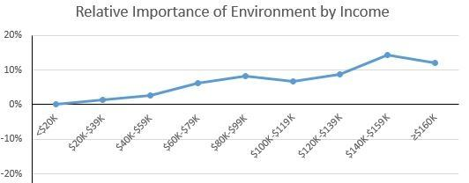
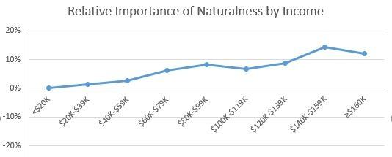
I = Population x Affluence x Technology
Illustration: Food Values by Income Category
3 food values where importance decline with income: price, safety, and taste.
5 food values where importance increased with income: naturalness, nutrition, environment, novelty, and origin.

Slide 62

Is Richer Really Greener?
Not by itself, no!
Soviet Union got dirtier as it got richer
Institutions matter

Slide 63
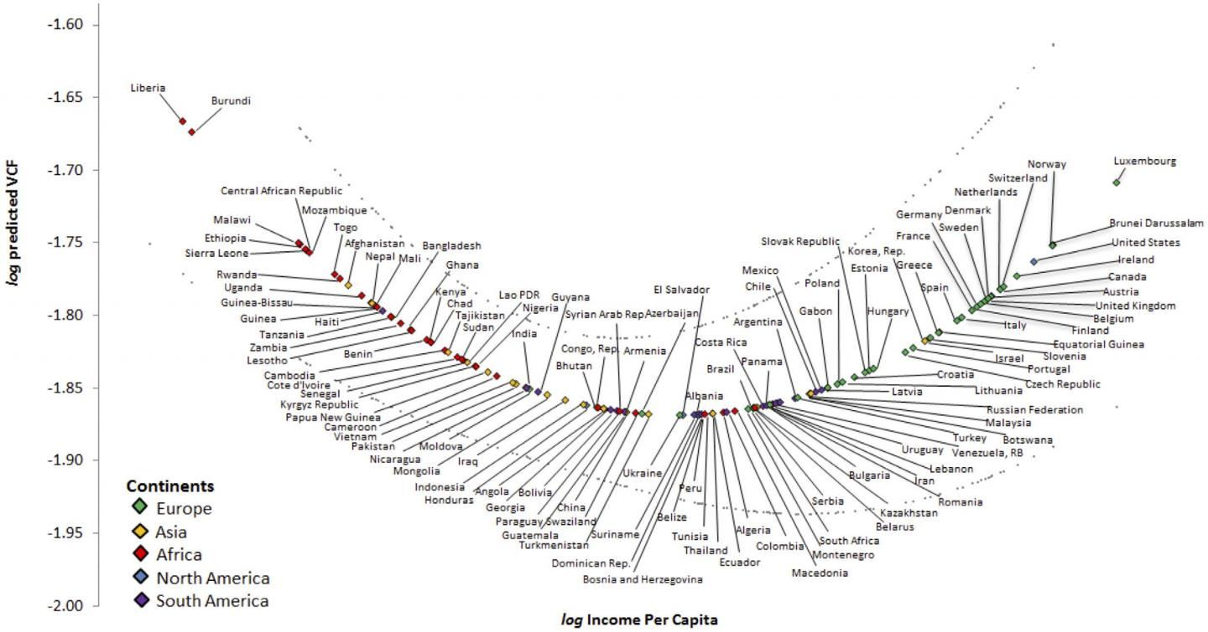
Economic Growth and Deforestation
$8,200 is turning point here

Slide 64
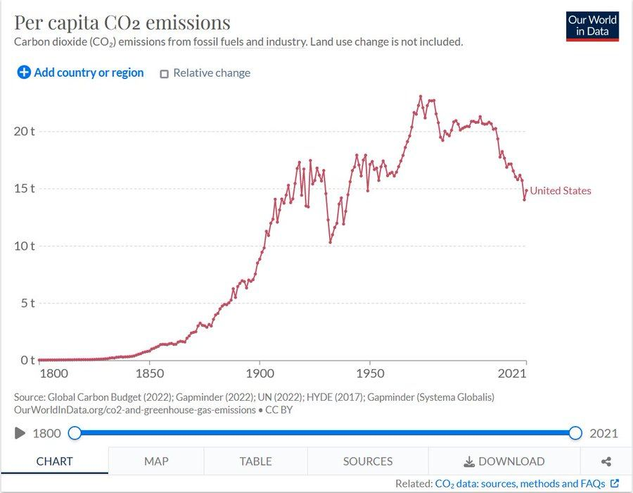
Per Capita Emissions Now Below … World War 1 Levels

Slide 65
Growth != More “Stuff”
Decoupling:
Pollution
Carbon emissions?
Wood
Copper cables
Computer chips/silicon
AL, NI, CU, Steel, AU
Fertilizer
Plastics, Paper, Timber, Phosphate, Potash, Lead, Iron, Cadmium, Thorium, more
WATER (e.g. we use, overall, LESS than 50 years ago)
Oil? Nitrogen? Cement? And CROPLAND.
Land - Humans today use 0.9 hectares per person
Contrasted with 4.0 hectares per person 7,000 years ago

Slide 66
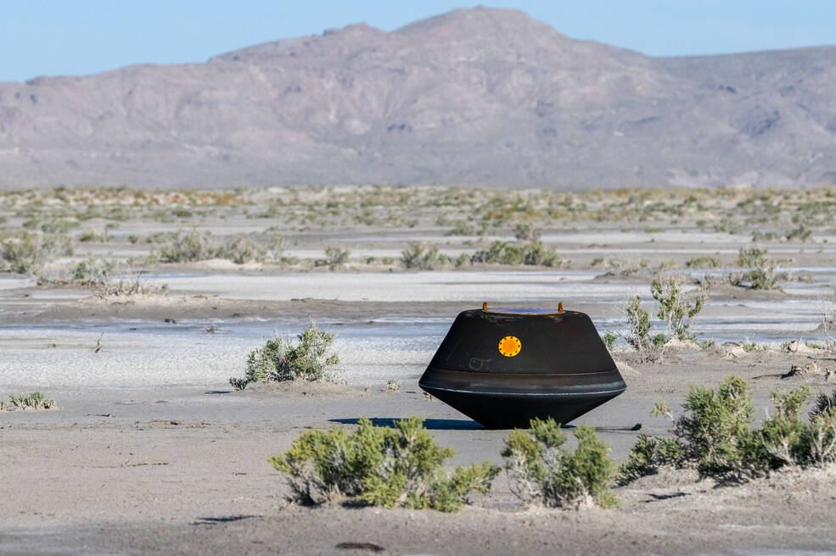
Ho Hum?
“humans sent out a spacecraft 200 million miles or so, grabbed some rocks, and brought them back” That only cost $1.2 billion”
COVID vaccine was ready in a month

Slide 67
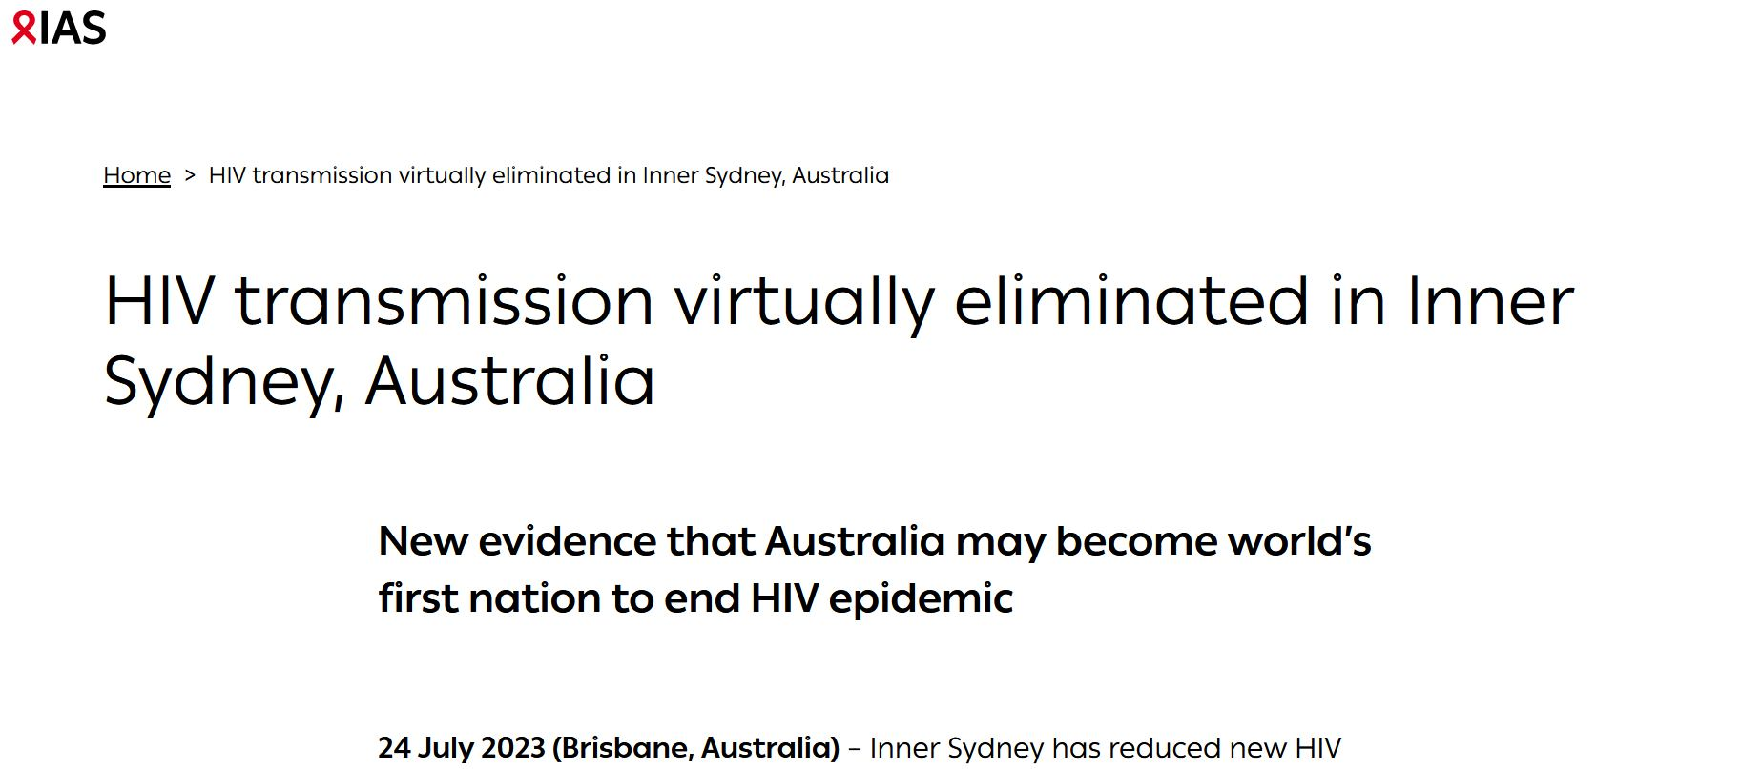
Ho Hum? An End to the HIV Catastrophe?

Slide 68


Six We Have Many Affordable Lifelines Already

Slide 69

BatSh!t Crazy Ideas?
Mine the Glaciers!
Grow the Glaciers!
Pay Off the Fossil Fuel Owners (most of them are governments, Exxon is SMALL)
Make Lots and Lots MORE Plastic
Build Lots MORE Wooden Housing
Nuclear Sequestration
Iron the Oceans, Space Mirrors, Grow Clams, Seed Clouds

Slide 70


Example: Make “Safe” Chalk Volcanoes
“GW, though not ocean acidification, is quickly and cheaply reversed by ejecting calcite nanoparticles (with an avg radius ~90nm) into the stratosphere.
The particles should be carried up by hydrogen balloons, and very preferably released over the tropics. The total amount needed will be on the order of several hundred kilotons yearly, and the total cost should be somewhere between $1B and $5B yearly.
Calcite is alkaline and can also scavange ozone-depleting gases from the ozone layer. These tend to be very strong greenhouse gases, as well”

Slide 71
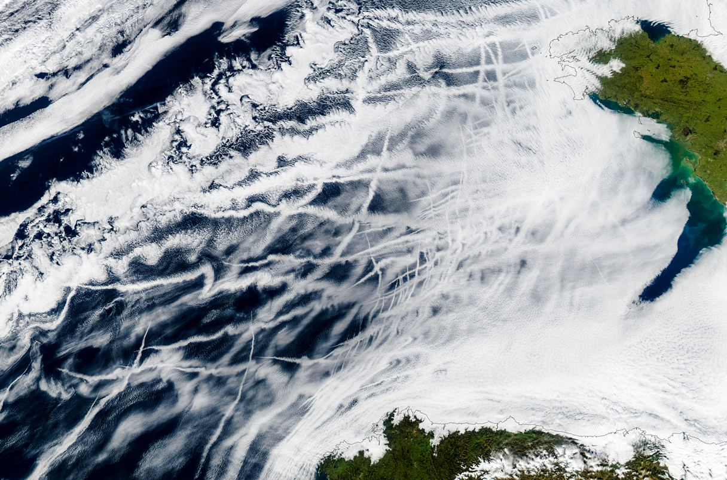
Example: Make “Ship Track” Volcanoes
Marine cloud brightening
Cargo ships inject salt particles back into the air, to make clouds more reflective.
“Humanity could cool off the planet significantly by brightening the clouds. “It suggests pretty strongly that if you wanted to do it on purpose, you could”
Extremely Cheap:
Cost <$200M per Year
(UR Budget is $5,000M)
Few Side Effects
Quick to Implement

Slide 72

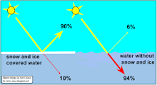
Albedo Illustration
5% increase in cloudiness/reflectiveness would offset entirely the impacts of a CO₂ doubling

Slide 73

Six-Thirty The Batsh!t Crazy Worst-Case Scenarios: 1. Unfold Over Centuries 2. May Not Matter

Slide 74
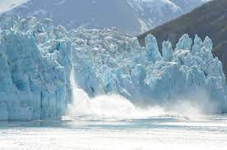
“Sudden Tipping Points” Not Suddent
“Catastrophic” Events Unfold over:
* Decades, centuries and millenia time scales
E.G. Can the THC stop abruptly?
Leads to weather changes over decades and centuries
Can Ice Sheets PRECIPITOUSLY melt?
ENTIRE WAIS melting would raise sea levels by 10 feet
… under MOST HORRIFIC scenarios … this … takes … CENTURIES
(RCP 8.5 assumes all melt in a century not from just WAIS may increase levels by a meter)..

Slide 75
Six-Thirty: Glacial Catastrophies?
West Antarctic and Greenland Ice Sheet Melting
Permafrost Melting and Methane Release
Artic Sea Ice Loss
Ocean Circulation Changes/Losses (e.g. AMOC).
Amazon Rainforest die off (how?)
Coral Reef Collapse
West African Monsoon Shift

Slide 76

Seven We Won’t Buy The Farm

Slide 77
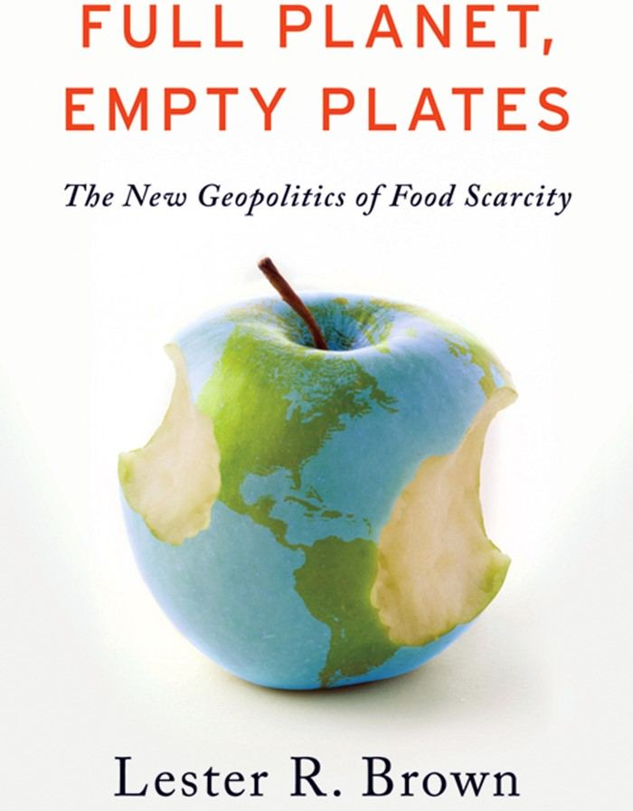
Lester Brown on Food and Population
(1974) farmers could no longer keep up with rising demand
(1981) “global food insecurity is increasing”
(1984) “Slim margin between food production and pop growth continues to narrow”
(1989) “pop growth is exceeding farmers’ ability to keep up”
(1994) “Seldom has the world faced an unfolding emergency whose dimensions are as clear as the growing imbalance between food and people … output per person has reversed with unanticipated (???? – did not HE anticipate it????) abruptness ”
(2007) “cheap food may now be history”

Slide 78
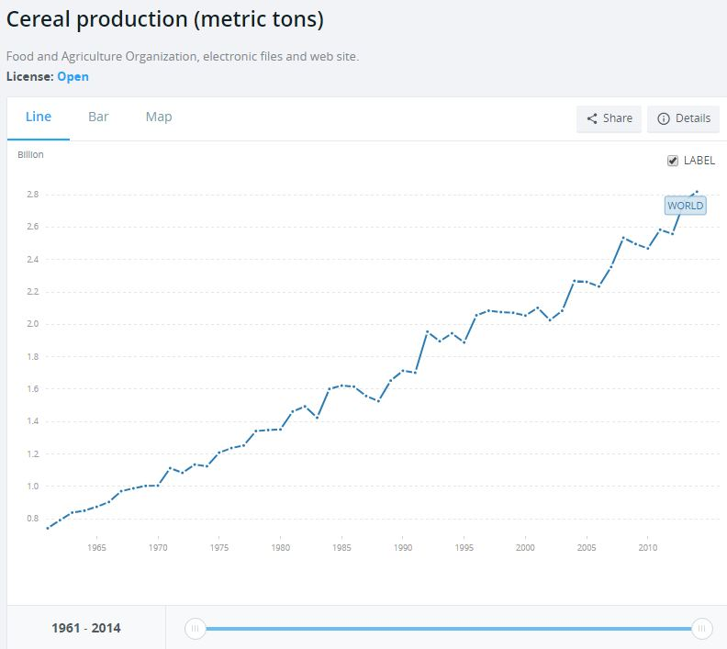
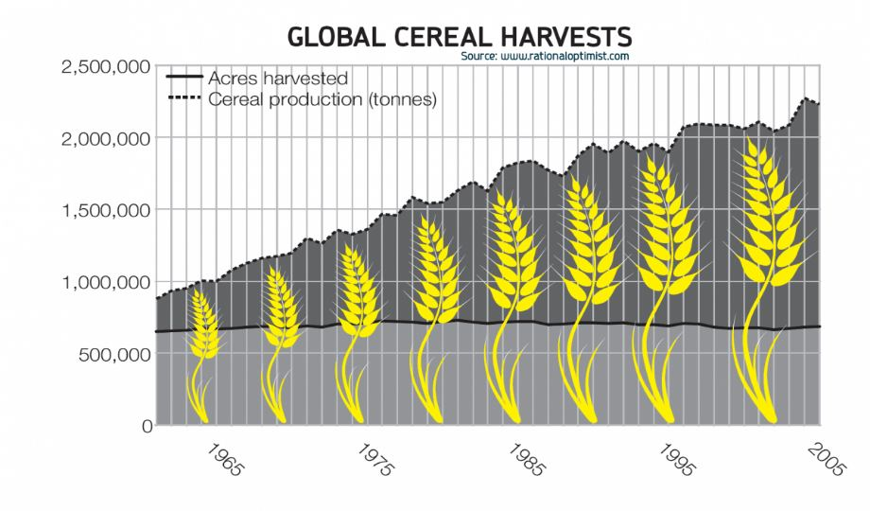
William and Paul Paddock: “Haiti, Egypt and India were beyond saving and should be left to starve … the world’s efforts should be focused on less desperate cases” - they called for a moratorium on research programs designed to increase food production in poor countries

Slide 79
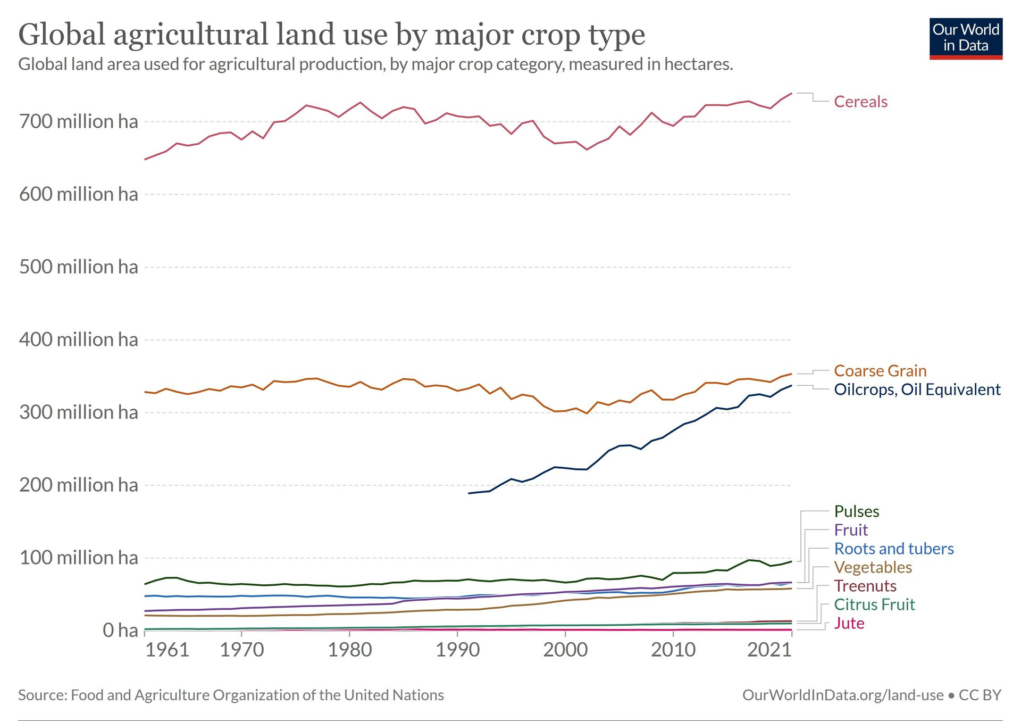
Since these predictions, the globe produces over 3 ½ times more crops on virtually the same land footprint → global calories per capita up by 30% and human-wildlife conflicts fall

Slide 80
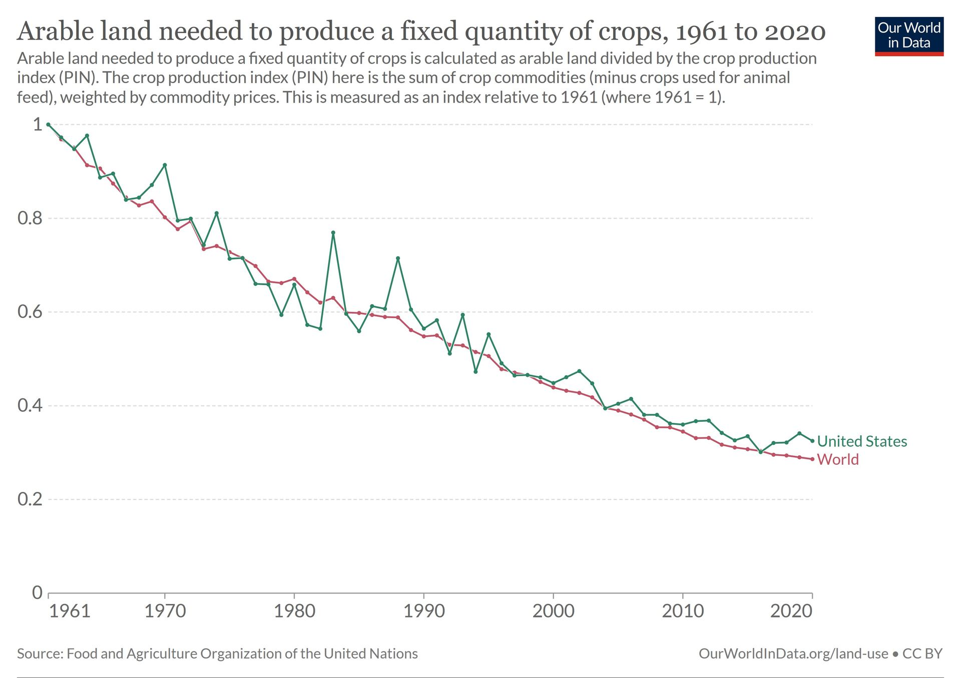

Slide 81
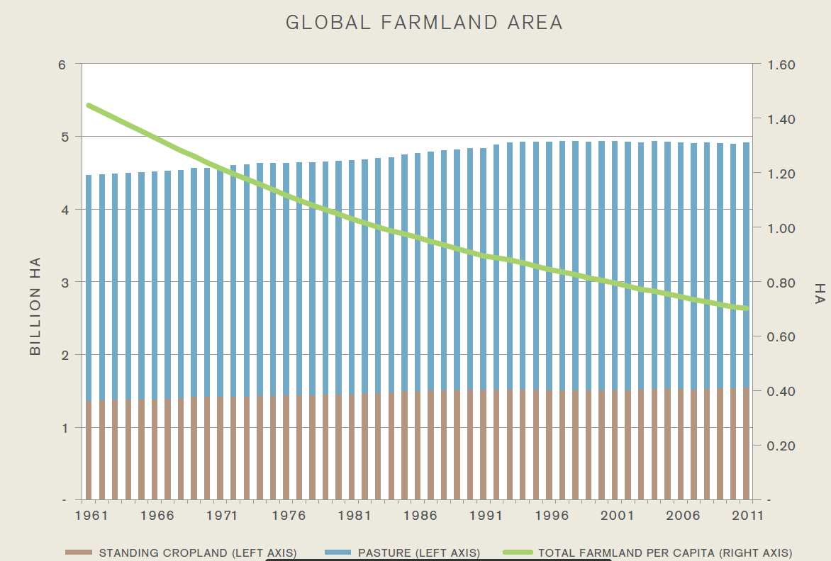
Global Farmland per capita Declines for 50 Years
Apx 2% per annum improvement in yields since 1960s
Avg. # of harvests per season increased from 0.78 to 0.89
Pork, beef and poultry production much more efficient

Slide 82

US Corn – Farmland Decoupling

Slide 83


Slide 84

Is Temperature Limiting?

Slide 85
Implications, a Glimpse
And we don’t really “need” all of that corn
We dedicate the land area of Alabama to feed corn to … cars
Of the 12B bu. we grow, only 10% is used as food for Americans
Another 10% is food for export
Rest is fed to cattle, cars and booze
How much US land would be spared if we merely stopped ethanol and all corn farms reached the current max yield of 500?
Climate is NOT the limiting factor in poor country agriculture either.

Slide 86

“If countries produced current crops in each cell according to potential yields, the rich-poor agricultural yield gap would virtually disappear, from 214 percent to 5 percent. Additional aggregate productivity gains are attainable through spatial and crop reallocation.”

Slide 87

Grain to Protein Decoupling
And we don’t really “need” all of that corn
You might crudely think of animals as living machines that convert grain inputs to meat outputs
Pork is a 3.3 times more efficient machine than beef
Chicken is a 50% more efficient machine than pork (i.e. 5 times more efficient than beef)
Costs, conscientiousness and chemistry have all led to chicken winning market share

Slide 88

Do Rising Yields Mean Rising Inputs?
What happened around 1970?
Earth Day … ?
… computers and precision agriculture

Slide 89
Seven: Agriculture
Climate is Not the Limiting Agricultural Productivity Factor
Historical and potential yields
Farmland decoupling
Inputs decoupling
The Ongoing AgTech revolution
Seeds (bred for resilience, salinity, drought, nutrition, insect resistance, disease resistance, custom to location/needs),
Precision farming
Water conservation and management
Intercropping, no till and soil management
Robots, drones and AI

Slide 90


Drone, Robot and GPS Farms
In tractors …
Computers to display machine performance
Precise field position (to within an inch)
Operating data on attachments (planters, harvesters)
Increasingly …
Self-propelled machinery
Flying robots to survey, assess AND treat crops individually
Soil nutrient, water, quality, testing → variable rate seed planting
Ultrasonic sensors
High throughput plant phenotyping (like personalized medicine for plants)

Slide 91
Are We At Our Limit?
American farm yield averages are nowhere near its limit
Illustration:
Average yield of corn farm in IOWA: 175 bushels/acre
NC farmer (Russell Hedrick): 459.1 bushels/acre dryland in 2022
GEORGIA farmer (Randy Dowdy) hit 513 bushels per acre
He also broke soybean record at 190 bushels
US average soybeans? 55 bushels per acre
India? 20 bushels per acre

Slide 92
Land and Resource Sparing Potential
Under optimistic scenarios where:
We stop feeding grain to cars
We reduce food waste
We reduce obesity
We get global yields equal to American best
We can spare an amount of land almost 400 million hectares (i.e. all of India or the US east of the Mississippi)
What if we reduced beef consumption some more?
Implemented widespread transgenic techniques?
Developed drone precision technology?
Had warmer temps and more CO₂?
We’ve already started
US has likely hit peak farmland. Has the world? When will the world?
Florian Schierhorn study indicates that 30 to 60 million hectares has already been spared in Soviet Union and Eastern Europe
This is an area the size of Poland and has already happened in Russia

Slide 93
Seven: Agriculture
Global Yields Substantially Below US Yields
COTTON:
US yield → 1000 lbs per acre
World → 700 lbs per acre
India → 400 lbs per acre
CORN:
US yield → 180 bushels per acre
World → 80-95 bushels per acre
India → 45 bushels per acre
WHEAT:
US yield → 60 bushels per acre
World → 45 bushels per acre
India → 30 bushels per acre
RICE:
US yield → 80 bushels per acre
World → ~60 bushels per acre
India → 35 bushels per acre

Slide 94

Seven: Agriculture
Application: The Netherlands vs. Brazil
BRAZIL
5th largest country on Earth
1/8 of world’s freshwater
Exports $105B food per year
NED:
203x smaller than Brazil
26% of land below sea level
Exports $115B of food per year,
2nd largest on Earth

Slide 95

Eight We Are Already Incredibly Resilient

Slide 96

Eight: Extreme Weather Resilience
Assume That Extreme Weather WILL Be More Likely …

Slide 97


Eight: Extreme Weather Resilience
Despite Us Moving and Building Where the Extremes Occur

Slide 98

Eight: Phoenix Hit 110° for 30 Straight Days

Slide 99

Eight: Extreme Weather Resilience
Current US Southwestern Drought is Driest 22-Year Period in 1,200 Years, Yet Relative to What Would Have Occurred?
Has GDP been damaged there?
Have real estate prices been hurt?
Has this stopped migration?

Slide 100

Eight: Global Resilience

Slide 101

Eight: Global Resilience

Slide 102
Storm Damage, Closer Look
Global disaster losses as share of GDP:
Constant at 0.3% since 1990
Despite gross dollar cost of disasters doubling since then (same rate as growth in global economy)
Mortality rates from storms
Fell from 0.11 per 100,000 in 1920
To 0.04 per 100,000 in 2010s
Death rates from floods and droughts have fallen more sharply

Slide 103
Eight: Extreme Weather Resilience
IPCC AR5 – WGI Report on Extremes
... low confidence regarding the sign of trend in the magnitude and/or frequency of floods on a global scale.“
... low confidence in a global-scale observed trend in drought or dryness (lack of rainfall) since the middle of the 20th century...
... low confidence in trends in small-scale severe weather phenomena such as hail and thunderstorms..."
"... confidence in large scale changes in the intensity of extreme extratropical cyclones [storms] since 1900 is low."

Slide 104
Eight: Extreme Weather Resilience
Just as Climate is Not the Limiting Agricultural Factor … … Climate is NOT the Limiting Factor in Storm Resilience
IPCC (SREX): “most studies of long-term disaster loss records attribute these increases in at-risk areas … and to underlying societal trends – demographic, economic, political, and social – that shape vulnerability to impacts.”
IPCC (AR5): “growth, including greater concentrations of people and wealth in periled areas and rising insurance penetration, is the most important driver of increasing losses.” The “worldwide burden of human ill-health from climate change is relatively small compared with the effects of other stressors and is not well quantified.”

Slide 105
Eight: Extreme Weather Resilience
Just as Climate is Not the Limiting Agricultural Factor … … Climate is NOT the Limiting Factor in Storm Resilience
Chicago Heat Wave (1995)
Most of the 739 people who were killed were elderly and African Americans, living alone in poor, violent, segregated neighborhoods.
“Communities where businesses did not flee, and community organizations remained active, saw people survive. Churches, block clubs, and especially commercial activity provided an informal social support network that ensured many fewer people died during the city’s worst natural disaster.”

Slide 106
Eight: Extreme Weather Resilience
Disasters Are Not a Surprise
A very small amount of movement of physical structures and infrastructure can offset most of the impacts of storm activity
Nordhaus: ~ 3% of the US capital stock is located below 10M altitude and is in the hurricane zones of the Atlantic coast.
The major vulnerable items are structures, and these amount to about $600 billion of capital today.
Securing the nation’s capital from hurricanes would cost only about 0.01 percent of GDP annually over the next half century.
This is much smaller than the costs if no such adaptations are made.

Slide 107

1.5° or Catastrophe?

Slide 108

2.0?

Slide 109

Nine Are There Any More Logs for the Fire?

Slide 110
Nine: Could We Boil Ourselves ON PURPOSE?
Do Climate Models Assume Infinite Stored Carbon Supplies?
Cruz and Rossi Simulation: Cumulative flow of CO₂ emissions over 500 years is 19,500 Gt of CO₂ (19.5 trillion tons). Annual peak at 116Gt
Banktrack: 2,795 Gt of CO₂ (65% coal, 22% oil, 13% in gas).
Oreskes et al: 750 Gt of C → 2,000 Gt of CO₂ when combusted
Estimate that we’d burn 440Gt out of remaining “budget” of 210
UPSHOT: Are our workhorse “worst case” models (RCP8.5) assuming we burn SIX PLANET EARTH's worth of Carbon to generate the scary scenarios?

Slide 111
Nine: Boil in Joy
Assume We Instantly Burn All 3,000 Gt of Carbon Reserves
Since 1750, we have emitted 1,500 Gt CO₂ → 1 degree of warming, let’s assume another ½ degree.
If future is like the past, burning all 3,000 Gt → 3 more degrees
The temperature difference between NYC and OKC
4.5° total warming is 95th percentile warming predicted from “middle range” climate models when we double CO₂ concentrations, not burn all of it
The “math” → every 7.81 Gt of CO₂ emissions increases atmospheric concentrations by 1ppm → 384ppm increase implied

Slide 112
Nine: Back of Envelope Estimates?
Proved Coal Reserves: 1 trillion tons
Combusts into 2,500 Gt of CO₂
Adds 321 ppm
Proved Oil Reserves: 1.7 trillion barrels.
Combusts into 731 Gt of CO₂.
Adds 94 ppm
Proved Natural Gas Reserves: 6,600 trillion cf.
Combusts into 5,140 Gt of CO₂
Adds 659 ppm

Slide 113
Nine: The IEA Doesn’t Think We Can
“The combination of growing momentum behind clean energy technologies and structural economic shifts around the world has major implications for fossil fuels , with peaks in global demand for coal, oil and natural gas all visible this decade – the first time this has happened in a WEO scenario based on today’s policy settings.
In this scenario, the share of fossil fuels in global energy supply, which has been stuck for decades at around 80%, declines to 73% by 2030, with global energy-related carbon dioxide (CO2) emissions peaking by 2025.”

Slide 114

Ten What if October 2025 is just as “awful” as October 2023?

Slide 115

Ten: The Economic Costs Reconsidered
Great Depression:
People were forced to live no better
than their parents … and it was found to
be intolerable
Housing Crisis of 2008
People had to maintain year 2007 living
standards for four years longer than
otherwise … and it was intolerable
COVID-19
Economic improvement was put on pause
for two full years … and it was intolerable

Slide 116

Ten: The Economic Costs Reconsidered
CLIMATE CHANGE WILL NOT CANCEL THE PARTY
It’s merely going to turn the music down a few decibels
Under NO Climate Scenarios, Even Hottest Ones, Does:
Life expectancy not rise
Poverty not fall
Hunger not fall
Average incomes not go up
All Futures Will Be Better Than Today
How much better is the question
And FOR WHOM – the benefits and costs are NOT distributed equally

Slide 117
Ten: The Economic Costs Reconsidered
STOP CLIMATE CHANGE
If we “end cows and cars”:
World average income will surpass $84,000 in the year 2100
American average income will surpass $300,000 in the year 2100
This is ONLY if “stop climate change” efficiently …
“DO NOTHING” / Catastrophe
RCP8.5/SSP5-8.5
World average income will surpass $84,000 in the year 2102
American average income will surpass $300,000 in the year 2102

Slide 118
Ten: The Economic Costs Reconsidered
Levels vs. Growth (above assumes slower than historic growth)
Most costs are 1x adjustment costs
Assuming There Still Is a Negative Relationship Between Heat and Economic Growth
Revisitation of data from seminal 2012 paper doesn’t replicate

Slide 119


Slide 120

Perspective
World Average Income in 2021?
$18,000
Up 71% in a decade
Up 120% since 2000
2.6% annual growth

Slide 121
Ten: The Economic Costs Reconsidered
IPCC AR4 and AR5 Results Illustrate Mendelsohn Paper
Under RCP8.5 (worst case, do nothing) scenarios:
Over a meter of sea level rise, 10°F warming, 10% less precip
TOTAL damages in the year 2100
$19 billion to $273 billion
Only 1/10th of a percent of GDP per year
Annual losses of $28.70 as compared to baseline.
This is not a typo.

Slide 122
Ten: The Economic Costs Reconsidered
While the overall losses seem small, they are very unevenly distributed … poor countries will suffer while wealthy country costs may be small to negative
“… poor countries, mainly in Africa and Southeast Asia, will face the largest losses (0.2 to 1.2% reduction in GDP) and, under experimental models, up to 23.8% drop in GDP; in contrast, the richest quartile will encounter both positive and negative effects, ranging –0.1% to +0.2% GDP, and up to a 0.9% GDP increase under experimental models.”
Experimental Illustration: “24% drop” means
Instead of poor countries being 6x richer in a century
They will only be 4.5x richer

Slide 123
Ten: The Economic Costs Reconsidered
Mendelsohn Paper is More Pessimistic than Current IPCC:
Absent climate change, the typical person in the poorest countries is expected to be 2.3 times richer at the end of the century than they are today (likely to be 4x to 6x)
For example, if your income is $2,500 in the year 2023, then it would be over $5,800 by 2120.
Under the worst-case climate scenario this person’s income would be only about 1.8 times larger – our hypothetical resident would be earning $4,510.

Slide 124
Ten: The Economic Costs Reconsidered
Economics Nobel Laureate William Nordhaus
“When we quantify the proposed economic model for the world economy at a fine level of spatial resolution we obtain local effects of global warming on welfare that range from losses of 19% to gains of 12%.”
These gains and losses are not equally distributed.
In one model, Alaska, Greenland and Russia see productivity double
Middle East and Africa and Australia see declines of 77%

Slide 125


Slide 126


Slide 127
Ten: The Economic Costs Reconsidered
Our Best Guess, Then at the Expected Economic Costs of AGW:
IPCC AR4 (2007): from 1% to 5% of GDP for 4° of warming
IPCC AR5 (2013): does not report numerical estimate, on p.692 under Impacts they say, “in sum, estimates of the aggregate economic impact of climate change are relatively small but with large downside risk”
Nordhaus (2015): -2.04% of GDP for warming of 3°C (+/- 2.21)
At 6°C of warming -8.16% impact on gross GDP (+/- 2.43)

Slide 128
Ten: The Economic Costs Reconsidered
IPCC AR5:
“For most economic sectors, the impact of climate change will be small relative to the impacts of other drivers (medium evidence, high agreement).
Changes in population, age, income, technology, relative prices, lifestyle, regulation, governance, and many other aspects of socioeconomic development will have an impact on the supply and demand of economic goods and services that is large relative to the impact of climate change.”

Slide 129
Ten: The Economic Costs Reconsidered
Resources for the Future (2020):
Climate models are tremendously uncertain
E.G. 95% CI for GDP growth in 2100 of -84% to +359%.
Expected GDP loss of 1% to 3% (95% CI of -8.5% to +1.8%)
Find significant marginal effects of hot temperatures on the levels of poor country GDP and agricultural GDP, but do not identify statistically significant temperature effects on GDP growth

Slide 130
Ten: The Economic Costs Reconsidered
Economic Cost of Flooding (Desmet et al, 2022):
“Under an intermediate scenario of greenhouse gas emissions, permanent flooding is projected to reduce global real GDP by 0.19 percent in present value terms.
By the year 2200, a projected 1.46 percent of the population will be displaced. Losses in coastal localities are much larger. When ignoring the dynamic response of investment and migration, the loss in real GDP in 2200 increases from 0.11 percent to 4.5 percent.”

Slide 131

Eleven “Give me your tired, your poor, Your huddled masses yearning to breathe free, The wretched refuse of your teeming shore, Send these, the homeless, tempest-tossed to me, I lift my lamp beside the golden door!”

Slide 132
Eleven: Migration
Economic and Environmental Costs Will Fall on Poorer Countries
AR5: “the poor nations will bear the brunt of climate change damages primarily because they are located in the low latitudes and are already too hot.”
IPCC and Norman Myers: “When global warming takes hold” Professor Myers argues, “there could be as many as 200 million people overtaken by disruptions of monsoon systems and other rainfall regimes, by droughts of unprecedented severity and duration, and by sea-level rise and coastal flooding”

Slide 133
Eleven: Migration
Practically Speaking …
United Nations: the estimated number of international migrants worldwide in 2020 was around 281 million
3.6% of the global population
Climate refugee numbers not that high
We have over half-century to adapt
Immigration/migration is a one-time adjustment

Slide 134

Eleven: Migration
IPCC Does Not Tell Us Expected Cost of International Migration
Assume that 100% of expected global warming costs will be borne by the dislocations and nothing else
At “worst” the cost is $2 trillion per year (ignoring the non-financial and emotional costs) … but … →

Slide 135
Eleven: Migration Net BENEFITS
The Benefits to Migrants and the World if Half of the Poor World Emigrating would be ~ 40% of global GDP (over $40 trillion)
These do not include the emotional and non-financial benefits
These are not likely to be transitory
UPSHOT: “Forced” climate migration delivers (ongoing) Benefits that are at least 20x greater than the (one-time) Cost of displacement

Slide 136
Caplan: “Niagara Falls Economics”
"You might think that moving from Haiti to the United States would cause a 20% increase in wages, but no. It’s more like 2,000%"
"The difference between the productivity of labor in poor countries and rich countries is so vast, it’s hard to wrap your mind around it."
A doubling of world GDP is a reasonable estimate.
COMPARE:
RCP8.5 Worst Case is Climate Change Pauses Growth for 2 Years
Open Migration would add 35 years of economic growth at a 2% rate permanently →about the economic difference between a middle-income country and a rich country today.

Slide 137

Twelve Catastrophe? Then Where are the Bodies Buried?

Slide 138

TWELVE: BODYCOUNT
What does SUNY Morrisville’s Athletic Field Have to Do with Ding Dong?
School Officials: “and we found that it’s at most two to three degrees hotter than a green field with similar infield.”

Slide 139

TWELVE: Global Burden of Disease 2019
COMPARE:
31,000 global disaster deaths in 2022
Extra 250,000 deaths expected to come from: “malnutrition, malaria, diarrhoea and heat stress”
Estimates down to 8m from 2010-2019 if remove maternal/neonatal health
Estimates at 7-9m*
56 .5 million deaths annually, over 40 million of which occur in developing world
They updated to 250,000 in 2017

Slide 140


Slide 141

Worldwide Deaths 2019

Slide 142

Air Pollution, Closer Look
Lancet Commission on Pollution and Health, 2017
Pollution responsible for 9 million premature deaths
Kills 1-in-4 people in poor countries
Estimated cost $4.6 trillion per year globally

Slide 143

TWELVE: Causes of Death in USA: Today

Slide 144
War, Death and Destruction
Battle of the Somme: 1 million casualties
Stalingrad: 2.1 million casualties
Germany lost 44,000 per million in WWII. It lost 450,000 in January 1945 alone, more than …
40 million civilian casualties during WWII, up to 85 million total, worse than 320 global warming events
100,000 Japanese casualties in just two nights of B-29 raids

Slide 145

Causes of Death Poor Countries, 2019
Dirty Air
Dirty Water
Mosquitos
EX: decrease in HIV deaths = magnitude of expected climate deaths. Diarrhoea larger

Slide 146
Water Pollution Harms, A Glimpse
Diarrheal diseases kill one over million children every year
Every dollar spent to improve water sanitation translates into nine times as much economic activity
Less transparent harms:
“Women spend 97 billion hours a year looking for a safe place to go to the loo. That equals 46 million working years, which is the same workforce as Germany, the fourth largest economy in the world.”

Slide 147

Global Burden of
Disease to 2019

Slide 148


Slide 149
The Challenge of High Causal Density
It is estimated that INADEQUATE CONSUMPTION OF PRODUCE is responsible for apx 5% of all global deaths annually → so over 2.8 million (over 10x climate predictions)
Suboptimal fruit consumption resulted in in nearly 1.3 million deaths from stroke and more than 520,000 deaths from coronary heart disease.
Suboptimal vegetable consumption resulted in around 200,000 deaths from stroke and more than 800,000 deaths from coronary heart disease

Slide 151


I’ll GIVE YOU ONE LEVER to Pull To “Solve” Environmental Problems…
What is killing turtles, what is eutrophying waterways, what is destroying biodiversity, what killed 3 billion birds? what is spreading disease? Why was the Libyan flood so harmful? Child abuse?
“the authors find that a 10-degree F increase in daily temperature is associated with a 4.6% increase in the rate of substantiated child maltreatment. These findings contribute to our understanding of the causes of child maltreatment by highlighting the role of environmental factors, such as temperature, in shaping patterns of child maltreatment.”

Slide 152
Assume I am Wrong
French electric sector eliminated CO2 in three decades
Nuclear powered coal phaseout completed in just 9 years in Ontario.
Abundant energy is “all” it takes to “reverse” the problem
We already build indoor ski slopes … in the DESERT
Humans already live continuously … in OUTERSPACE
Humans flourish across a temperature gradiant of OVER 100 degrees, in deserts, in rain forests, on oceans
No place on earth has too little fresh water for human needs
We are spectacularly safer from natural disasters
We are on the cusp of biomedical and biotech revolution
Resources are more, not less abundant. And the planet has barely been strafed

Slide 153

Can We Breathe Easy?
What You SHOULD Care About?
Extreme scenarios, really cannot be modeled
Build resilience, not fragility
The IPCC is ruling “Doom Scenarios” Out
We are accumulating adaptation and mitigation tools at a rapid clip
Methane, water vapor, land use change, etc.
Focusing on CO₂ now, other processes not well understood
IPCC focuses on costs only, not NET benefits
CO₂ is not the planet’s limiting factor

Slide 154

Why I’m Probably Full of Sh!t
Planet does not stop at 2100 like our estimates, warming continues
We do NOT have the resources to practice precaution against many doom scenarios (asteroids, war, etc), and adding one more …
GW adds stress to an already stressed planet
Our political and private reactions to whatever climate change we do or do not get is going to dictate how serious a problem it is
See US debt ceiling battles and long-term fiscal problems
Future generations may care MORE about the climate?
Hi I’m Michael, and I’m an Apocaholic

Slide 155

Does Nature Have “Last Licks?”
I Don’t Know the Unknown Unknowns

