Slide 1
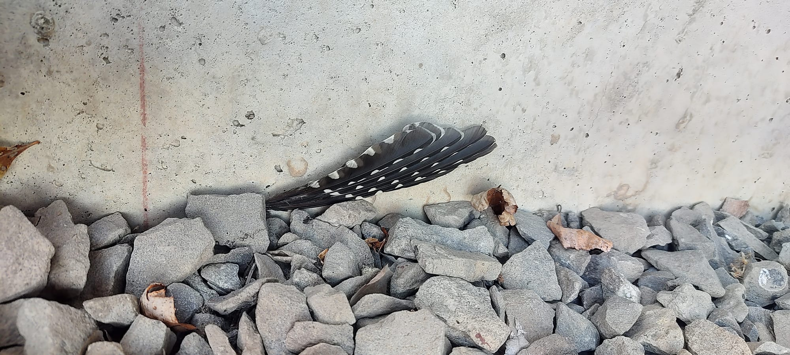
RESEARCH OPPORTUNITY
SMASH THE CRASH
Fall 2026 study of
bird-window collisions
at the River Campus
from September 7 to October 31
No experience needed!
Email smashthecrashROC@gmail.com to learn more

