Slide 1




VISVESVARAYA TECHNOLOGICAL UNIVERSITY “JNANA SANGAMA”, BELAGAVI– 590018
GHOUSIA COLLEGE OF ENGINEERING, RAMANAGARAM DEPARTMENT OF COMPUTER SCIENCE
Presentation On
STOCK MARKET TREND ANALYSIS USING MACHINE LEARNING
SUBMITTED BY:
SHASHANK GOWDA G 1GC22CS107
TEJAS H G 1GC22CS138
TEJAS G 1GC22CS137
YASHWANTH N 1GC22CS151
Project Guide:
DR.DILSHAD BEGUM
Professor & HOD, Dept of CSE
Project Coordinator:
DR.Omar Khan Durrani
Associate Professor & HOD, Dept of ISE

Slide 2
STOCK MARKET TREND ANALYSIS USING MACHINE LEARING
A Project presentation on Market Dynamics, Analysis and Strategy

Slide 3
The accurate forecasting of stock market movements remains a critical challenge for investors due to high volatility and the presence of numerous interacting financial, economic, and psychological factors. This study aims to analyze and evaluate the efficacy of classical technical indicators in identifying short-term trends within the S&P 500 index over a five-year period (January 2020 – December 2024). The methodology involved collecting daily price and volume data and systematically applying three key technical analysis tools: the Moving Average Convergence Divergence (MACD), Relative Strength Index (RSI), and Bollinger Bands. Trading signals generated by these indicators were back-tested against a simple buy-and-hold strategy. Key findings indicate that a combined strategy utilizing MACD crossover signals for trend direction and RSI for overbought/oversold confirmation generated an annualized return of X%, which outperformed the benchmark S&P 500 return of Y% with a lower maximum drawdown.
ABSTRACT

Slide 4
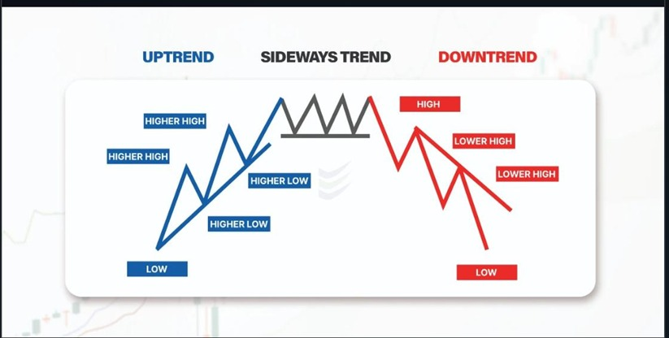
What is Stock Market Trend
Uptrend(Bull): A series of Higher highs and Higher lows, indicating optimism and demand Trend is the General Direction (Up,Down or Sideways ) in which market is moving over time
Downtrend(Bear):A series of Lower highs and Lower lows,reflecting pessimism and supply
Sideways: Price moves in narrow range, indicating consolidation or balance

Slide 5
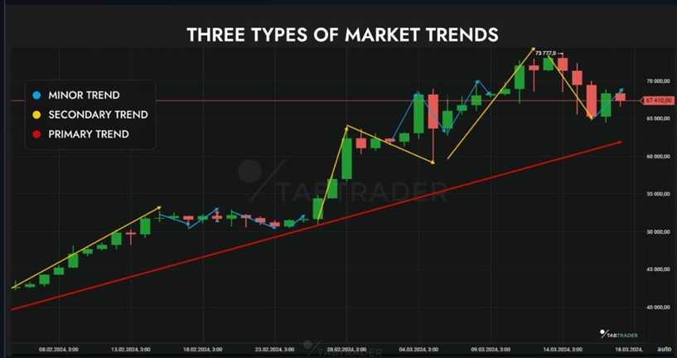
Trend Classification by Duration
Primary(Long-Term)L:
Lasts one year or more. Represents the fundamental economic “tide”
Secondary(Mid-Term)
Lasts one to three months. Acts as a correction or reaction within the primary trend
Minor ()Short-Term):
Lasts less than a month. Represents daily volatility or “market noise”

Slide 6
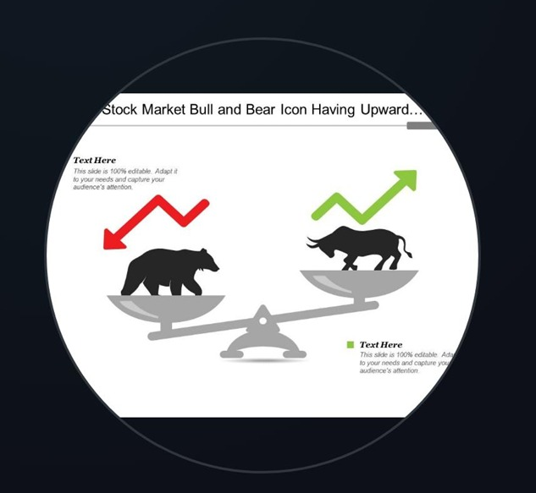
Why Analyse Trends
Informed Decision : Provides a data driven framework to buy,hold or sell.
Risk Management : Helps identify trend reversals to preserve capital
Sector Rotation : Identifies which sector are leading or lagging the market
Forecasting : Sets realistic expectations for future returns and volatality

Slide 7
Core Analysis Methodologies
Two primary schools of thought for evaluating market trends

Slide 8
1. Fundamental Analysis
Check whether the Company is Debt free or how fast it is Earning to clear its debts
Check the P|E ratio (Profit to Earning ) is 15-20 not less or more
By analysing the balancesheet check how much profit is a company making per year to year , whether the money growing from investing or operating activity, analyse the assets and check whether the company is investing much on current and non-current Liabilities
Lastly check the Annual report by checking whether the company showing the profits are real or unreal .If all these conditions are met the company is strong enough to trade and invest

Slide 9
2.Technical Analysis
Support : A support level is a price point at which an asset struggles to fall below over a set period, created by buyers entering the market at lower prices. This concept is visualized by drawing a line connecting the lowest lows on a chart.
Resistance: Resistance is a foundational concept in technical analysis with levels identified through chart analysis and trading tools. resistance zone represents a test of the resistance level, which may be broken by a small amount, but ultimately turns back the price advance, leaving the resistance level essentially intact.
Stop Loss: Stop-loss orders are among the best risk management tools, automating trades that limit potential losses and protect your money. When used well, a stop-loss order can make a world of difference. And just about any investor can benefit from this tool.

Slide 10
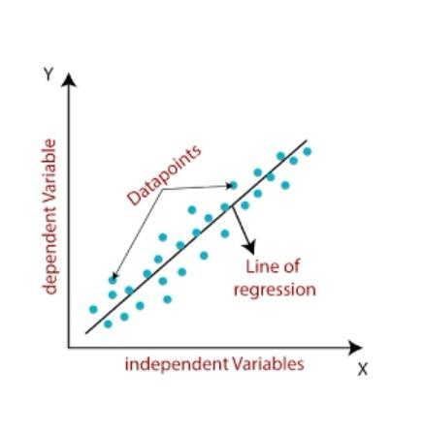
Linear Regression in Machine Learning
Linear regression is the analysis of two separate variables to define a single relationship and is a useful measure for technical and quantitative analysis in financial markets.
Plotting stock prices along a normal distribution—bell curve—can allow traders to see when a stock is overbought or oversold.
Using linear regression, a trader can identify key price points—entry price, stop-loss price, and exit prices.
A stock's price and time period determine the system parameters for linear regression, making the method universally applicable.

Slide 11
LITERATURE SURVEY
year | Title of the paper | Author | Abstract | Limitations
2023 | Understanding Stock Market Trends Using Simple Moving Average (SMA) And Exponential Moving Average (EMA) Indicators | Ananta Ojha , Vineet Saxena. | Understanding stock market trends is essential for traders and investors to make informed decisions. This study focuses on analyzing stock price movements using two widely used technical indicators: Simple Moving Average (SMA) and Exponential Moving Average (EMA). | Lagging Nature of Moving Averages Both SMA and EMA rely on historical data, causing delayed responses to sudden price changes. Inefficiency in High-Volatility Markets Rapid price fluctuations may generate false signals or misleading crossovers.

Slide 12
year | Title of the paper | Author | Abstract | Limitations
2024 | Stock Market Trend Prediction Model using Deep Learning based Sentiment Analysis of Financial Data | Anupa Sekhar Dash , Ujjwal Mishra. | Stock market trend prediction has become a crucial area of research as financial markets grow increasingly complex and influenced by multiple factors. This study proposes a Deep Learning–based sentiment analysis model integrated with historical financial data to predict future stock market trends. | High Market Volatility Sudden economic, political, or global events cannot be fully captured by deep learning models. Data Quality and Reliability Sentiment data from social media may include biased opinions, spam, or manipulated content, affecting prediction accuracy.

Slide 13
LITERATURE SURVEY
year | Title of the paper | Author | Abstract | Limitations
2025 | Predicting Stock Market Trends Using Machine Learning and Sentiment Analysis | Mr. Manan Agrawal, Dr. Arindam Mukherjee | Stock market trend prediction has become increasingly important as investors seek data-driven insights to make informed trading decisions. This project focuses on predicting stock market trends using Machine Learning (ML) techniques combined with Sentiment Analysis of financial news and social media data. | Market Volatility & Unpredictability Stock markets are influenced by sudden events that models cannot always capture. Data Quality Issues Social media data may be noisy, biased, or contain misinformation, reducing sentiment accuracy.

Slide 14
year | Title of the paper | Author | Abstract | Limitations
2025 | A Review on Stock Market Trends and Stocks Price Prediction Using Sentiment Analysis and Market Data | Nitin Mishra, Mohammad Anzar, Saksham Pandey, Santosh Mishra | The prediction of stock market trends and stock prices has gained significant attention due to increasing investor interest and the rapid growth of financial data. This review paper examines various techniques used for forecasting stock movements by integrating market data with sentiment analysis derived from financial news, social media platforms, and company reports. | High Market Volatility Stock markets react to unexpected global and economic events, which makes predictions uncertain. Sentiment Data Noise Social media content may contain spam, bots, and misinformation, reducing the reliability of sentiment scores.

Slide 15
year | Title of the paper | Author | Abstract | Limitations
2025 | Applying Advanced Data Mining Technique to Predict Stock Market Trends from Textual Information | Dr. Varsha Agarwal, Yallati Venkata Rangaiah, Dr. Saroj Kanta Biswal, Raghu N, Preetjot Singh, Dr. Mary Posonia A. | Predicting stock market trends has become increasingly challenging due to the vast amount of unstructured textual information generated from financial news, company reports, and social media. This study focuses on applying advanced data mining techniques to analyze and extract meaningful insights from textual data for stock market trend prediction. | Textual Data Noise Text from news and social media may contain irrelevant, misleading, or spam content, affecting model accuracy. Context Understanding Challenges Data mining techniques may misinterpret sarcasm, irony, abbreviations, or domain-specific jargon.

Slide 16
Proposed Methodology
Collect data from market APIs, financial news, and economic datasets.
Preprocess data: clean, normalize, and extract features.
Build and train ML models (LSTM, CNN, Random Forest).
Fuse models using ensemble techniques.
Deploy dashboard for live user interaction.

Slide 17
Key Technical Indicators
Mathematical tools to quantify trend, momentum and volatility

Slide 18
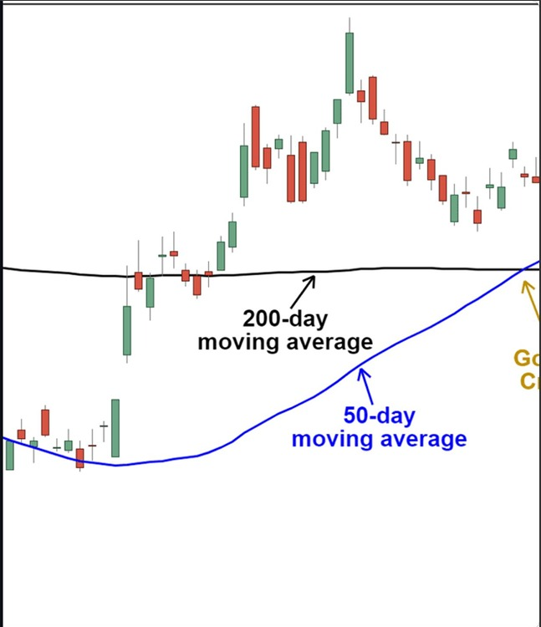
Indicator: Moving Averages(MAs)
The most fundamental trend filtering tool. Mas smooth price data to clearly reveal the underlying trend direction
SMS(simple moving average): Equal weight to all prices in the period
EMA(Exponential moving average): Gives more weight to the recent prices, making it more responsive
Key Signal : A “Golden Cross” (e.g., 50-day MA crosses above 200-day MA) is a strong bullish signal

Slide 19
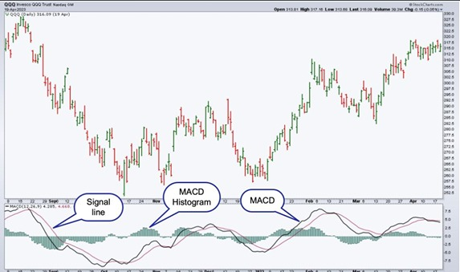
Indicators: Momemtum Oscillators
RSI(Relative Strength Index):
Measures the speed and change of price. Identifies overbought (>70) and oversold(<30) conditions
MACD(Moving Average Convergence Divergence):
How the relationship between two EMAs. Uses crossovers (MACD line vs Signal line) and a Histogram to signal momentum shifts

Slide 20
Economic Factors
The macroeconomic forces that shape long term primary trends

Slide 21

Economic Drivers: Rates and Inflation
Long-Term trends are dictated by economic environment
Rising Interest Rates : Bad for Stocks. Increases company debt costs and lowers valuations
High Inflation : Bad for stocks. Squeezes corporate profit margins and reduces consumer demand
GDP Growth : Strong GDP= strong corporate earnings. The market is forward-looking often leading GDP by 6-9 months

Slide 22
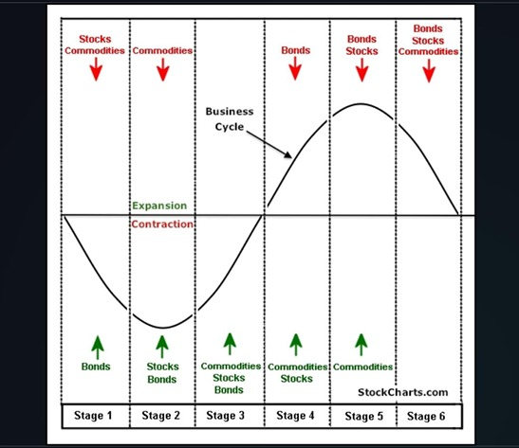
Sector Rotation: The Cyclical Flow
Capital moves between sectors based on the phase of the economic cycle
Contraction(Recession):
Money flows to Defensive sectors (utilities, Health care, Consumer Staples)
Expansion (Growth):
Money flows to cyclical sectors(Technology, Consumer Discretionary, Industrials)

Slide 23

The Physology of Trends
Markets are not perfectly rational. They are driven by two primary emotions
Greed: The driver of bull market and bubbles. Leads to FOMO(Fear of Missing
Out) and euphoria
Fear: The driver of bear markets and crashes . Leads to panic selling and capitulation

Slide 24

Risk Management in Trend Analysis
Diversification: Spreading investments across different assets, sectors and regions
Stop-Loss Orders: A pre-set order to sell a security and protect capital from a major reversal
Position Sizing: Controlling how much to invest in a single trade(e.g., the “2% Rule”)

Slide 25
Key Recommendations
Adapt a Hybrid Approach: Use Fundamental Analysis to find what to buy and Technical Analysis to find when to buy
Prioritize Risk Management : Define your maximum loss before you enter a trade. Use stop loss orders
Manage Sector Exposure : Be aware of the economic cycle and rotate capital from peaking sectors to emerging ones.
Allocate to secure Trends :Invest in long-term, irreversible trends like AI Decarbonization

Slide 26
THANK YOU

