Slide 1
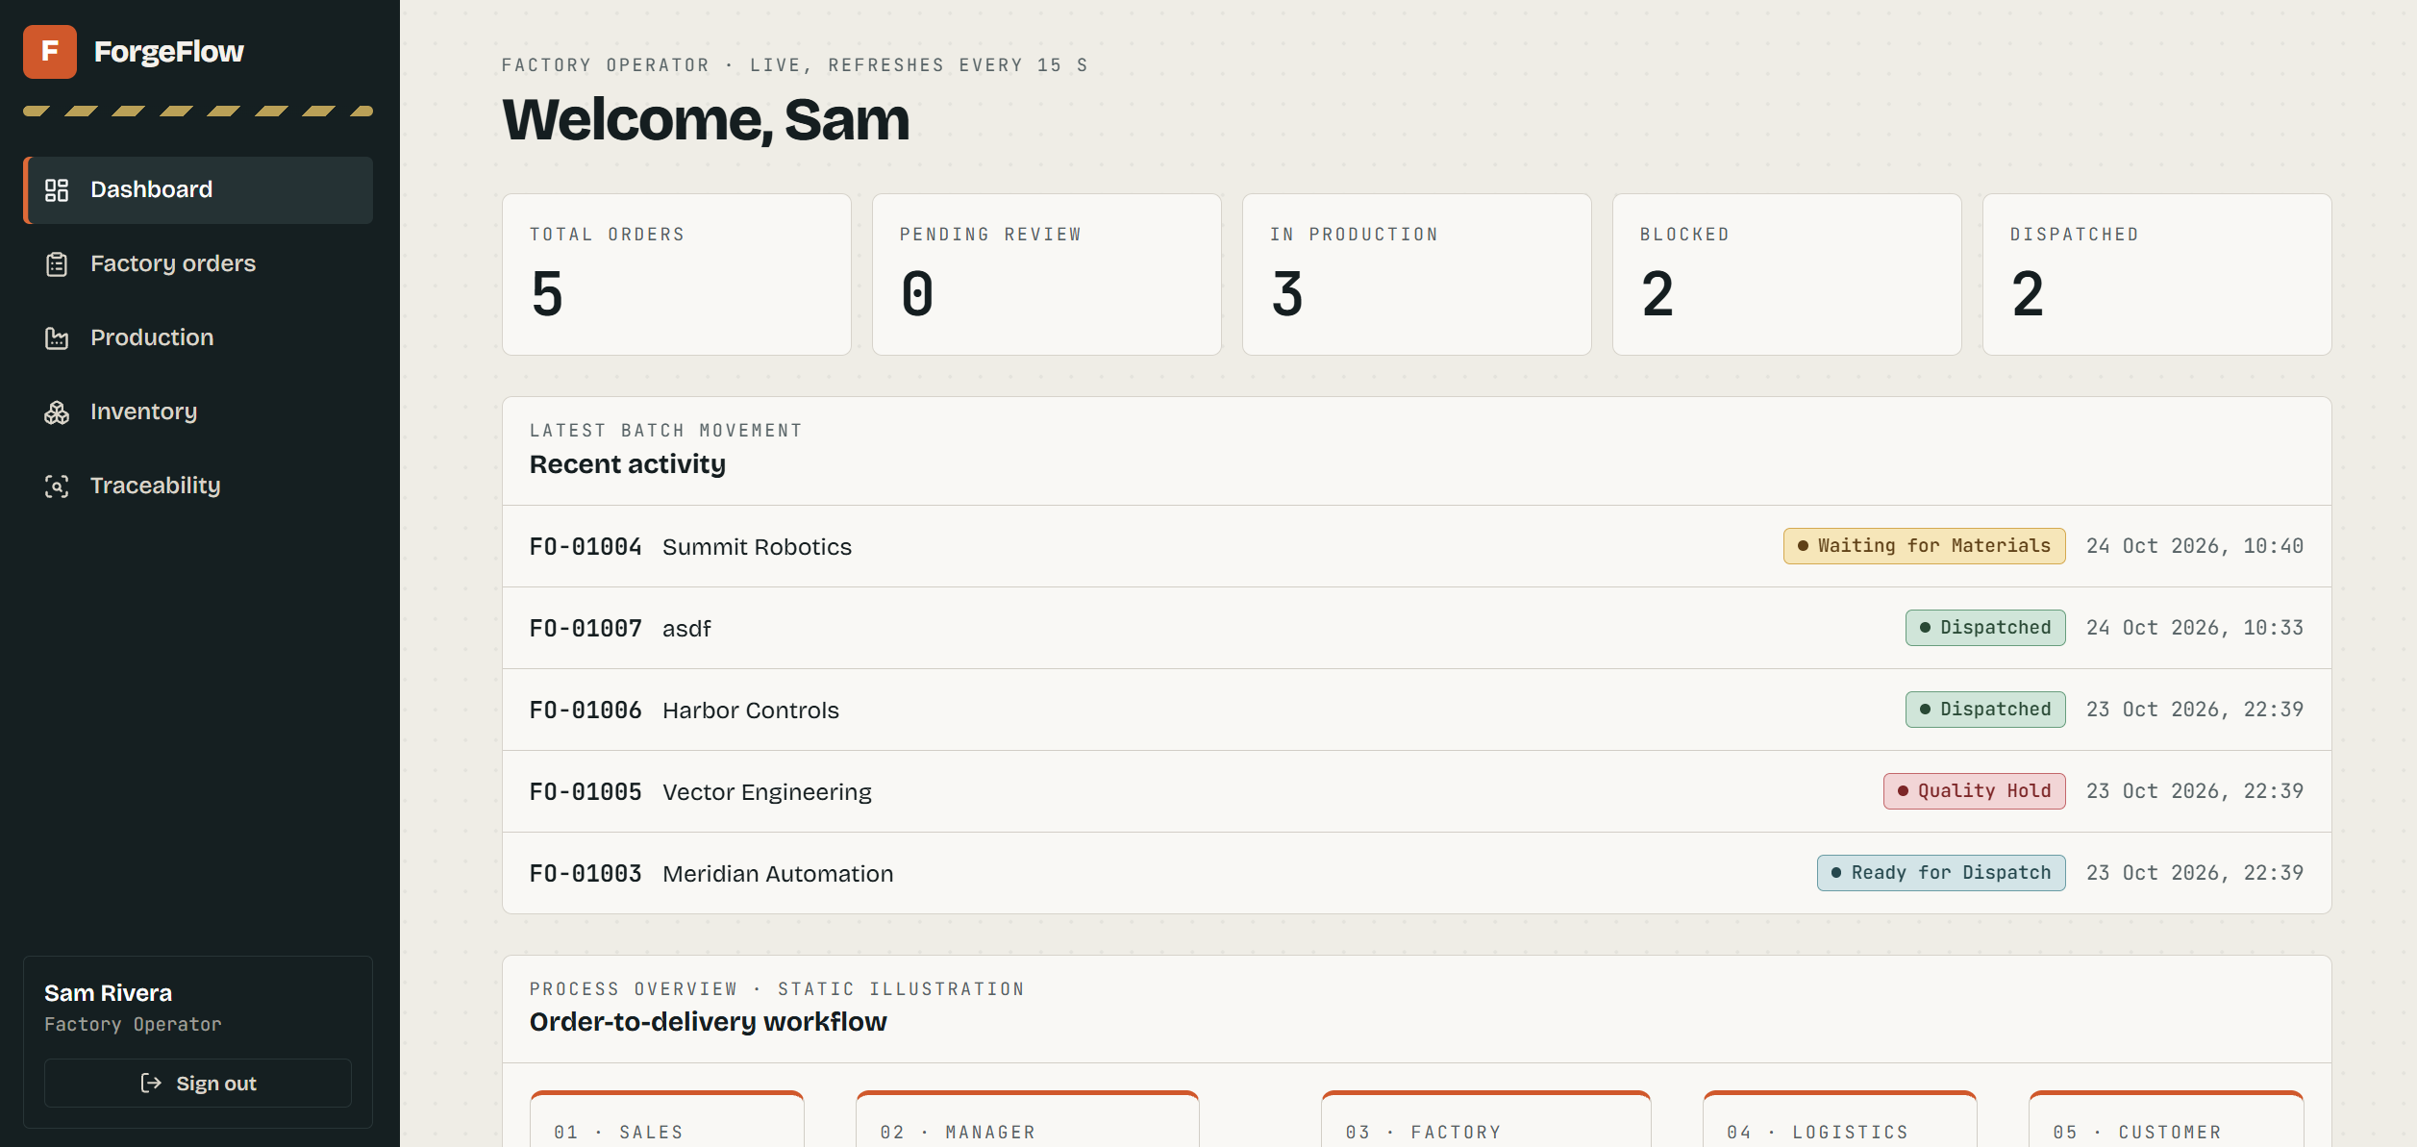
F
ForgeFlow
SDC HACKATHON 2026
When a product fails,
stop chasing the paper trail.
One shared order record for customers, managers and factory teams.
Orders · Production · Traceability
The dashboard says it refreshes every 15 seconds; the workflow overview says order and product status is visible to all users.
For mid-sized manufacturers with slow factory updates and long customer inquiry chains.
Team: Debug The World
From “Where is my order?” to a status customers can check for themselves.
Notes:
Suggested timing: 0:25
Speaker notes:
Hello, we are Hackathon-Debug-The World, and this is ForgeFlow. We are building for mid-sized manufacturers where order updates move slowly and customers have to ask several people before they get an answer. When a product fails, teams can spend valuable time piecing together which batch, process and inspection record explains what happened. ForgeFlow gives sales, managers and factory staff a shared order record. This dashboard refreshes every 15 seconds, so we describe the status as near real time, not instant.

Slide 2
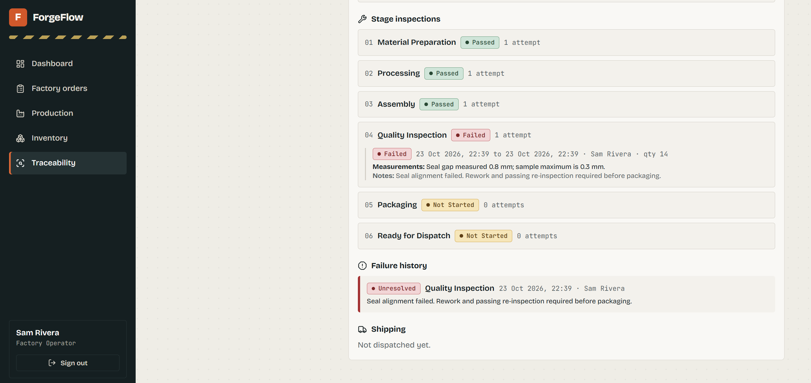
F
ForgeFlow
SDC HACKATHON 2026
01 · THE BUSINESS PROBLEM
When a product fails, finding the batch and the cause takes too much effort
A specific operational pain: updates are slow, records are scattered, and answers travel through several people.
Not just “low efficiency”
A batch is held at inspection:
Which stage found the issue?
How far out was the measurement?
Who recorded it, and when?
What must happen before release?
When evidence lives in paper forms, spreadsheets and chats, sales and managers must ask around—and the customer waits.
Demo record: 0.8 mm vs. a 0.3 mm sample limit
Sample data, not a real customer incident. The point: the issue, evidence and next action are together.
Team: Debug The World
02
Notes:
Suggested timing: 0:40
Speaker notes:
This is the concrete problem we are addressing. In this demo record, order FO-01005 failed a quality inspection: the seal gap measured 0.8 millimeters against a sample limit of 0.3. The traceability view records the stage, operator, timestamp, measurement, reason for failure and the required rework and reinspection. The shipment is still on hold. In a real factory, if those details are scattered across forms and messages, people have to chase the evidence before they can act. This is sample data from our prototype, not a real customer incident. Traceability should help teams find and fix process issues—not simply assign blame.

Slide 3
F
ForgeFlow
SDC HACKATHON 2026
WHO WE BUILD FOR
Mid-sized manufacturers: customers ask Sales, and Sales has to ask the factory
We focus on manufacturers with slow production updates and long order-status handoffs.
A customer asks: “Where is my order?”
Customer
Sales
Manager
Factory
→
→
→
asks Sales
asks Manager
asks the floor
searches records
ForgeFlow keeps order status, production stages and quality records on one fulfillment trail.
The customer-side Sales account sees its own orders. Managers review the same order; factory updates are visible to the roles that need them.
Less waiting. Fewer repeat inquiries.
Team: Debug The World
03
Notes:
Suggested timing: 0:35
Speaker notes:
Our target is a mid-sized manufacturer whose factory updates are slow and whose customers must go through Sales, a manager and the production floor to get a status. ForgeFlow brings the order, production stages and quality history into one fulfillment trail. In this prototype, Sales is the customer-side entry point: a Sales account sees its own orders, while a manager can review the same order. Factory updates then appear in the shared status view. These are intended workflow benefits; any time saved must be measured in a customer pilot.

Slide 4
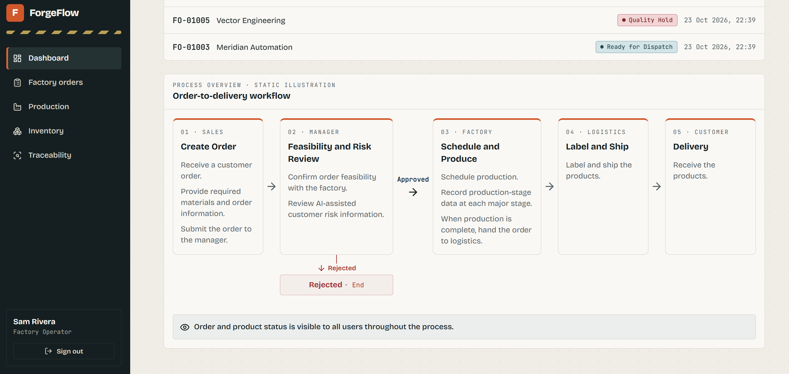
F
ForgeFlow
SDC HACKATHON 2026
02 · HOW CUSTOMERS USE IT
One order, visible from submission through delivery
The website overview is a static illustration; users carry out the work in Orders, Inventory, Production and Traceability.
1
Customer-side Sales
Submits the order and product requirements
2
Manager
Checks feasibility, reviews risk and approves or rejects
3
Factory operator
Checks stock, advances stages and records inspections
4
Logistics
Labels and dispatches the products
5
Customer-side Sales
Checks order status and delivery progress
Updates become part of the order and batch record.
Team: Debug The World
04
Notes:
Suggested timing: 0:45
Speaker notes:
Here is the customer journey. First, customer-side Sales submits the order and product requirements. A manager checks feasibility, reviews the available risk information, and records a reason when approving or rejecting the order. The factory operator checks finished goods and raw materials, schedules work, and records each major production stage and quality inspection. Logistics records labeling and dispatch. Meanwhile, the customer-side Sales account can follow the order status. The screenshot on the left is a static workflow overview; the interactive work happens in the order, inventory, production and traceability pages.

Slide 5
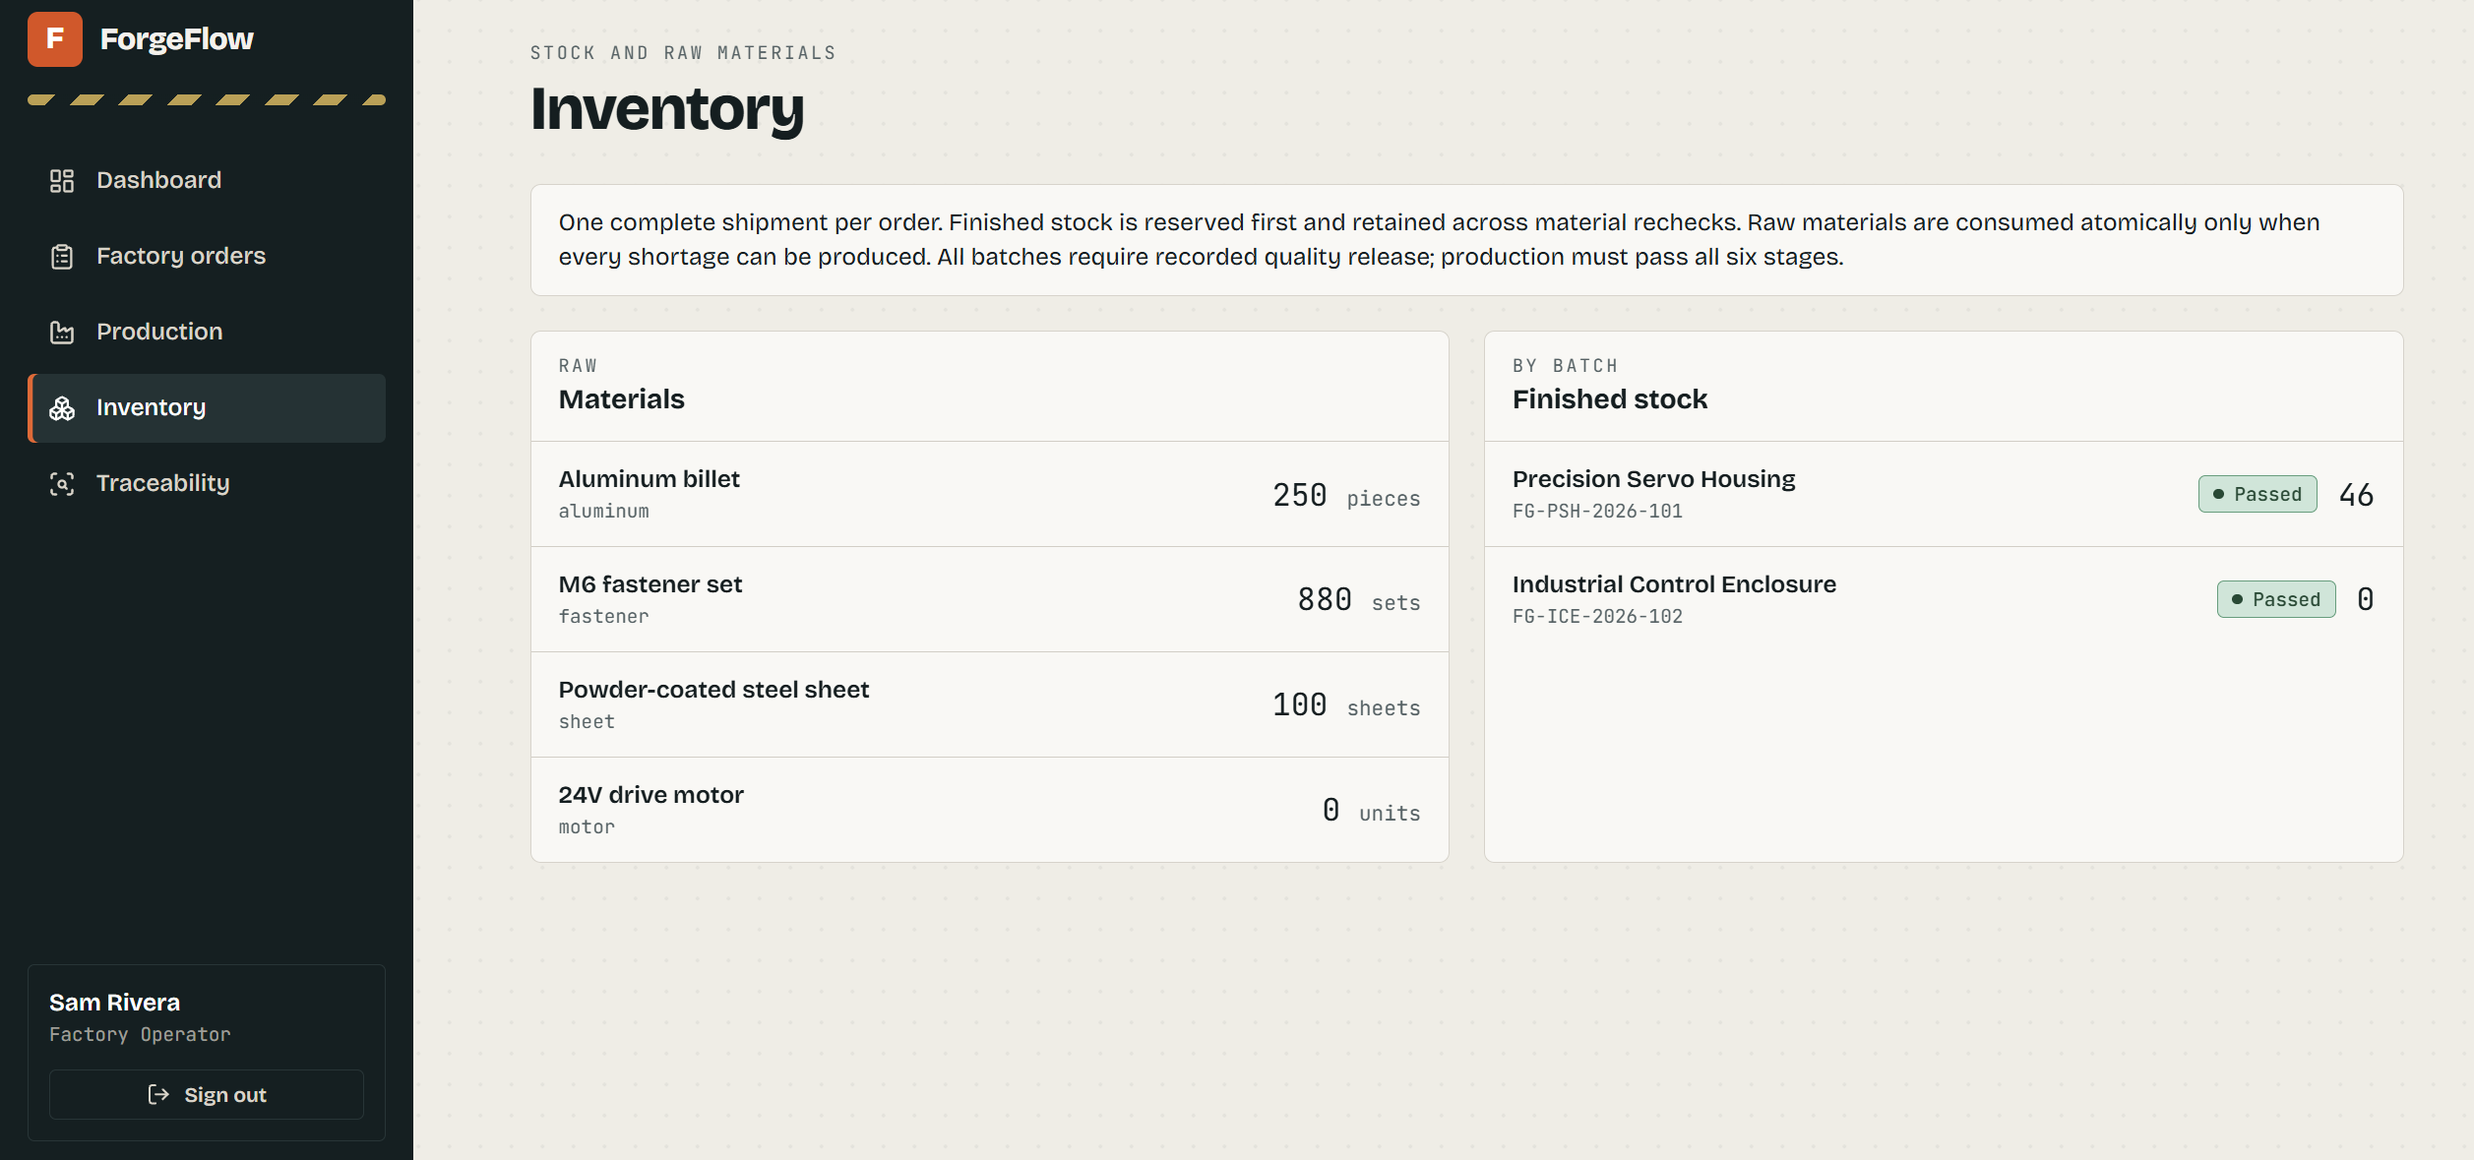
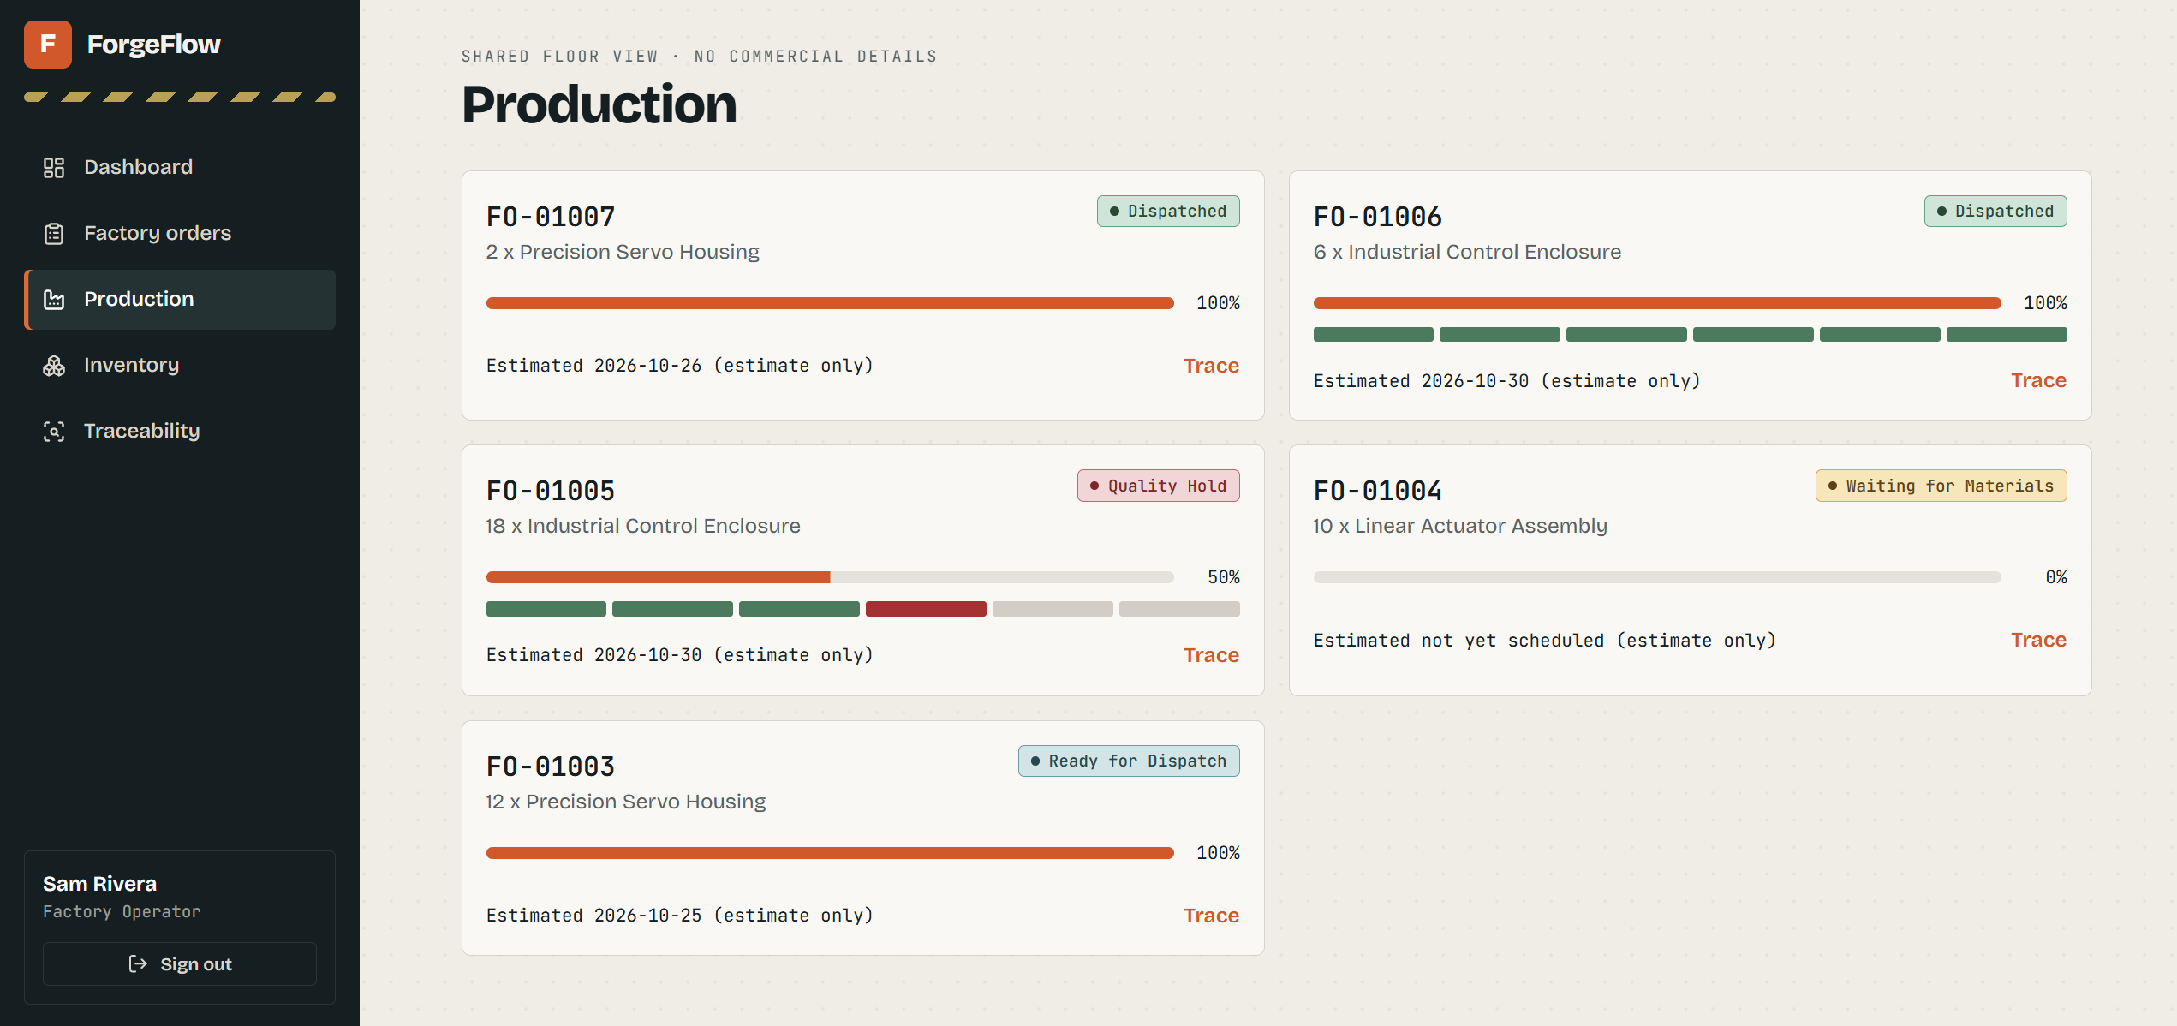
F
ForgeFlow
SDC HACKATHON 2026
03 · FACTORY FOLLOW-THROUGH
Check stock first. Then see where production stands.
Material shortages, quality holds and estimated dispatch dates are visible in the workflow.
Inventory | Can we fulfill from stock?
Production | Where is the order held up?
Raw materials and finished goods are listed; shortages show as Waiting for Materials.
Status, progress and a Trace link are shown together. Dates are marked “estimate only.”
A visible hold beats another round of phone calls
Team: Debug The World
05
Notes:
Suggested timing: 0:40
Speaker notes:
After approval, the factory checks Inventory. Raw materials and finished goods are listed so the team can decide whether the order can ship from stock or needs production. The Production page shows each order’s status and completion progress. In these examples, FO-01005 is on Quality Hold and FO-01004 is waiting for materials. Dispatch dates are explicitly estimates, not promised delivery dates. Because the customer-side Sales account and the manager can see the shared status, they can understand why an order has not moved without starting another chain of calls.

Slide 6
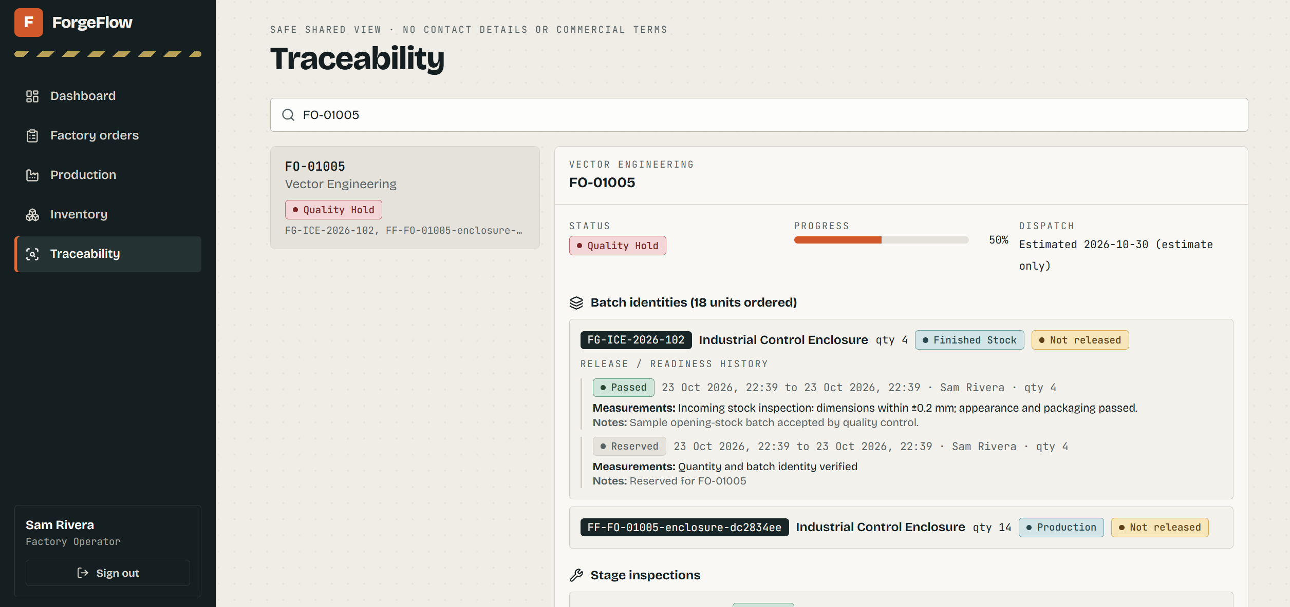
F
ForgeFlow
SDC HACKATHON 2026
04 · SCAN AND TRACE
Scan a product or batch QR code to open its traceability record
Customers or factory staff can find the product history by order, serial number or batch ID.
What should the scan answer?
Which order is this?
FO-01005
Which batch?
Finished-stock or production batch ID
Where is it in the process?
Stage, progress and release status
Why is it on hold?
Inspection result, measurement and next action
Screenshot shows search and batch records. Demonstrate the QR scan live in the video.
Team: Debug The World
06
Notes:
Suggested timing: 0:40
Speaker notes:
A customer or factory staff member scans the QR label attached to a product or batch and opens its traceability record. This screenshot shows the Traceability page after searching for FO-01005: it links the order to finished-stock and production batch identities, current status and an estimated dispatch date. The stage inspection history helps answer how far the product has progressed, whether it passed inspection and, if it failed, what must happen next. The screenshot verifies the search and batch record. In the video, demonstrate the physical QR scan and confirm that it opens the correct record.

Slide 7
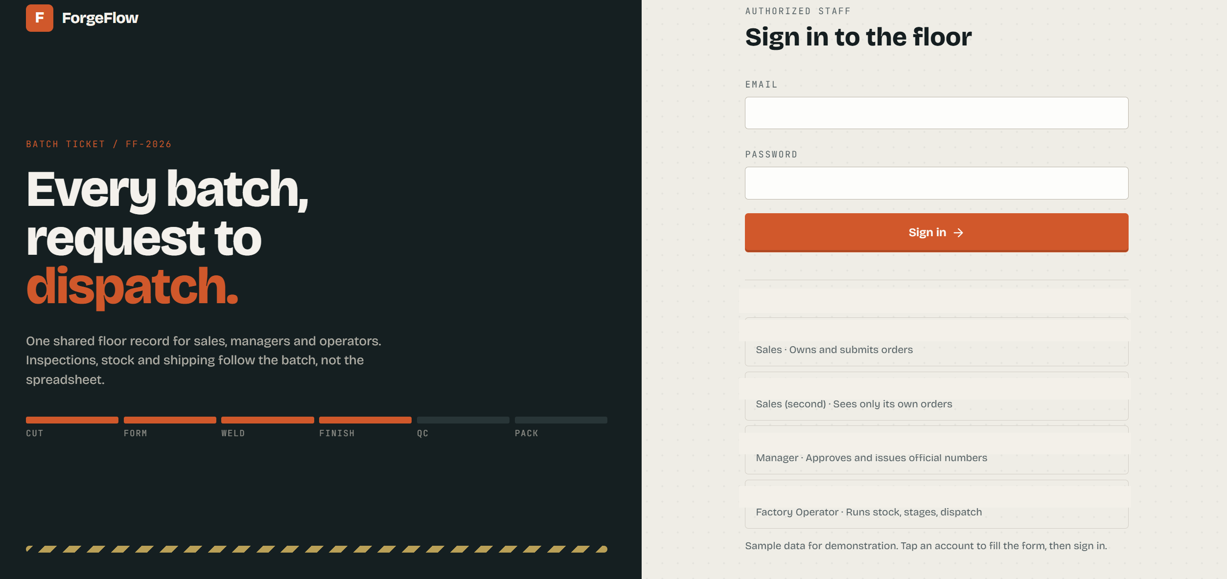
F
ForgeFlow
SDC HACKATHON 2026
05 · SHARED VISIBILITY
One order: customers follow progress; managers see the full picture and approve
In this project, Sales is the customer-side login and sees only its own orders.
Each role sees what it needs
Sales / customer side
Submits and follows its own orders; another Sales account sees only its own.
Manager
Reviews order context, approves and issues official order numbers.
Factory Operator
Runs stock, production stages and dispatch; the shared floor view hides commercial details.
Order and product status is shared; the dashboard says it refreshes every 15 seconds.
Team: Debug The World
07
Notes:
Suggested timing: 0:40
Speaker notes:
This sign-in screen shows the roles in the prototype. Sales submits orders, and a second Sales account sees only its own orders. The Manager reviews orders, approves them and issues official order numbers. The Factory Operator handles stock, production stages and dispatch. In our product model, Sales is the customer-side account: customers follow their own order while the manager reviews that same order. The workflow overview says order and product status is visible to all users, and the dashboard says it refreshes every 15 seconds, so we call this near-real-time visibility. The shared floor view hides commercial details, and the traceability view hides contact details and commercial terms. Demo credentials have been removed from the screenshot.

Slide 8
F
ForgeFlow
SDC HACKATHON 2026
06 · HUMAN CONTROL
The system presents the evidence. People make the key decisions.
Risk information supports review; it does not approve, reject or release an order automatically.
Action / record
Sales / customer side
Manager
Factory Operator
View order status
Own orders
All orders / pending review
Production / dispatch
Submit / update
Submit requirements
Review context
Stage and inspection records
Key decision
No approval authority
Approve / reject; reason required
Record outcome; no release, no dispatch
Audit trail
Order submission
Decision and order number
Operator, time, batch and inspection
AI boundary: the current risk card is a deterministic demo assessment—not validated, not connected to external credit data.
Team: Debug The World
08
Notes:
Suggested timing: 0:40
Speaker notes:
Control stays with the people responsible for the work. Sales submits requirements and follows its own orders; it does not approve them. Managers review the order and risk information, then choose approve or reject and provide a decision reason. The system records the decision trail. Factory operators enter inventory, stage and quality records, and dispatch details; a batch that has not been released cannot proceed to dispatch. One important boundary: the current risk card is a deterministic demo assessment using unverified sample data. It is not connected to external credit research and it never makes the decision. It gives a manager context to review, not an automated verdict.

Slide 9
F
ForgeFlow
SDC HACKATHON 2026
07 · ORBYTE AND REUSE
Share the business capability. Keep each company’s data and rules separate.
This is a proposed integration approach; the current ForgeFlow prototype does not demonstrate an Orbyte connection.
ForgeFlow shared capability
Orbyte shared business center
Company adapter
Order and status model
Batch and quality traceability
Approval and audit events
→
Connect business information and services
Use shared identity and interfaces
Make reusable capabilities available
→
Map each company’s fields and statuses
Apply company-specific permissions
Isolate customer and batch data
First confirm Orbyte’s interfaces, identity, permissions and data-isolation requirements; then build and test the connector.
Reuse the configurable service—not one company’s customer data.
Team: Debug The World
09
Notes:
Suggested timing: 0:35
Speaker notes:
Our Orbyte work is a proposed integration path, not a completed connection. ForgeFlow’s reusable services could include order status, batch traceability, quality checks and approval audit events. Orbyte’s shared business center could connect those services through its identity and interface model. A company-specific adapter would map each organization’s fields, statuses and permissions while keeping customer and batch data separate. Before building, we need Orbyte’s interface, identity, permission and tenant-isolation requirements, followed by cross-company testing. What we propose to reuse is the service and its configuration—not one company’s customer records.

Slide 10
F
ForgeFlow
SDC HACKATHON 2026
08 · BUSINESS VALUE AND SDG 9
Spend less time chasing updates and tracing batches. Spend more time improving delivery.
We do not claim savings we have not measured. A pilot should establish the baseline and track change.
Today’s cost
ForgeFlow’s path
What a pilot should measure
Ask several people for order status
Search records by hand for a batch
Reconstruct the cause and response
Share order status with the customer
Link batch, stage and inspection history
Keep unresolved holds visible
Time from customer inquiry to update
Time to locate a batch and cause
Record completeness and rework time
SDG 9 · Industry, Innovation and Infrastructure
More transparent production status and traceable quality records can support more reliable manufacturing operations.
Expected value: fewer follow-ups, faster investigations and fewer missing records—subject to pilot results.
Team: Debug The World
10
Notes:
Suggested timing: 0:40
Speaker notes:
The business value we expect is straightforward: customers and managers spend less time asking for the latest status, and teams can find the relevant batch, stage, measurement and corrective action sooner when a quality issue occurs. We will validate that with a pilot, tracking time from inquiry to update, time from issue to batch and cause identification, inspection record completeness and rework time. We are not claiming a savings percentage today. This supports SDG 9 by using digital records to strengthen more reliable industrial operations. A subscription or deployment model is something to validate with customers after the pilot demonstrates value.

