Slide 1

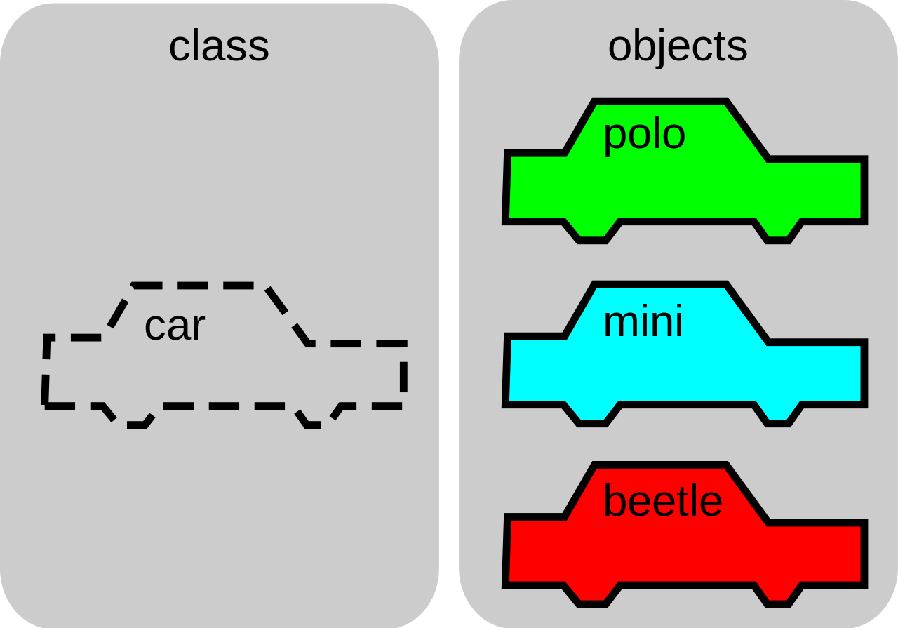


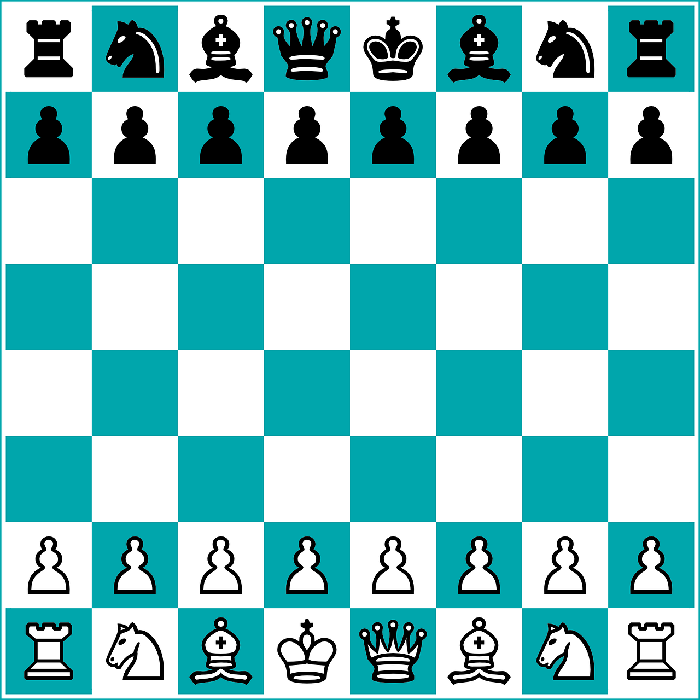

Jian Pan 5728309
Xiaohan Yu 5718303
Chess Game

Slide 2
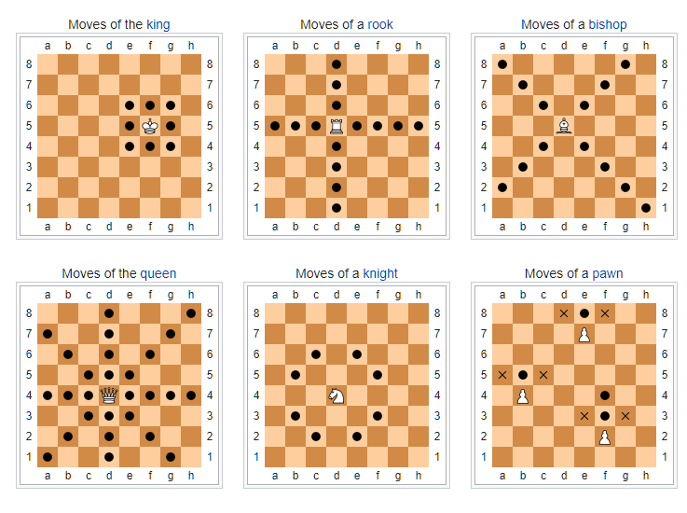
Chess Game
Source: wiki, https://en.wikipedia.org/wiki/Chess

Slide 3
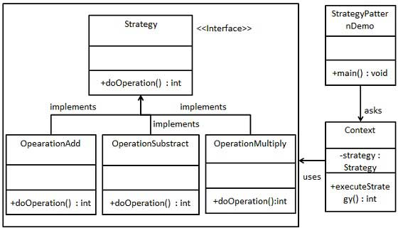
Strategy Pattern
In Strategy pattern, a class behavior or its algorithm can be changed at run time. This type of design pattern comes under behavior pattern.
In Strategy pattern, we create objects which represent various strategies and a context object whose behavior varies as per its strategy object. The strategy object changes the executing algorithm of the context object.

Slide 4
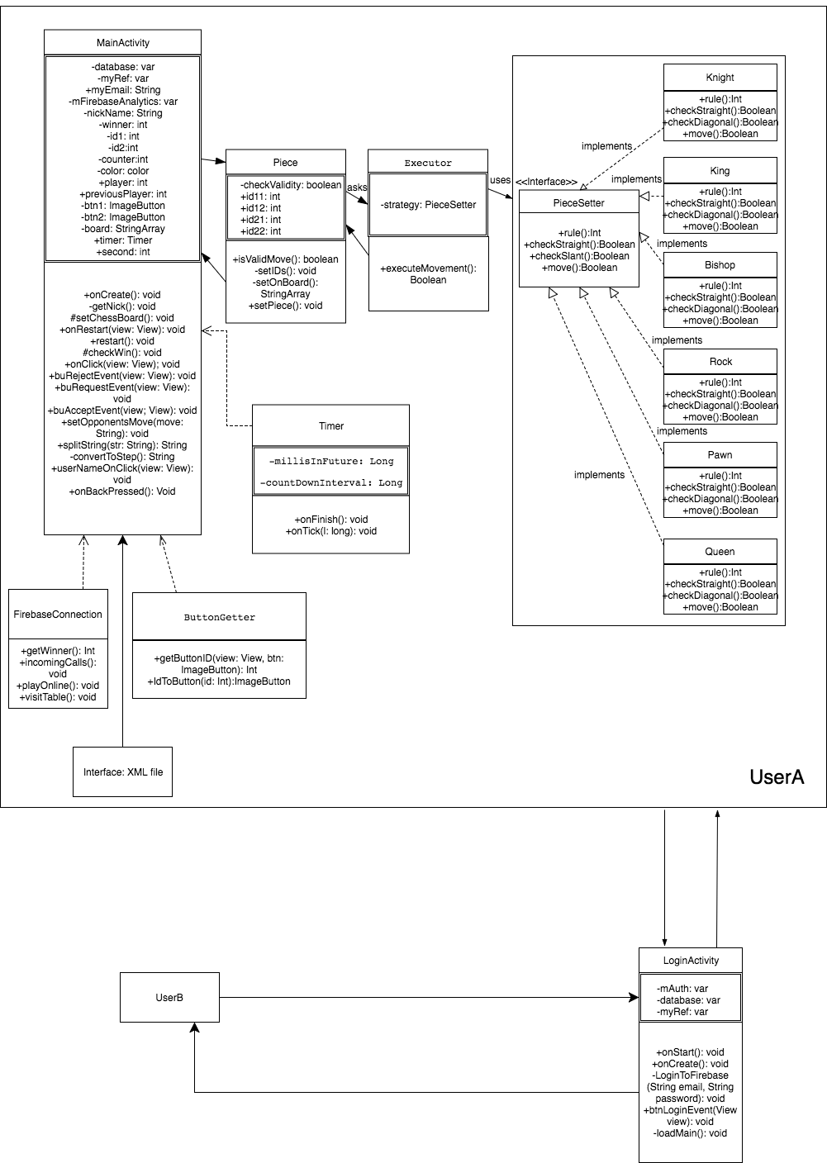
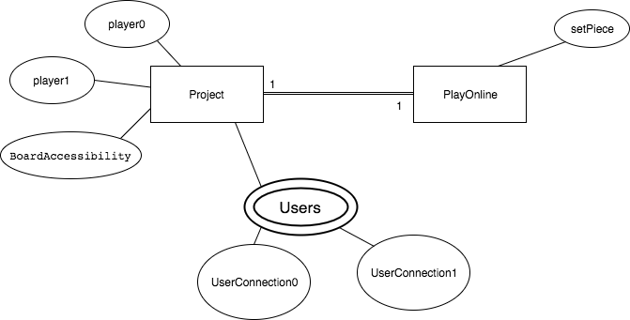
UML & DB Diagram

Slide 5
Extra content
About AI and other platform application

