Slide 1
SAGE Analytics
Tim Kartawijaya
Johan Sulaiman
Notes:
Hello everybody, so I’m presenting today on the analytics portion of our team’s project, and Johan would present later on SAGE architechture.

Slide 2
Agenda
Data Analysis Plan and Framework
Current Progress
Next Steps
Notes:
So in this presentation, I will first be give a summary on what the data analysis process will look like, showing you how the data will be processed, what statistical model I intend to use and what results I hope to get.
Then I will talk about what progress has been done and the next steps in this project.

Slide 3
Data Analysis Framework
Clean Data
Map PECT Score based on Block Presence
Unify Data
Perform Statistical Analyses on Scores
Integrate process to Scratch Analyzer
Notes:
- The languages I intend to use in the cleaning and analyzing of data is in R

Slide 4
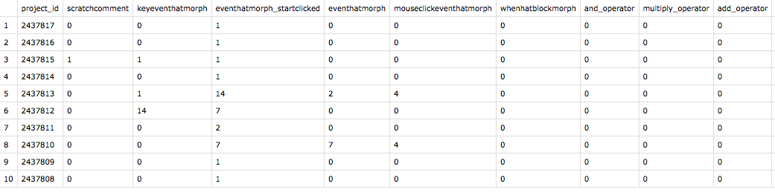
Clean Data
Wild Data:
Notes:
This is the format of the Scratch wild data. Identified by project ID, as well as how many times each block occurs (columns). There’s not much cleaning to do in this format.

Slide 5
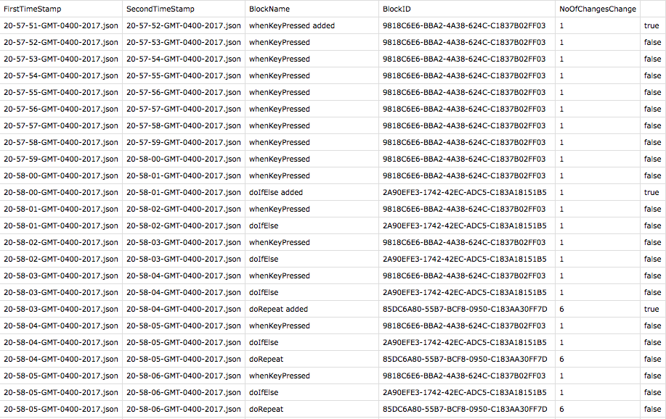
Clean Data
SAGE Data:
Notes:
However, there needs to be some parsing done from SAGE data. The output of the current Scratch anlayzer has a timeStampOutput and an ID that identifies which block. From this, I have to parse the row of blocks at the latest minute, as that’s when the project ends. Furthermore, I have to display how many times each block appears.
I have not focused here as I heard from Jeff the Gameful Intelligent Tutoring team is working on the output, so I thought to wait until there’s more information about that.
The original scratch analyzer does give me the dataset I need, but since we’re utilizing timeStamps this is an extra step I have to take.
I’m

Slide 6
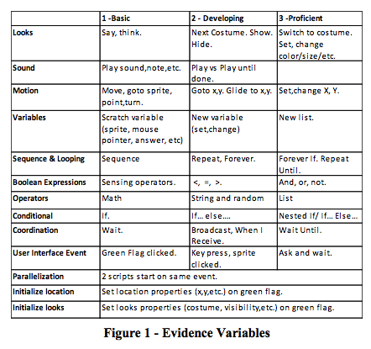
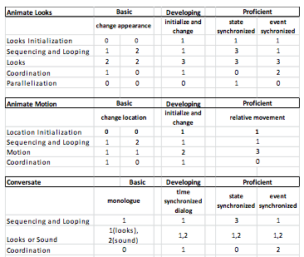
Map PECT Score
Notes:
Rubric used to score evidence variables. Depends on the presence of a blocktype

Slide 7
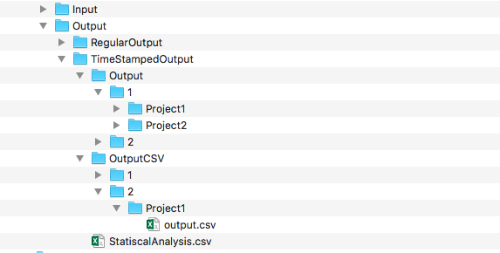
Unify Data
Specific on SAGE data, from Scratch Analyzer
Need to unify all project’s output files alongside student name for statistical analyses
Notes:
- Mapping of scores can be done within each project through the Scratch Dispatcher, yet to do an overarching statistical analysis, it would be much easier if all the output files are in one dataset

Slide 8
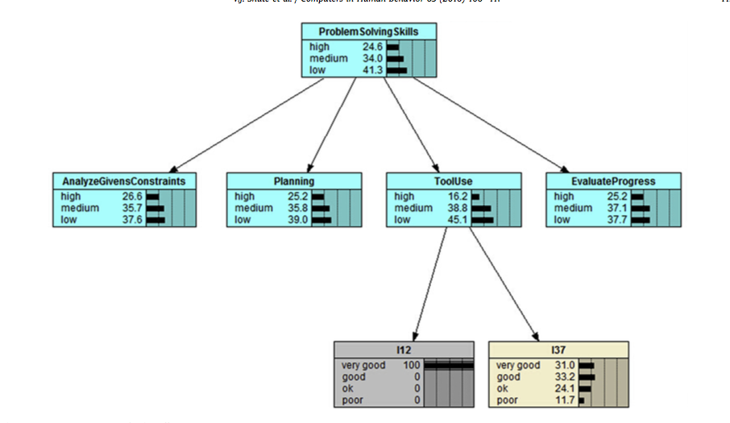
Statistical Analysis
Perform descriptive statistics and group comparison (SAGE vs Wild Data)
Hierarchical Bayesian Analysis:
Group Scores
Multinomial Logistic Regression
Data (y_{i}) – Project Scores

Slide 9
Integrate to Scratch Analyzer
Scratch Dispatcher: use JRI interface to execute Rscripts

Slide 10
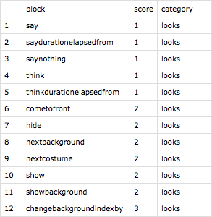
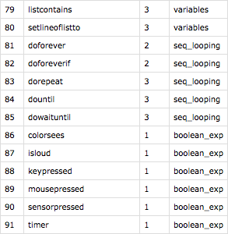
Map Block Types to EV Scores
Created .csv ”key” which maps each block type to evidence variable (EV) scores
“Manually” matched block type to EV using R
Made assumptions regarding some categories
Notes:
Progress so far has been on the Wild data. I’ve made my R scripts in the way that it would make it easier as I transition to SAGE data, as the only adjustments would just need to be on the format of the input dataset
A list of all possible project blocks in Scratch is provided by MIT in the form of a webpage, which gives each block a category. Using this and R, I was able to manually give each block a score
I had to tell R which block is which category and what score
In this process, I often encountered categories in which the score cannot be computed by block type appearance.
For example, for the “Conditional” category, to get a score of 3, you need a nested if else statement. However, the dataset (at least in the Wild Data) did not
A document regarding these assumptions are made so that if an error was made a fix can be done
This is all done in a way that if there was an error, a quick fix can be made
This key would make the process of mapping project appearance to scores much easier, as we then we can join the key table with the data table, thanks to an R library that enables combination of data sets by their key value.

Slide 11
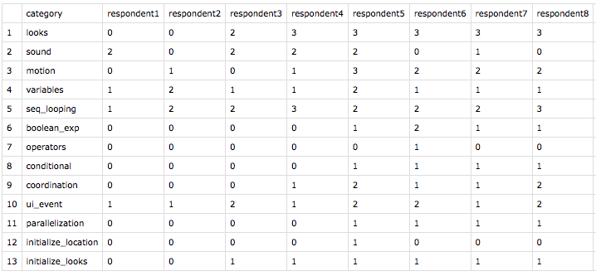
Evidence Variables Mapping
Wild Data mapping results
To properly use the Rscript, input dataset has to be in a specific format
Notes:
Using this key, I was then able to make an Rscript which automates the mapping of a data set that contains the number of times a block appears in a project.

Slide 12
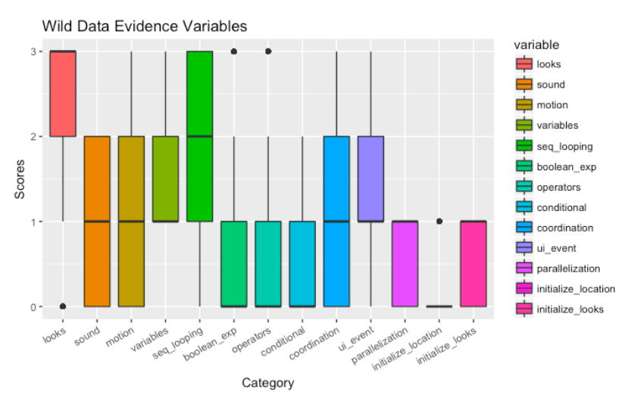
Evidence Variables Result
Notes:
Here is a graphical representation of 1000 projects in Scratch 1.0. Note that some categories like variable, have a minimum of 1 due to our assumptions. Even though this is just evidence variables and not the overarching CT concept, I thought it would be interesting to share how in Scratch 1.0, respondents are able to do the basic looks and sounds, but struggle in boolean expressions, conditionals, and coordination.

Slide 13
Next Steps
Map Evidence Variables to Design Pattern Variables and CT Concept Scores
Adjust mapping process to SAGE data
Integrate process to Scratch Analyzer
Provide Bayesian Analyses on Student Scores

