Slide 1
Class Administration
By Harsimran Bath and Yuval Schaal
Notes:
background: purpose…. Organize students

Slide 2
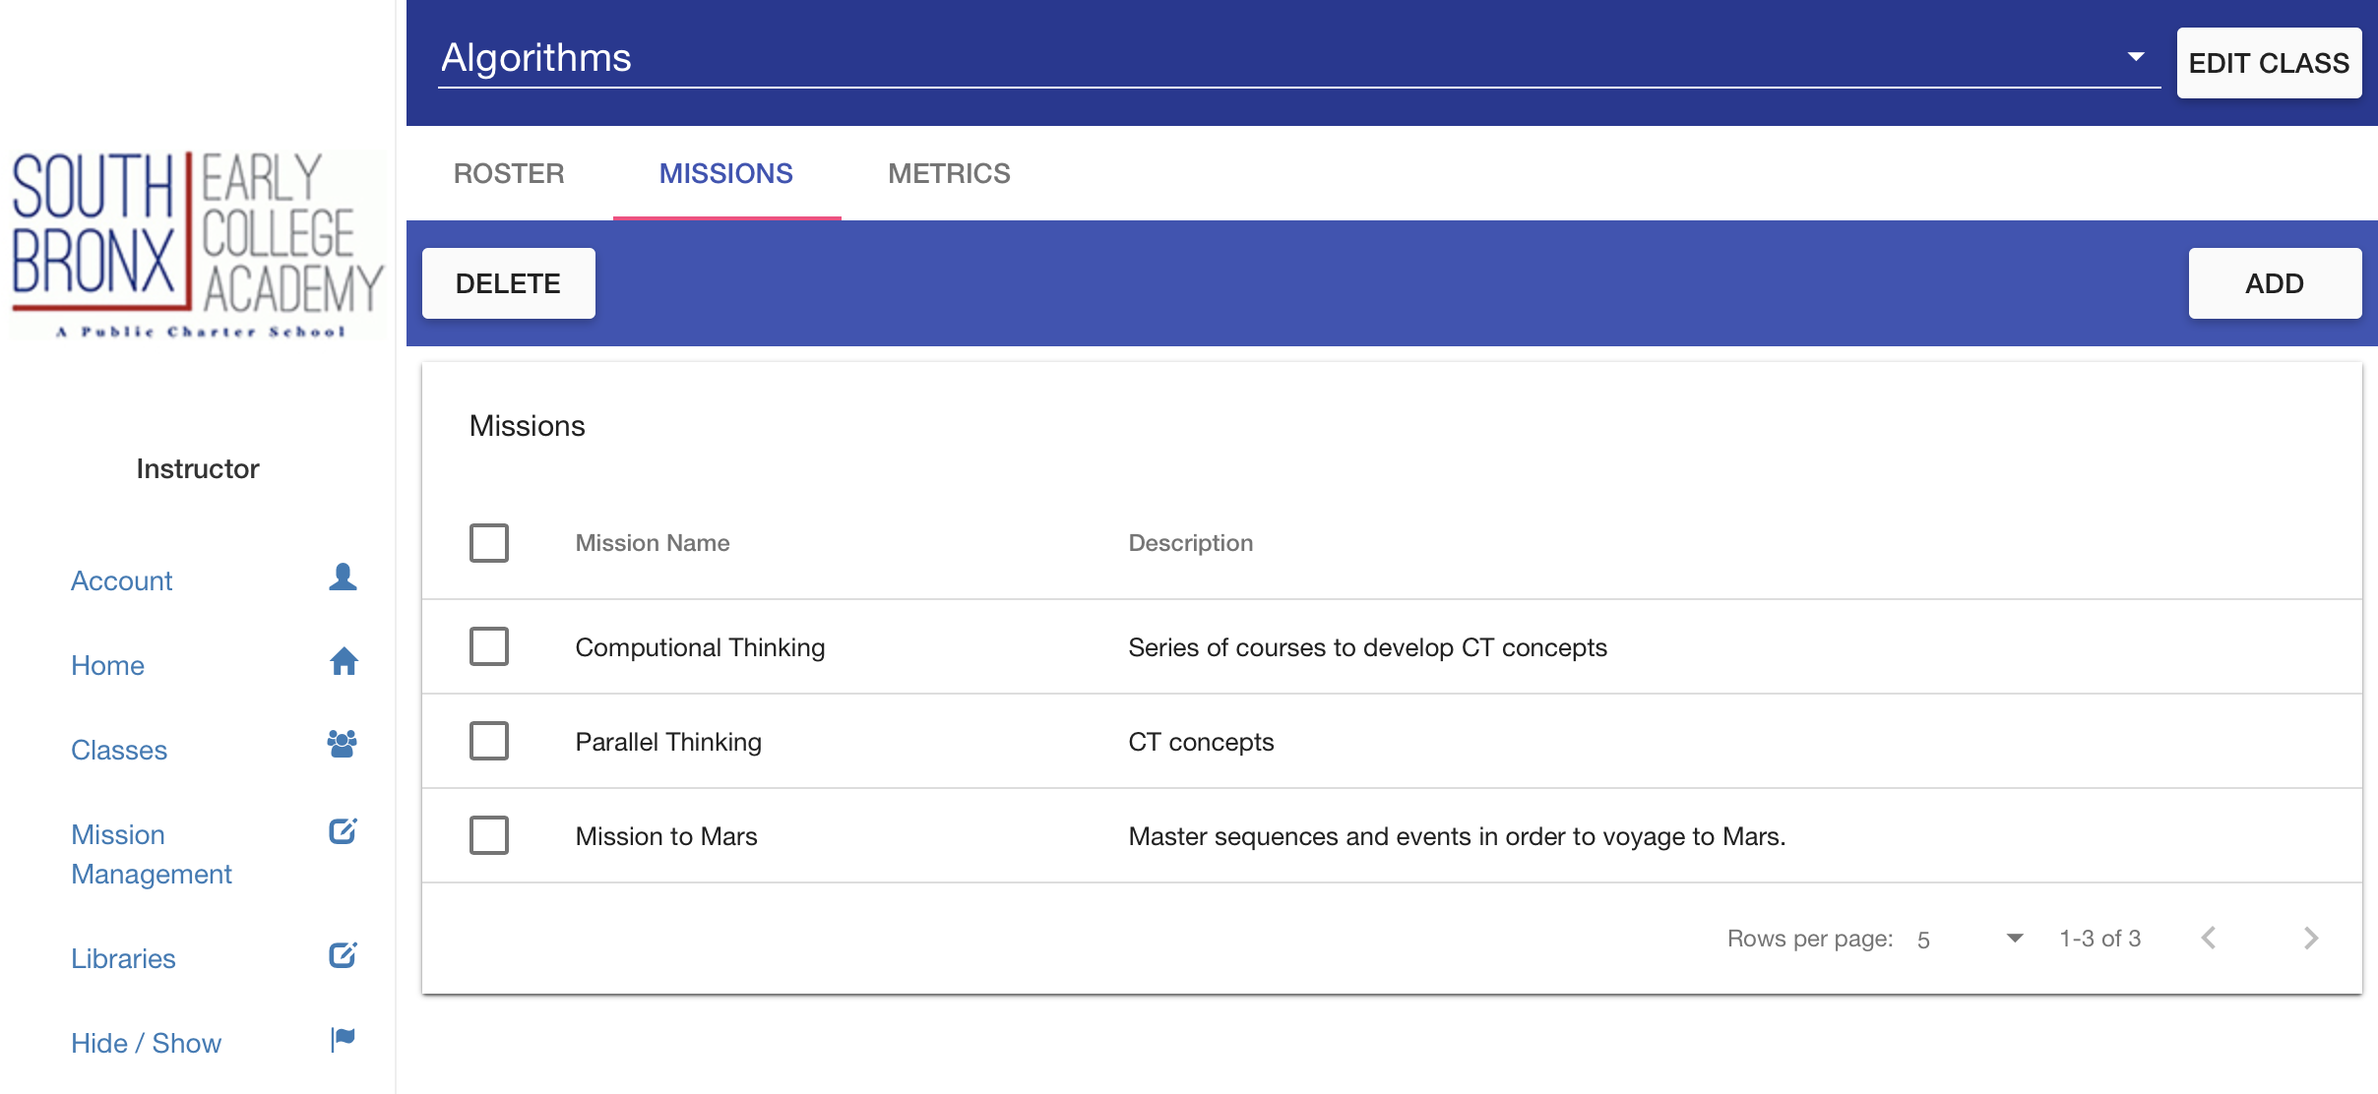
Class
Notes:
Material -UI Design paradigm
Unified look and feel, and possibility of consistency throughout the UI
East for future users, well documented library, created and supported by Google.

Slide 3
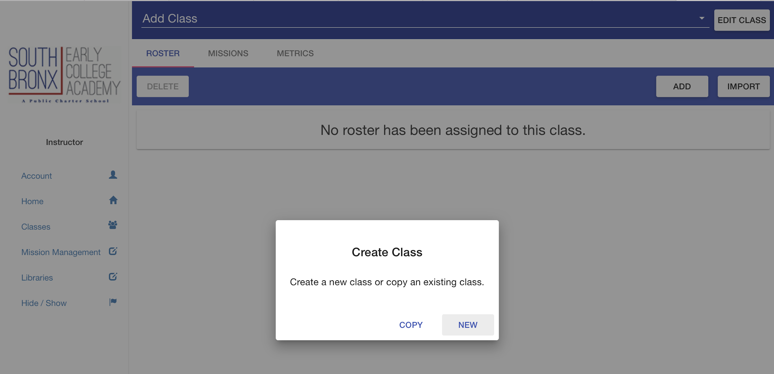
Create Class - New

Slide 4
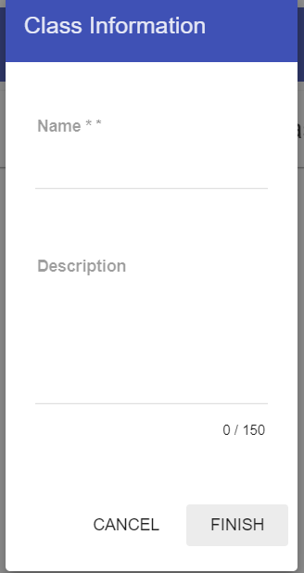
Create Class - name description

Slide 5
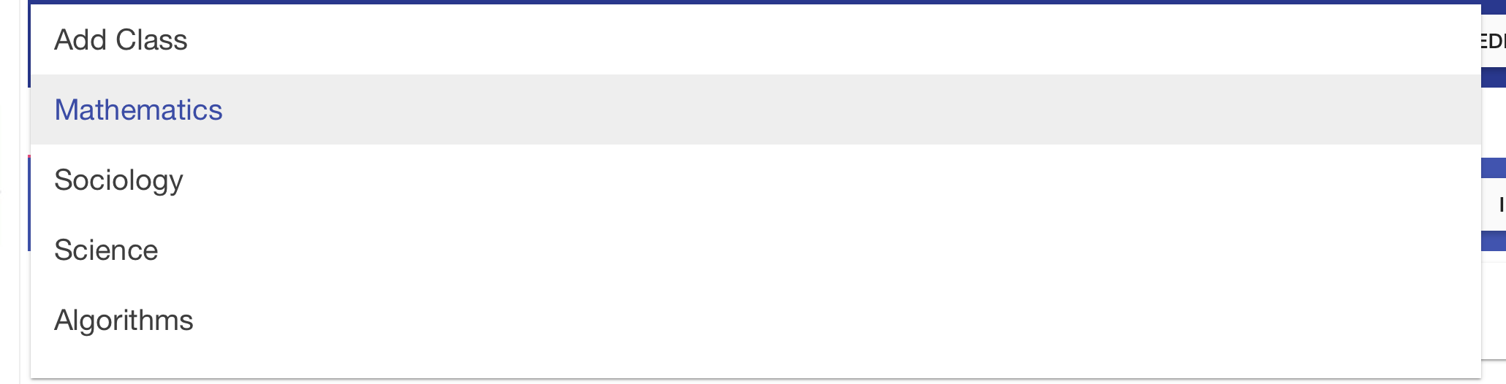
Select Class

Slide 6
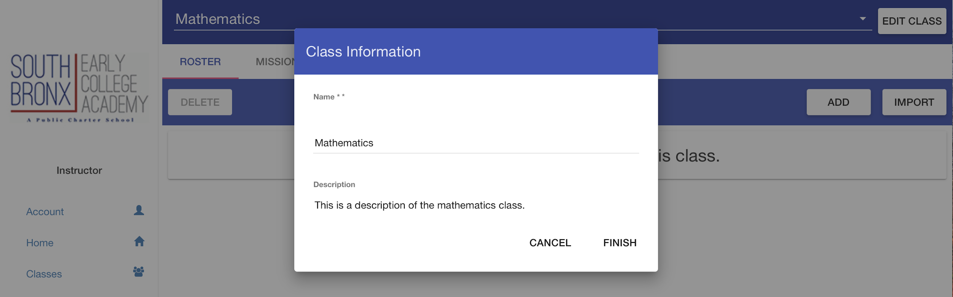
Edit Class

Slide 7
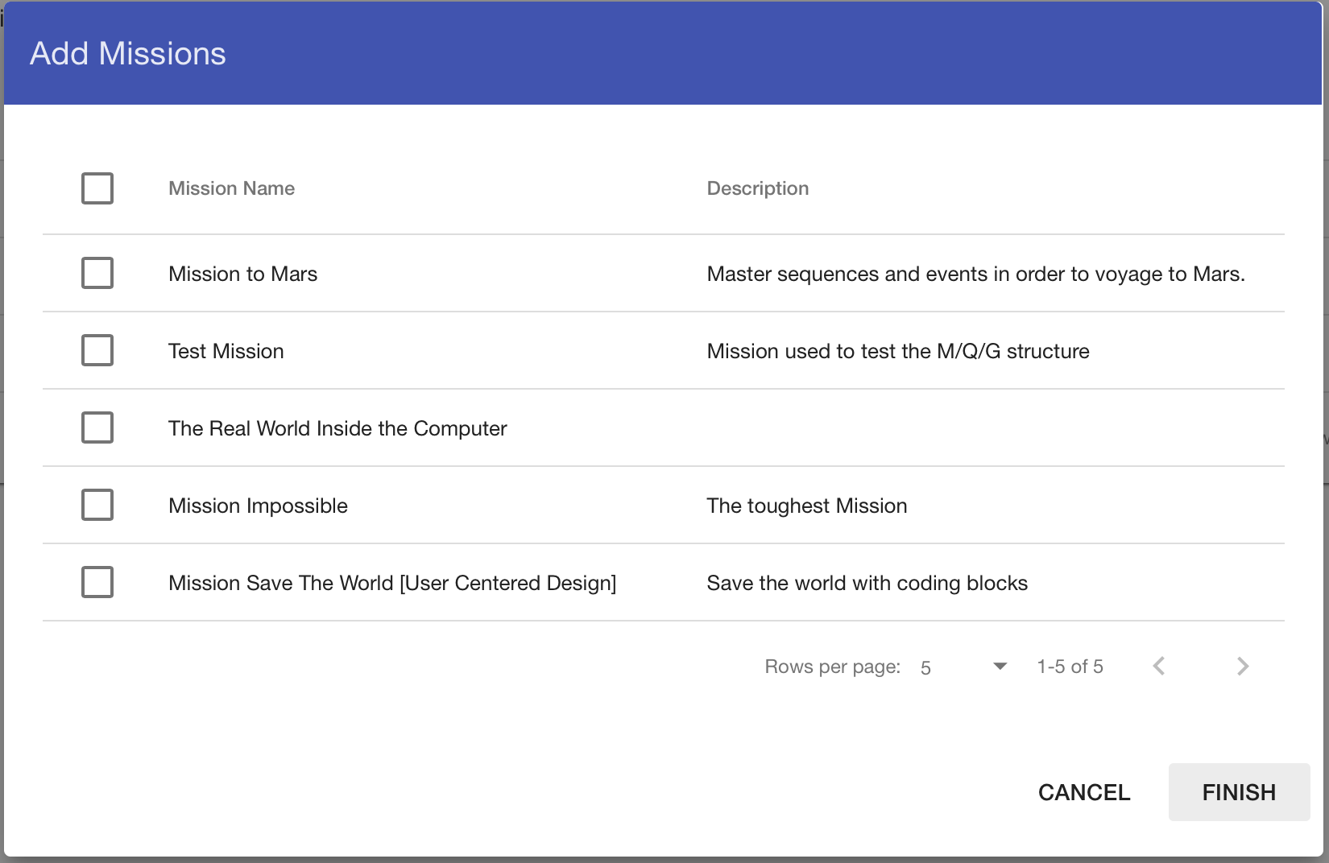
Add Missions

Slide 8
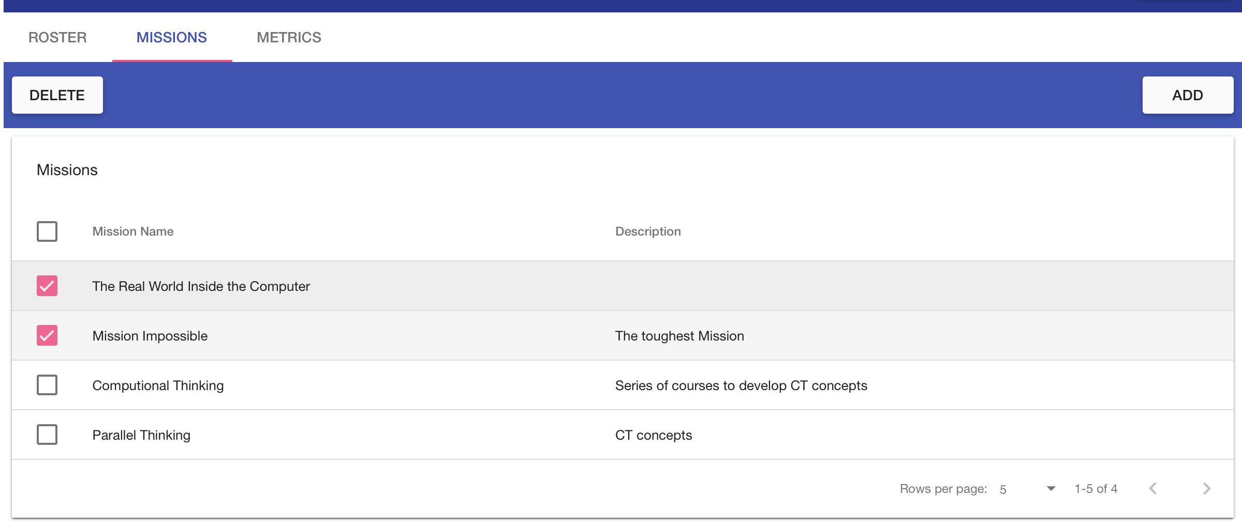
Manage Missions

Slide 9
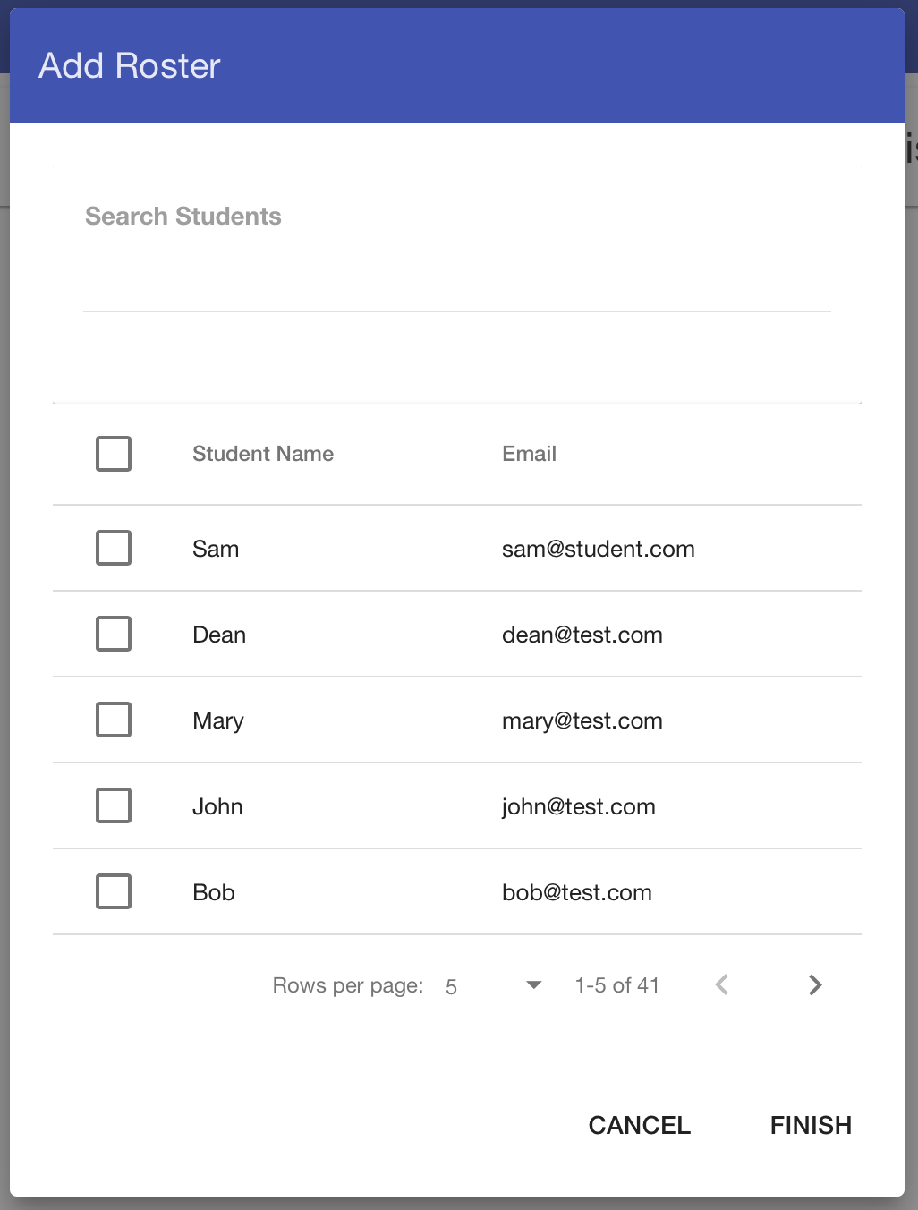
Add Roster
Notes:
Search also available

Slide 10
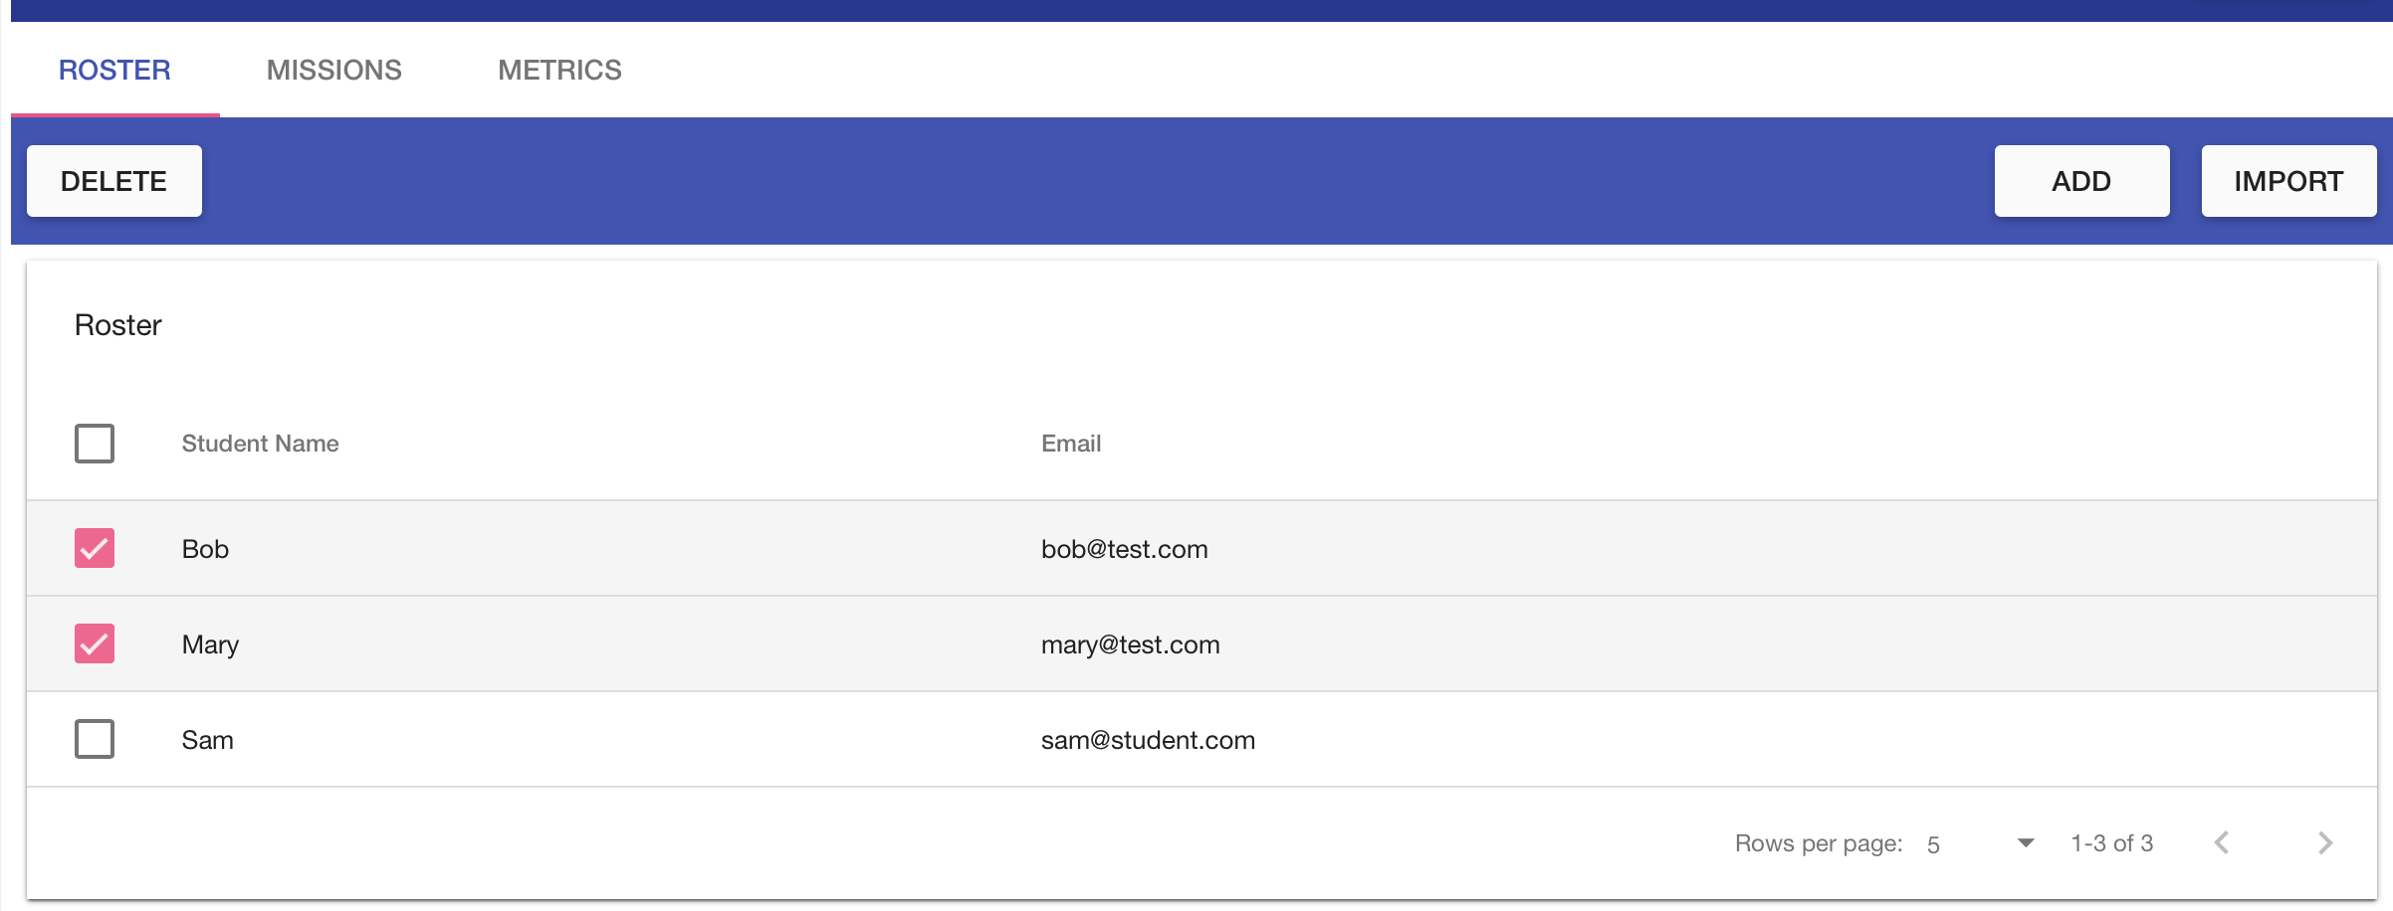
Manage Roster

Slide 11
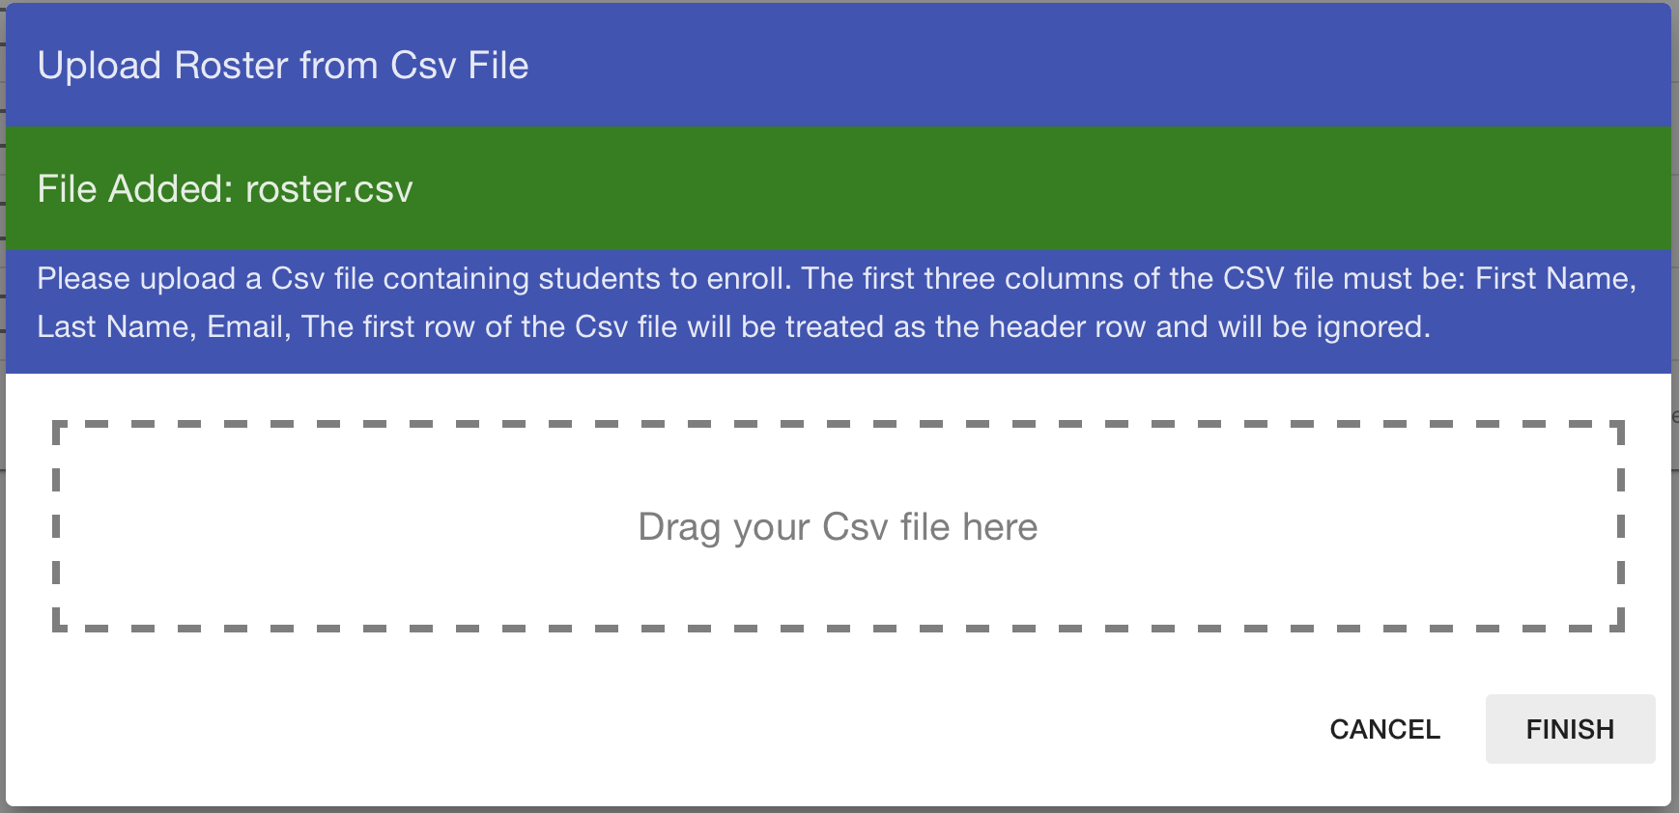
Upload Roster

Slide 12
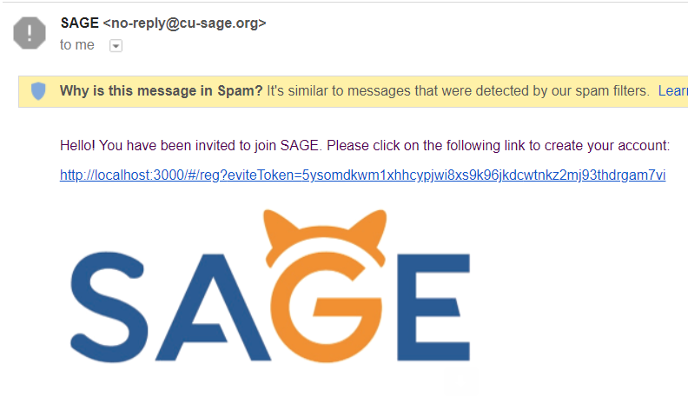
Email New Students

Slide 13
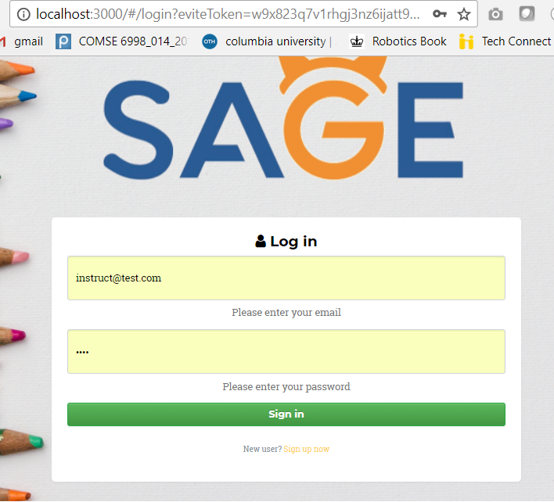
Student Register

Slide 14
Demo!

Slide 15
Next steps
Copy Class
Delete Class

Slide 16
Thank You!
Questions?

