Slide 1
Gameful Intelligent Tutoring System: Using BITS and Data-Driven Models to Design an Animated User Interface for Hint Generation
Proposal by: Calvin G. Goah
COMS 3998 W, Section 28
Fall 2017

Slide 2
What Must ITS Do?

Slide 3
ITS Must:
Accurately diagnose a student’s knowledge level using principles rather than pre-programmed responses;
Decide what to do next and adapt instruction accordingly;
Provide feedback [2].

Slide 4
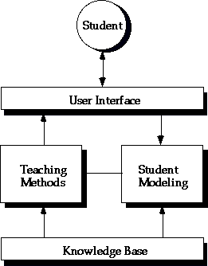
Consists of:
Knowledge domain;
Student model;
Teaching strategies;
User interface.

Slide 5
Capabilities of Current Model
Provides automated/unprompted hints at specified intervals
Hints are generic, i.e. currently issued, when available, to all students in the same manner, regardless of a student’s past experience or competence with the topic in question
Blocks shake to indicate next steps[5]

Slide 6
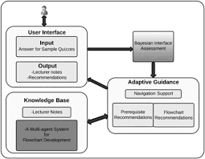
Areas of Interest
Potential Research Tactics
Need to provide unprompted hints
Need to create a student database that contains updates for each in the specified module[2]
Need hints that encourage problem solving, i.e. instead of just shaking blocks that lead to a solution, we should shake blocks that are prerequisites for the current task, thus prompting the user to think critically[2,4]
Might be useful to also have a side window that accesses the database and provides files/materials for users to read[2]
Method 1: Web Based Bayesian Intelligent Tutoring System (BITS)

Slide 7
Some Pros/Cons of BITS
Pros:
Bayesian networks serve as an inference engine to guide the students’ learning process.
BITS adapts to the individual user by obtaining updating its Bayesian networks with evidence collected from the student
Provides links for students to read
Cons
Does not deal with problem solving
In updating the Bayesian network, at times the user is asked if she understands a certain topic

Slide 8
Method 2: Data-Driven Approach to Automatic Feedback
Pros:
Uses AST(Abstract Syntax Trees) to create a solution space that can be used to generate feedback
Uses Hint Factory & Markov Decision Process
Maps out progression for students
Helps with problem solving
Cons:
Generating feedback is still rather arduous
Difficult to know whether feedback given is actually useful to students

Slide 9
The Proposal
If we combine BITS Architecture with some Data-Driven approaches described in [4] we should be able to create a hinting system that is tailored to each student and has multiple means of hinting: Unprompted hinting, Automated Hinting, Direct syntax hinting, and visual hinting (such as coloring blocks or having a visual that moves blocks around relative to one another in a side diagram for the user to see and build her knowledge off of)

Slide 10
Time Table
Milestones | Sprint
Environment Setup | Sprint 0
Implementing BITS/ Data-Driven Architecture | Sprint 1
Combining BITS and Data-Driven Approach | Sprint 2
midterm | -
Creating Scratch UI Animation | Sprint 3
On-Demand Hinting/ Fetching Relevant Information | Sprint 4
Final | -

Slide 11
Future Work
Affect Detection
Determining if feedback given ends up helping students
Try to incorporate a Bayesian Network template for teachers to use in 6-8 CS curricula

Slide 12
References
[1]Alla Anohina 2007, Advances in Intelligent Tutoring Systems: Problem-solving Modes and Model of Hints, International Journal of Computers, Communications & Control Vol. II, No. 1, pp. 48-55
[2]C.J. Butz, S. Hua, R.B. Maguire 2006, A Web-based Bayesian Intelligent Tutoring System for Computer Programming, Journal of Web Intelligence and Agent Systems Vol. IV, No. 2, pp. 77-97
[3]Kenneth R. Koedinger, Emma Brunskill et al. 2013, New Potentials for Data-Driven Intelligent Tutoring System Development and Optimization, AI Magazine
[4]Kelly Rivers and Kenneth R. Koedinger, Automatic Generation of Programming Feedback: A Data-Driven Approach
[5]Sambhav Anand and Allison Sawyer 2017, Enhanced Data Collection, Student Progress Modeling, and Intelligent Hinting in SAGE COMS 3998 Sec. 14

Slide 13
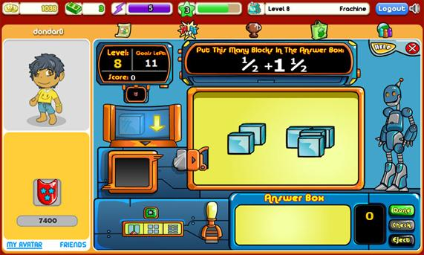
Thanks!

