Slide 1
SAGE Final Presentation
Team JIR
December 16, 2016
Julie Chien
Iris Zhang
Ray Tsai
Notes:
INTRO Gamification and assessment server.

Slide 2
Intro to Gamification
Goal of our educational system is to teach computational thinking, which is a way of thinking that allows for better problem solving and system design by drawing on fundamental Computer Science concepts (Wing, 2006).
Adding points to SAGE will increase students’ motivation to engage with the system and drive the learning of computational thinking.
Notes:
Before i get into how adding points to sage will achieve our computational thinking goal, let me run through a demo to refresh us on the points system

Slide 3
Block Points
Each block is associated with a point value. Teachers can assign weights to blocks.
Automatically quantify different problem-solving approaches
Example 1: blocks that represent complex programming concepts worth more points than blocks that represent simple concepts. Goal: get the highest number of points.
Example 2: Code Golf - complete the level with the lowest point value possible.
Example 3: Parson’s Programming Puzzles - several ways to solve a programming puzzle, but “better” solutions are worth more points
Notes:
There may be several ways to solve some particular programming problem. Block points allow us to quantify each of these methods. For example, blocks that represent more complex programming concepts may be worth more points than blocks that represent simple concepts. In this scenario, teachers will encourage students to get more points by using blocks with greater point values.
Ex: printing 1-10, 10 printfs worth 1 pt each or 1 for loop worth 20 points Alternatively, perhaps a teacher wants students to program concisely and elegantly, and she does so by encouraging students to complete the level with the lowest point value possible.

Slide 4
Demo: Block Points in Play Mode

Slide 5
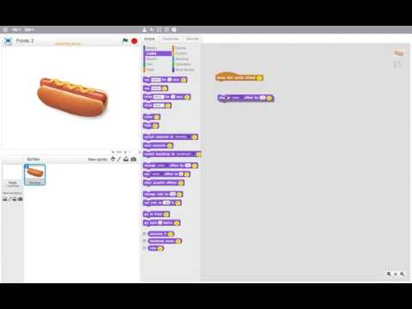
Notes:
Points are simply numbers displayed on the block inside a star. Student can see point values while they work.
Assign points to certain blocks - quantify the worth of individual blocks. As students build projects, the point values of the blocks they use are summed and displayed on the scratch editor. You can see the point values are displayed on the block and the sum of the points in the script pane is displayed in the upper left of the editor.
Points are accumulated (summed) in the editor. Students can see their progress as they work on the project.

Slide 6
Demo: Setting Points in Design Mode

Slide 7
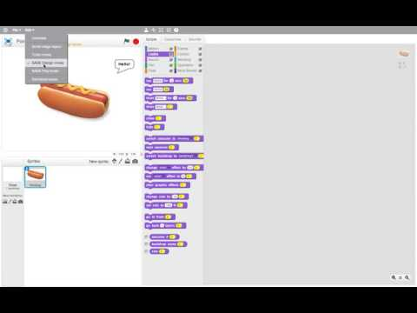
Notes:
Teachers can configure point values in design mode. The UI design is intentionally similar to what the student sees in play mode. The more familiarity the teacher has with what the student has to deal with, the better.
From Jairo’s final report: “The American Educational Research Association prescribes curriculum design that encourages teachers to develop strong subject matter knowledge on the topics presented to students (Davis & Krajcik, 2005).” By having the UI be as similar as possible between design and play mode, teachers will develop familiarity with what students will experience, allowing teachers to (hopefully) come up with good point configurations.
These are saved into a dictionary keyed by the spec’s name. The changes the teacher makes here are auto-saved -- every edit writes to the dictionary.

Slide 8
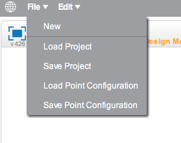
Saving and Loading Point Configurations
Notes:
There are a lot of blocks. Setting points every time can be tedious. Luckily, Point configs can be saved to file and loaded from file. When loaded from file, the point config is stored as an in-memory static dictionary in the specs class, which is what the program reads/writes from. When saved, this dictionary gets serialized to a JSON file.

Slide 9
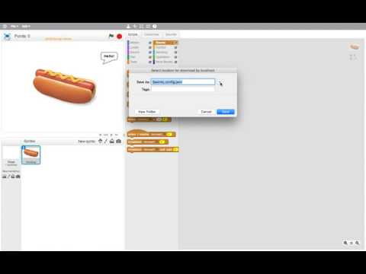
Notes:
Saving point config - also saved when you save a project

Slide 10
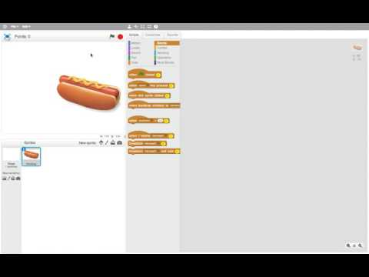
Notes:
Loading point config - also loaded when u load a project

Slide 11
Additional Features
Deleting and undeleting blocks from scripts pane results in points being added and subtracted
Points are saved and loaded along with project (thanks to Parsons team)
Point totals aren’t displayed while in Design Mode
Handles multiple updates to point value of same block in Design Mode
User can no longer edit points in the scripts pane

Slide 12
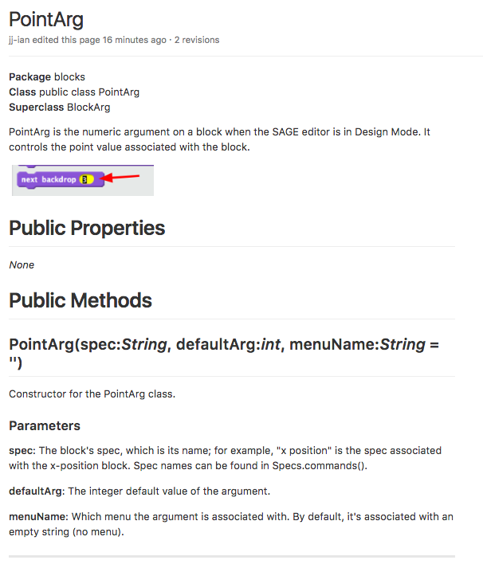
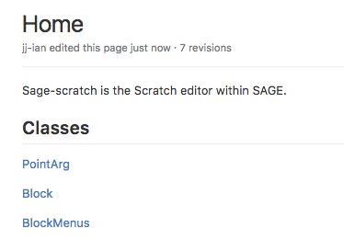
Documentation
https://github.com/cu-sage/sage-scratch/wiki

Slide 13
Constructionist Video Games
Constructionist video games - building things in-game is the main gameplay. Empowers players to be architects of their own learning (Weintrop, Holbert, Wilensky, & Horn, 2012).
Principle 1: Construction tools must be sufficiently expressive
Principle 2: In-game goals should encourage exploration.
Points can help make SAGE more of a constructionist video game by encouraging exploration of different solutions.
Reward exploration through points by making more interesting blocks worth more points
Create “discovery rich” (Papert, 1980) environment; encourage exploration by not limiting player to single winning strategy. With points system, all correct solutions are rewarded with points, but user can always try to find a better solution with a better point value.
Notes:
Examples of constructionist games - minecraft, roller coaster tycoon
Think creatively, learn more, set own goals
Weintrop et al propose 2 principles to define consturctionist video games
Discovery rich - Having points means user can always work towards having a better number of points. There are many different ways to solve a problem, so user is incentivized to explore diff solutions to receive better points.

Slide 14
Intelligent Tutoring and Games
How adding game-based features may improve effectiveness of educational software by improving motivation (McNamara, Jackson, & Graesser, 2010).
Points in SAGE serve as extrinsic motivation that can act as as springboard for intrinsic motivation.
Motivational constructs that can be increased by points:
Self-regulation: student seeks to understand a topic by monitoring and adapting their own cognitive processes (Greene & Azevedo, 2007).
Self-efficacy - learner’s sense of success and achievement (Bandura, 2000; Pajares, 1996). Having a point value provides an indicator of success to user.
Interest - interest in subject material. Framing the content within a game can be used to capture the interest of student (McNamara, Jackson, & Graesser, 2010).
Engagement - interested, not bored. Bored learners think less and learn less (Craig et al., 2004). Gamification through points can help stave off boredom and increase engagement.
Notes:
Talk about this in context of intelligent tutoring systems - educational software that works like a teacher, providing feedback and guidance during the teaching process
Self-regulation: Having to think about how to obtain an optimal number of points will encourage student to set goals and be creative to come up with solutions. Within context of ITS, how are students supposed to set their own goals to learn something if htey dont know that thing? Its more reasonable to expect students to set and achieve tangible game-based goals, such as obtaining a certain number of points. Overt goal to achieve points, but along the way of achieving this overt goal, learning happens. Such extrinsic motivators, particluarly when combined w components that improve engagement w material, are expected to increase motivation to perform well and learn material if they dont know programming, students dont know what theyre supposed to be working towards (other than completingt the task at hand), they wont know that a good program to do something is generally fewer lines than other ways of doing the same thing. having points provides a tangible goal for them to meet that lets students create projects with few blocks without explicitly having to be aware that fewer lines = good programming giving student a goal - make them more interested/engaged, makes them think about what theyre doing in order to achieve goal points - give them a goal to work towards
Self-efficacy - build sense of success thru points. More empowered/successful learner feels, more engaged with system
Motivation - Competition - points leaderboard. Eg code golf - do it w/ the lowest number of points of anyone in the class

Slide 15
Intelligent Tutoring and Games
Point-based feedback is a feature characteristic of games, less common to ITSs.
Points can provide feedback. Even if user doesn’t know anything about programming, he or she can tell that a score of 50 is clearly better than a score of 30.
Feedback can be further exploited as a form of competition.
Challenge level can be calibrated via points
(McNamara, Jackson, & Graesser, 2010).
Notes:
Points - direct and quantifiable feedback, even if you don’t know programming, a score of 50 is clearly better than a score of 30
Point-based feedback can facilitate self-regulation and self-efficacy in computer based learning environments (Anderson et al 1995, Corbett & Anderson 1990; foltz et al 2000; jackson & graesser 2007, Schunk and Pajares 2001, Shute 2006)
Points can provide both turn by turn indicator of student performance and also global indicator of performance quality over a period of time(provoiding both local and global feedback). These kind of performance contingent rewards have been shown to produce a corresponding increase in self-efficacy and motivation (Schunk and Pajares, 2001)
SUCCESSFUL GAMES HAVE OPTIMAL LEVELS OF CHALLENGE
More challenging levels - more blocks availalbe, more point to be earned, but also more options/decisions to make
So points could be a way to increase challenge, say first you solve a problem, then you have to solve a problem using below a certain number of points
challenge difficulty set by things like more complex programming assignments, more difficult parsons puzzles, or restrictions in points (ie u must solve this level using below a certain number of points). or solve it using only certain blocks
select a task of some dificulty
if too hard, make it easiser with additional scaffolding
if that’s too hard, empower student thru feedback strategy and attempt to restore student’s sense of self efficacy

Slide 16
Future Work: Testing the Value Added by Points
The hope is that gamification of SAGE via points will increase student motivation/engagement with the material and drive learning.
Important: Points are a toolkit that must be used within some system and serve some purpose. By themselves, they add little value.
Examples: Parson’s, levels, leaderboard, goals, unlockable rewards
Adding game-like features isolation without context provide no benefits to either learning or motivation (Jackson & Graesser, 2007).
Does gamified SAGE work better than regular SAGE?
When testing people, observe which aspects of motivation are enhanced, if any, and examine what the points make them do to see what the learning benefits are (McNamara, Jackson, & Graesser, 2010).
How do you quantify individual blocks?
Notes:
I’ve made a lot of claims that could use more evidence
Parsons - many ways to solv ea puzzle, but points can automatically quantify different solutions
Does gamified sage work better? We can test on people with Parson’s with points vs Parson’s without points. Does it actually drive motivation/engagement or is it just confusing?

Slide 17
Assessment Editor Improvements

Slide 18
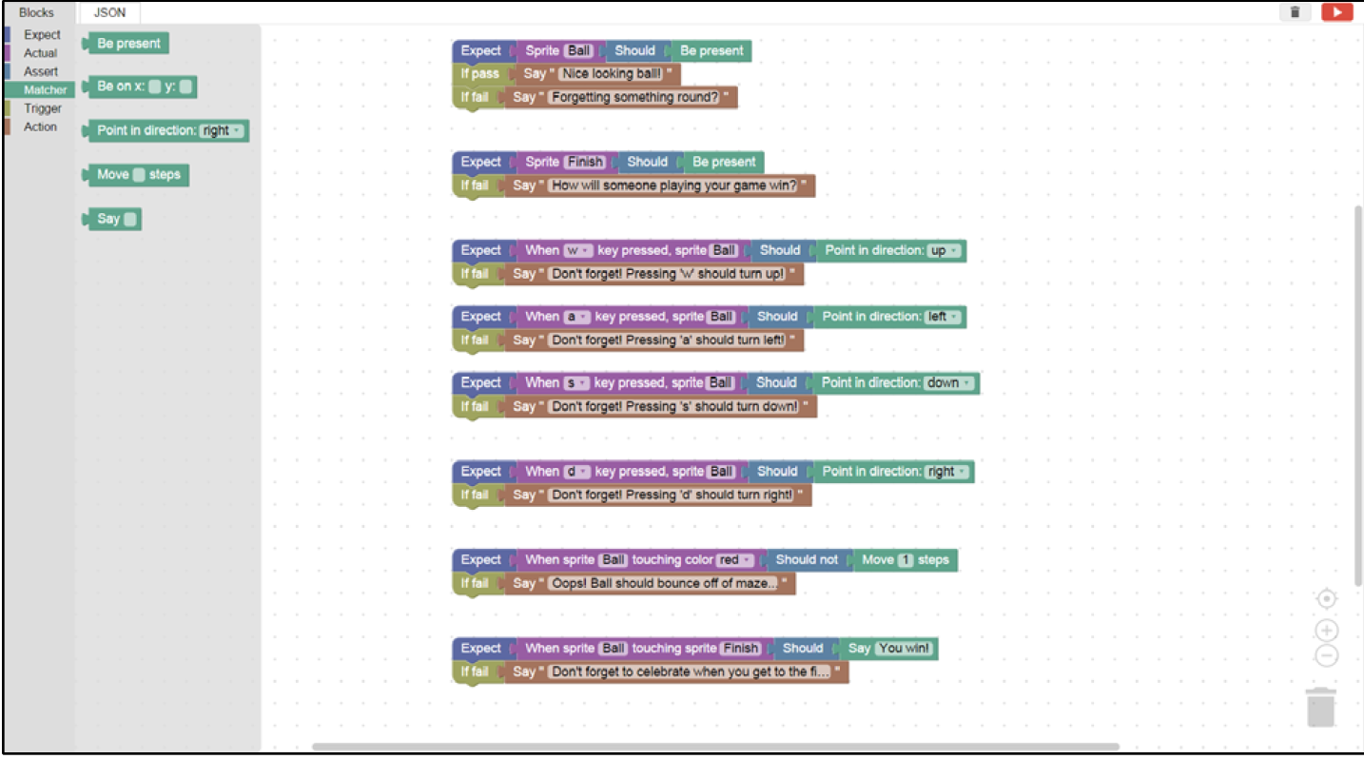
Improving the Blockly Assignment Editor
Notes:
Teacher tool
Isolated from the rest of the architecture
As a teacher, you could create a set of grading criteria for a particular scratch project and upload it to the SAGE assessment server

Slide 19
Motivation
Mapping of Computational Thinking Concepts to Design Pattern Variables (animate looks, collide, user interaction, etc.) already exists in the PECT mode
Grouping of Design Pattern Variables into digestible, scaffolded chunks supported by the PECT’s model of proficiency
Looks - > Motion - > Conversate ->Collide ->Interact ->Scoring
Add in-game assessment to improve understanding and engagement
Executable goals
Sense of progression
Adaptive learning and gaming through unlocking
intelligently monitor and interpret learner behavior in a non-invasive manner

Slide 20
Improving the Assessment Editor
Point Value to Blocks
Student Progression
Infrastructure
Enable teachers to add point values to assessment blocks, associating the action “add points” to a particular trigger block with specified values.
Allow teachers to design an unlocking mechanism for students as they work through assessments, scaffolding them through computational learning goals.
Improve service architecture to make the assessment editor more integrated with the rest of the SAGE and Scratch suite.
Notes:
Point value to blocks - done
Student progression front end
Infrastructure - Back end implemented, fully integrated with the SAGE Blockly Editor Language tool

Slide 21
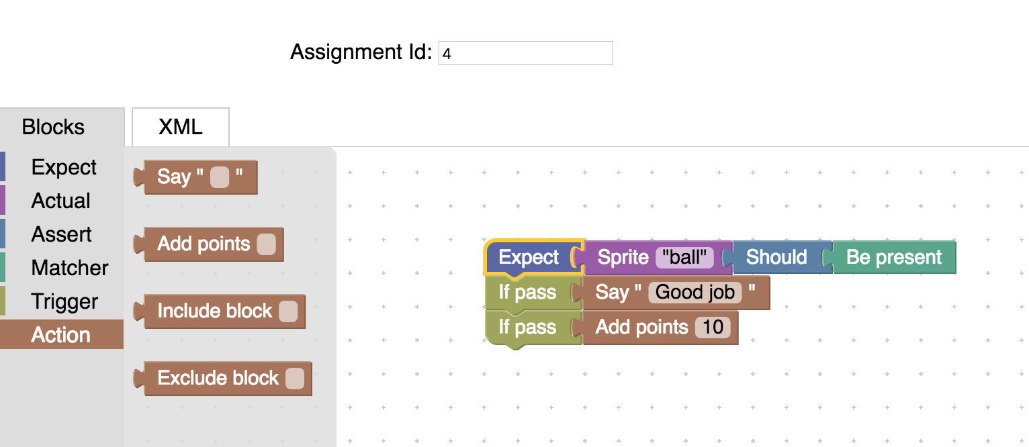
Point Value Blocks - SAGE Assessment Editor
Notes:
Added:
-the numbers are now validated, can only enter number between 0 and 500, only whole numbers. Blockly.FieldNumber
-Update Blockly to latest version

Slide 22
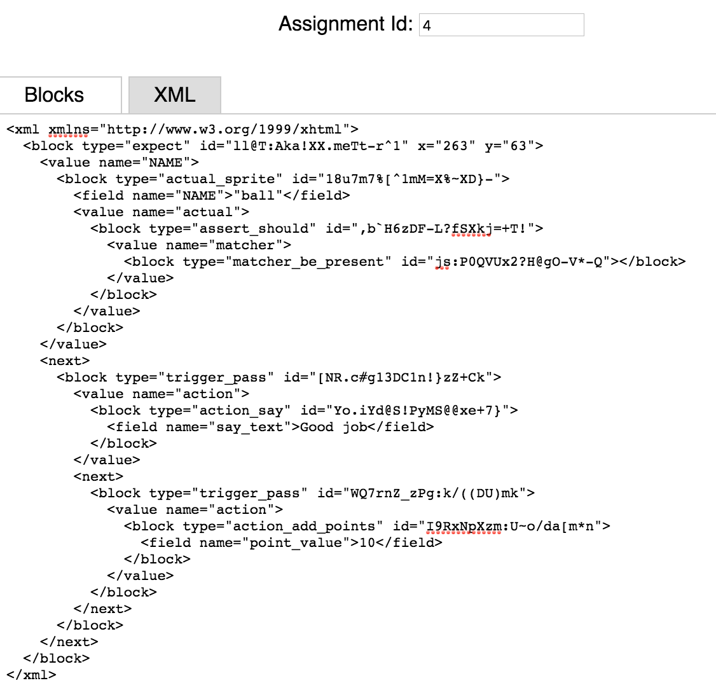
Infrastructure Improvements - LIVE DEMO
POST
SAGE Server
GET
Notes:
New Features:
-Block point values are evaluated on front end and sent to the server
-Loading prior assignments thru hash
-Uploading assignments to new SAGE server thru run button
DEMO

Slide 23
Teacher Dashboard UI Design
Wireframes
Teacher-designed quests and assignments
Grouping of assignments
Point unlocking and point totals
Future work: integrated with Student and Teacher dashboard
Notes:
Design decision - how to present this on front end? It should be static - only thing you can do is click on a specific assignment to edit it.
Unsorted assignments will also be here

Slide 24
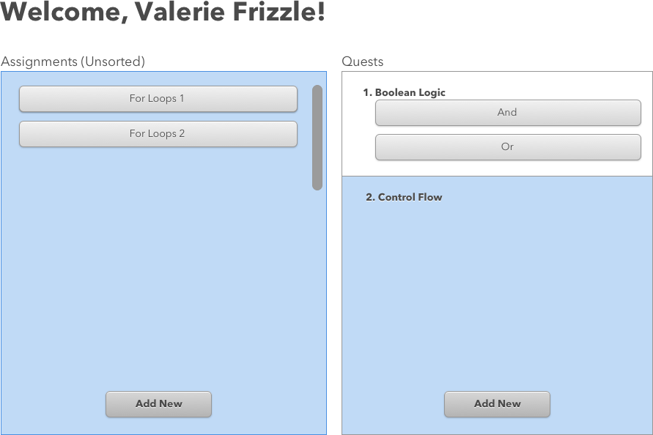
POST/assignment/new
Notes:
“Add New” would take us to the Blockly Editor that allows us to make a new assignment and add points
POST/assignment/new

Slide 25
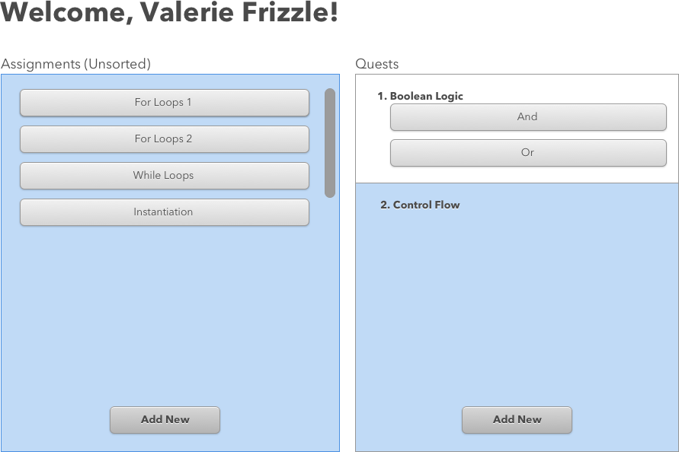
Notes:
Added two new assignments - one called while loop, one called instantiation
This is shown after something in Blockly would trigger going back to this dashboard or refreshing this view

Slide 26
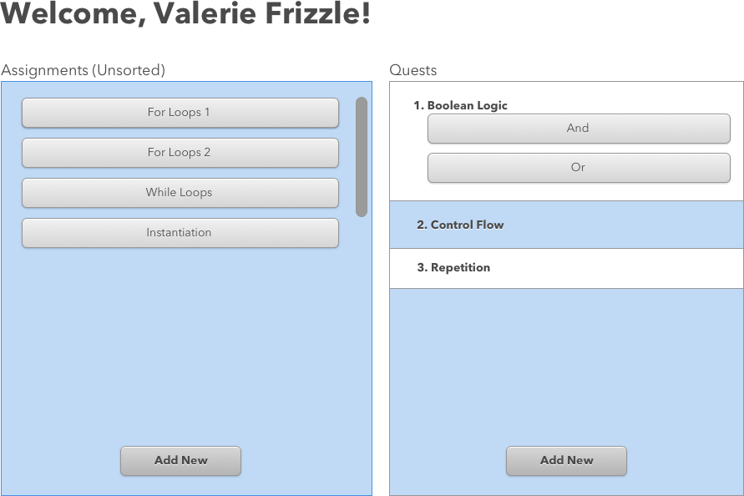
POST/quests/new
Notes:
Adding a new quest
POST/quests/new

Slide 27
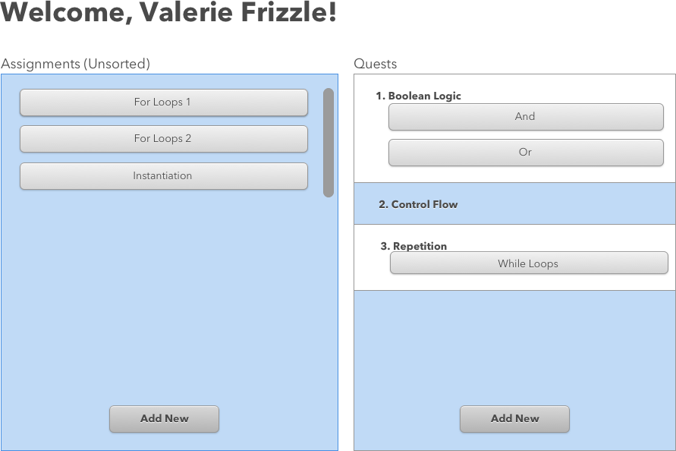
POST/assignment/update_quest
Notes:
Drag and drop interface allows easy organization of assignments under quests
POST/assignment/update_quest

Slide 28
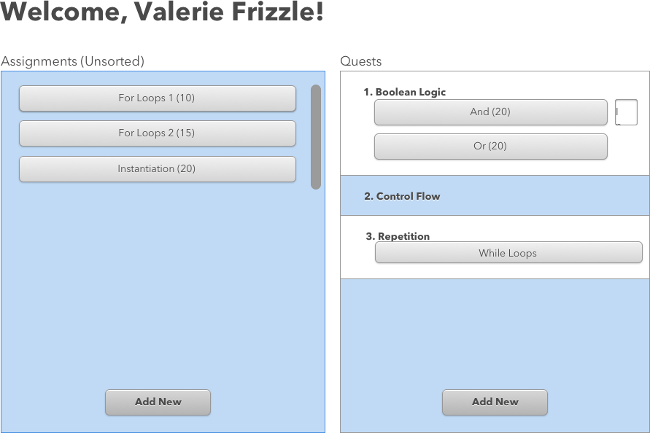
POST/assignment/update_quest

Slide 29
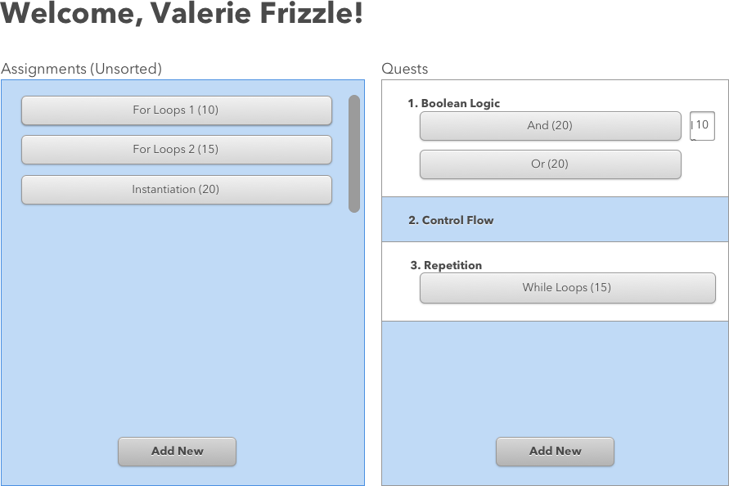
Notes:
Additional considerations:
Double clicking or adding an edit button next to each assignment brings you back into the Blockly editor so you can update the config of thos

Slide 30
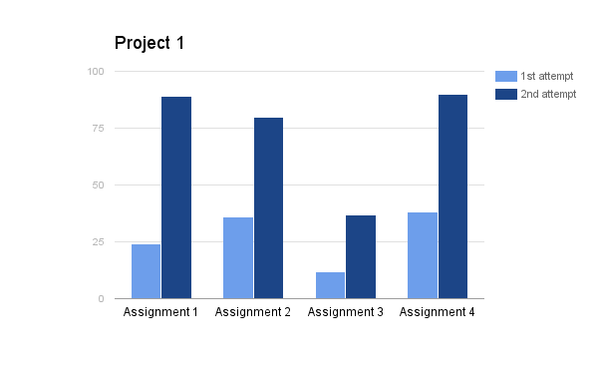
Student Progression - Assessment Dashboard Frontend
Still locked:
Assignment 5
Assignment 6
Assignment 7
Assignment 8
Achieve 70 points or more on Assignment 3 to unlock new puzzles!
Notes:
What student progression may look like on the front end

Slide 31
Future Goals
Point Value to Blocks
Student Progression
Infrastructure
Done!
Implement a front end interface for teachers to group assignments into quests
Design a front end interface for students to view their progression
Done!

Slide 32
SAGE Assessment Server

Slide 33
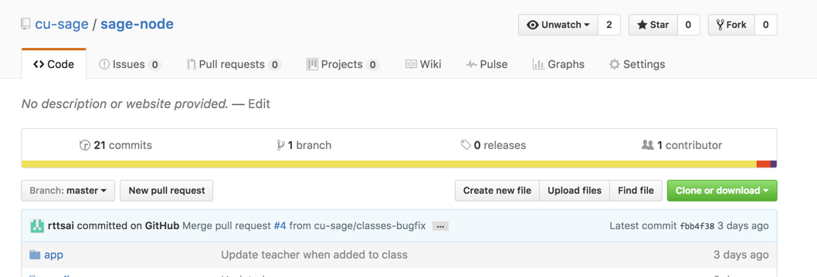
New SAGE Assessment Server
Found on Github at cu-sage/sage-node. Uses Node.js and MongoDB.
Will contain all old functionalities of existing server and add new endpoints.
The existing server will be deprecated in the future.

Slide 34
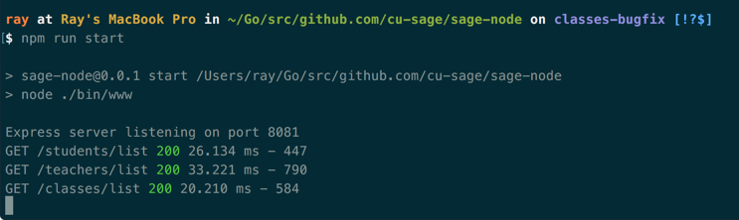
Useful Server Commands
“mongod” - start the database
“npm run start” - start the server
“npm run mocks” - import mock data
“npm run test:integration” - run integration tests

Slide 35
Database Collections
Assessments
Assignments
Class
Quests
Students
Teachers

Slide 36
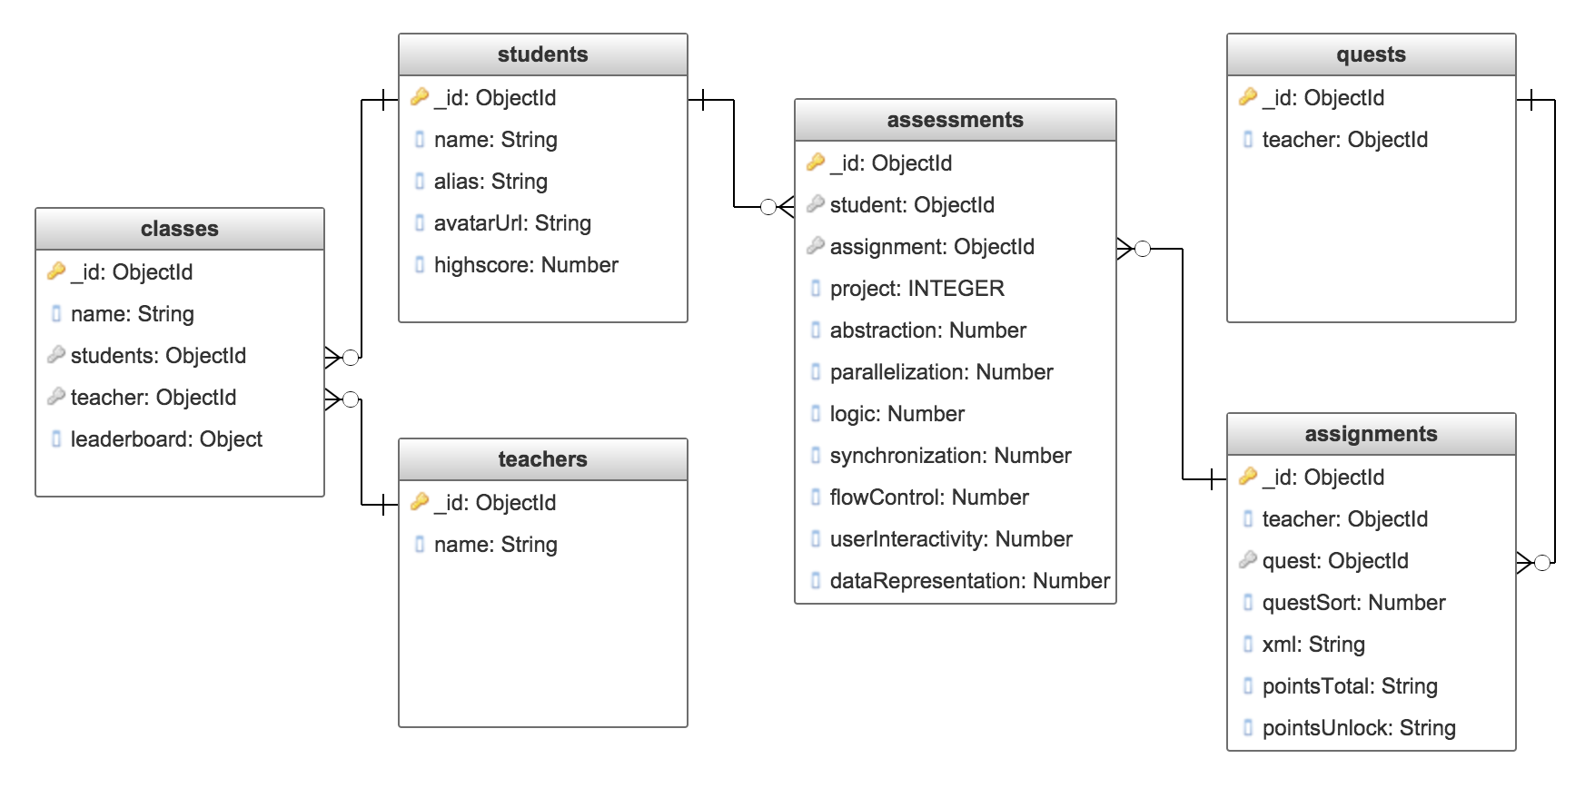
Database Schema Diagram

Slide 37
REST API Endpoints
Routes
/students
/teachers
/classes
/assignments
/quests
/assessments

Slide 38


Application Architecture
Scratch
MongoDB
SAGE Assessment Server
Scratch Editor
SAGE Front-end

Slide 39
Application Architecture
Scratch
/assessments endpoints
MongoDB
SAGE Assessment Server

Slide 40
Application Architecture
/assignments endpoints
/quests endpoints
MongoDB
SAGE Assessment Server
Scratch Editor

Slide 41
Application Architecture
/students endpoints
/teachers endpoints
/classes endpoints
MongoDB
SAGE Assessment Server
SAGE Front-end

Slide 42
/students Endpoints
GET /students/:id
GET /students/list
POST /students/new

Slide 43
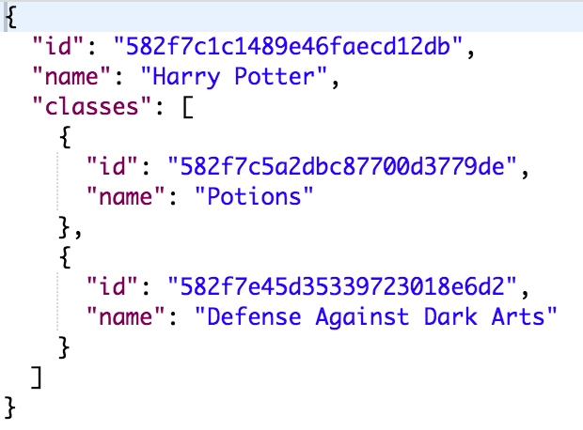
/students Example Response
GET /students/582f7c1c1489e46faecd12db

Slide 44
/teachers Endpoints
GET /teachers/:id
GET /teachers/list
POST /teachers/new

Slide 45
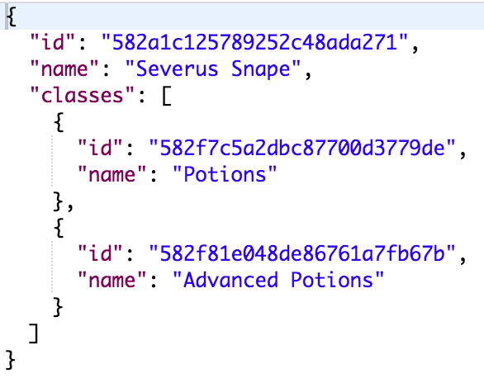
/teachers Example Response
GET /teachers/582a1c125789252c48ada271

Slide 46
/classes Endpoints
GET /classes/:id
GET /classes/list
POST /classes/new
POST /classes/update_teaacher
POST /classes/remove_teacher
POST /classes/add_student
POST /classes/remove_student

Slide 47
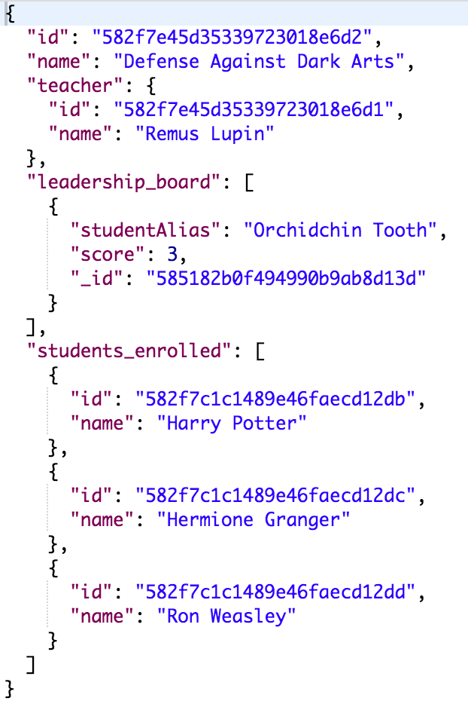
/classes Example Response
GET /classes/582a1c125789252c48ada271

Slide 48
/assignments Endpoints
GET /assignments/:id
GET /assignments/list
POST /assignments/new
POST /assignments/remove_quest
POST /assignments/update_xml

Slide 49
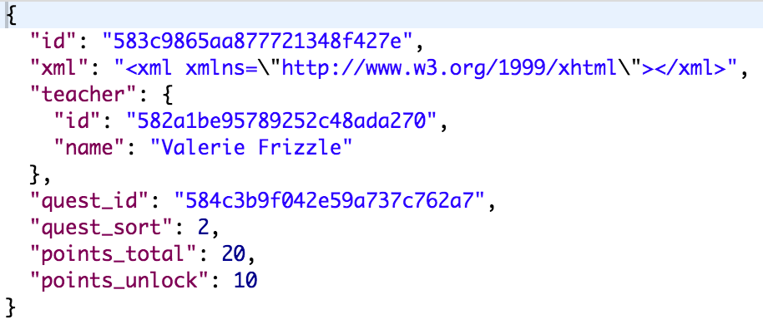
/assignments Example Response
GET /assignments/583c9865aa877721348f427e

Slide 50
/quests Endpoints
GET /quests/:id
GET /quests/list
POST /quests/new

Slide 51
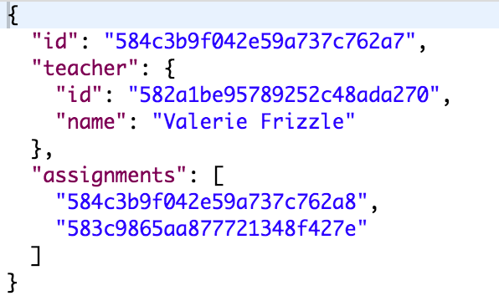
/quests Example Response
GET /quests/584c3b9f042e59a737c762a7

Slide 52
/assessments Endpoints
GET /assessments/:id
GET /assessments/list
GET /assessments/latest
POST /assessments/update

Slide 53
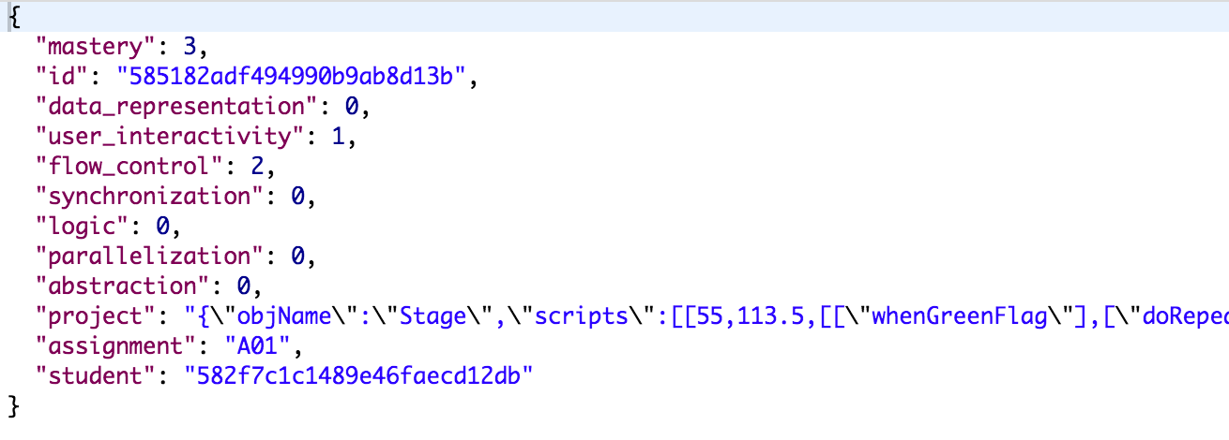
/assessments Example Response
GET /assessments/latest?student=582f7c1c1489e46faecd12db

Slide 54
REST API Endpoints Summary
/students
GET /:id
GET /list
POST /new
/classes
GET /:id
GET /list
POST /new
POST /:id/update_teacher
POST /:id/remove_teacher
POST /:id/add_student
POST /:id/remove_student
/assignments
GET /:id
GET /list
POST /new
POST /update_quest
POST /update_xml
/quests
GET /:id
GET /list
POST /new
/assessments
GET /:id
GET /list
GET /latest
POST /update
/teachers
GET /:id
GET /list
POST /new

Slide 55
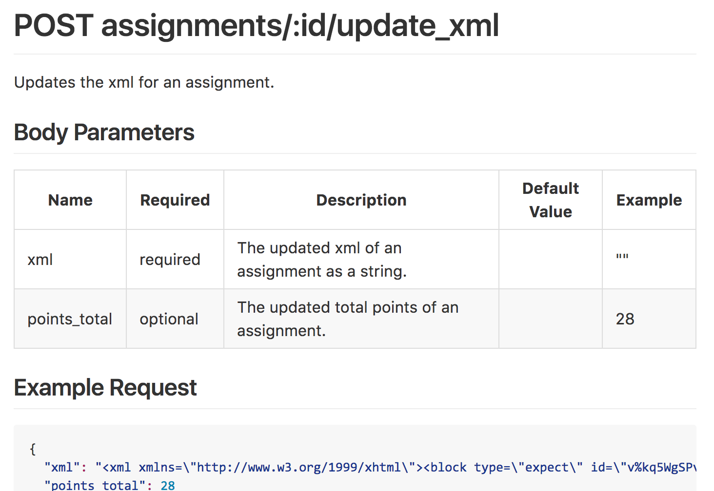
REST API Endpoints Documentation
https://github.com/cu-sage/sage-node/wiki/API-Documentation

Slide 56
Class Leaderboards

Slide 57
Class Leaderboards
How does it work?
Receive a project update from Scratch
Use hairball plugins to analyze the student submission
Check if the student has a new highscore
Update the leaderboards of the student’s enrolled classes
Keep leaderboard anonymous by using student aliases

Slide 58
Future Work
Production Server
Create a live server using Heroku or OpenShift
Assessments
Remove dependency on Python
Student Progression
Save points from assignments

Slide 59
Project Summary

Slide 60
Summary: Block Points
Block points provide a toolkit to increase gamification of SAGE. Points, when employed within a useful context, can help increase the student’s motivation and engagement with the system. Increased motivation can encourage exploration of the material and help drive learning. The goal is to lead students towards computational thinking via SAGE/Scratch with extrinsic motivation in the form of points.
Points displayed on blocks
Modifying points in design mode
Points incrementing when blocks dragged from palette to scripts pane, decrementing when blocks dragged from scripts pane to palette
Saving and loading of point configurations, both individually and as part of a project
Github wiki for documentation of SAGE-Scratch editor code

Slide 61
Summary: Improvements on Blockly
Infrastructure support for Point Value association with Assessment criteria
Saving and loading of Assignments to the SAGE Server
Full front end design and wireframing of Teacher Dashboard for Quests and Assignments
The goal is to improve computational thinking using scaffolding of learning and extrinsic motivation in the form of points.

Slide 62
Summary: SAGE Assessment Server
Migrated SAGE assessment server from Go to Node.js.
Created new API endpoints to:
Store Scratch projects and analyze projects using Hairball.
Store students, teachers, and classes for SAGE front-end.
Store assignments for Scratch Editor.
Created class leaderboards for SAGE front-end.
Created new Github wiki to store all documentation.
Created mock data for all endpoints.
Created integration tests for all endpoints.

Slide 63
References
Wing, Jeannette M. "Computational Thinking." Communications of the ACM 49.3 (2006): 33.
Weintrop, David, Nathan Holbert, Uri Wilensky, and Michael S. Horn. "Redefining Constructionist Video Games: Marrying Constructionism and Video Game Design." Constructionism 2012 (2012): 645-649.
Mcnamara, Danielle S., G. Tanner Jackson, and Art Graesser. "Intelligent Tutoring and Games (ITaG)." Gaming for Classroom-Based Learning (2010): 44-65.

Slide 64
Thank You
Jeff Bender
Professor Kaiser
Parsons team
Dashboard team

Slide 65

Questions?

