Slide 1
SAGE Assessments
Parson’s Puzzles
COMS E 6901, Section 14
Fall 2016
Akanksha Gupta (ag3749)
Sudhanshu Mohan (sm4241)

Slide 2
Outline
Motivation
Parson’s Puzzles
Related Work
Designing a Parsons Palette
Selection of Blocks
Score Allocation
Distractors
Questions & Hints
Submission
Load and solve puzzle: Play Mode
Score Metric
Final Summary
Demo

Slide 3
Motivation
Empower author/teacher to design Parsons puzzles for gameful and guided learning for students
Students guided to a solution using constraint logic
Reduces cognitive load for the student
Active learning rather than passive rote-learning

Slide 4
Parson’s Puzzles
Short code snippets
Complete logic in itself
Drag and drop blocks/LOC to correct order
Score as an incentive to student to perform better

Slide 5
Related Work
Hot Potatoes
Ville
Cort
Dr. Scratch

Slide 6
Designing a Parson’s Palette
As Sage opens, Design Mode gets loaded
Platform to design Parson’s Puzzle
Checkboxes against each block for selection to Parson’s palette
Select blocks for Parson’s palette, so as student does not digress from problem

Slide 7
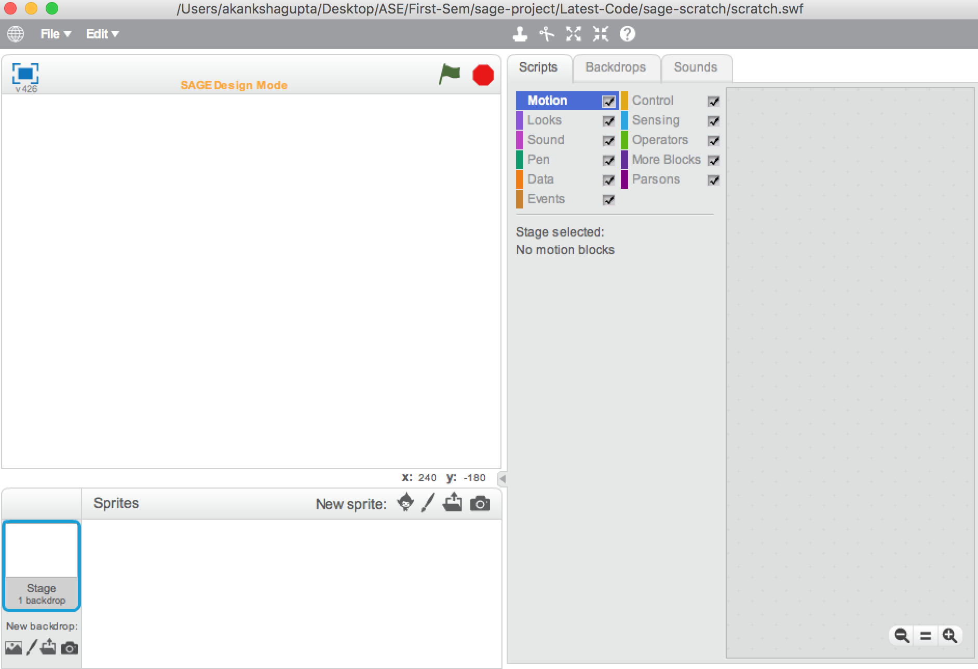
Designing a Parson’s Palette

Slide 8
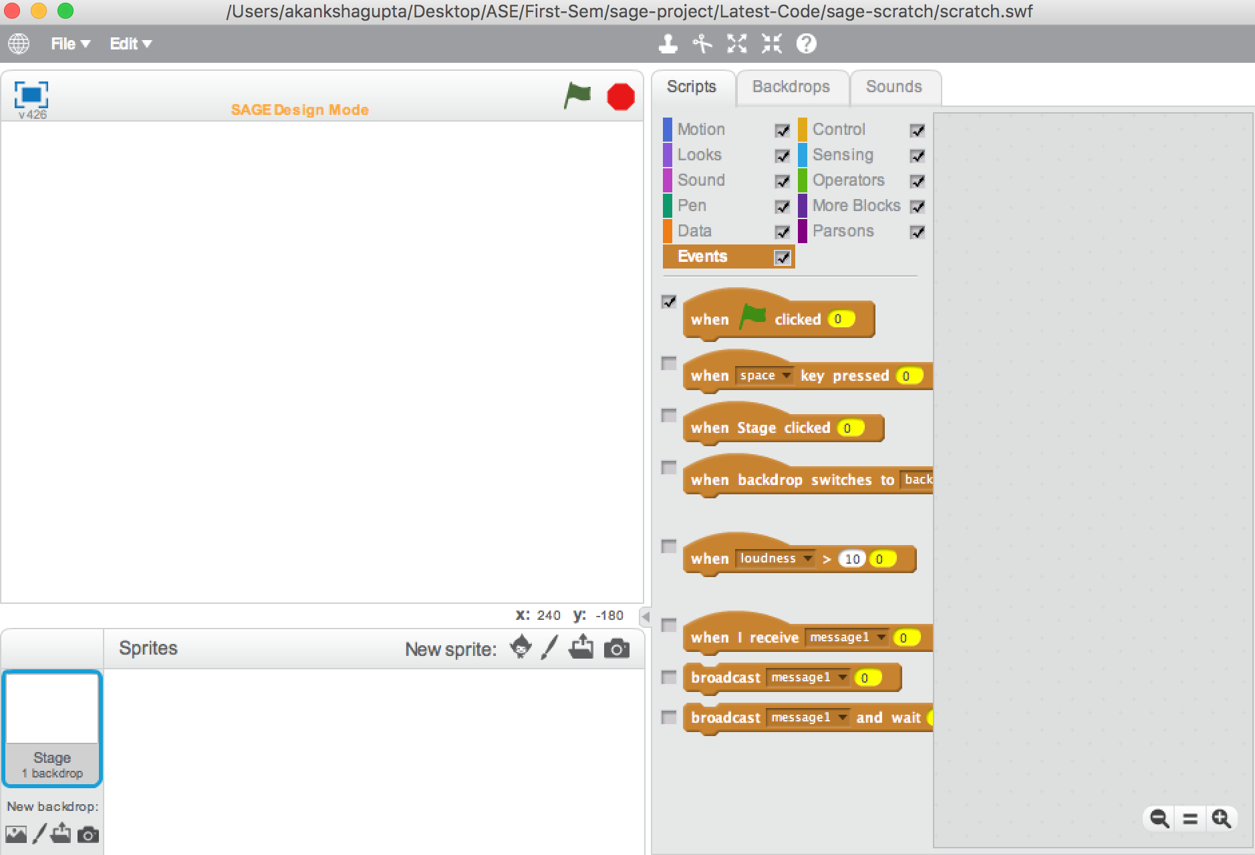
Selection of Blocks

Slide 9
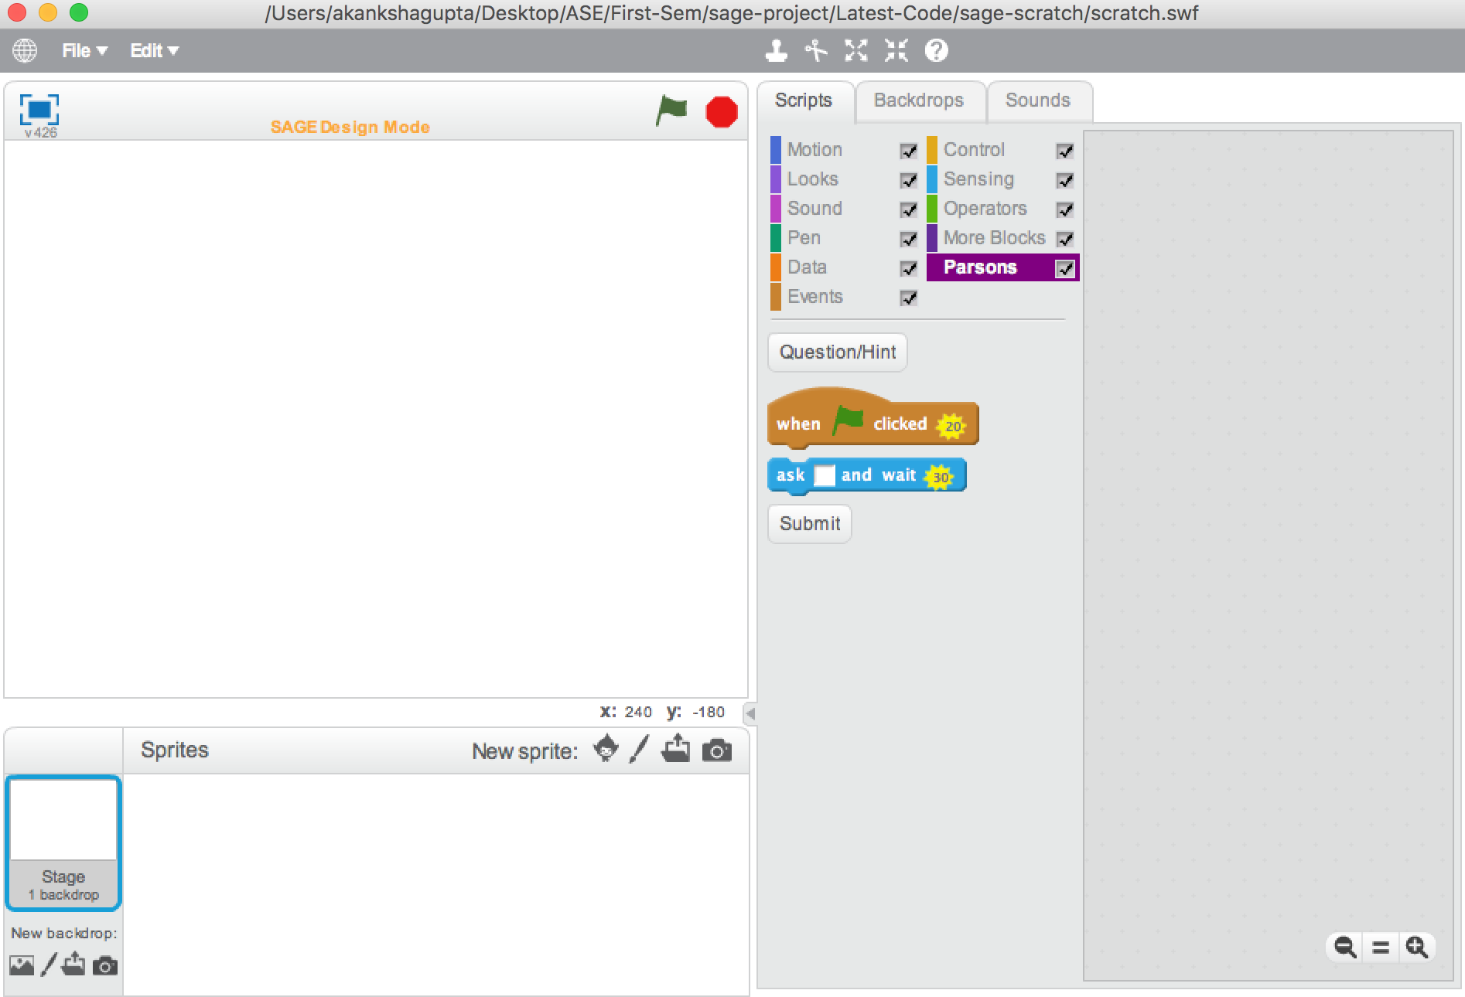
Score Allocation
( Thanks to Julie for providing the Points Framework.)

Slide 10
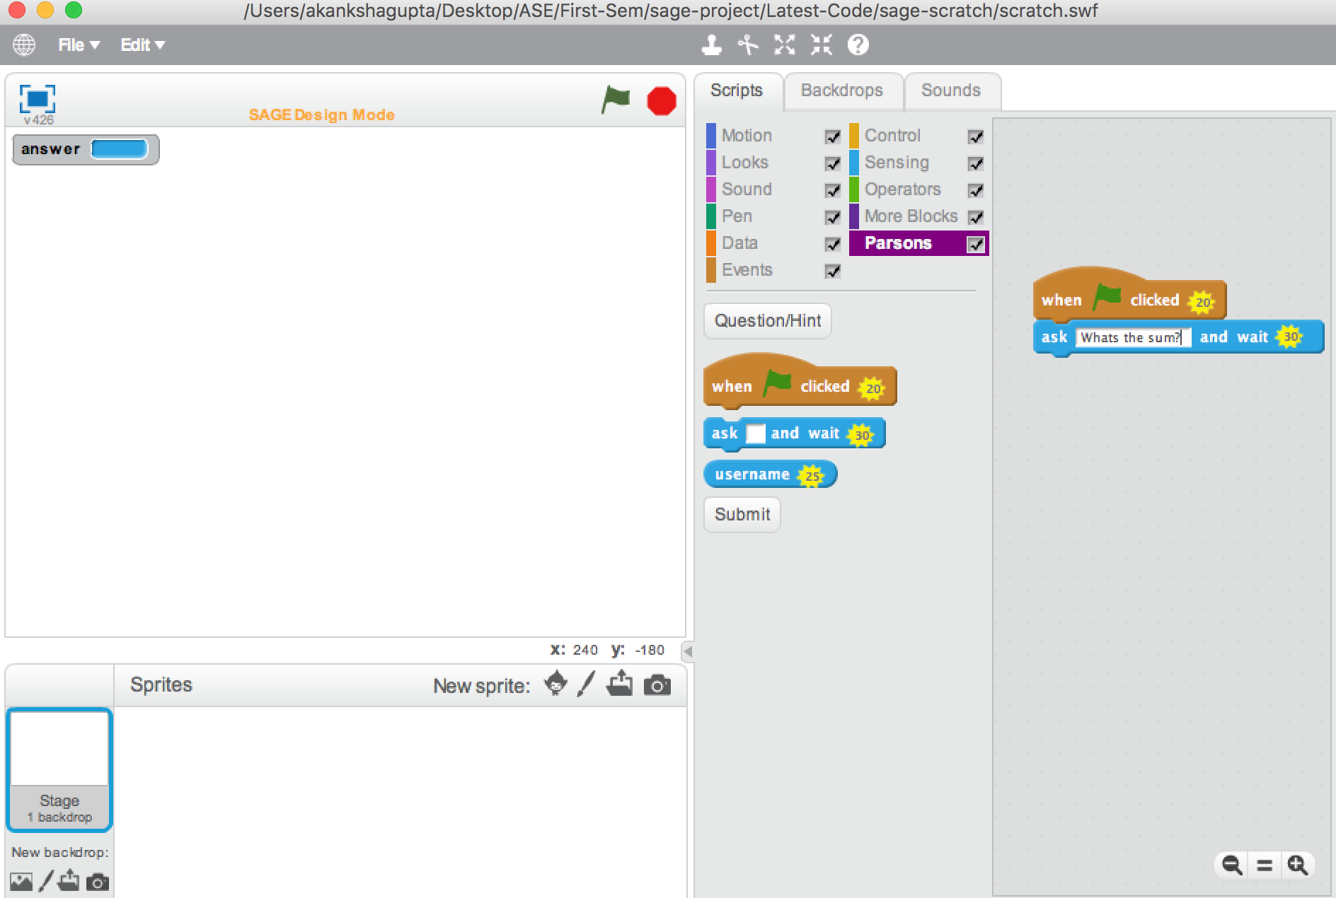
Distractors

Slide 11
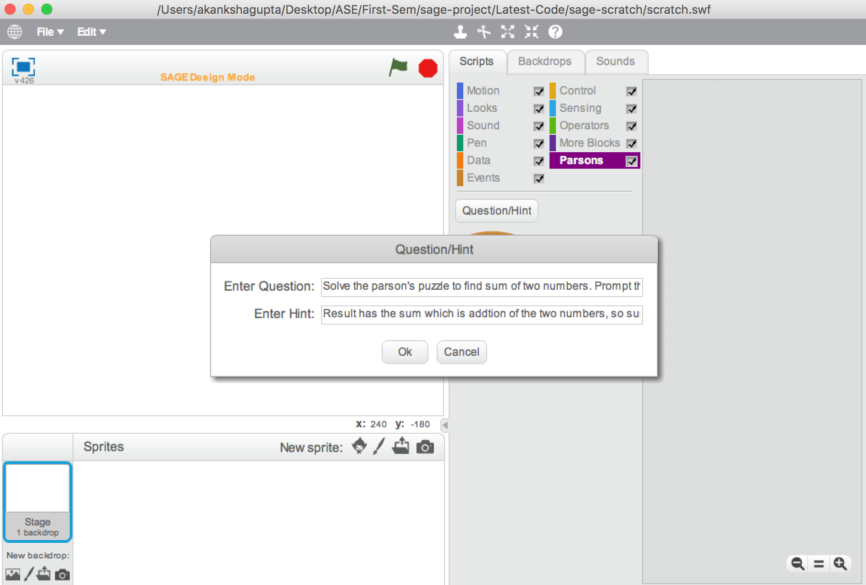
Question & Hints

Slide 12
Submit

Slide 13
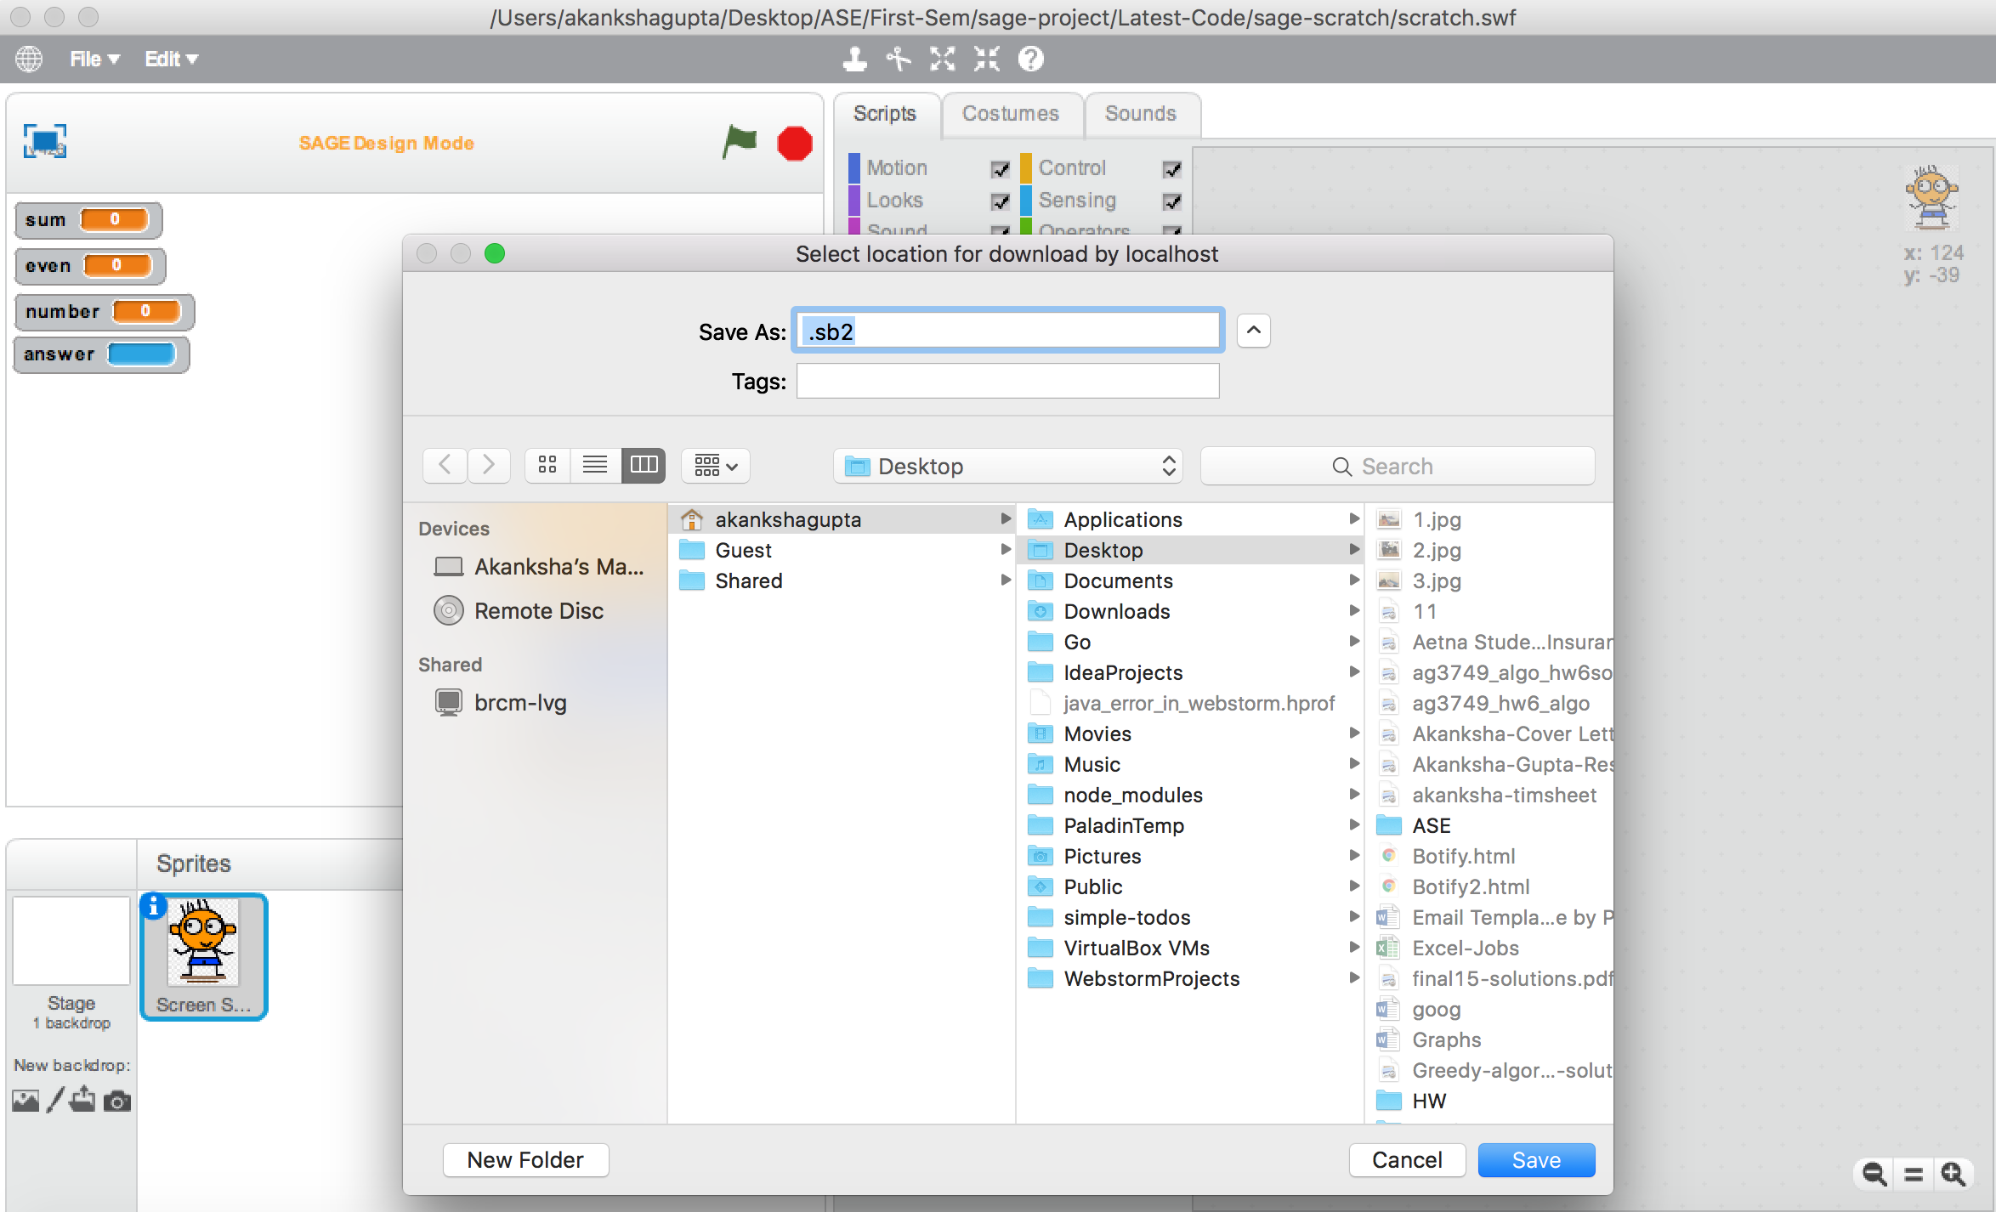
Submission

Slide 14
Play Mode
Student loads the assignment
Uses Parson’s palette to solve the puzzle
Begin’s assignment by Reading question/problem statement
Specific score metrics to control score
Dynamic message with each move to guide the student

Slide 15
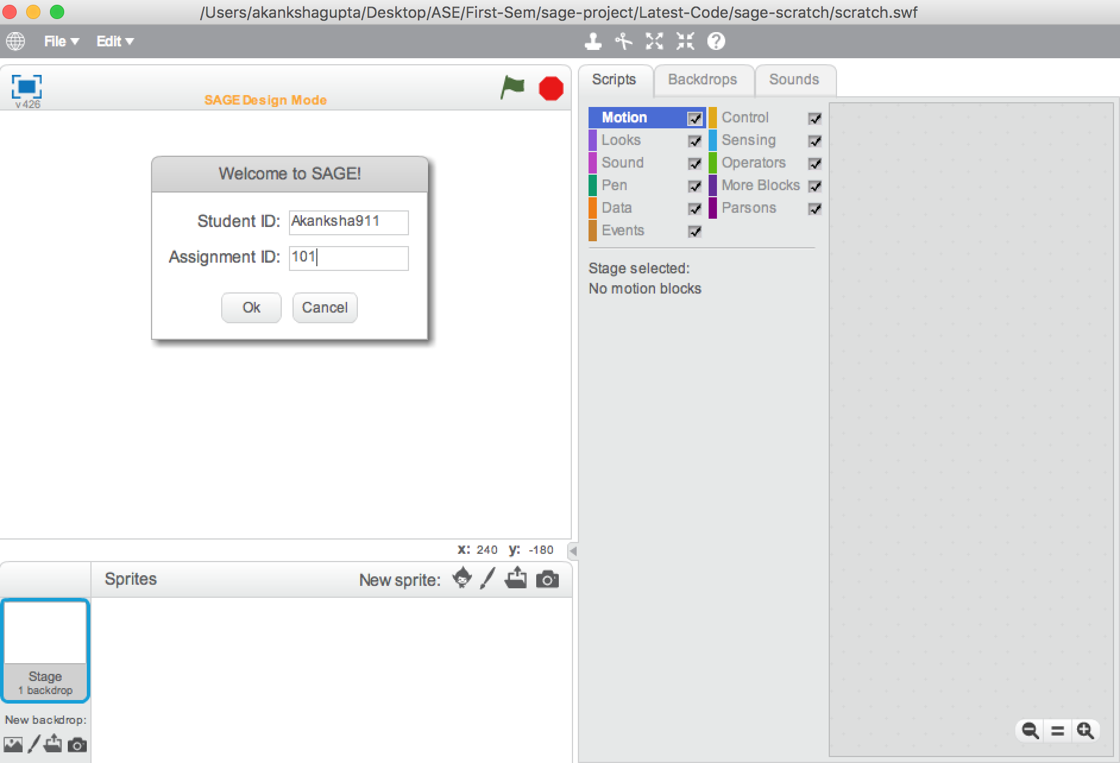
Login to solve puzzle

Slide 16
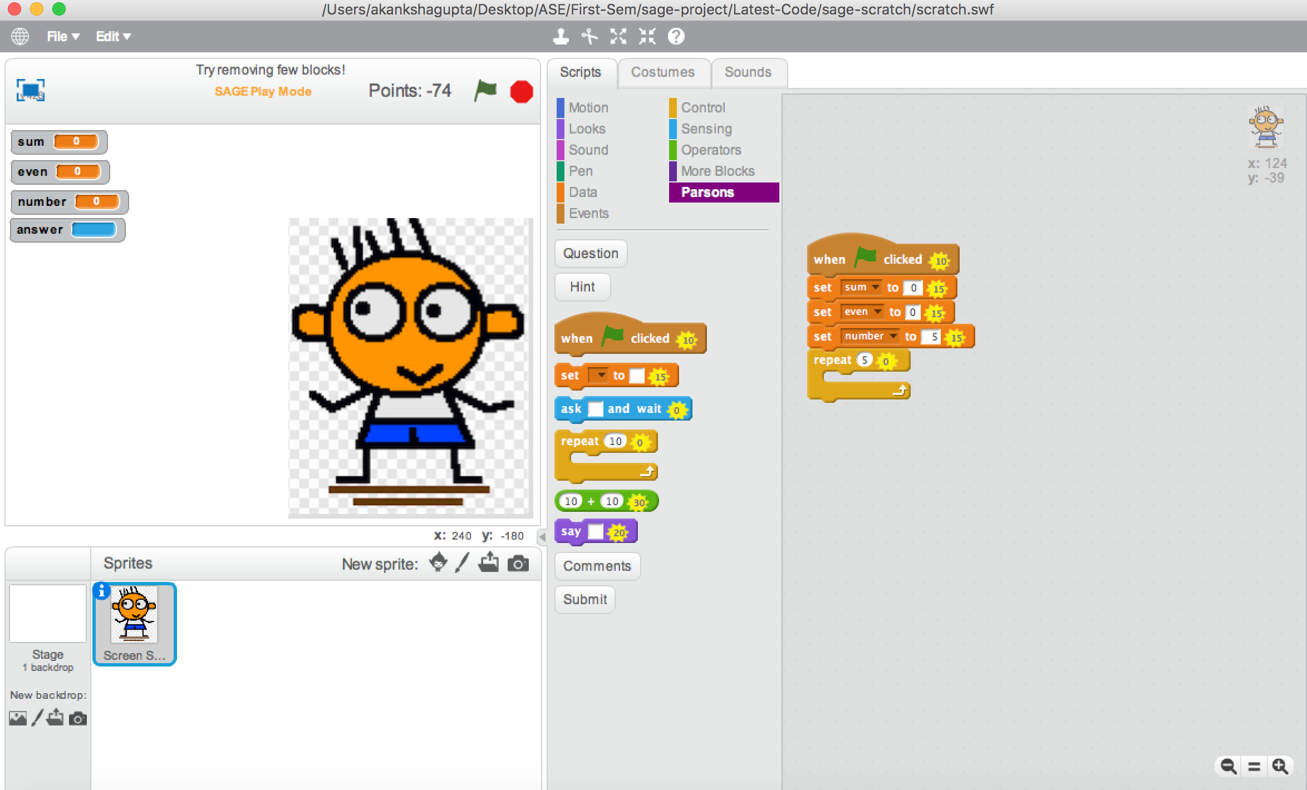
Blocks in Parson palette

Slide 17
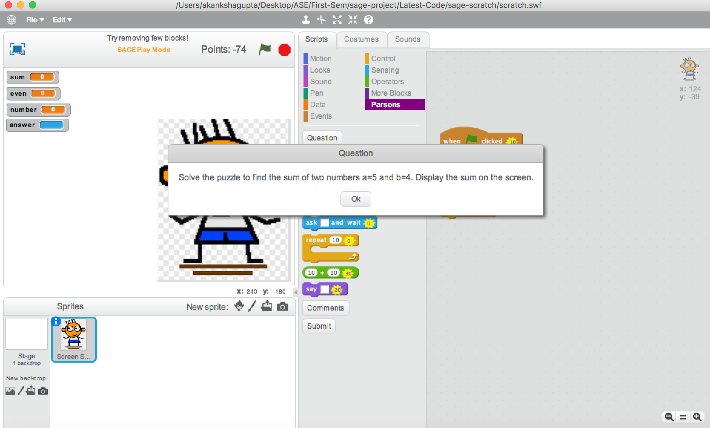
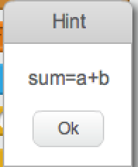
Question & Hint

Slide 18
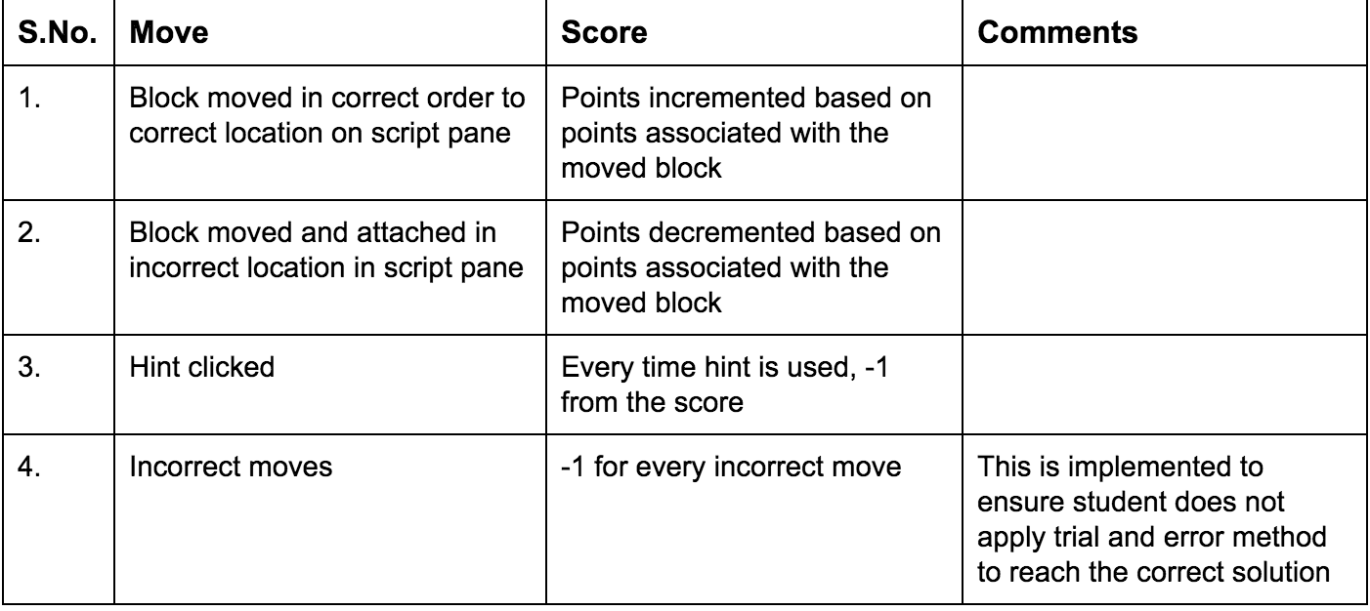
Score Metric

Slide 19
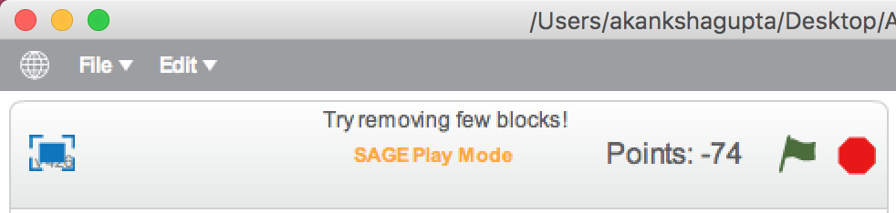
Scoring and Message
Every move causes a change in score and the message.
Messages like “ Try removing few blocks”, “Great! Good Going” can prove as motivators for the student

Slide 20
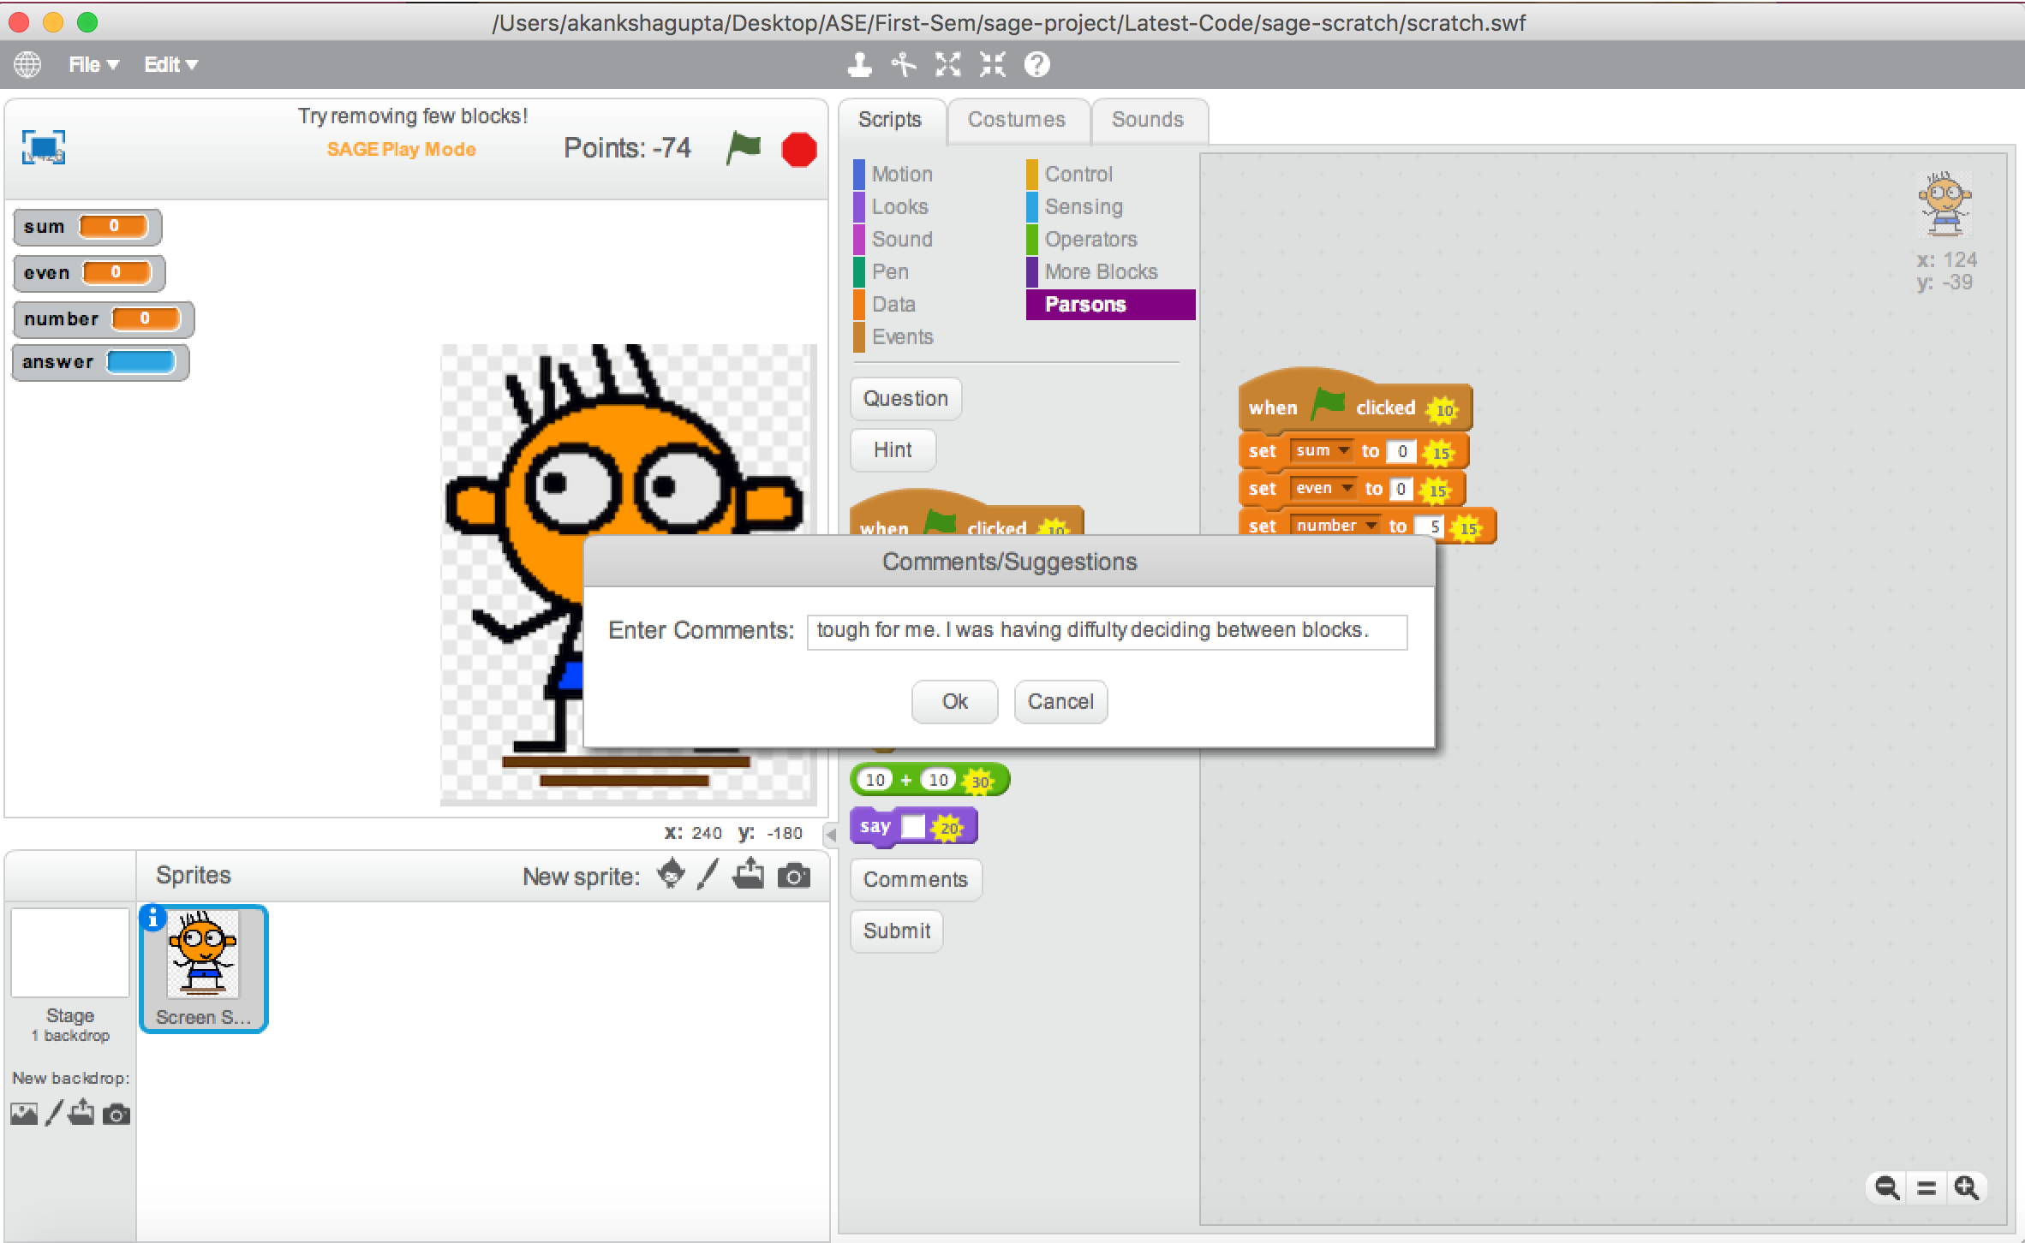
Comments/Feedback: Play Mode
Comments/ Feedback from student for teacher/author to improve puzzles

Slide 21
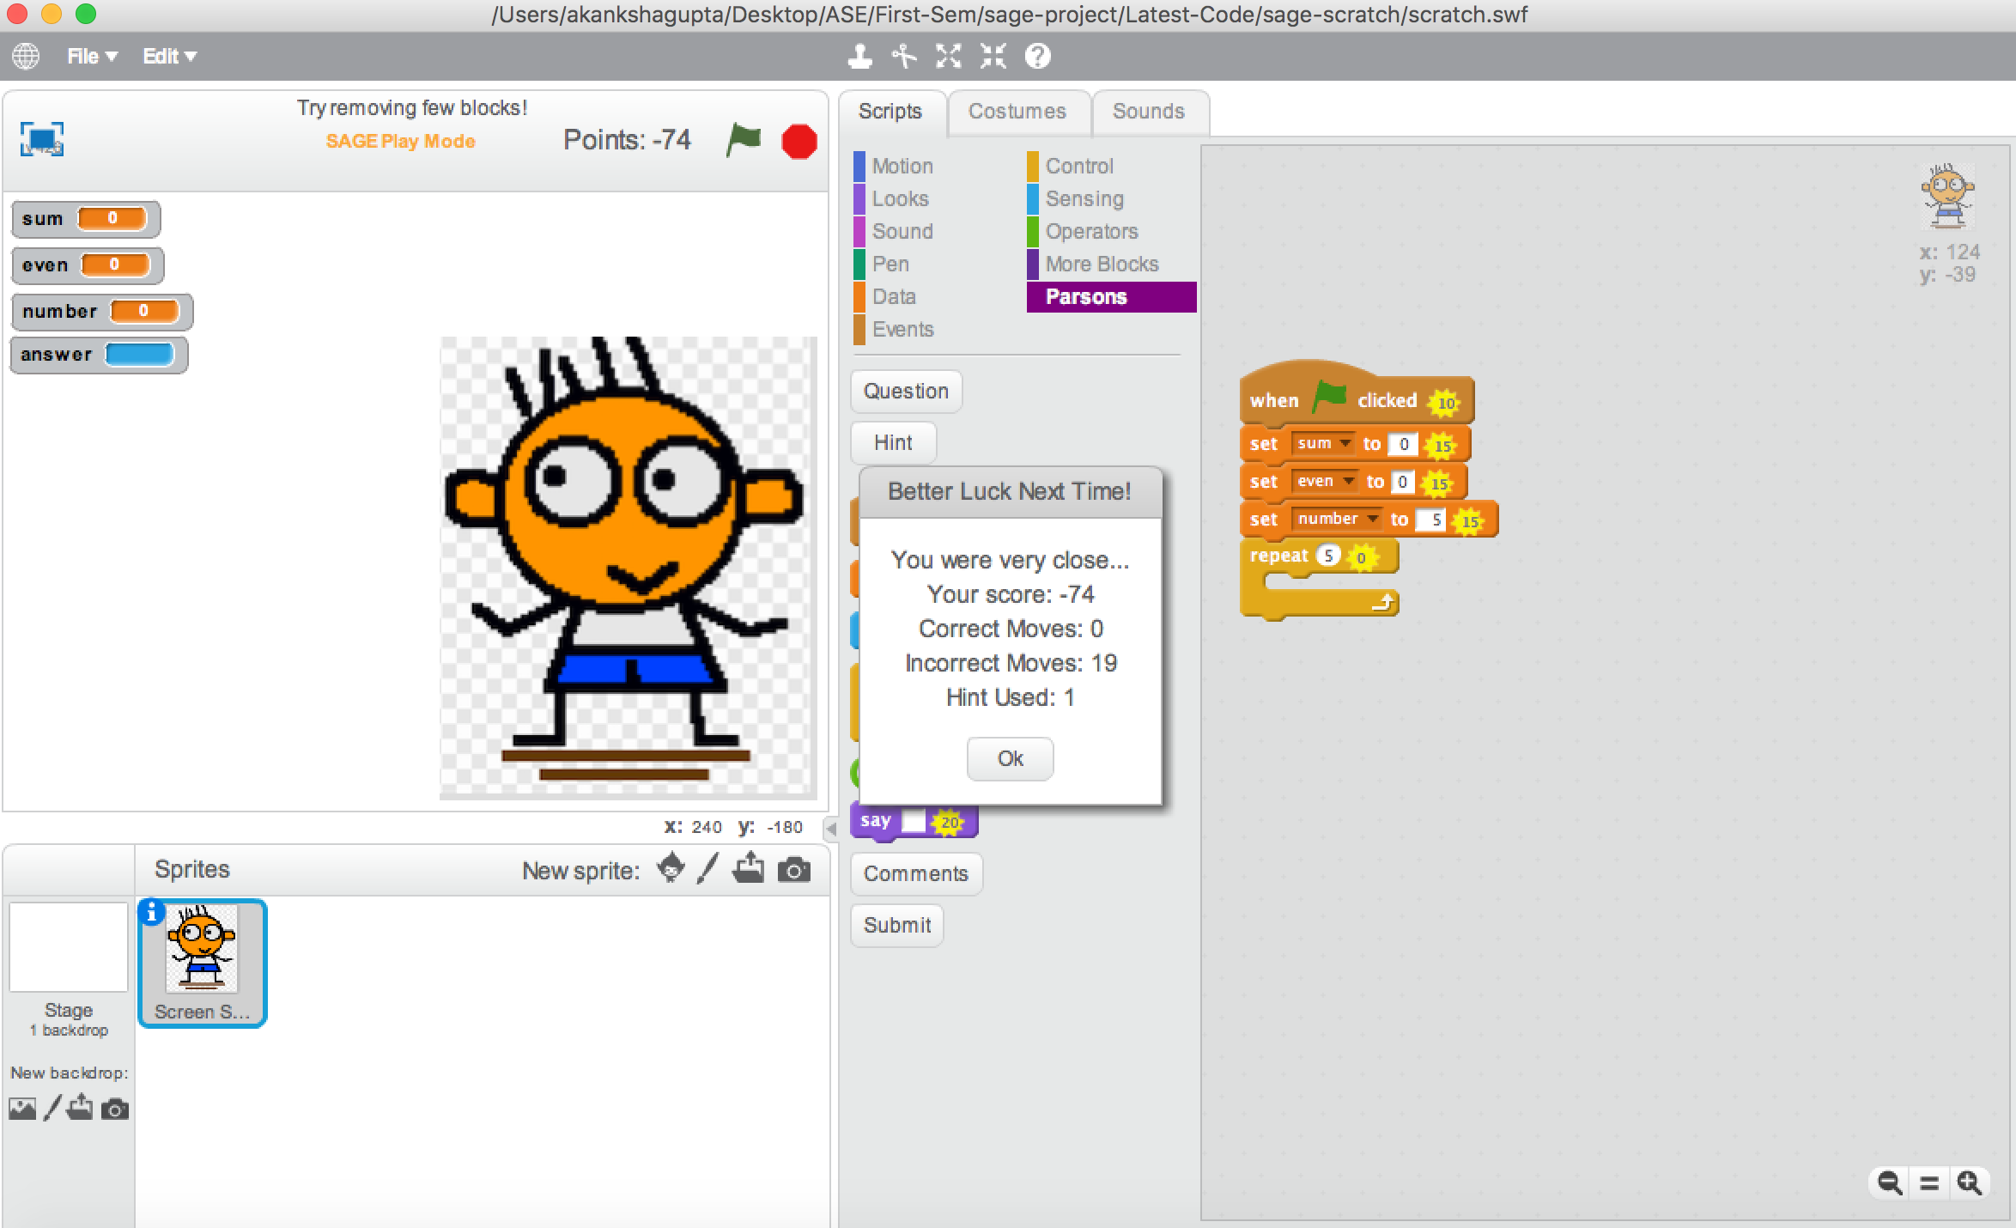
Submission and Score Summary

Slide 22
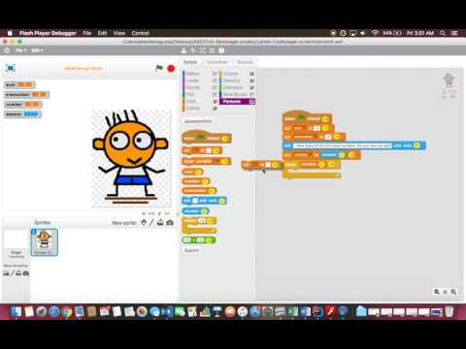
Demo
Link:
https://www.youtube.com/watch?v=ZU2dqEUqbDo&feature=youtu.be

Slide 23
Future Work
Multiple solutions to same problem
Different scores for different solutions
Review option for student to review the correct result
Different difficulty levels for Puzzles: Easy, Moderate, Advanced

Slide 24
Thank You

