Slide 1
SAGE Midterm Presentation
November 17, 2016
Julie Chien
Iris Zhang
Ray Tsai
Notes:
INTRO Gamification and assessment server.

Slide 2
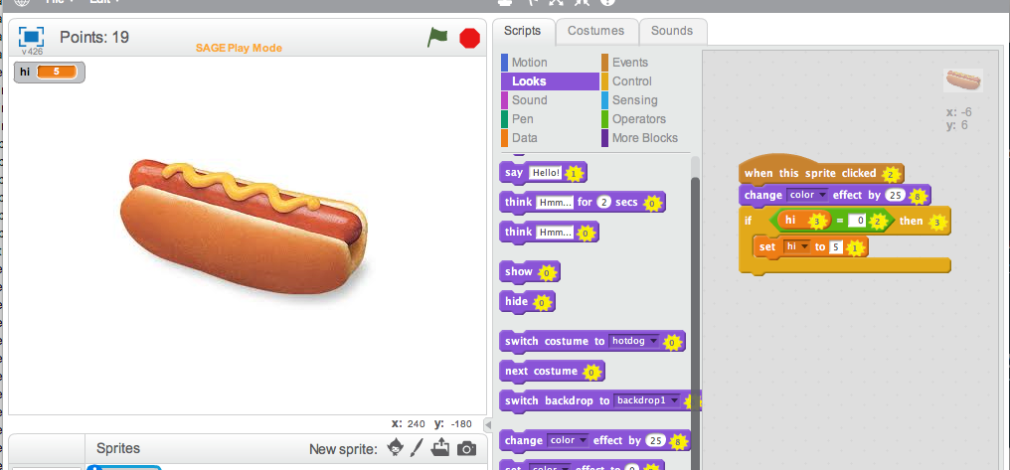
Block Points
Notes:
Assign points to certain blocks - quantify the worth of individual blocks. As students build projects, the point values of the blocks they use are summed and displayed on the scratch editor. You can see the point values are displayed on the block and the sum of the points in the script pane is displayed in the upper left of the editor.

Slide 3
Block Points
Each block is associated with a point value. Teachers can assign weights to blocks.
Automatically quantify different problem-solving approaches
Example 1: blocks that represent complex programming concepts worth more points than blocks that represent simple concepts. Goal: get the highest number of points.
Example 2: Code Golf - complete the level with the lowest point value possible.
Notes:
There may be several ways to solve some particular programming problem. Block points allow us to quantify each of these methods. For example, blocks that represent more complex programming concepts may be worth more points than blocks that represent simple concepts. In this scenario, teachers will encourage students to get more points by using blocks with greater point values.
Ex: printing 1-10, 10 printfs worth 1 pt each or 1 for loop worth 20 points Alternatively, perhaps a teacher wants students to program concisely and elegantly, and she does so by encouraging students to complete the level with the lowest point value possible.

Slide 4
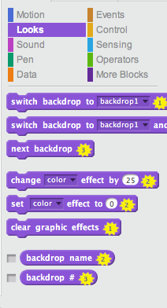
Block Points in Play Mode
Notes:
Points are simply numbers displayed on the block inside a star. Student can see point values while they work.

Slide 5
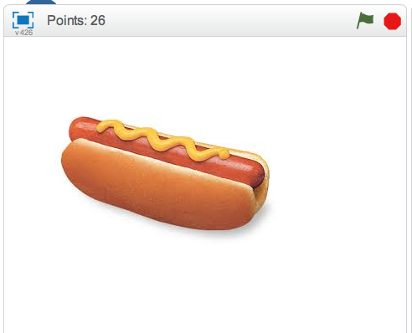
Points Are Accumulated In the Project
Notes:
Points are accumulated (summed) in the editor. Students can see their progress as they work on the project.

Slide 6
Demo: Points in Play Mode

Slide 7
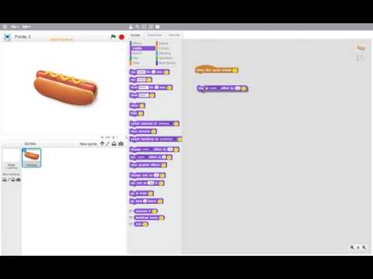

Slide 8
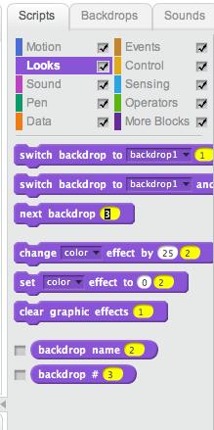
Block Points in Design Mode
Notes:
Teachers can configure point values in design mode. The UI design is intentionally similar to what the student sees in play mode. The more familiarity the teacher has with what the student has to deal with, the better.
From Jairo’s final report: “The American Educational Research Association prescribes curriculum design that encourages teachers to develop strong subject matter knowledge on the topics presented to students (Davis & Krajcik, 2005).” By having the UI be as similar as possible between design and play mode, teachers will develop familiarity with what students will experience, allowing teachers to (hopefully) come up with good point configurations.
These are saved into a dictionary keyed by the spec’s name. The changes the teacher makes here are auto-saved -- every edit writes to the dictionary.

Slide 9
Demo: Setting Points in Design Mode

Slide 10
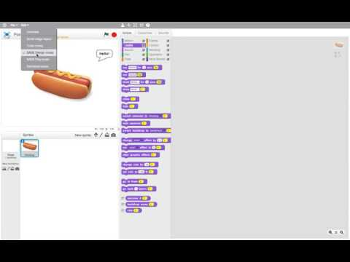

Slide 11
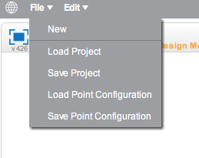
Saving and Loading Point Configurations
Notes:
There are a lot of blocks. Setting points every time can be tedious. Luckily, Point configs can be saved to file and loaded from file. When loaded from file, the point config is stored as an in-memory static dictionary in the specs class, which is what the program reads/writes from. When saved, this dictionary gets serialized to a JSON file.

Slide 12
Demo: Saving Point Configs

Slide 13
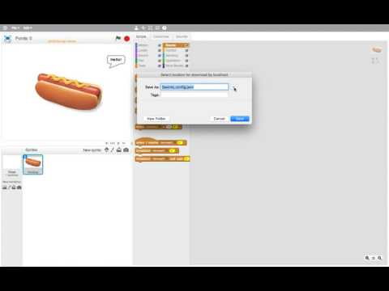

Slide 14
Demo: Loading Point Configs

Slide 15
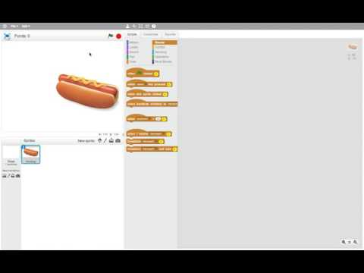

Slide 16
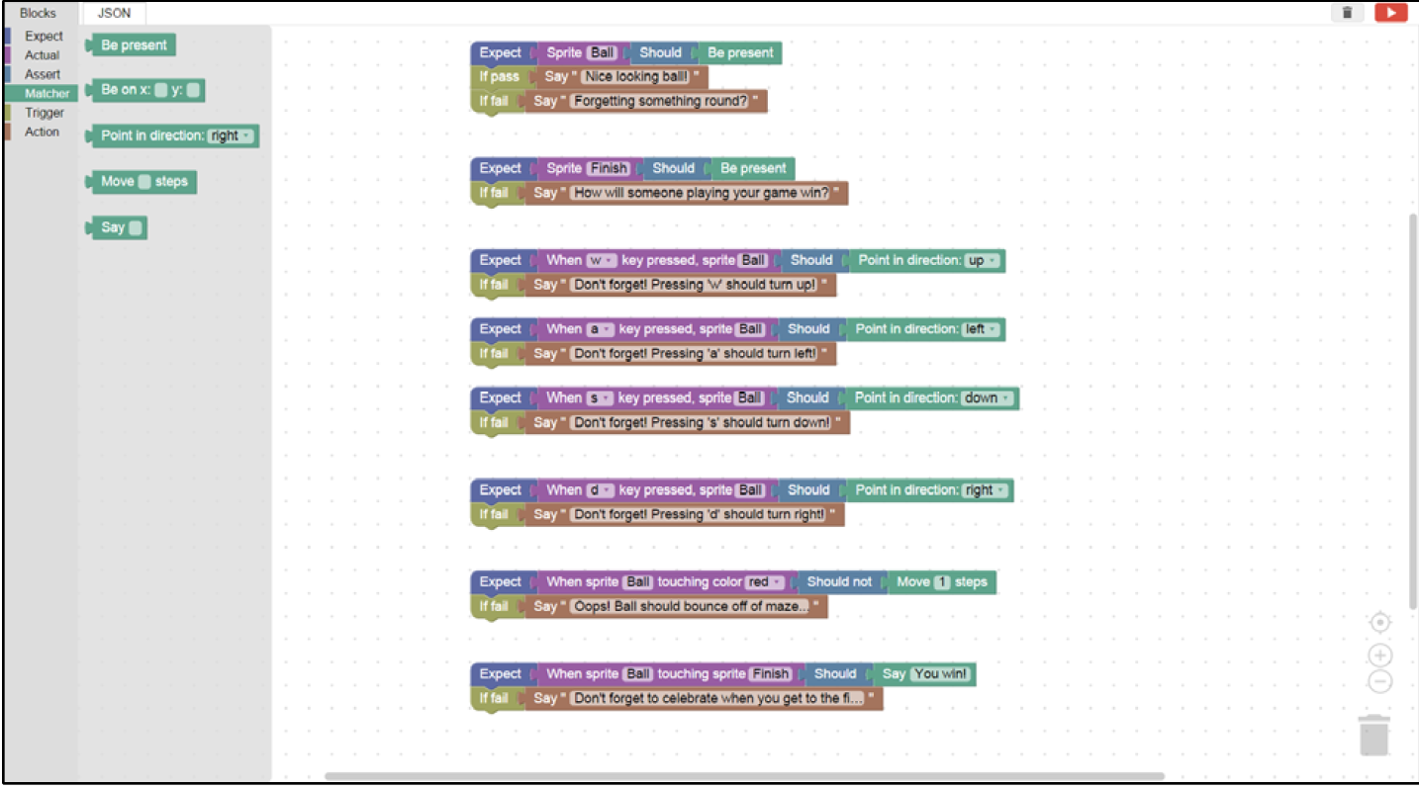
Improving the Assessment Editor

Slide 17
Improving the Assessment Editor - Goals
Point Value to Blocks
Student Progression
Infrastructure
Enable teachers to add point values to assessment blocks, associating the action “add points” to a particular trigger block with specified values.
Allow teachers to design an unlocking mechanism for students as they work through assessments, scaffolding them through computational learning goals.
Improve service architecture to make the assessment editor more integrated with the rest of the SAGE and Scratch suite.
Notes:
Point value to blocks - done
Student progression and infrastructure - design phase finished, implementation mostly not started

Slide 18
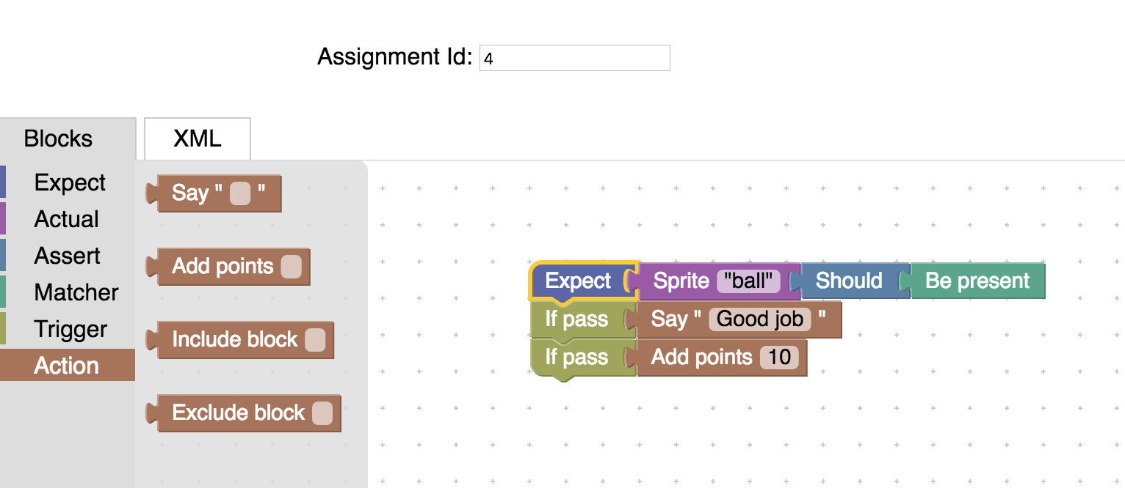
Point Value Blocks - SAGE Assessment Editor
Notes:
Screenshot

Slide 19
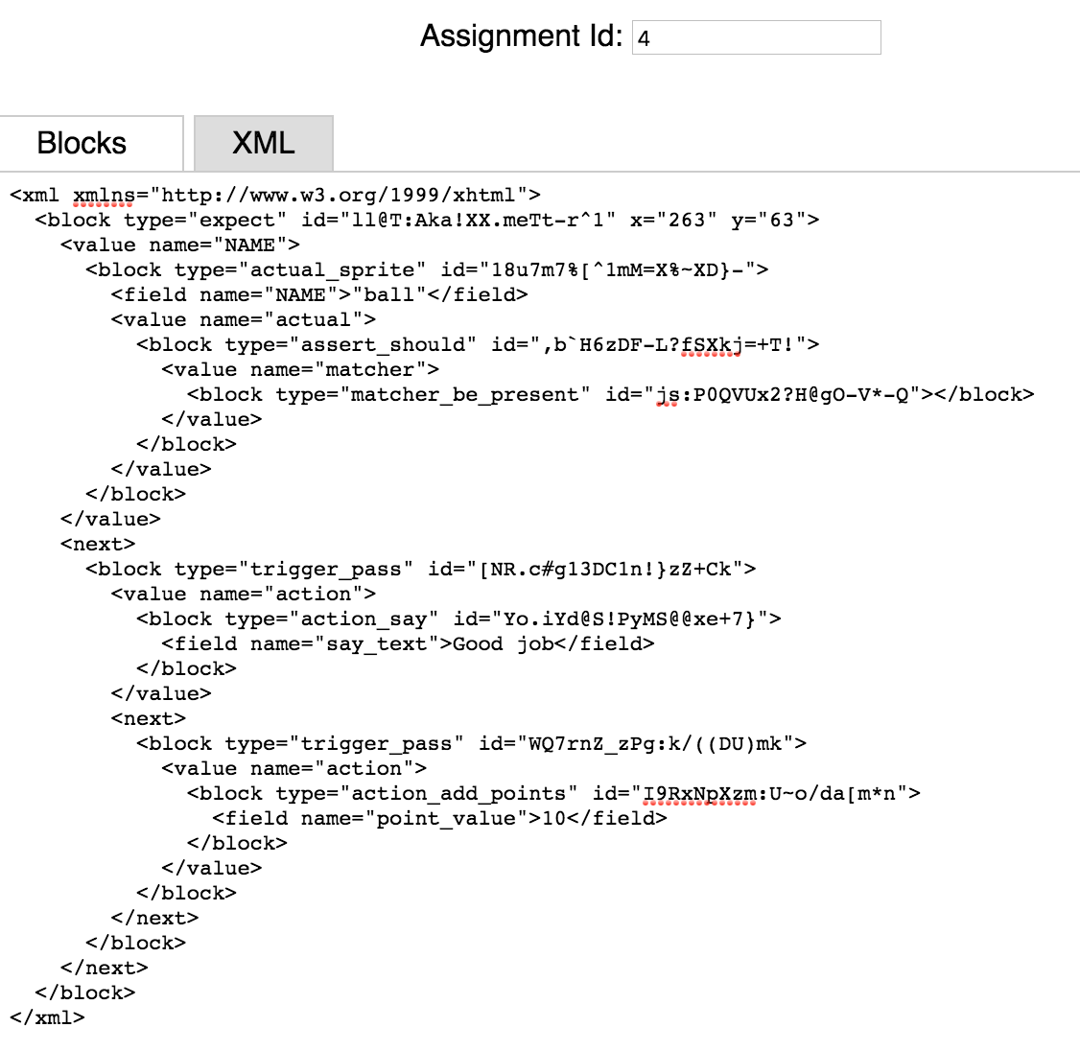
Infrastructure Improvements - SAGE Assessment Editor
POST
SAGE Server
GET
Notes:
Once the SAGE Editor can make GET requests from the server to get back the XML generated code, we can query for the saved states of the blocks and load them, showing a prior state for an assignment being edited.

Slide 20
Infrastructure Improvements - SAGE Assessment Editor
Welcome, <Teacher Name>
Click on any assignment to load in the Assessment Editor
Assignment 1
Made possible by GET request to server
Assignment 2
Project 1
Assignment 3
Assignment 4
Notes:
Design decision - how to present this on front end? It should be static - only thing you can do is click on a specific assignment to edit it.
Unsorted assignments will also be here

Slide 21
Infrastructure Improvements - SAGE Assessment Editor
You are editing
Welcome, <Teacher Name>
Notes:
You can load assignment details - blocks you made previously will be there.

Slide 22
Student Progression - SAGE Assessment Editor
PROJECT 1
Assignment # | Point Value | Passing Value
1 | 45 | 25
2 | 30 | 30
3 | 55
SAVE
Notes:
You associate assignments with particular projects via a drag and drop interface, and assign passing values to them.
So in this case assignment 1’s successful completion with 25 points will unlock assignment 3, etc. Blank spaces mean no need to pass and the next assignment will automatically be unlocked with the previous.
Design Decision - meta assessment info should be done via direct front end manipulation rather than the assessment language
But we COULD use the blockly language. Warrants more investigation

Slide 23
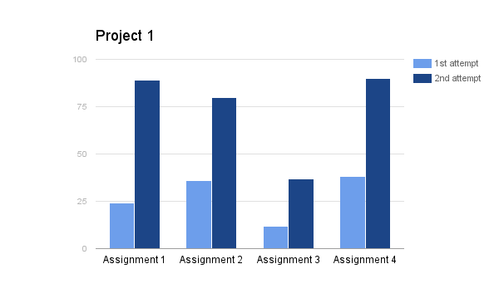
Student Progression - Assessment Dashboard Frontend
Still locked:
Assignment 5
Assignment 6
Assignment 7
Assignment 8
Achieve 70 points or more on Assignment 3 to unlock new puzzles!
Notes:
What student progression may look like on the front end

Slide 24
Future Goals
Point Value to Blocks
Student Progression
Infrastructure
Done!
Use blockly to aid in creation of grouped assignments and unlocking
OR - design a front end interface to do the same
Collaborate with Dashboard team to determine front end for student progression
Enable GET requests to the server from the SAGE editor, and display the information

Slide 25
SAGE Assessment Server

Slide 26
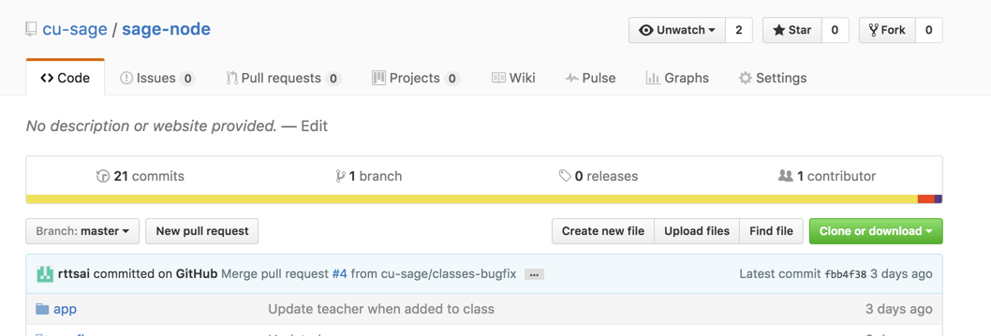
New SAGE Assessment Server
Found on Github at cu-sage/sage-node. Uses Node.js and MongoDB.
Will contain all old functionalities of existing server and add new endpoints.
The existing server will be deprecated in the future.

Slide 27
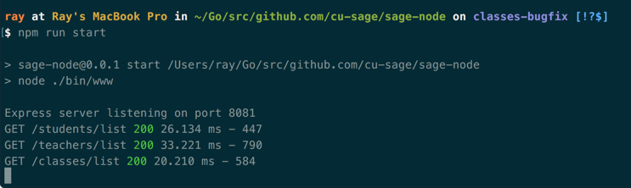
Useful Server Commands
“mongod” - start the database
“npm run start” - start the server
“npm run mocks” - import mock data
“npm run test:integration” - run integration tests

Slide 28
New Database Schemas
Students
Teachers
Models

Slide 29
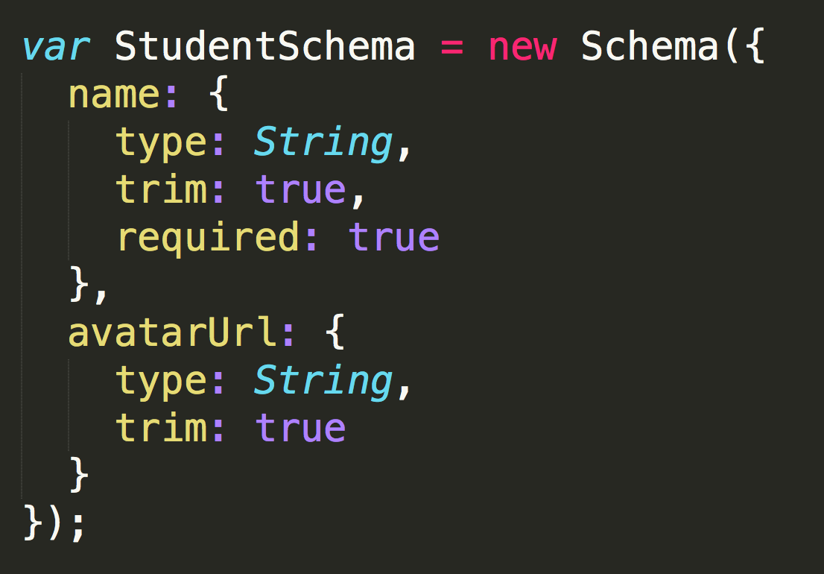
Student Schema

Slide 30
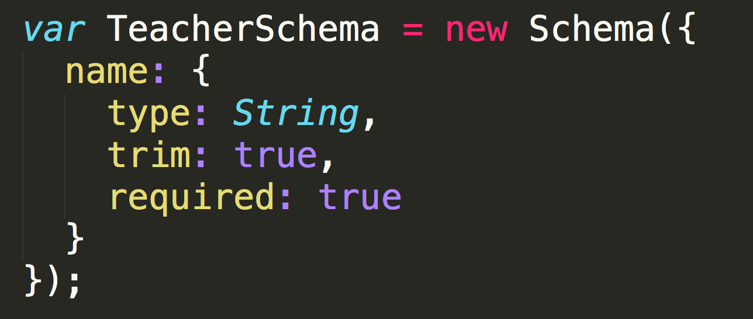
Teacher Schema

Slide 31
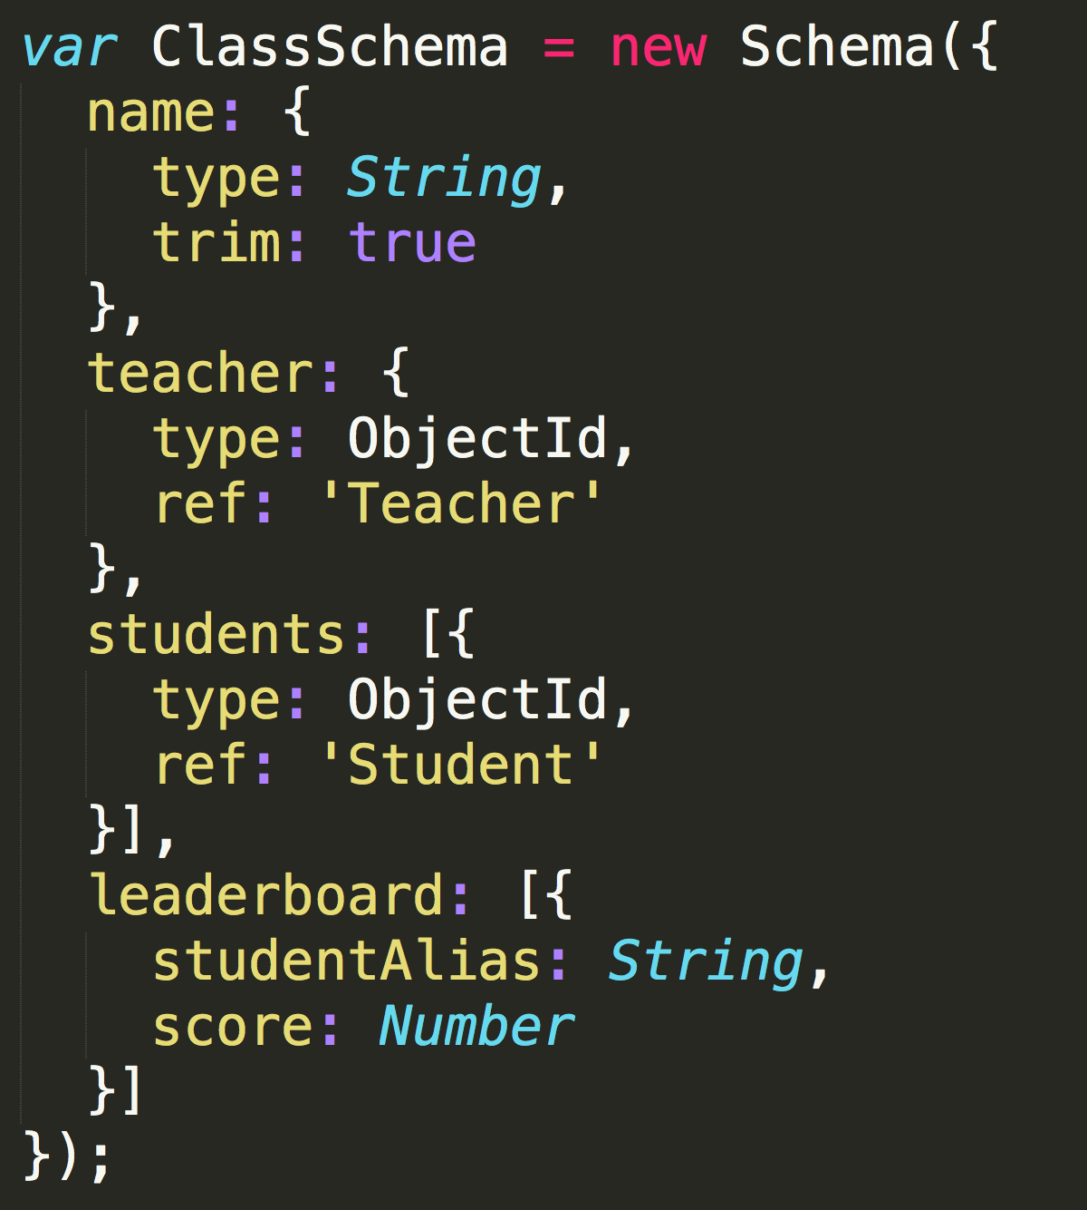
Class Schema

Slide 32
New REST API Endpoints
Routes
/students
/teachers
/classes

Slide 33
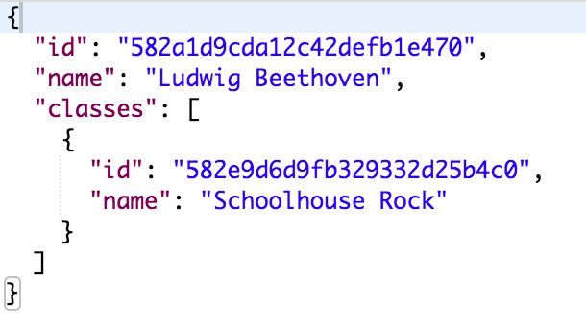
GET /students/:id and GET /students/list
Response

Slide 34
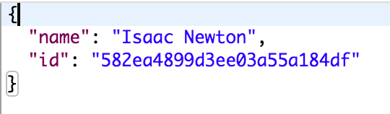
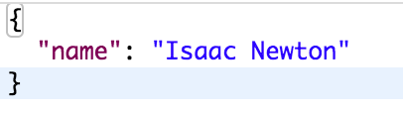
POST /students/new
Request
Response

Slide 35
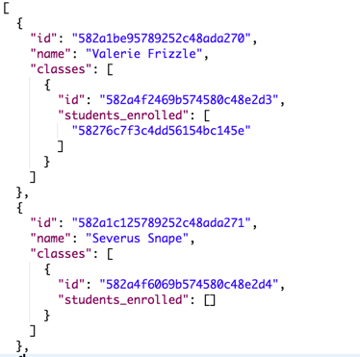
GET /teachers/:id and GET /teachers/list
Response

Slide 36
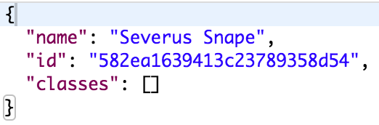
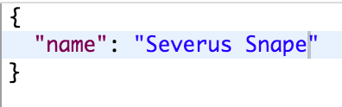
POST /teachers/new
Request
Response

Slide 37
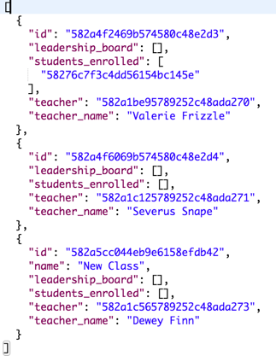
GET /classes/:id and GET /classes/list
Response

Slide 38
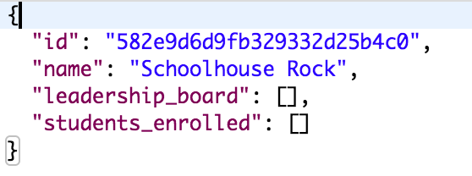

POST /classes/new
Request Body
Response

Slide 39
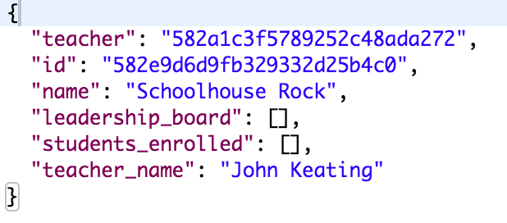
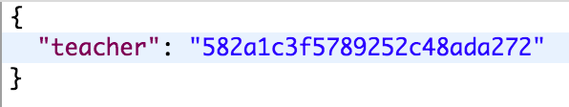
POST /classes/:id/update_teacher
Request Body
Response

Slide 40
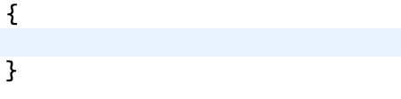
POST /classes/:id/remove_teacher
Request Body
Response

Slide 41
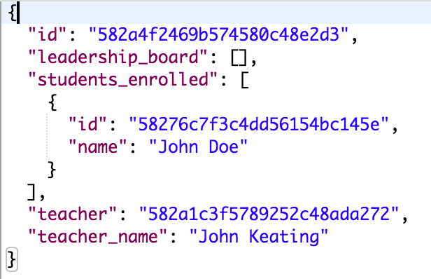
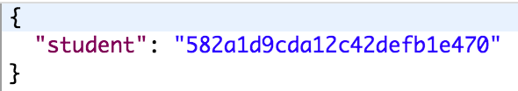
POST /classes/:id/add_student
Request Body
Response

Slide 42
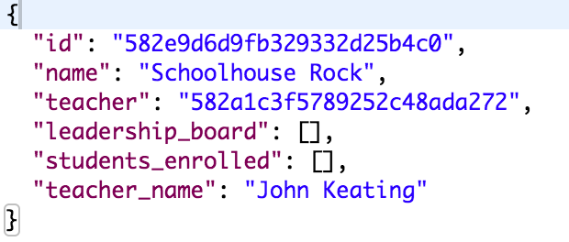
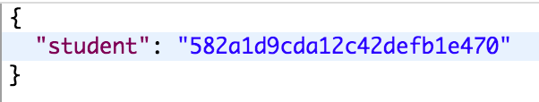
POST /classes/:id/remove_student
Request
Response

Slide 43
New REST API Endpoints Summary
Students
GET /students/:id
GET /students/list
POST /students/new
Teachers
GET /teachers/:id
GET /teachers/list
POST /teachers/new
Classes
GET /classes/:id
GET /classes/list
POST /classes/new
POST /classes/update_teacher
POST /classes/remove_teacher
POST /classes/add_student
POST /classes/remove_student

Slide 44
Future Goals
Assignments
Save and retrieve assignments
Read XML from Scratch-Editor
Return assignment data as JSON
Student Progression
Save points from assignments
Leaderboards
Generate aliases
Calculate point leaderboards

Slide 45
Questions?

